Slide 1


The Inconsistency Quantification Problem
April 2, 2026 Oliver Richardson

Slide 2

“A man with one watch always knows the time; a man with two watches is never sure.” [San Diego Union, 1930]
given the chance to build artificial minds, we tried to avoid it.
Inconsistency is scary;
but with just one watch, are we really better-off?

Slide 3


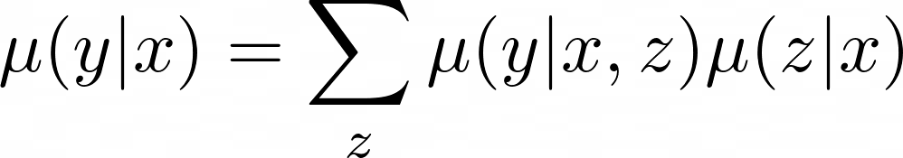



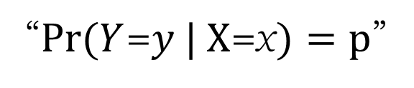



Probabilistic Claims
$$(x_{2},y_{2})$$
“$Pr⁡(Y$=$y | X\text{=}\text{x})=p$”
$$(x_{1},y_{1})$$
$$p_{2}$$
$$p_{1}$$
Not necessarily consistent (i.e., obey the laws of probability)
probability measure
must satisfy
Exact satisfaction is hard. Violation is a matter of degree. How to measure inconsistency?
implies, e.g.,

Slide 4
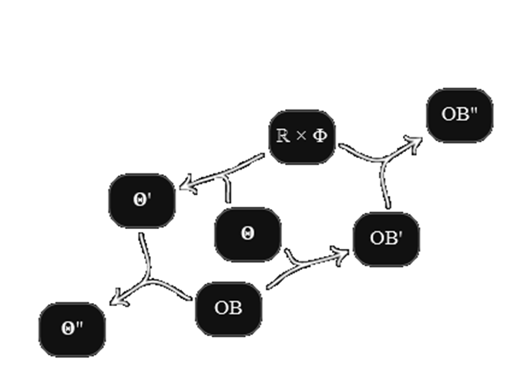
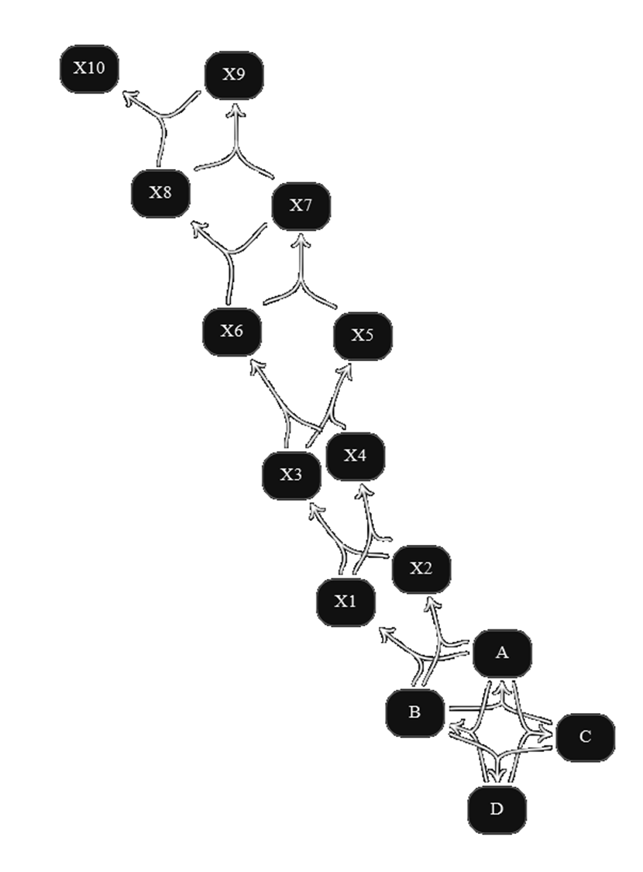
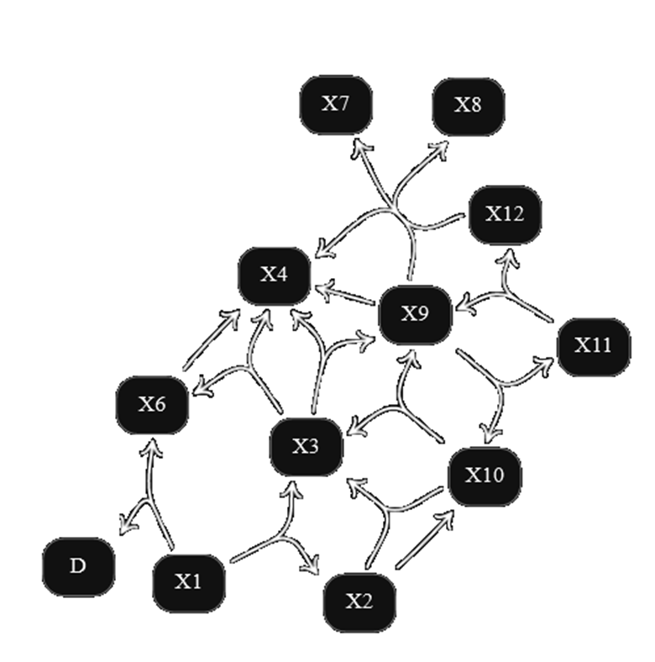
Probabilistic Dependency Graphs (PDGs)

Slide 5
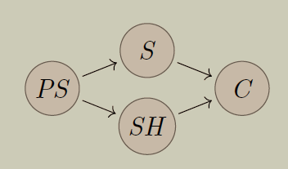
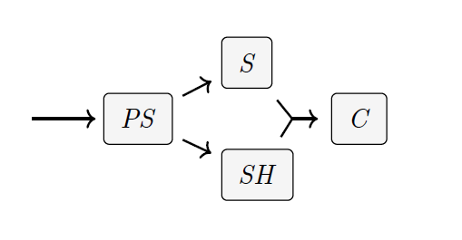
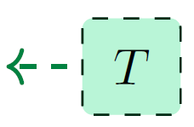
Reinventing Bayesian Networks (BNs)
BN
is smoker
parents smoke
cancer
Not just probabilistic claims, but also structure that encodes independence
second-hand
smoke
PDGs can model multiple beliefs about the same variable,
can capture inconsistency!

Slide 6
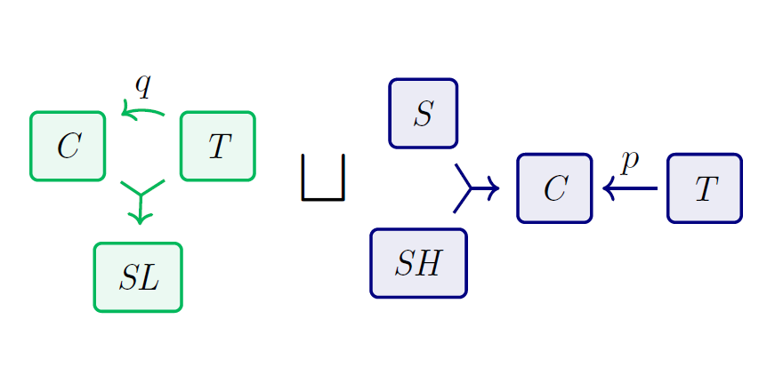


Inconsistency-tolerance → modularity
+

Slide 7
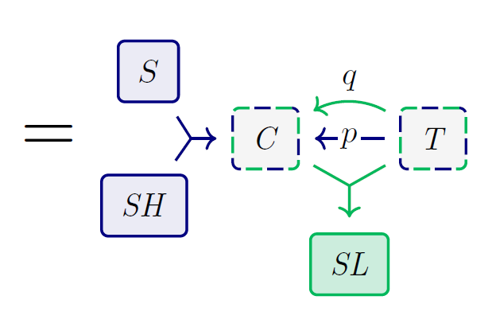
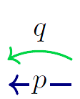


Inconsistency-tolerance → modularity
Combine independent PDGs by taking disjoint union of arcs, union of variables

Slide 8
Formal PDG Syntax
Directed Hypergraphs
Conditional Probability Distributions

Slide 9
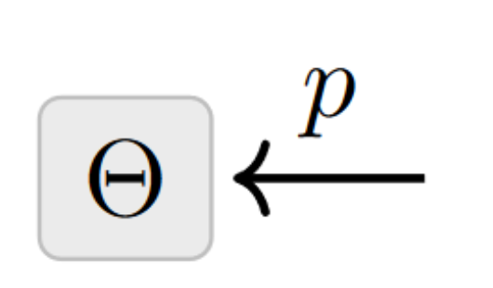
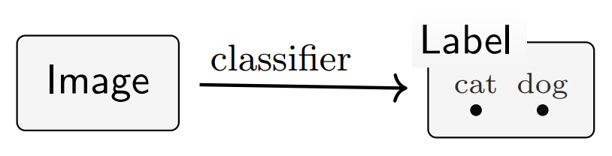
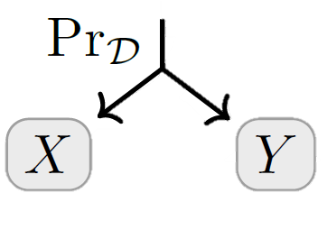
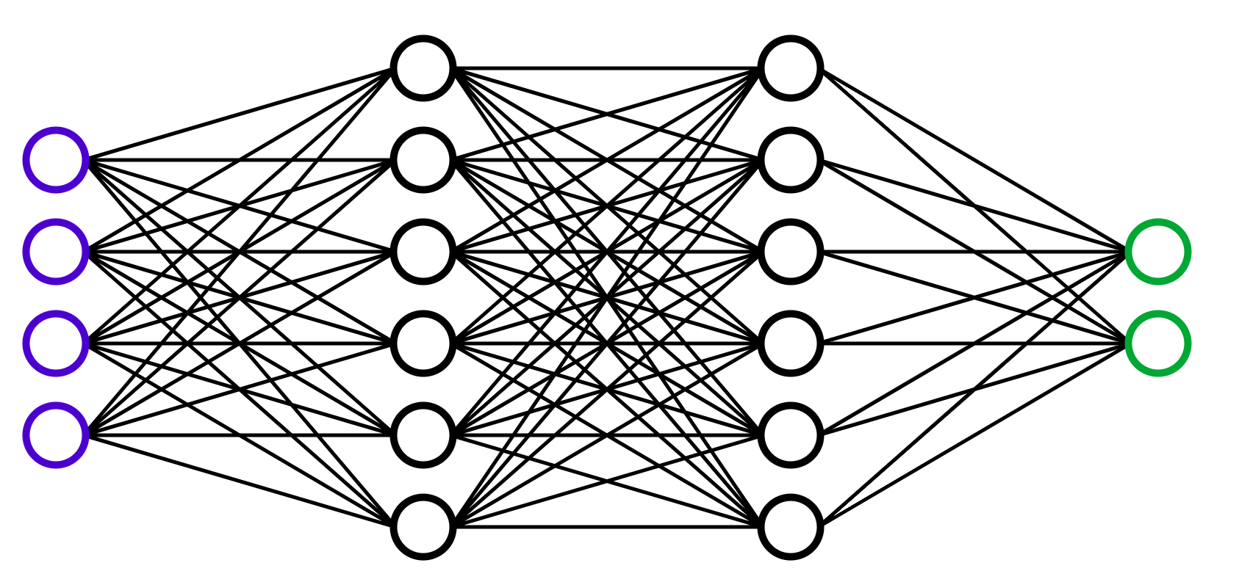
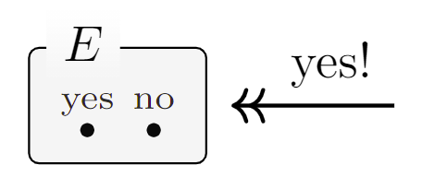











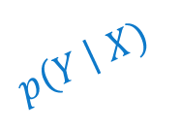



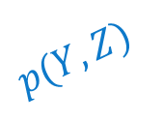














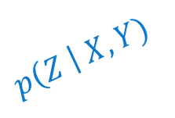











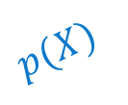



PDG SYNTAX
Directed Hypergraphs
Conditional Probability Distributions
(cpds)
$$p\left(Y \right| X)$$
$$p\left(Z \right| X,Y)$$
$$p(X)$$
X
Y
$$y_{1}$$
$$y_{2}$$
$$y_{3}$$
$$z_{1}$$
$$z_{2}$$
$$z_{3}$$
$$x_{1}$$
$$x_{2}$$
$$x_{3}$$
$$x_{1}$$
$$x_{1}$$
$$y_{1}$$
.7 .2 .1
.7 .2 .1
$$x_{1}$$
$$y_{2}$$
$$∗$$
.7 .2 .1
$$x_{2}$$
.1 .2 .7
.1 .2 .7
$$x_{2}$$
$$y_{1}$$
.3 .2 .5
Z
$$x_{3}$$
.7 .1 .2
$$x_{2}$$
$$y_{2}$$
.7 .1 .2
$$p(Y,Z)$$
$$x_{3}$$
$$y_{1}$$
.5 .2 .3
$$y_{1}$$
$$y_{1}$$
$$y_{1}$$
$$y_{2}$$
$$y_{2}$$
$$y_{2}$$
$$x_{3}$$
$$y_{2}$$
.5 .3 .2
$$z_{1}$$
$$z_{2}$$
$$z_{3}$$
$$z_{1}$$
$$z_{2}$$
$$z_{3}$$
$$∗$$
.1 0 .3 .2 .1 .3
Examples:
audio
priors
neural networks
constraints
datasets

Slide 10
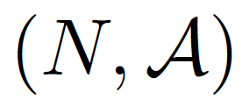



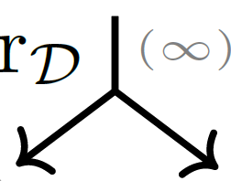















PDG SYNTAX
Directed Hypergraphs
Conditional Probability Distributions
set of nodes
X
$$p_{2}$$
Y
set of hyperarcs;
$$ℝ$$
$$p_{1}$$
$$x_{0}$$
$$x_{1}$$
$$x_{2}$$
each
has
$$p_{3}$$
sources
Z
$$p_{4}$$
targets
.
PDG:
X
Y
a directed (hyper)graph whose nodes correspond to variables,
Z
and whose arcs correspond to cpds
(weighted by confidence)

Slide 11

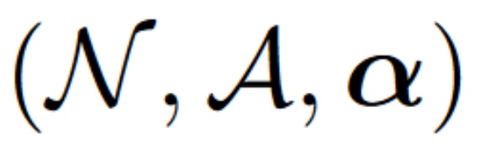
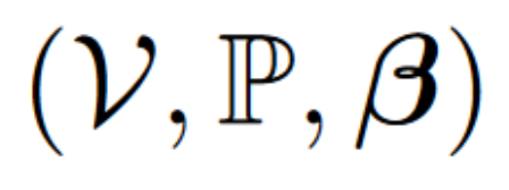



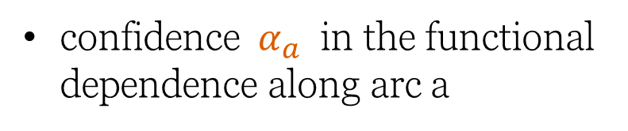
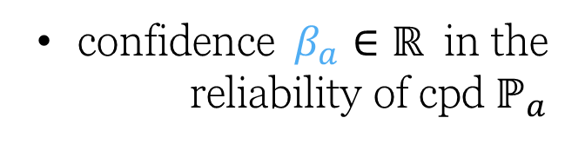
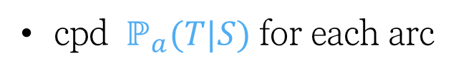
Probabilistic Dependency Graph: Definition
Probabilistic Dependency Graph: Definition
Structural Info
Observational Info
(measurable) space of values for each node
set of nodes
set of directed (hyper)arcs
cpd $ℙ_{a}(T|S)$ for each arc
confidence $α_{a}$ in the functional dependence along arc a
confidence $β_{a}∈ℝ$ in the reliability of cpd $ℙ_{a}$
Functor
Weighted Directed Hypergraph

Slide 12
PDG SEMANTICS
How to interpret conflicting or underspecified information?

Slide 13

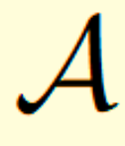





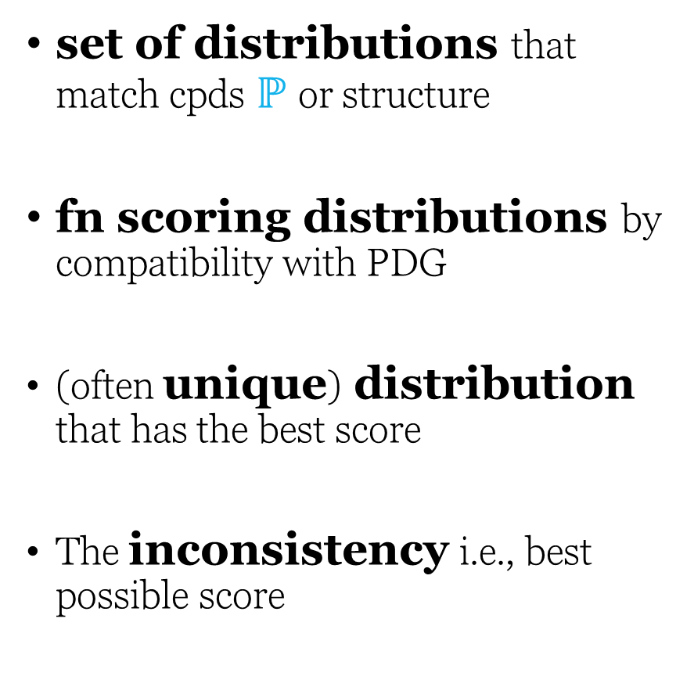


PDG Semantics
set of distributions that match cpds $ℙ$ or structure
fn scoring distributions by compatibility with PDG
(often unique) distribution that has the best score
The inconsistency i.e., best possible score
Joint probability Δistributions
over 𝒱alues of 𝒳

Slide 14
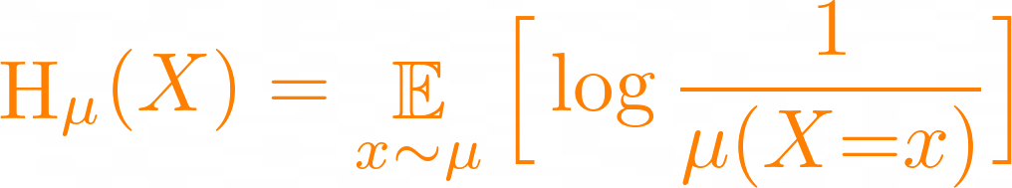
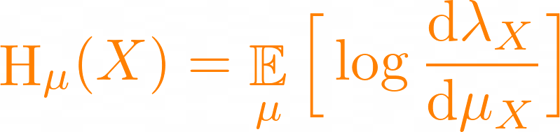
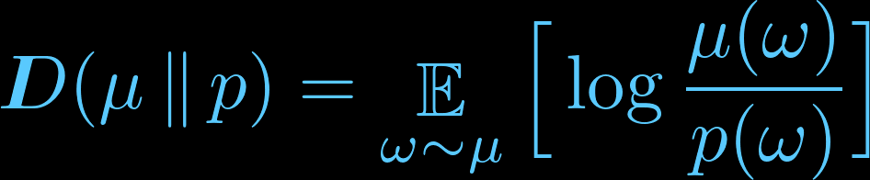
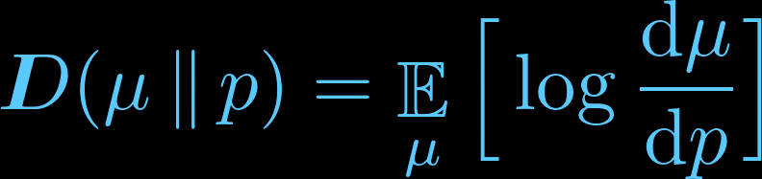
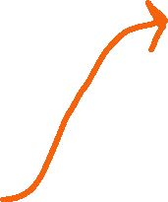



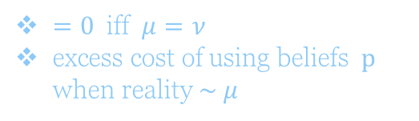
Entropy
“structural”
name of variable
randomness / information in X
expected surprise at learning value of X
reality
belief
“observational”
relative entropy
= KL Divergence
$=0$iff $μ=ν$
excess cost of using beliefs $p$ when reality $\sim μ$

Slide 15
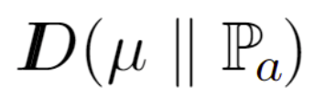
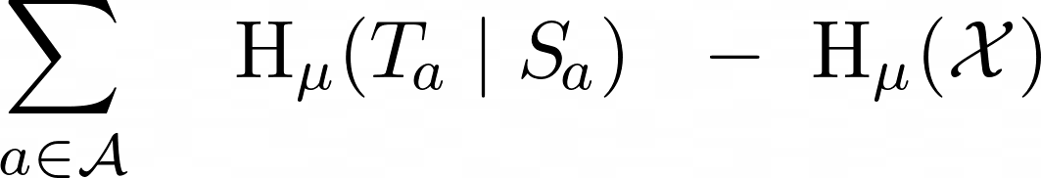

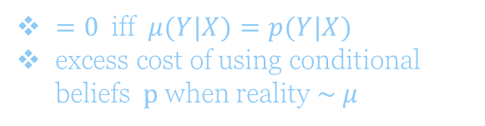

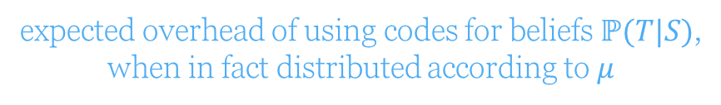




Entropy
Conditional
Y
$$H(Y)$$
expected overhead of using codes for beliefs $ℙ(T|S)$,
when in fact distributed according to $μ$
$$I(X;Y)$$
$=0$iff $μ(Y|X)=p(Y|X)$
excess cost of using conditional beliefs $p$ when reality $\sim μ$
= 0 iff Y is a function of X
information in Y if we already know X
$$H(X)$$
X
$$H\left(X\right|Y)$$

Slide 16
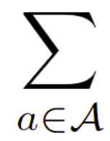
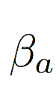

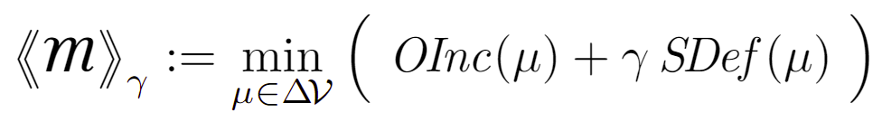


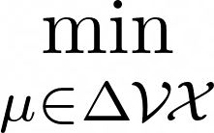
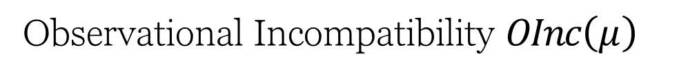
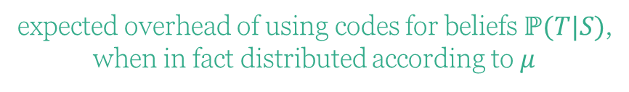



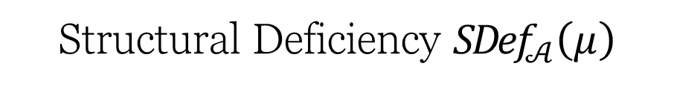
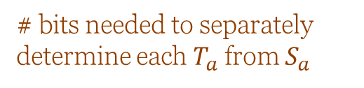
Scoring Function Semantics
over Δistributions over 𝒱alues of 𝒳
Observational Incompatibility $OInc\left(μ\right)$
Structural Deficiency ${SDef}_{𝒜}\left(μ\right)$
expected overhead of using codes for beliefs $ℙ(T|S)$,
when in fact distributed according to $μ$
# bits needed to determine $μ$ along its own structure $$(∅→𝒳)$$
# bits needed to separately determine each $T_{a}$ from $S_{a}$
(scaled by confidence)
(Observational)
Inconsistency of a PDG := the smallest possible incompatibility with any $μ$
Optimal Distribution(s) for a PDG := those with the best score
$$0^{+}$$
importance of structure ($≥0$)

Slide 17
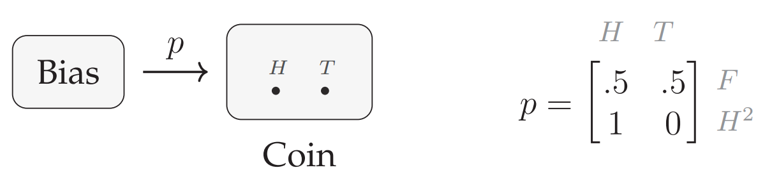




PDGs capture …
Strict PDGs. insist on graph or multi-graph instead of hypergraph
Separated PDGs. have two distinct kinds of arcs, carrying observational and structural information
allow cpds to have missing values, a range of values, subprobabilities …
use parameterized cpds
Other Probabilistic Graphical Models
Representations of Knowledge and Uncertainty
Probability Distributions, Conditioning / Jeffrey’s Rule via (+)
Convex sets of probability distributions, Dempster-Shafer Belief functions
Relations and Constraints
“Generalizations” of PDGs
Systems of Neural Networks
X
X
Y
XY
Z
Y

Slide 18

Minimizing Inconsistency is a “universal” objective.
predictor
data
priors

Slide 19
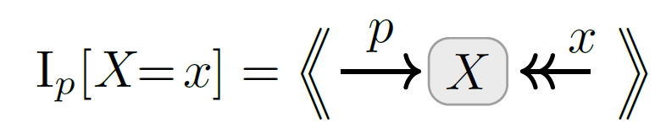



Surprisal / negative log likelihood standard measure of discrepancy between a probability $p(X)$ and an event $X=x$

Slide 20







Information-Based Losses as Inconsistencies
+ multi-sample
+latent variables
cross entropy (supervised)
+ conditional model

Slide 21






cross entropy (supervised)
Mean Squared Error

Slide 22







Regularizers $↔$ Priors
Terms added to loss functions to incentivize “simple models”
Distributions over
model parameters
regularizer

Slide 23







Statistical Divergence as Inconsistency
You believe both $p(X)$ and $q(X)$.
Your inconsistency: a divergence between $p$ and $q$?

Slide 24



Map of as $(r,s)$ vary

Slide 25
More belief can only increase inconsistency

Slide 26






VAEs, Take 2
Structure:
encoder $e(Z|X)$
decoder $d(X|Z)$
prior $p\left(Z\right)$
observe a sample $x$
loss function is free:
β-VAE
Objective
believing more cannot make you less inconsistent
Relax to get Renyi VAEs
- “Evidence of X”

Slide 27
… back to the computational problem

Slide 28









Two Computational Problems for PDGs
INC-CALC
INFERENCE
Given
a PDG
Given:
a PDG ,
and $γ>0$,
variables
values
,
Compute
and $γ>0$,
Compute:
the conditional probability of y given x
in (all) optimal distribution(s)

Slide 29










Is this even hard?
*(provided $β≥γα$)
just have to find $μ$ that minimizes
strictly ($γ$-strongly) convex,*
known in closed form
$C^{∞}$ smooth.
:
,
a function that is…
Difficulties
D1. even writing down $μ$ takes exponential time ( let alone evaluating or minimizing it )
D2. these properties are not enough! ( is neither Lipshitz nor self-concordant)
D3. even if we can find optimizers , how do we find the observational limit ?
🙈
🙈

Slide 30












PDG Inference* and
Calculating Inconsistency*
in Polynomial Time*
?
$0^{+}$ semantics
(limit as $γ→0$)
When $β≥γα$,
$$β$$
can do inference and
factor graphs
($α,β,γ=1$)
calculate inconsistency
for a PDG that has
N arcs and vars and treewidth T,
confidence in observation
BNs (acyclic, $α=1$)
factored exponential families ($γα=β$)
in
time.
$$±γ$$
$$\text{confidence} \text{in} \text{structure}$$
$$γα$$
* assuming bounded tree-width

Slide 31


Empirical Results
our algorithm
(using cvx solver)
baselines (ADAM, L-BFGS)
faster
Implementation
more accurate
connects PDG python library to commercial solvers such as MOSEK and ECOS, via cvxpy.
http://github.com/orichardson/pdg

Slide 32
Ok, without bounded treewidth, clearly both problems are NP-hard.
But are they in NP? PSPACE? EXPTIME?

Slide 33
SAT
BN Inference
Approximate Inconsistency Calculation
Approximate PDG Inference
legend
Exponential Conic Programming
Karp reduction in polynomial time
Karp reduction in polynomial time, assuming bounded treewidth

Slide 34





SAT
BN Inference
Approximate Inconsistency Calculation
Approximate PDG Inference
$$f(x)$$
find min $y^{∗}$
find argmin $x^{∗}$
$$y^{∗}$$
$$x^{∗}$$
legend
Exponential Conic Programming
Karp reduction in polynomial time
Karp reduction in polynomial time, assuming bounded treewidth

Slide 35


Expressing Probabilistic Claims (i.e., “$Pr⁡(Y$=$y|X\text{=}\text{x})=p$”) with a PDG
$$p\left(Y \right| X)$$
$$y_{1}$$
$$y_{2}$$
$$y_{3}$$
$$x_{1}$$
.7 .2 .1
$$x_{2}$$
.1 .2 .7
?
$$x_{3}$$
.7 .1 .2

Slide 36






Expressing Probabilistic Claims (i.e., “$Pr⁡(Y$=$y|X\text{=}\text{x})=p$”) with a PDG
Proposition: in any context (another PDG $M$ ),
$μ^{∗}$ is an optimal distribution for $M$ (i.e., ) and has marginal $μ^{∗}\left(y | x\right)=p$ ⬄ $μ^{∗}$ is an optimal distribution for $M$ + widget
Widget for claim (x,y,p)
Widget for claim (x,y,p)
Proposition : in any context M,
Widget for claim (x,y,p)
with equality iff

Slide 37






Simplification: Expressing “$Pr⁡(Y$=$y)=p$” with a PDG
“this construction does the right thing.”
Lemma 22.
For every PDG
,
with equality iff
.
.
Lemma 23. The function $f(p)$ is strictly convex.

Slide 38






Algorithm: cvx “binary search”
Goal: find $p^{∗}≔argmin f∈[0,1]$ (to within $±ε$)
State: $(a,b,c)$
invariant: $p^{∗}∈[a,c]$
$$>$$
f(a)
f(z)
f(c)
f(b)
$$<$$
…
…
a
z
b
c

Slide 39













( a small problem )
$$>$$
How do we compare two real numbers?
If we compare bit-by-bit, will it ever terminate? (i.e., is it even a recursive procedure?)
How long will it take?
If
and
,
then
$$<$$
The numbers are not too close; can compare them quickly!
(requires 18 pages of math to prove; all months after the conference)

Slide 40



Slide 41






Summary
PDG inference is a very general problem
It is equivalent to calculating inconsistency;
Both can now be done in polynomial time (assuming bounded treewidth, which was the best we could hope for)
model inconsistency & conflict
separate observation ($β$) from structure ($α$)
capture + explain loss functions,
Thanks!
Inconsistency Calculation
Exponential Conic Programming
PDG Inference

Slide 42
The inference procedure

Slide 43
Why is this even hard?
*(provided $β≥γα$)
just have to find $μ$ that minimizes
strictly ($γ$-strongly) convex,*
known in closed form
$C^{∞}$ smooth.
:
,
a function that is…
Difficulties
D1. even writing down $μ$ takes exponential time ( let alone evaluating or minimizing it )
D2. these properties are not enough! ( is neither Lipshitz nor self-concordant)
D3. even if we can find optimizers , how do we find the observational limit ?
🙈
🙈

Slide 44









exponential conic programming
Non-symmetric cone, but can still be solved in polynomial time with interior point methods.
(positive orthants)
exponential cone
[ Nesterov, 1999. Infeasible-start primal-dual methods and infeasibility detectors for nonlinear programming problems. ]
or “relative entropy cone"

Slide 45





$0$-inference (observational information only)

Slide 46

$0$-inference (observational information only)

Slide 47










$γ$-inference
( difficulties )
D1. storing $μ$ takes exponential time
D2. need more structure to optimize
D3. finding observational limit
when $β≥γα$
Rewriting PDG scoring function …

Slide 48











$0^{+}$-inference
Minimizers of
… so it suffices to do 0-inference once to find a set of linear constraints characterizing .
Problem: is not at all convex...
… but its restriction to
is!
uniquely among them, best minimizes
The Plan:
constrain to , then minimize .

Slide 49









$0^{+}$-inference
Find

Slide 50




( difficulties )
These optimization problems grow exponentially with the number of variables! 😬
D1. storing $μ$ takes exponential time
D2. need more structure to optimize
D3. finding observational limit
$$γ=0$$
$$γ≤\min_{a}\frac{β_{a}}{α_{a}}$$
$${γ→0}^{+}$$
Find

Slide 51


Tree Decompositions & Tree Marginals
A tree decomposition
of a hypergraph
is a tree
whose vertices
are subset of N, called “clusters”, such that:
each hyperedge is contained in some cluster,
the intersection of any two clusters is a subset of every cluster on the unique path (since it's a tree) between them
width of := size biggest cluster - 1;
treewidth of hypergraph := smallest possible width of any tree decomposition
tw =1

Slide 52

Tree Decompositions & Tree Marginals
A tree decomposition
of a hypergraph
is a tree
whose vertices
are subset of N, called “clusters”, such that:
each hyperedge is contained in some cluster,
the intersection of any two clusters is a subset of every cluster on the unique path (since it's a tree) between them
2
width of := size biggest cluster - 1;
treewidth of hypergraph := smallest possible width of any tree decomposition
Tree Marginal
a distribution over every cluster
tw =2

Slide 53




Polynomial Inference under Bounded Treewidth
A
B
C
D
P(A,B)
P(B,C)
P(C,D)
For PDGs, too, suffices to search over tree marginals , because PDGs have a similar independence property:
A
B
$$ℳ_{2 }$$
C
$$ℳ_{1 }$$

Slide 54




More Involved Analogues…
$0$-inference
Cluster marginal matching constraints
P(A,B)
P(B,C)
B

Slide 55




More Involved Analogues…
$γ$-inference (small $γ)$

Slide 56




More Involved Analogues…
$0^{+}$-inference
Find

Slide 57



Compact inference using tree marginals!
Difficulties overcome!
D1. storing $μ$ takes exponential time
D2. need more structure to optimize
D3. finding observational limit
$$γ=0$$
$$γ≤\min_{a}\frac{β_{a}}{α_{a}}$$
$${γ→0}^{+}$$
Find

