Slide 1
Loss as the Inconsistency of a P D G : Choose Your Model, Not Your Loss
robabilistic
ependency
raph
Oliver E Richardson
Cornell University

Slide 2

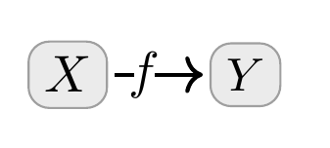

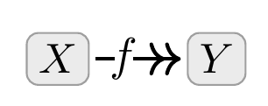
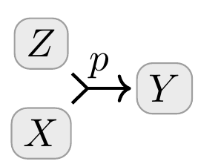
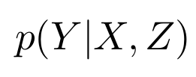
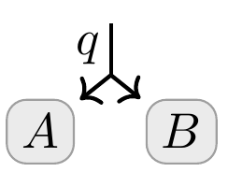

Probabilistic Dependency Graphs
A weighted collection of cpds
Generalize Bayesian Networks and Factor Graphs
Comes with a Measure of Inconsistency…

Slide 3
Semantics of PDGs

Slide 4
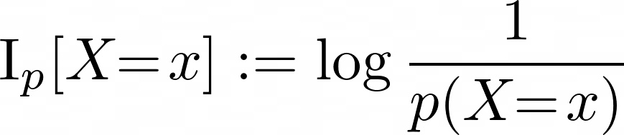
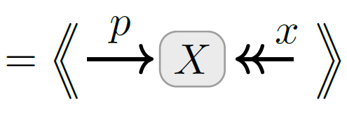
Information Content / Neg Log Likelihood as Inconsistency
Standard measure of discrepancy between $p$ and $X=x$
Known as “surprisal”, an expression of epistemic conflict

Slide 5
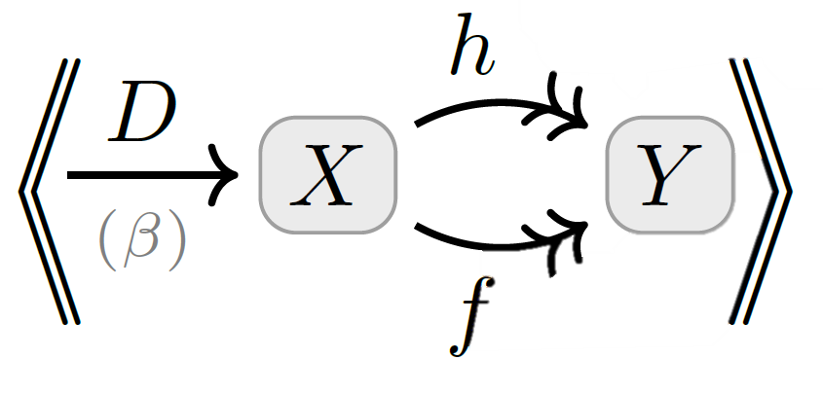


Accuracy as Inconsistency

Slide 6
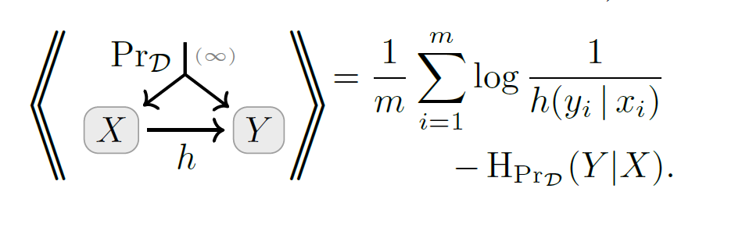

Slide 7
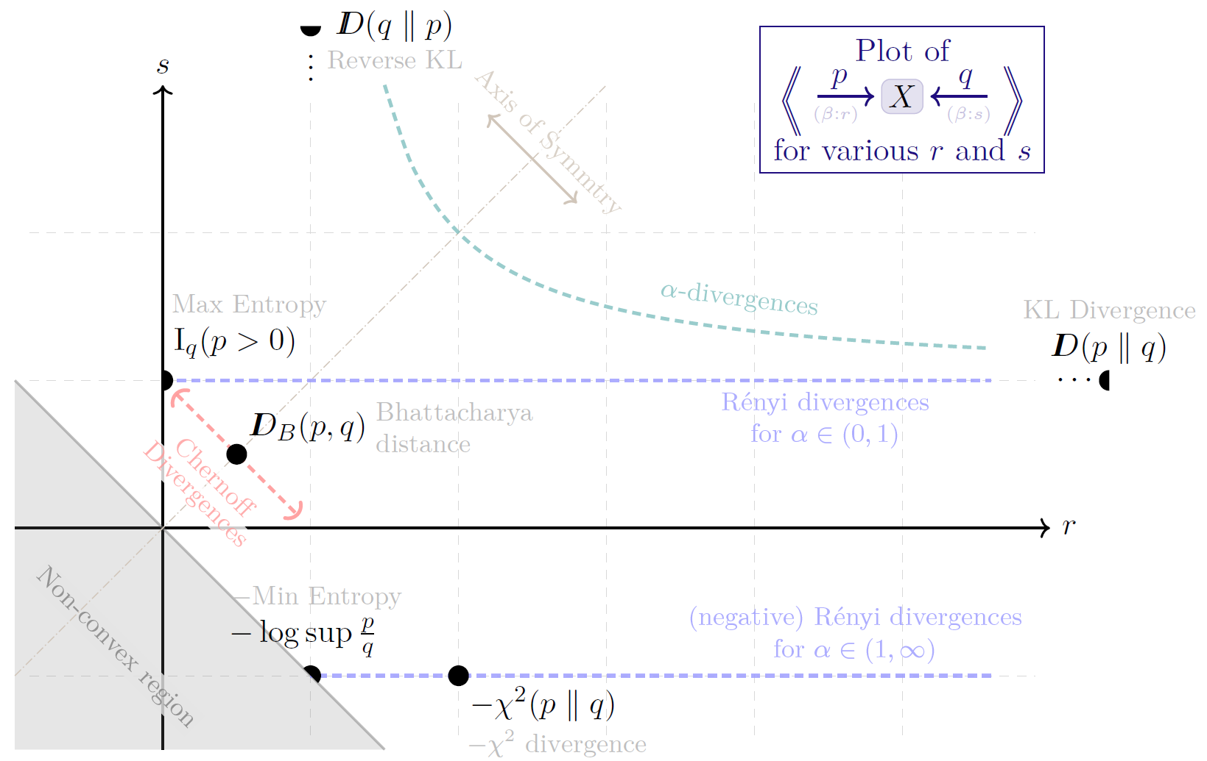

Slide 8
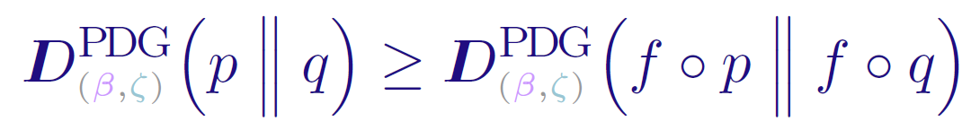
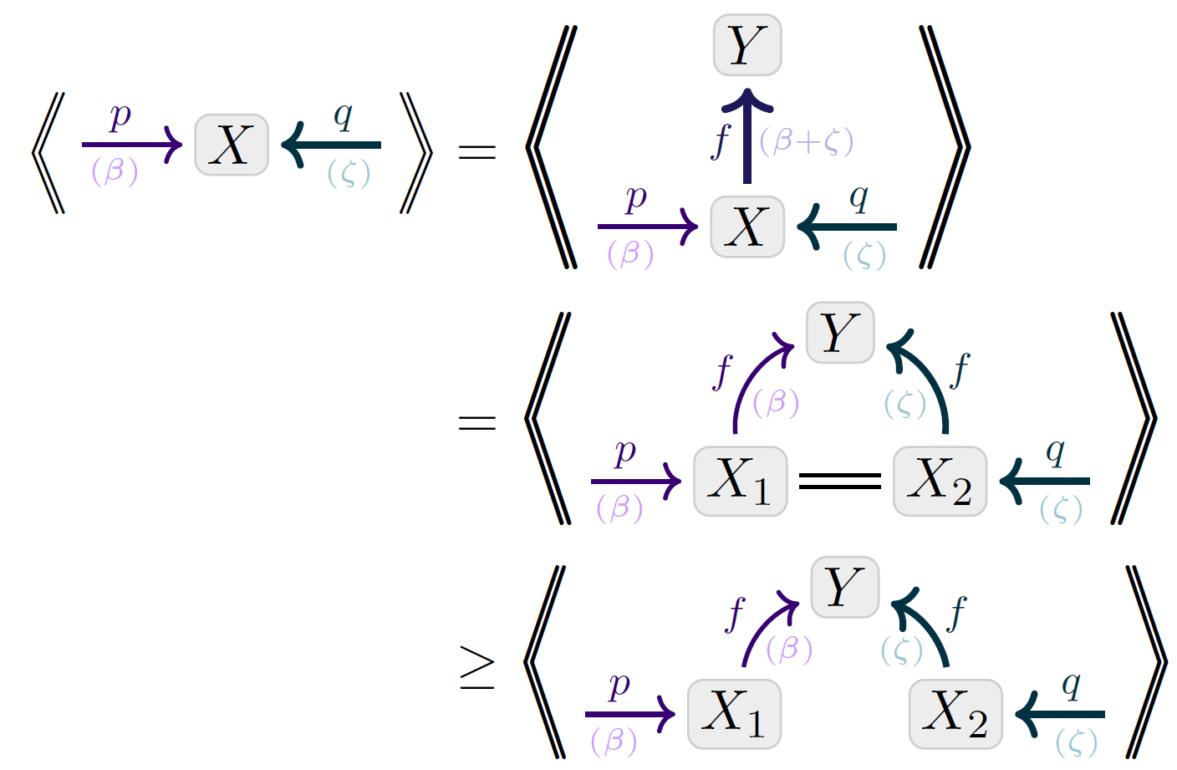
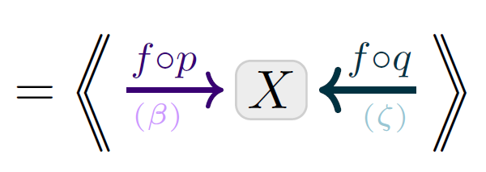
Visual Proof: Data-Processing Inequality
Monotonicity of inconsistency

Slide 9
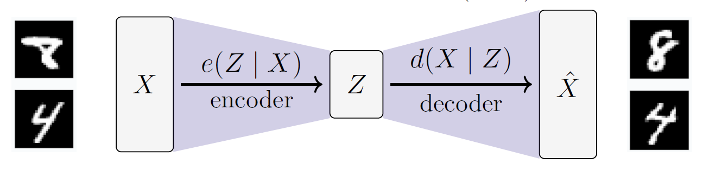

Slide 10
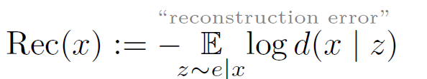
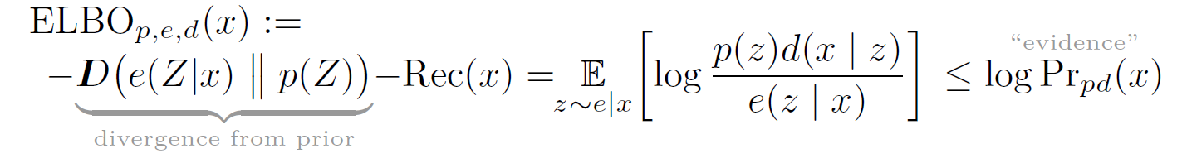

Slide 11
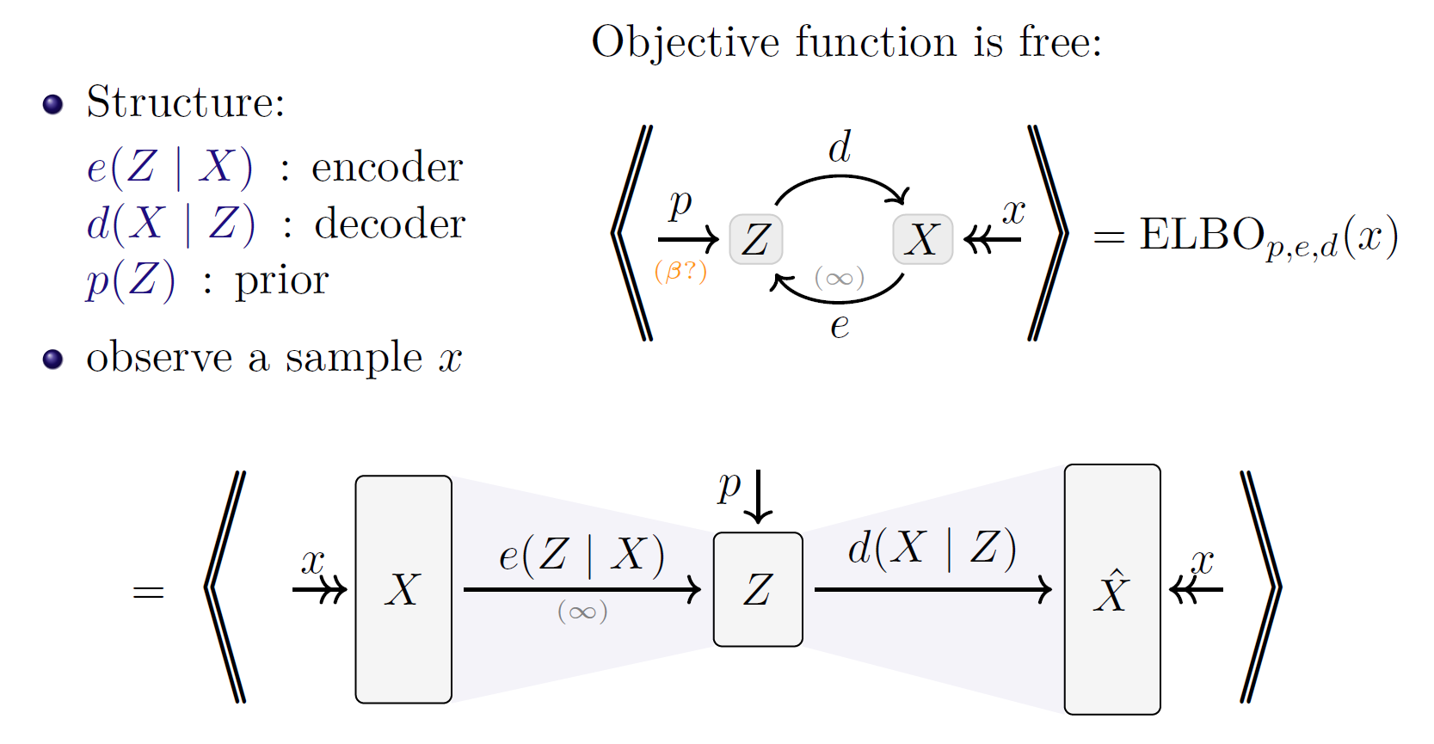

Slide 13
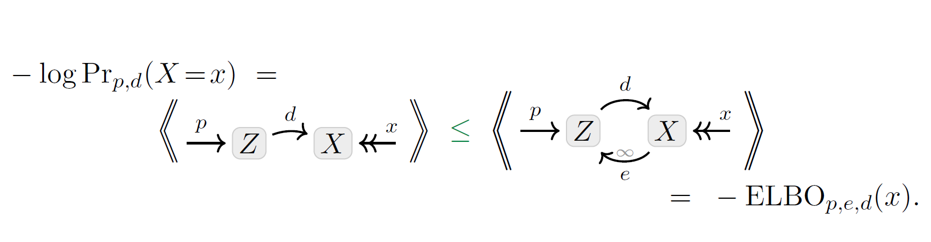
Visual Proof: The ELBO

