Slide 1
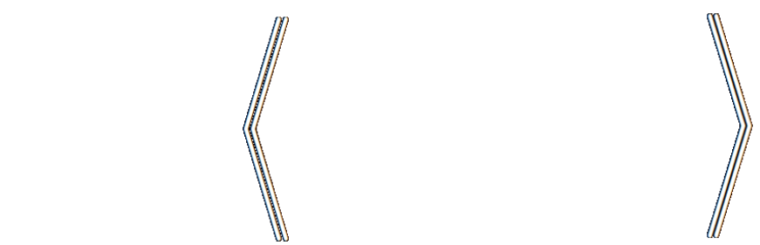
Loss as the Inconsistency of a P D G : Choose Your Model, Not Your Loss
robabilistic
ependency
raph
Oliver E Richardson
Cornell University

Slide 2
How To Select A Loss Function?
Casting AI as optimization is useful … but what to optimize?
(Cross Entropy, Square Loss, +Regularizers, …)
Choice of loss is made by instinct, tradition, pragmatics.
But a choice of model admits more principled discussion;
models, unlike losses, make testable claims.

Slide 3
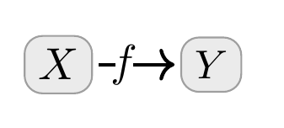

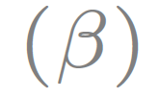
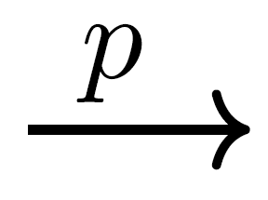
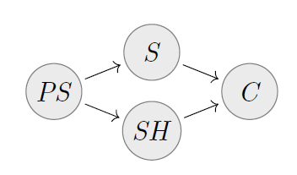
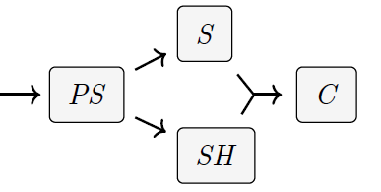

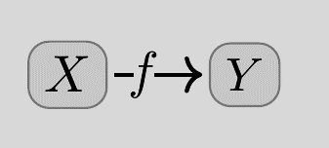
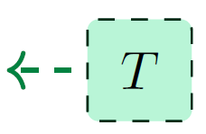
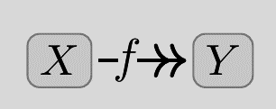

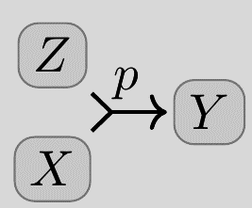
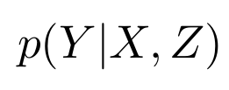
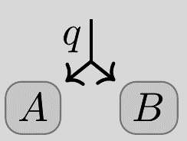

Probabilistic Dependency Graphs (PDGs)
Syntax: a weighted set of cpds (conditional probability distributions)
weighted
Very general class of graphical models including Bayesian Networks & Factor Graphs
How to draw cpds:
BN
PDG
(Deterministic)
(Joint Dependence)
Can model inconsistent information, and can measure the degree of inconsistency.
(Joint Distribution)

Slide 4
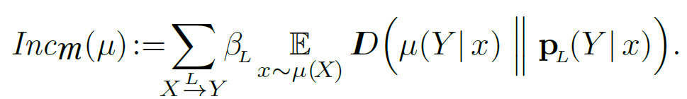
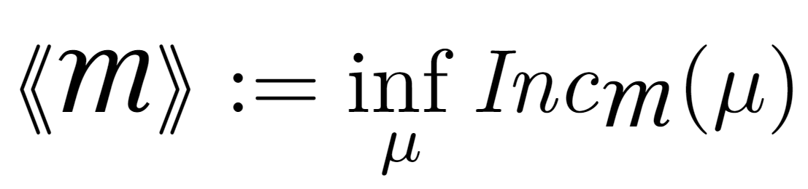
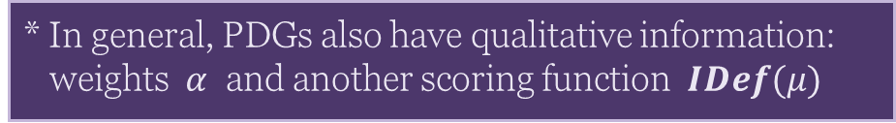
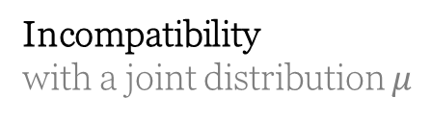
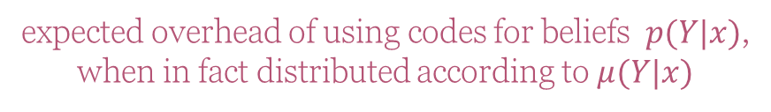
Semantics of PDGs
Incompatibility
with a joint distribution $μ$
expected overhead of using codes for beliefs $p(Y|x)$,
when in fact distributed according to $μ(Y|x)$
(scaled by confidence)
Inconsistency: the smallest possible incompatibility with any $μ$
* In general, PDGs also have qualitative information: weights $α$ and another scoring function $IDef(μ)$

Slide 5
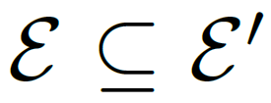
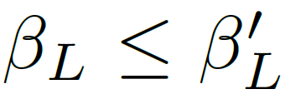
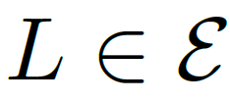
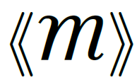
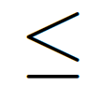
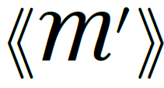

Useful Fact: Monotonicity of Inconsistency
Believing more things cannot make you any less inconsistent.
(more beliefs)
(higher confidence)
for all
(more inconsistency)

Slide 6
How To Choose A Loss Function?
Casting AI as optimization is useful … but what to optimize?
(Cross Entropy, Square Loss, +Regularizers, …)
Choice of loss is made by instinct, tradition, pragmatics.
But a choice of model admits more principled discussion;
models, unlike losses, make testable claims.
Surprising Fact: Standard loss functions can be viewed as the degree of inconsistency of the PDG describing the situation.
Bonus: A visual calculus for reasoning about the relationships between loss functions

Slide 7
INFORMATION-BASED LOSSES as Inconsistencies

Slide 8
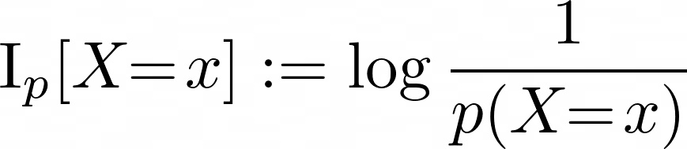
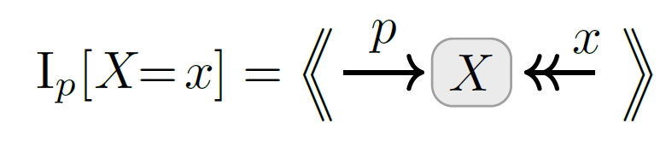
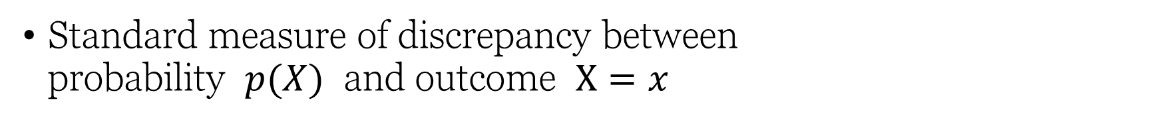
Information Content as Inconsistency
Standard measure of discrepancy between probability $p(X)$ and outcome $X=x$
known as “surprisal”, an expression of epistemic conflict

Slide 9
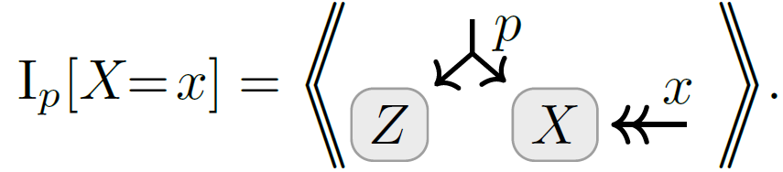
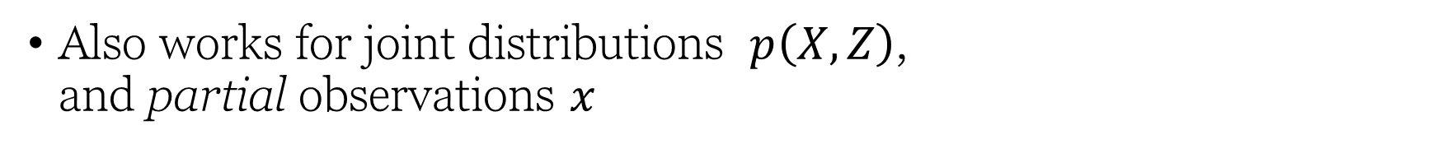
Marginal Information Content as Inconsistency
Also works for joint distributions $p\left(X,Z\right)$, and partial observations $x$

Slide 10
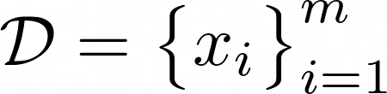
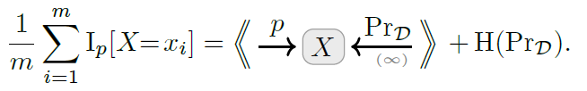
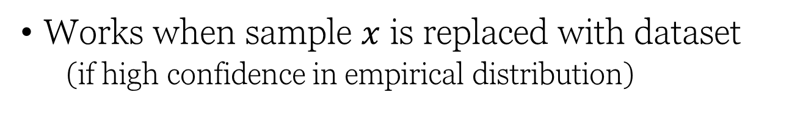
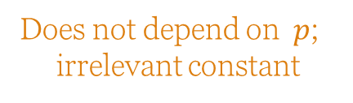
Average Information Content (Cross Entropy, Unsupervised) as Inconsistency
Works when sample $x$ is replaced with dataset
(if high confidence in empirical distribution)
Does not depend on $p$;
irrelevant constant

Slide 11
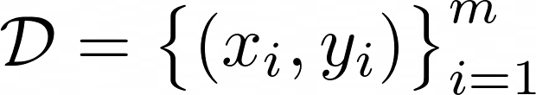
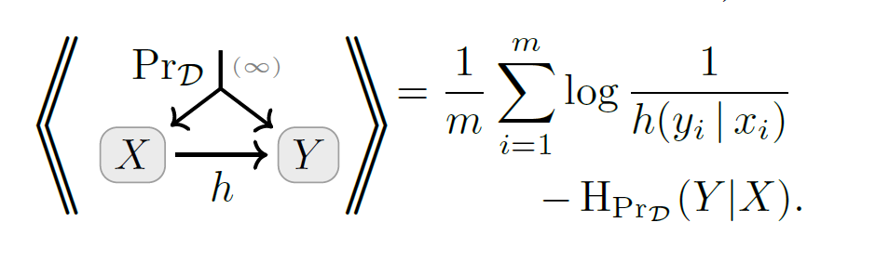
Conditional Information Content (Cross Entropy, Supervised) as Inconsistency
… and for discriminative models;

Slide 12
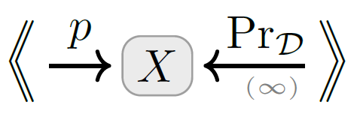
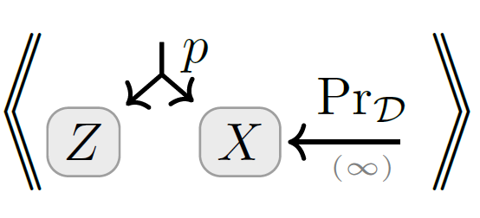
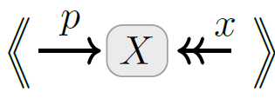
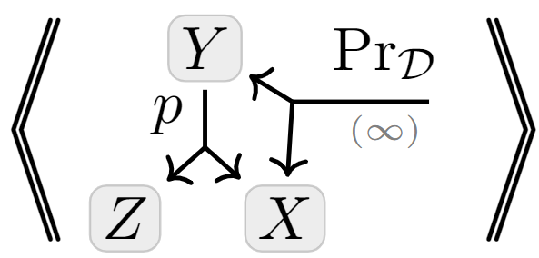
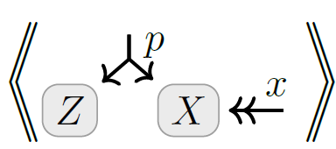
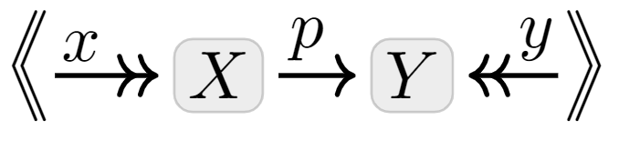
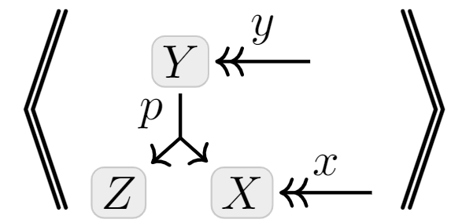
A Map
Full-Dataset
Unsupervised
+ multi-sample
+ marginal
Exact Models
+ conditional
Latent Variable Models
Single- Observation
Supervised

Slide 13
STANDARD METRICS as Inconsistency
Accuracy
Mean-Squared Error (MSE)

Slide 14
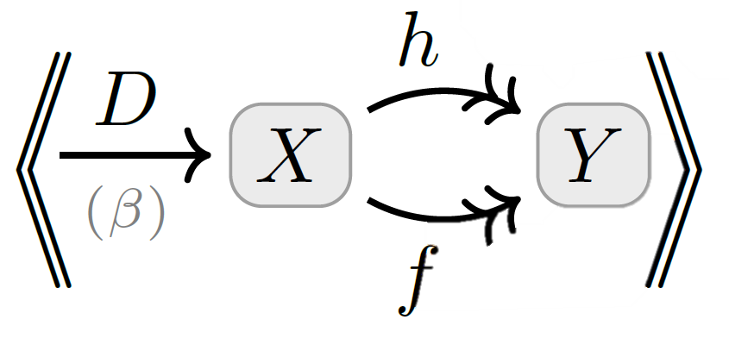

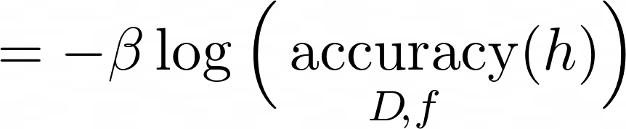


(Log) Accuracy as Inconsistency

Slide 15
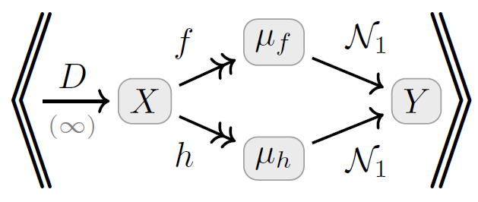
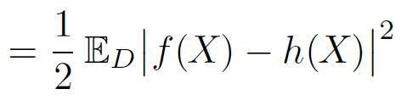



Mean Square Error as Inconsistency
where
is a unit Gaussian on Y with mean $μ$

Slide 16
Regularizers as Inconsistencies

Slide 17
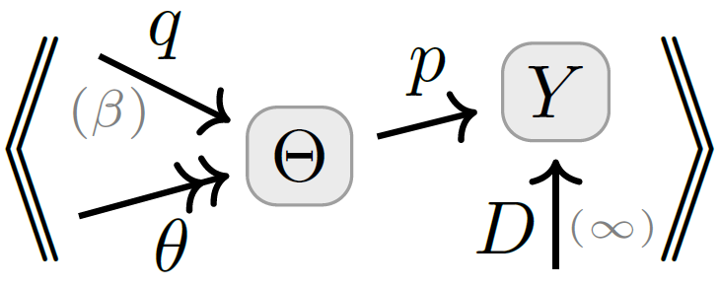
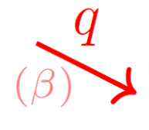



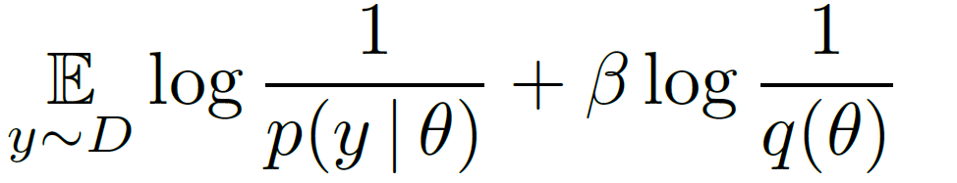
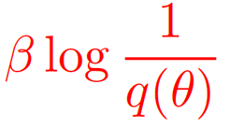



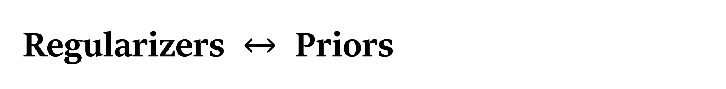
Regularizers $↔$ Priors
Terms added to loss functions to incentivize “simple models”
Distributions over
model parameters
parameterized model
trusted empirical distribution
prior over parameters

Slide 18
Statistical Divergences as Inconsistencies

Slide 19




Statistical Divergence as Inconsistency
You believe both $p(X)$ and $q(X)$.
Your inconsistency: a divergence between $p$ and $q$?

Slide 20




Map of as $(r,s)$ vary

Slide 21

By Monotonicity…
Twice Bhattacharya Distance is no larger than forward or reverse KL.
Rényi Entropy is Monotonic in $α$.

Slide 22



Visual Proof: Data-Processing Inequality
Monotonicity

Slide 23
Variational Objectives as Inconsistencies

Slide 24











Variational Auto Encoders (VAEs), Take 1.
Loss Function: Negative ELBO(x)
= reconstruction error + divergence from prior $p(Z)$
Variational “Justification”:
might suffice to maximize this?
want to maximize
“evidence” of x
VAEs are Not Graphical Models:
e(Z|X) and p(Z) are both dists over Z; can’t have both
The heart of a VAE is not the networks, but the loss function

Slide 25





VAEs, Take 2
Structure:
encoder $e(Z|X)$
decoder $d(X|Z)$
prior $p\left(Z\right)$
observe a sample $x$
loss function is free:
β-VAE
Objective

Slide 26

Visual Proof: The ELBO
Monotonicity

Slide 27
SEE PAPER FOR MORE…
free energy as inconsistency
a case study: PDGs give a “better” objective in a complex scenario;
further relationships between loss functions;
how to reverse-engineer a PDG from a loss, and why it’s a bad idea;
precise definitions and proofs

Slide 28



