Slide 1
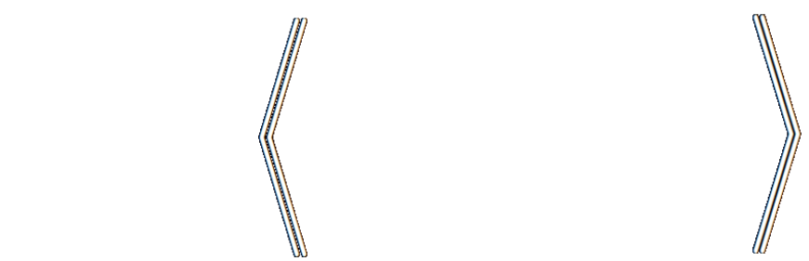
Loss as the Inconsistency of a P D G : Choose Your Model, Not Your Loss
robabilistic
ependency
raph
Oliver E Richardson
Cornell University

Slide 2
How To Select A Loss Function?
Casting AI as optimization is useful … but what to optimize?
(Cross Entropy, Square Loss, +Regularizers, …)
Choice of loss is made by instinct, tradition, pragmatics.
But a choice of model admits more principled discussion;
models, unlike losses, make testable claims.

Slide 3
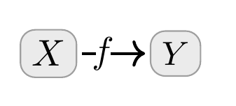

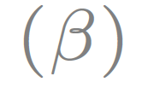
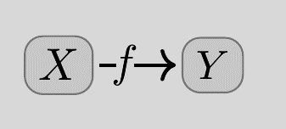
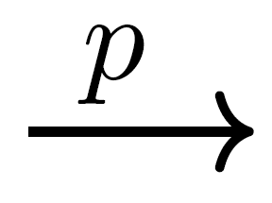
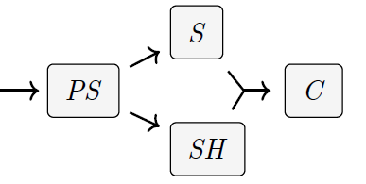

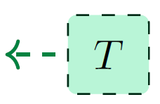
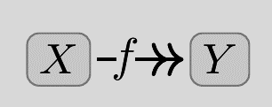

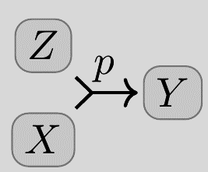
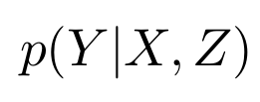
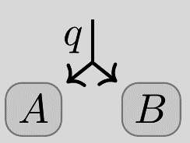

Probabilistic Dependency Graphs (PDGs)
weighted
Syntax: weighted sets of cpds (conditional probability distributions)
Very general class of graphical models including Bayesian Networks & Factor Graphs
How to draw cpds
(Deterministic)
(Joint Dependence)
Can model inconsistent information, and can measure the degree of inconsistency.
(Joint Distribution)

Slide 4
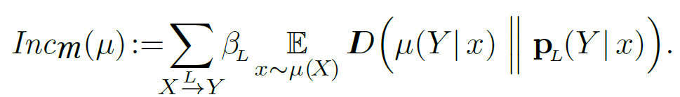
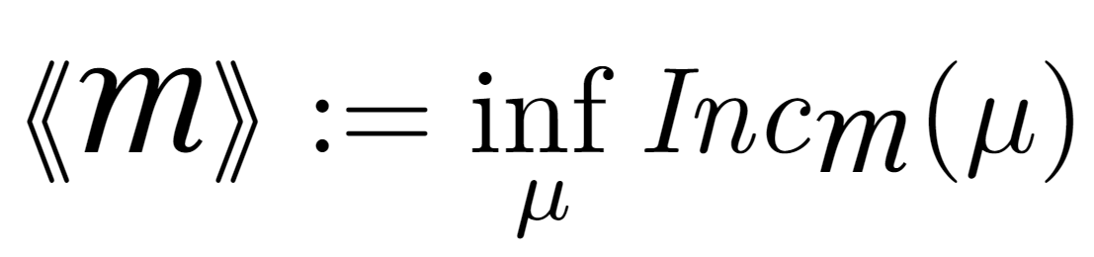
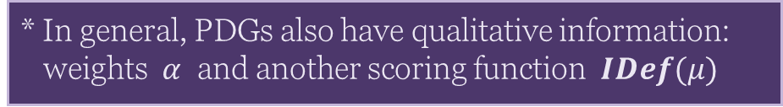
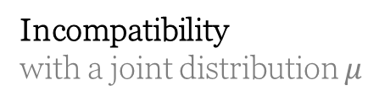
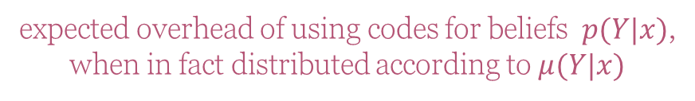
Semantics of PDGs
Incompatibility
with a joint distribution $μ$
expected overhead of using codes for beliefs $p(Y|x)$,
when in fact distributed according to $μ(Y|x)$
(scaled by confidence)
Inconsistency: the smallest possible incompatibility with any $μ$
* In general, PDGs also have qualitative information: weights $α$ and another scoring function $IDef(μ)$

Slide 5
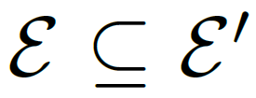
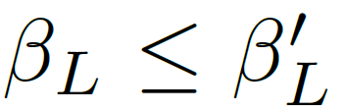
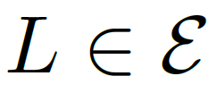
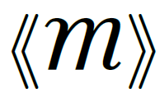

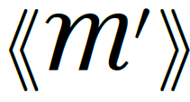

Useful Fact: Monotonicity of Inconsistency
Believing more things cannot make you any less inconsistent.
(more beliefs)
(higher confidence)
for all
(more inconsistency)

Slide 6
How To Choose A Loss Function?
Casting AI as optimization is useful … but what to optimize?
(Cross Entropy, Square Loss, +Regularizers, …)
Choice of loss is made by instinct, tradition, pragmatics.
But a choice of model admits more principled discussion;
models, unlike losses, make testable claims.
Surprising Fact: Standard loss functions can be viewed as the degree of inconsistency of the PDG describing the situation.
Bonus: A visual calculus for reasoning about the relationships between loss functions

Slide 7
INFORMATION-BASED LOSSES as Inconsistencies

Slide 8
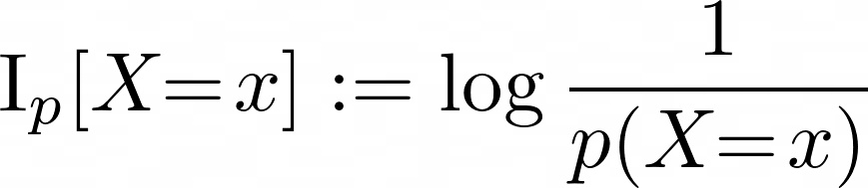
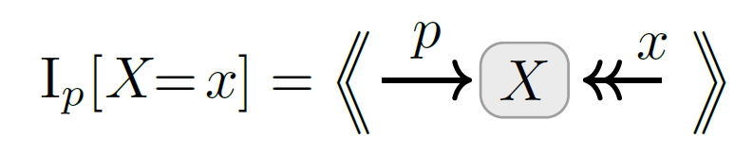
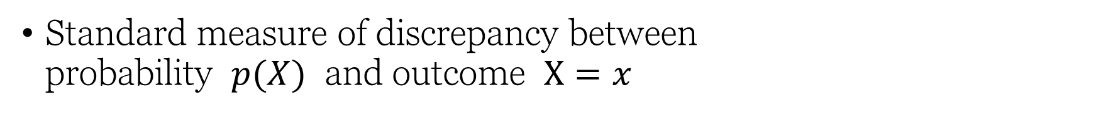
Information Content as Inconsistency
Standard measure of discrepancy between probability $p(X)$ and outcome $X=x$

Slide 9
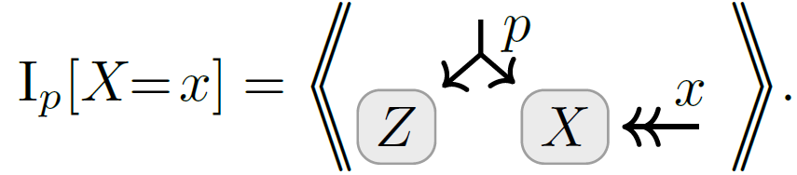
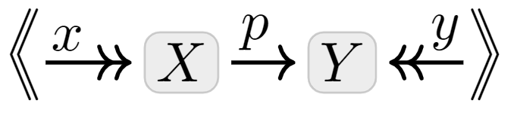

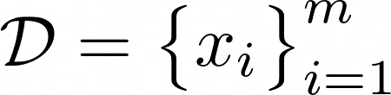
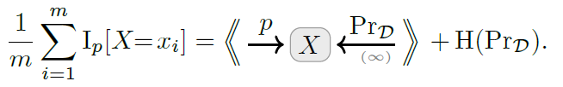
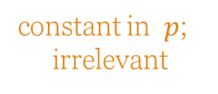
Variants of Information Content as Inconsistencies
Marginal Information
for partial observations
Conditional Information
for conditional models
Average Information
Works whole dataset at once (if high confidence in data)
constant in $p$;
irrelevant

Slide 10
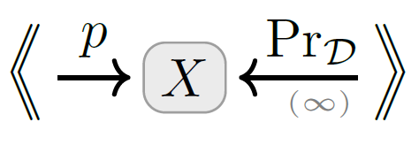
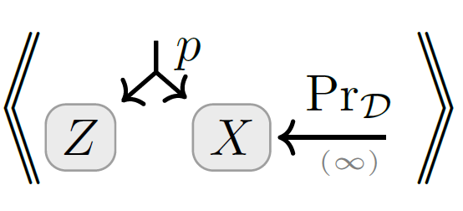
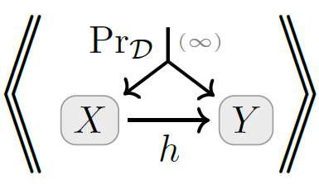
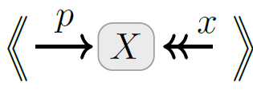
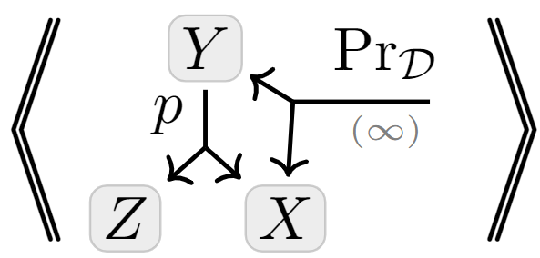
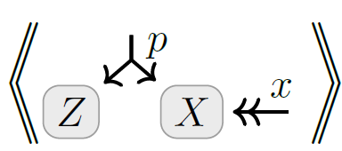
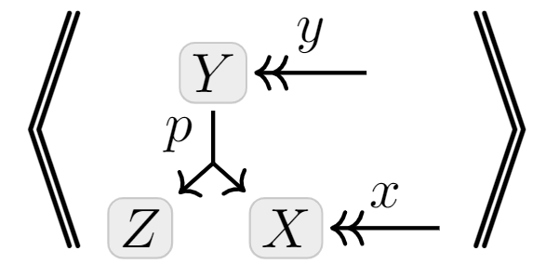
A Map
Full-Dataset
Unsupervised
+ multi-sample
+latent variables
Exact Models
+ conditional model
Latent Variable Models
Single- Observation
Supervised

Slide 11
MORE STANDARD METRICS & REGULARIZERS as Inconsistencies
Accuracy
Mean-Squared Error (MSE)
… see full paper.

Slide 12
STATISTICAL DIVERGENCES as Inconsistencies

Slide 13
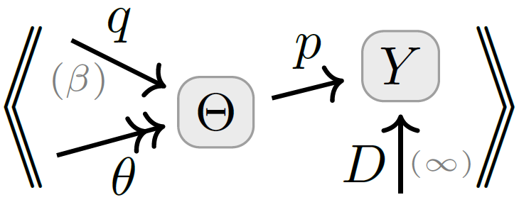
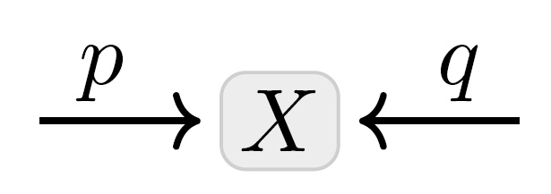
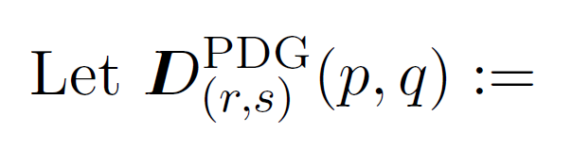


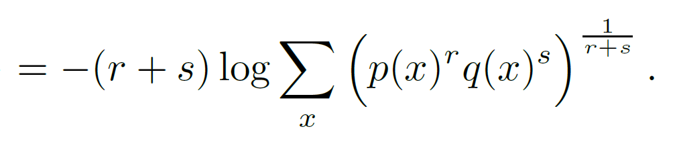

Statistical Divergences as Inconsistencies
You believe both $p(X)$ and $q(X)$.
Your inconsistency: a divergence between $p$ and $q$?

Slide 14
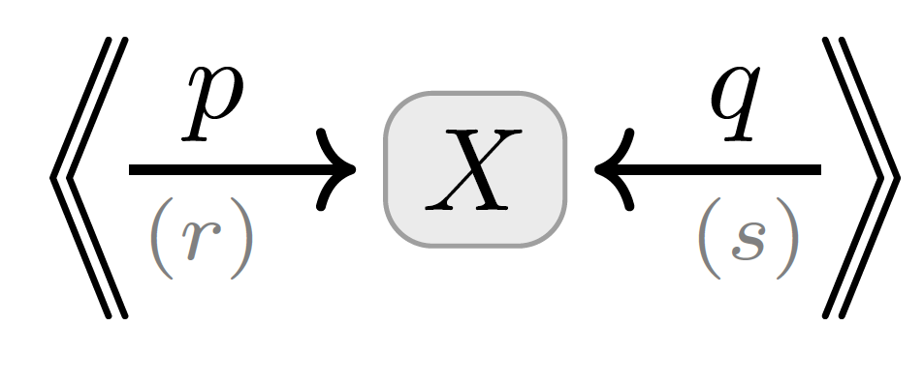
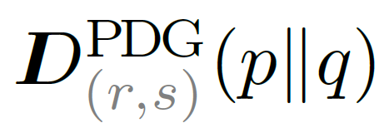
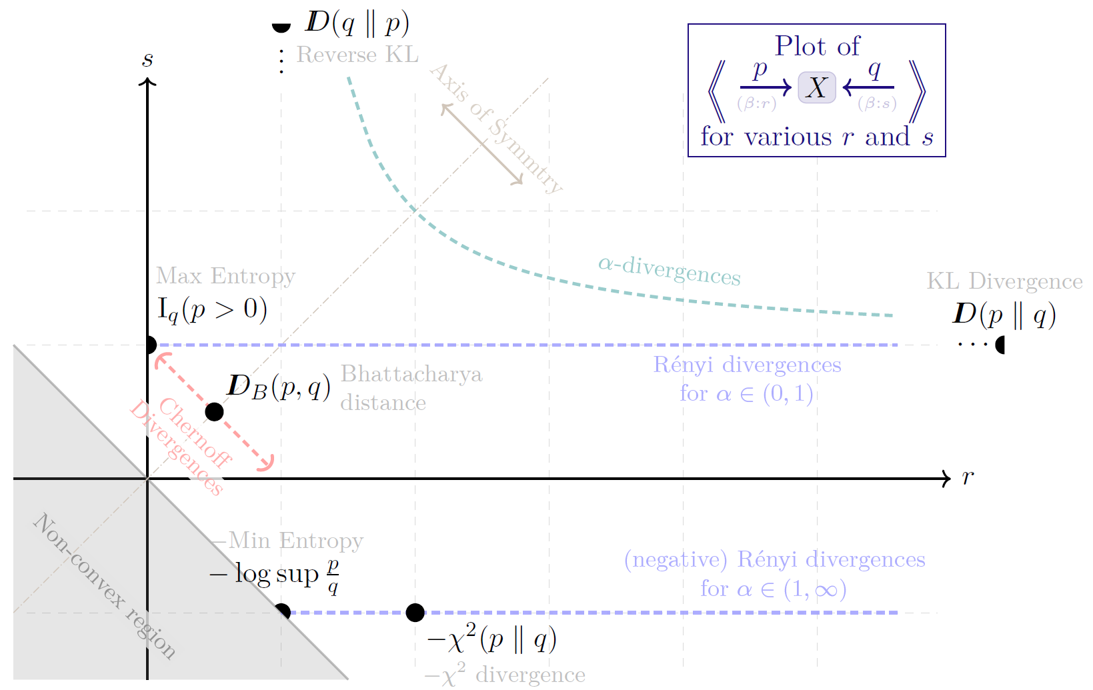
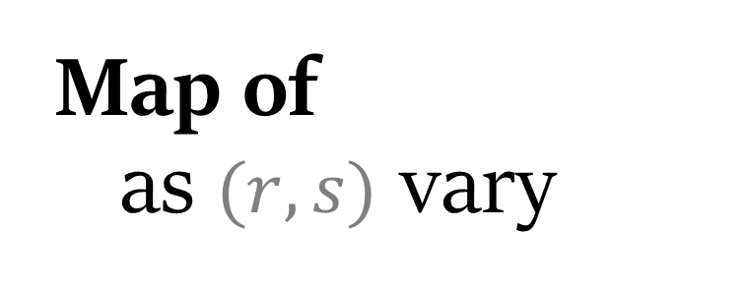
Map of as $(r,s)$ vary

Slide 15

By Monotonicity …
Twice Bhattacharya Distance is no larger than forward or reverse KL.
Rényi Entropy is Monotonic in $α$.

Slide 16
VARIATIONAL OBJECTIVES as Inconsistencies

Slide 17
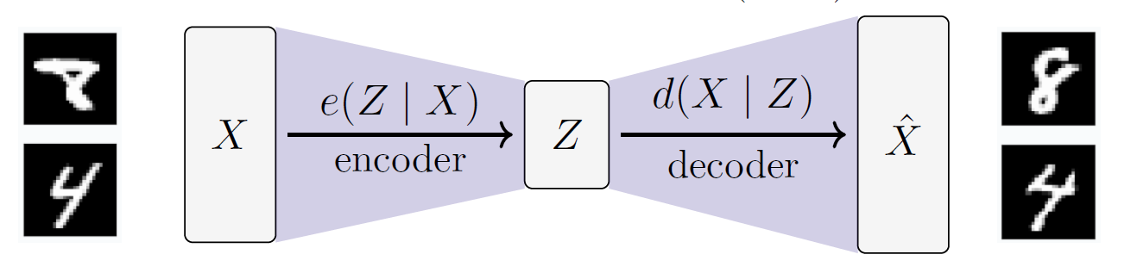
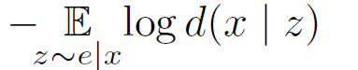

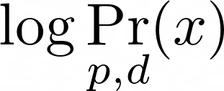

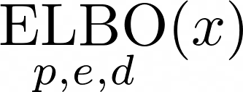
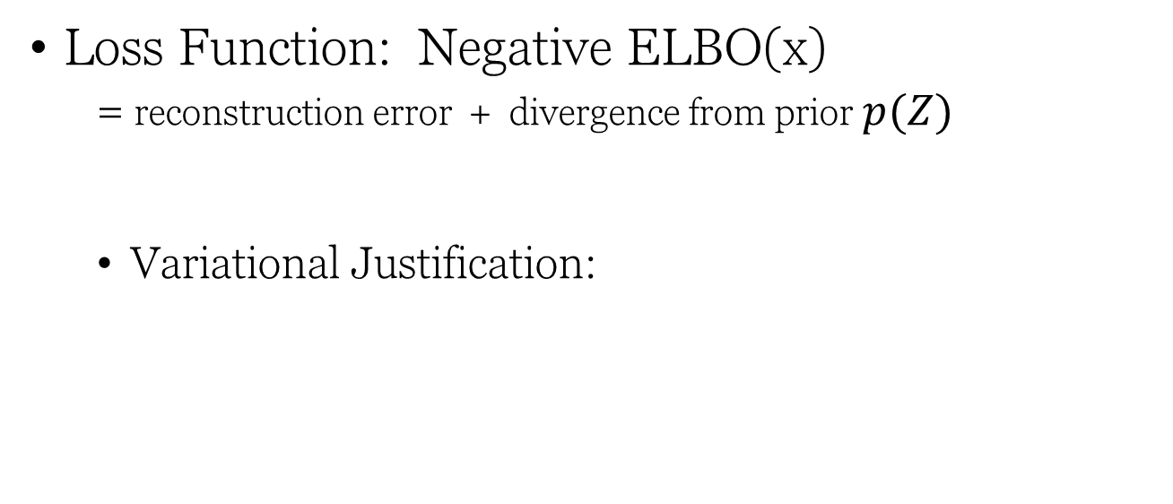
Variational Auto Encoders (VAEs), Take 1.
Loss Function: Negative ELBO(x)
= reconstruction error + divergence from prior $p(Z)$
Variational Justification:
might suffice to maximize this?
want to maximize
“evidence” of x

Slide 18





VAEs, Take 2
Structure:
encoder $e(Z|X)$
decoder $d(X|Z)$
prior $p\left(Z\right)$
observe a sample $x$
loss function is free:
β-VAE
Objective

Slide 19

Visual Proof: The ELBO
Monotonicity

Slide 20
SEE PAPER FOR MORE…
Free energy, MSE, accuracy, regularizers as inconsistencies
Case study: PDGs give a “better” objective in a complex scenario;
More visual proofs
the Data-Processing Inequality
Further relationships between loss functions;
How to reverse-engineer a PDG from a loss, and why that’s a bad idea;
Precise definitions and proofs

