Slide 1
Loss as the Inconsistency of a P D G : Choose Your Model, Not Your Loss
robabilistic
ependency
raph
Oliver E Richardson
Cornell University

Slide 2
Fruitful in AI to cast problems as optimization.
But what to optimize? (Cross Entropy, Square Loss, …)
Choice of model admits more principled discussion
Model makes claims about reality
Surprising Result:
Bonus: A visual language for reasoning about the relationships between loss functions

Slide 3

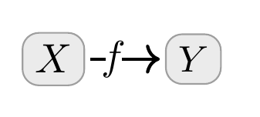

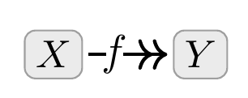
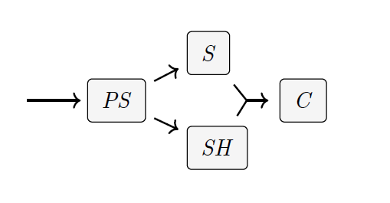
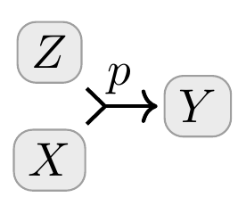
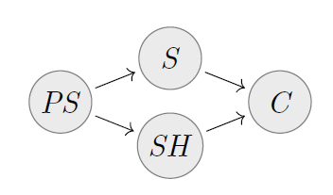
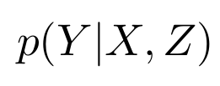
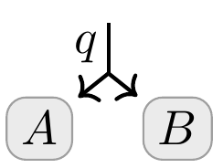

Probabilistic Dependency Graphs
A Class of Graphical Models
A weighted collection of cpds
Generalize Bayesian Networks and Factor Graphs
Comes with a Measure of Inconsistency…

Slide 4
Semantics of PDGs
Two Scoring Functions:
Inc_{\dg M
Inc

Slide 5
Lemma: Monotonicity of Inconsistency

Slide 6
STANDARD METRICS as Inconsistencies
Surprisal
Cross Entropy
of many varieties

Slide 7
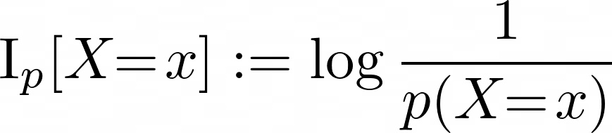
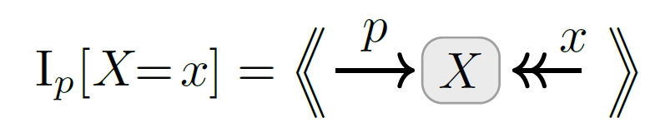
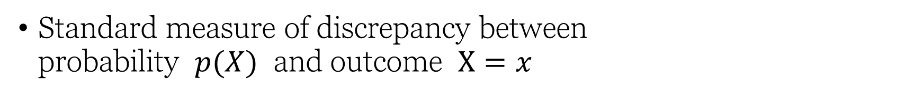
Information Content as Inconsistency
Standard measure of discrepancy between probability $p(X)$ and outcome $X=x$
Also known as “surprisal”, an expression of epistemic conflict

Slide 8
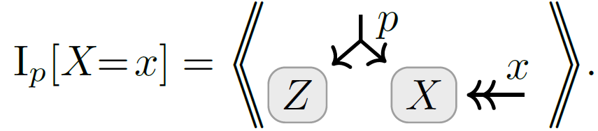
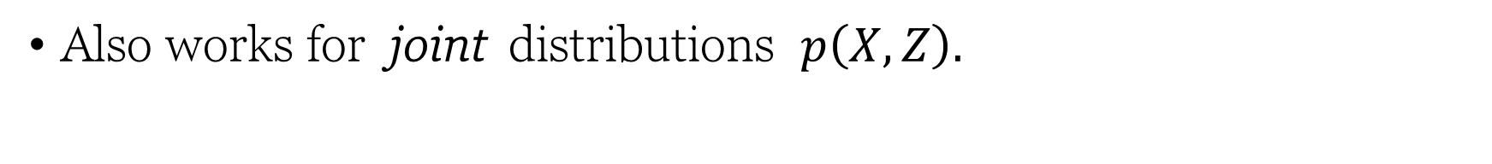
Marginal Information as Inconsistency
Also works for joint distributions $p\left(X,Z\right).$

Slide 9
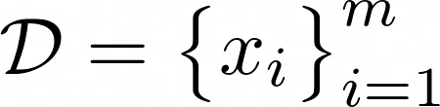
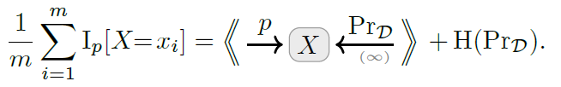

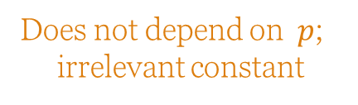
Average Information Content (Cross Entropy, Unsupervised) as Inconsistency
Works when sample $x$ is replaced with dataset
with high confidence in data
Does not depend on $p$;
irrelevant constant

Slide 10
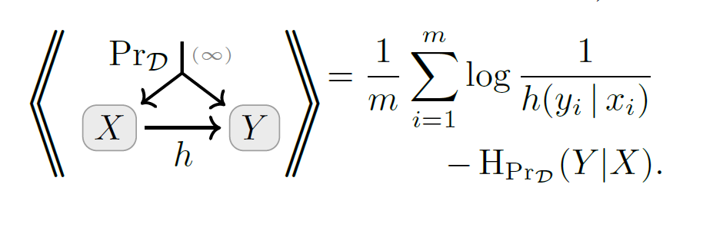
Conditional Information Content (Cross Entropy, Supervised) as Inconsistency

Slide 11
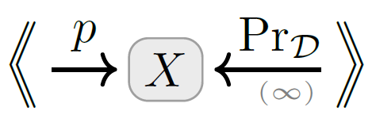
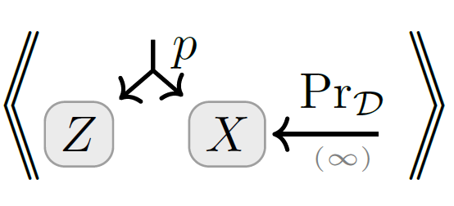
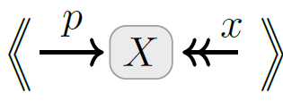
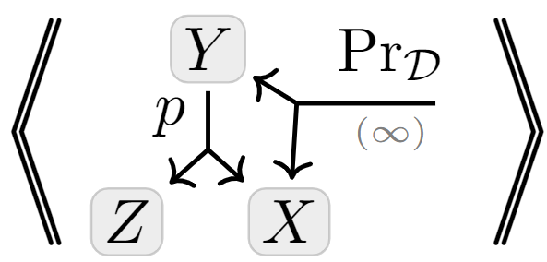
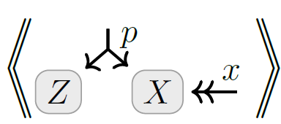
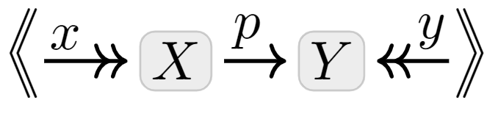
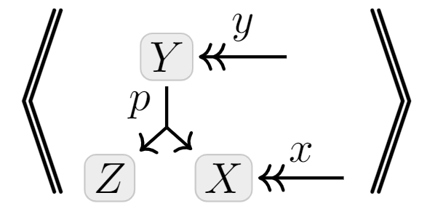
A Map
Full-Dataset
Unsupervised
+ multi-sample
+ marginal
Exact Models
+ conditional
Latent Variable Models
Single- Observation
Supervised

Slide 12
Other Standard Metrics as Inconsistency
Accuracy
Mean-Squared Error (MSE)

Slide 13
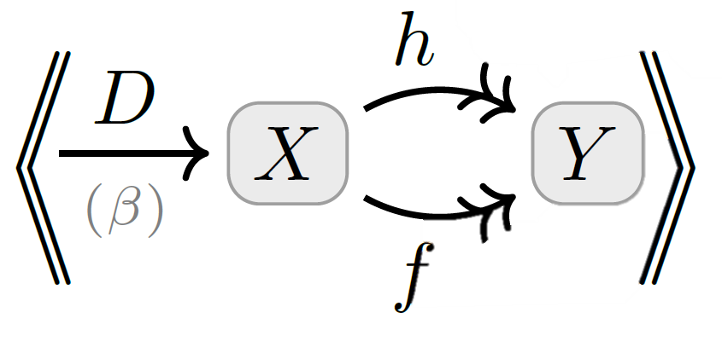


Accuracy as Inconsistency

Slide 14
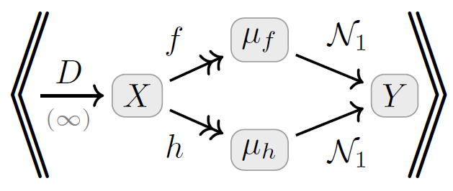
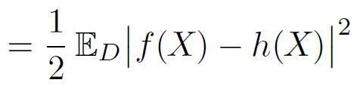



Mean Square Error as Inconsistency
where
is a unit Gaussian on Y with mean $μ$

Slide 15
Regularizers as Inconsistencies

Slide 16
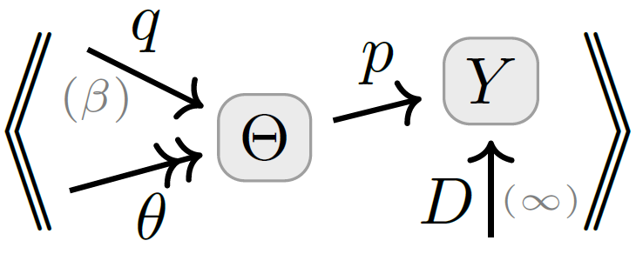
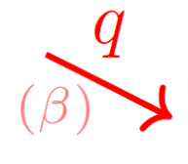



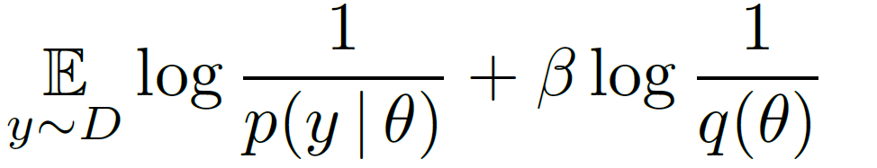
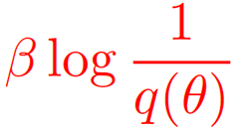




Regularizers $↔$ Priors
Terms added to loss functions to incentivize “simple models”
Distributions over
model parameters
parameterized model
trusted empirical distribution
prior over parameters

Slide 17
Statistical Divergences as Inconsistencies

Slide 18
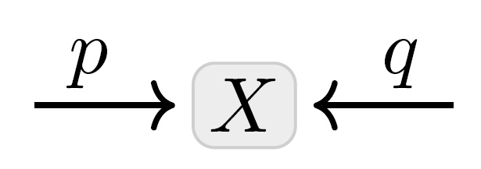
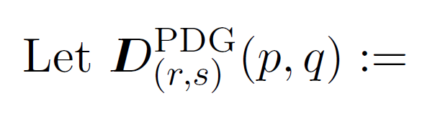
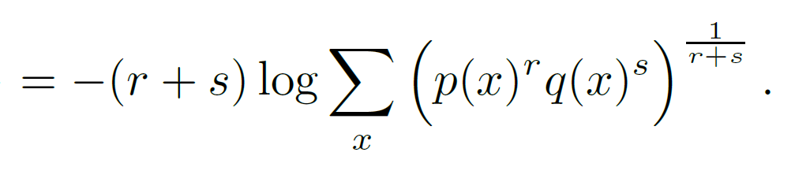

Statistical Divergence as Inconsistency
You believe both $p(X)$ and $q(X)$.
Your inconsistency: a divergence between $p$ and $q$?

Slide 19
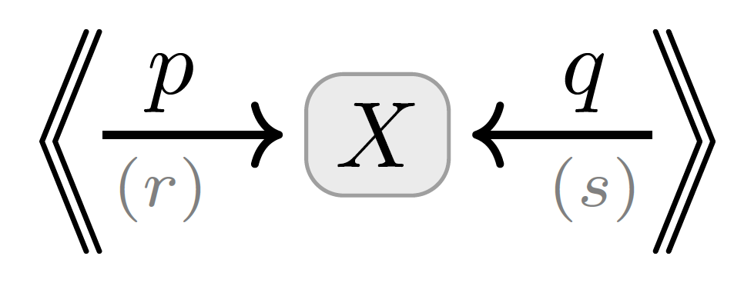
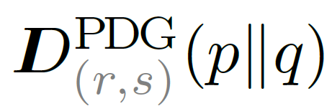
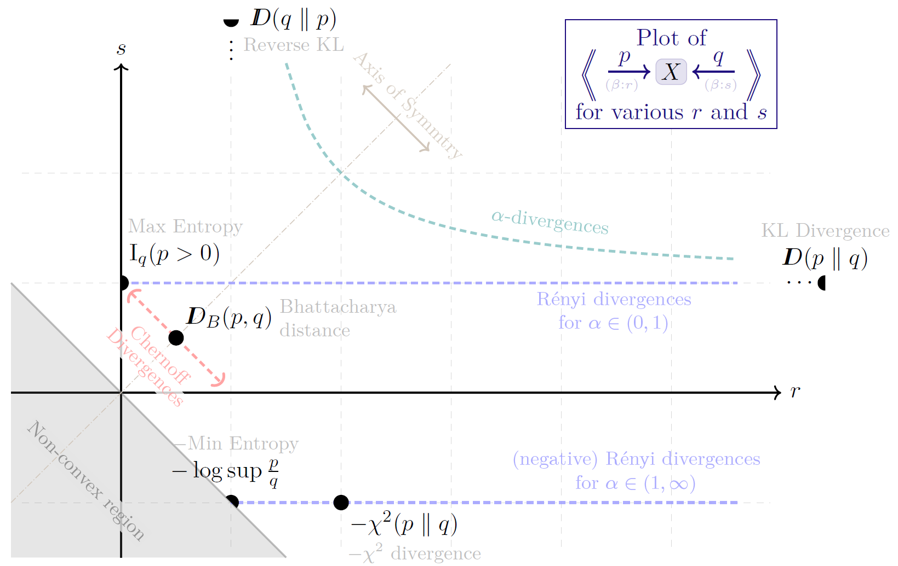
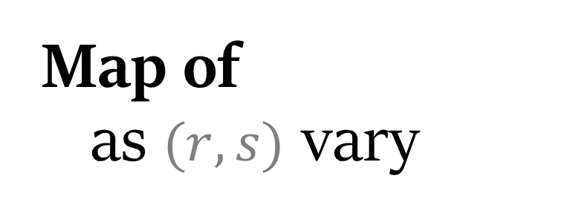
Map of as $(r,s)$ vary

Slide 20
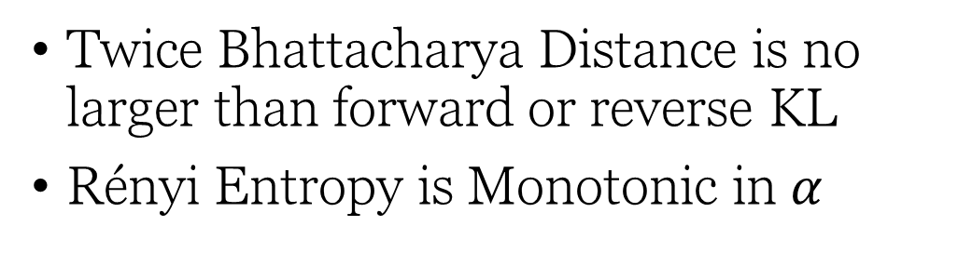
Monotonicity of Inconsistency immediately gives…
Twice Bhattacharya Distance is no larger than forward or reverse KL
Rényi Entropy is Monotonic in $α$

Slide 21
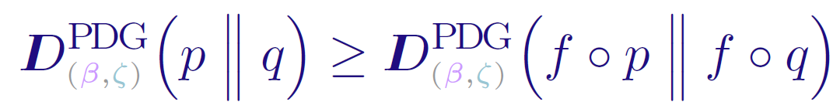
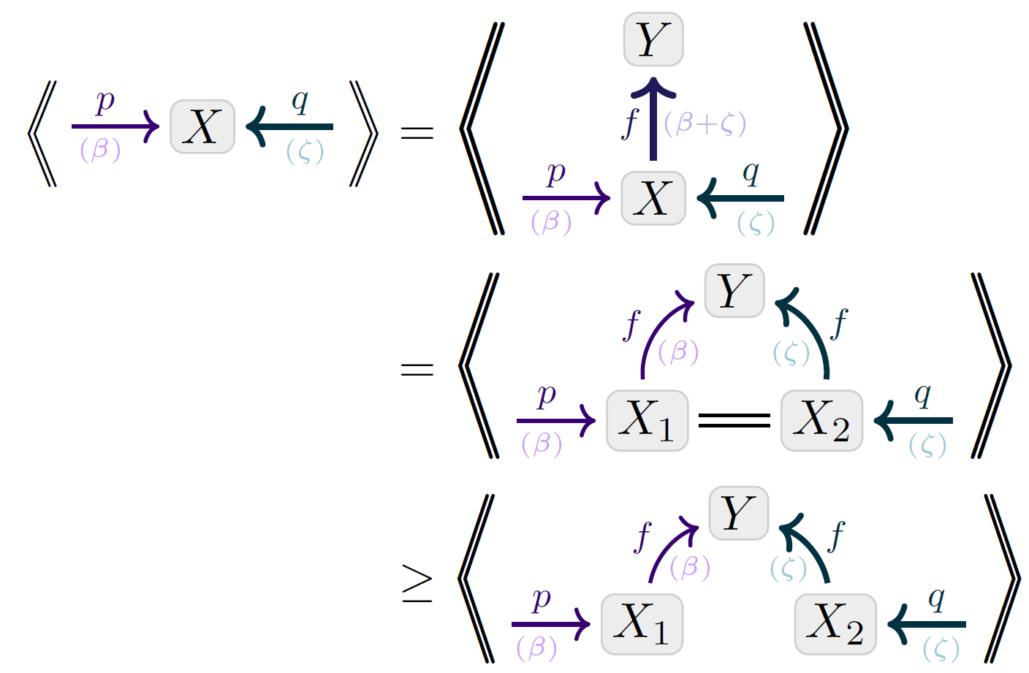
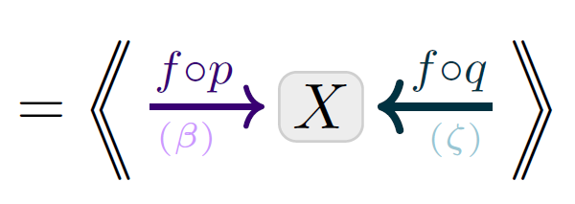
Visual Proof: Data-Processing Inequality
Monotonicity of inconsistency

Slide 22
Variational Objectives as Inconsistencies

Slide 23
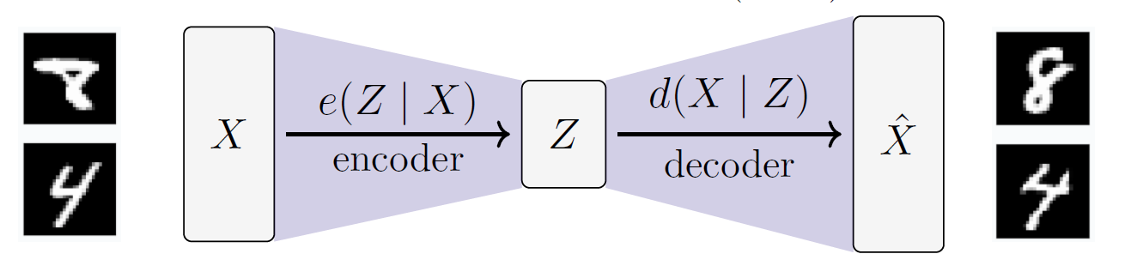
VAEs

Slide 24
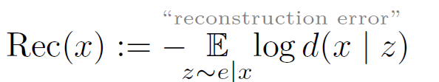
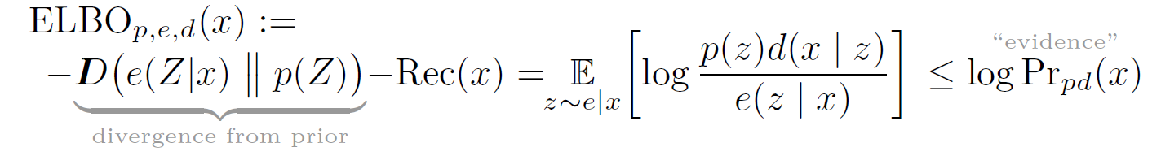

Slide 25
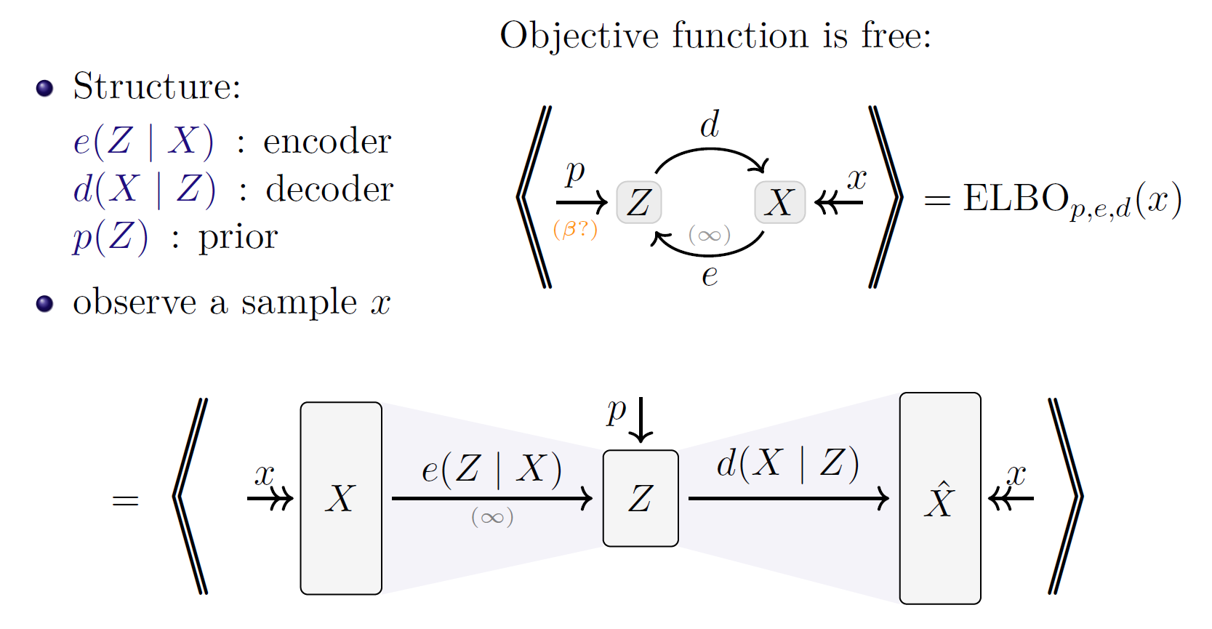

Slide 27
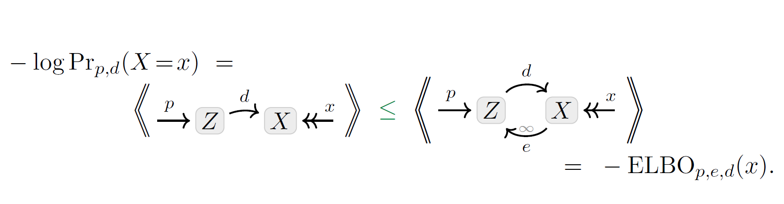
Visual Proof: The ELBO

Slide 28
Statistical Divergences as Inconsistencies

Slide 29
