Slide 1
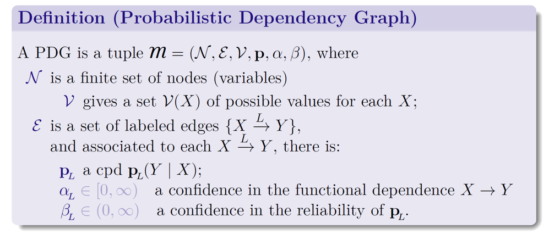
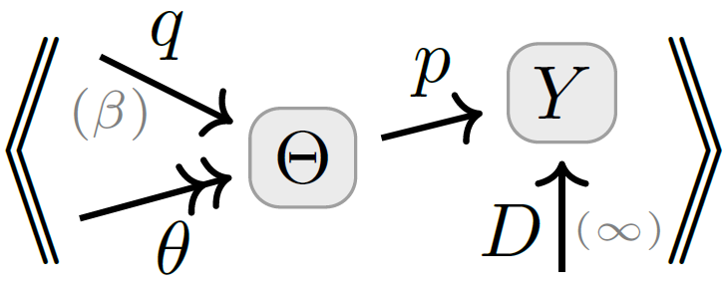
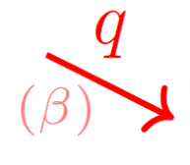









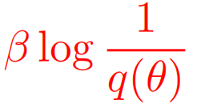
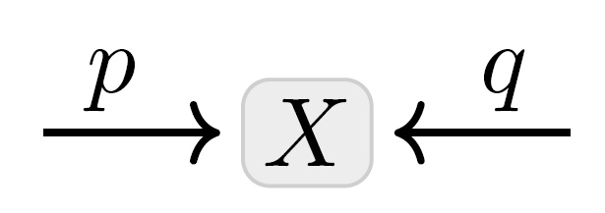





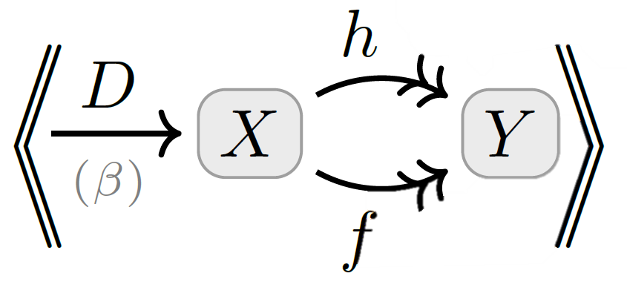

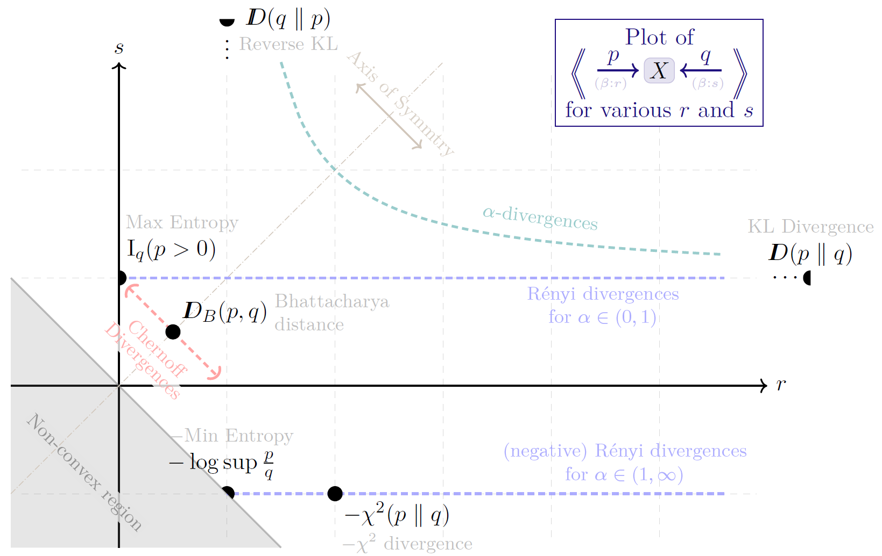
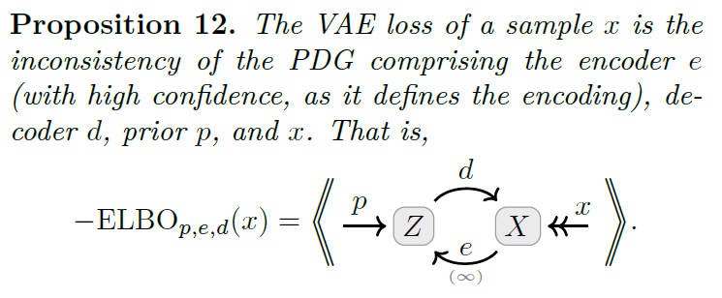


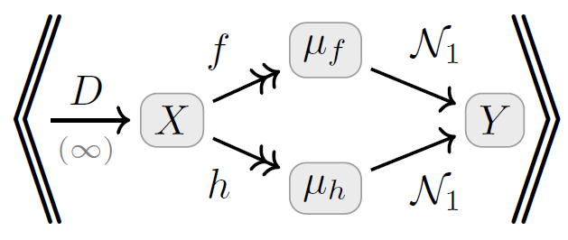


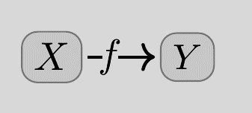
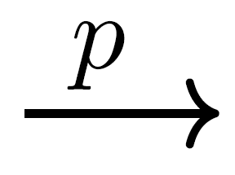


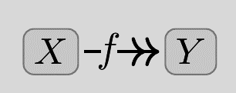

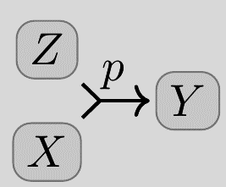

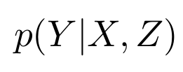

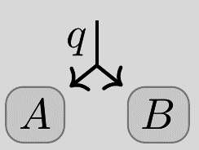


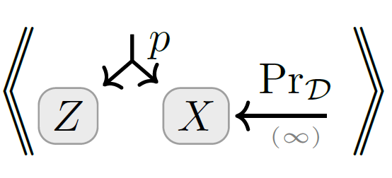






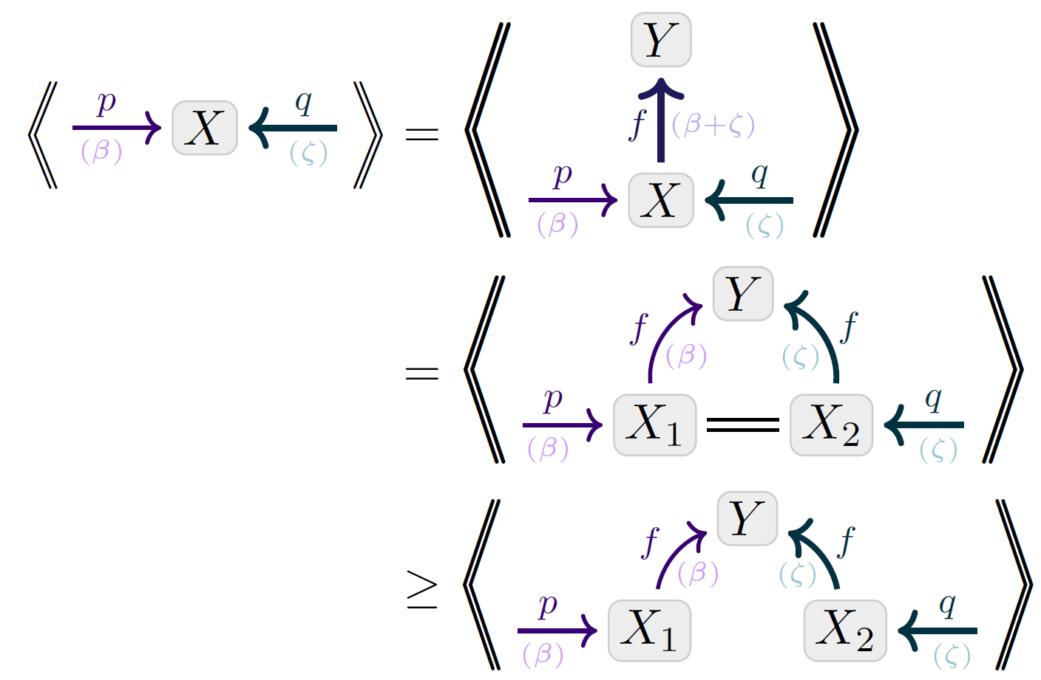

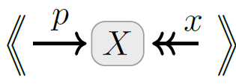
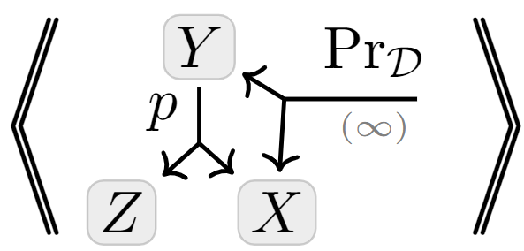





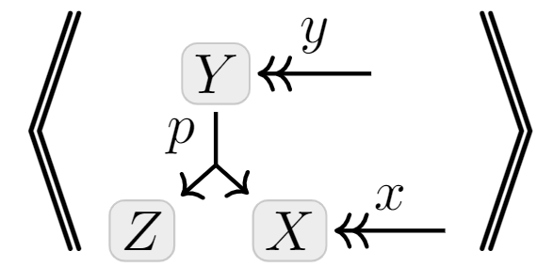
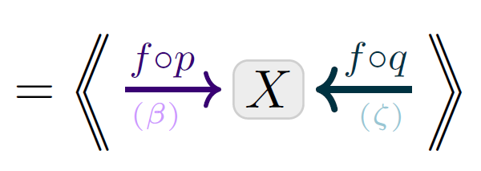




Loss as the Inconsistency of a Probabilistic Dependency Graph: Choose Your Model, Not Your Loss
Oliver Richardson
REGULARIZERS as Inconsistencies.
parameterized model
VARIATIONAL OBJECTIVES
as Inconsistencies
PDG Semantics: Inconsistency.
trusted empirical distribution
prior over parameters
Incompatibility with a
joint distribution $μ$
expected overhead of using codes for beliefs $p(Y|x)$,
when in fact distributed according to $μ(Y|x)$
STATISTICAL DIVERGENCES as Inconsistencies
(scaled by confidence)
Inconsistency: the smallest possible incompatibility with any $μ$
(Log) Accuracy as Inconsistency.
MSE as Inconsistency.
How to draw cpds.
where
is a unit Gaussian on Y with mean $μ$
Visual Proof: Evidence Lower Bound
INFORMATION-BASED LOSSES as Inconsistencies
Simulator + Data Case study: Which Loss?
Visual Proof: Data-Processing-Inequality
+ multi-sample
+latent variables
+ conditional model
Monotonicity

