Slide 2
known as “surprisal”, an expression of epistemic conflict

Slide 3
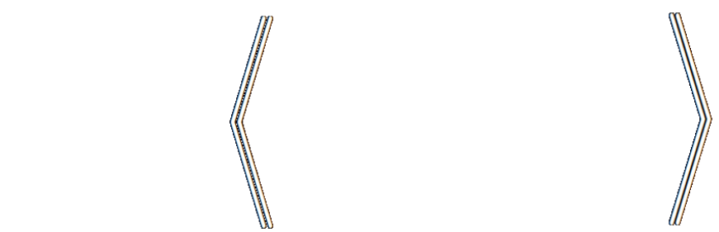
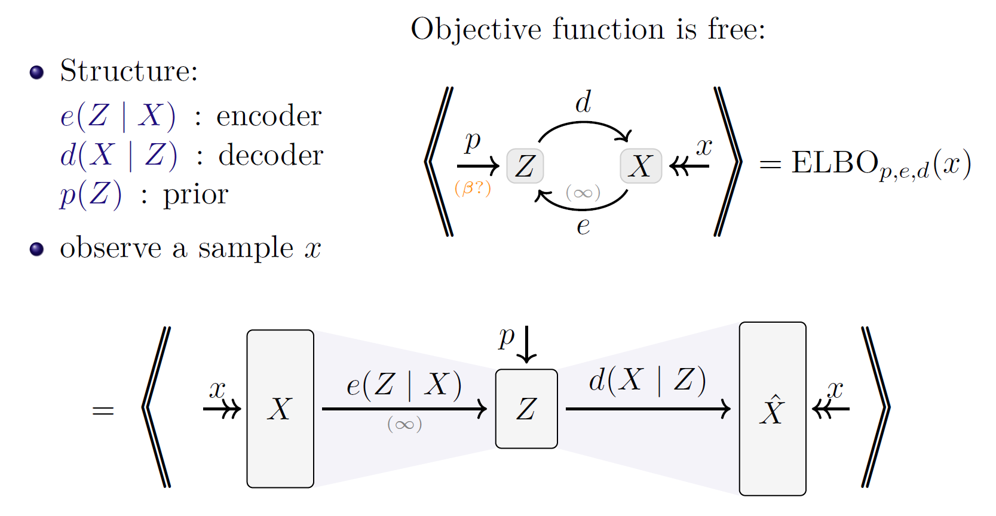

Loss as the Inconsistency of a P D G : Choose Your Model, Not Your Loss
robabilistic
ependency
raph
Oliver E Richardson
Cornell University

Slide 4

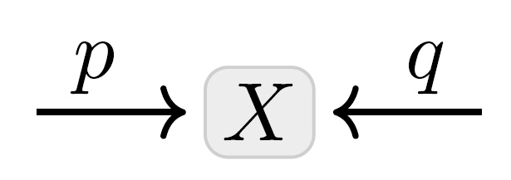




Probabilistic Dependency Graphs
= weighted collections of cpds
generalize Bayesian Networks and Factor Graphs
Have a natural “degree of inconsistency”

Slide 5
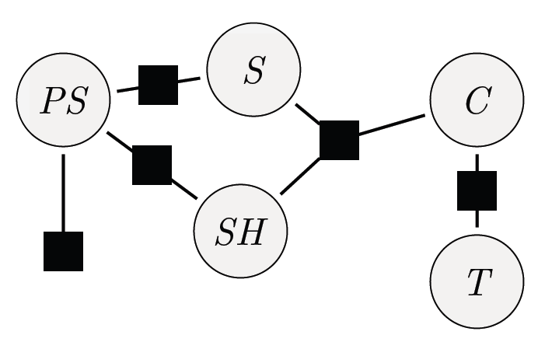
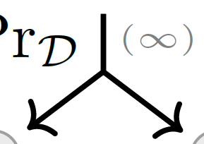
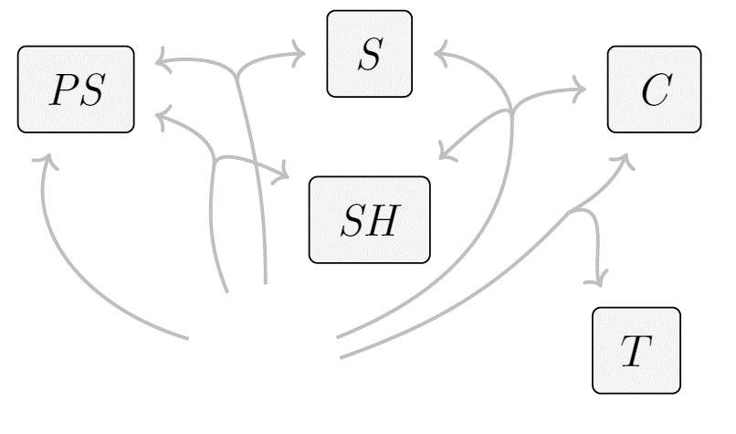
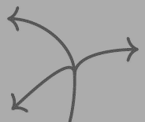

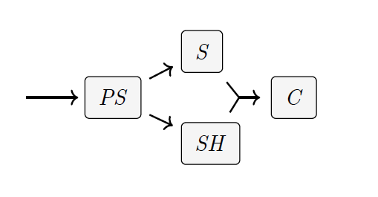
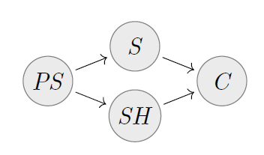
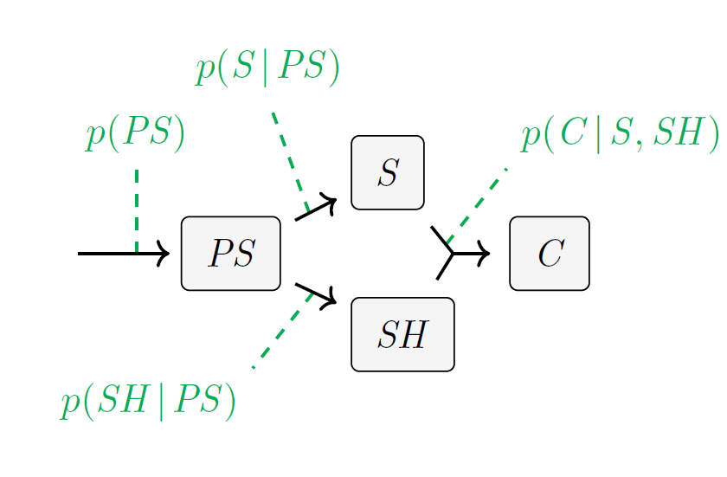
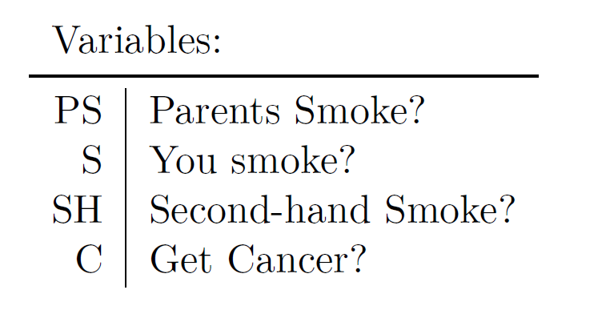




Primer on Probabilistic Dependency Graphs
A Class of Graphical Models
A weighted collection of cpds
Generalize Bayesian Networks and Factor Graphs
Come with a natural measure of inconsistency
$$p(S|PS)$$
$$p(C|S,SH)$$
$$p(PS)$$
$$p(SH|PS)$$

Slide 6
Fruitful to cast AI as optimization.
… but what to optimize? (Cross Entropy, Square Loss, …)
This choice is made by instinct, tradition, and pragmatics.
Choice of model admits more principled discussion.
because it makes claims about reality
Surprising Result: Standard loss functions can be viewed as the degree of inconsistency of the PDG describing the situation.
Bonus: A visual proof language for reasoning about the relationships between objectives.

Slide 7
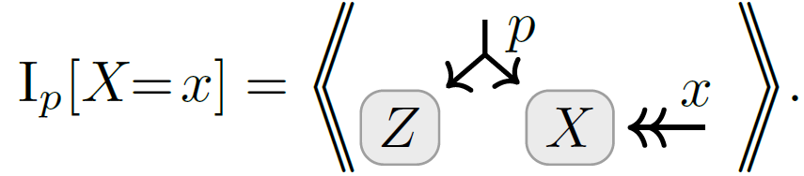
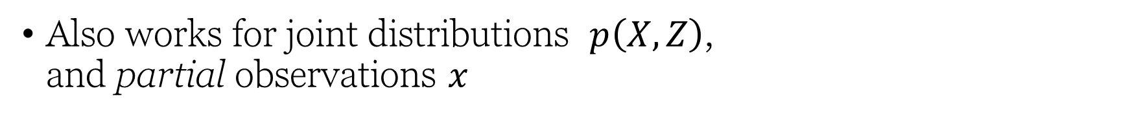
Marginal Information Content as Inconsistency
Also works for joint distributions $p\left(X,Z\right)$, and partial observations $x$

Slide 8
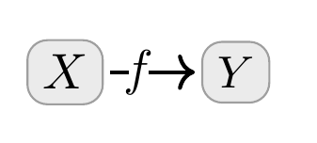

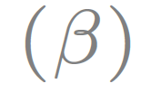
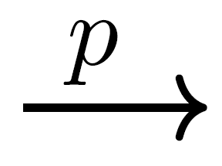

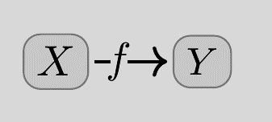
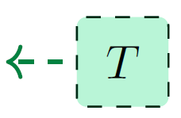
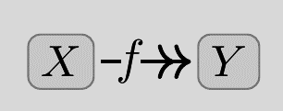

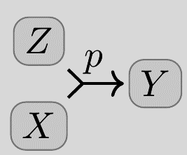
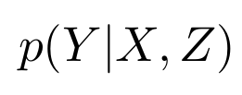
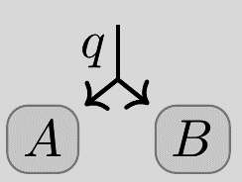

Probabilistic Dependency Graphs (PDGs)
Syntax: a weighted set of cpds (conditional probability distributions)
weighted
Very general class of graphical models including Bayesian Networks & Factor Graphs
How to draw cpds:
BN
PDG
(Deterministic)
(Joint Dependence)
Can model inconsistent information, and can measure the degree of inconsistency.
(Joint Distribution)

Slide 9
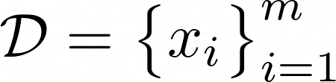
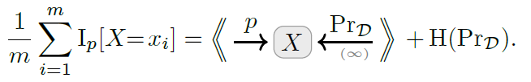
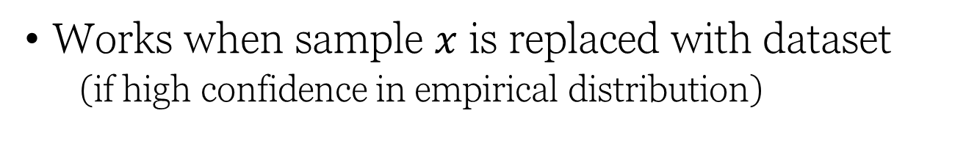
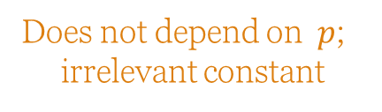
Average Information Content (Cross Entropy, Unsupervised) as Inconsistency
Works when sample $x$ is replaced with dataset
(if high confidence in empirical distribution)
Does not depend on $p$;
irrelevant constant

Slide 10
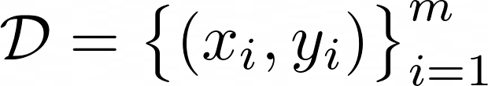
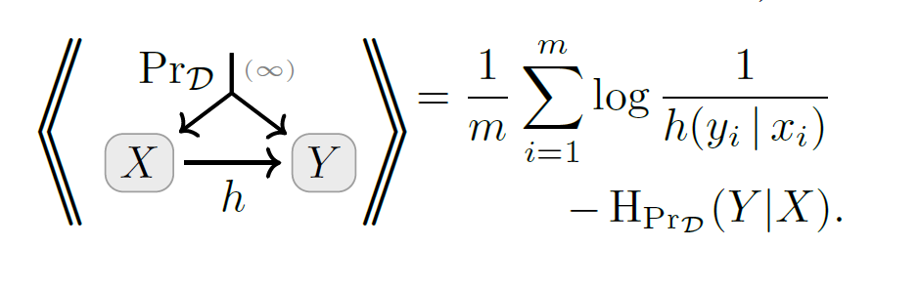
Conditional Information Content (Cross Entropy, Supervised) as Inconsistency
… and for discriminative models;

Slide 11
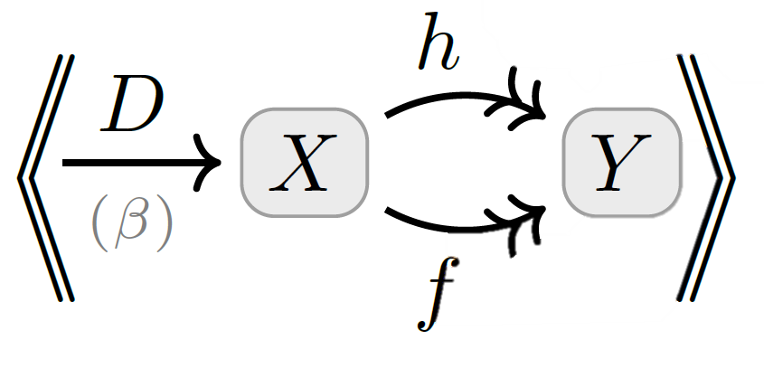
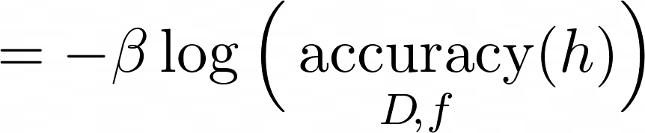

(Log) Accuracy as Inconsistency

Slide 12
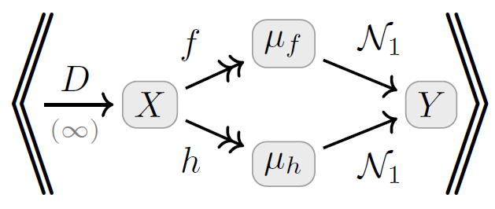
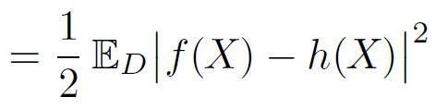



Mean Square Error as Inconsistency
where
is a unit Gaussian on Y with mean $μ$

Slide 13
REGULARIZERS as Inconsistencies

Slide 14
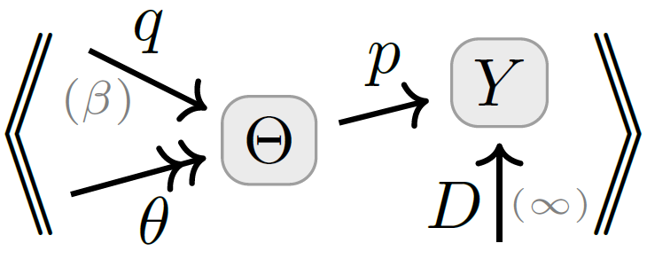
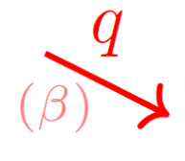



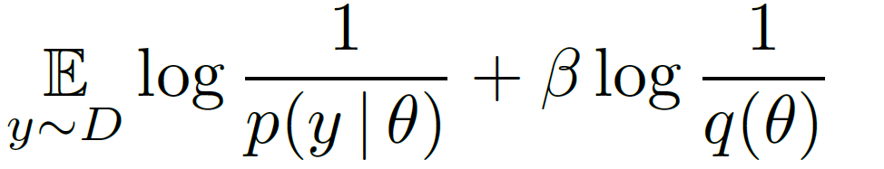
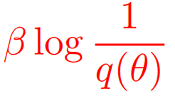



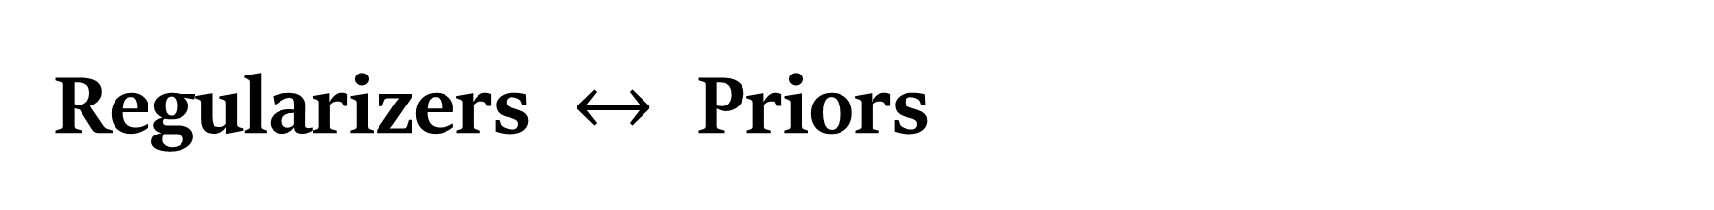
Regularizers $↔$ Priors
Terms added to loss functions to incentivize “simple models”
Distributions over
model parameters
parameterized model
trusted empirical distribution
prior over parameters

Slide 15
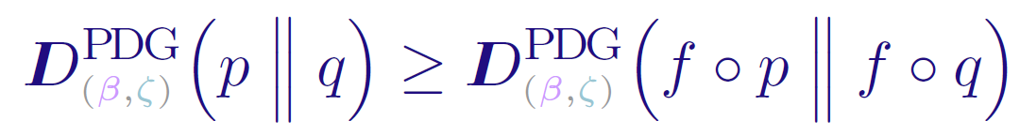
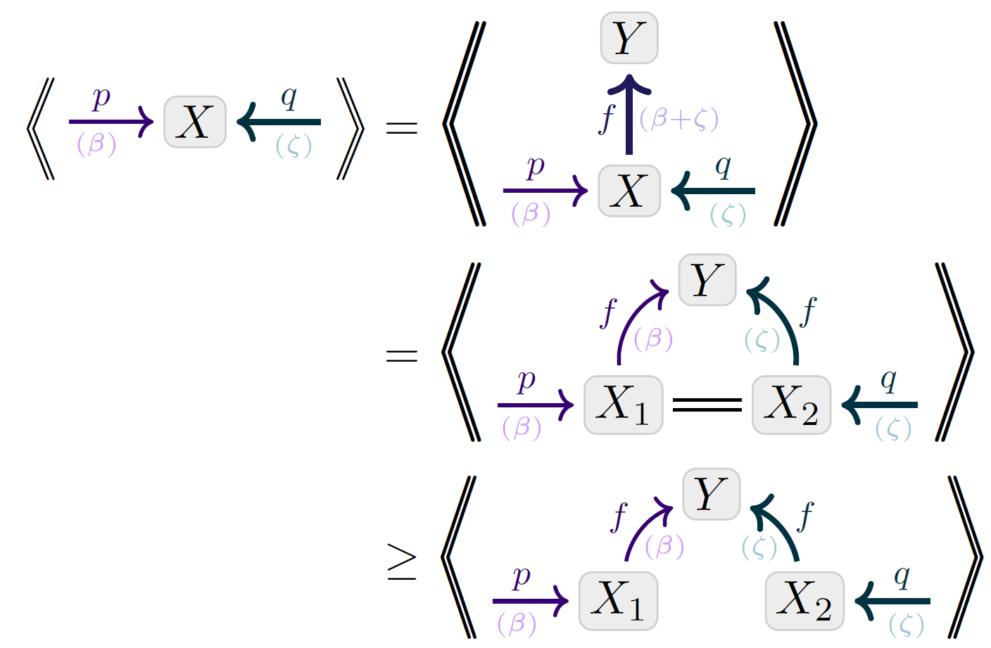
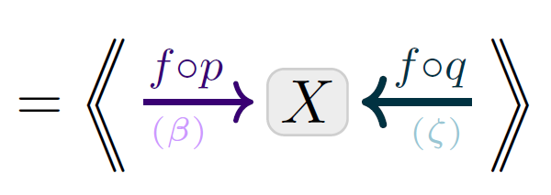
Visual Proof: Data-Processing Inequality
Monotonicity

Slide 16
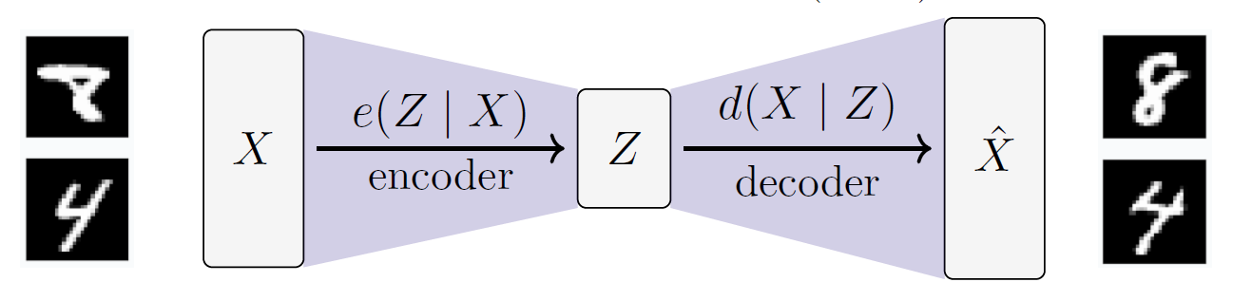
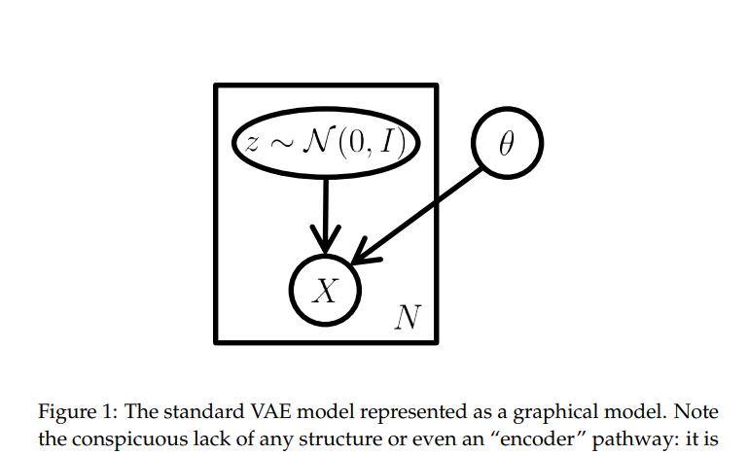
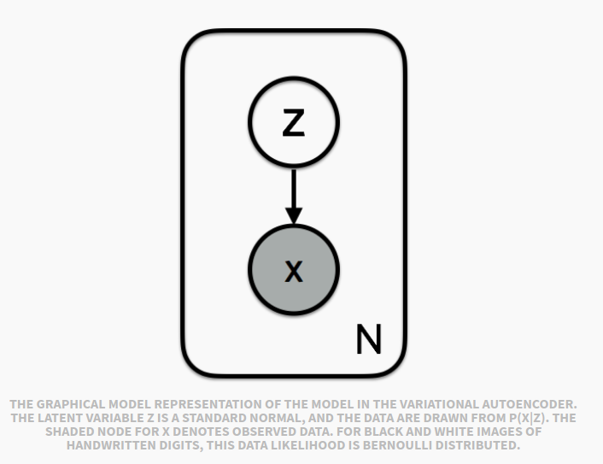
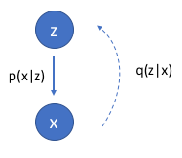
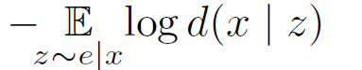

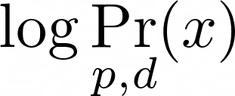

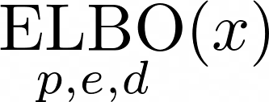

Variational Auto Encoders (VAEs), Take 1.
Loss Function: Negative ELBO(x)
= reconstruction error + divergence from prior $p(Z)$
Variational “Justification”:
might suffice to maximize this?
want to maximize
“evidence” of x
VAEs are Not Graphical Models:
e(Z|X) and p(Z) are both dists over Z; can’t have both
The heart of a VAE is not the networks, but the loss function

Slide 17
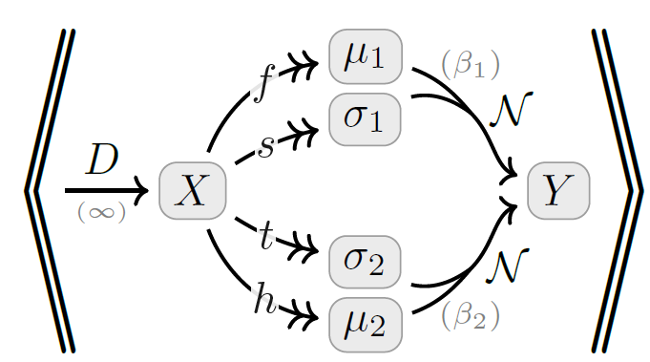
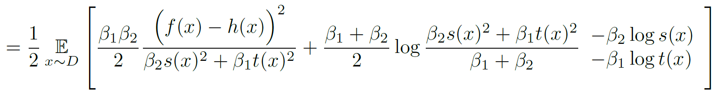

Slide 18

Visual Proof: The ELBO
Monotonicity (believing more cannot make you less inconsistent)

