Slide 1
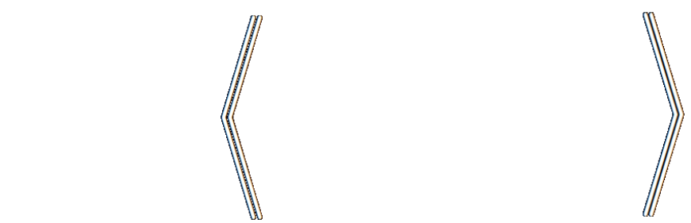
Loss as the Inconsistency of a P D G : Choose Your Model, Not Your Loss
robabilistic
ependency
raph
Oliver E Richardson
Cornell University

Slide 2
How To Select A Loss Function?
Casting AI as optimization is useful … but what to optimize?
(Cross Entropy, Square Loss, +Regularizers, …)
Choice of loss is made by instinct, tradition, pragmatics.
But a choice of model admits more principled discussion;
models, unlike losses, make testable claims.

Slide 3
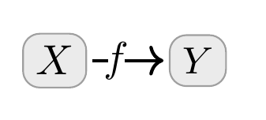

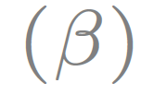
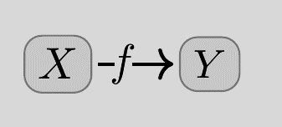
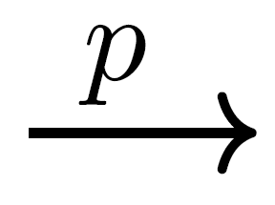
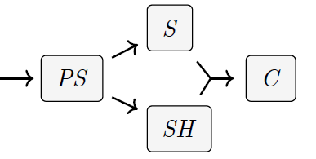

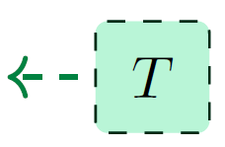
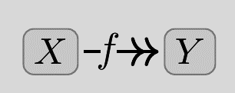

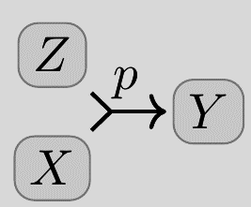
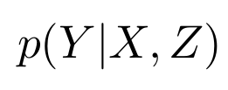
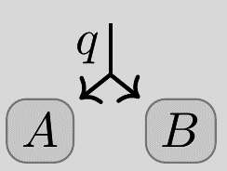

Probabilistic Dependency Graphs (PDGs)
weighted
Syntax: weighted sets of cpds (conditional probability distributions)
Very general class of graphical models including Bayesian Networks & Factor Graphs
How to draw cpds
(Deterministic)
(Joint Dependence)
Can model inconsistent information, and can measure the degree of inconsistency.
(Joint Distribution)

Slide 4
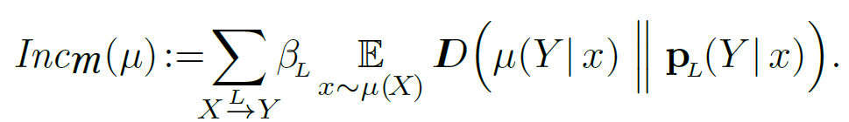
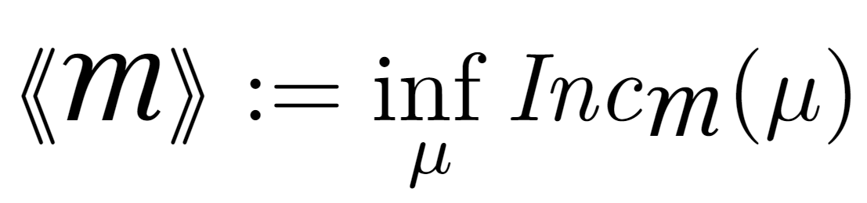
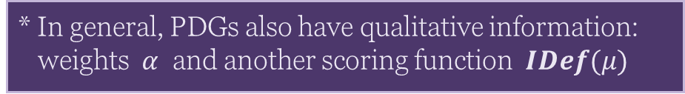
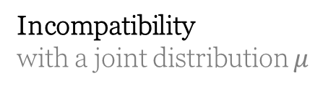
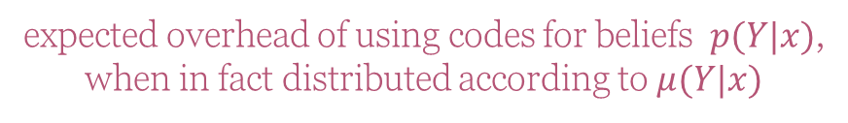
Semantics of PDGs
Incompatibility
with a joint distribution $μ$
expected overhead of using codes for beliefs $p(Y|x)$,
when in fact distributed according to $μ(Y|x)$
(scaled by confidence)
Inconsistency: the smallest possible incompatibility with any $μ$
* In general, PDGs also have qualitative information: weights $α$ and another scoring function $IDef(μ)$

Slide 5
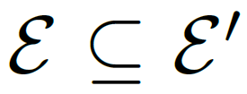
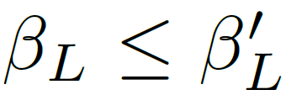
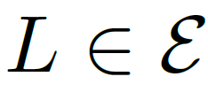
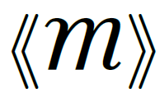

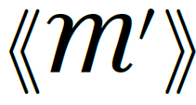

Useful Fact: Monotonicity of Inconsistency
Believing more things cannot make you any less inconsistent.
(more beliefs)
(higher confidence)
for all
(more inconsistency)

Slide 6
How To Choose A Loss Function?
Casting AI as optimization is useful … but what to optimize?
(Cross Entropy, Square Loss, +Regularizers, …)
Choice of loss is made by instinct, tradition, pragmatics.
But a choice of model admits more principled discussion;
models, unlike losses, make testable claims.
Surprising Fact: Standard loss functions can be viewed as the degree of inconsistency of the PDG describing the situation.
Bonus: A visual calculus for reasoning about the relationships between loss functions

Slide 7
INFORMATION-BASED LOSSES as Inconsistencies

Slide 8
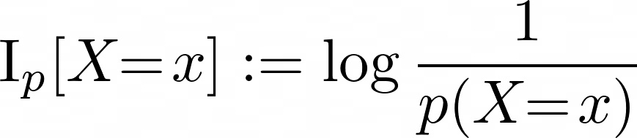
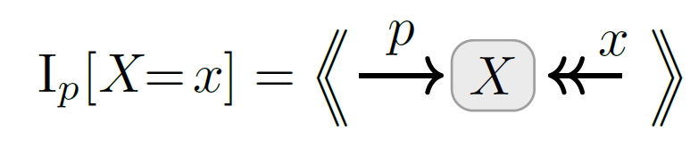
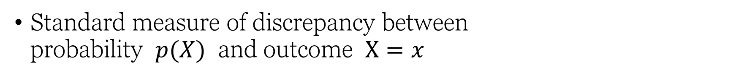
Information Content as Inconsistency
Standard measure of discrepancy between probability $p(X)$ and outcome $X=x$

Slide 9
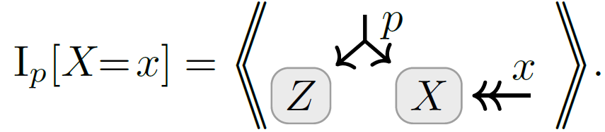
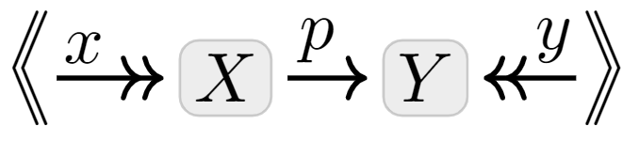

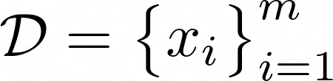
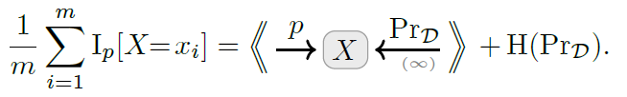
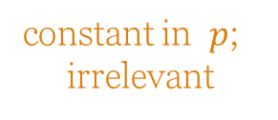
Variants of Information Content as Inconsistencies
Marginal Information
for partial observations
Conditional Information
for conditional models
Average Information
Works for whole dataset at once (if high confidence in data)
constant in $p$;
irrelevant

Slide 10
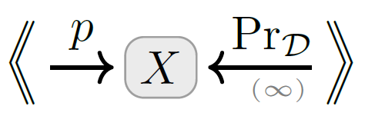
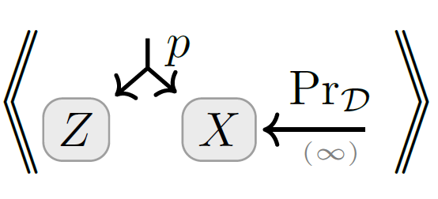
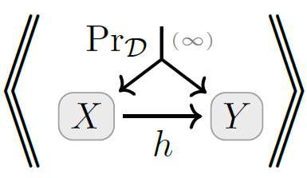
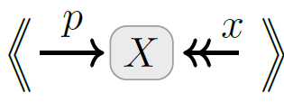
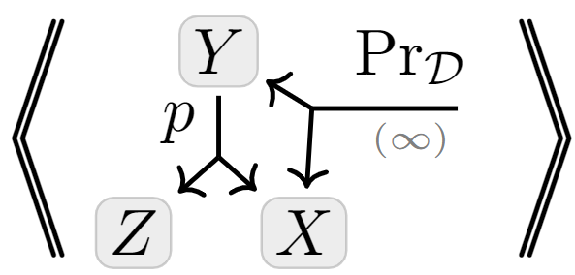
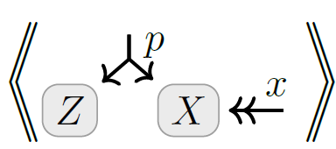
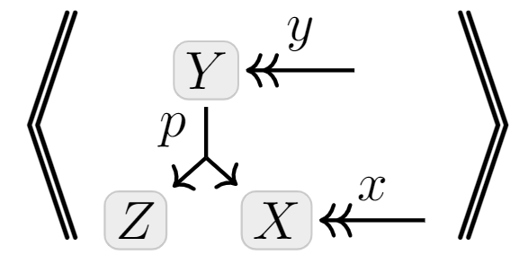
A Map
Full-Dataset
Unsupervised
+ multi-sample
+latent variables
Exact Models
+ conditional model
Latent Variable Models
Single- Observation
Supervised

Slide 11
MORE STANDARD METRICS & REGULARIZERS as Inconsistencies
Accuracy
Mean-Squared Error (MSE)
… see full paper.

Slide 12
STATISTICAL DIVERGENCES as Inconsistencies

Slide 13
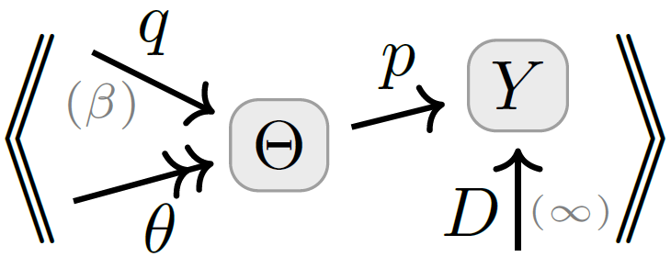
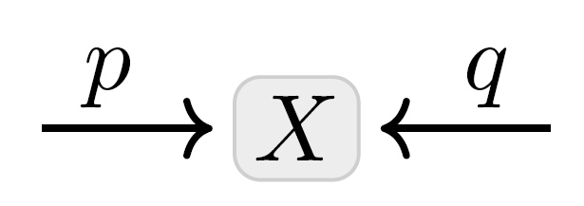
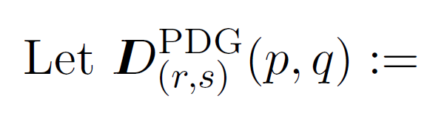


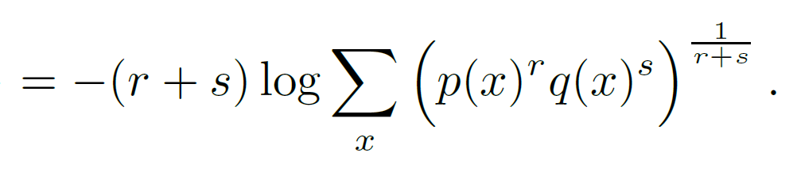

Statistical Divergences as Inconsistencies
You believe both $p(X)$ and $q(X)$.
Your inconsistency: a divergence between $p$ and $q$?

Slide 14
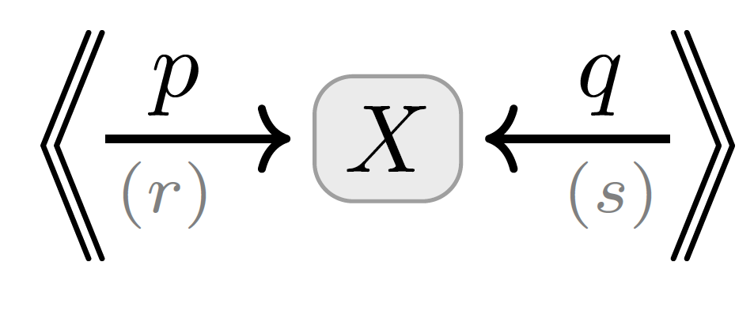
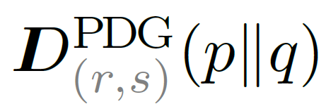
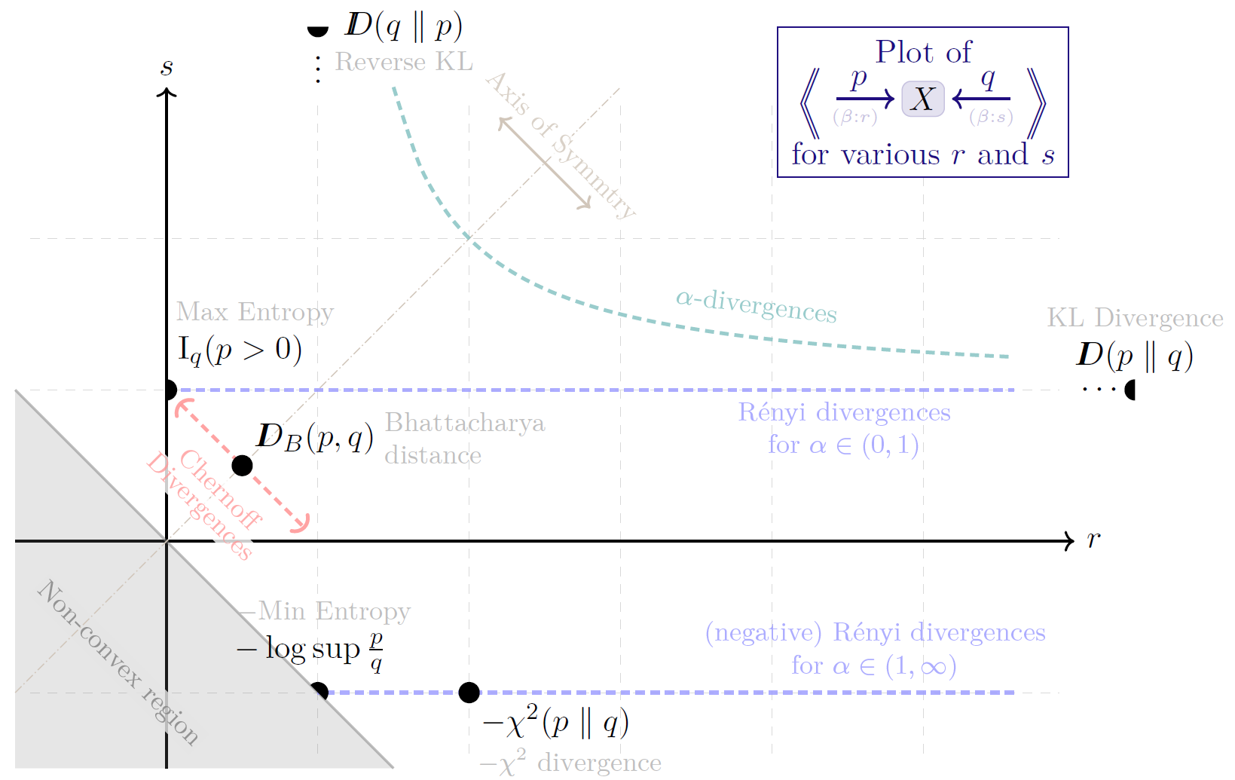
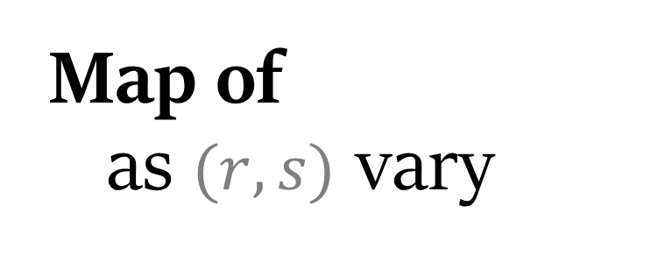
Map of as $(r,s)$ vary

Slide 15

By Monotonicity …
Twice Bhattacharya Distance is no larger than forward or reverse KL.
Rényi Entropy is Monotonic in $α$.

Slide 16
VARIATIONAL OBJECTIVES as Inconsistencies

Slide 17
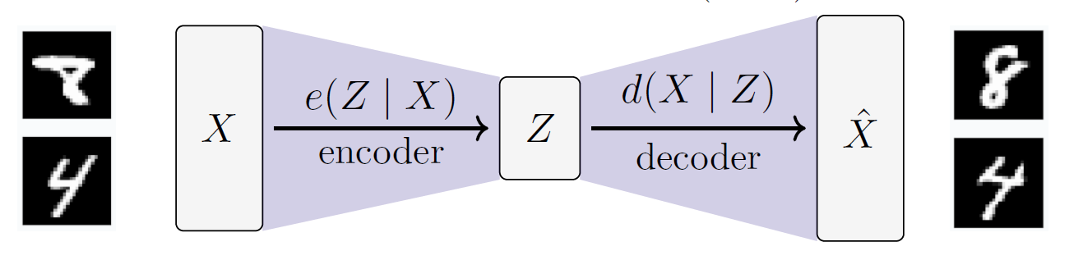
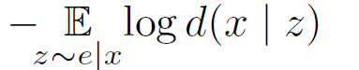

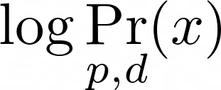

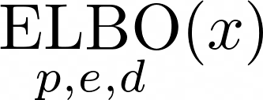
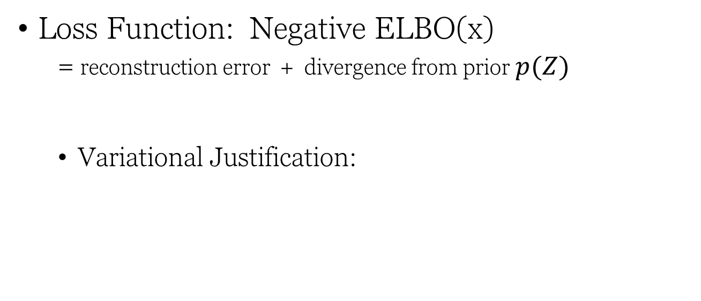
Variational Auto Encoders (VAEs), Take 1.
Loss Function: Negative ELBO(x)
= reconstruction error + divergence from prior $p(Z)$
Variational Justification:
might suffice to maximize this?
want to maximize
“evidence” of x

Slide 18





VAEs, Take 2
Structure:
encoder $e(Z|X)$
decoder $d(X|Z)$
prior $p\left(Z\right)$
observe a sample $x$
loss function is free:
β-VAE
Objective

Slide 19

Visual Proof: The ELBO
Monotonicity

Slide 20
SEE PAPER FOR MORE…
More visual proofs
the Data-Processing Inequality, ELBO variants
Free energy, MSE, accuracy, regularizers as inconsistencies
Case study: PDGs give a “better” objective in a complex scenario;
Further relationships between loss functions;
How to reverse-engineer a PDG from a loss, and why that’s a bad idea;
Precise definitions and proofs

