Slide 1
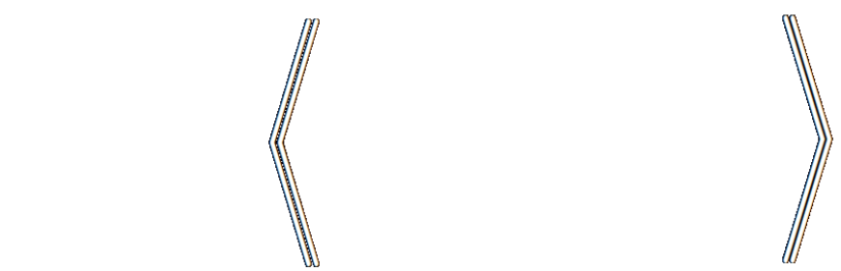
Loss as the Inconsistency of a P D G : Choose Your Model, Not Your Loss
robabilistic
ependency
raph
Oliver E Richardson
Cornell University

Slide 2
How To Select A Loss Function?
Casting AI as optimization is useful … but what to optimize?
{ Cross Entropy, Square Loss, +Regularizers, …}
Choice of loss is by honed instinct, tradition, pragmatics.
but a choice of model admits more principled discussion;
models can be validated; make claims about reality.

Slide 3


PDG
loss

Slide 4
WHAT IS A PDG?
/pʌdgàh/

Slide 5

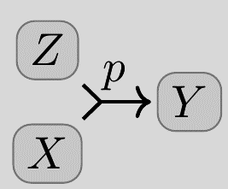

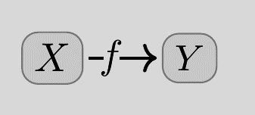
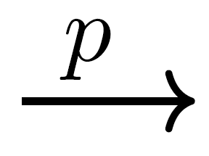
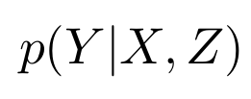

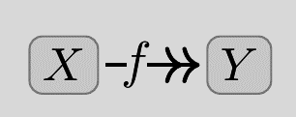
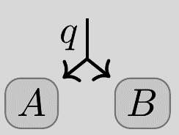

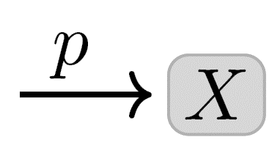

conditional probability distributions (cpds)
and how to draw them
(Deterministic
functions)
(unconditional
probabilities)

Slide 6
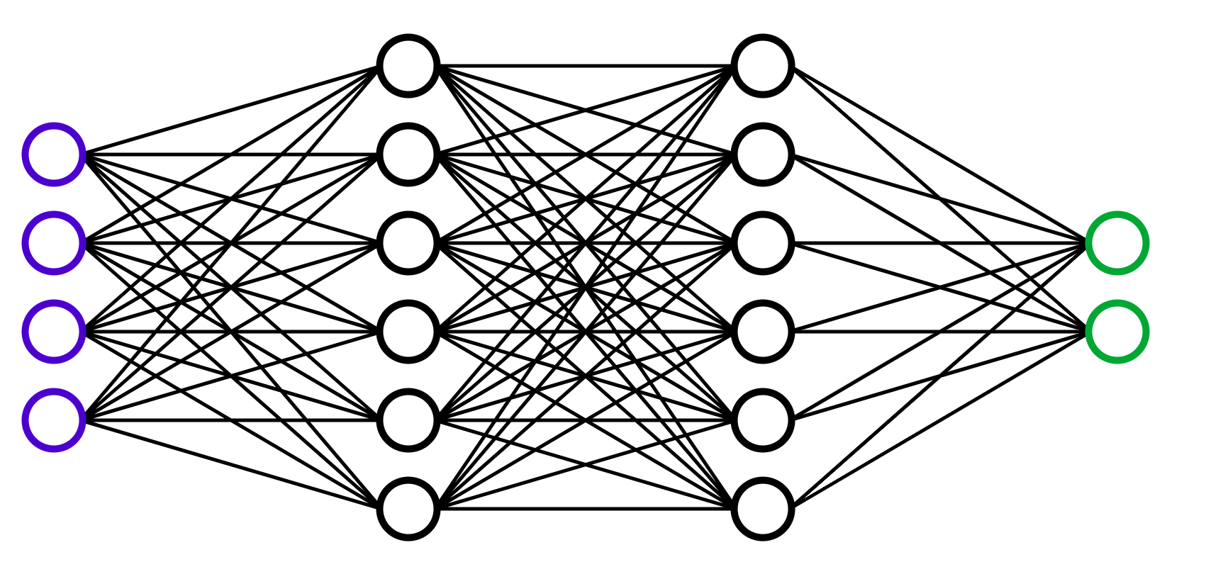

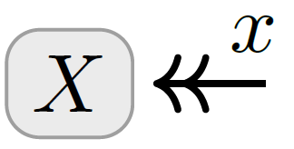
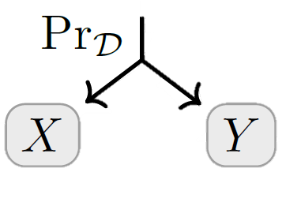

cpds can represent…
neural networks with a final softmax layer;
events;
datasets.

Slide 7
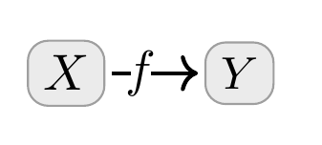

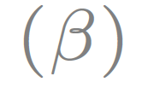



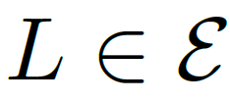
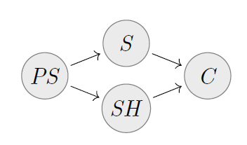
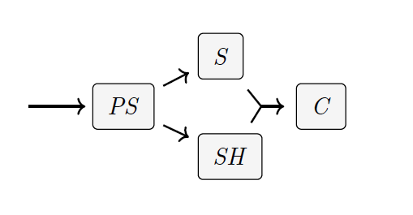
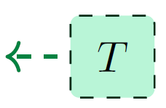
Probabilistic Dependency Graphs (PDGs)
a very general class of graphical models including Bayesian Networks and Factor Graphs
Bayesian Networks
Syntax: a collection of cpds
weighted by confidence
weighted by confidence
β = 0 “no confidence”
β = ∞ “absolute confidence”
β = 1 default
(Deterministic)
BN
PDG
(Joint Dependence)
can model inconsistent information, and can measure the degree of inconsistency.
(Joint Distribution)

Slide 8
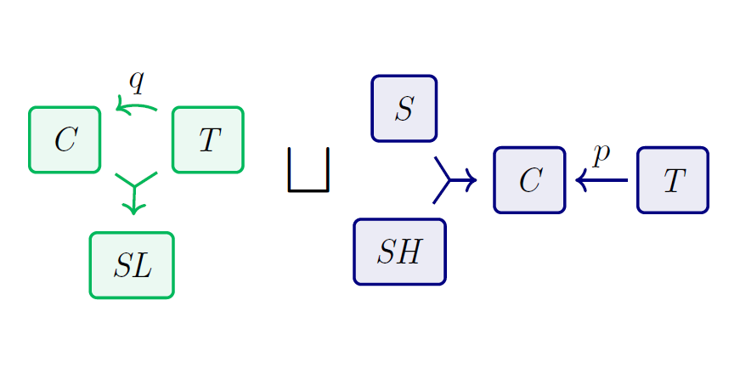
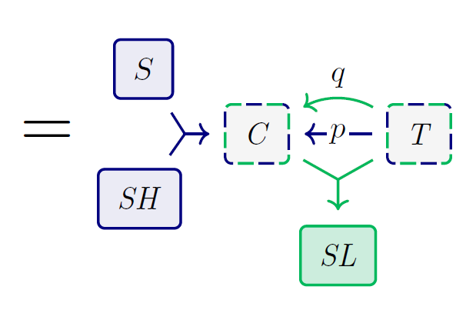
+

Slide 9
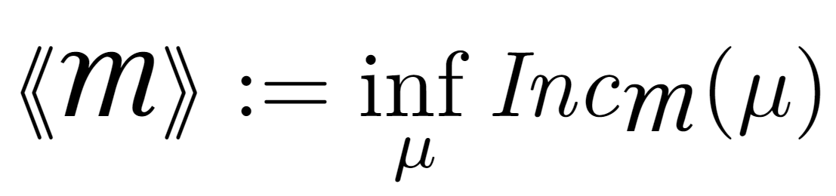
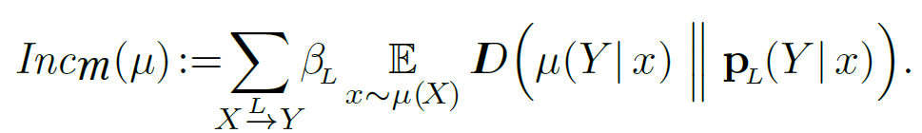
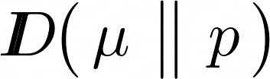
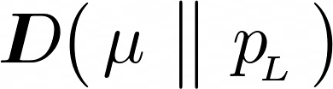
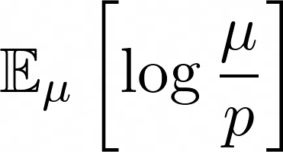


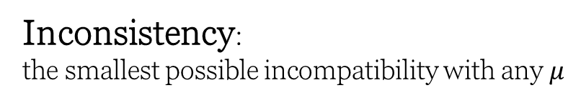
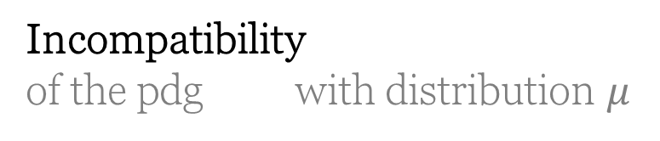
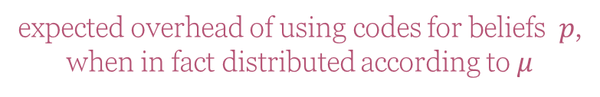
Semantics of PDGs
(quantitative limit)
Incompatibility
of the pdg with distribution $μ$
expected overhead of using codes for beliefs $p$,
when in fact distributed according to $μ$
(scaled by confidence)
Inconsistency:
the smallest possible incompatibility with any $μ$
* In general, PDGs also have qualitative confidences $α$ and another scoring function $IDef(μ)$

Slide 10
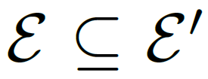
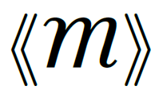


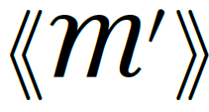
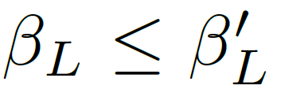
Useful Fact: Monotonicity of Inconsistency
Believing more things cannot make you any less inconsistent.
for all

Slide 11
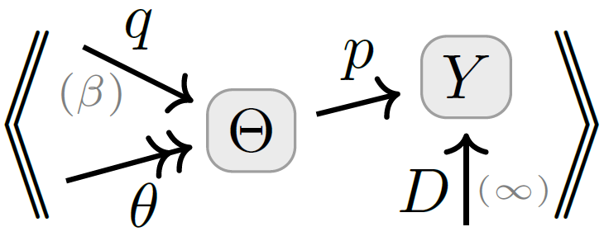

So…How To Choose A Loss Function?
One Answer: model all relevant information with a PDG, and measure how inconsistent it is.
Surprising Fact: Standard loss functions can be viewed as measuring the degree of inconsistency of the PDG describing the situation.
Bonus: A visual calculus for reasoning about the relationships between loss functions
data
priors
predictor

Slide 12
INFORMATION-BASED LOSSES as Inconsistencies

Slide 13
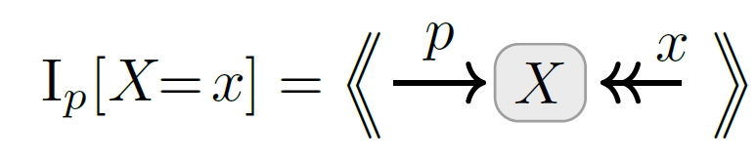
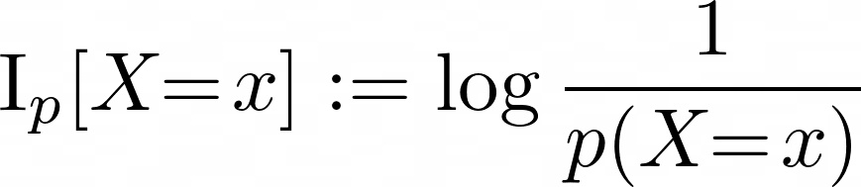
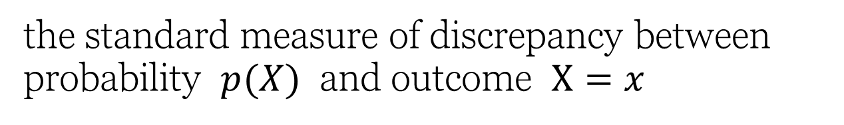
Information Content / Surprisal / NLL as Inconsistency
the standard measure of discrepancy between probability $p(X)$ and outcome $X=x$

Slide 14
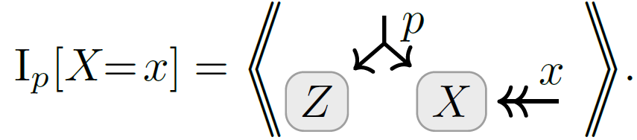
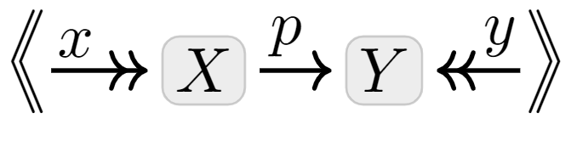

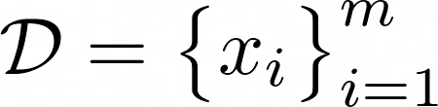
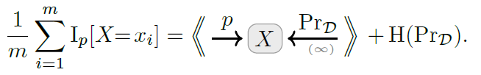
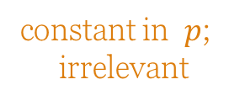
Variants of Information Content as Inconsistencies
Marginal Information
for partial observations
Conditional Information
for conditional models
Average Information
Works for whole dataset at once
--- if high confidence in data
constant in $p$;
irrelevant

Slide 15
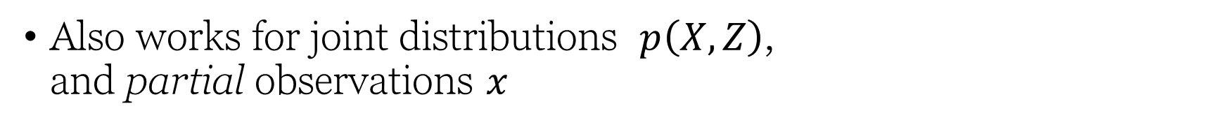
Marginal Information Content as Inconsistency
Also works for joint distributions $p\left(X,Z\right)$, and partial observations $x$

Slide 16
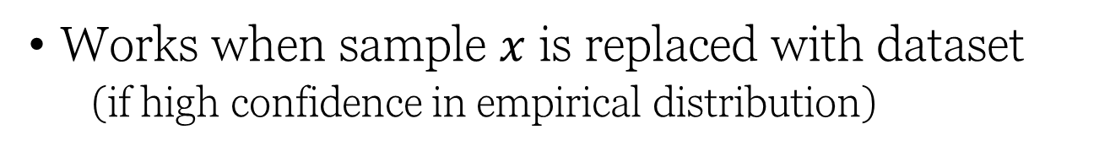
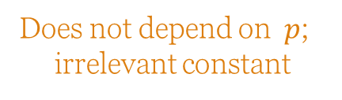
Average Information Content (Cross Entropy, Unsupervised) as Inconsistency
Works when sample $x$ is replaced with dataset
(if high confidence in empirical distribution)
Does not depend on $p$;
irrelevant constant

Slide 17
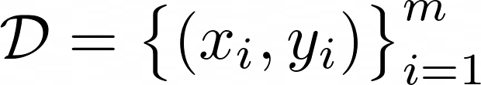
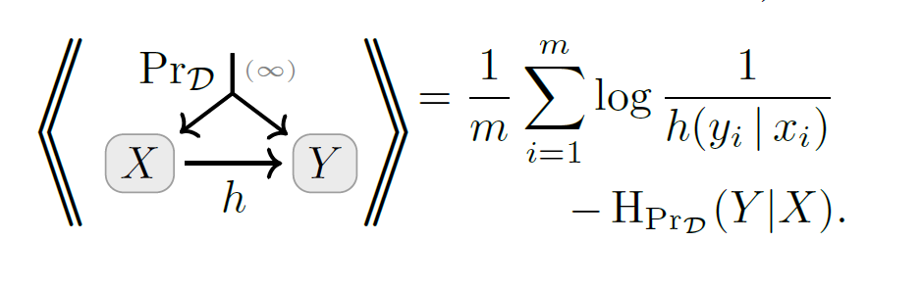
Conditional Information Content (Cross Entropy, Supervised) as Inconsistency
… and for discriminative models;

Slide 18
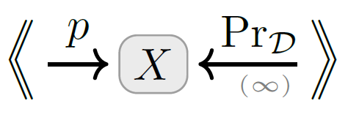
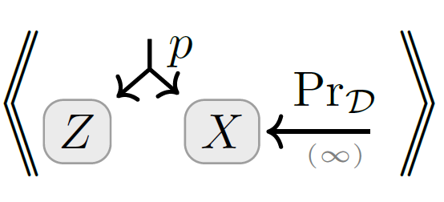
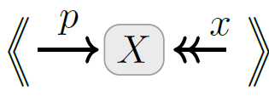
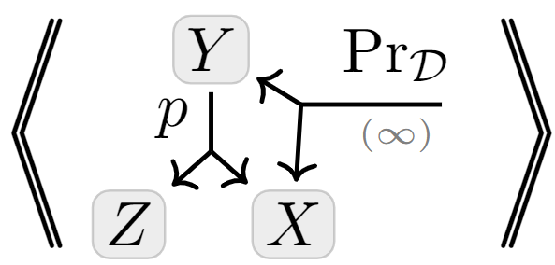
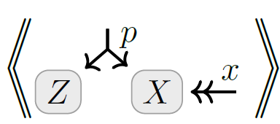

A Map
Full-Dataset
Unsupervised
+ multi-sample
+latent variables
Exact Models
+ conditional model
Latent Variable Models
Single- Observation
Supervised

Slide 19
OTHER STANDARD METRICS as Inconsistency
Accuracy
Mean-Squared Error (MSE)

Slide 20





(Log) Accuracy as Inconsistency

Slide 21





Mean Square Error as Inconsistency
where
is a unit Gaussian on Y with mean $μ$

Slide 22
REGULARIZERS as Inconsistencies

Slide 23













Regularizers $↔$ Priors
Terms added to loss functions to incentivize “simple models”
Distributions over
model parameters
parameterized model
trusted empirical distribution
parameter setting
prior over parameters
$$↔$$
regularizer

Slide 24


Regularizers $↔$ Priors
parameterized model
trusted empirical distribution
parameter setting
Terms added to loss functions to incentivize “simple models”
Distributions over
model parameters
prior over parameters
For example, using a (discretized) Gaussian as a prior
, we get

Slide 25
STATISTICAL DIVERGENCES as Inconsistencies

Slide 26




Statistical Divergence as Inconsistency
You believe both $p(X)$ and $q(X)$.
Your inconsistency: a divergence between $p$ and $q$?

Slide 27




Map of as $(r,s)$ vary

Slide 28

By Monotonicity …
Twice Bhattacharya Distance is no larger than forward or reverse KL.
Rényi Entropy is Monotonic in $α$.

Slide 29

Visual Proof: Data-Processing Inequality
p
f
f(p)
f
f(q)
q

Slide 30


Visual Proof: Data-Processing Inequality
Monotonicity

Slide 31
VARIATIONAL OBJECTIVES as Inconsistencies

Slide 32










Variational Auto Encoders (VAEs), Take 1.
Loss Function: Negative ELBO(x)
= reconstruction error + divergence from prior $p(Z)$
Variational Justification:
might suffice to maximize this?
want to maximize
“evidence” of x
VAEs are Not Graphical Models:
e(Z|X) and p(Z) are both distributions over Z; can’t have both.
The heart of a VAE is not the architecture, but the loss function

Slide 33





VAEs, Take 2
Structure:
encoder $e(Z|X)$
decoder $d(X|Z)$
prior $p\left(Z\right)$
observe a sample $x$
loss function is free:
β-VAE
Objective

Slide 34

Visual Proof: The ELBO
Monotonicity (believing more cannot make you less inconsistent)

Slide 35
A NON-STANDARD SETTING “Do PDGs ever prescribe a loss that’s not what you’d first think of?”

Slide 36





Want to predict Y from X,
and have access to both simulated and real data.
What loss to use?
Simulator & data don’t interact!
Uncalibrated!
Geometric mean of
s and d

Slide 37

Recap
Simply model your scenario and measure inconsistency for:
standard loss functions and metrics
variational objectives
the usual connections between regularizers and priors
many statistical divergences
free calibrated losses for new settings!
See the paper for more:
PDG
free energy = factor graph inconsistency
how to reverse-engineer a PDG from a loss, and why it’s a bad idea;
precise definitions
a cute proof technique
loss

Slide 38





From Factor Graphs to PDGs

Slide 39


General Result for Gaussians

