Slide 1
Loss as the Inconsistency of a P D G : Choose Your Model, Not Your Loss
robabilistic
ependency
raph
Oliver E Richardson
Cornell University

Slide 2


Slide 3
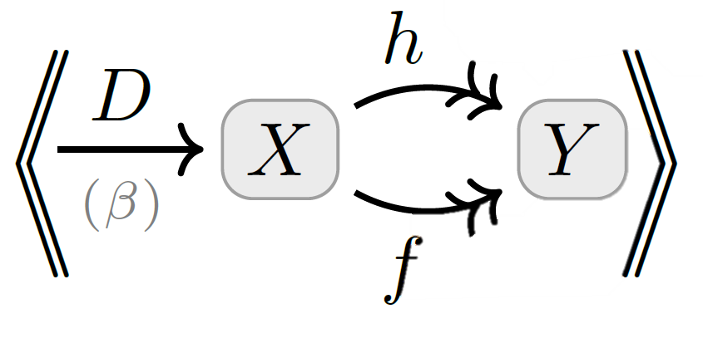
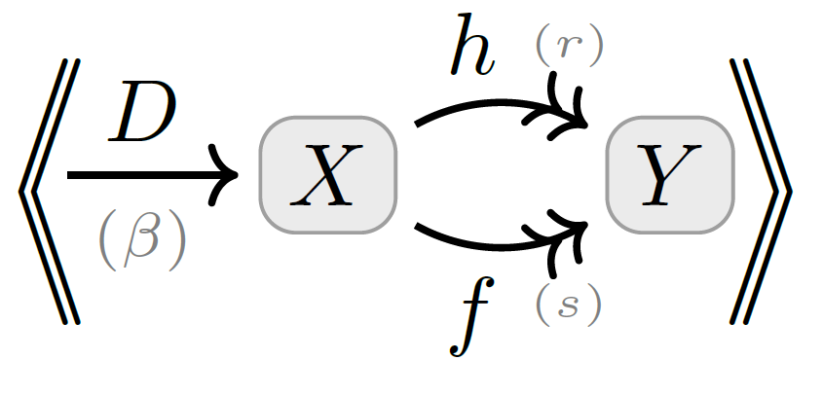

Slide 4


Slide 5
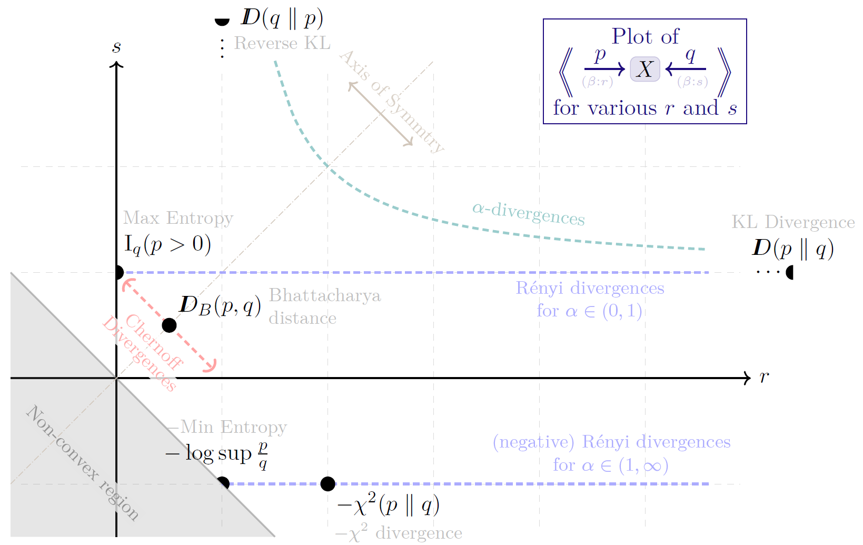

Slide 6

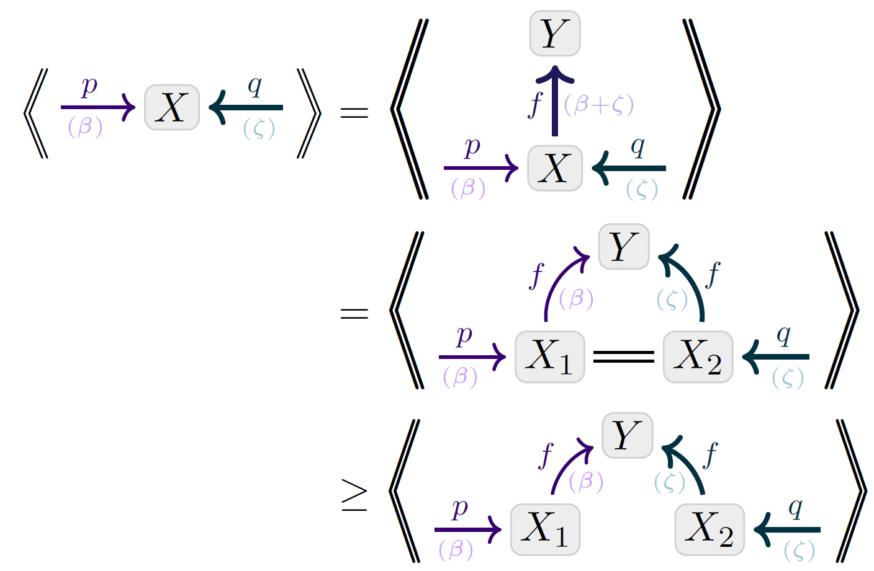
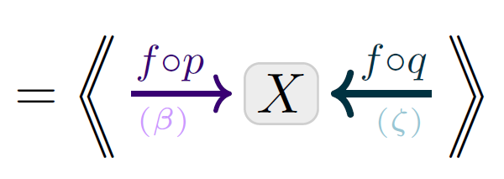
Visual Proof: Data-Processing Inequality
Monotonicity of inconsistency

Slide 7


Slide 8



Slide 9
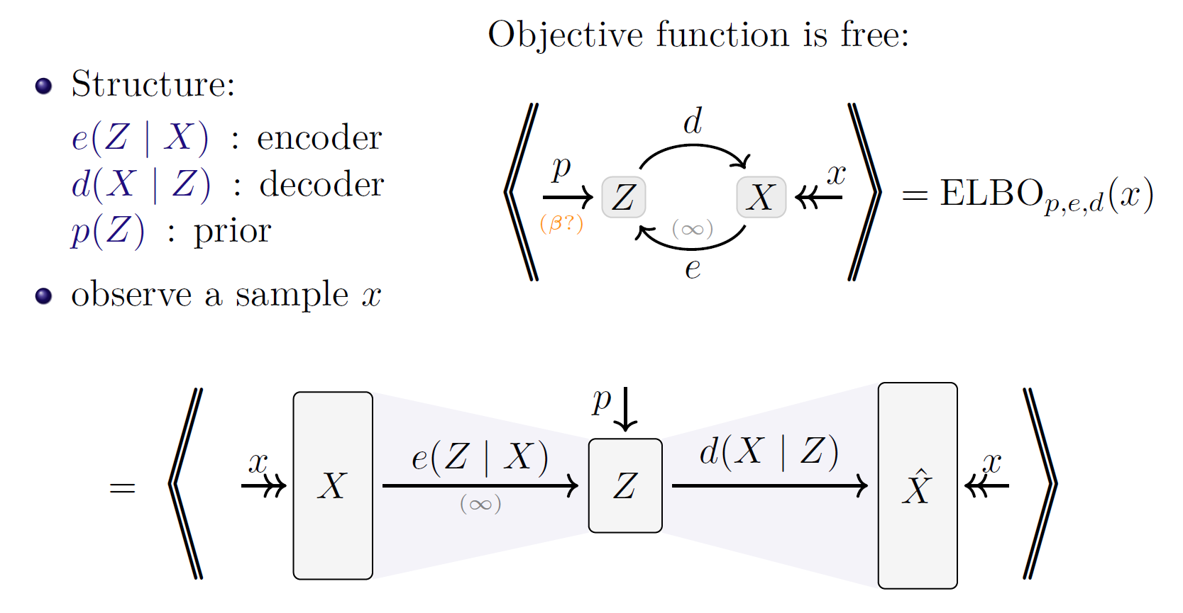

Slide 10

Visual Proof: The ELBO

