Slide 1
NN Project
Ori Daniel & Or Sasson

Slide 2
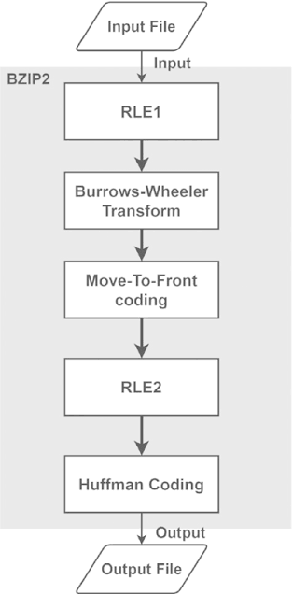
Benchmark #1 - Pyflate
What is Pyflate?
Implementation Overview
Initial Analysis
Software Optimizations
Performance Comparison
Hardware Accelerator Proposal

Slide 3
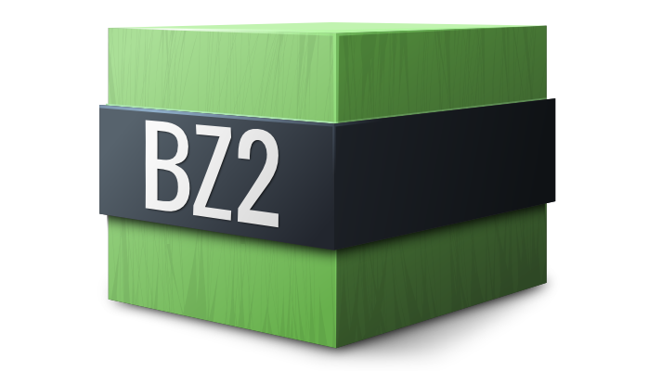
What is Pyflate Benchmark?
Pyflate is a benchmark that tests the speed of the Bzip2 compression algorithm
It is implemented in pure-python, with no calls to fast C libraries.
The test consists of decompressing a file using a python implementation of bzip2 decompression.
It tests how fast a Python version can execute math and logic operations for decompression without external C-based shortcuts.

Slide 4

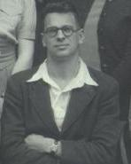
Bzip2
Bzip2 is a file format and a file compression algorithm.
It utilizes the Burrows-Wheeler algorithm, invented by David Wheeler and published by Michael Burrows in 1994.
It is a 5 stage algorithm, which runs on small chunks of a file in parallel.

Slide 5
Bzip2
Run-Length Encoding - pass #1: Replace sequence of 4-255 identical consecutive bytes with a single character and count. Prevents repetative data from degrading the BWT sorting phase.
Burrows-Wheeler Transform (BWT): Reorders chunks of the file to group similar characters together.
Move-to-Front (MTF) Encoding: turns identical characters to 0's, which keeps logical meaning of repeated character, but helps Huffman Coding.
Run-Length Encoding (RLE, Pass 2): targets the large amount of 0's generated by the last stage.
Huffman Coding: encodes characters by their frequency. High frequency characters receive low bitcount sequences. Give example.

Slide 6
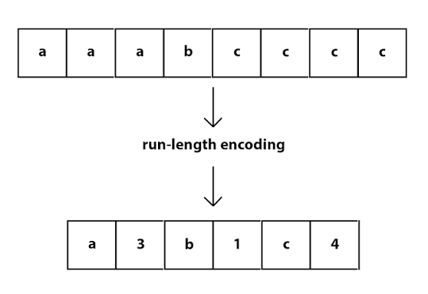


Run-Length Encoding
Run-Length Encoding compresses long repeating strings of the same character to a compressed format. It outputs the first 4 instances of a character and then symbolizes the rest of it’s appearances with a number:
aaaaaaaaaa -> aaaa6

Slide 7

Burrows-Wheeler Transform (BWT)
The most crucial stage of the algorithm.
The idea is to rearrange a block of data into runs of identical characters without actually compressing it or losing any information.
The resulting column is the compressed version of the string, which will be used for restructuring during uncompression.
We will demonstrate the algorithm with a worked example.

Slide 8
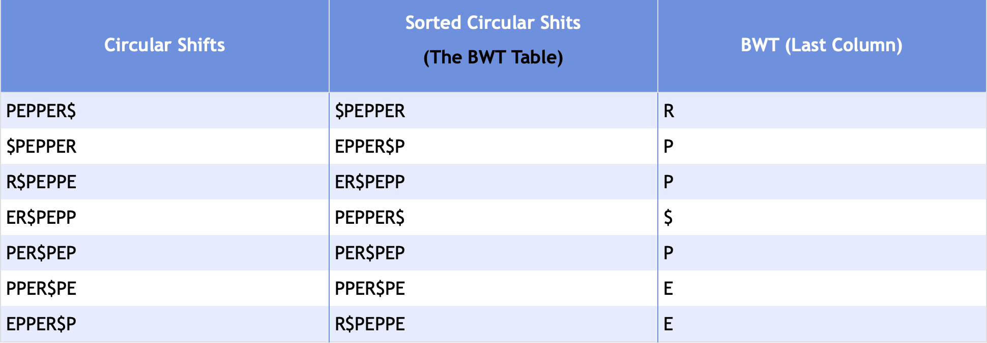

Burrows-Wheeler Transform (BWT)
We will show the algorithm with the example string: PEPPER
For an input string of length N -
Add $ to the end of the string: PEPPER$
Generate all N cyclic shifts:
Sort the circular shifts:
Take the last column; That is
the BWT string.

Slide 9
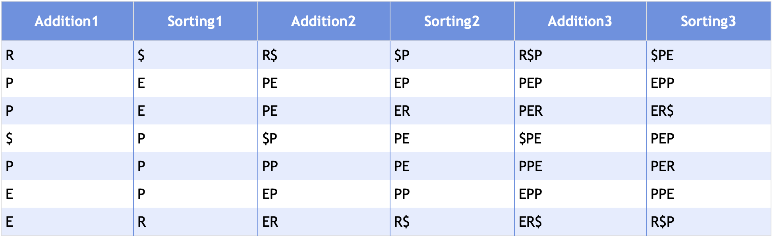
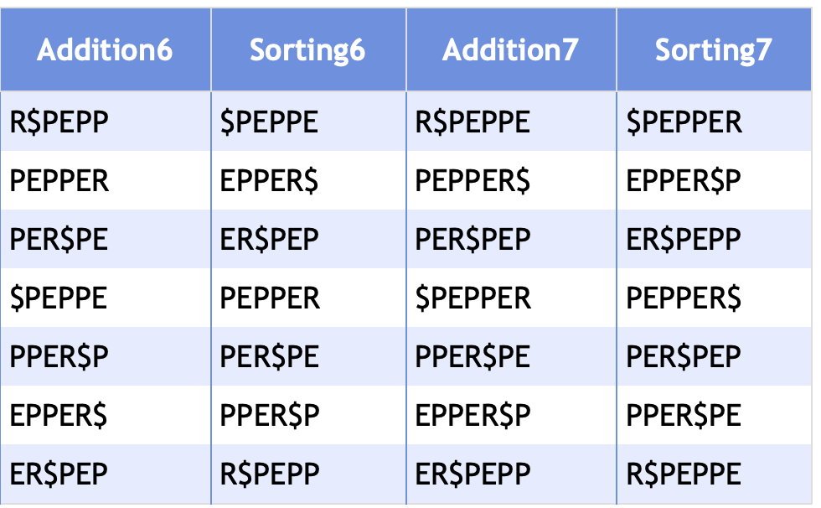


Burrows-Wheeler Transform (BWT)
We will show how to decode the word from the BWT string: RPP$PEE:
Run N times:
  Add the transformed string to an empty table - Addition1
  Sort the table - Sorting1
  Combine the two columns – Addition2
The decoded string is the one with $ at the end: PEPPER$
$$→ …→$$

Slide 10
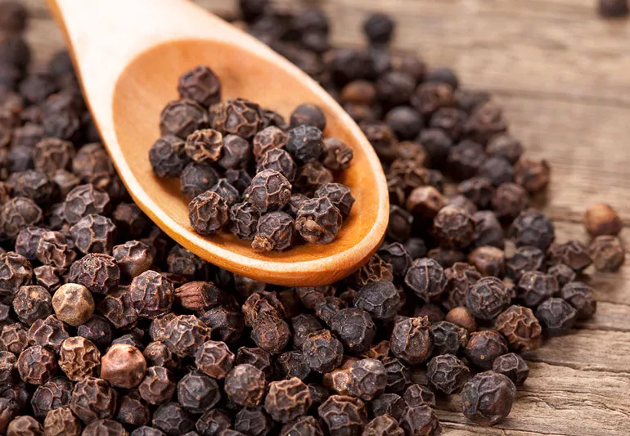
Burrows-Wheeler Transform (BWT)
From “PEPPER” we got RPP$PEE.
Why does this help us?
Sorted data is easily compressible.
The Burrows-Wheeler Transform aims to exploit the property of local context of real world data. In real languages and structured data, specific characters precede certain sequences, such as the letter ‘t’ before ‘he’ in the word ‘the’.

Slide 11

Move-To-Front & Huffman Encoding
The BWT gave us consecutive letters in the string, but now we need to actually compress them.
First we will explain Huffman Encoding:
  The algorithm takes a string with a fixed amount of characters, and compresses it based on the frequency of those characters.
  The Algorithm uses a tree and greedy search assumption to give each character a readable encoding - (can be distinguished when in a contiguous string).
  For example: in the string “PPPPPPPPPABCD”, there are 5 characters total. It would be most efficient to give ‘P’ a more conservative encoding – like “0”.
  An example of encodings would be:
  P: 0
  A: 100
  B: 101
  C: 110
  D: 111
  And the resulting encode would be: 00000000000100101110111, or 0x000977

Slide 12
Move-To-Front & Huffman Encoding
Move-to-front simply takes consecutive letters, and turns all but the first appearance to ‘0’. A 0 indicates a “duplicate the letter before me” operation.
Considering the other steps, this makes sense to use – we will get a high frequency of consecutive letters following the BWT algorithm. After a simple manipulation, a “consecutive letter” becomes it’s own character, which is exactly what the following Huffman Encoding wants to exploit.
The RLE in the middle is used to compress all the 0’s together, for maximum compression.

Slide 13

Benchmark #1 - Pyflate
What is Pyflate?
Implementation Overview
Initial Analysis
Software Optimizations
Performance Comparison
Hardware Accelerator Proposal

Slide 14
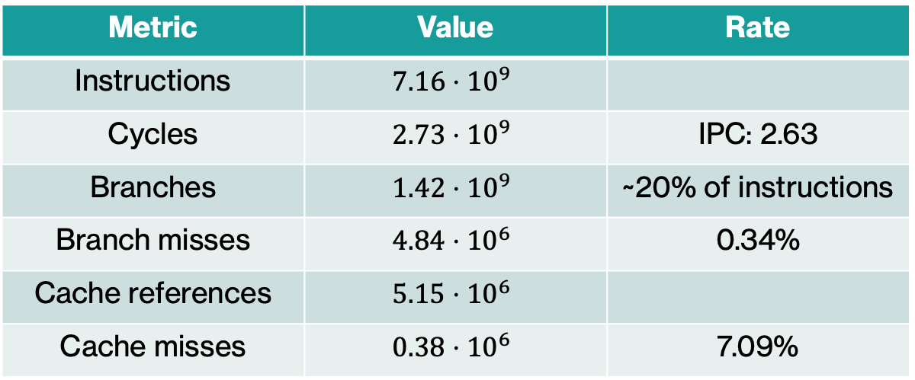
Pyflate – Baseline results
We ran: pyperformance run --python /usr/bin/python3.10 --bench pyflate
60 decompressions of a 67.5 KB bzip2 archive (399 KB decompressed), across 20 different processes. These were the results:
Timing – 60 samples
Hardware counters — per single decompression
Metric | Value
Mean | 1.124 s ± 0.018 s
Min / Max | 1.108 s / 1.229 s
Samples | 60 (20 processes × 3 values)
Metric | Value | Rate
Instructions | $$7.16⋅{10}^{9}$$
Cycles | $$2.73⋅{10}^{9}$$ | IPC: 2.63
Branches | $$1.42⋅{10}^{9}$$ | ~20% of instructions
Branch misses | $$4.84⋅{10}^{6}$$ | 0.34%
Cache references | $$5.15⋅{10}^{6}$$
Cache misses | $$0.38⋅{10}^{6}$$ | 7.09%

Slide 15
Pyflate – Baseline results
We used py-spy to profile the Cpython benchmark.
To get the flamegraph we ran: py-spy record --rate 999 --output results/baseline/flamegraph.svg
Hotspot metrics with py-spy
Metric | Self time
move_to_front | 15.6%
Find_next_symbol | 14.2%
readbits/snoopbits/_mask/_read | 25%
bwt_transform + bwt_reverse | 12%

Slide 16
Benchmark #1 - Pyflate
What is Pyflate?
Implementation Overview
Initial Analysis
Software Optimizations
Performance Comparison
Hardware Accelerator Proposal

Slide 17
Pyflate – Initial Analysis
Looking at the results, one metric stands above the rest – pure instruction count.
We see that this is not an issue of branch or cache misses, but simply of running too many lines of code.
This is mainly a result of being a pure python library – no efficient C call libraries.
We can see this clearly by comparing pyflate to a bzip program written in C:
 | Time per decompression | Instructions per output byte
C bzip2 (system) | 18 ms | -
Python pyflate | 1.124 ms | ~17,900

Slide 18
Pyflate – Initial Analysis
Let’s analyze the flamegraph to understand what’s providing the bottleneck.
As we can see, the decode_huffman_block is running for essentially all of the program.
The breakdown:
 | % of runtime
Find_next_symbol | 47.22%
Move_to_front | 15.39%
Bwt_reverse | 13.50%
Own lines | 21.58%

Slide 19
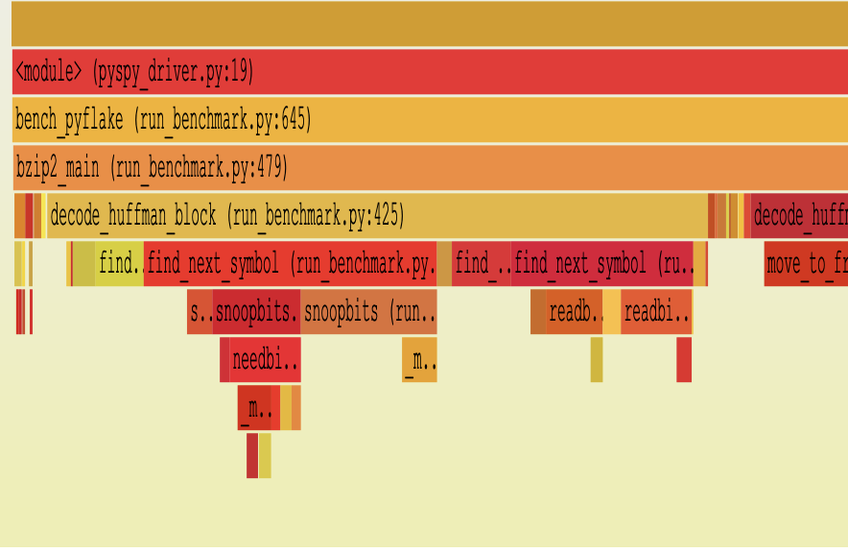
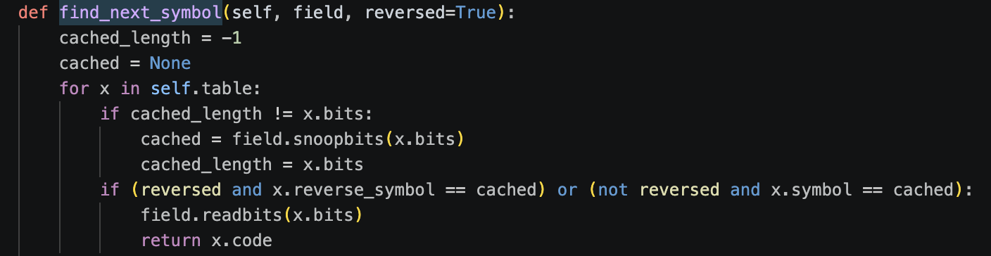

Pyflate – Initial Analysis
Let’s analyze find_next_symbol:
looking at the flame graph and hotspots, this is the largest section of our code.
What find_next_symbol does:
Decodes one Huffman symbol from the bitstream:
This is called for every symbol, costing the program ~22,800 instructions per symbol.

Slide 20
Pyflate – Initial Analysis
What’s going on here?
The algorithm is trying to decode the Huffman Symbols.
Since bzip2 is a file format, it can control both the encode and decode stage.
This allows us to use something called Canonical Huffman; basically always using the same static symbols for each code length.
The only job the decode has? Map the symbols (the bit patterns) from the symbol table to their code (the letter ”A”, or “%”).
The code searches
010 -> “A”

Slide 21
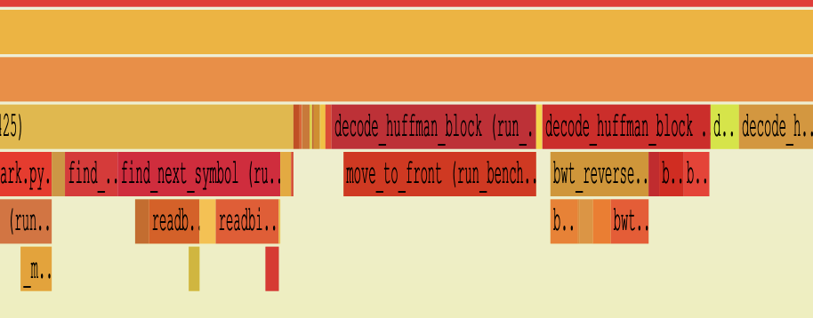
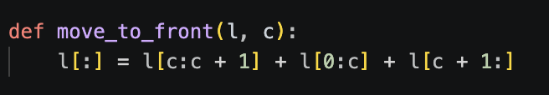

Pyflate – Initial Analysis
Let’s analyze the move_to_front section.
looking at the flame graph and hotspots, we find a plateau on move_to_front stage.
Looking at move_to_front’s code – 15.6% of the run:
This method is called on average 90k times per decomposition, with an average list length of 150.
The problem is that the implementation ignores that locality completely and rebuilds the entire 150-element list every time.

Slide 22

Pyflate – Initial Analysis
This method is called on average 90k times per decomposition, with an average list length of 150.
The problem is that the implementation ignores that locality completely and rebuilds the entire 150-element list every time.

Slide 23
Benchmark #1 - Pyflate
What is Pyflate?
Implementation Overview
Initial Analysis
Software Optimizations
Performance Comparison
Hardware Accelerator Proposal

