Slide 1
Introduction

Slide 2
Build yourself your own Dev environment (network).
Utilize your PC resources.
Independent of IT managers and domain resources.

Slide 3


Slide 4
Solution Architecture

Slide 5
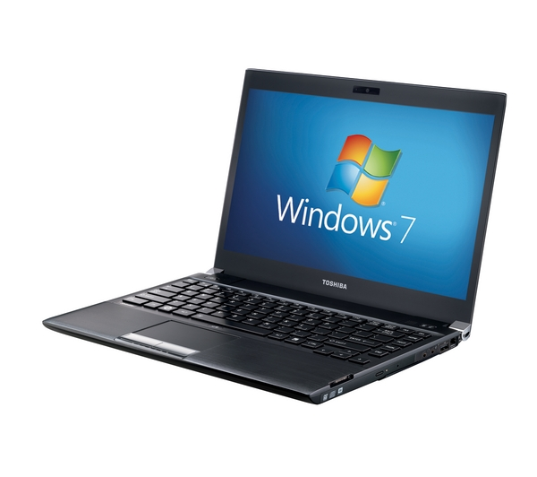
PC : Windows OS

Slide 6
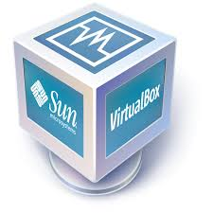
VirtualBox
PC : Windows OS

Slide 7

VirtualBox managed by Vagrant
PC : Windows OS

Slide 8


Slide 9

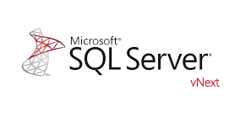
VagrantBox image icludes SQL Server vNext on Linux Ubuntu 16.04
+
VirtualBox managed by Vagrant
PC : Windows OS

Slide 10
Installations

Slide 11
Configuration Settings

Slide 12
The Vagrantfile

Slide 13
Spin up SQL Server

Slide 14


