Slide 1

Ukulima
Ukulima is a mobile phone application that connects :
Farmers to other Farmers
Farmers to produce buyers e.g. Hotels, individuals
Farmers to credible Input Suppliers e.g. Hardware stores, veterinary cares.
Provides information on prevailing market prices
Provides information on prevailing weather conditions to farmers based on their location.

Slide 2
Problem
Middle men eating into the profits of farmers.
Farmers don’t have a centralized way of finding credible input suppliers.
Farmers have to rely on media (Television, Radio) to get information on prevailing weather conditions.
Farmers don’t have an easy way of finding produce buyers.

Slide 3
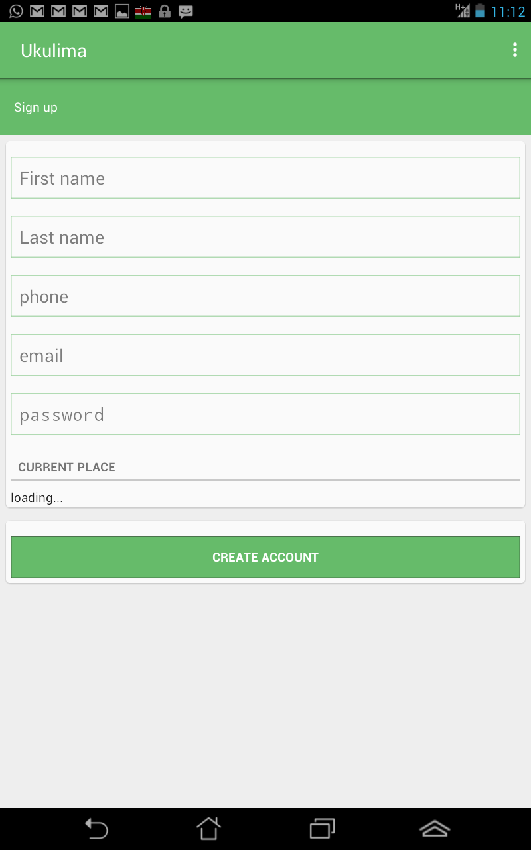
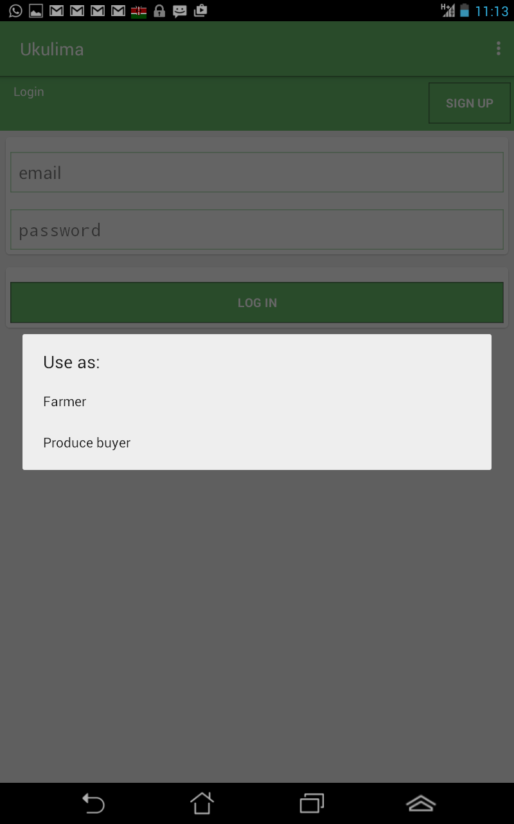
Solution (Ukulima)
Sign up
Login

Slide 4
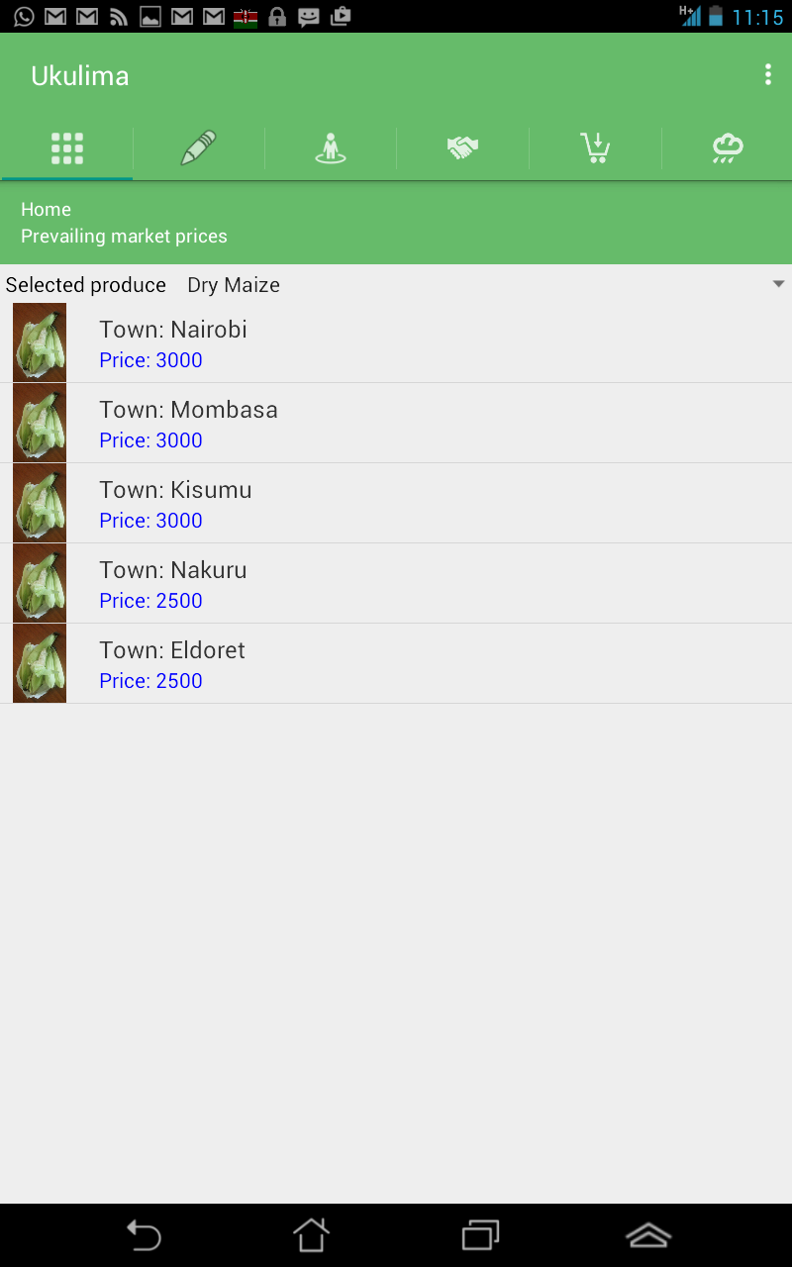
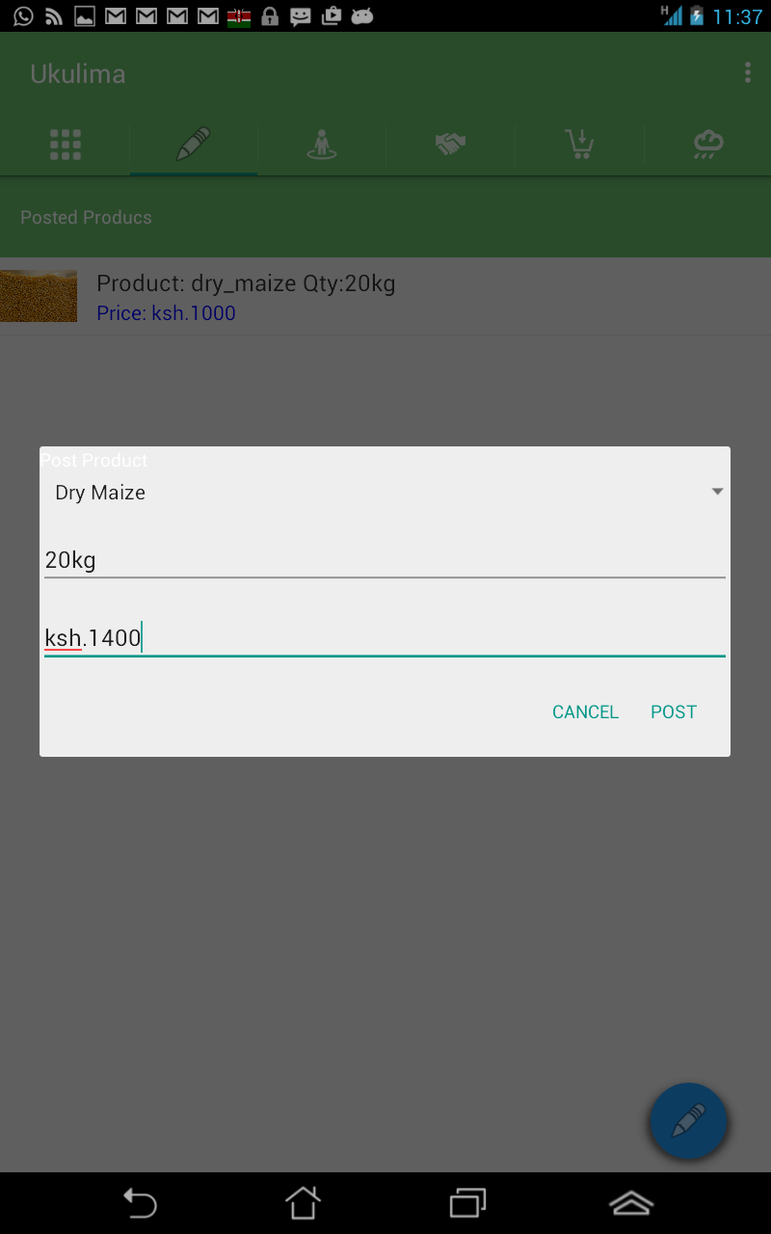
Farmers section

Slide 5
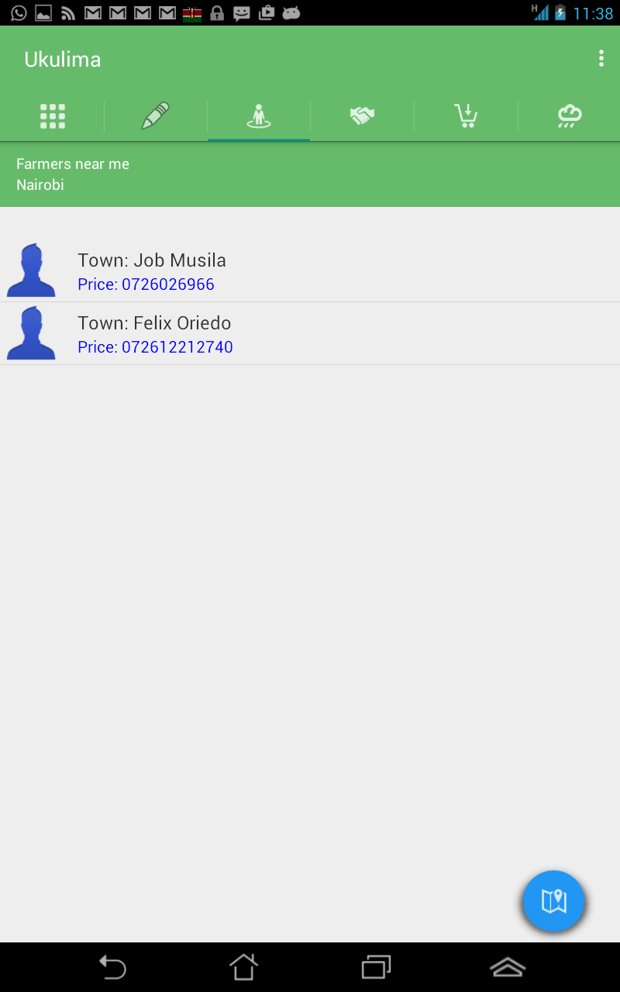
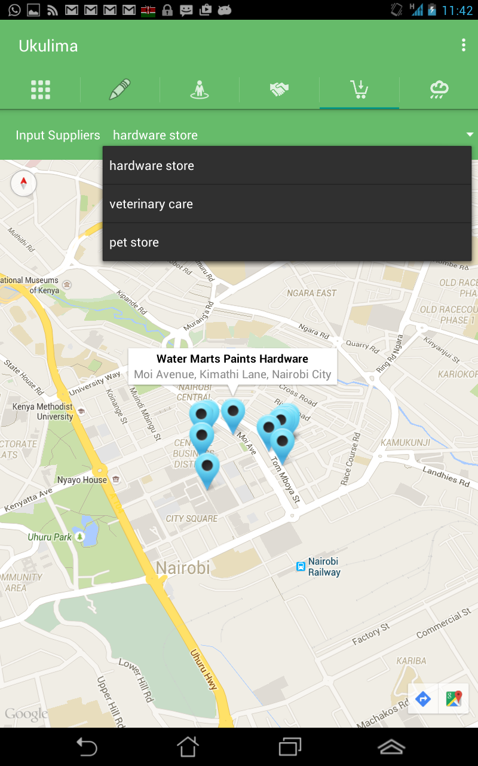
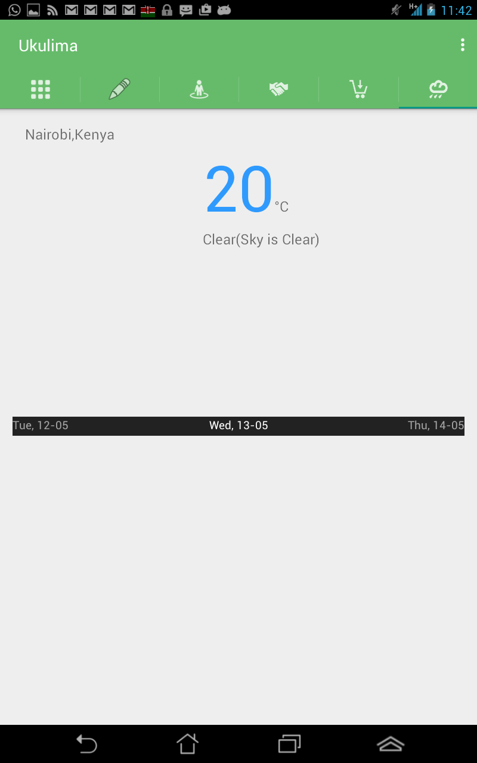
Farmers section

Slide 6
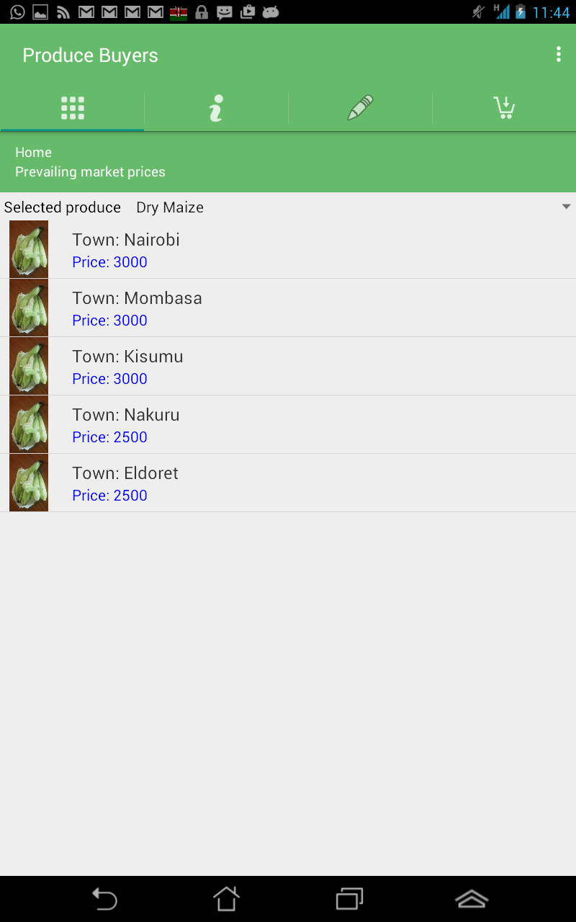
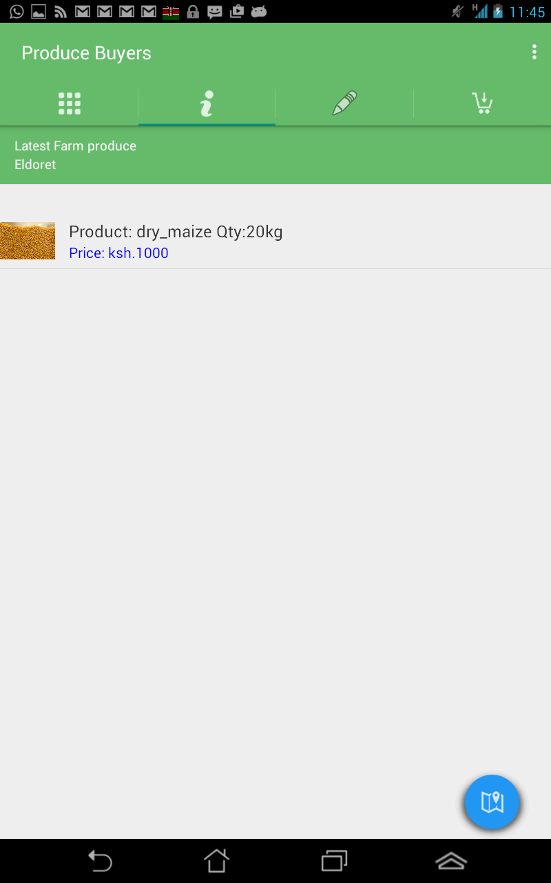
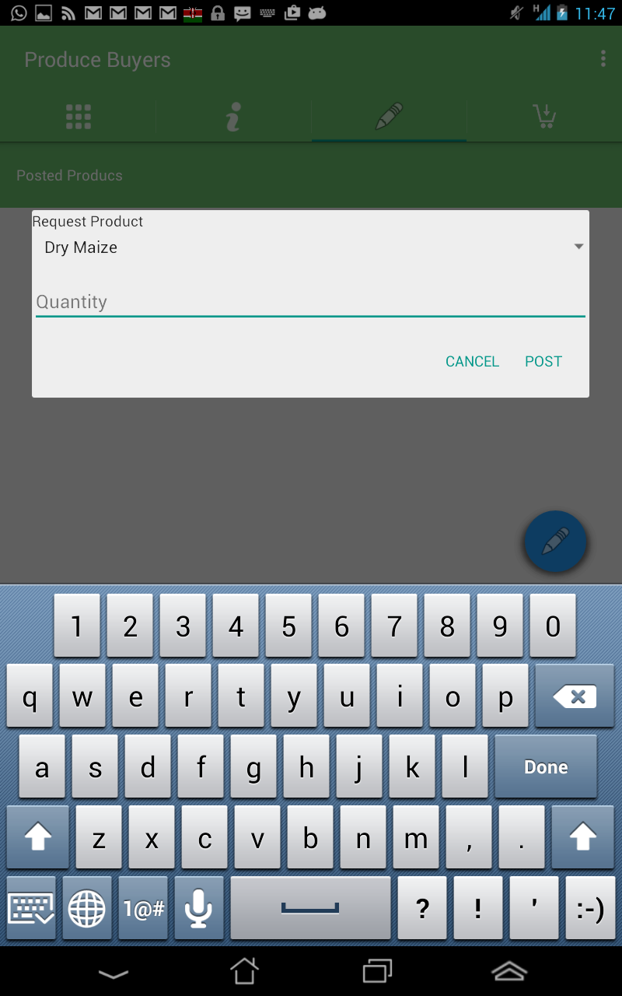
Produce buyers section

Slide 7
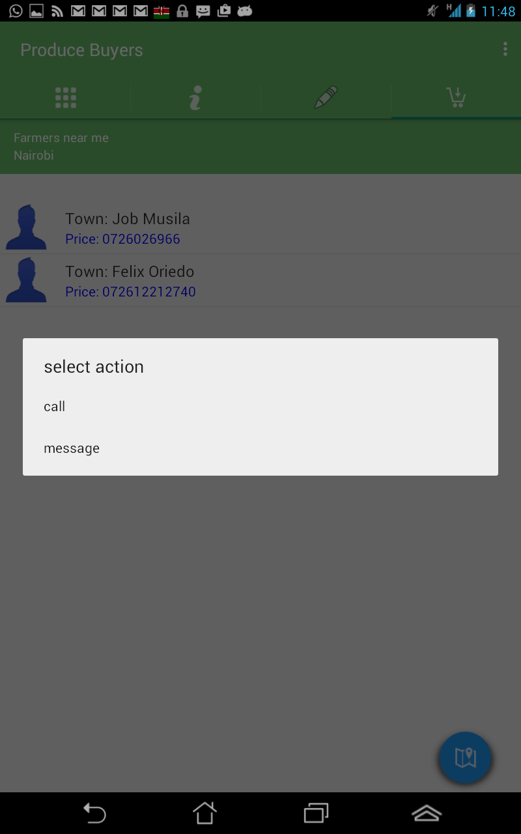
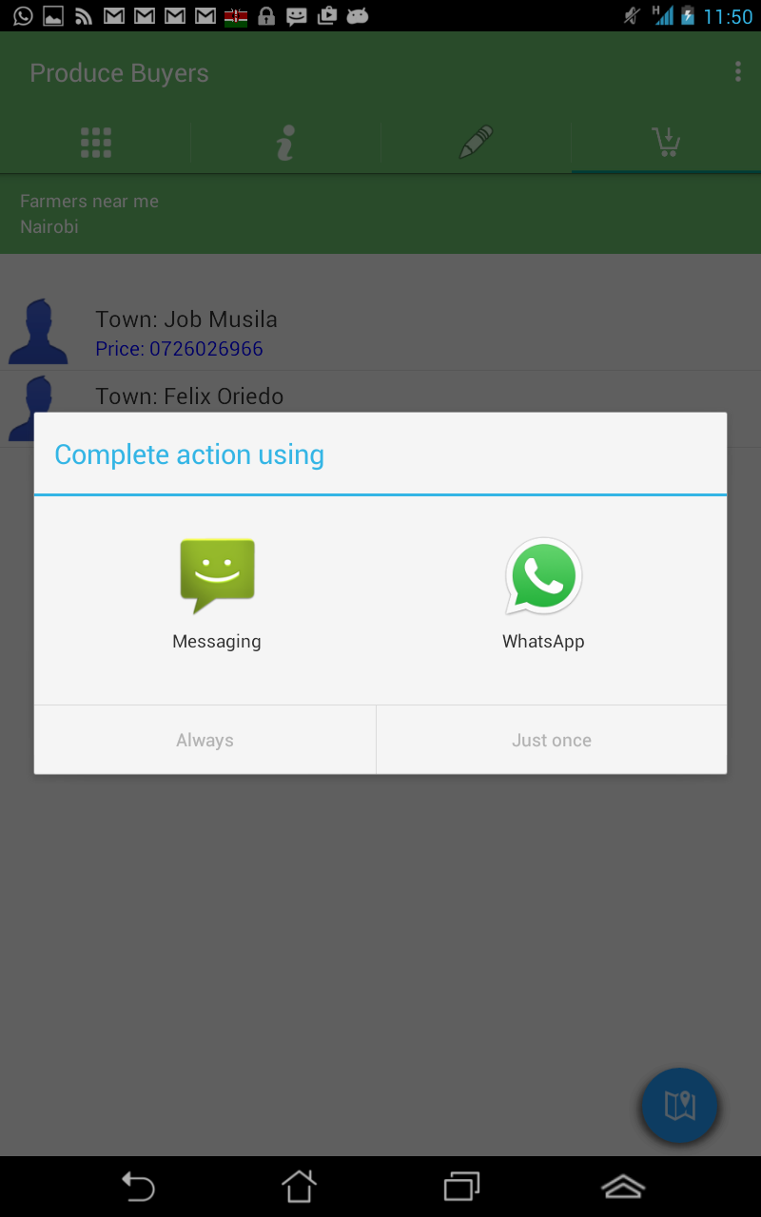
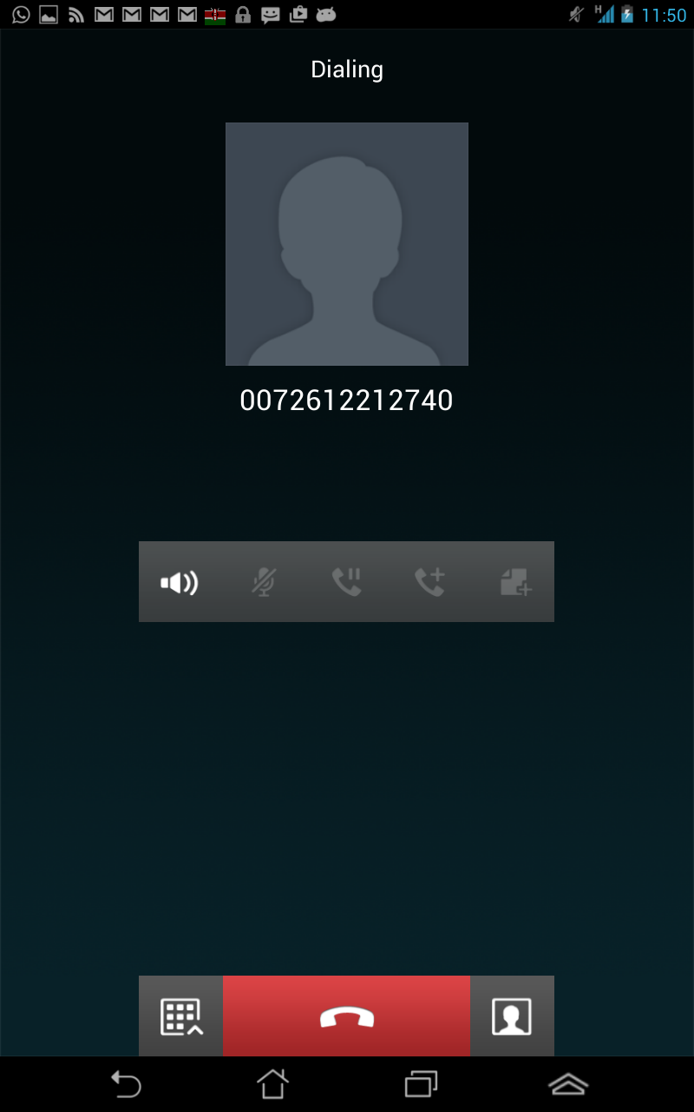
Produce buyers section

Slide 8
Advantages of Ukulima application
Farmers will gain maximum profit on their farm work since the application gets rid of middle men.
Farmers will be encouraged to invest more in agriculture which is the backbone of our economy.
Profits of input suppliers will be increased since their visibility has been increased through the ukulima mobile application.
The country will witness an improvement in the growth of the economy.

