Slide 1


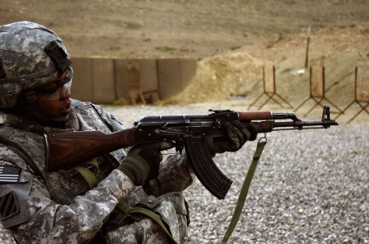
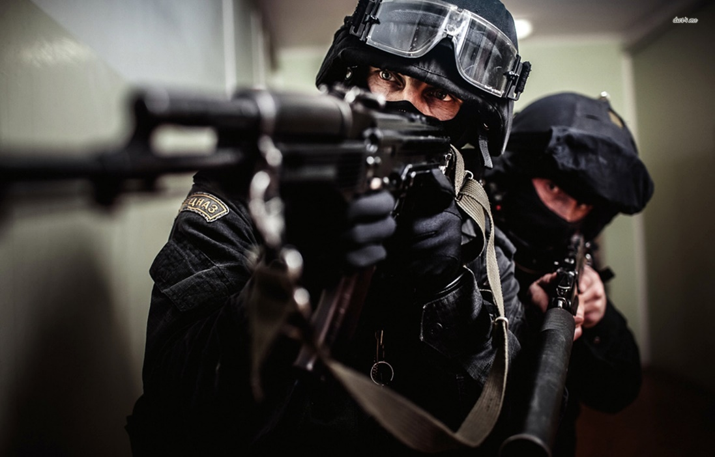
An All New Generation
With No New Generation Weapons

Slide 2
IT IS TIME FOR A CHANGE
Imagine just for a second, a weapon, a smart handheld weapon, that will do more than fire rounds-it will notify you when it jams, it will tell you how many bullets you have left in your magazine and connect wireleslly to a variety of peripherals.
It will become an unseperateable part of you and the battlefield.
Welcome to future, now everything is possible

