Slide 1
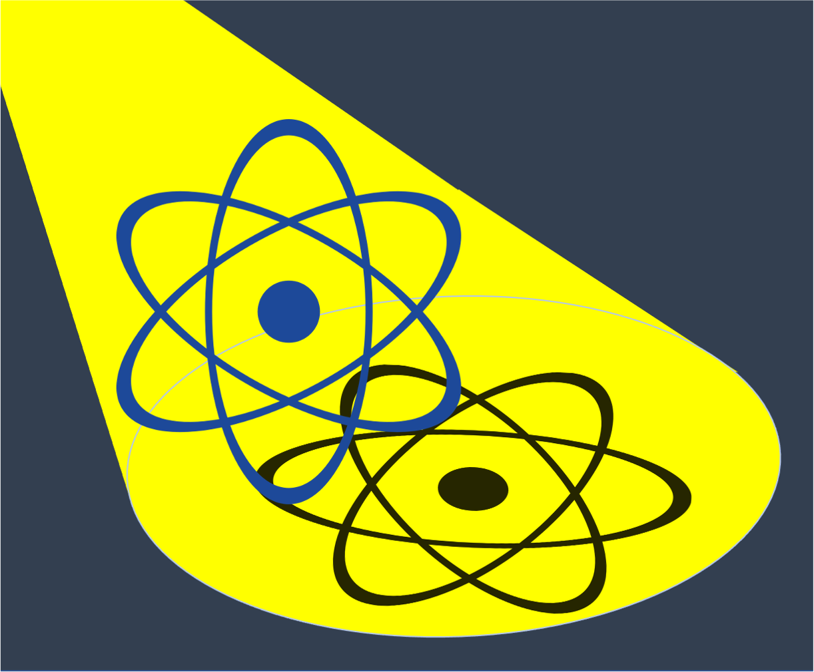
Learning ground state properties from few measurement
Oriel Kiss Physics application of AI
29th May 2024 UNIGE

Slide 2
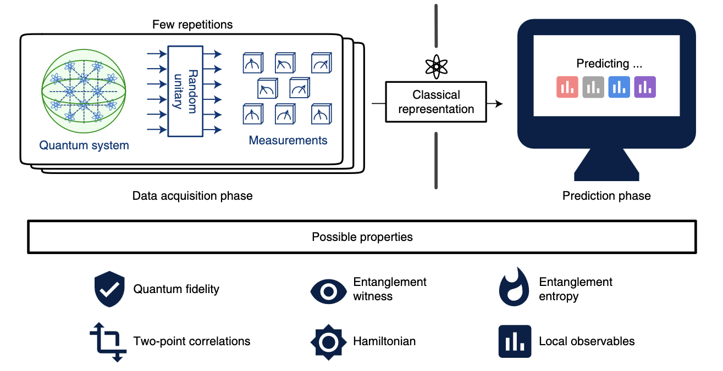

// Classical shadows formalism
extract information from quantum states with few measurements (optimal protocol).
generalize to new configurations.
Generalize to different configurations
State
preparation
(here DMRG)
Huang, HY., Kueng, R. & Preskill, J. Nat. Phys. 16, 1050–1057 (2020)

Slide 3
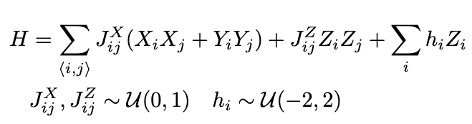
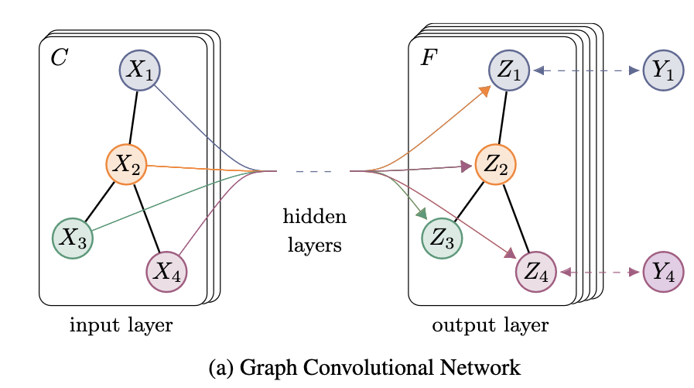
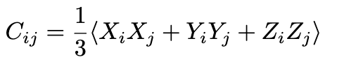
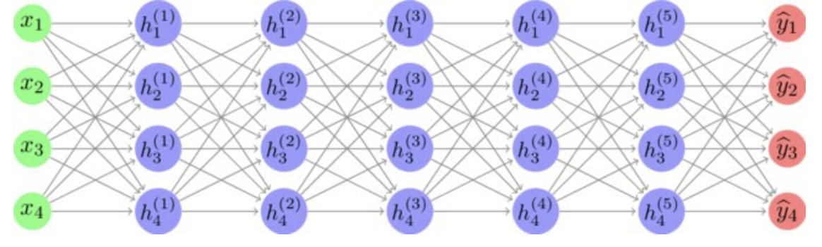

// The Pipeline
Network
Input (graphs):
Coupling (edges), External field (vertices)
2d XXZ Hamiltonian with transverse field
GCNN
(with message
passing)
Target: correlators
Loss function: MSE
Optimizer: ADAM
MLP
(constant width)
Symmetrisation + Normalization
Kipf and Welling, at ICLR 2017
Tran, Lewis, Huang, Kofler, Kueng, Hochreiter and Lehner, at Neurips ML4PS22

Slide 4
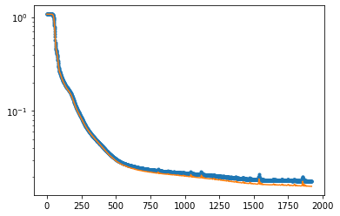
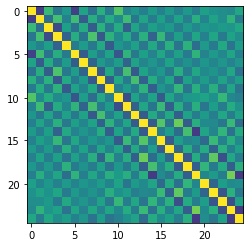
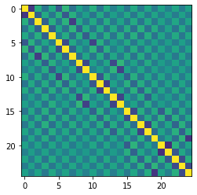
// Results
Training
5x5 spin-lattice
no measurement error
(i.e. no shadows, for now)
DMRG initial state
300 training points
Test data
Prediction

Slide 5
// Next Steps
Study the effect of noise on the training data (finite measurements).
Study the scaling with the system size.
Study the scaling with the number of training data.
Learn non-linear properties (e.g. entropies).
Study more exotic topologies (Kagome lattice, frustrated systems, … ).

