Slide 1
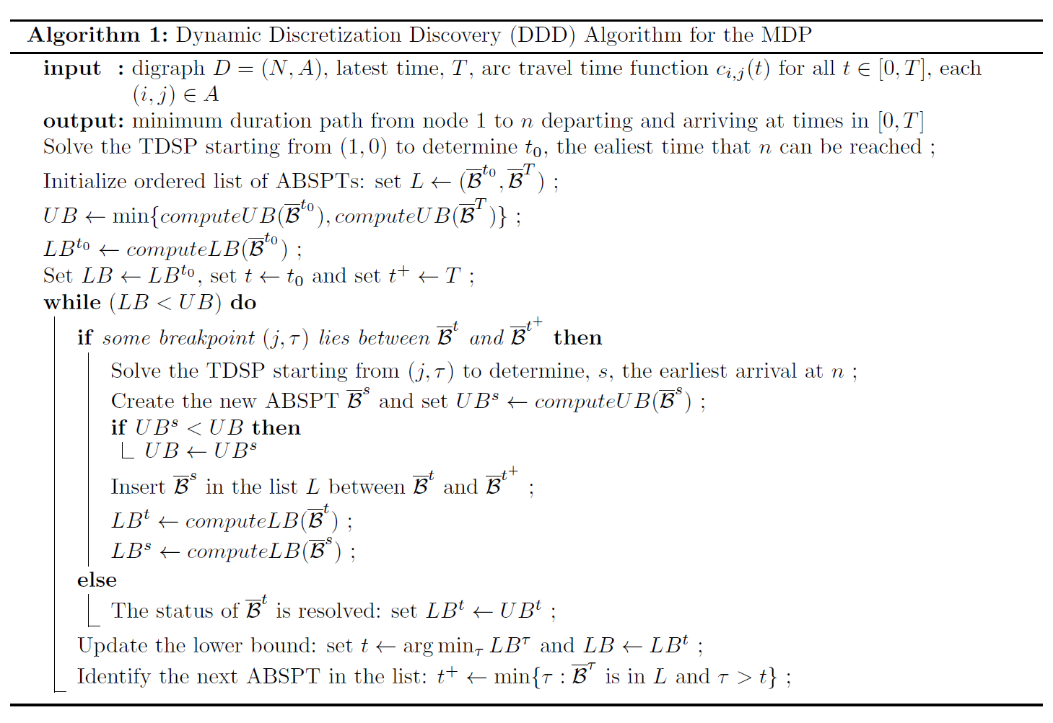





MDP Problem configuration
Physical transportation network
4 nodes, 5 directed links
2
$$c_{0,2}$$
$$c_{2,3}$$
0
$$c_{1,2}$$
3
$$c_{0,1}$$
$$c_{1,3}$$
1
Origin node: 0
Destination node: 3
Time horizon = [0, 5]
We want to find a path from origin node to destination node, such that the duration is the minimum.

Slide 2
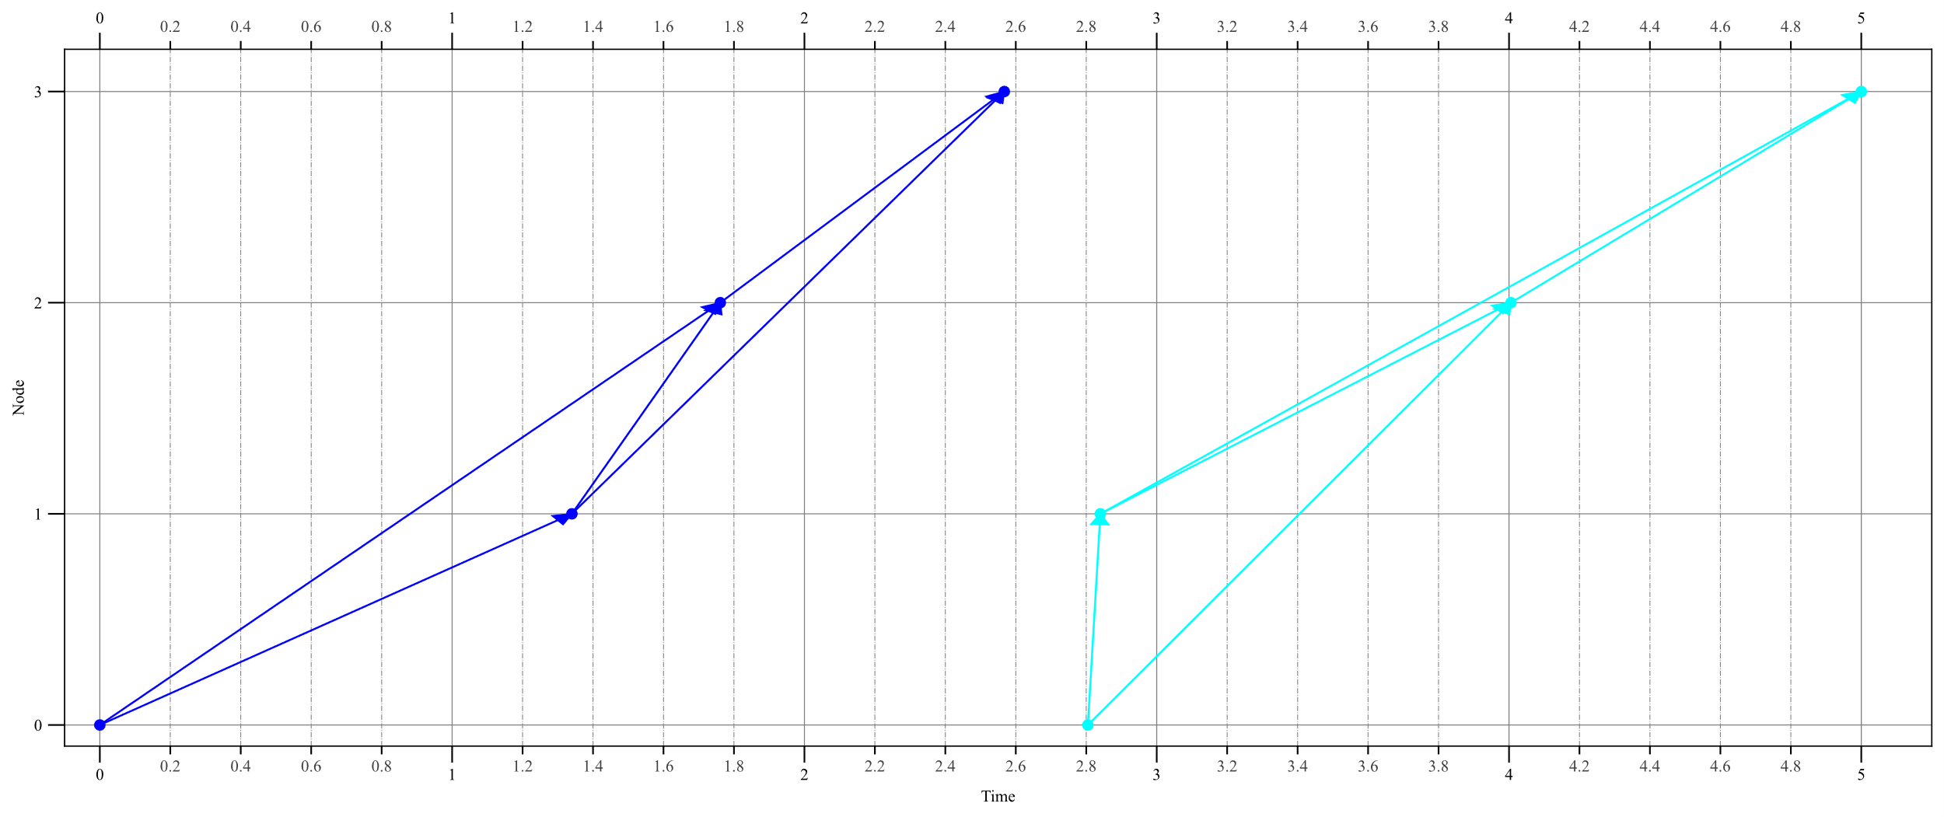
Adding ABSPT:(0,0), 2.5674
Times of Nodes in FSPT
0 0.000000
1 1.340000
2 2.850000
3 2.567400
Times of Nodes in BSPT
0 0.000000
1 1.340000
2 1.761273
3 2.567400
UB=2.5674
no previous ABSPT, this should only occur during first or second ABSPT
Inserting ABSPT:2.5674
Adding ABSPT:(3,5), 5
Times of Nodes in FSPT
0 6.000000
1 6.000000
2 6.000000
3 5.000000
Times of Nodes in BSPT
0 2.804665
1 2.840059
2 4.005635
3 5.000000
UB=2.19533
Updating ABSPT:2.5674: LB=1.26279
Inserting ABSPT:5
current lower bound=1.26279
current upper bound=2.19533
Iteration no | $$t$$ | $$t^{+}$$ | $$LB^{2.5674}$$ |  |  |  |  |  |  | $$LB^{5}$$
1 | 2.5674 | 5 | 1.26279 |  |  |  |  |  |  | 2.19533

Slide 3

Iteration no | $$t$$ | $$t^{+}$$ | $$LB^{2.5674}$$ |  | $$LB^{3.0826}$$ |  |  |  |  | $$LB^{5}$$
1 | 2.5674 | 5 | 1.26279 |  |  |  |  |  |  | 2.19533
2 | 3.0826 | 5 | 1.8874 |  | 1.45799 |  |  |  |  | 2.19533
Adding ABSPT:(0,1), 3.0826
Times of Nodes in FSPT
0 1.000000
1 1.660000
2 3.275400
3 3.082600
Times of Nodes in BSPT
0 1.000000
1 1.660000
2 2.239054
3 3.082600
UB=2.0826
newabspt LB=1.45799
Updating ABSPT:2.5674: LB=1.8874
Inserting ABSPT:3.0826
current lower bound=1.45799
current upper bound=2.0826

Slide 4
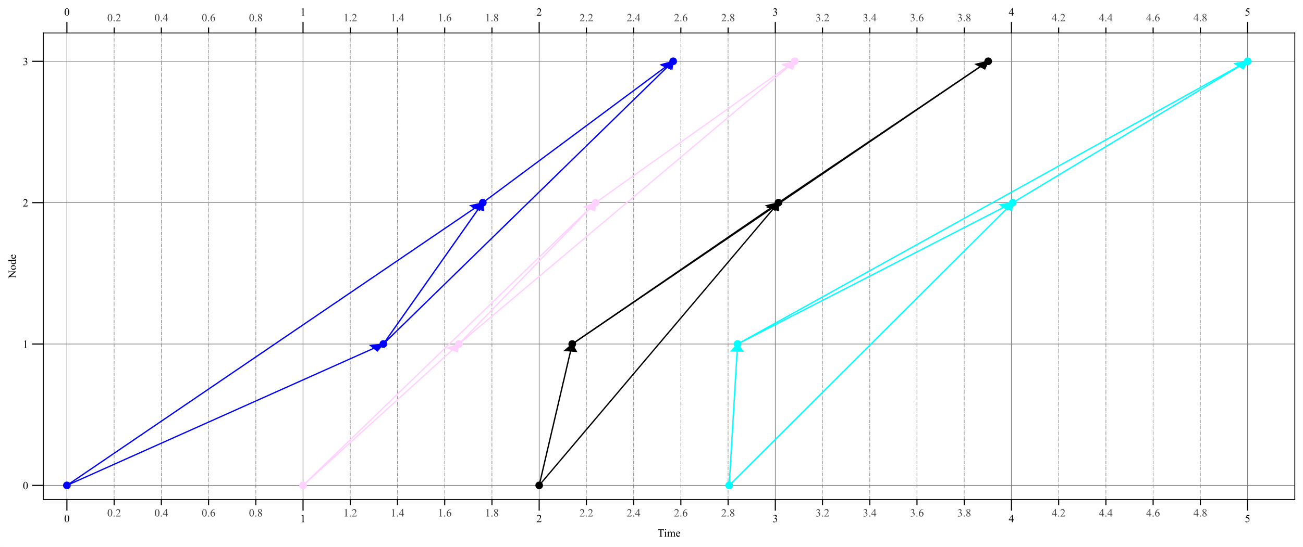
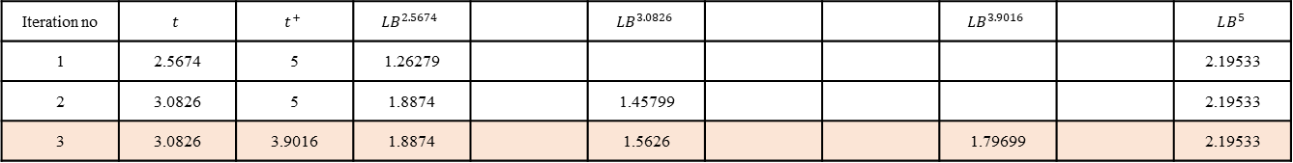
Iteration no | $$t$$ | $$t^{+}$$ | $$LB^{2.5674}$$ |  | $$LB^{3.0826}$$ |  |  | $$LB^{3.9016}$$ |  | $$LB^{5}$$
1 | 2.5674 | 5 | 1.26279 |  |  |  |  |  |  | 2.19533
2 | 3.0826 | 5 | 1.8874 |  | 1.45799 |  |  |  |  | 2.19533
3 | 3.0826 | 3.9016 | 1.8874 |  | 1.5626 |  |  | 1.79699 |  | 2.19533
Adding ABSPT:(0,2), 3.9016
Times of Nodes in FSPT
0 2.000000
1 2.140000
2 3.592600
3 3.901600
Times of Nodes in BSPT
0 2.000000
1 2.140000
2 3.013481
3 3.901600
UB=1.9016
newabspt LB=1.79699
Updating ABSPT:3.0826: LB=1.5626
Inserting ABSPT:3.9016
current lower bound=1.5626
current upper bound=1.9016

Slide 5
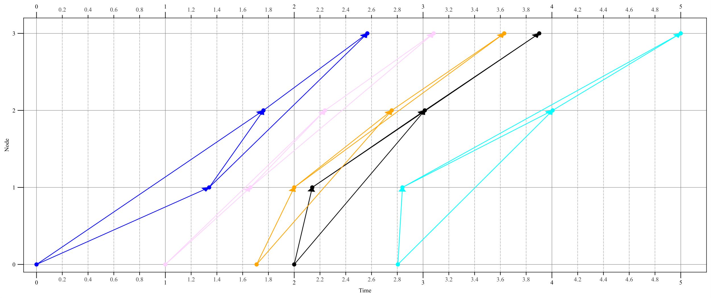
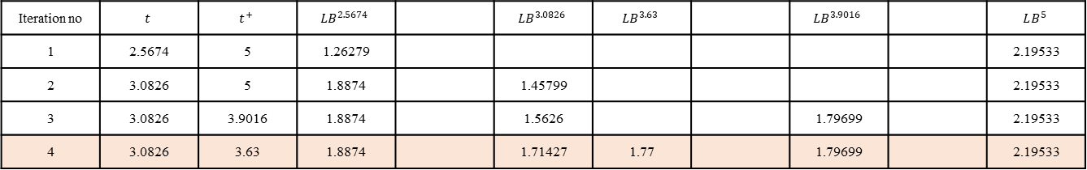
Adding ABSPT:(1,2), 3.63
Times of Nodes in FSPT
0 6.000000
1 2.000000
2 3.510000
3 3.630000
Times of Nodes in BSPT
0 1.708333
1 2.000000
2 2.757098
3 3.630000
UB=1.92167
newabspt LB=1.77
Updating ABSPT:3.0826: LB=1.71427
Inserting ABSPT:3.63
current lower bound=1.71427
current upper bound=1.9016
Iteration no | $$t$$ | $$t^{+}$$ | $$LB^{2.5674}$$ |  | $$LB^{3.0826}$$ | $$LB^{3.63}$$ |  | $$LB^{3.9016}$$ |  | $$LB^{5}$$
1 | 2.5674 | 5 | 1.26279 |  |  |  |  |  |  | 2.19533
2 | 3.0826 | 5 | 1.8874 |  | 1.45799 |  |  |  |  | 2.19533
3 | 3.0826 | 3.9016 | 1.8874 |  | 1.5626 |  |  | 1.79699 |  | 2.19533
4 | 3.0826 | 3.63 | 1.8874 |  | 1.71427 | 1.77 |  | 1.79699 |  | 2.19533

Slide 6
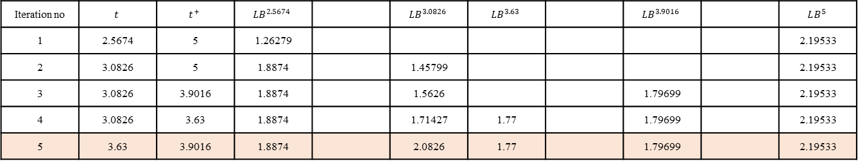
Iteration no | $$t$$ | $$t^{+}$$ | $$LB^{2.5674}$$ |  | $$LB^{3.0826}$$ | $$LB^{3.63}$$ |  | $$LB^{3.9016}$$ |  | $$LB^{5}$$
1 | 2.5674 | 5 | 1.26279 |  |  |  |  |  |  | 2.19533
2 | 3.0826 | 5 | 1.8874 |  | 1.45799 |  |  |  |  | 2.19533
3 | 3.0826 | 3.9016 | 1.8874 |  | 1.5626 |  |  | 1.79699 |  | 2.19533
4 | 3.0826 | 3.63 | 1.8874 |  | 1.71427 | 1.77 |  | 1.79699 |  | 2.19533
5 | 3.63 | 3.9016 | 1.8874 |  | 2.0826 | 1.77 |  | 1.79699 |  | 2.19533
Resolving ABSPT:(0,1),3.0826
current lower bound=1.77
current upper bound=1.9016

Slide 7
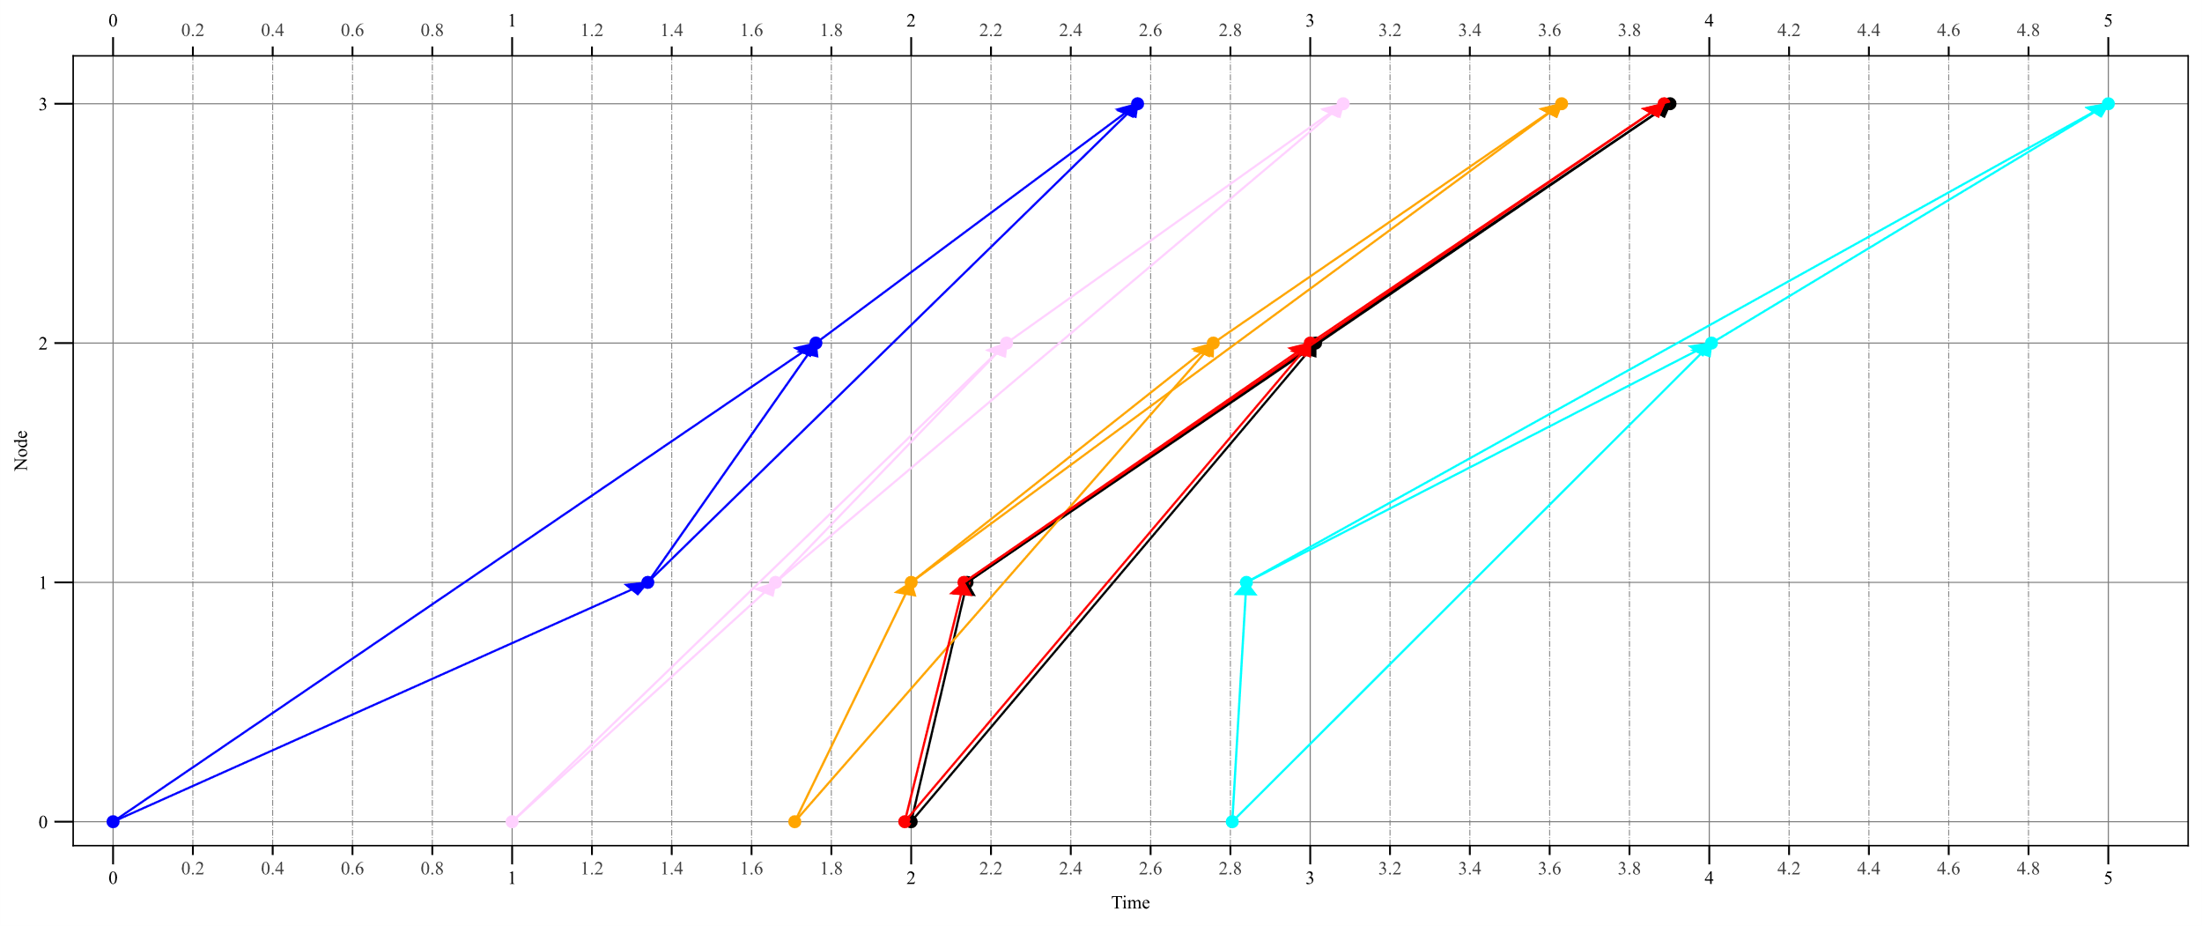
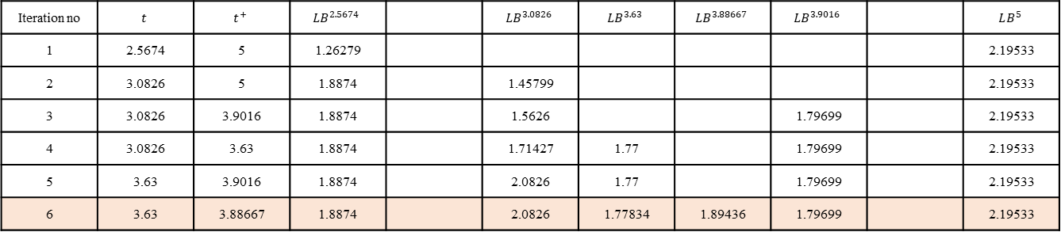
Adding ABSPT:(2,3), 3.88667
Times of Nodes in FSPT
0 6.000000
1 6.000000
2 3.000000
3 3.886667
Times of Nodes in BSPT
0 1.983964
1 2.132303
2 3.000000
3 3.886667
UB=1.9027
newabspt LB=1.89436
Updating ABSPT:3.63: LB=1.77834
Inserting ABSPT:3.88667
current lower bound=1.77834
current upper bound=1.9016
Iteration no | $$t$$ | $$t^{+}$$ | $$LB^{2.5674}$$ |  | $$LB^{3.0826}$$ | $$LB^{3.63}$$ | $$LB^{3.88667}$$ | $$LB^{3.9016}$$ |  | $$LB^{5}$$
1 | 2.5674 | 5 | 1.26279 |  |  |  |  |  |  | 2.19533
2 | 3.0826 | 5 | 1.8874 |  | 1.45799 |  |  |  |  | 2.19533
3 | 3.0826 | 3.9016 | 1.8874 |  | 1.5626 |  |  | 1.79699 |  | 2.19533
4 | 3.0826 | 3.63 | 1.8874 |  | 1.71427 | 1.77 |  | 1.79699 |  | 2.19533
5 | 3.63 | 3.9016 | 1.8874 |  | 2.0826 | 1.77 |  | 1.79699 |  | 2.19533
6 | 3.63 | 3.88667 | 1.8874 |  | 2.0826 | 1.77834 | 1.89436 | 1.79699 |  | 2.19533

Slide 8
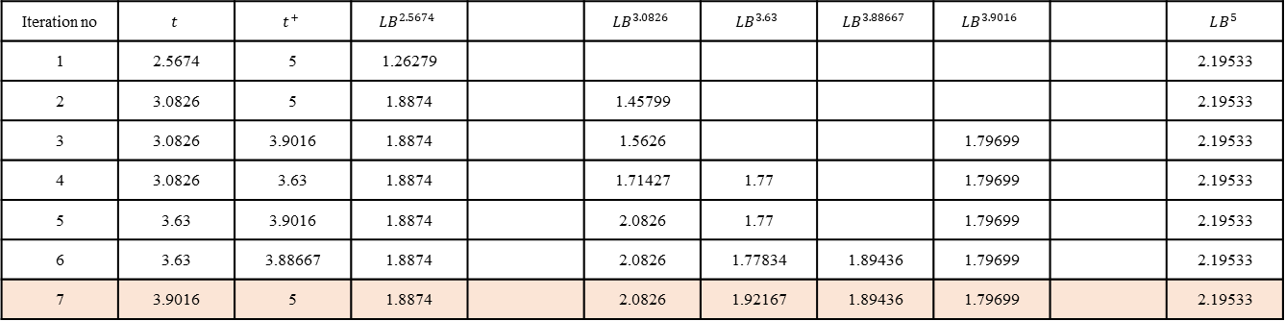
Iteration no | $$t$$ | $$t^{+}$$ | $$LB^{2.5674}$$ |  | $$LB^{3.0826}$$ | $$LB^{3.63}$$ | $$LB^{3.88667}$$ | $$LB^{3.9016}$$ |  | $$LB^{5}$$
1 | 2.5674 | 5 | 1.26279 |  |  |  |  |  |  | 2.19533
2 | 3.0826 | 5 | 1.8874 |  | 1.45799 |  |  |  |  | 2.19533
3 | 3.0826 | 3.9016 | 1.8874 |  | 1.5626 |  |  | 1.79699 |  | 2.19533
4 | 3.0826 | 3.63 | 1.8874 |  | 1.71427 | 1.77 |  | 1.79699 |  | 2.19533
5 | 3.63 | 3.9016 | 1.8874 |  | 2.0826 | 1.77 |  | 1.79699 |  | 2.19533
6 | 3.63 | 3.88667 | 1.8874 |  | 2.0826 | 1.77834 | 1.89436 | 1.79699 |  | 2.19533
7 | 3.9016 | 5 | 1.8874 |  | 2.0826 | 1.92167 | 1.89436 | 1.79699 |  | 2.19533
Resolving ABSPT:(1,2), 3.63
current lower bound=1.79699
current upper bound=1.9016

Slide 9
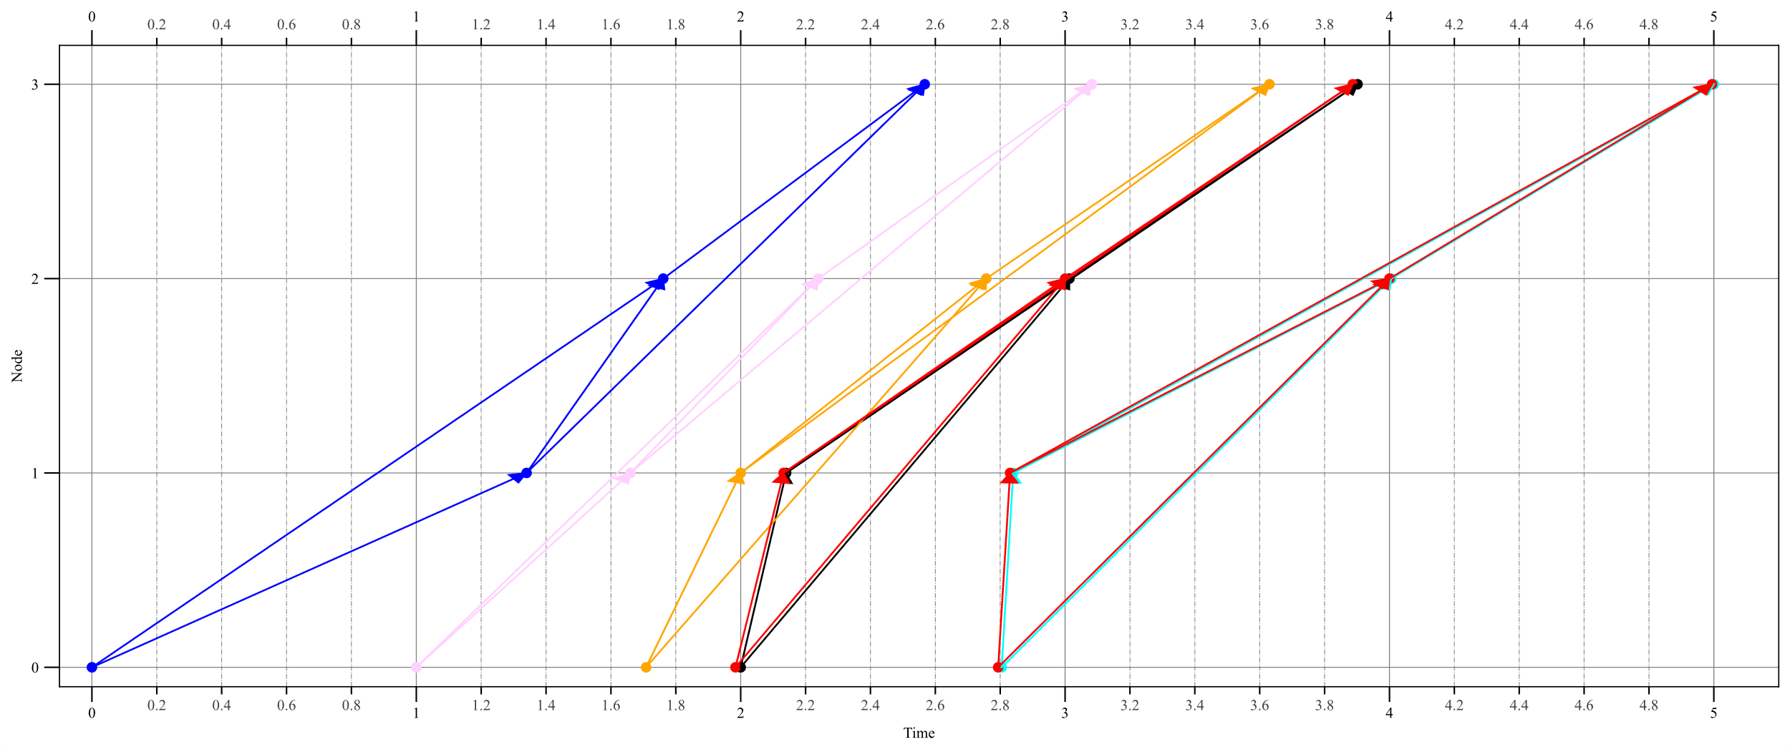
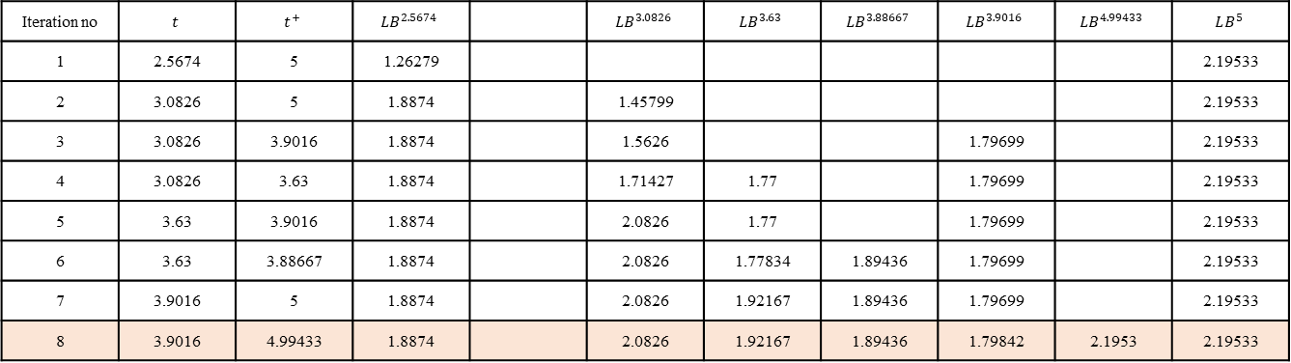
Iteration no | $$t$$ | $$t^{+}$$ | $$LB^{2.5674}$$ |  | $$LB^{3.0826}$$ | $$LB^{3.63}$$ | $$LB^{3.88667}$$ | $$LB^{3.9016}$$ | $$LB^{4.99433}$$ | $$LB^{5}$$
1 | 2.5674 | 5 | 1.26279 |  |  |  |  |  |  | 2.19533
2 | 3.0826 | 5 | 1.8874 |  | 1.45799 |  |  |  |  | 2.19533
3 | 3.0826 | 3.9016 | 1.8874 |  | 1.5626 |  |  | 1.79699 |  | 2.19533
4 | 3.0826 | 3.63 | 1.8874 |  | 1.71427 | 1.77 |  | 1.79699 |  | 2.19533
5 | 3.63 | 3.9016 | 1.8874 |  | 2.0826 | 1.77 |  | 1.79699 |  | 2.19533
6 | 3.63 | 3.88667 | 1.8874 |  | 2.0826 | 1.77834 | 1.89436 | 1.79699 |  | 2.19533
7 | 3.9016 | 5 | 1.8874 |  | 2.0826 | 1.92167 | 1.89436 | 1.79699 |  | 2.19533
8 | 3.9016 | 4.99433 | 1.8874 |  | 2.0826 | 1.92167 | 1.89436 | 1.79842 | 2.1953 | 2.19533
Adding ABSPT:(2,4), 4.99433
Times of Nodes in FSPT
0 6.000000
1 6.000000
2 4.000000
3 4.994333
Times of Nodes in BSPT
0 2.793688
1 2.830508
2 4.000000
3 4.994333
UB=2.20065
newabspt LB=2.1953
Updating ABSPT:3.9016: LB=1.79842
Inserting ABSPT:4.99433
current lower bound=1.79842
current upper bound=1.9016

Slide 10
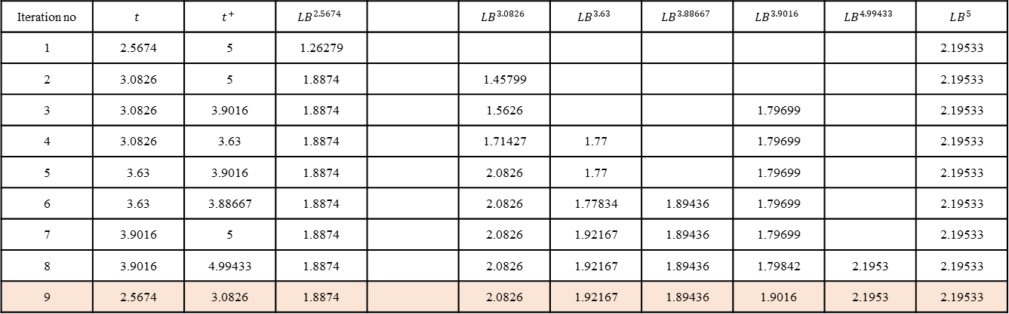
Iteration no | $$t$$ | $$t^{+}$$ | $$LB^{2.5674}$$ |  | $$LB^{3.0826}$$ | $$LB^{3.63}$$ | $$LB^{3.88667}$$ | $$LB^{3.9016}$$ | $$LB^{4.99433}$$ | $$LB^{5}$$
1 | 2.5674 | 5 | 1.26279 |  |  |  |  |  |  | 2.19533
2 | 3.0826 | 5 | 1.8874 |  | 1.45799 |  |  |  |  | 2.19533
3 | 3.0826 | 3.9016 | 1.8874 |  | 1.5626 |  |  | 1.79699 |  | 2.19533
4 | 3.0826 | 3.63 | 1.8874 |  | 1.71427 | 1.77 |  | 1.79699 |  | 2.19533
5 | 3.63 | 3.9016 | 1.8874 |  | 2.0826 | 1.77 |  | 1.79699 |  | 2.19533
6 | 3.63 | 3.88667 | 1.8874 |  | 2.0826 | 1.77834 | 1.89436 | 1.79699 |  | 2.19533
7 | 3.9016 | 5 | 1.8874 |  | 2.0826 | 1.92167 | 1.89436 | 1.79699 |  | 2.19533
8 | 3.9016 | 4.99433 | 1.8874 |  | 2.0826 | 1.92167 | 1.89436 | 1.79842 | 2.1953 | 2.19533
9 | 2.5674 | 3.0826 | 1.8874 |  | 2.0826 | 1.92167 | 1.89436 | 1.9016 | 2.1953 | 2.19533
Resolving ABSPT:(0,2), 3.9016
current lower bound=1.8874
current upper bound=1.9016

Slide 11
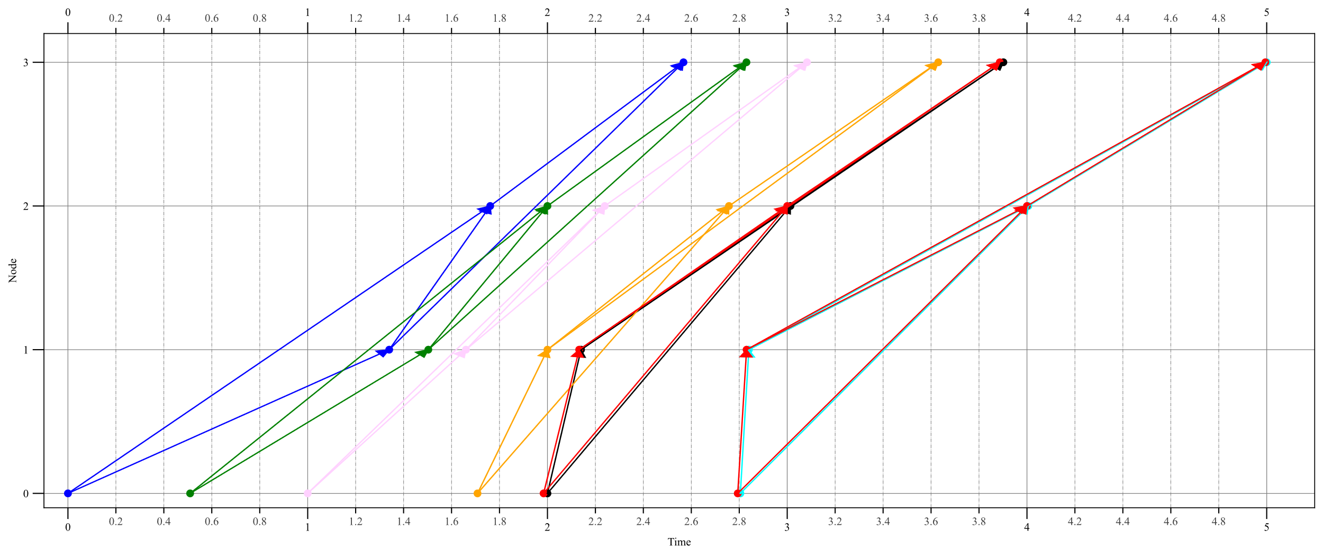
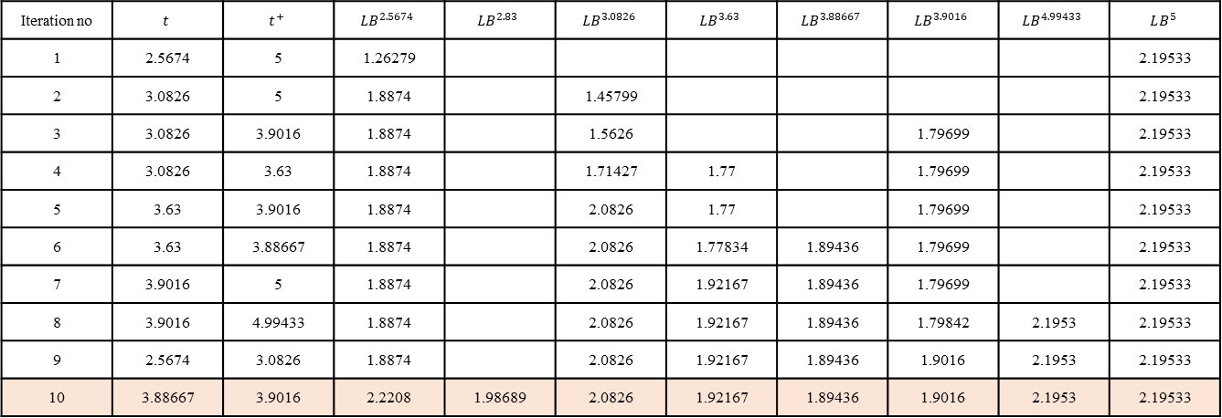
Iteration no | $$t$$ | $$t^{+}$$ | $$LB^{2.5674}$$ | $$LB^{2.83}$$ | $$LB^{3.0826}$$ | $$LB^{3.63}$$ | $$LB^{3.88667}$$ | $$LB^{3.9016}$$ | $$LB^{4.99433}$$ | $$LB^{5}$$
1 | 2.5674 | 5 | 1.26279 |  |  |  |  |  |  | 2.19533
2 | 3.0826 | 5 | 1.8874 |  | 1.45799 |  |  |  |  | 2.19533
3 | 3.0826 | 3.9016 | 1.8874 |  | 1.5626 |  |  | 1.79699 |  | 2.19533
4 | 3.0826 | 3.63 | 1.8874 |  | 1.71427 | 1.77 |  | 1.79699 |  | 2.19533
5 | 3.63 | 3.9016 | 1.8874 |  | 2.0826 | 1.77 |  | 1.79699 |  | 2.19533
6 | 3.63 | 3.88667 | 1.8874 |  | 2.0826 | 1.77834 | 1.89436 | 1.79699 |  | 2.19533
7 | 3.9016 | 5 | 1.8874 |  | 2.0826 | 1.92167 | 1.89436 | 1.79699 |  | 2.19533
8 | 3.9016 | 4.99433 | 1.8874 |  | 2.0826 | 1.92167 | 1.89436 | 1.79842 | 2.1953 | 2.19533
9 | 2.5674 | 3.0826 | 1.8874 |  | 2.0826 | 1.92167 | 1.89436 | 1.9016 | 2.1953 | 2.19533
10 | 3.88667 | 3.9016 | 2.2208 | 1.98689 | 2.0826 | 1.92167 | 1.89436 | 1.9016 | 2.1953 | 2.19533
Adding ABSPT:(2,2), 2.83
Times of Nodes in FSPT
0 6.000000
1 6.000000
2 2.000000
3 2.830000
Times of Nodes in BSPT
0 0.509705
1 1.503106
2 2.000000
3 2.830000
UB=2.3203
newabspt LB=1.98689
Updating ABSPT:2.5674: LB=2.2208
Inserting ABSPT:2.83
current lower bound=1.89436
current upper bound=1.9016

Slide 12
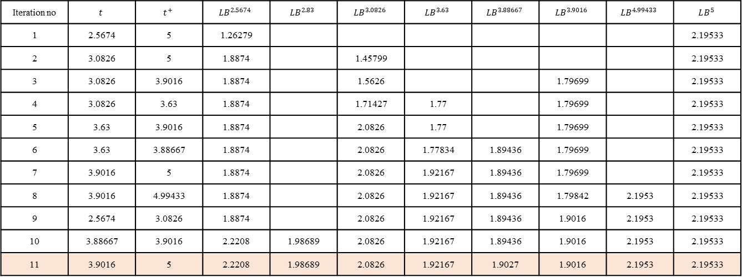
Iteration no | $$t$$ | $$t^{+}$$ | $$LB^{2.5674}$$ | $$LB^{2.83}$$ | $$LB^{3.0826}$$ | $$LB^{3.63}$$ | $$LB^{3.88667}$$ | $$LB^{3.9016}$$ | $$LB^{4.99433}$$ | $$LB^{5}$$
1 | 2.5674 | 5 | 1.26279 |  |  |  |  |  |  | 2.19533
2 | 3.0826 | 5 | 1.8874 |  | 1.45799 |  |  |  |  | 2.19533
3 | 3.0826 | 3.9016 | 1.8874 |  | 1.5626 |  |  | 1.79699 |  | 2.19533
4 | 3.0826 | 3.63 | 1.8874 |  | 1.71427 | 1.77 |  | 1.79699 |  | 2.19533
5 | 3.63 | 3.9016 | 1.8874 |  | 2.0826 | 1.77 |  | 1.79699 |  | 2.19533
6 | 3.63 | 3.88667 | 1.8874 |  | 2.0826 | 1.77834 | 1.89436 | 1.79699 |  | 2.19533
7 | 3.9016 | 5 | 1.8874 |  | 2.0826 | 1.92167 | 1.89436 | 1.79699 |  | 2.19533
8 | 3.9016 | 4.99433 | 1.8874 |  | 2.0826 | 1.92167 | 1.89436 | 1.79842 | 2.1953 | 2.19533
9 | 2.5674 | 3.0826 | 1.8874 |  | 2.0826 | 1.92167 | 1.89436 | 1.9016 | 2.1953 | 2.19533
10 | 3.88667 | 3.9016 | 2.2208 | 1.98689 | 2.0826 | 1.92167 | 1.89436 | 1.9016 | 2.1953 | 2.19533
11 | 3.9016 | 5 | 2.2208 | 1.98689 | 2.0826 | 1.92167 | 1.9027 | 1.9016 | 2.1953 | 2.19533
Resolving ABSPT:(2,3), 3.88667
current lower bound=1.9016
current upper bound=1.9016

Slide 13
Done! Thank you!

