Slide 1
Very Cool Title
TITLE!

Slide 2
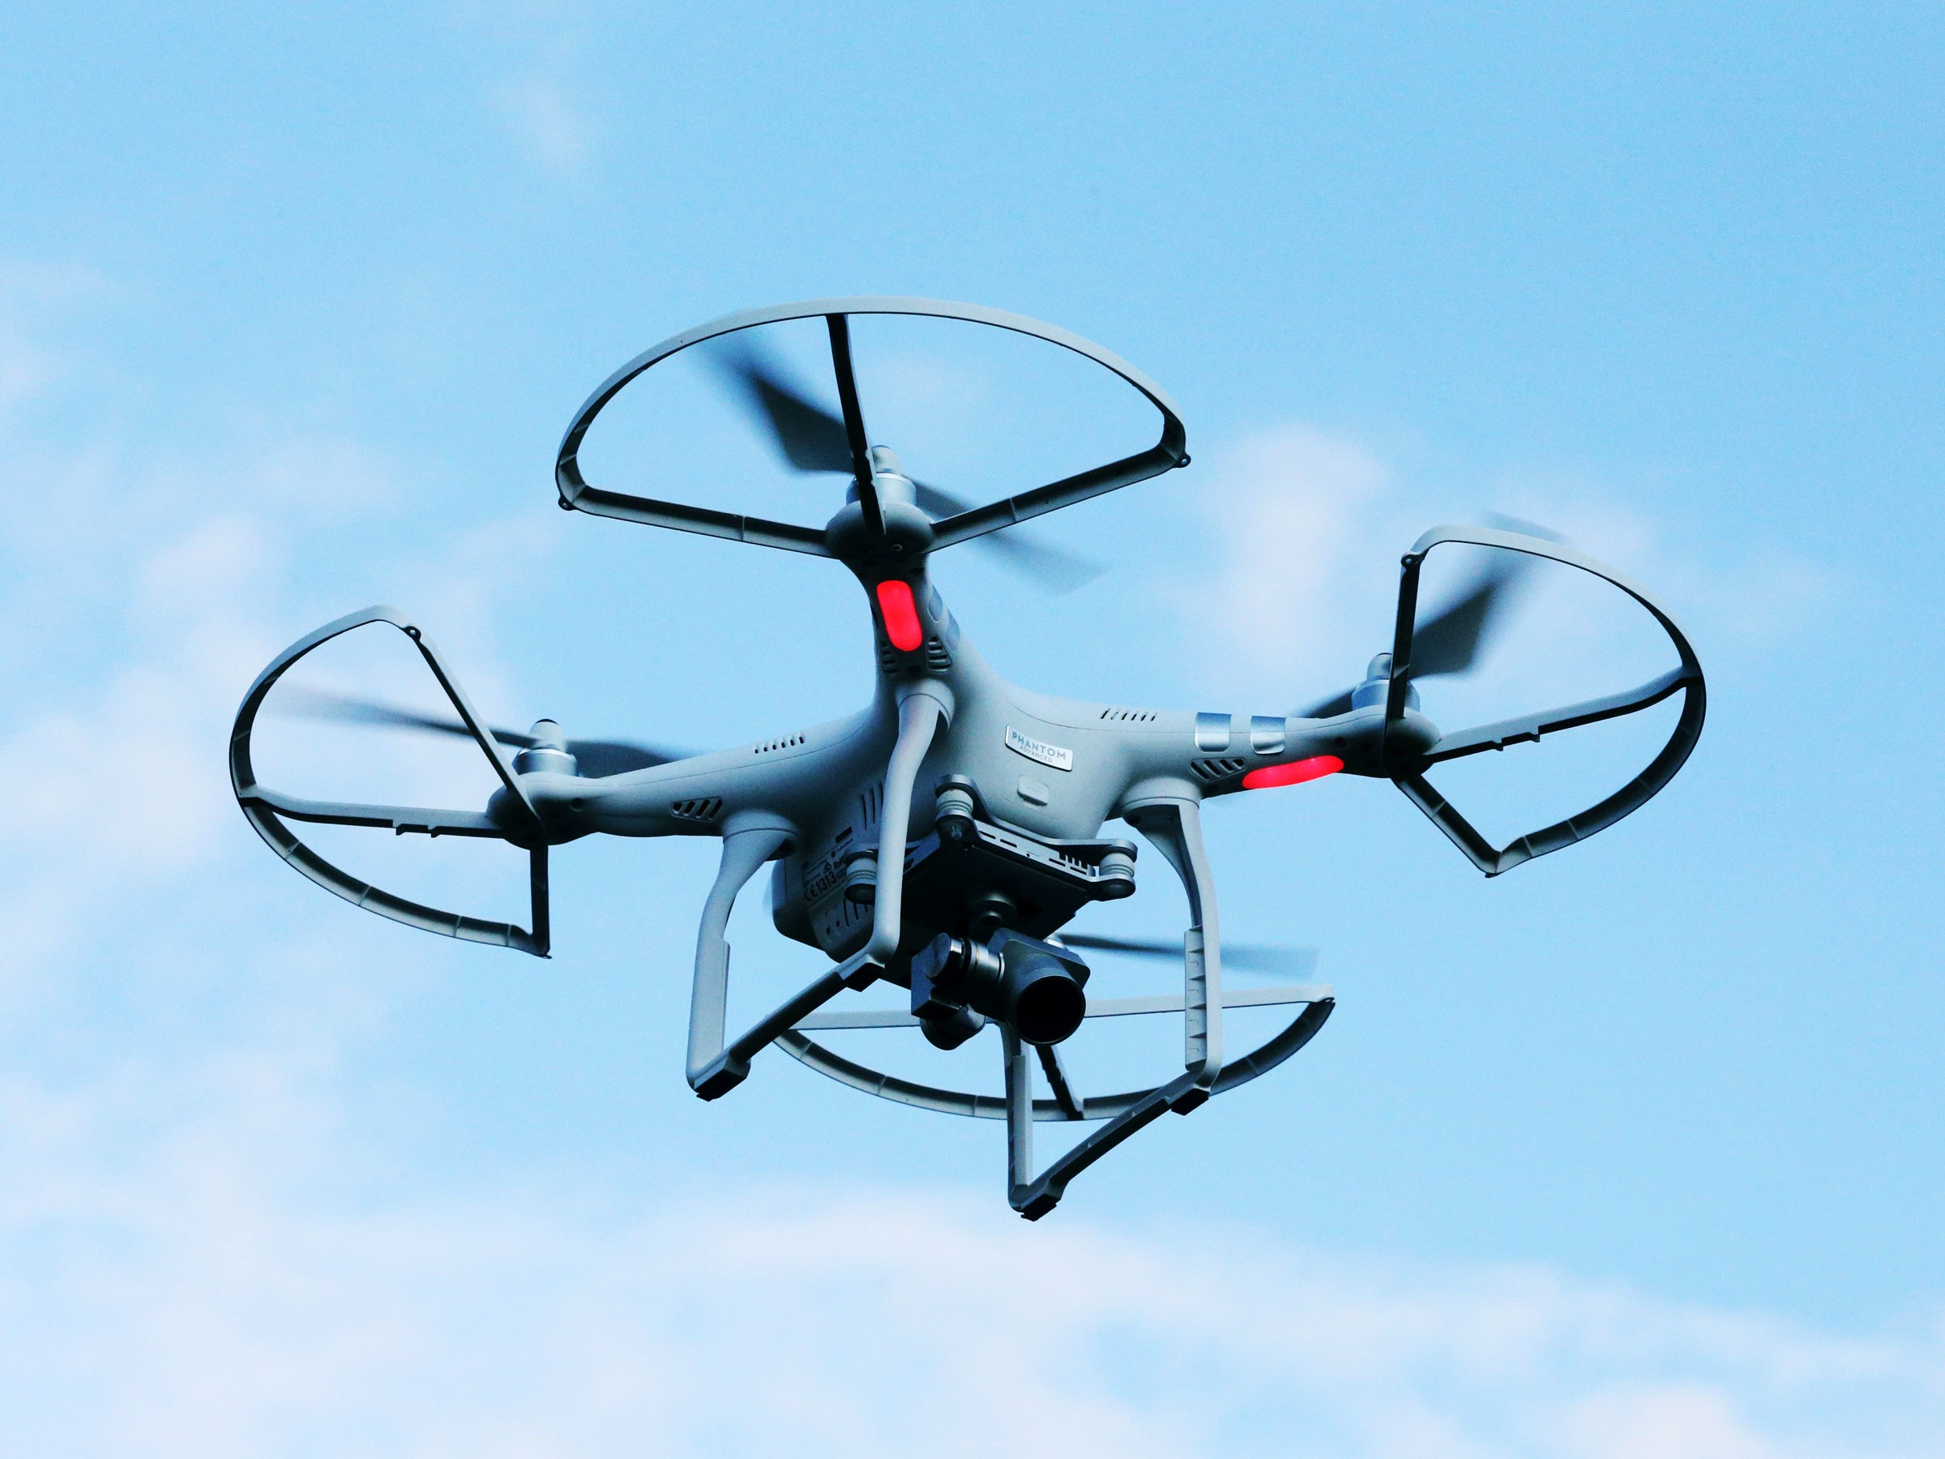
Introduction
The purpose of this research is to be able to use computer vision to autonomously land a quad-rotor onto a moving platform.

Slide 3
The Problem
Battery (Landing done at the end of missions)
Unpredictability of moving platform
Limited computation resources

Slide 4
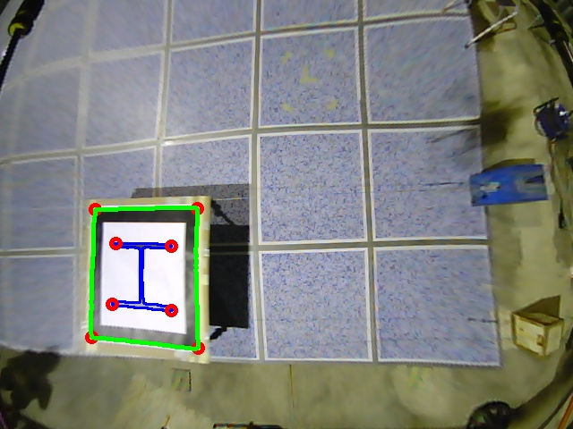
Summary of Reading
Proposed Approach:
  3 Stage Method:
    Estimation: Acquire position & velocity of moving platform
    Prediction: Use prediction algorithm
    Fast Landing: Move/Land to the predicted place

Slide 5
Algorithms Used
Helipad Detection: Algorithm based on Canny Edge Detector
Post-Processing Algorithm: Filter false positive, extract corners from object of interest
Position Estimator: Perspective-n-Point (estimation given a set of 3D points)
Motion Estimator: Estimate the position and velocity of the platform using Linear Kalman Filter

