Slide 1

工业控制软件设计
Part 2：Programming for the hardware (Key Problems)
By Richard Lee

Slide 2

主要内容
软件开发具体过程中的一些关键问题
这些问题包括：

Slide 3
Introduction
Method for System Analysis and Design
系统分析与建模
Synchronous and Asynchronous Messaging/Communication
同步/异步通讯
Multi-Threaded Programming
多线程编程
Architecture and Framework
体系结构设计

Slide 4
Problem 1 – System Analysis and Design
系统分析与设计

Slide 5
系统分析与设计
构建软件系统的第一步
对于大型的软件系统而言是非常重要的
核心是软件模型设计
方法
  面向对象的分析和设计方法 (OOA)
  结构化的分析方法
    数据流图和数据字典
软件设计方法的简短历史

Slide 6
O-O
基本思想
  对现实世界的模拟
    实体之间的交互
  抽象
    实体之间的联系和交互

Slide 7
O-O
Basic Concept 基本概念
  Object vs. Class / 对象与类
  Inheritance / 继承
  Polymorphism / 多态
  Aggregation / 聚集
  Interface / 接口
面向对象的设计方法可以实现对象之间复杂的各种关系

Slide 8
对象和类
Very important, very fundamental concept
Class is an abstraction of objects with same properties
Attribute
  state, quality, characteristics
Method
  behavior, action
Object is the concrete of the class

Slide 9
Language Support
VB – partially support
  有类的概念，但是不支持多态、继承等类特性
  不支持接口
  Since VB6.0
C++, Java – fully support
  C++允许多继承 – Multi-parents
  Java只允许单继承 – Single-parent

Slide 10
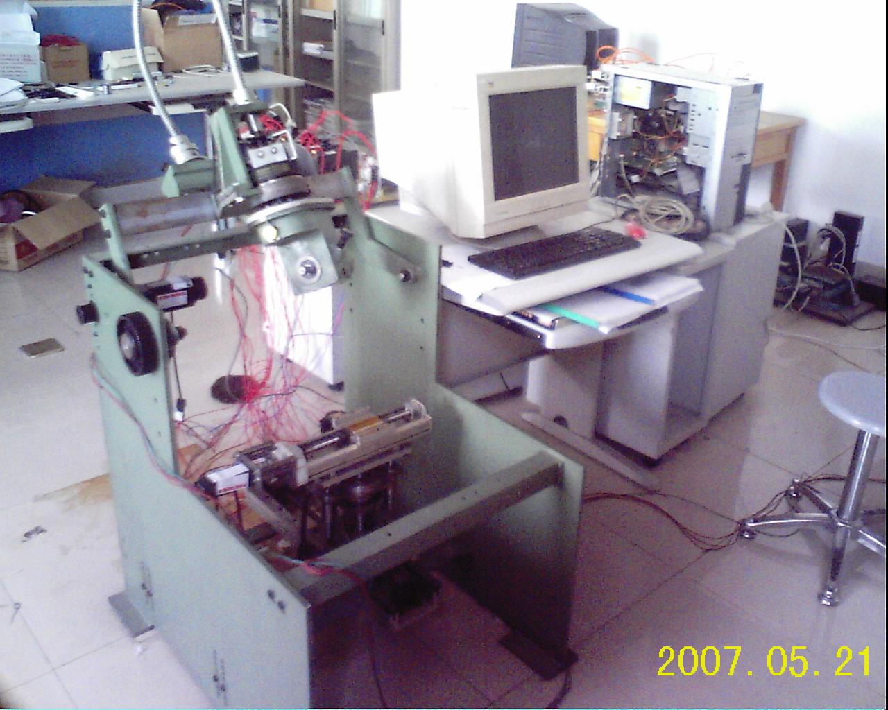
Example
鞋底打磨装备
  5个交流伺服电机
  2张固高运动控制卡
  PC
  气动夹具

Slide 11
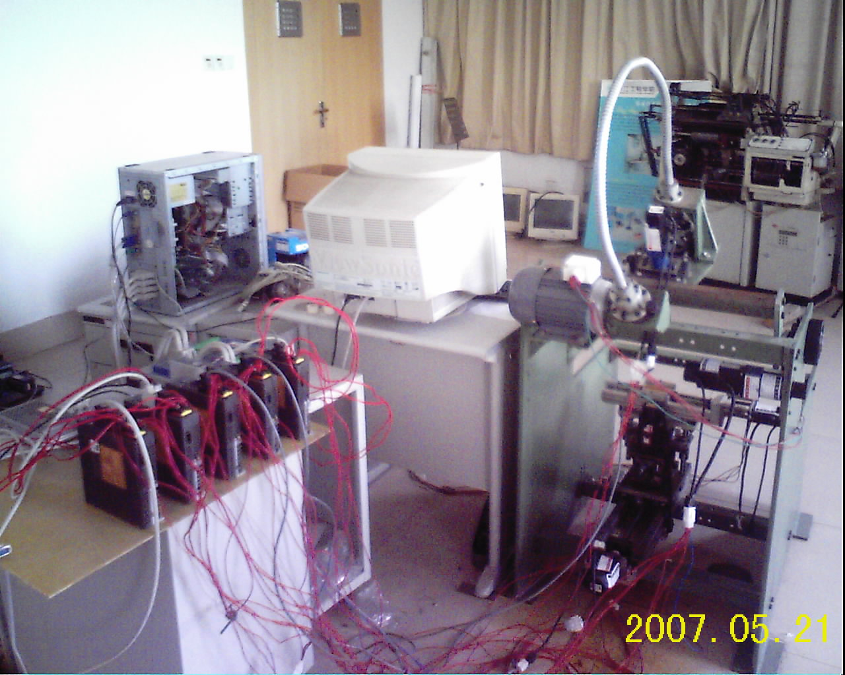

Slide 12
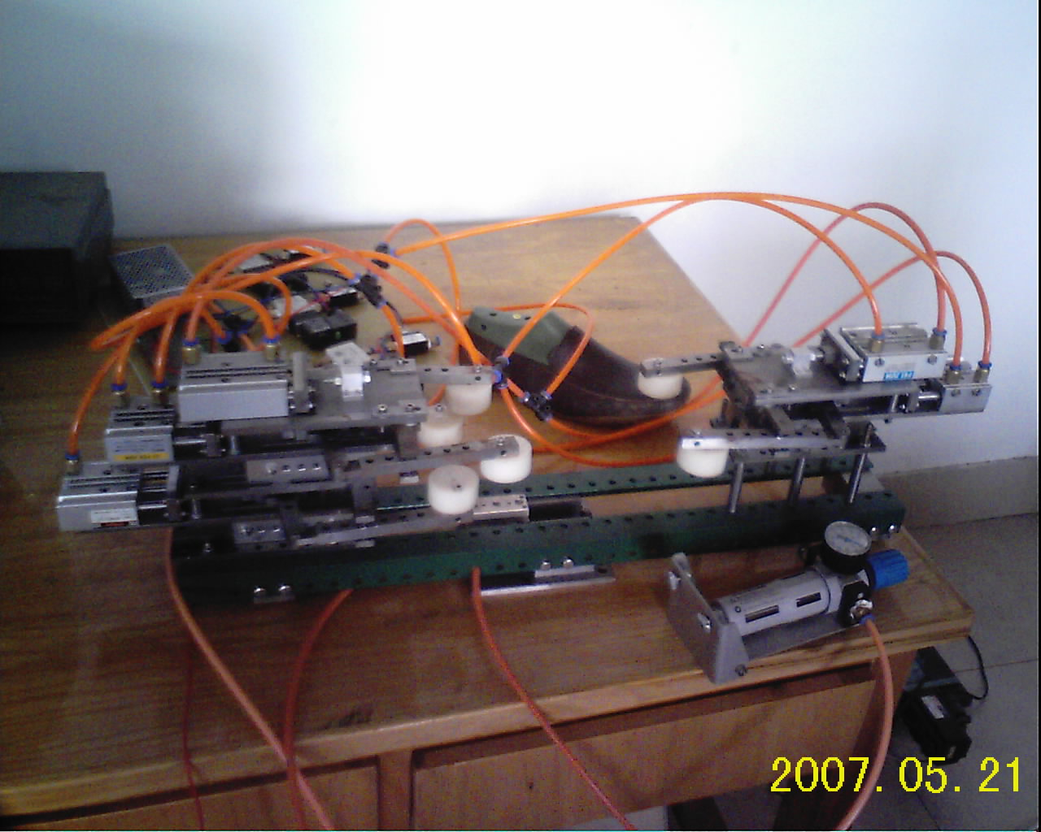

Slide 13
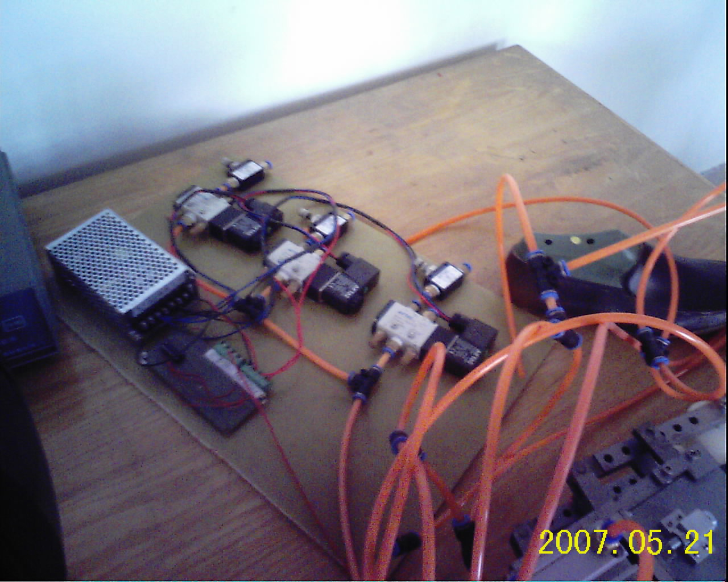

Slide 14
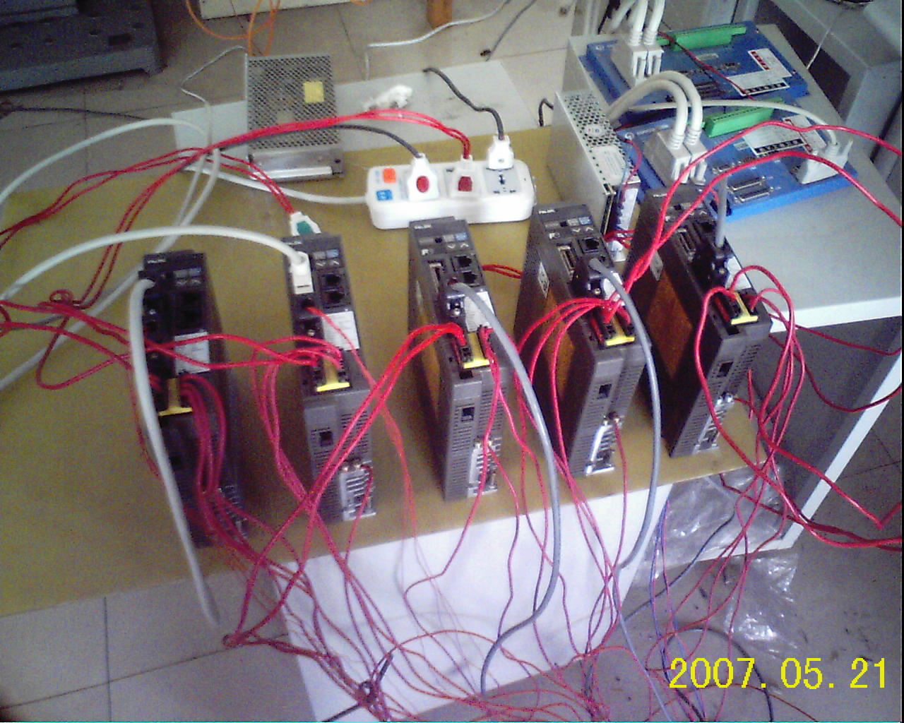

Slide 15
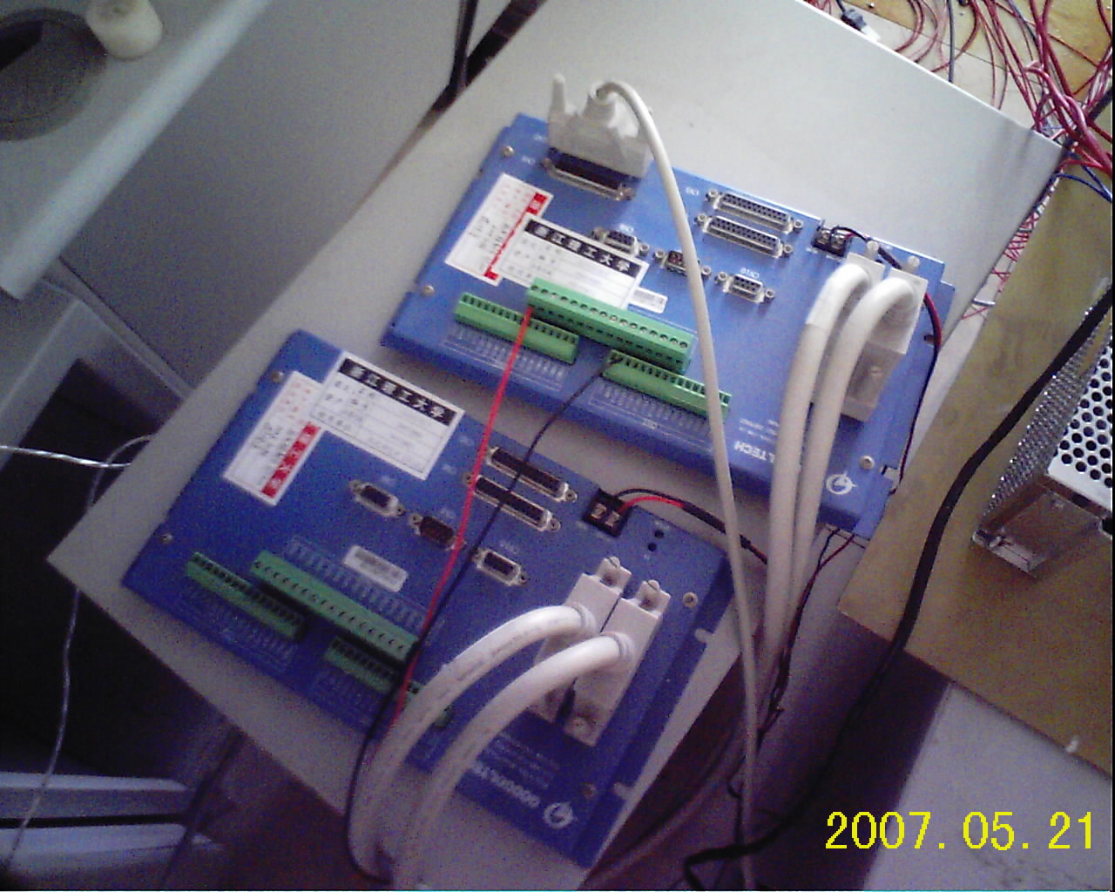

Slide 16
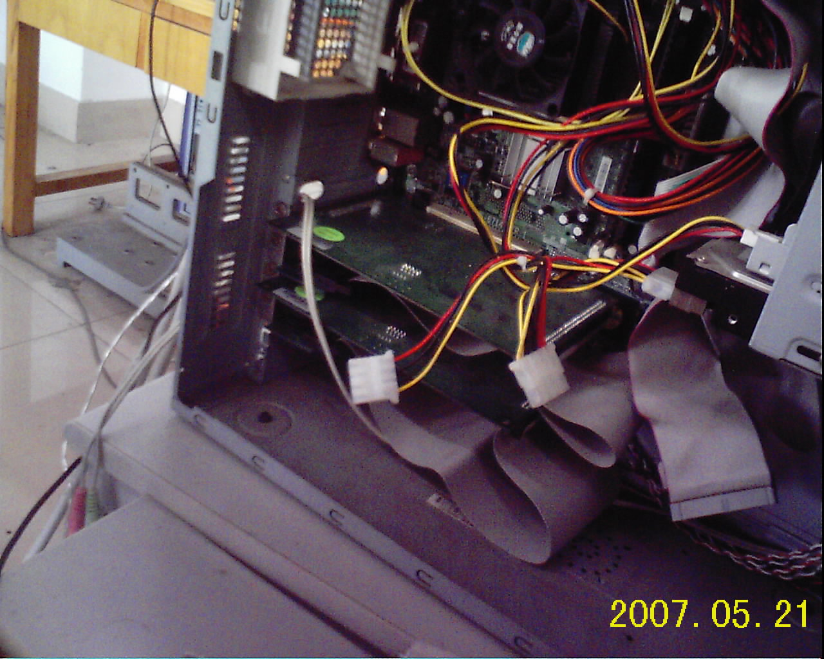

Slide 17
控制结构
PC
运动控制卡
运动控制卡
伺服电机
伺服电机
伺服电机
伺服电机
伺服电机
夹具控制

Slide 18
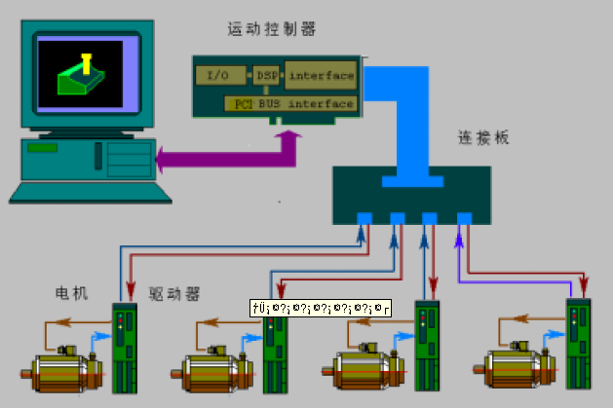
控制系统结构

Slide 19
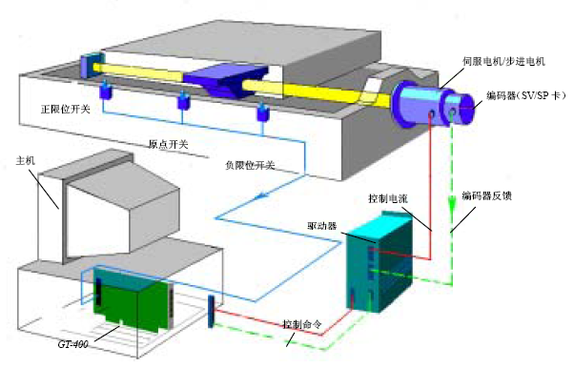
控制系统基本结构

Slide 20
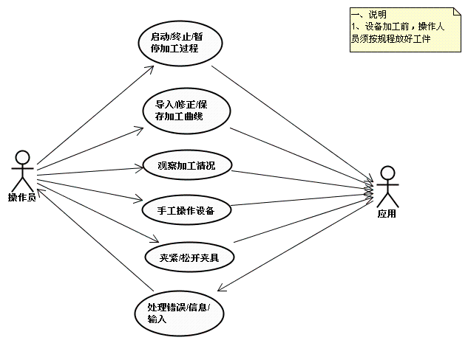
How to Modeling?
Requirements Analysis

Slide 21
How to modeling
Objects – Device、controller、other real or virtual entities
In this example system, we have
  Motors / Encoders
  Control card, two of them
  Clamp 夹具
  overtravel-limit switch 行程开关
  Operator 操作者
  PC and its software

Slide 22
Define the boundaries
The range the software can handle
  Operator, Motor, switch are out of the range
    It’s the object of the action, not the object in the system
    But virtually there should be objects as their counterparts in the software world.
  Control card are within the range
    Action dispatcher
    Interfaced through API (provided by its driver)
    Generally need to be re-capsulated
  Control software itself, obviously
    Can be abstracted as “Controller”

Slide 23
Definition of the boundaries
It is difficult.
It should be flexible.

Slide 24
Finding objects
Devices in the system
  Control card → MotionController
  Software → TaskController
Break up the existing object
  AxisController, FixerController
  UI
Auxiliary Object
  Path, Point, Config

Slide 25
Coarse Modeling
Path
Point
UI
TaskController
MotionController
AxisController
Config
FixerController

Slide 26
Enrich your design
Using Class Diagram
  One of the UML elements
Define the attributes
  What owns by all the objects in this category, but can make one distinguished with each other
Define the methods
  What the objects in this category can do
  May behavior differently according to its attributes

Slide 27
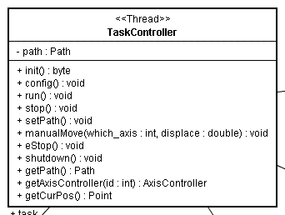
Example - TaskController

Slide 28
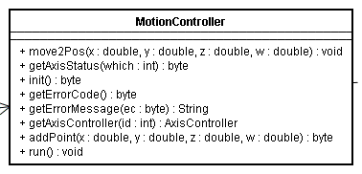
Example - MotionController

Slide 29
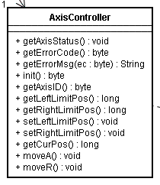
Example - AxisController

Slide 30
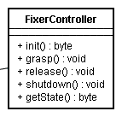
Example - FixerController

Slide 31
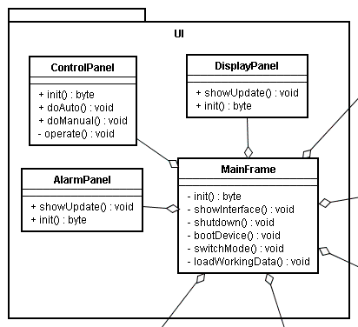
Example – User Interace

Slide 32
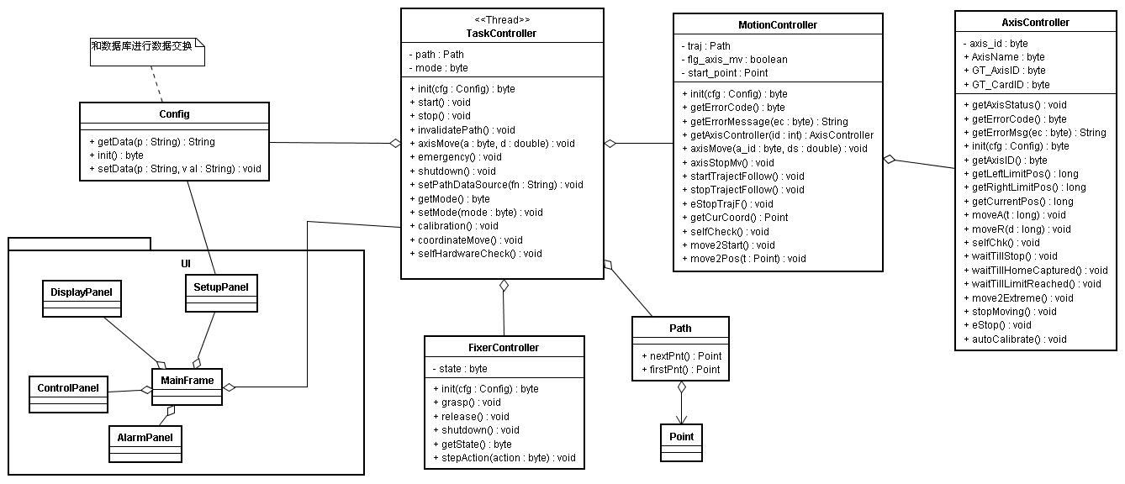
Example – Class Diagram

Slide 33
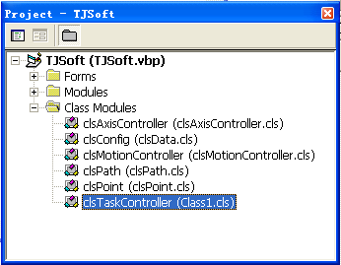
VB support for this class diagram

Slide 34
Source code
Option Explicit
Private Declare Sub Sleep Lib "Kernel32" (ByVal dwMilliseconds As Long)
Private Const tj_OK As Byte = 0
Private cardid As Byte
Private axisid As Byte
Private p(5) As Double
Private pos(5) As Double
Public Function move2Start() As Byte
move2Start = tj_OK
End Function
……

Slide 35
Summarize
OO modeling method is in nature a new way to re-organize your source code
Experience is very important
Design Pattern
Reference
  Ronald J. Norman，Object-Oriented System Analysis and Design,清华大学出版社，1998年6月
  徐宝文等，UML与软件建模，清华大学出版社，2006年1月

Slide 36
Problem 2 - Synchronous and Asynchronous Messaging/Communication
同步和异步通讯

Slide 37
Messaging/Communication
Messaging between objects
  Synchronous – return with result
  Asynchronous – result send in other way
Physical communication
  Generally asynchronous
  Can be treated in the synchronous way
Hardware interface (API)
  Be careful! Most of them are asynchronous

Slide 38
How to handle them
Synchronous
  Easy in programming, but
  Blocking… 阻塞
Asynchronous
  Non-blocking 非阻塞
  Comparatively harder in programming

Slide 39
Example – Motor Control
调用“SetPos”发送位置指令
  Return immediately 函数立即返回
  Have no idea on how the motor response to this command
  Need to call the “getSts” function repeated to check the motion status
处理流程
  调用“SetPos”后立即循环调用“GetSts”函数查询运动状态直至运动结束或者出错

Slide 40
Example – Motor Control
代码
GT_SetPos(target_pos)
Do
rst = GT_GetSts(flg)
if (rst <> 0) then
…
exit do
end if
rst = check_sts(flg)
if (rst = 1) then ‘运动结束
…
exit do
end if
…
While (true)

Slide 41
Example – Serial Communication
Direct call Writer.write to send data to serial port in java
It is synchronous method, and blocking
The program will hung if there ‘s anything wrong with the communication chanel
处理方法：
  另外开辟一个线程专门用于数据的写操作

Slide 42
Summarize
Be careful with the synchronous and asynchronous method, dealing with them using different ways
Using sync- or async- Method, it depends on the architecture/framework you are using.
在我们的鞋底打磨设备上，我们用的是同步方法调用

Slide 43
Part 3 – Multi-threaded programming
多线程编程

Slide 44
Process and Thread
Process 进程
  Application level
  Heavy level 重量级的，系统开销比较大
  Supported by most operating systems
  进程间通讯 - difficult
Thread 线程
  Within the application
  Light level 轻量级的，系统开销小
  Unix-like OS does not support it, but can mimic it
  线程间通讯 - easy

Slide 45
Why thread
Make programming easy
Handle blocked method
Doing some process in the “same” time 可以同时做多件事情
Modern control software usually requires multi-thread
  Control
  User Interaction
  Communication
  Etc.

Slide 46
Caution! Synchronization
Problems caused by two or more threads visit the same object, resources, etc.
和硬件接口程序中，要知道哪些操作是线程安全（Thread-safe）的，哪些是需要进行同步的
Solution
  同步对象 C++，Java
  同步代码段 Java
  VB当中必须调用操作系统API来进行线程操作

Slide 47
Architecture and Framework
体系结构和框架

Slide 48
Architecture
Organization of modules
Function distribution among modules
Relationship between modules

Slide 49
Framework
How to reuse the existing work
Insert your modules into framework to get an application that you need
Distinguish with architecture
  Framework itself is an architecture
  To framework users, it is a framework

Slide 50
Why framework?
Reuse of knowledge
Reuse of modules
Expandability
Flexibility
Rapid application development

Slide 51
Example
An XML-Driven Component-Based Software Framework for Mobile Robotic Applications
  A formal way to organize the modules used in the project, usually in the form of components.
  An uniform communication mechanism between modules, hiding many technical details from the programmer.
  Reuse of modules in the binary level
  starting point for beginners

Slide 52
Philosophy of the framework
Ease of use.
Expansibility vs. Extensibility.
Being flexible in architecture.

Slide 53
Framework elements
Component
Communication
Composition / Platform

Slide 54
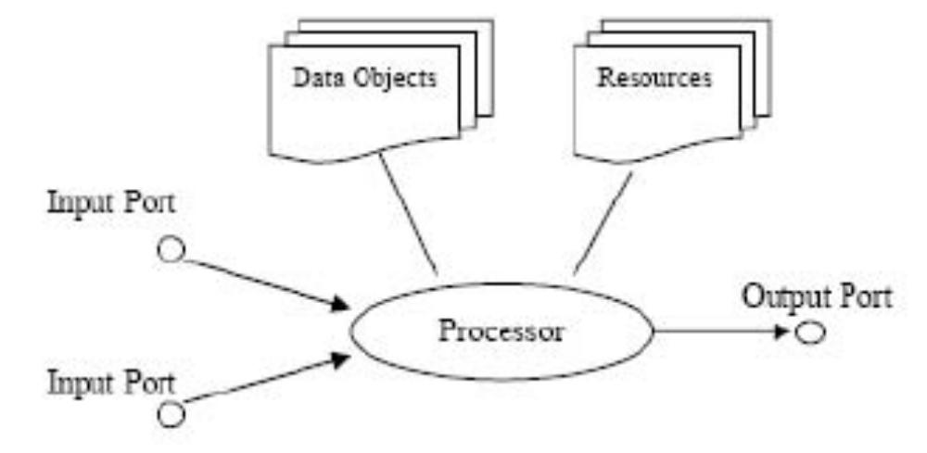
Component
Structure
  Ports – communication
  Acts like an agent
  Processor – processing

Slide 55
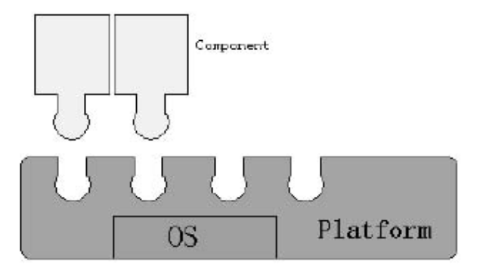
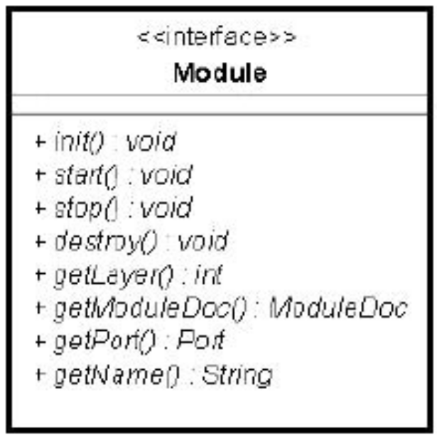
Component
Interface
  Need to communicate with platform
Functionality
  Embodied by processor

Slide 56
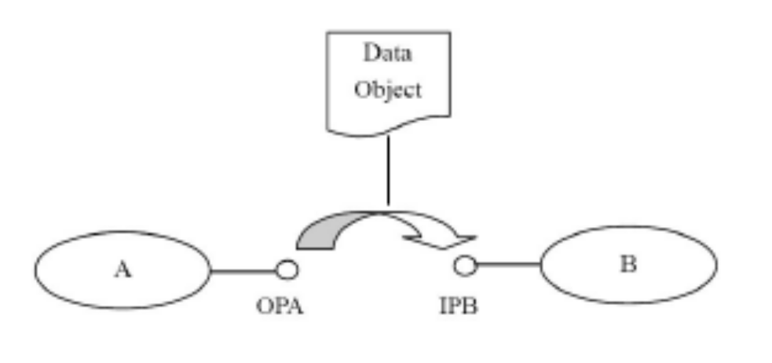
Communication Mechanism
Using ports
  output port → input port
Data being transferred has a life period
  Prevent component using the stale data
  Allow multiple, layered inputs
Port is extensible
  E.g. a port support networking communication

Slide 57
Principle for composition
Platform
  integrate the components into a whole
  manage the components
  A complete program by itself
Wire
  A communication cable for components
  Can be dynamically changed

Slide 58
XML-Driven Model
Using XML to describe how to integrate the components into a function-complete application
Modules
Wires

Slide 59
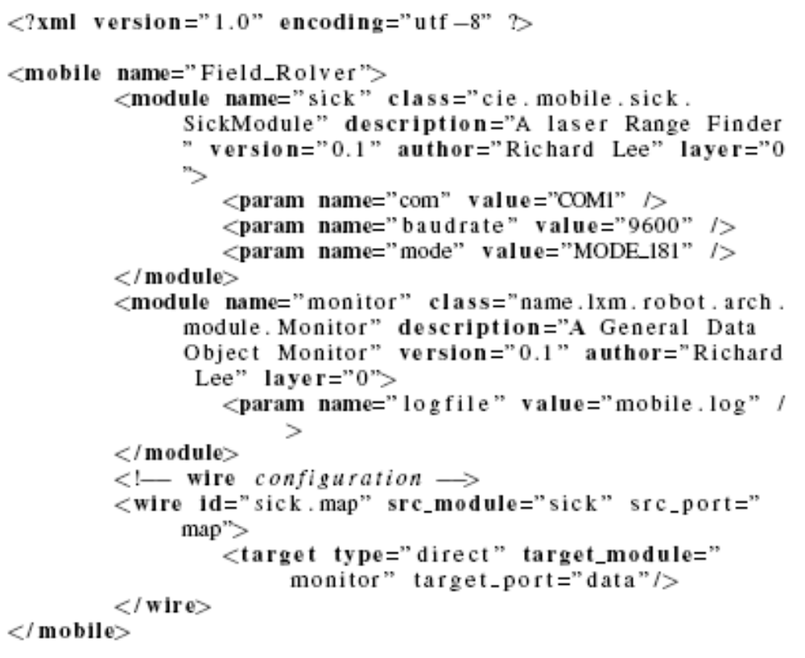
Example XML file

Slide 60
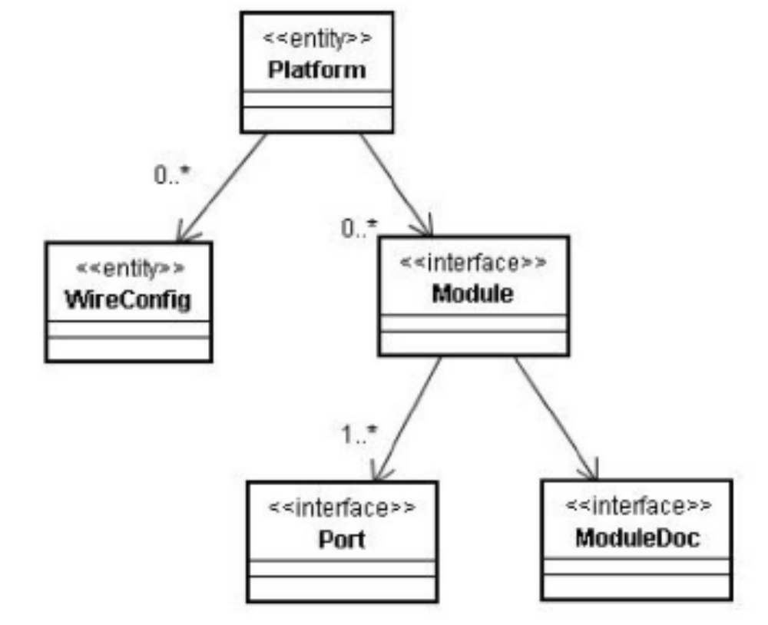
Implementation of the framework

Slide 61
Some experiments we have done
Tele-robotic application
Autonomous mobile robot

Slide 62
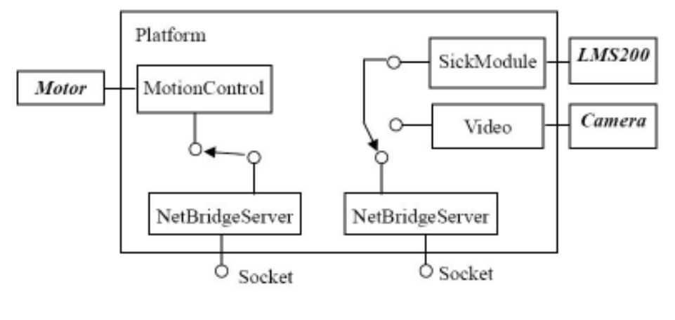
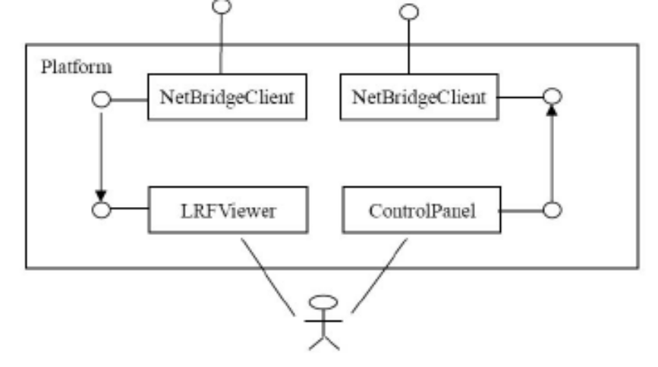
Tele-robotic application

Slide 63
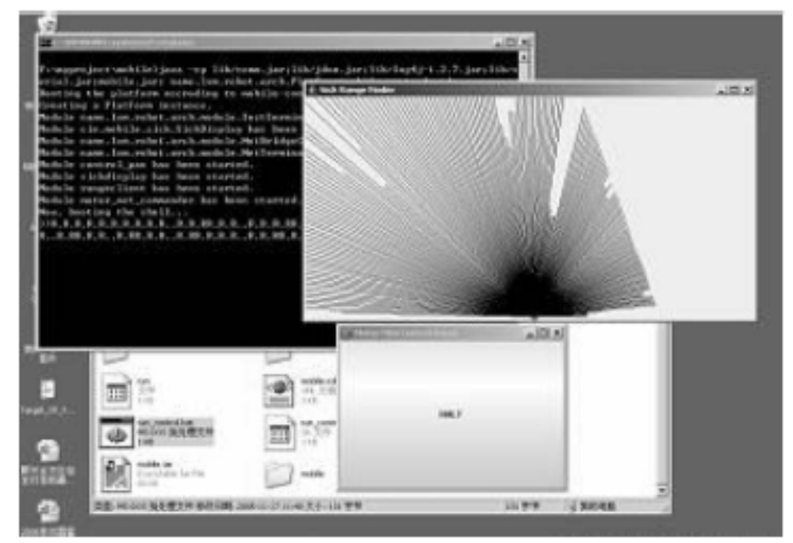
Tele-robotic application

Slide 64
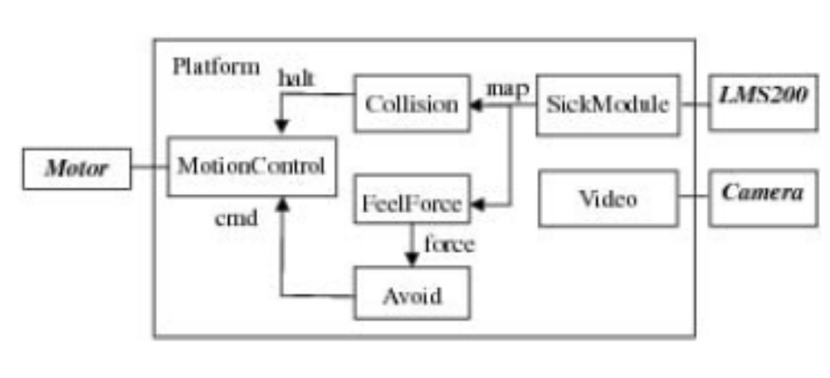
Autonomous application

Slide 65
Autonomous Application
A demo video can be download at
  http://www.lxm.name/research/robotics/framework_xml.html
Together with the source code in java

Slide 66
Summarize
A framework can really minimize the complexity for building complex software, and lower the risk of failure in building such system
No longer need to start the whole project from scratch, since we have already had such a good base.

Slide 67
总结
本报告指出了控制软件设计中的常见的几个问题，一些是全局性的问题，例如框架和建模；另一些是实现的具体细节，例如多线程和同步异步。
每个部分进行的介绍并不全面，也不深入
控制软件设计和其他通用软件的设计没有太大的区别，可以互相借鉴。
控制软件中设计模式(Design patterns)很重要

