Slide 1
1 Introduction
Dr. Xiaoming Li (lxm@lxm.name)

Slide 2
Outline
Why learn this course
Core ideas about this course
Relation with the discipline
Covering the whole contents
How the course be conducted
Evaluation method
About the lecturer
Questions/Discussions

Slide 3
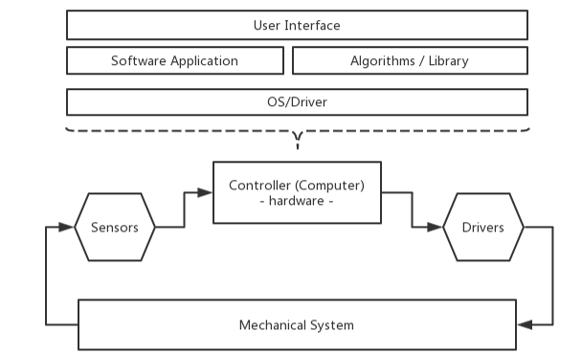
1-Why this course (1)
Typical Mechatronic System

Slide 4
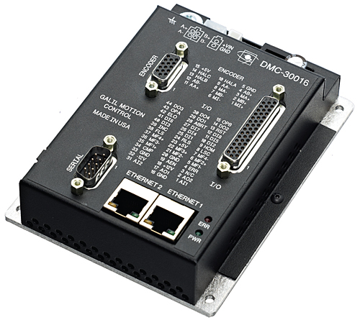
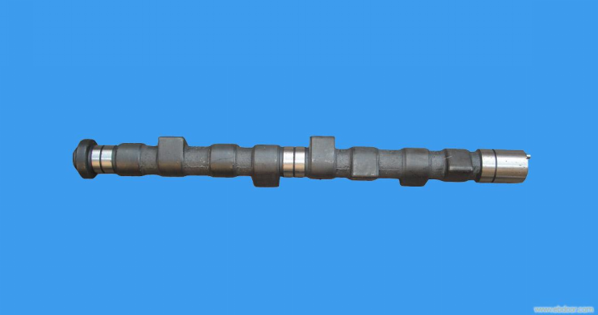
1-Why this course (2)
Software is an essential part of a Mechatronic System
Mechanical System is changing from hardware driven to software driven

Slide 5
1-Why this course (3)
Complication of mechatronic system
improved automation and intelligence: Robotics, Machine Vision
networked system: BUS, ethernet, internet
IoT and Big Data
challenge of environment: space, deep sea, disaster area

Slide 6

source: http://offshore-systems.no/business-areas/rig-platform-solutions/

Slide 7

source: http://www.northcountrypublicradio.org/news/npr/366841324/in-disaster-city-learning-to-use-robots-to-face-ebola

Slide 8
1-Why this course (4)
Increase of the complexity of software
increasing functions and features required by customers
required by the complexity of hardware / system
More flavors added to the software applications, such as AI, big data, etc
knowledge should be prepared
Flexibility, extendability and simplicity
extreme programming and continuous integration

Slide 9
1-Why this course (5)
You should know when this course has finished:
have experience and knowledge to develope software applications on MCU, embedded, PC-based or Server platforms;
know how to use, design, implement software framworks / architectures;
know basic ideas about software engineering, including tool-chains, development tools, environments, and etc.
have ability to develope AI (deep learning) based softwares

Slide 10
2 Main contents
Arduino hardware and learn to design a framework for MCU-based system
Raspberry Pi hardware and learn to design server-side applications
learn to design desktop applications
Software development methods and tools.

Slide 11
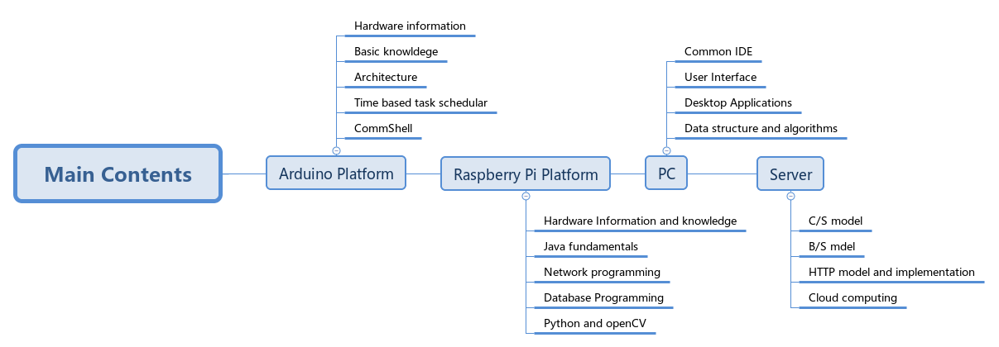

Slide 12
3 What's the next
lectures
knowledge about software engieering
knowledge about mechatronical system
hands on skills and experiences on software development
class project
DO IT YOURSELF on experiments discussed in the classroom
MAKE YOUR OWN software application based on specific mechatronic system

Slide 13
4 Evaluation method
Class paticipation: 20%
Class project: 40%
Examinition: 40%

Slide 14
5 About the lecturer
contact:
Email: origin@foxmail.com/lxm@lxm.name
Office hours: Thur 15:30 - 17:00
Office: 23-218
Background:
Ph.D 2004 Zhejiang University, B.D 1998 XI'an Jiaotong University
2011-2012: Texas A&M University, Computer Science and Engineering Dept
2015-2016: University of Texas, Arlington. CSE.
Research interests: IoT, Mechatronic Software Engieering, Computer Vision
Website: http://www.lxm.name

Slide 15

6 Questions?

Slide 16
7 Discussions
past sotfware design experience
favorite programming language
how computers interact with machines
knowledge about OS
role of smart phone today
user-interface
mobile computing vs server computing

