Slide 1
Chapter 2 - Preface
Dr. Xiaoming Li (lxm@lxm.name)

Slide 2
Outline
Basics of the Software Engineering
Basics of Mechatronic System
Challenge of SE in Mechatronic System
Questions/Discussions

Slide 3
1 Software Engineering
What is software engieering?
Difference with programming
History of Sofware Engieering
Terminology in Software Engineering

Slide 4
What is Software Engineering
Software engineering is the application of engineering to the development of software in a systematic method.
"the systematic application of scientific and technological knowledge, methods, and experience to the design, implementation, testing, and documentation of software"—The Bureau of Labor Statistics—IEEE Systems and software engineering - Vocabulary
"The application of a systematic, disciplined, quantifiable approach to the development, operation, and maintenance of software"—IEEE Standard Glossary of Software Engineering Terminology
"an engineering discipline that is concerned with all aspects of software production"—Ian Sommerville
"the establishment and use of sound engineering principles in order to economically obtain software that is reliable and works efficiently on real machines"—Fritz Bauer

Slide 5
Difference between SE and Programming
SE : Systematic / Scientific ways to build software applications
Programming: Coding skills and language specific tasks
Software engineering is a team activity. Programming is primarily a solitary activity.
A software engineer is involved in the complete process. Programming is one aspect of software development.
A software engineer works on components with other engineers to build a system. A programmer writes a complete program.

Slide 6
History
origins
(1945-1965)
Software Crisis
(1965-1985)
No silver-bullet
(1985-1989)
Prominence of the Internet
(1990-1999)
Lightweight Methodologies
(2000-2015)
-Aspects
-Agile
-Experimenal
-Software Product lines

Slide 7
Terminology in SE A-Z
abstraction (抽象)
A view of an object that focuses on the information relevant to a particular purpose and ignores the remainder of the information
A description of something that omits some details that are not relevant to the purpose of the abstraction. It is the converse of refinement
The act or process of leaving out of consideration one or more properties of a complex object so as to attend to others.
adaptability (适配性，兼容性)
Adaptability concerns the alteration of a system to fit the needs of a user without necessarily changing it from one machine to another.

Slide 8
agile software development (敏捷软件开发)
According to Scott W. Ambler, respected authority in the agile methods community, agile software development is an iterative and incremental (evolutionary) approach to software development which is performed in a highly collaborative manner with "just enough" ceremony that produces high quality software which meets the changing needs of its stakeholders. Agile methods refer to a collection of "ligthweight" software development methodologies that are basically aimed at minimising risk and achieving customer satisfaction through a short feedback loop.

Slide 9
architecture (架构)
The organizational structure of a system or component
The fundamental organisation of a system embodied in its components, their relationships to each other, and to the environment, and the principles guiding its design and evolution.
The architecture of a software system is the structural and behavioural framework on which all other aspects of the system depend. It is the organisational structure of a software system including components, connections, constraints, and rationale.
A software system's architecture is the set of principal design decisions about the system. (Richard Taylor)

Slide 10
aspect (切面)
A modular unit designed to implement a (crosscutting) concern. In other words, an aspect provides a solution for abstracting code that would otherwise be spread throughout (i.e., cross-cut) the entire program. Aspects are composed of pointcuts and advices.
benchmark (基准)
(1) A standard against which measurements or comparisons can be made.
(2) A problem, procedure, or test that can be used to compare systems or components to each other or to a standard as in (1).
(3) A recovery file.
A benchmark is a set of tests used to compare the performance of alternative tools, methods, or techniques.
black-box reuse (黑盒复用)
A kind of reuse where a component is reused ìas isî (i.e. without changing anything to the component). Paul Bassett argues that this is not a kind of reuse, but simply a use of the component!

Slide 11
Capability Maturity Model (CMM) (成熟度)
Defined by the Software Engineering Institute (SEI) at Carnegie Mellon University. Describes the level of capability and maturity a software team could aim for and could be assessed against.
case study
A case study is a research technique where you identify key factors that may affect the outcome of an activity and then document the activity: its inputs, constraints, resources, and outputs. Case studies usually look at a typical project, rather than trying to capture information about all possible cases; these can be thought of a "research in the typical". Formal experiments, case studies and surveys are three key components of empirical investigation in software engineering. [Fenton&Pfleeger 1996]

Slide 12
compatibility (兼容性)
The ease of combining software elements with others [Meyer 1997]
The ability of two or more systems or components to perform their required functions while sharing the same hardware or software environment [IEEE Std 610.12-1990]
The ability of two or more systems or components to exchange information [IEEE Std 610.12-1990]
complexity (复杂性)
The degree to which a system or component has a design and implementation that is difficult to understand and verify [IEEE Std 610.12-1990]
That property of a language expression which makes it difficult to formulate its overall behaviour, even when given almost complete information about its atomic components and their inter-relations. [Edmonds 1997]

Slide 13
component (组件)
A component is a high-quality workproduct, designed, documented, and packaged to be reusable. A component is cohesive and has a stable interface [Jacobson et al. 1997].
A component is a physical and replaceable part of a system that conforms to and provides the realisation of a set of interfaces (Grady Booch).
A component is a self-contained piece of software with clearly-defined interfaces and explicitly-declared context dependencies [Stahl&Volter 2006].
Mary Shaw and David Garlan define software components as "the loci of computation and state. Each component has an interface specification that defines its properties, which include the signatures and functionality of its resources together with global relations, performance properties, and so on. (...)''

Slide 14
domain (领域)
A problem area. Typically, many application programs exist to solve the problems in a single domain. The following prerequisites indicate the presence of a domain: the existence of comprehensive relationships among objects in the domain, a community interested in solutions to the problems in the domain, a recognition that software solutions are appropriate to the problems in the domain, and a store of knowledge or collected wisdom to address the problems in the domain. Once recognized, a domain can be characterized by its vocabulary, common assumptions, architectural approach, and literature. [Arango Prieto-Diaz 1991]
An area of knowledge or activity characterized by a set of concepts and terminology understood by practitioners in that area [Booch et al 1990]

Slide 15
ease of use (易用性)
The ease with which people of various backgrounds and qualifications can learn to use software products and apply them to solve problems. It also covers the ease of installation, operation and monitoring.
efficiency (效率)
The ability of a software system to place as few demands as possible on hardware resources, such as processor time, space occupied in internal and external memories, bandwidth used in communication devices [Meyer 1997]
The degree to which a system or component performs its designated functions with minimum consumption of resources. In case of time resources we speak of execution efficiency. In case of available storage resources we speak of storage efficiency [IEEE Std 610.12-1990]

Slide 16
evolutionary software development
This is basically the same as iterative incremental software development, but the term stresses the fact that a software system is never completely finished, and that it continues to evolve after it has been delivered.
extendability (扩展性)
The ease with which a system or component can be modified to increase its storage or functional capacity [IEEE Std 610.12-1990]
The ease of adapting software products to changes of specification [Meyer1997].

Slide 17
flexibility (灵活性)
The ease with which a system or component can be modified for use in applications or environments other than those for which it was specifically designed [IEEE Std 610.12-1990]
framework (框架)
A framework is a reusable design of all or part of a software system described by a set of abstract classes and the way instances of those classes collaborate[Roberts&Johnson 1996].
A framework is a micro-architecture that provides an extensible template for applications within a specific domain [OMG 1997].
A framework is anything that can be adapted or extended via systematic extension or configuration [Stahl&Volter 2006].

Slide 18
implementation (实现)
The phase in the software life-cycle where the actual software is implemented. The result of this phase consists of source code, together with documentation to make the code more readable.
iterative incremental software development
The process of developing a software system in small steps (increments) by iterating a number of times over the different software phases.
maintainability (可维护性)
The ease with which a software system or component can be modified to correct faults, improve performance or other attributes, or adapt to a changed environment [IEEE Std 610.12-1990]

Slide 19
model (模型)
A model is a simplified representation of a system or phenomenon with any hypotheses required to describe the system or explain the phenomenon, often mathematically. It is an abstraction of reality emphasizing those aspects that are of interest to someone [ISERN]
A model is a coherent set of formal elements describing something (e.g., a system, bank, phone or a train) built for some purpose that is amenable to a particular form of analysis, such as: communication of ideas between people and machines, completeness checking, race condition analysis, test case generation, viability in terms of indicators such as cost and estimation, standards, transformation into an implementation. [MCF2003]
Modeling, in the broadest sense, is the cost-effective use of something in place of something else for some cognitive purpose. It allows us to use something that is simpler, safer, or cheaper than reality instead of reality for some purpose.
A model represents reality for the given purpose; the model is an abstraction of reality in the sense that it cannot represent all aspects or reality. This allows us to deal with the world in a simplified manner, avoiding the complexity, danger and irreversibility of reality.

Slide 20
object-oriented design (面向对象设计)
A software development technique in which a system or component is expressed in terms of objects and connections between those objects [IEEE Std 610.12-1990]
object-oriented language (面向对象语言)
A programming language that allows the user to express a program in terms of objects and messages between those objects [IEEE Std 610.12-1990]
pattern (模式)
A standard (object-oriented) design for addressing frequently occuring problems, described in a standard way [Gamma et al. 1994]

Slide 21
platform (平台)
A set of subsystems and technologies that provide a coherent set of functionality through interfaces and specified usage patterns, which any application supported by that platform can use without concern for the details of how the functionality provided by the platform is implemented [Kleppe et al. 2003]
portability (可移植性)
The ease of transferring software products to various hardware and software environments [Meyer 1997]
Portability is the property of a system which permits it to be mapped from one environment to a different environment[NATO 1970]

Slide 22
refactoring (重构)
[noun]A change made to the internal structure of software to make it easier to understand and cheaper to modify without changing its observable behaviour.
[verb]To restructure software by applying a series of refactorings without changing its observable behaviour. [Fowler 1999]
reliability (可靠性)
Software reliability is the probability of a failure-free operation of a computer program in a specified environment for a specified time [Musa et al. 1987].

Slide 23
requirement (需求)
a statement about what the proposed system will do that all stakeholders agree must be made true in order for the customer's problem to be adequately solved [LehtbridgeLaganiere2001]
reusability (可重用性)
The ability of software elements to serve for the construction of many different applications [Meyer 1997]
The degree to which a software module or other work product can be used in more than one computer program or software system [IEEE Std 610.12-1990]

Slide 24
reverse engineering (逆向工程)
The process of analysing an existing system to identify its components and their interrelationships and create representations of the system in another form or at a higher level of abstraction. Reverse engineering is usually undertaken in order to redesign the system for better maintainability or to produce a copy of a system without access to the design from which it was originally produced. For example, one might take the executable code of a computer program, run it to study how it behaved with different input and then attempt to write a program oneself which behaved identially (or better). An integrated circuit might also be reverse engineered by an unscrupulous company wishing to make unlicensed copies of a popular chip. (1995-10-06)
The process of extracting software system information (including documentation) from source code [IEEE Std 1219-1998]

Slide 25
software life-cycle
The phases a software product goes through between when it is conceived and when it is no longer available for use.
The software life-cycle typically includes the following: requirements analysis, design, construction, testing (validation), installation, operation, maintenance, and retirement.
The development process tends to run iteratively through these phases rather than linearly; several models (spiral, waterfall, etc.) have been proposed to describe this process.
Other processes associated with a software product are: quality assurance, marketing, sales and support.(1996-12-27)

Slide 26
wrapper (包装器)
A software component that encapsulates a system component (a procedure, a program, a file, an API) in order to transform its interface with its environment. For instance, a wrapper associated with a legacy program can give the latter an object-oriented interface.
In a database setting, a data wrapper is a software component that encapsulates a database or a set of files in order to change its model and the API through which the data can be manipulated. For example, a data wrapper built on top of a standard file can allow application programs to access the contents of the file as if it were a relational table or a collection of XML documents.

Slide 27
2 Mechatronic System
What is mechatronic system?
Typical structure of Mechatronic System

Slide 28
What is Mechatronic System
Mechatronics is an interdisciplinary area of engineering that combines mechanical and electrical engineering and computer science. A typical mechatronic system picks up signals from the environment, processes them to generate output signals, transforming them for example into forces, motions and actions.
It is the extension and the completion of mechanical systems with sensors and microcomputers which is the most important aspect. The fact that such a system picks up changes in its environment by sensors, and reacts to their signals using the appropriate information processing, makes it different from conventional machines.

Slide 29
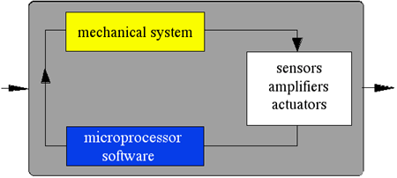
What is Mechatronic System

Slide 30
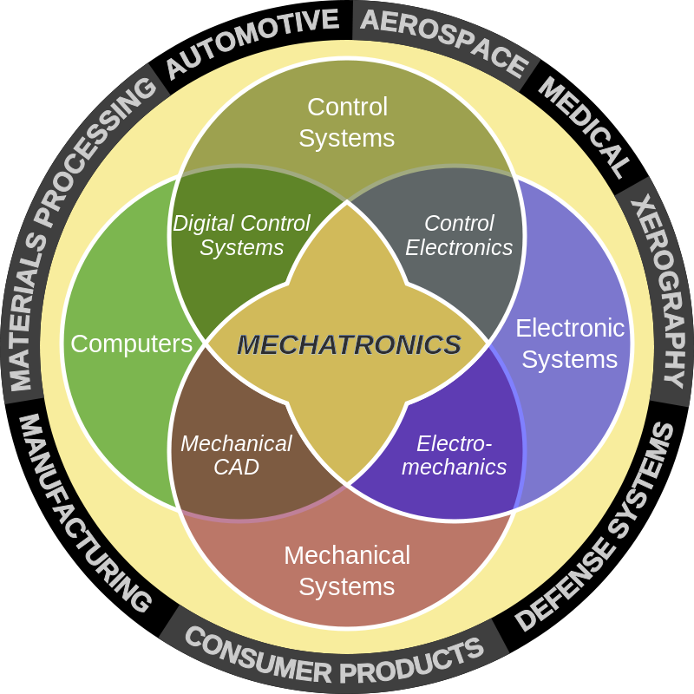

Slide 31
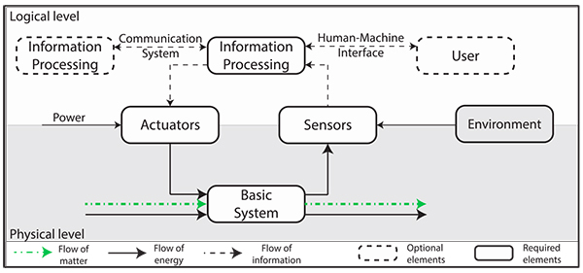
Typical Structure of Mechatronic System

Slide 32
Challenge of SE in Mechatronics
Multiple platforms
Hardware
Computing
Domain expertise
Industry expert
Environment
Reliability
Real-time ability
Robustness

Slide 33
Conclusion
Basic knowledge of Software Engineering
Challenge of Software Engineering in Mechatronic Systems
Discussions

