Slide 1
Arduino Basics
Dr. Xiaoming Li
(lxm@lxm.name)

Slide 2
Outline
Know the board - facts
Arduino workflow
Software architecture for Arduino
Learn Arduino programming skills by examples

Slide 3
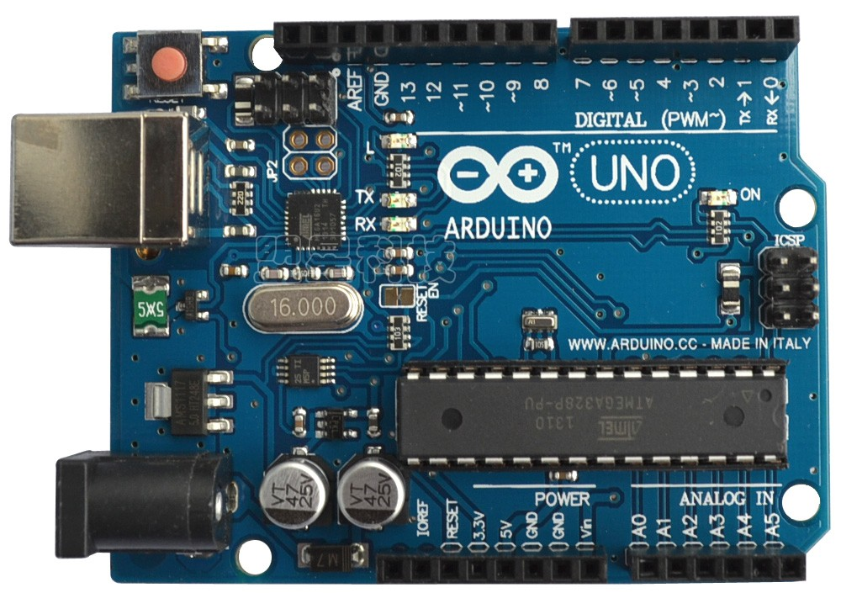
Arduino the board
Credit card size
Full function
MCU-based
Easy to learn
Widely used in non-industrial fields, such as art, education, prototyping, etc.

Slide 4
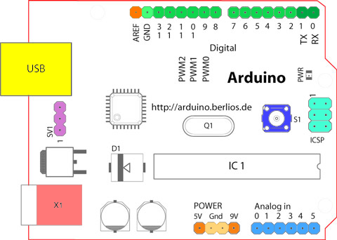
About the board
14 Digital I/O, programable
6 Analog Input
6 PWM output
1 UART
1 Reset button
1 USB, 1 Power jack
Onboard 5.5/3.3V
Onboard 4 LEDs
Microcontoller: ATmega328p

Slide 5
How to use Arduino
Arduino is a computer
Without Operation System
Can only execute binary codes
How to program
How to execute
1 Coding/Compiling
Host PC
4 Interact through Serial Port
Arduino
3 Running the program
2 Download program to Arduino

Slide 6
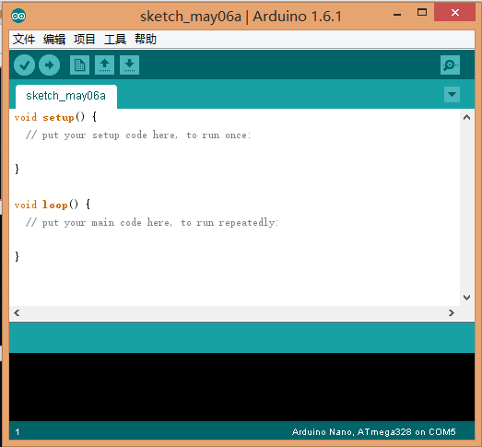
Arduino IDE
Download the installation file from http://www.arduino.cc
After installation, run the IDE
Configure the connection by using the menu “tools” --> “Serial port”
Select the board type by using “tools” --> “board”

Slide 7
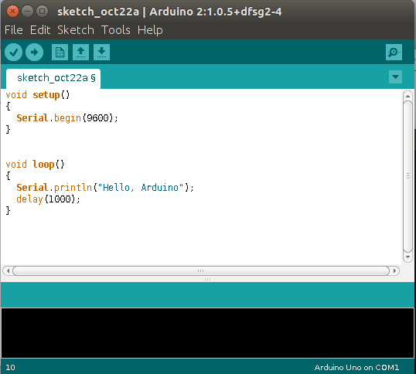
Arduino Workflow Demo
Click a to compile the source code
Click è to download binary code to the board
Click  to view the output

Slide 8
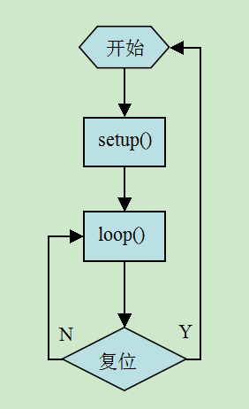
Introduce the software architecture
Arduino bootloader
Communicate with PC to recieve the binary
Run binary
setup()
Execute only once
Do some initialization / Configuration
loop()
Called repeatly and infinitely
Start
Reset

Slide 9
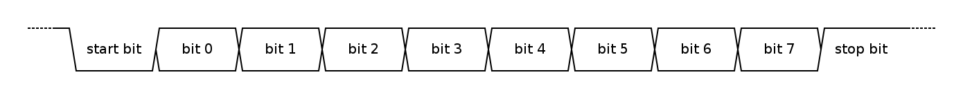
Learn Arduino programming skills by examples
Serial Communication
Serial.begin(9600);
Serial.println(“some text”);
Serial.print(“some text”);
Serial.println();
Serial.print(somevar);

Slide 10
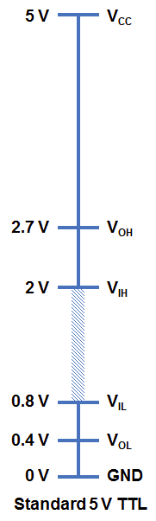
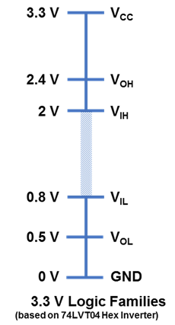
Digital I/O
pinMode()
INPUT/OUTPUT
digitalRead()
get the pin logical voltage value: HIGH/LOW
digitalWrite()
set the pin logical voltage value: HIGH/LOW
Logic Level: 0 / 1
TTL: 0~5V
CMOS: 0 ~3.3V

Slide 11
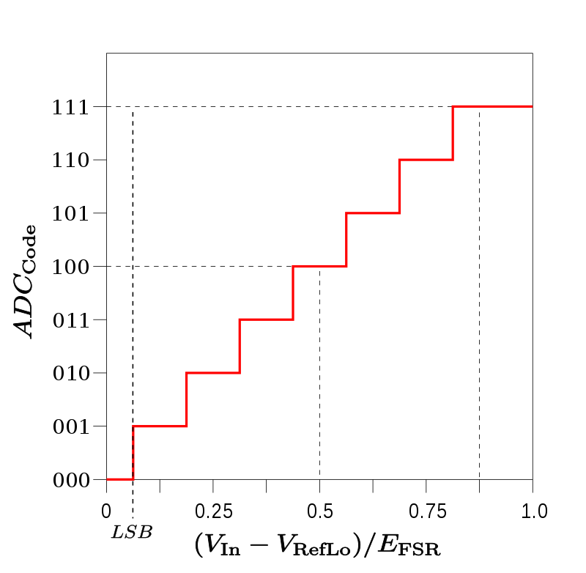
Analog Input / Output
analogRead()
convert voltage to binary value
Analog-Digit-Convert (ADC)
analogWrite()
convert binary value to voltage
Arduino support only PWM

Slide 12
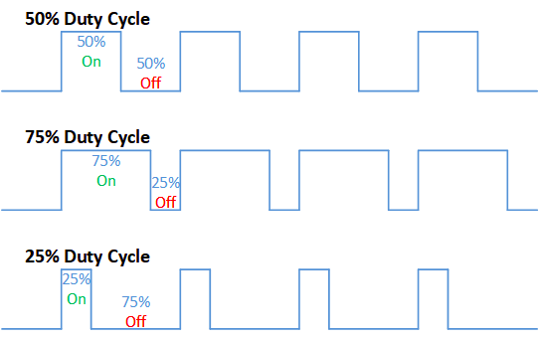
What's PWM
The average value of voltage (and current) fed to the load is controlled by turning the switch between supply and load on and off at a fast rate. The longer the switch is on compared to the off periods, the higher the total power supplied to the load

Slide 13
Time based function
tone()/noTone()
Generate specified frequency square wave
pulseIn()
Evalue the time elapsed before the pulse (HIGH or LOW)
millis()
micros()
delay()
delayMicroseconds()

Slide 14
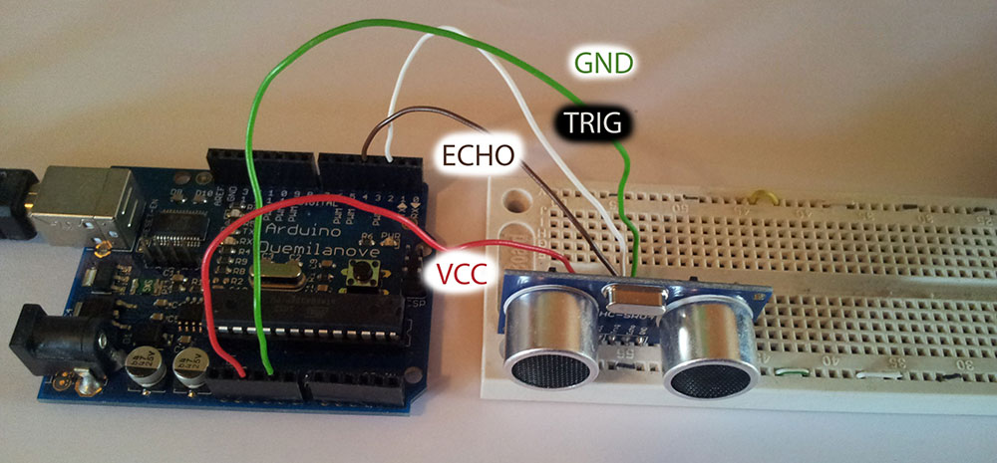
Demo Program
Ultrasonic distance measurement

Slide 15
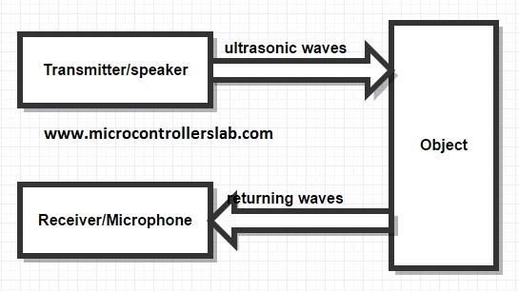
Principle
Distance = 344 x time / 2 meter

Slide 16
Practice
Define Configuration
int sinputPin = 8; //echo pin
int soutputPin = 7; //trig pin
int wait = 1000; //cycle
Setup
pinMode(sinputPin, INPUT);
pinMode(soutputPin, OUTPUT);
Serial.begin(9600);

Slide 17
Loop
digitalWrite(soutputPin, LOW);
delay(100);
digitalWrite(soutputPin, HIGH);
delayMicroseconds(15);
digitalWrite(soutputPin, LOW);
unsigned int time = pulseIn(sinputPin, HIGH);
double distance = time *0.172;
Serial.println(distance/1000.0);
delay(wait);

Slide 18

6 Questions?

