Slide 1
Catalog Nagios
Field Catalog Monitoring With Nagios

Slide 2


Monitoring the Field Catalog
Monitor all data is impossible
Handle ingest problems
Field data quality and health
Multiple plugins to monitor field data
Highly configurable

Slide 3
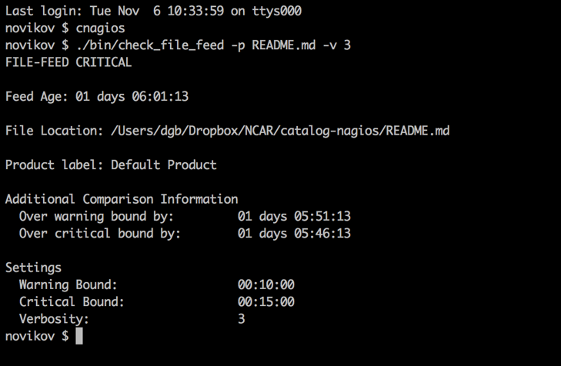
Features
General Monitoring Services
Monitoring Incoming File Streams
Checking Whole Product Datasets
YAML Configuration

Slide 4
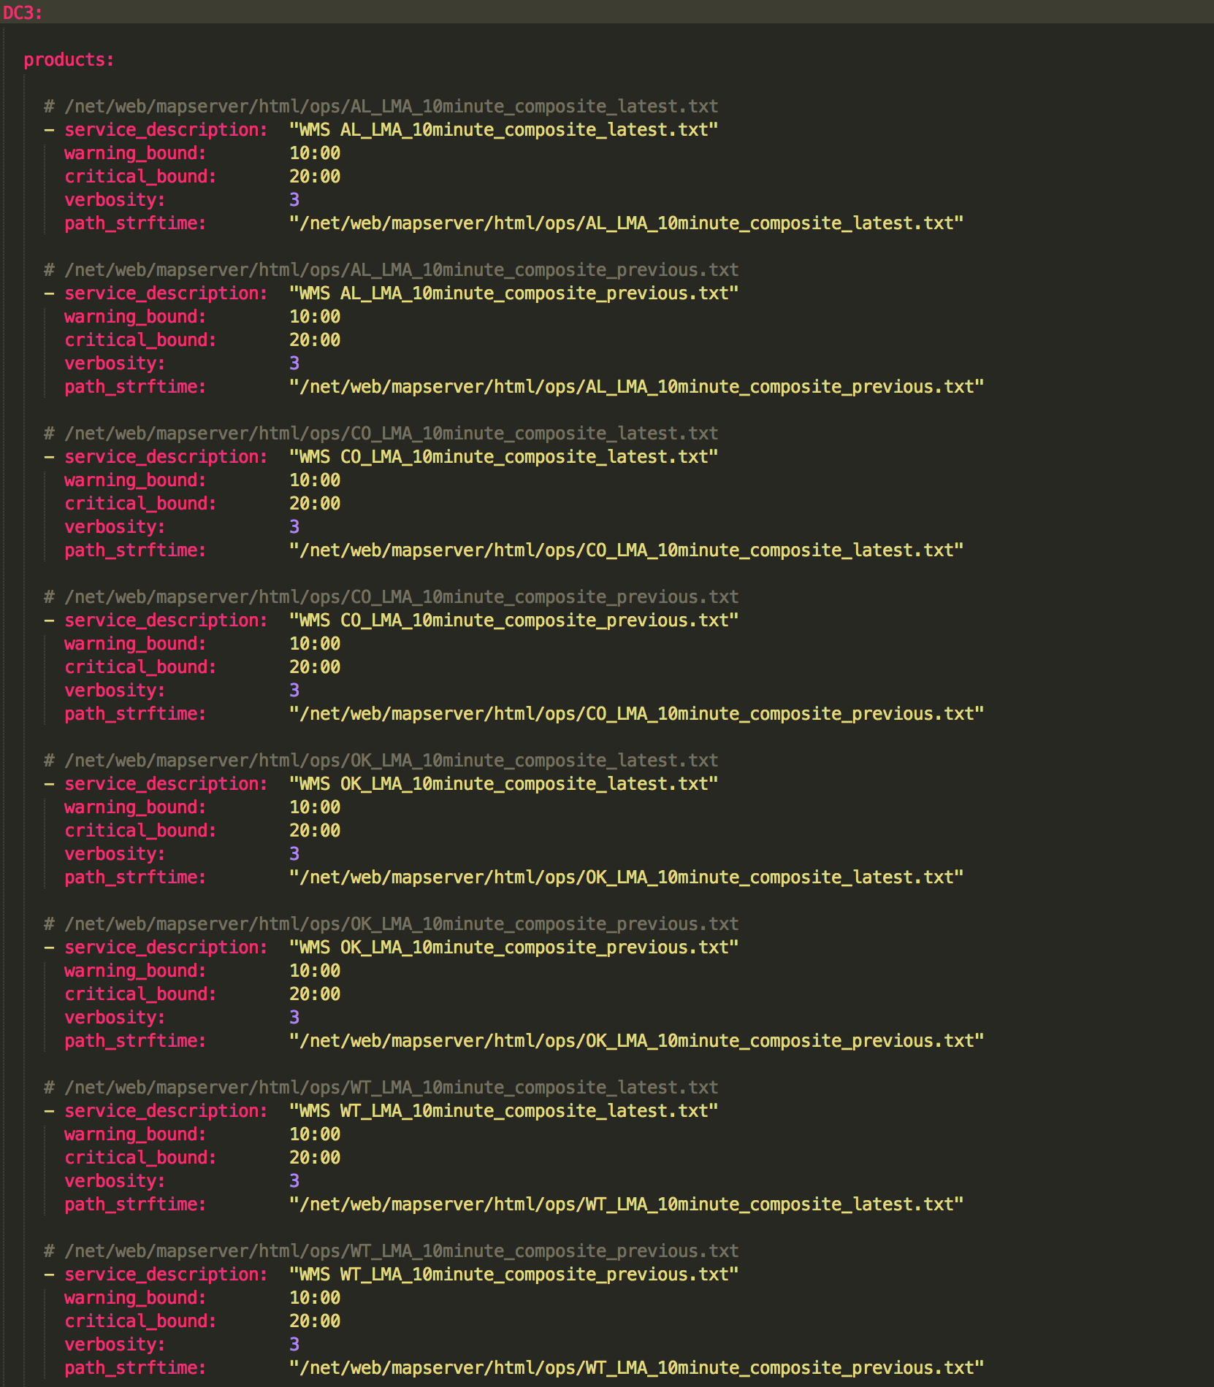

Slide 5
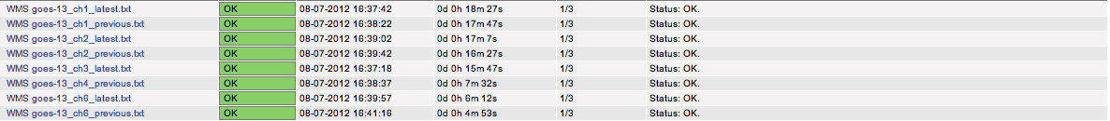
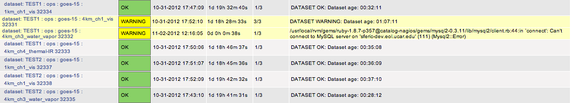

Slide 6
Implementation
Ruby 1.8.7
Rails 3.2.8
Nagios 3.3.1
Zith9 Integration

Slide 7

Challenges

Slide 8
Acknowledgments

