Slide 1
March 23, 2023
Web
Unleashing the Power of Web Analytics: Insights That Will Keep You Ahead of the Curve
Analytics
Presentation
ORINAME AGBI
22139986

Slide 2
March 23, 2023
1
Introduction
Today's Agenda
2
Twitter Analysis
3
Graph Analysis
4
Topic Modelling Analysis
4
Libraries Used

Slide 3

March 23, 2023
Are you ready?
Let's Begin!

Slide 4
Visualization
March 23, 2023
Preprocessing
Analysis
Twitter Data Exploratory Data Analysis Process
Collect data from using Snscrape Python
Analyze the data to identify trends and insights that are relevant
Use visualization tools such as matplotlib or seaborn to create visualizations that communicate the insights derived from the analysis
Clean the data to drop NaN, None and Irrelevant rows and Columns
Use Python libraries like pandas for statistical analysis to identify patterns and relationships within the data, tweeting patterns, geolocation tweeting pattern, top relevant tweets etc
Transform the data into a format that is suitable for analysis, such as converting timestamps to date-time format, split the coordinates column into Longitude and Latitude
Create charts, graphs, or maps to visually represent the patterns and trends within the data
Use visualizations to tell a story about the data

Slide 5
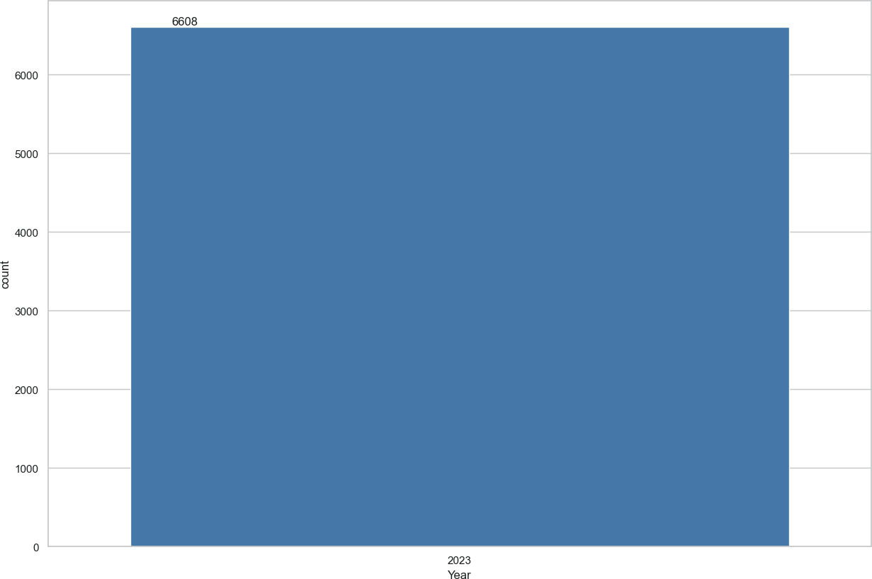
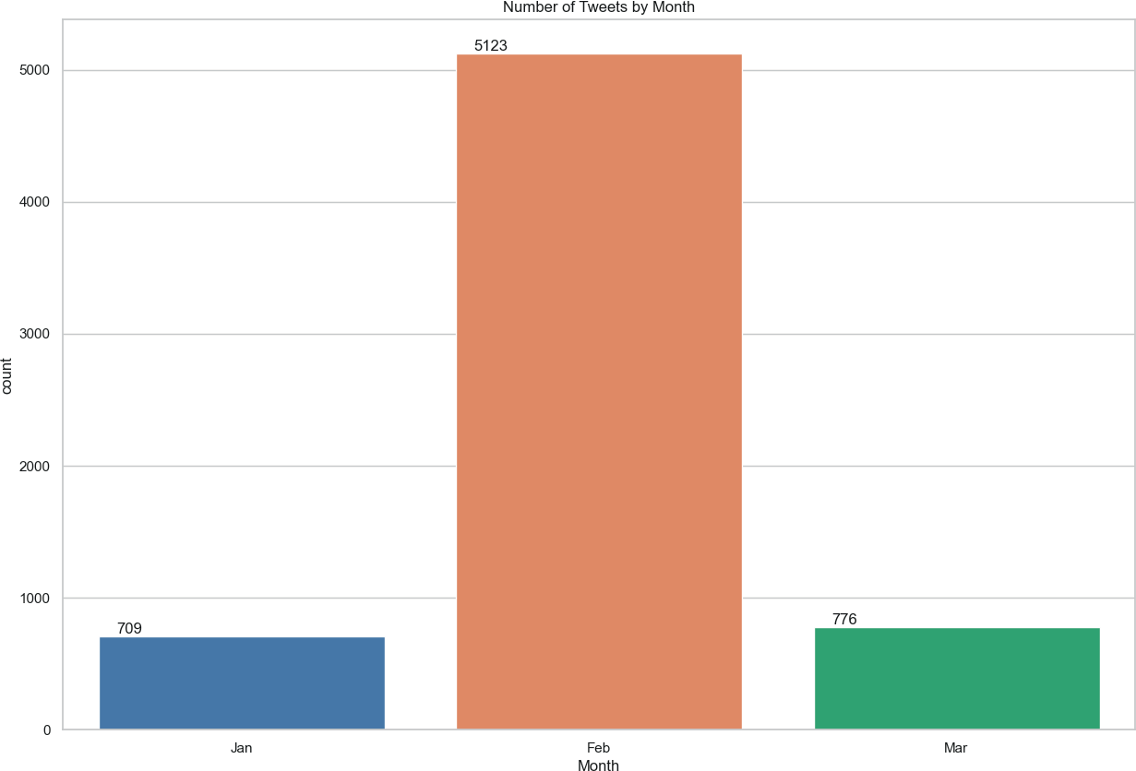
Visualizing Twitter Data (INEC)
June 1, 2021
Total Tweets
Tweets by Month

Slide 6
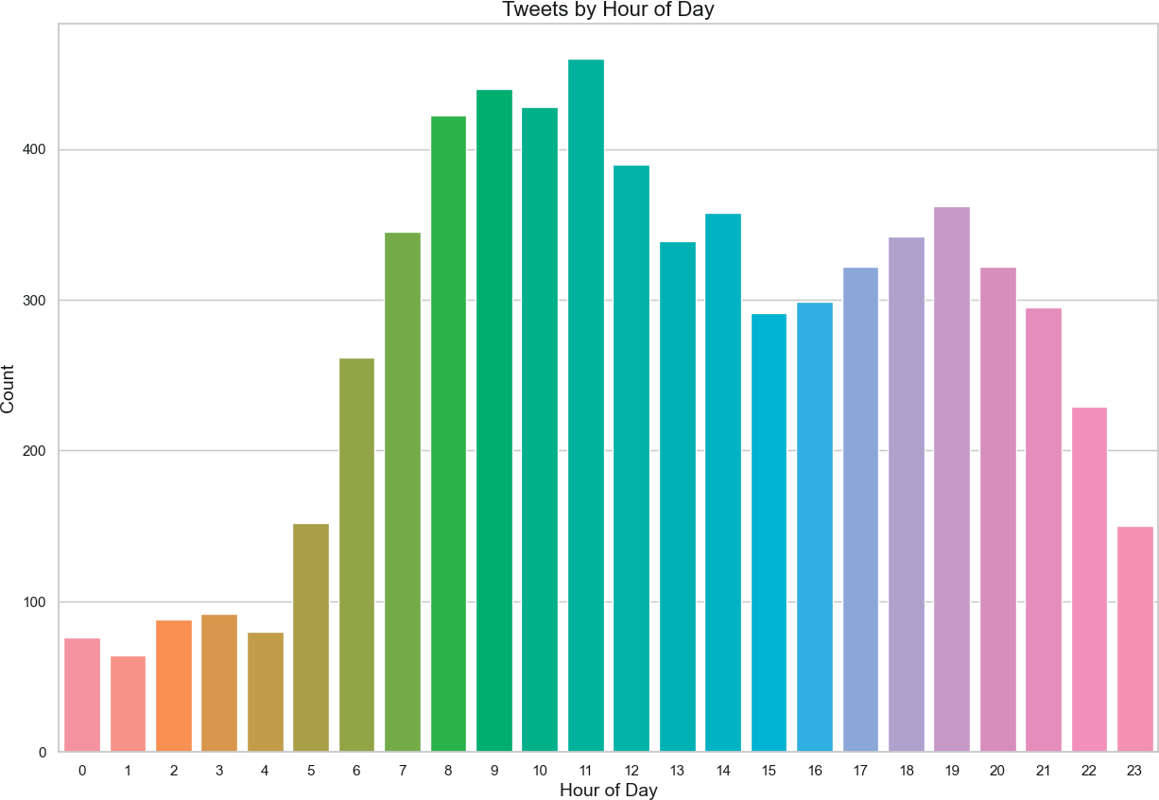
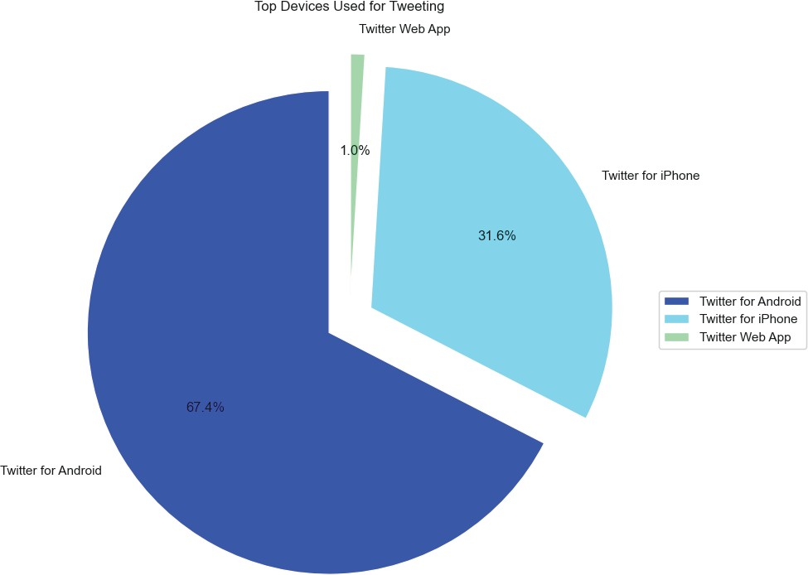
Visualizing Twitter Data (INEC)
March 23, 2023
Active Hours
Top Devices

Slide 7
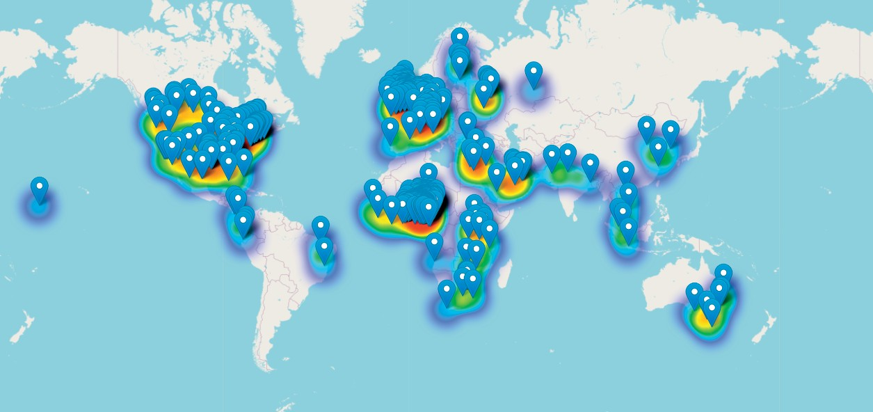
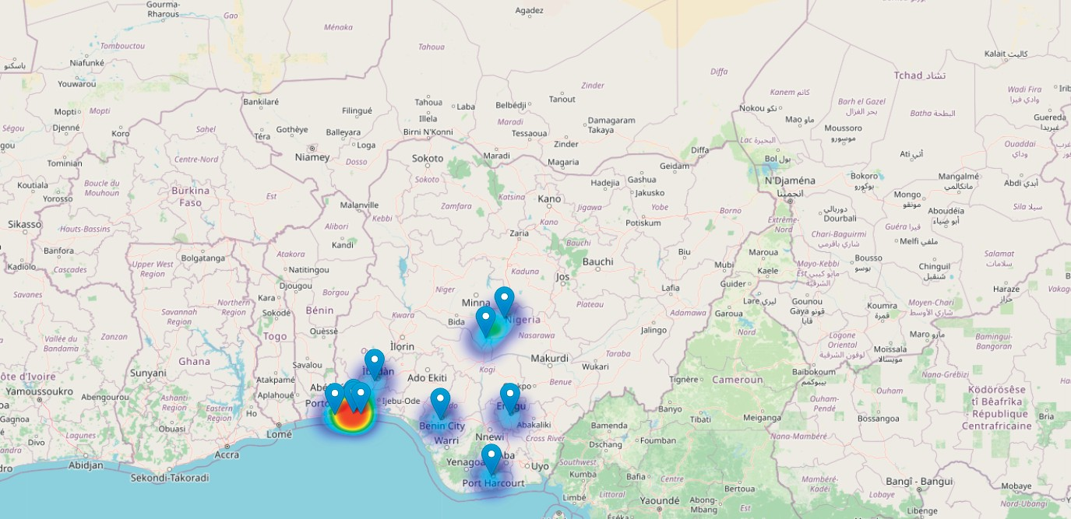
Visualizing Twitter Data (INEC)
March 23, 2023
Heat Map
Top Ten Location

Slide 8
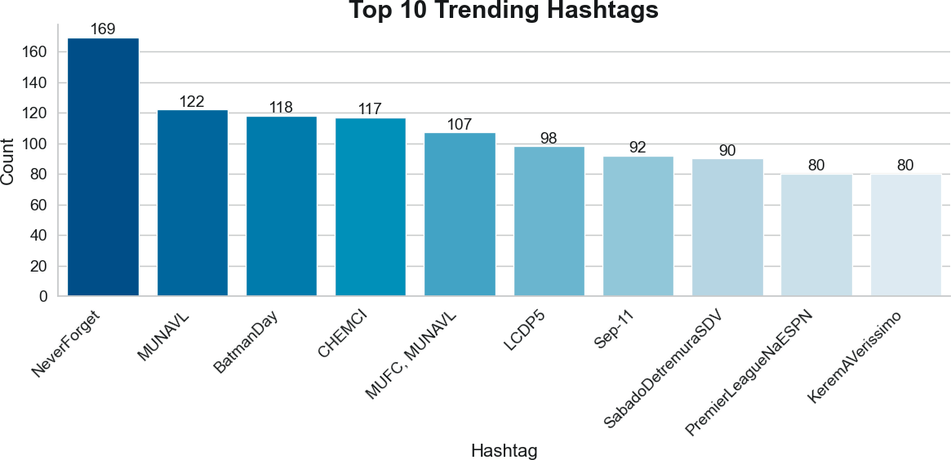
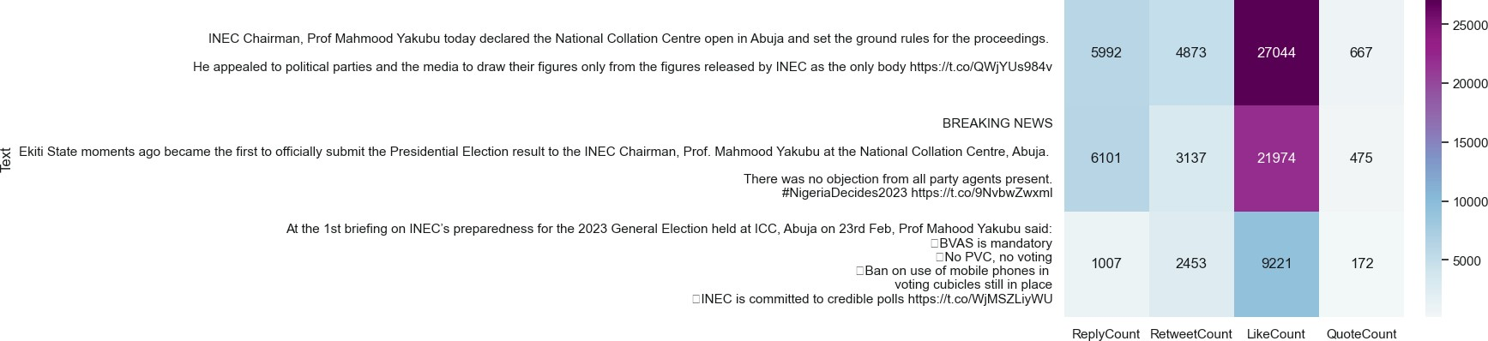
Visualizing Twitter Data (INEC)
March 23, 2023
Most liked Tweets
Top Ten Trending Hashtags

Slide 9
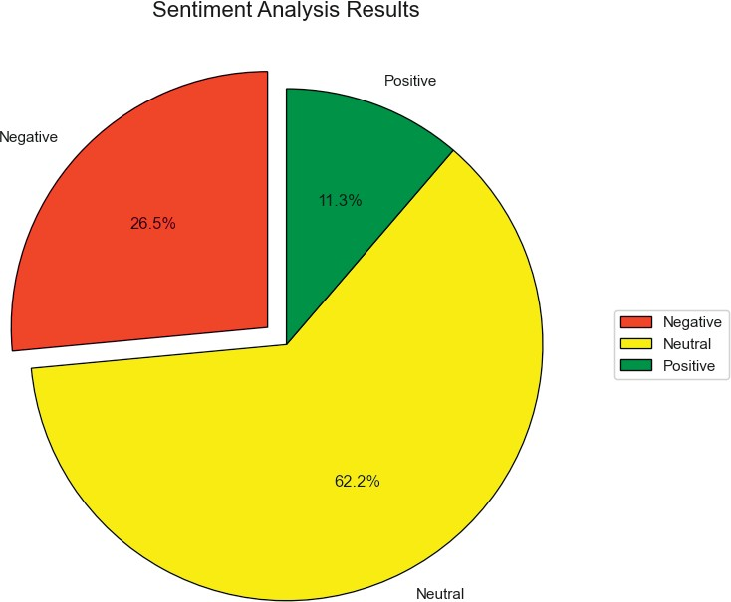
Visualizing Twitter Data (INEC)
March 23, 2023
Sentiment Analysis

Slide 10
Analysis
March 23, 2023
Data Processing
Visualization
Graph Analysis Process of Enron Email
Data collection: The first step is to obtain the Enron email dataset. This dataset is available from multiple sources, such as Network Repository.
Graph construction: After preprocessing the data, the next step is to construct a graph using the email addresses as nodes and the emails exchanged between them as edges.
After feature extraction, the graph can be analyzed to answer specific research questions. For example, the graph can be analyzed to identify the key players or communities within Enron, detect anomalies or suspicious behavior, or study the spread of information through the email network.
Feature extraction: extract relevant features from the graph. These features are centrality measures, such as betweenness or eigenvector centrality, clustering coefficients, degree distributions and community structures.

Slide 11
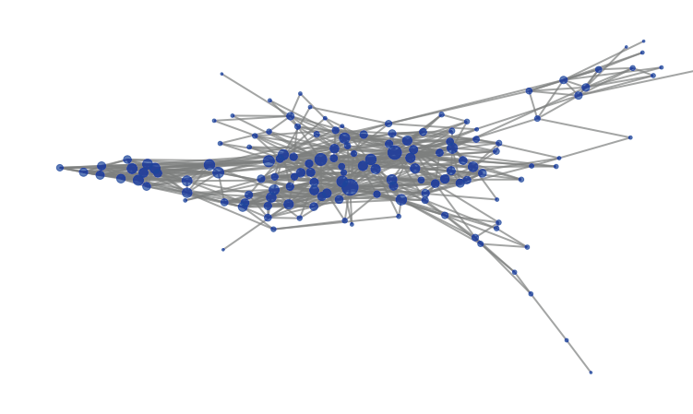
Enron Email - Graph Analytics
March 23, 2023
Nodes
143
Edges
623
Average Degree
8

Slide 12
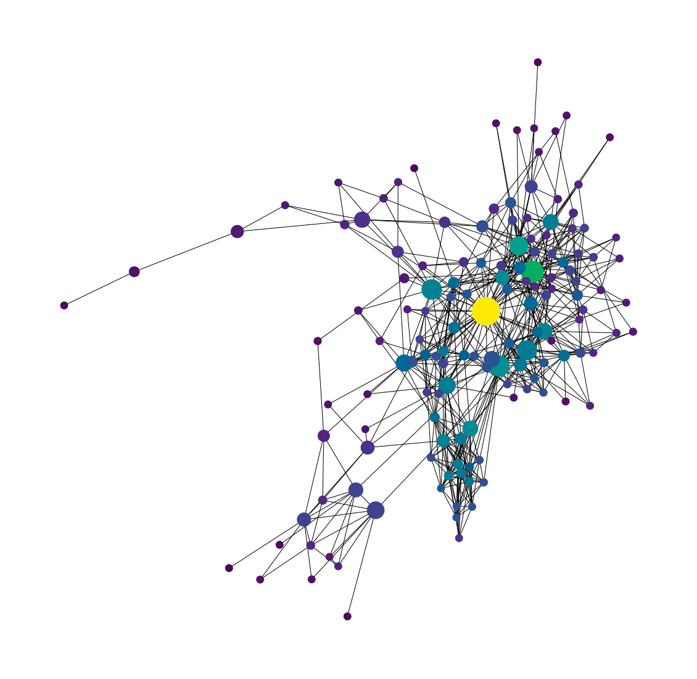
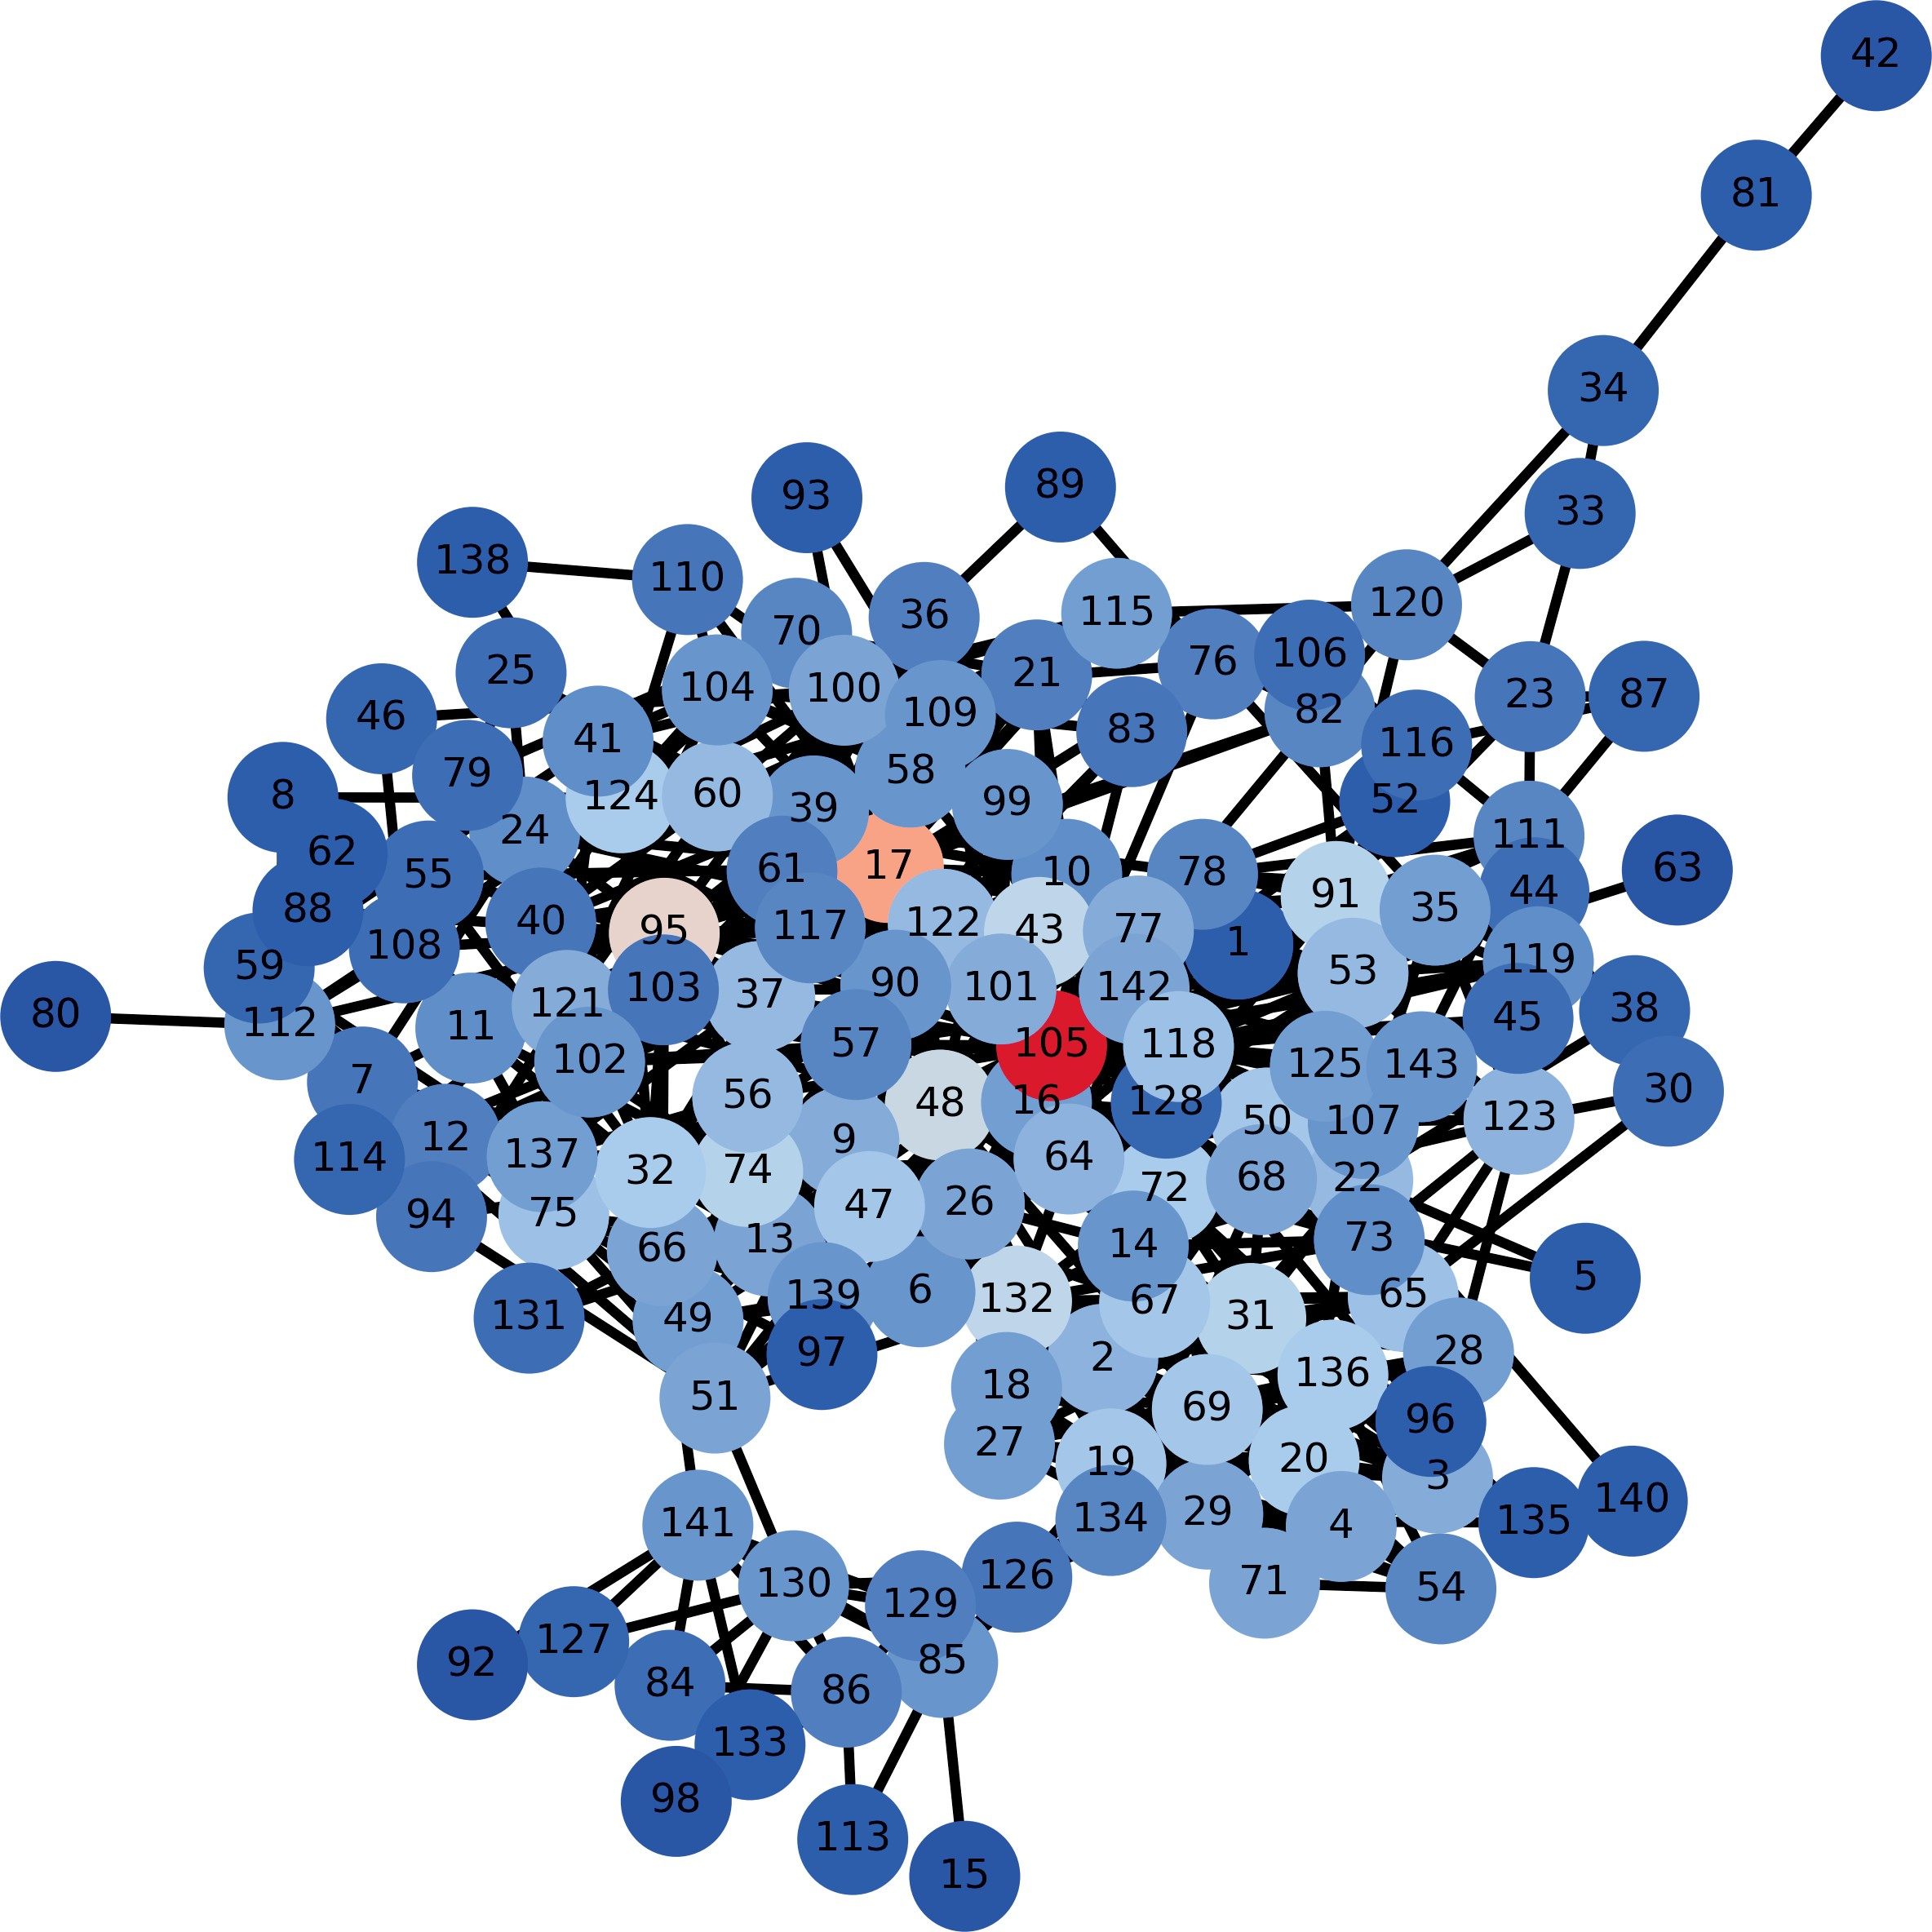
Enron Email - Graph Analytics
Centrality Measures
March 23, 2023
105 has the highest degree centrality value of 0.2958, followed by node 17 with a degree centrality value of 0.2112.

Slide 13
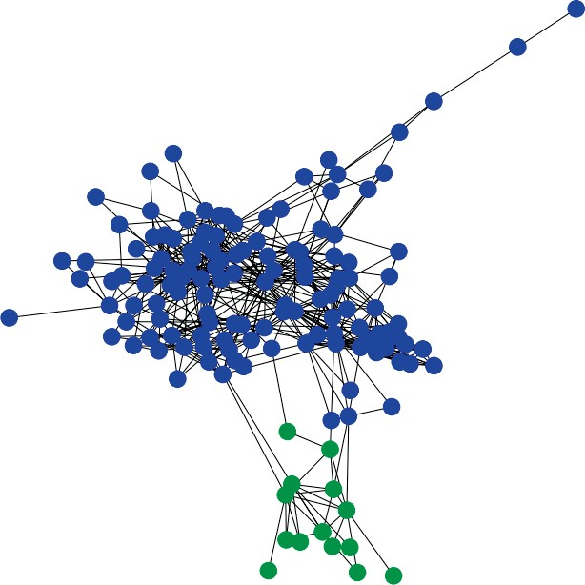
Enron Email - Graph Analytics
Community Detection
March 23, 2023
Discovered community clusters representing 2 different communities

Slide 14
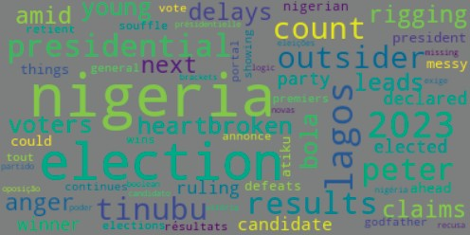
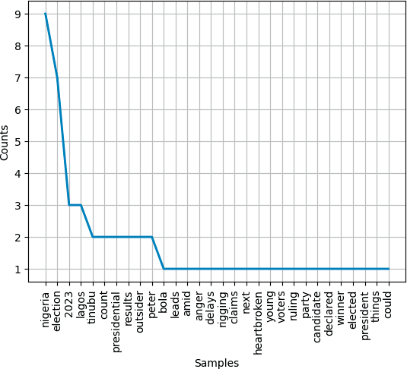
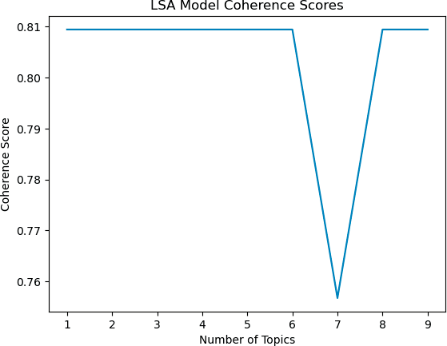
March 23, 2023
Topic Modelling (INEC)

Slide 15
Libraries Used
March 23, 2023
1
Snscrape - Twitter
2
Matplotlib
3
Networkx
4
Scipy
5
Nltk

Slide 16
March 23, 2023
Thank you

