Slide 1
Feature importance
Bram Droppers

Slide 2
Workshop
Three sections
Impurity feature importance
Permutation feature importance
SHAP feature importance

Slide 3
Workshop
Three sections
Impurity feature importance
Permutation feature importance
SHAP feature importance
Per section
Small exercise
Presentation and questions

Slide 4
Why feature importance?

Slide 5
Why feature importance?
Common sense check
Uncertainty analysis
Reducing model size and complexity

Slide 6
Impurity feature importance

Slide 7
Impurity feature importance
Also called:
Gini importance
Mean decrease impurity
Decrease in node impurity, weighted by the probability of reaching that node

Slide 8
Input feature criteria

Slide 9
Impurity feature importance
Also called:
Gini importance
Mean decrease impurity
Decrease in node impurity, weighted by the probability of reaching that node
+ Already calculated - Only for random-forest models

Slide 10
Permutation feature importance

Slide 11
Permutation feature importance
Difference in model output after permutation of input features

Slide 12
Input feature 1
Input feature 2
Input feature 3
Outputs

Slide 13
Input feature 1
Input feature 2
Input feature 3
Outputs
Input feature 1
Input feature 2
Input feature 3
Outputs

Slide 14
Input feature 1
Input feature 2
Input feature 3
Outputs
Importance
Input feature 1
Input feature 2
Input feature 3
Outputs

Slide 15
Input feature 1
Input feature 2
Input feature 3
Outputs
Importance
Input feature 1
Input feature 2
Input feature 3
Outputs

Slide 16
Input feature 1
Input feature 2
Input feature 3
Outputs
Importance
Input feature 1
Input feature 2
Input feature 3
Outputs

Slide 17
Permutation feature importance
Difference in model output after permutation of input features
+ Applicable to all models - Slow
- Limited accounting for complex non-linear interactions

Slide 18
SHAP feature importance

Slide 19
SHAP feature importance
Represents the marginal contribution of a feature’s value to the prediction averaged over all possible combinations

Slide 20
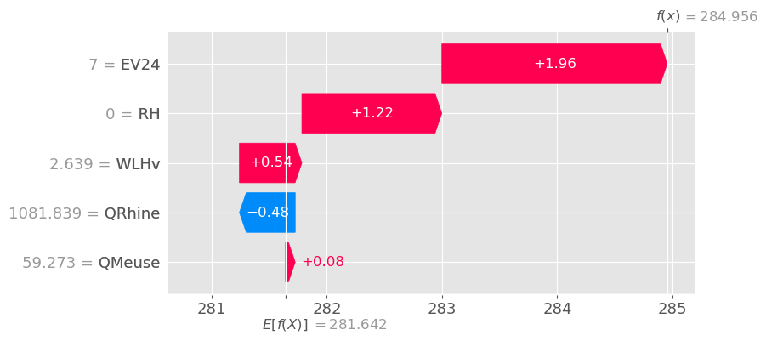

Slide 21
SHAP feature importance
Represents the marginal contribution of a feature’s value to the prediction averaged over all possible combinations
Theoretically requires permutation of all features for every timestep

Slide 22
SHAP feature importance
Represents the marginal contribution of a feature’s value to the prediction averaged over all possible combinations
Theoretically requires permutation of all features for every timestep
In practice only a few permutations and a generalized additive model to estimate relations

Slide 23
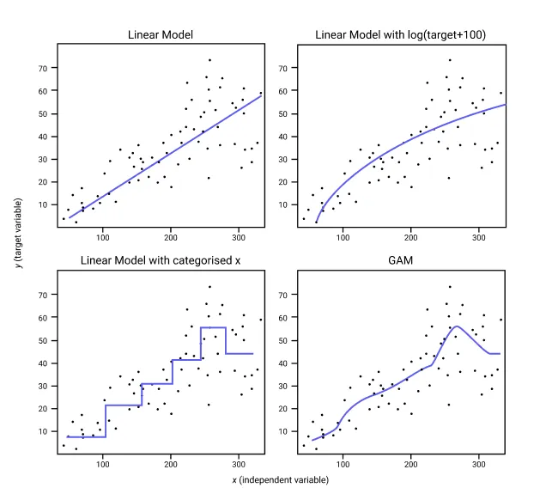

Slide 24
SHAP feature importance
Represents the marginal contribution of a feature’s value to the prediction averaged over all possible combinations
Theoretically requires permutation of all features for every timestep
In practice only a few permutations and a generalized additive model to estimate relations
+ Applicable to all models - Even slower

Slide 25
Input feature correlation

Slide 26
Input feature correlation
We do not know how our models handle correlated input features
Ignore one
Use both

Slide 28
Input feature correlation
We do not know how our models handle correlated input features
Ignore one
Use both
This is reflected in the feature importance analysis

Slide 29
Input feature correlation
Combine correlated features
Omit correlated features
Design a better train-test set

Slide 30
Feature importance
Bram Droppers

