Slide 1


GRECO TFBS Benchmarking Initiative Selection, curation, and preparation of benchmarking data
Dr. Oriol Fornes
Deputy Group Leader @ Wasserman Lab
Centre for Molecular Medicine and Therapeutics
BC Children’s Hospital Research Institute
University of British Columbia
oriol@cmmt.ubc.ca
@OFornes
March 20, 2019

Slide 2
Outline
Aim
Experiments
TF Families
Model Organisms
Annotation
Clustering

Slide 3
Aim
Obtain a representative set of TFs:
Supported by high-quality experimental data;
From different structural families; and
For several model organisms.

Slide 4
Experiments
In vivo:
ChIP-seq (from GTRD); and
DAP-seq (plants; PMID 27203113; SRA SRP045296)
In vitro:
HT-SELEX (PMIDs 23332764 and 28473536; SRAs ERP001824 and ERP010942);
PBM (UniPROBE and CIS-BP); and
SMiLE-seq (PMID 28092692; SRA SRP073361).
Should we consider additional sources of uniformly processed ChIP-seq data? (e.g. ReMap, ChIP-Atlas, CistromeDB, ModERN)
Should we consider additional experiment types? Which?

Slide 5
TF Families
Examples of TF family classification:
Pfam → TFs can be assigned multiple Pfam IDs
OrthoDB → Zinc fingers are grouped in a single (huge) family
TFClass → Great, but limited to mammals
Should we automate the TF family assignment? (e.g. CIS-BP)

Slide 6
Model Organisms
Arabidopsis thaliana (1,693 TFs from the PlantTFDB 4.0)
Caenorhabditis elegans (745 TFs from the AnimalTFDB 3.0)
Danio rerio (2,414 TFs from the AnimalTFDB 3.0)
Drosophila melanogaster (650 TFs from the AnimalTFDB 3.0)
Homo sapiens (1,635 TFs from the AnimalTFDB 3.0)
Mus musculus (1,548 TFs from the AnimalTFDB 3.0)
Saccharomyces cerevisiae (180 TFs from the AnimalTFDB 3.0)
Xenopus tropicalis (1,001 TFs from the AnimalTFDB 3.0)
Anyone can confirm these numbers? (e.g. zebrafish)

Slide 7
Annotation
Animal
TFDB
Pfam
RTGD
(Ivan)
OrthoDB
Gene Name
UniAcc
UniEntry
Sequence
Species
Pfam ID
OrthoDB
JASPAR ID
HOCOMOCO ID
GTRD ID
DAP-seq (SRA)
HT-SELEX (SRA)
CIS-BP ID
UniPROBE ID
SMiLE-seq (SRA)
Ensembl
FlyBase
Gene Name
SGD
WormBase
Pfam-A.regions.uniprot.tsv
UniProt
UniAcc
Gene Name
TAIR
Plant
TFDB
CIS-BP
UniPROBE
SRA

Slide 8
Annotation
GTRD: 840 (~80%) out of 1,047 TFs mapped
DAP-seq: 400 (~75%) out of 536 TFs mapped
HT-SELEX: 668 (~96%) out of 697 TFs mapped
CIS-BP: 851 (~80%) out of 1,065 TFs mapped
UniPROBE: 537 (~93%) out of 576 TFs mapped
SMiLE-seq: 54 (~92%) out of 59 TFs mapped
Should we manually check those cases that could not be mapped directly? (e.g. DAP-seq)

Slide 9
Clustering
For each Pfam id:
Make a FASTA database with all TF sequences that have assigned that Pfam ID; and
Clustering of the sequences using MMseqs2 “easy-cluster” with options “--min-seq-id 0.3 -c 0.5”
From the MMseqs2 user’s guide:
“We are using MMseqs2 to regularly update versions of the UniProtKB database clustered down to 30% sequence similarity¹ threshold”
¹Most likely, authors refer to sequence identity.

Slide 10
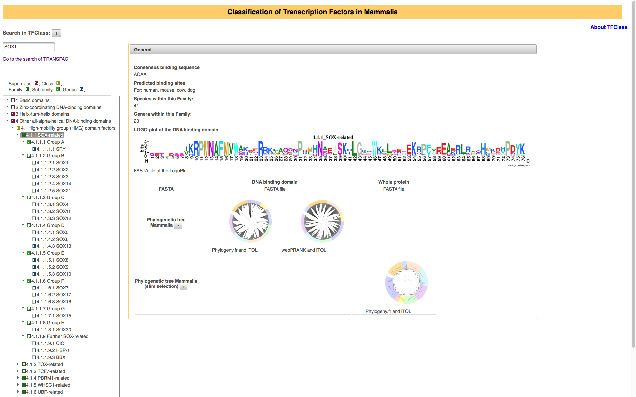
Clustering
Sox100B HMG_box 11
sox-4 HMG_box 19
Sox15 HMG_box 26
SOX15 HMG_box 30
Sox15 HMG_box 30
SOX13 HMG_box 31
SOX5 HMG_box 31
SOX6 HMG_box 31
Sox13 HMG_box 31
Sox5 HMG_box 31
Sox6 HMG_box 31
sox13 HMG_box 31
sox13 HMG_box 31
sox13 HMG_box 31
sox5 HMG_box 31
sox5 HMG_box 31
sox6 HMG_box 31
sox6 HMG_box 31
Sox21a HMG_box 33
Sox14 HMG_box 36
Sox21b HMG_box 39
SoxN HMG_box 39
Sox102F HMG_box 43
sox9b HMG_box 46
SOX1 HMG_box 47
SOX14 HMG_box 47
SOX2 HMG_box 47
SOX21 HMG_box 47
SOX3 HMG_box 47
Sox1 HMG_box 47
Sox14 HMG_box 47
Sox2 HMG_box 47
Sox21 HMG_box 47
Sox3 HMG_box 47
sox-3 HMG_box 47
sox14 HMG_box 47
sox14 HMG_box 47
sox1a HMG_box 47
sox1a HMG_box 47
sox1a HMG_box 47
sox1b HMG_box 47
sox2 HMG_box 47
sox2 HMG_box 47
sox21 HMG_box 47
sox21a HMG_box 47
sox21a HMG_box 47
sox21b HMG_box 47
sox3 HMG_box 47
sox3 HMG_box 47
SOX11 HMG_box 48
SOX12 HMG_box 48
SOX4 HMG_box 48
Sox11 HMG_box 48
Sox12 HMG_box 48
Sox4 HMG_box 48
sox11a HMG_box 48
sox11b HMG_box 48
sox12 HMG_box 48
sox12 HMG_box 48
sox17a HMG_box 48
sox17b.1 HMG_box 48
sox17b.2 HMG_box 48
sox4a HMG_box 48
sox4b HM_box 48
SOX30 HMG_box 50
Sox30 HMG_box 50
sox-2 HMG_box 53
sox1 HMG_box 53
sox19a HMG_box 53
sox19a HMG_box 53
sox19b HMG_box 53
sox32 HMG_box 53
SOX10 HMG_box 56
SOX17 HMG_box 56
SOX18 HMG_box 56
SOX7 HMG_box 56
SOX8 HMG_box 56
SOX9 HMG_box 56
Sox10 HMG_box 56
Sox17 HMG_box 56
Sox18 HMG_box 56
Sox7 HMG_box 56
Sox8 HMG_box 56
Sox9 HMG_box 56
sox10 HMG_box 56
sox10 HMG_box 56
sox17 HMG_box 56
sox18 HMG_box 56
sox7 HMG_box 56
sox7 HMG_box 56
sox8 HMG_box 56
sox8a HMG_box 56
sox8b HMG_box 56
sox9 HMG_box 56
sox9a HMG_box 56
G

