Slide 1


GRECO TFBS Benchmarking Initiative Selection, curation, and preparation of TF benchmarking data
Dr. Oriol Fornes
Deputy Group Leader @ Wasserman Lab
Centre for Molecular Medicine and Therapeutics
BC Children’s Hospital Research Institute
University of British Columbia
oriol@cmmt.ubc.ca
@OFornes
February 18-19, 2020 (yes, the future)

Slide 2
Outline
Aim
Experiments
Model Organisms
TF Families
Annotation
Clustering

Slide 3
Aim
Obtain a representative set of TFs:
Supported by high-quality experimental data;
From different model organisms; and
From different structural families.

Slide 4
Experiments
In vivo:
¹ChIP-seq (data sources: ChIP-Atlas, CistromeDB, GTRD and ReMap); and
DAP-seq (plants; PMID: 27203113; SRA: SRP045296)
In vitro:
HT-SELEX (PMID: 23332764 and 28473536; SRA: ERP001824 and ERP010942);
PBM (data sources: UniPROBE and CIS-BP v2.0); and
SMiLE-seq (PMID: 28092692; SRA: SRP073361).
¹Might include experiments from ChIP-Exo/Nexus

Slide 5
Model Organisms
Arabidopsis thaliana (1,717 TFs from the PlantTFDB 4.0)
Caenorhabditis elegans (741 TFs from the AnimalTFDB 3.0)
Drosophila melanogaster (649 TFs from the AnimalTFDB 3.0)
Homo sapiens (1,636 TFs from the AnimalTFDB 3.0)
Mus musculus (1,591 TFs from the AnimalTFDB 3.0)
Saccharomyces cerevisiae (277 TFs from the YeTFaSCo)

Slide 6
TF Families
Examples of TF family classification:
Pfam → TFs can be assigned multiple Pfam IDs
OrthoDB → Zinc fingers are grouped in a single (huge) family
TFClass → Great, but limited to mammals

Slide 7
Annotation
Ensembl
FlyBase
Gene Name
WormBase
Animal
TFDB
ChIP-Atlas
CistromeDB
GTRD
(Ivan)
ReMap
2020
YetFasCo
UniProt
UniAcc
GRECO.xlsx
Gene Name
Ordered
Locus
Name
xref: Pfam
Plant
TFDB
CIS-BP
(2.0)
UniPROBE
SRA
Araport

Slide 8
Annotation
GTRD: 851 TFs mapped (2,040 features; 84%)
DAP-seq: 436 TFs mapped (854 features; 81%)
HT-SELEX: 668 (~96%) out of 697 TFs mapped
CIS-BP: 851 (~80%) out of 1,065 TFs mapped
UniPROBE: 537 (~93%) out of 576 TFs mapped
SMiLE-seq: 54 (~92%) out of 59 TFs mapped

Slide 9
Clustering
For each Pfam ID combination (e.g. Homeodomain + Pou):
Make a FASTA database with all TF sequences that have assigned these Pfam IDs; and
Cluster sequences using MMseqs2 “easy-cluster” with options “--min-seq-id 0.3 -c 0.5”
From the MMseqs2 user’s guide:
“We are using MMseqs2 to regularly update versions of the UniProtKB database clustered down to 30% sequence similarity¹ threshold”
¹Most likely, authors refer to sequence identity.

Slide 10
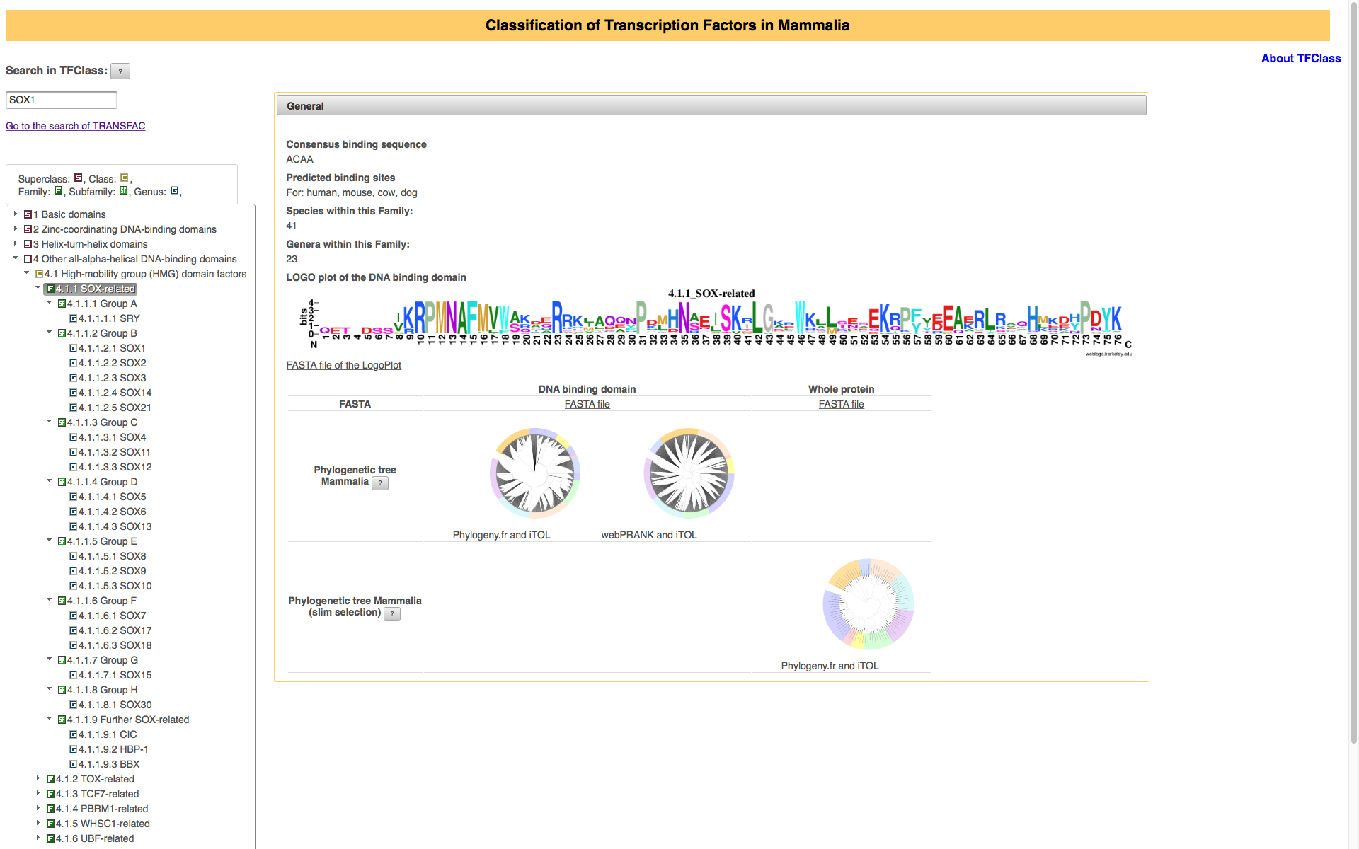
Clustering
Sox100B HMG_box 11
sox-4 HMG_box 19
Sox15 HMG_box 26
SOX15 HMG_box 30
Sox15 HMG_box 30
SOX13 HMG_box 31
SOX5 HMG_box 31
SOX6 HMG_box 31
Sox13 HMG_box 31
Sox5 HMG_box 31
Sox6 HMG_box 31
sox13 HMG_box 31
sox13 HMG_box 31
sox13 HMG_box 31
sox5 HMG_box 31
sox5 HMG_box 31
sox6 HMG_box 31
sox6 HMG_box 31
Sox21a HMG_box 33
Sox14 HMG_box 36
Sox21b HMG_box 39
SoxN HMG_box 39
Sox102F HMG_box 43
sox9b HMG_box 46
SOX1 HMG_box 47
SOX14 HMG_box 47
SOX2 HMG_box 47
SOX21 HMG_box 47
SOX3 HMG_box 47
Sox1 HMG_box 47
Sox14 HMG_box 47
Sox2 HMG_box 47
Sox21 HMG_box 47
Sox3 HMG_box 47
sox-3 HMG_box 47
sox14 HMG_box 47
sox14 HMG_box 47
sox1a HMG_box 47
sox1a HMG_box 47
sox1a HMG_box 47
sox1b HMG_box 47
sox2 HMG_box 47
sox2 HMG_box 47
sox21 HMG_box 47
sox21a HMG_box 47
sox21a HMG_box 47
sox21b HMG_box 47
sox3 HMG_box 47
sox3 HMG_box 47
SOX11 HMG_box 48
SOX12 HMG_box 48
SOX4 HMG_box 48
Sox11 HMG_box 48
Sox12 HMG_box 48
Sox4 HMG_box 48
sox11a HMG_box 48
sox11b HMG_box 48
sox12 HMG_box 48
sox12 HMG_box 48
sox17a HMG_box 48
sox17b.1 HMG_box 48
sox17b.2 HMG_box 48
sox4a HMG_box 48
sox4b HM_box 48
SOX30 HMG_box 50
Sox30 HMG_box 50
sox-2 HMG_box 53
sox1 HMG_box 53
sox19a HMG_box 53
sox19a HMG_box 53
sox19b HMG_box 53
sox32 HMG_box 53
SOX10 HMG_box 56
SOX17 HMG_box 56
SOX18 HMG_box 56
SOX7 HMG_box 56
SOX8 HMG_box 56
SOX9 HMG_box 56
Sox10 HMG_box 56
Sox17 HMG_box 56
Sox18 HMG_box 56
Sox7 HMG_box 56
Sox8 HMG_box 56
Sox9 HMG_box 56
sox10 HMG_box 56
sox10 HMG_box 56
sox17 HMG_box 56
sox18 HMG_box 56
sox7 HMG_box 56
sox7 HMG_box 56
sox8 HMG_box 56
sox8a HMG_box 56
sox8b HMG_box 56
sox9 HMG_box 56
sox9a HMG_box 56
G

Slide 13
Annotation
Ensembl
FlyBase
Gene Name
WormBase
Animal
TFDB
ChIP-Atlas
CistromeDB
GTRD
(Ivan)
ReMap
2020
Gene Name
UniAcc
UniEntry
Sequence
Species
Pfam ID
OrthoDB
JASPAR ID
HOCOMOCO ID
ChIP-Atlas ID
CistromeDB ID
GTRD ID
ReMap ID
DAP-seq (SRA)
HT-SELEX (SRA)
CIS-BP ID
UniPROBE ID
SMiLE-seq (SRA)
YetFasCo
UniProt
UniAcc
Gene Name
Ordered
Locus
Name
xref: Pfam
Plant
TFDB
CIS-BP
(2.0)
UniPROBE
SRA
Araport

