Slide 1


Improving web panel respondent behaviour The effect of encouragement messages throughout the course of the survey
Oriol J. Bosch | RECSM-UPF
Anna DeCastellarnau | RECSM-UPF
Melanie Revilla | RECSM-UPF

Slide 2
BACKGROUND
Motivational messages in web surveys
Web surveys may damage motivation and trigger satisficing behaviours
Motivating respondents might affect respondent’s willingness to participate and increase response rates
If extra answers are given without appropriate thinking, this can decrease data quality
Contrary to F2F, in web surveys feedback must be decided in advance

Slide 3
BACKGROUND
Spain in comparative perspective
Few researches have analyzed the measurement quality of survey questions in Spain.
Saris et al. (2010), conducting experiments from ESS rounds 2 and 3, found that overall Spain had a higher quality than the ESS average
Revilla, Saris and Krosnick (2014), analyzing the ideal number of points in agree-disagree scales, found a higher measurement quality for Spain than for the ESS.
Few researches have analyzed the measurement quality of survey questions in Spain.
Saris et al. (2010), conducting experiments from ESS rounds 2 and 3, found that overall Spain had a higher quality than the ESS average
Revilla, Saris and Krosnick (2014), analyzing the ideal number of points in agree-disagree scales, found a higher measurement quality for Spain than for the ESS.
However, to our knowledge, no research has focused on detail on comparing Spain with other countries in terms of measurement quality.
upf.edu/web/survey

Slide 4
BACKGROUND
Measurement quality of survey questions
Quality = part of variance explained by the latent concept of interest
→ complement of measurement errors
Quality = reliability x measurement validity
Validity coefficient
Reliability coefficient
Quality = strength of the relationship between the latent concept of interest and the observed answers

Slide 5
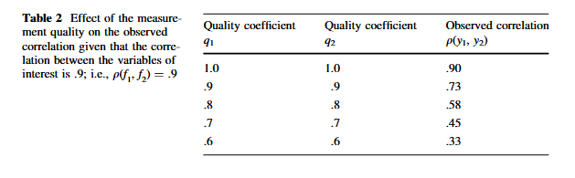
BACKGROUND
Implications
Measurement errors can have serious implications when conducting cross-national research. If the measurement errors are not comparable across countries, comparisons of relationships across countries can result in very wrong substantive conclusions.
Saris and Revilla., 2016
Saris, W. E., & Revilla, M. (2016). Correction for measurement errors in survey research: necessary and possible. Social Indicators Research, 127(3), 1005-1020

Slide 6
BACKGROUND
Spain in comparative perspective
Few researches have analyzed the measurement quality of survey questions in Spain.
Saris et al. (2010), conducting experiments from ESS rounds 2 and 3, found that overall Spain had a higher quality than the ESS average
Revilla, Saris and Krosnick (2014), analyzing the ideal number of points in agree-disagree scales, found a higher measurement quality for Spain than for the ESS.
Few researches have analyzed the measurement quality of survey questions in Spain.
Saris et al. (2010), conducting experiments from ESS rounds 2 and 3, found that overall Spain had a higher quality than the ESS average
Revilla, Saris and Krosnick (2014), analyzing the ideal number of points in agree-disagree scales, found a higher measurement quality for Spain than for the ESS.
However, to our knowledge, no research has focused on detail on comparing Spain with other countries in terms of measurement quality.
upf.edu/web/survey

Slide 7
BACKGROUND
Goals
The first goal of this research is to compare the measurement quality in Spain compared to other countries.
Moreover, if existent, our second goal is to assess the implications of these differences
In order to do so, this study uses data from an MTMM experiment about attitudes towards immigration conducted in the ESS Round 8 in 23 countries. The experiment evaluates three different traits, each measured with three different methods. The traits aim to measure three aspects of the concept ‘qualification for entry or exclusion of immigrants’.

Slide 8


METHOD AND DATA
The True Score MTMM Model
TS-MTMM model for 3 traits and 3 methods
t1: Education
t2: Christian background
t3: Work skills
M1: 11 points scale
Time 1
hi
t1: Education
t2: Christian background
t3: Work skills
3 Traits
3 Methods
9 survey questions
M2: 10 points scale
Time 2
t1: Education
t2: Christian background
t3: Work skills
M3: 11 points scale
Time 3

Slide 9
METHOD AND DATA
The True Score MTMM Model
The three-group SB-TS-MTMM design
In order to reduce the cognitive burden of the respondents and to limit possible memory effects due to the repetitions of the same questions to the same respondents:
Combine the MTMM approach with a Split-Ballot approach (SB-MTMM), where respondents are split randomly into several groups.
Each split-ballot group gets a combination of two methods for a given set of three traits, instead of getting all three methods, but all reliability and validity coefficients can be estimated.
 | Time 1: section C | Time 2: section I
Group 1 | Method 1 | Method 2
Group 2 | Method 2 | Method 3
Group 3 | Method 3 | Method 1
In Round 8, we implemented the three-group split-ballot design, where respondents are randomly assigned to three groups: Group 1 gets Methods 1 and 2, Group 2 gets Methods 2 and 3, and Group 3 gets Methods 3 and 1, as suggested by Saris et al., 2004. With this design, all possible correlations between methods are observed.

Slide 10
METHOD AND DATA
Country-language groups in ESS Round 8
ESS Round 8 countries and languages available
Country | Language 1 | Language 2 | Language 3
Austria | German [ATGER]
Belgium | Dutch [BEDUT] | French [BEFRE]
Switzerland | German [CHGER] | French [CHFRE] | Italian*
Czech Republic | Czech [CZCZE]
Germany | German [DEGER]
Estonia | Estonian [EEEST] | Russian [EERUS]
Spain | Spanish [ESSPA] | Catalan*
Finland | Finnish [FIFIN] | Swedish*
France | French [FRFRE]
United Kingdom | English [GBENG]
Hungary | Hungarian [HUHUN]
Ireland | England [IEENG]
Israel | Arabic [ILARA] | Hebrew [ILHEB] | Russian*
Iceland | Icelandic [ISICE]
Italia | Italian [ITITA]
Lithuania | Lithuanian [LTLIT] | Russian*
Netherlands | Dutch [NLDUT]
Norway | Norwegian [NONOR]
Poland | Polish [PLPOL]
Portugal | Portuguese [PTPOR]
Russia | Russian [RURUSS]
Sweden | Swedish [SESWE]
Slovenia | Slovene [SISLV]
The SB-MTMM experiment was conducted in 23 of the participating countries. In multilingual countries, the data is split by language (Zavala-Rojas, 2016).
The cases with an asterisk (*) were not analysed because the sample size was <100 cases per split-ballot group. Thus, we analysed 27 country-language models.

Slide 11
METHOD AND DATA
The SB-MTMM design
Survey questions included in the ESS Round 8 main and supplementary questionnaires
Trait | Questions’ request for an answer
Good educational qualifications | How important do you think having good educational qualifications should be in deciding whether someone born, brought up and living outside should be able to come and live here.
Christian background | How important you think coming from a Christian background should be in deciding whether someone born, brought up and living outside should be able to come and live here?
Work skills needed in the country | How important you think work skills that [country] needs should be in deciding whether someone born, brought up and living outside should be able to come and live here?

Slide 12
METHOD AND DATA
The SB-MTMM design
Variation in the characteristics and formulation for each method
Not at all important |  |  |  |  |  |  | Extremely important
00 | 01 | 02 | 03 | 04 | 05 | 06 | 07 | 08 | 09 | 10
Method 1
Battery format
11 points
Not at all important |  |  |  |  |  | Extremely important
01 | 02 | 03 | 04 | 05 | 06 | 07 | 08 | 09 | 10
Method 2
Questions in the SC
10 points
Not at all important |  |  |  | Very important
00 | 01 | 02 | 03 | 04 | 05
Method 3
Battery format
6 points

Slide 13
METHOD AND DATA
Analyses and testing
In order to test if there are misspecifications, we use the JRule software (van der Veld, Saris, & Satorra, 2008). This leads in many cases to the introduction of corrections with respect to the general model presented earlier. Principally, the changes on the 3-group TS analyses consist in:
Allowing unequal effects of one method on the different traits
Freeing error variances because of timing effects
Adding a correlation between two methods when they are very similar
Allowing correlations between errors because of memory effects.
After conducting the MTMM analyses and testing the models, we will present the quality estimates for the different methods and traits. We will present the average quality across countries, as well as the quality only for Spain

Slide 14
RESULTS
Average quality over all country-language groups for the different traits and methods
Average quality (q²) over all country-language groups and only for Spain, per trait and method
 | M1 | M2 | M3
Average | .78 | .68 | .72
Spain | .87 | .71 | .66

Slide 15
RESULTS
Average quality over all country-language groups for the different traits and methods
Average quality (q²) over all country-language groups and only for Spain, per trait and method
 | M1 | M2 | M3
Average | .78 | .68 | .72
Spain | .87 | .71 | .66
Spain has a higher quality than the average for methods 1 and 2

Slide 16
RESULTS
Average quality over all country-language groups for the different traits and methods
Average quality (q²) over all country-language groups and only for Spain, per trait and method
 | M1 | M2 | M3
Average | .78 | .68 | .72
Spain | .87 | .71 | .66
Spain has a higher quality than the average for methods 1 and 2
Quality estimates in Spain are especially good for Method 1.

Slide 17
RESULTS
Average quality over all country-language groups for the different traits and methods
Average quality (q²) over all country-language groups and only for Spain, per trait and method
 | M1 | M2 | M3
Average | .78 | .68 | .72
Spain | .87 | .71 | .66
Spain has a higher quality than the average for methods 1 and 2
Quality estimates in Spain are especially good for Method 1.
Thus, in general and for Spain we would recommend using an 11-points scale, presented as a battery and not shown in the SC.

Slide 18
RESULTS
Average quality over all traits for country-language groups
Average quality (q²), over all traits, per country-language group and method
The average quality for Spain is ranked 9th of all 27 country-language groups.
Spain has the 4th highest quality for Method 1 and the 10th highest for Method 2.
However, for Method 3, Spain presents the 4th lowest quality of all countries.
Thus, there are important differences across methods and countries .
upf.edu/web/survey

Slide 19
Discussion and Conclusions
Main results
Quality estimates for Spain are slightly higher than the ESS average, similar to what Saris et al. (2010) and Revilla, Saris and Krosnick (2014) found. Besides, Method 1 performs especially well for Spain.
Looking in more detail, there are important differences across methods and countries:
Method 1 performs especially well for Spain compared with all other countries, ranking 4th of all 27 country-language groups
For Method 3, Spain presents the 4th lowest quality estimate
Although overall Spain presents a higher quality than the ESS average, the tendency is not the same for all methods. These differences may have important implications in cross-national research
upf.edu/web/survey

Slide 20
Discussion and Conclusions
Implications
Following the approach developed by Saris and Revilla (2016), we compare the strength of relationship of “Christian background” and “Work skills needed in the country” in both Spain and Italy measured with method 3.
Observed correlation ρ(y₁, y₂):
Spain= .41
Italy= .40
Quality of the measures q₁ and q₂ :
Spain= .70 and .64
Italy= .92 and .79
Hence, the difference across countries is small and nonsignificant.
Correcting for measurement errors and Common Method Variance (CMV) with the equation developed by Saris and Revilla (2016):
ρ(f₁, f₂)= [ρ(y₁, y₂)-CMV]/q₁ q₂
Real correlation ρ(f₁, f₂):
Spain= .46
Italy= .37
If not corrected for measurement errors, substantive conclusions can be very wrong
upf.edu/web/survey

Slide 21
Discussion and Conclusions
Conclusions
This and past research show that Spain has a higher measurement quality than the ESS average. However, differences across methods should be considered
Measurement errors can lead to very wrong conclusions not only for correlations, but also for regression and SEM analyses.
Hence, measurement errors should be corrected when possible
Easier procedure: using the Survey Quality Predictor (SQP) sqp.upf.edu
Limits
One experiment: findings are specific for the topics analysed and the methods used. To be able to draw general conclusions, more topics would need to be studied and/or SQP should be used.
More sources of error (e.g. sampling). Only focused on measurement quality.
upf.edu/web/survey

Slide 22



upf.edu/web/survey
Universitat Pompeu Fabra
Research and Expertise Centre for Survey Methodology
Ramon Trias Fargas, 25-27 08005 Barcelona, Spain
oriol.bosch@upf.edu
Recsm Upf
@RECSM_UPF

Slide 23
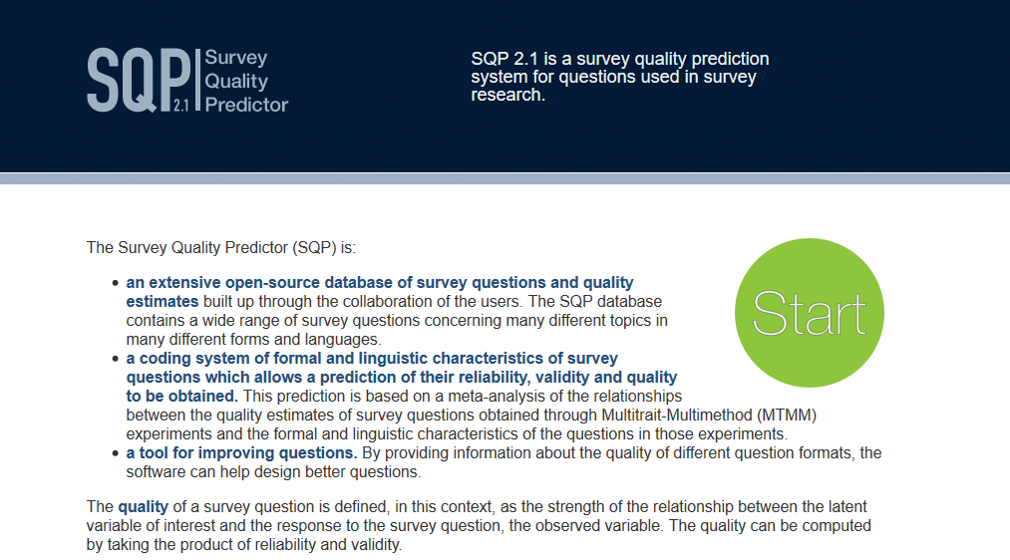
EL NOSTRE ESTUDI
Anàlisis
SQP 2.1: Aquest programa utilitza una base de dades amb l'estimació de la qualitat de més de 3.400 preguntes, el què permet generar prediccions sobre la fiabilitat, la validesa i la qualitat fins i tot de preguntes que no estan a la seva base de dades (Saris et al., 2011).
upf.edu/web/survey

Slide 24
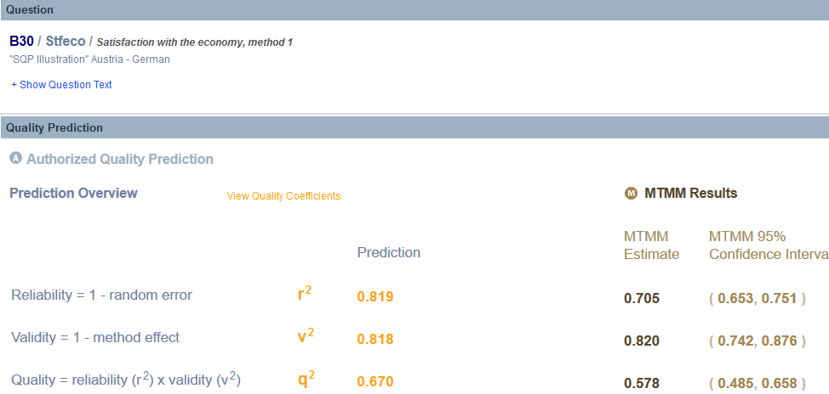
EL NOSTRE ESTUDI
Anàlisis
SQP 2.1: Aquest programa utilitza una base de dades amb l'estimació de la qualitat de més de 3.400 preguntes, el què permet generar prediccions sobre la fiabilitat, la validesa i la qualitat fins i tot de preguntes que no estan a la seva base de dades (Saris et al., 2011).
upf.edu/web/survey

