Slide 1




Millennials and emojis in Spain and Mexico:
Using emojis in surveys targeting millennials
Oriol J. Bosch, RECSM-UPF
Melanie Revilla, RECSM-UPF
ESRA conference 2017, Lisbon

Slide 2
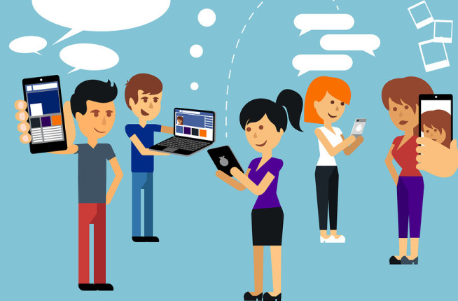
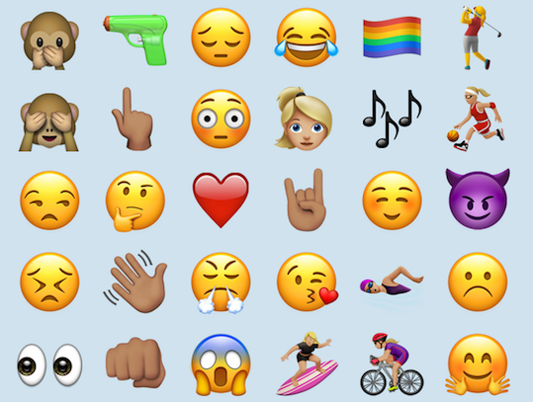
BACKGROUND
MILLENNIALS AND EMOJIS

Slide 3
BACKGROUND
MILLENNIALS AND EMOJIS
Individuals born between 1982 and 2003 (Howe and Strauss, 1991)
First generation to have had, during their formative years, access to the Internet

Slide 4
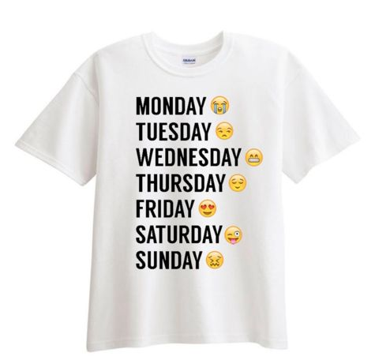


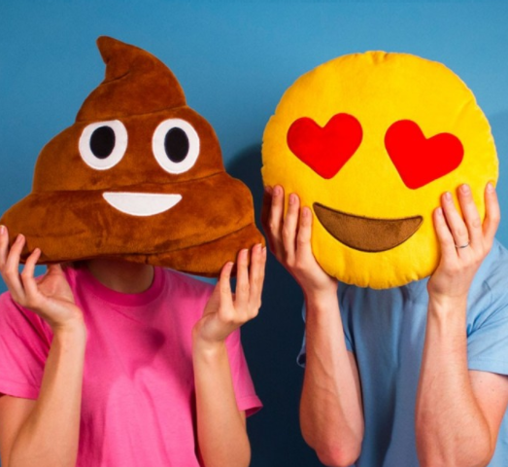
BACKGROUND
MILLENNIALS AND EMOJIS
6 billions sent every day in 2016 (SwiftKey)
64% of the online populations used emojis at least several times a week in 2016 (Emogi)
Emojis everywhere online and offline

Slide 5


BACKGROUND
USING EMOJIS IN WEB SURVEYS TARGETTING MILLENNIALS
“
Millennials stand to abandon research altogether unless it’s
mobile-friendly and device-agnostic [...] since this group incorporates mobile into their digital fluency, researchers need to be equally fluent in our survey design.
(Yazbeck and Scarlet 2013, p.52)
”

Slide 6
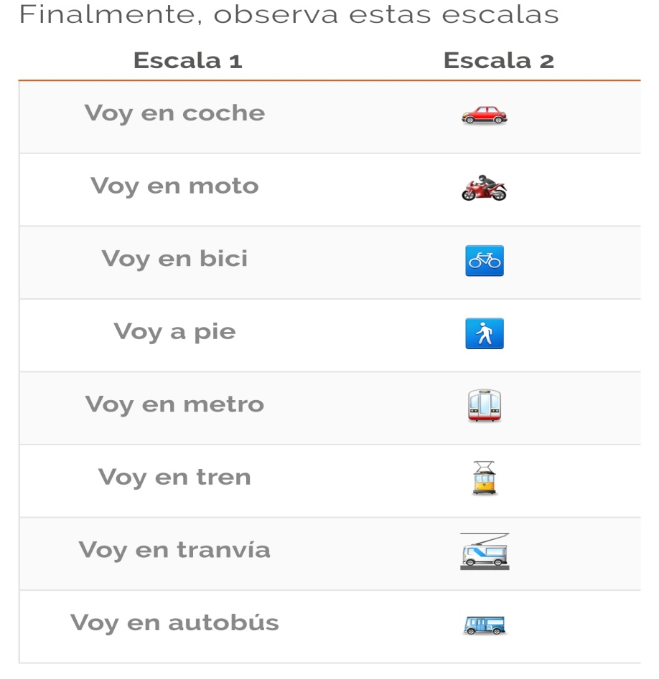
BACKGROUND
USING EMOJIS IN WEB SURVEYS TARGETTING MILLENNIALS
2 ways of using emojis in web surveys
1) As labels for scales

Slide 7
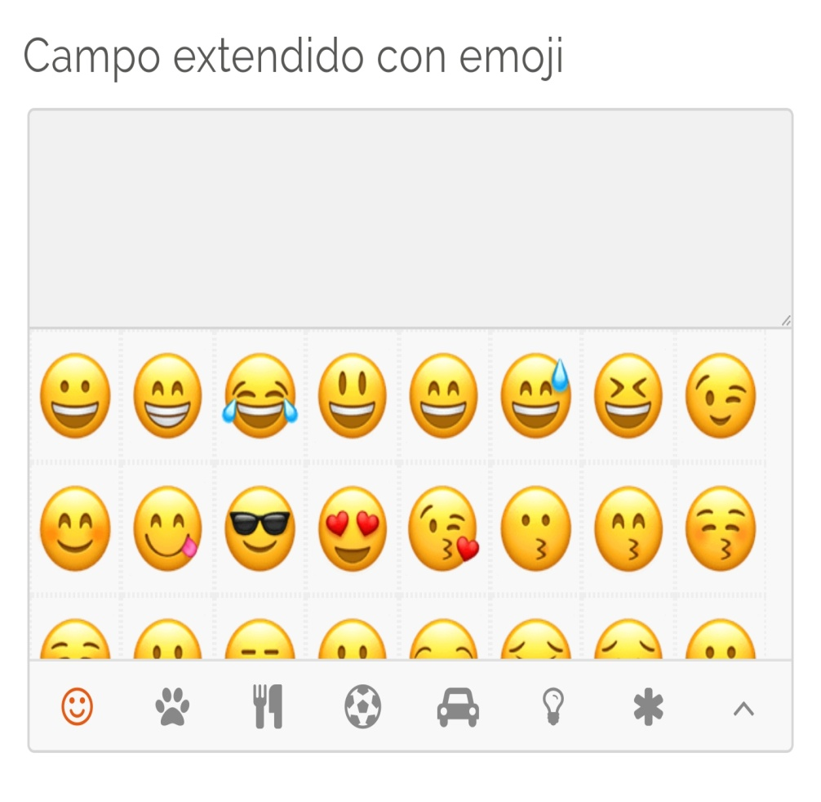
BACKGROUND
USING EMOJIS IN WEB SURVEYS TARGETTING MILLENNIALS
2 ways of using emojis in web surveys
1) As labels for scales
2) In open-ended questions

Slide 8
BACKGROUND
USING EMOJIS IN WEB SURVEYS TARGETTING MILLENNIALS
2 ways of using emojis in web surveys
1) As labels for scales
2) In open-ended questions

Slide 9

BACKGROUND
USING EMOJIS IN WEB SURVEYS TARGETTING MILLENNIALS
Several potential advantages of using emojis in web surveys:
Common tool: used in every day life
Visual tool: no reading skills required
Free tool: no extra costs
International tool: can be used in all countries (even if possible differences in meaning)
Emotional component: can help interpreting the meaning
Expected consequences:
Higher motivation of the millennials to complete the survey
Higher data quality: more information conveyed and less item missing
Improved satisfaction with the survey

Slide 10


BACKGROUND
EMOJIS USE: RECENT PHENOMENON SO LITTLE PREVIOUS LITERATURE
Literature mainly about emoticons and other non-verbal tools
Effect on satisfaction
Desmet (2003)
Couper et al. (2004)
Jäger and Bortz (2011)
Toepoel and Couper (2011)
Derhman (2011a, 2011b)
Emde and Fuchs (2012)
Desmet (2003)
Lokman et al. (2012)
Lu et al. (2016)
Barbieri, Ronzano and Saggion (2016)
Derks, Bos and von Gublok (2007)
Kavanagh (2010)
Halvorsen (2012)
Kelly and Watts (2015)
Parkins (2012)
Nishimura (2015)
Pérez Sabater (2015)
Komrsková (2015)
Couper et al. (2006)
Huang, Yan and Zhang (2006)
Never studied the impact of using emojis in surveys on satisfaction
Never studied the impact in open-ended questions
Never studied the determinant variables
Mostly based in small and convenience samples
Cross-cultural applications
Reasons behind use
Gender differences
Effect on time & quality

Slide 11

OUR STUDY
GOALS
3 main objectives:
Estimate the proportions of millennials who use emojis in surveys when we explicitly propose them this option
Investigate which variables affect this use
→ We expect that gender, technological variables and personality will be the main factors
Explore the impact of encouraging respondents to use emojis on data quality, respondents behavior, survey satisfaction and perceived usability

Slide 12
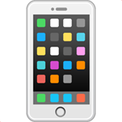


OUR STUDY
DATA
Population of interest
Survey
Panelists who have smartphone and use Internet more than once a week
Total of 62 questions (skipping allowed)
Focus on subset of questions part of an experiment with Treatment and Control group:
Same set of 6 open-ended questions
But encouraged to use emojis with a specific introduction only in Treatment.
“In the questions that follow, we are going to ask you to use emojis to express your opinions, attitudes, feelings, etc.”
Quotas
Cross quotas for country, age and gender based on the full panel
Data collection
2th – 19th June, 2017
Netquest opt-in online panels
Final sample for analyses
1,614 respondents who completed the survey until the end: Spain = 808; Mexico = 806
% of those who started: Spain= 66.4; Mexico= 59.7
% of those who answered the first main survey question: Spain= 97.3 ; Mexico= 97.7

Slide 13
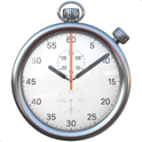
OUR STUDY
DATA PREPARATION
Code the 6 open questions in the experimental part:
Code if respondents answered or not the question (item missing)
Code the number of ideas/emotions for each answer (information conveyed )
Code if emojis are used
Compute the average completion time:
Compute the completion time per question (sum of focus times)
Sum these times for the 6 questions
Divide by the number of questions answered (excluding missings)
To deal with outliers, substitute the highest 1% values by the mean of the others
Study the proportions of millennials using emojis and the variables affecting this use
Focus on the treatment group
In control group: less than 2%
2) Compare treatment and control groups on:
Data quality (item missing and average information conveyed)
Respondent behavior (average completion time)
Usability (self-reported: if respondents found it easy to answer the 6 open questions)
Satisfaction (self-reported: if respondents liked to answer the 6 open questions)
ANALYSES

Slide 14
MAIN RESULTS
USE OF EMOJIS (treatment group)
Use of emojis for the different questions by country (in%)
*
* Based on three questions of three different slogans
Notes:
2% of the control group used emojis

Slide 15
MAIN RESULTS
USE OF EMOJIS (treatment group)
Use of emojis for the different questions by country (in%)
-13.9%
*
* Based on three questions of three different slogans
Notes:
2% of the control group used emojis

Slide 16
MAIN RESULTS
USE OF EMOJIS (treatment group)
Use of emojis for the different questions by country (in%)
-9.1%
-13.9%
*
* Based on three questions of three different slogans
Notes:
2% of the control group used emojis

Slide 17
MAIN RESULTS
USE OF EMOJIS (treatment group)
Use of emojis for the different questions by country (in%)
Differences between countries are not significant
-9.1%
-13.9%
*
* Based on three questions of three different slogans
Notes:
2% of the control group used emojis

Slide 18

MAIN RESULTS
USE OF EMOJIS (treatment group)
Use of emojis for the different questions by country (in%)
Differences between countries are not significant
-9.1%
-13.9%
The actual emoji use is higher than the stated willingness in general and for all the types
*
* Based on three questions of three different slogans
Notes:
2% of the control group used emojis

Slide 19
MAIN RESULTS
DETERMINANTS OF THE USE OF EMOJIS – BINARY LOGISTIC REGRESSION
 | General | Like | Personality | Opinion | Emotion
Women | 3.8 | 1.0 | 1.3 | 1.4 | 1.1
Age | 1.0 | 1.0 | 1.0 | 1.0 | 1.0
Mexico | .5 | 1.2 | 1.0 | 1.7 | 2.0
Emoji Usage | 6.5 | 1.9 | 1.4 | 1.0 | 1.3
Internet Usage | .7 | 1.0 | 1.0 | 1.0 | 1.0
No. SN used per week | 1.2 | 1.2 | 1.2 | 1.6 | 1.5
Extroversion | 1.1 | 1.0 | 1.0 | 1.1 | 1.0
Creativity | .9 | 1.1 | 1.1 | 1.0 | 1.1
Laziness | 1.0 | 1.0 | 1.0 | 1.0 | 1.0
Alone | .7 | .9 | .8 | .8 | 1.3
Public | 1.0 | .7 | 1.0 | 1.1 | .9
Constant | 9.1 | 7.8 | 4.1 | 1.1 | .5
No. observations | 540 | 773 | 744 | 737 | 697
Negelkerke R² | .17 | .04 | .03 | 1.4 | .08
Coefficient in bold if p-value <.05; coefficients in Odds Ratios

Slide 20
MAIN RESULTS
DETERMINANTS OF THE USE OF EMOJIS – BINARY LOGISTIC REGRESSION
 | General | Like | Personality | Opinion | Emotion
Women | 3.8 | 1.0 | 1.3 | 1.4 | 1.1
Age | 1.0 | 1.0 | 1.0 | 1.0 | 1.0
Mexico | .5 | 1.2 | 1.0 | 1.7 | 2.0
Emoji Usage | 6.5 | 1.9 | 1.4 | 1.0 | 1.3
Internet Usage | .7 | 1.0 | 1.0 | 1.0 | 1.0
No. SN used per week | 1.2 | 1.2 | 1.2 | 1.6 | 1.5
Extroversion | 1.1 | 1.0 | 1.0 | 1.1 | 1.0
Creativity | .9 | 1.1 | 1.1 | 1.0 | 1.1
Laziness | 1.0 | 1.0 | 1.0 | 1.0 | 1.0
Alone | .7 | .9 | .8 | .8 | 1.3
Public | 1.0 | .7 | 1.0 | 1.1 | .9
Constant | 9.1 | 7.8 | 4.1 | 1.1 | .5
No. observations | 540 | 773 | 744 | 737 | 697
Negelkerke R² | .17 | .04 | .03 | 1.4 | .08
Coefficient in bold if p-value <.05; coefficients in Odds Ratios

Slide 21
MAIN RESULTS
DETERMINANTS OF THE USE OF EMOJIS – BINARY LOGISTIC REGRESSION
 | General | Like | Personality | Opinion | Emotion
Women | 3.8 | 1.0 | 1.3 | 1.4 | 1.1
Age | 1.0 | 1.0 | 1.0 | 1.0 | 1.0
Mexico | .5 | 1.2 | 1.0 | 1.7 | 2.0
Emoji Usage | 6.5 | 1.9 | 1.4 | 1.0 | 1.3
Internet Usage | .7 | 1.0 | 1.0 | 1.0 | 1.0
No. SN used per week | 1.2 | 1.2 | 1.2 | 1.6 | 1.5
Extroversion | 1.1 | 1.0 | 1.0 | 1.1 | 1.0
Creativity | .9 | 1.1 | 1.1 | 1.0 | 1.1
Laziness | 1.0 | 1.0 | 1.0 | 1.0 | 1.0
Alone | .7 | .9 | .8 | .8 | 1.3
Public | 1.0 | .7 | 1.0 | 1.1 | .9
Constant | 9.1 | 7.8 | 4.1 | 1.1 | .5
No. observations | 540 | 773 | 744 | 737 | 697
Negelkerke R² | .17 | .04 | .03 | 1.4 | .08
Coefficient in bold if p-value <.05; coefficients in Odds Ratios

Slide 22
MAIN RESULTS
DETERMINANTS OF THE USE OF EMOJIS – BINARY LOGISTIC REGRESSION
 | General | Like | Personality | Opinion | Emotion
Women | 3.8 | 1.0 | 1.3 | 1.4 | 1.1
Age | 1.0 | 1.0 | 1.0 | 1.0 | 1.0
Mexico | .5 | 1.2 | 1.0 | 1.7 | 2.0
Emoji Usage | 6.5 | 1.9 | 1.4 | 1.0 | 1.3
Internet Usage | .7 | 1.0 | 1.0 | 1.0 | 1.0
No. SN used per week | 1.2 | 1.2 | 1.2 | 1.6 | 1.5
Extroversion | 1.1 | 1.0 | 1.0 | 1.1 | 1.0
Creativity | .9 | 1.1 | 1.1 | 1.0 | 1.1
Laziness | 1.0 | 1.0 | 1.0 | 1.0 | 1.0
Alone | .7 | .9 | .8 | .8 | 1.3
Public | 1.0 | .7 | 1.0 | 1.1 | .9
Constant | 9.1 | 7.8 | 4.1 | 1.1 | .5
No. observations | 540 | 773 | 744 | 737 | 697
Negelkerke R² | .17 | .04 | .03 | 1.4 | .08
Coefficient in bold if p-value <.05; coefficients in Odds Ratios

Slide 23
MAIN RESULTS
IMPACT OF ENCOURAGING RESPONDENTS TO USE EMOJIS
 |  | Spain |  | Mexico
Impact on… |  | Control | Treatment | Control | Treatment
Data Quality | Avg. information conveyed per question | 1.4 | 1.9** | 1.4 | 2.3
 | Avg. item missing | 0.4 | 0.4 | 0.2 | 0.2
Respondent Behavior | Avg. time spent (seconds) per question | 26.7** | 37.0** | 31.1 | 43.4
Usability | Easy/Very Easy (%) | 89.9 | 86.4 | 90.2 | 86.6
Satisfaction | Liked/Liked a lot (%) | 66.9** | 80.1 | 79.7 | 84.3
Coefficient in bold (respectively **) if differences in distributions (Kolmogorov-Smirnov test) or means (t-test) between control/treatment groups (resp. countries) are significant (p<.05)

Slide 24
MAIN RESULTS
IMPACT OF ENCOURAGING RESPONDENTS TO USE EMOJIS
 |  | Spain |  | Mexico
Impact on… |  | Control | Treatment | Control | Treatment
Data Quality | Avg. information conveyed per question | 1.4 | 1.9** | 1.4 | 2.3
 | Avg. item missing | 0.4 | 0.4 | 0.2 | 0.2
Respondent Behavior | Avg. time spent (seconds) per question | 26.7** | 37.0** | 31.1 | 43.4
Usability | Easy/Very Easy (%) | 89.9 | 86.4 | 90.2 | 86.6
Satisfaction | Liked/Liked a lot (%) | 66.9** | 80.1 | 79.7 | 84.3
Δ77.4%
Δ66.6%
Coefficient in bold (respectively **) if differences in distributions (Kolmogorov-Smirnov test) or means (t-test) between control/treatment groups (resp. countries) are significant (p<.05)

Slide 25
MAIN RESULTS
IMPACT OF ENCOURAGING RESPONDENTS TO USE EMOJIS
 |  | Spain |  | Mexico
Impact on… |  | Control | Treatment | Control | Treatment
Data Quality | Avg. information conveyed per question | 1.4 | 1.9** | 1.4 | 2.3
 | Avg. item missing | 0.4 | 0.4 | 0.2 | 0.2
Respondent Behavior | Avg. time spent (seconds) per question | 26.7** | 37.0** | 31.1 | 43.4
Usability | Easy/Very Easy (%) | 89.9 | 86.4 | 90.2 | 86.6
Satisfaction | Liked/Liked a lot (%) | 66.9** | 80.1 | 79.7 | 84.3
Δ77.4%
Δ66.6%
Δ72.2%
Δ71.7%
Coefficient in bold (respectively **) if differences in distributions (Kolmogorov-Smirnov test) or means (t-test) between control/treatment groups (resp. countries) are significant (p<.05)

Slide 26
MAIN RESULTS
IMPACT OF ENCOURAGING RESPONDENTS TO USE EMOJIS
 |  | Spain |  | Mexico
Impact on… |  | Control | Treatment | Control | Treatment
Data Quality | Avg. information conveyed per question | 1.4 | 1.9** | 1.4 | 2.3
 | Avg. item missing | 0.4 | 0.4 | 0.2 | 0.2
Respondent Behavior | Avg. time spent (seconds) per question | 26.7** | 37.0** | 31.1 | 43.4
Usability | Easy/Very Easy (%) | 89.9 | 86.4 | 90.2 | 86.6
Satisfaction | Liked/Liked a lot (%) | 66.9** | 80.1 | 79.7 | 84.3
Δ35.7%
Δ64.3%
Δ38.6%
Δ39.6%
Δ19.7%
Δ5.8%
Coefficient in bold (respectively **) if differences in distributions (Kolmogorov-Smirnov test) or means (t-test) between control/treatment groups (resp. countries) are significant (p<.05). Δ represent percentage increase ((treatment-control)/treatment)*100

Slide 27








CONCLUSIONS
MAIN RESULTS
High levels of emoji use for the millennials (treatment group):
In general terms, when encouraging between 97.9% and 98.1% of the millennials who participated used emojis.
There are differences between types of questions: the emotion question has the lowest percentage of use, contrary to expectations.
The number of social networks used per week and the emoji usage (weekly frequency and number of emojis sent per day) increase the probability of using emojis on open questions
Encouraging millennials to use emojis in open-ended questions:
Has a positive impact on data quality, respondents behavior and satisfaction.
37% of the treatment group respondents answered just with emojis, the interpretation of this answers could be more difficult.
Comparing countries:
No differences on the emoji use.
Differences between countries on the treatment group are significant for the average completion time and the average information conveyed.

Slide 28



CONCLUSIONS
LIMITS AND FUTURE RESEARCH
Millennials
Specific market research questions
Open-ended questions
Opt-in panel
Smartphones
Low goodness of fit of the regression models
Subjective codification of the open-ended questions
How to record emojis on surveys naturally?
Differences in the rendering can increase the semantical misconstructual.
Even with the same render, the meaning of emojis can vary across respondents, there is the need of further research
Limits in scope
Robustness of results?
Limits in the analysis
Technological problems

Slide 29




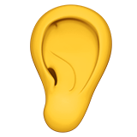


Contact
:oriolbsch@gmail.com

