Slide 1

PROJECT TITLE
Gym fitness and tracker portal
Student 1: Muhammad Hamza Khan
Roll No :- 2502941
Student 2: Muhammad Awais Bajwa
Department:
Dept. of Software engineer
Roll No :- 2502587
Supervisor: Sir Zulfiqar Ali
Date of submission:-
08/03/2026

Slide 2
PROJECT CATEGORY
Web based application system

Slide 3
ABSTRACT
The gym fitness and workout progress tracking application is designed to help users maintain a structured and healthy fitness routine. Many individuals struggle with improper workout techniques, a lack of progress tracking, and poor communication with trainers. this system provides features such as workout plan management, bmi and calorie tracking, tutorial videos, and trainer-client communication. the application allows users to monitor their fitness progress and receive professional guidance. the goal of this project is to improve workout efficiency, safety, and motivation.

Slide 4
IS THIS RESEARCH BASED PROJECT?
NO
This project focuses on system development rather than research paper implementation

Slide 5
PURPOSE OF PROJECT
Key Goals
Impact
Local impact
It is a web-based platform designed to help manage gym activities digitally.
Members can track workouts, diet plans, and fitness progress.
It offers exercise tutorial videos and includes a fitness calculator for BMI and calorie tracking.
The platform facilitates communication between members and trainers.
Administrators can manage memberships, trainers, and gym resources effectively.
It enhances gym management and boosts fitness tracking efficiency.
This system will help local gym members and fitness beginners track their workouts, diet, and progress easily. It will also help trainers guide their clients better.
International impact
This system will be used worldwide. This project supports the global trend of using digital technology to improve health and fitness management.
Professional impact
This project will help students learn important software development skills such as web/mobile development, database management, API integration, and user interface design.

Slide 6
System overview
What problem does your software solve?
Does similar system already exist ?
Yes
This kind of system already exist but our purpose to implement this kind of system will help us learn about complex system behind full stack development including back-end, front-end , and complex logic behind BMI calculator, calorie tracker and multi health indicator
It provides direct trainer communication to prevent incorrect workouts and uses a centralized system to track nutrition, BMI, and visual progress in one place.
Why are we developing this project?
We are developing this project to help client connect with trainer to make sure that clients receive proper guidance, tips and help them achieve their fitness goals
What skill will we learn from this project?
We expect to learn and gain experience to make full stack development , development of database , implementation of API and website design
2023

Slide 7
PROBLEM STATEMENT
CLIENTS CAN’T EASILY COMMUNICATE WITH THE TRAINER FOR LONG HOURS FOR TIPS, GUIDANCE, AND CORRECTIONS.
WHEN PEOPLE TRY TO FOLLOW A DIET, THEY FAIL TO CALCULATE CALORIE INTAKE, PROTEIN REQUIREMENTS, OR BALANCED MICRONUTRIENTS
EXERCISING ALONE FOR A LONG TIME WITHOUT ENCOURAGEMENT, ACHIEVEMENT, OR PROGRESS TRACKING VISUALLY LOSES COMMITMENT AND MOTIVATION
MANY PEOPLE ONLY TRACK WEIGHT, IGNORING BODY FAT PERCENTAGE, MUSCLE MASS, AND OTHER HEALTH-IMPORTANT FACTORS
WITHOUT PROPER DEMONSTRATION AND SUPERVISION, USERS PERFORM THE WORKOUT INCORRECTLY, INCREASING INJURY RISK
MOST PEOPLE DON’T HAVE A DEFINED GOAL (WEIGHT LOSS OR WEIGHT GAIN), WHICH LEADS TO CONFUSION AND SLOW PROGRESS
USER TRACKS BMI, WEIGHT, CALORIES, AND WORKOUT SEPARATELY, WHICH MAKES IT HARD TO ANALYZE PROGRESS
USERS DON’T RECEIVE FEEDBACK ON PERFORMANCE IMPROVEMENT, WORKOUT INTENSITY, OR GOAL ACHIEVEMENT RATE.

Slide 8
PROPOSED SOLUTION
THIS SYSTEM WILL PROVIDE DIRECT COMMUNICATION WHERE CLIENT CAN INTERACT WITH TRAINER DIRECTLY FOR GUIDANCE TIPS OR WORKOUT CORRECTION
IT WILL INCLUDE A DIET AND NUTRITION TRACKING MODULE THAT AUTOMATICALLY CALCULATES CALORIES, PROTEINS, AND OTHER NUTRIENTS
THE APPLICATION WILL SHOW VISUAL PROGRESS TRACKING WITH GRAPHS AND REPORT TO KEEP USERS MOTIVATED AND COMMITTED TO THEIR GOALS
USERS WILL BE ABLE TO MONITOR MULTIPLE HEALTH INDICATORS SUCH AS BMI, BODY FAT PERCENTAGE, WEIGHT AND WORKOUT PERFORMANCE
USERS CAN SET SPECIFIC FITNESS GOAL SUCH AS WEIGHT LOSS, MUSCLE GAIN, OR ENDURANCE PERFORMANCE
ALL FITNESS DATA SUCH AS BMI, CALORIES, WORKOUTS, AND PROGRESS WILL BE STORED IN ONE CENTRALIZED SYSTEM FOR EASIER ANALYSIS
TRAINER WILL BE ABLE TO TRACK PROGRESS AND MONITOR CLIENT PROGRESS TO IMPROVE WORKOUT PERFORMANCE AND ACHIEVE FITNESS GOAL

Slide 9

Advantages
Efficient Workout Management
Helps users organize and follow structured workout plans easily.
Health Monitoring
Features like BMI calculator and progress tracking help users monitor their fitness condition.
Nutrition Tracking
Allows users to track daily calorie intake and maintain a balanced diet.
Improved Communication
Enables interaction between trainers and users for guidance and feedback.
Progress Visualization
Graphs and reports help users see their fitness improvements over time.
User-Friendly Interface
Simple and modern design makes the system easy to use.

Slide 10
Related system analysis
APPLICATION NAME
WEAKNESS
PROPOSED SOLUTION
IT MAINLY FOCUSES ON DIET AND CALORIE TRACKING
There is no guidance from trainer for proper workout
There is no communication between trainer and clients
OUR PROJECT WILL INTEGRATE DIET, WORKOUTS, AND TRAINER-CLIENT CHAT
MYFITNESSPAL
JEFIT
IT HAS MANY EXERCISES BUT IS TOO COMPLICATED FOR BEGINNERS TO USE
A SIMPLE AND CLEAN DESIGN THAT GUIDES USERS STEP BY STEP
IT USES AI TO PICK WORKOUT BUT WON’T FIX YOUR POSTURE OR FORMS
ALLOWS DIRECT FEEDBACK FROM CLIENT FOR PROPER GUIDANCE AND TIPS
FITBOD

Slide 11
SCOPE OF PROJECT & MAJOR FUNCTIONALITIES
SCOPE OF PROJECT
The scope of the Gym Fitness and Workout Progress Tracking Application is to design and develop a centralized fitness management system that helps users monitor workouts, track health metrics, and communicate with trainers efficiently. The system will integrate multiple functionalities to improve fitness tracking and user engagement.
MAJOR FUNCTIONALITIES
User registration and login
User registration, login authentication, and profile management.
Progress Monitoring & Data Visualization
Displaying fitness progress through graphs and reports.
Workout Management System
Creation and assignment of personalized workout plans.
Trainer–Client interaction
Communication System Messaging platform for guidance and feedback.
Exercise Tutorial videos
Video and instructional guides for safe workout execution.
Nutrition & Health Tracking Monitoring BMI, calorie intake, and other fitness indicators.

Slide 12
MODULE OVERVIEW
Module 1: User Management
Handles user registration, login authentication, and profile management for trainers and clients.
The proposed Gym Fitness and Workout Progress Tracking Application will consist of several functional modules that work together to manage fitness activities, monitor user progress, and improve trainer–client interaction.
Module 2: Workout Management
Allows trainers to create and assign workout plans while users can view, complete, and track their exercise routines.
Module 3: Nutrition & Health Tracking
Module 5: Trainer–Client Communication
Tracks BMI, calorie intake, and other health-related data to help users maintain balanced fitness goals.s.
Provides a messaging platform for trainers and clients to communicate, share guidance, and provide feedback.
Module 4: Progress Monitoring & Data Visualization
Module 6: Exercise Tutorial System
Displays workout progress, weight changes, and performance statistics through charts and reports.
Provides instructional videos and guides to help users perform exercises correctly and safely.

Slide 13
MODULE 1:
USER MANAGEMENT MODULE
Description
The User Management Module handles user registration, login authentication, and profile management for both trainers and clients. It ensures secure access to the system and allows users to maintain their personal fitness information.
Key Features
User registration and login
Secure authentication system
Profile management (age, weight, height, goals)
Role management (trainer / client)

Slide 14
Description
The Workout Management Module allows trainers to create and assign personalized workout plans based on user fitness goals. Users can view their daily workout routines, mark exercises as completed, and maintain a workout history
KEY FEATURES
Create and assign workout plans
Daily exercise schedule
Workout completion tracking
Workout history records
MODULE 2
WORKOUT MANAGEMENT MODULE

Slide 15
Description
This module helps users monitor their fitness progress through visual reports and performance statistics. It collects health data such as weight, BMI, calories burned, and workout performance.
KEY FEATURES
BMI and calorie tracking
Weight progress monitoring
Charts and graphs for progress visualization
Performance analysis
MODULE 3
PROGRESS TRACKING & DATA VISUALIZATION MODULE

Slide 16
Description
This module allows users to monitor their daily nutrition and calorie intake. It helps users maintain a balanced diet by tracking protein, calories, and other nutritional information according to their fitness goals.
KEY FEATURES
Calorie intake tracking
Protein and nutrition monitoring
Diet plan recommendations
Daily nutrition records
MODULE 4
NUTRITION & DIET TRACKING MODULE

Slide 17
Description
This module enables communication between trainers and clients through a messaging system. Trainers can provide guidance, feedback, and workout corrections to help users achieve their fitness goals effectively.
KEY FEATURES
Direct messaging system
Trainer feedback and guidance
Workout advice and corrections
Progress discussion between trainer and client
MODULE 5
TRAINER–CLIENT COMMUNICATION MODULE

Slide 18
Description
The Exercise Tutorial Module provides instructional videos and guides for different workouts. It helps users learn the correct exercise techniques and reduces the risk of injury during workouts.
KEY FEATURES
Exercise tutorial videos
Step-by-step workout instructions
Equipment usage guidance
Safe exercise practices
MODULE 6
EXERCISE TUTORIAL MODULE

Slide 19
Limitations & Constraints
1
2
3
4
User Accountability:
Connectivity:
Payment Simulation:
Content Scope:
The system relies on self-reported workout data; it cannot physically verify if a user completed their set.
The portal requires a stable internet connection for real-time trainer chat and progress syncing.
Due to the scope of an Intro to SE project, the "Protein Shop" uses a simulated checkout rather than a live banking AP
The exercise library is limited to pre-uploaded tutorials and does not support live video streaming sessions.

Slide 20
Process & Design Methodology
Process: Agile
Why?
Allows for iterative development. We can deploy the "Login" and "Calculators" first, gather feedback, and then refine the "Trainer Chat" and "Protein Shop" modules.
Design: Object-Oriented Design (OOD)
Why?
The system is built around distinct entities (User, Member, Trainer, DietPlan). Using OOD allows for modularity and easier maintenance of the code.
the selection of model is not confirme yet

Slide 21
Tools & technology used
TOOLS AND TECHNOLOGY
VERSION
RATIONALE
VSCODE
LATEST
IDE FOR CODING DEVELOPMENT
SQL DATABASE
LATEST
DATABASE MANAGEMENT SYSTEM
FIGMA
LATEST
UX/UI DESIGN AND WIREFRAMES
PENCIL
3.1
MOCKUP CREATION
MS WORD
2019/365
DOCUMENTATION
HTML
5
WEBPAGE STRCUTURE
CSS
3
WEBPAGE STYLING
JAVASCRIPT
ES6
INTERACTIVE WEB FUNCTIONALITY
BOOTSTRAP
5
RESPONSIVE UI FRAMEWORK
SQL
LATEST
DATABASE QUERY LANGUAGE
CANVA
LATEST
DESGIN WORK AND PRESETATION GRAPHICS

Slide 22
Project StakeHolders
Project Sponsor:
Air University, Islamabad
(Academic Authority)
Primary Users:
Gym members (end-users)
Fitness Trainers (content creators)
System Admins (management)
Development Team:
Responsible for
Requirement analysis
Full-stack development
Testing
Project Supervisor:
Provides technical oversight and validates system architecture

Slide 23
Information & Requirement Gathering
Targeted Interviews:
Held discussions with local gym managers to understand the workflow of membership management and trainer-client interactions.
Conducted a survey via Google Forms among fitness enthusiasts to prioritize features like BMI tracking and diet suggestions.
Evaluated existing fitness portals (e.g., FitnessPal, Fitbit) to identify gaps in trainer-to-member communication.
This multi-tier approach ensures the portal is built on actual user pain points rather than assumptions.
Competitive Analysis:
User Survey:
Reasoning:

Slide 24
Learning Concept
Database Management
Understanding how to store and manage user data such as workout records, diet plans, and progress information using SQL databases. This concept helps maintain organized and efficient data storage.
Responsive Web Design
Learning how to design web pages that automatically adjust to different screen sizes using HTML, CSS, and Bootstrap to ensure a good user experience on desktops, tablets, and mobile devices.
Client-Side Scripting
Using JavaScript to add interactivity to the website such as updating workout progress, displaying notifications, and handling user input without reloading the page.
CRUD Operations
Implementing Create, Read, Update, and Delete operations to manage workout plans, user profiles, and fitness data stored in the database.
UI/UX Design Principles
Applying design principles using Figma and Canva to create an easy-to-use interface that improves user interaction with the fitness application.

Slide 25
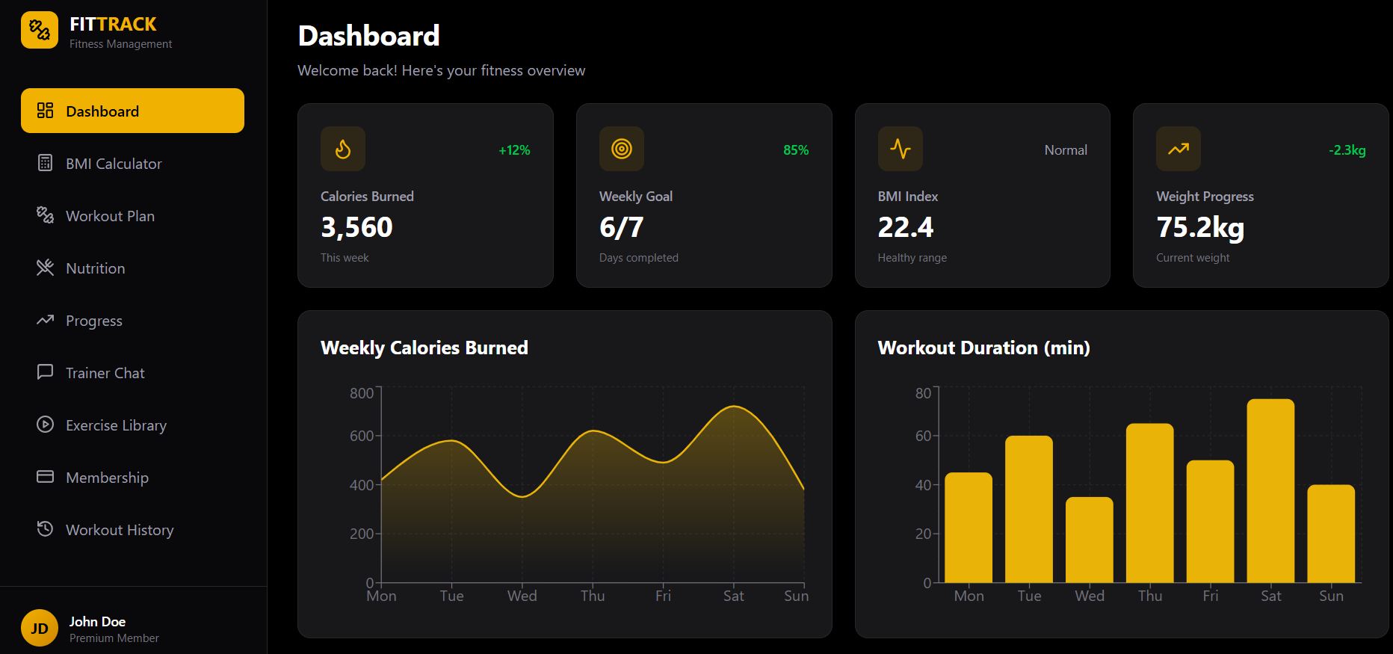
MOCKUP 1: MAIN DASHBOARD OF FITNESS MANAGEMENT SYSTEM

Slide 26
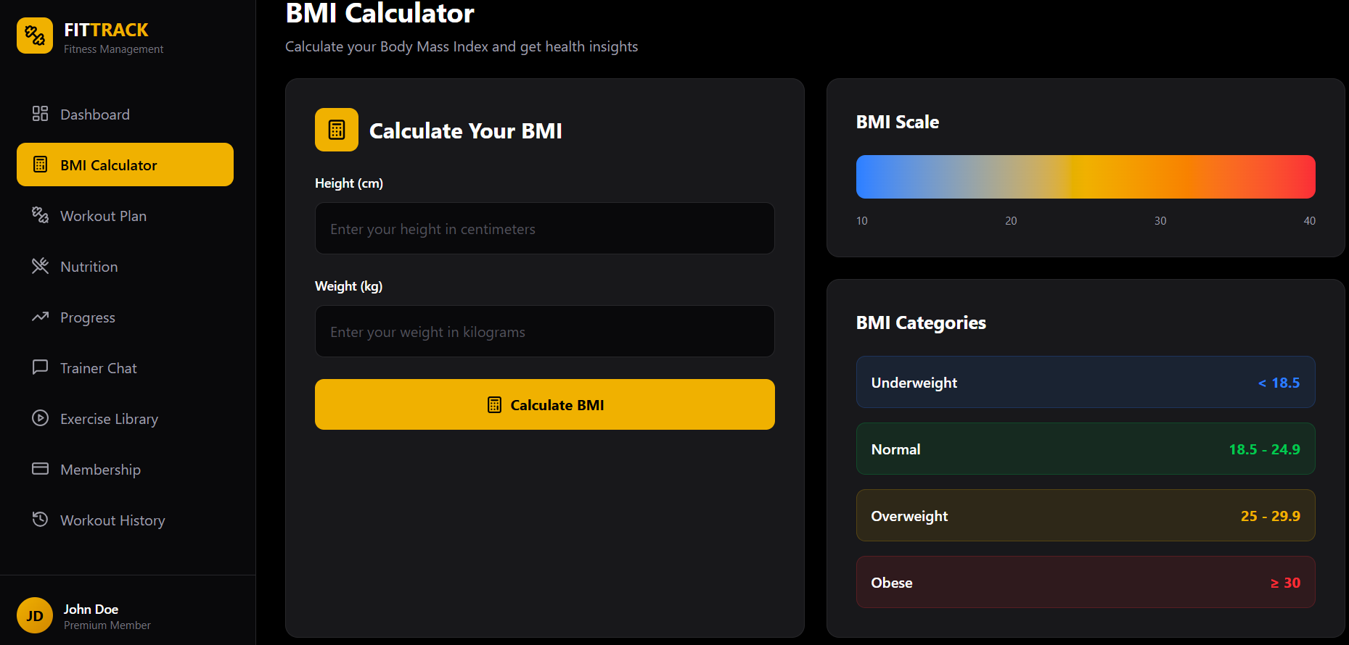
MOCKUP 2: BMI CALCULATOR INTERFACE FOR HEALTH MONITORING

Slide 27
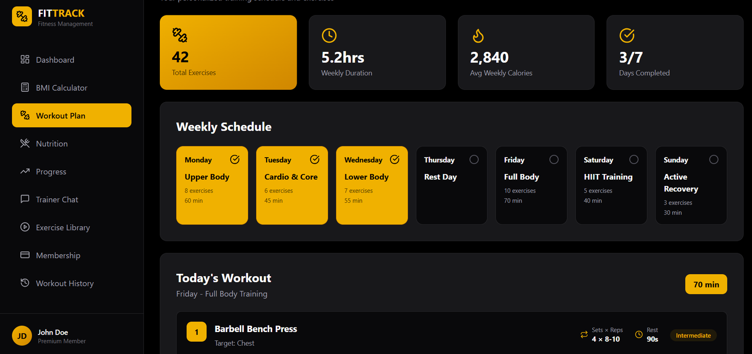
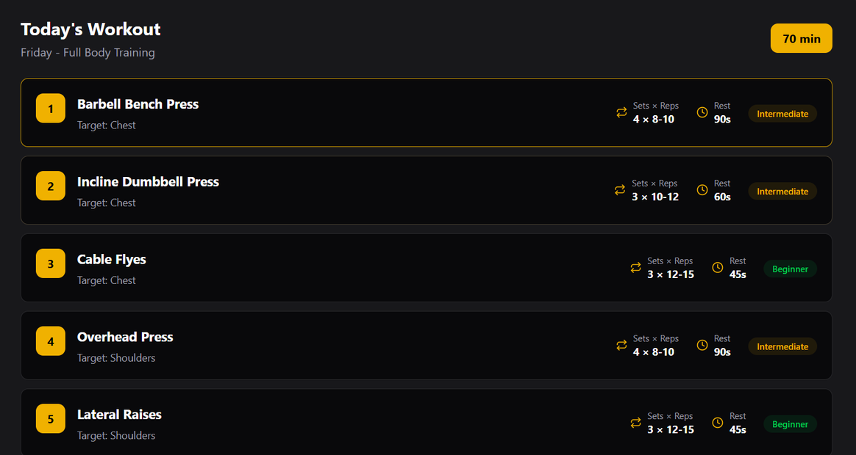
MOCKUP 3:
WORKOUT PLAN MANAGEMENT INTERFACE

Slide 28
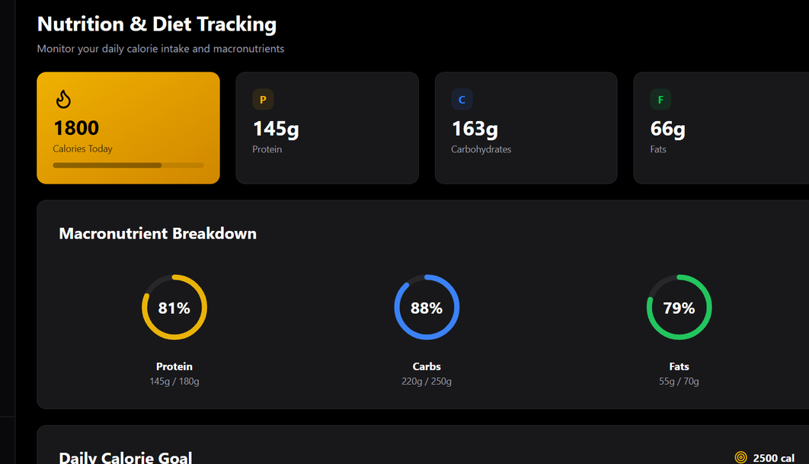
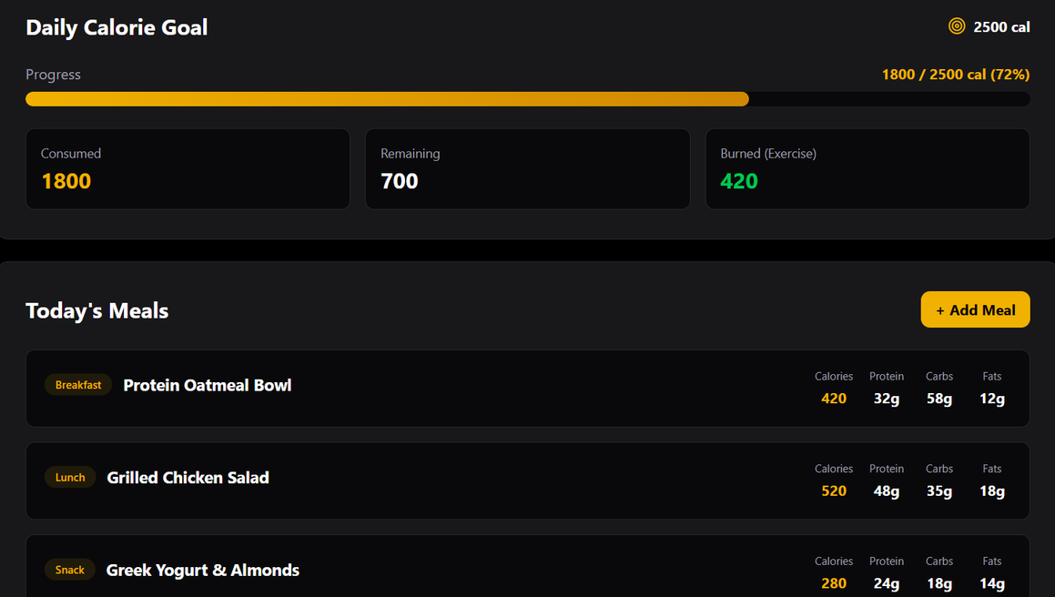
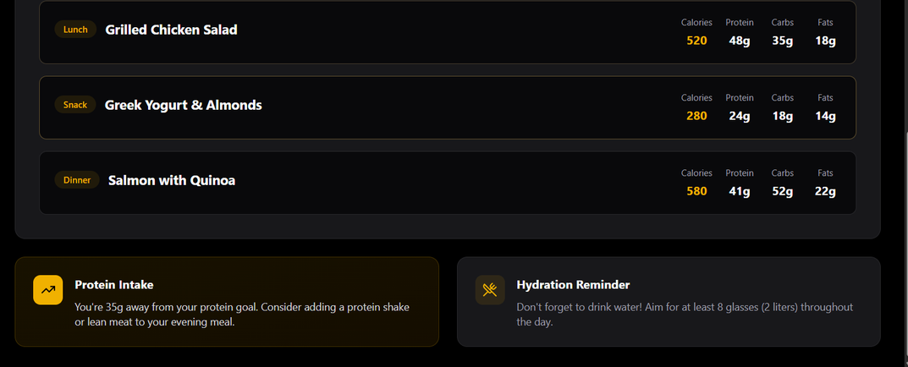
MOCKUP 4:
NUTRITION AND DIET TRACKING INTERFACE

Slide 29
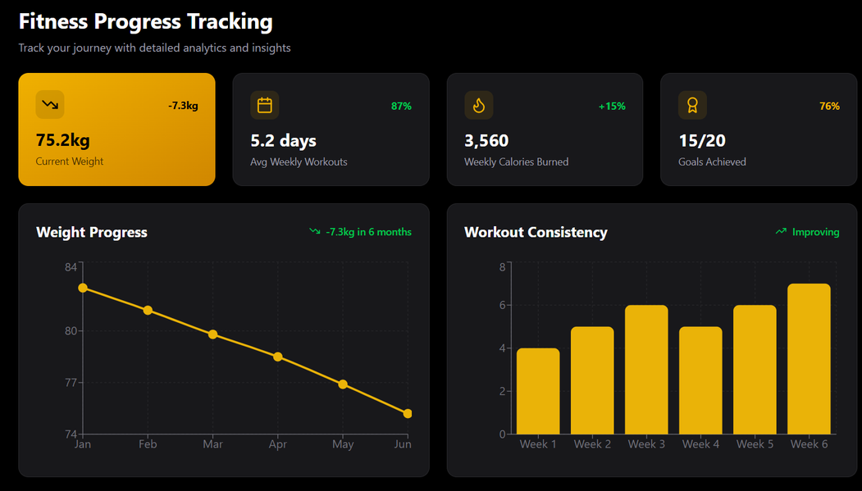
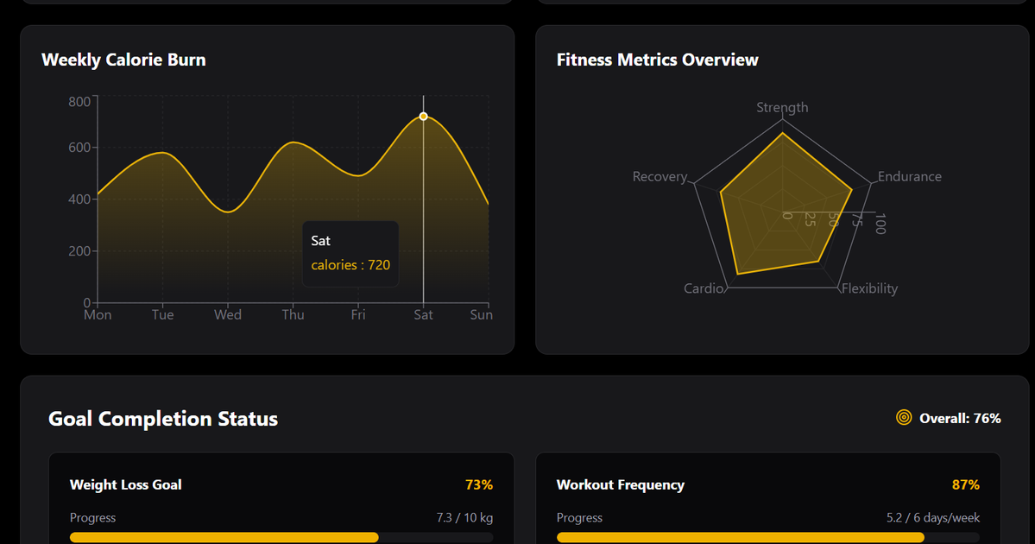
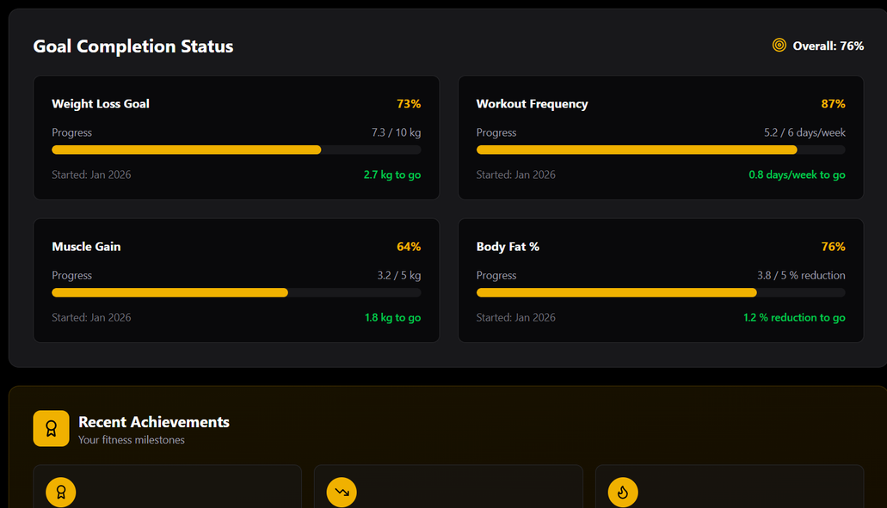
MOCKUP 5:
FITNESS PROGRESS MONITORING DASHBOARD

Slide 30
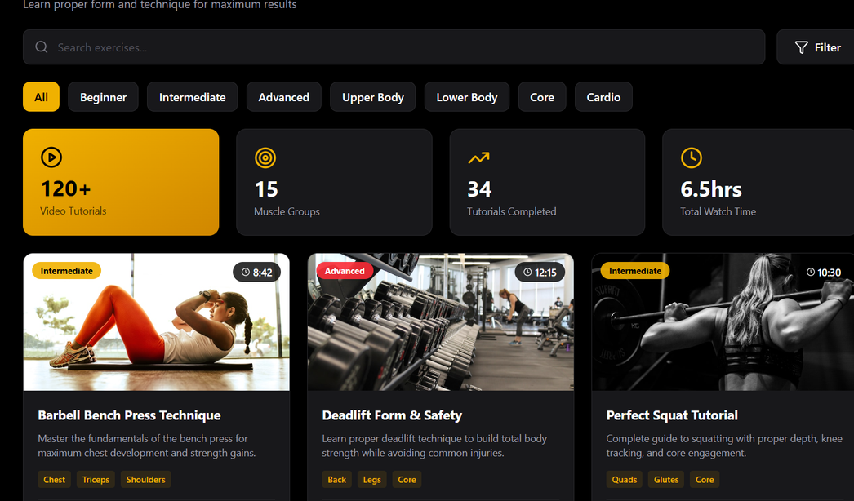
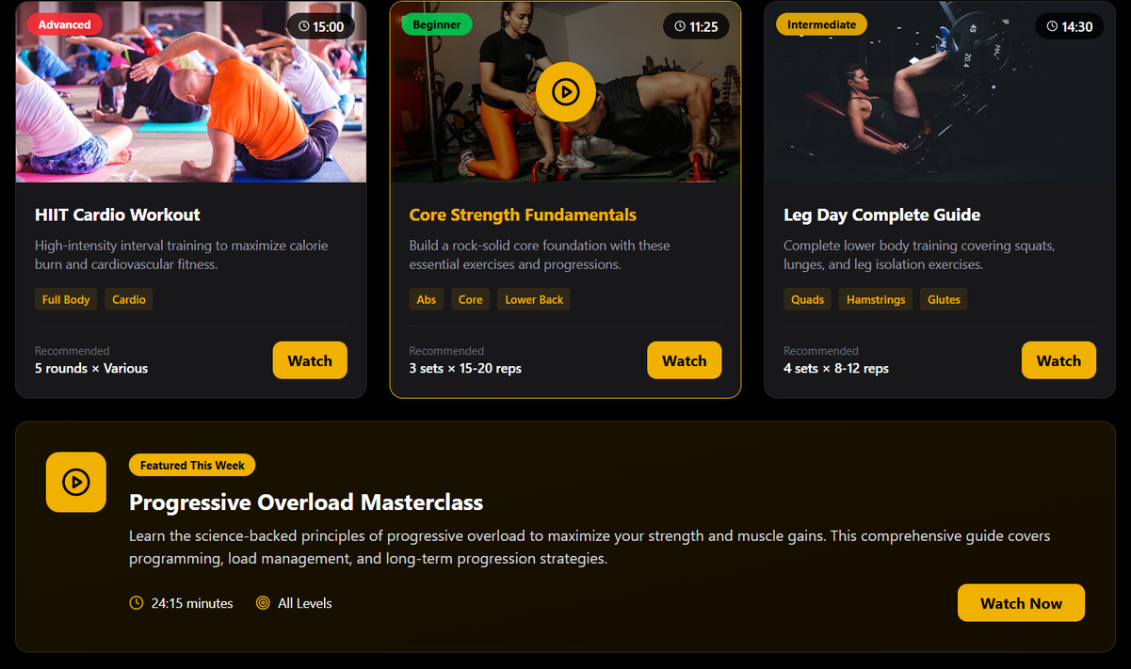
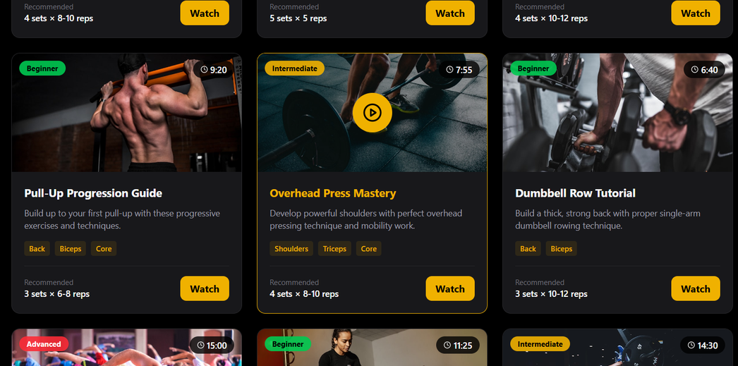
MOCKUP 6:
EXERCISE TUTORIAL VIDEOS INTERFACE

Slide 31
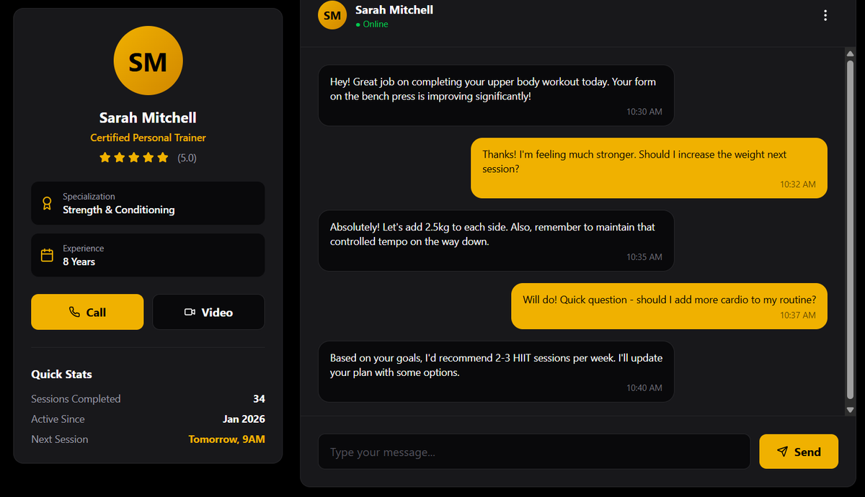
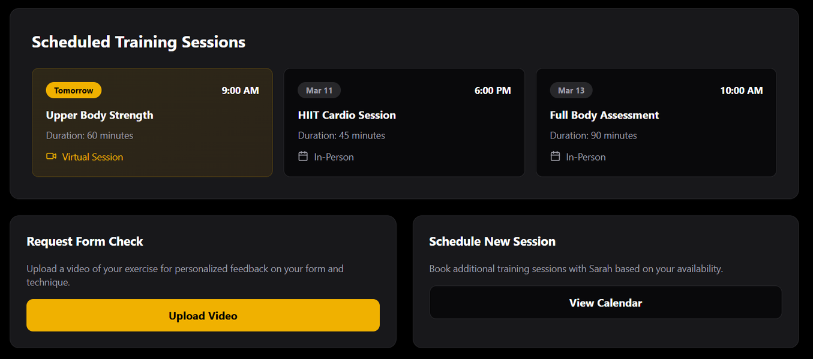
MOCKUP 7:
TRAINER-CLIENT COMMUNICATION INTERFACE

Slide 32
Teamwork division
STUDENT NAME
REGISTRATION NO
WORK/RESPONSIBILITY
DESIGN THE WEB INTERFACE (DASHBOARD, LOGIN/SIGNUP, WORKOUT TRACKING PAGE)
Implement responsive layouts (HTML, CSS, Bootstrap)
Integrate charts and graphs for statistics, BMI, calorie burn
Handle user input forms
(workout logging, profile updates)
MUHAMMAD HAMZA KHAN
2502941
SET UP DATABASE (USERS, WORKOUTS, PROGRESS)
Write APIs for login, registration, and data CRUD (Create, Read, Update, Delete)
Calculate stats like BMI, calorie burn, weekly progress
Ensure data validation and security
AWAIS BAJWA
2502587

Slide 33
REFERENCES
Canva:
for making slides
Figma & Dribble:
for templetes and design
Pinterest:
for ideas
Bootstrap:
Thompson, W. R. (2020). ACSM’s Guidelines for Exercise Testing and Prescription (10th ed.). Philadelphia, PA: Wolters Kluwer.
Baechle, T. R., & Earle, R. W. (2008). Essentials of Strength Training and Conditioning (3rd ed.). Champaign, IL: Human Kinetics.

Slide 34
CONCLUSION
The Gym Fitness and Workout Management System is designed to help users manage their fitness activities efficiently. The system provides features such as workout plan management, nutrition tracking, BMI calculation, and progress monitoring to support users in achieving their fitness goals.
By using modern web technologies, the application offers a user-friendly interface and organized data management. It helps improve workout planning, track fitness progress, and enhance communication between trainers and users.
Overall, the system provides a convenient digital platform for managing gym activities and promoting a healthier lifestyle.

Slide 35



