Slide 1
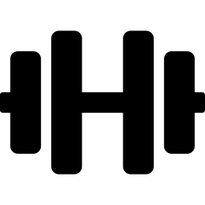
GYM FITNESS TRACKER
PORTAL SYSTEM
Muhammad Hamza Khan | Roll No: 2402941
Awais Bajwa | Roll No: 2502857

Slide 2


Introduction
What we built and why it matters
What is the System?
A web-based portal for tracking personal gym and fitness activities
Connects gym members with their trainers on one platform
Provides real-time insights through interactive dashboards
Purpose of the Project
Help users monitor workouts, nutrition, weight & BMI in one place
Eliminate scattered manual tracking with a centralized solution
Enable trainers to guide clients effectively through real-time chat

Slide 3


Problem Statement
Challenges faced by gym members and trainers today
No Centralized Tracking
Manual Tracking is Difficult
No Real-Time Progress Monitoring
Members use multiple disconnected apps or paper logs to track workouts and diet.
Recording every meal, exercise, and weight manually is tedious and error-prone.
Neither trainers nor clients can see live progress or trend data as it happens.

Slide 4
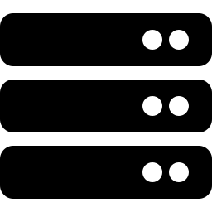


Proposed Solution
Our answer to the problem
Web-Based Fitness Tracking Portal
A single platform accessible from any browser — no app installation needed.
Real-Time Updates & Live Charts
Progress charts and stats update instantly whenever new data is added.
Trainer–Client Interaction
Trainers can send workout suggestions and chat directly with clients.
Secure & Role-Based Access
Separate dashboards for trainers and clients with JWT authentication.

Slide 5


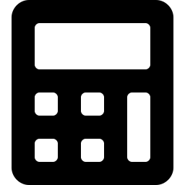


Key Features
Login & Registration
Dashboard with Charts
BMI Calculator
Nutrition Tracking
Workout Logging
Progress Tracking
Trainer–Client Chat

Slide 6
System Modules
Core building blocks of the portal
Authentication Module
Workout Module
User registration, login, JWT token management
Log exercises, sets, reps; receive trainer plans
Dashboard Module
Progress Module
Charts for BMI, calories, workout frequency
Weight history and trend visualization
Nutrition Module
Chat Module
Log daily meals, calories, macros
Real-time Socket.IO messaging between roles

Slide 7


Authentication & Security
How we keep user data safe
JWT Middleware for Route Protection
Every protected API route verifies a JSON Web Token before allowing access.
Password Hashing Using bcrypt
Passwords are never stored in plain text — bcrypt hashes them with a salt.
Token-Based Authentication (7 days)
Tokens expire after 7 days, requiring users to re-authenticate for security.

Slide 8
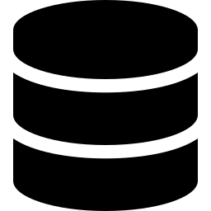
Database Design
Users
Workouts
Nutrition
id, name, email, role, password
id, user_id, exercise, sets, reps
id, user_id, food, calories, date
Progress
Chat
id, user_id, weight, bmi, date
id, sender_id, receiver_id, message
SQLite Database • Default trainer account pre-seeded on startup

Slide 9

Backend Implementation
Server-side technology stack
Node.js Backend
Server-side JavaScript runtime — fast, lightweight, and non-blocking.
Express.js Server
Minimal web framework for defining RESTful API routes and middleware.
Async/Await with Promise Wrapper
All database queries wrapped in promises for clean asynchronous code flow.

Slide 10
Real-Time Chat System
Trainer–client communication powered by Socket.IO
Socket.IO Integration
Full-duplex WebSocket connection between server and connected clients.
Room-Based Communication
Each trainer–client pair communicates in a private room for isolation.
Messages Stored in Database
All chat messages are persisted so history is available after reconnect.

Slide 11
Workout & Progress System
Role-Based Workout Handling
Trainer Sends Suggestions
Trainers and clients see different workout views based on their role.
Trainers can recommend specific exercises for each client.
User Logs Workouts & Weight
Charts Update Dynamically
Clients record completed exercises, sets, reps, and daily weight.
Dashboard charts re-render automatically whenever new entries are added.

Slide 12
How the System Works
Step-by-step user flow
1
Register / Login
User creates an account or logs in with credentials
2
Dashboard Loads
Charts and stats are fetched and displayed instantly
3
Add Data
User logs food, workout, or weight entries
4
Charts Update
Dashboard auto-refreshes with the latest data
5
Trainer Interacts via Chat
Trainer sends advice or workout suggestions in real time

Slide 13
System Diagrams
Use Case Diagram
Activity Diagram
Sequence Diagram
Shows actors (Trainer, Client) and their interactions with the system such as login, log workout, send message, and view charts.
Illustrates the flow of activities from login through data entry, chart rendering, and trainer-client communication.
Depicts the step-by-step message flow between the browser, Express server, SQLite database, and Socket.IO during key operations.
[Diagram Placeholder]
[Diagram Placeholder]
[Diagram Placeholder]
Insert your actual UML diagrams in the placeholders above

Slide 14
Code Highlights
Key implementation snippets
JWT Middleware
const token = req.headers['authorization'];
if (!token) return res.status(401).json({error});
const decoded = jwt.verify(token, SECRET_KEY);
Login & Registration Logic
const hash = await bcrypt.hash(password, 10);
await db.run('INSERT INTO users...');
const token = jwt.sign({id, role}, SECRET, {expiresIn:'7d'});
Workout Suggestion Function
socket.on('send_suggestion', async (data) => {
await db.run('INSERT INTO workouts...');
io.to(roomId).emit('new_suggestion', data);
});

Slide 15


Conclusion
What we achieved with this project
Improved Fitness Tracking
Users can now track workouts, nutrition, BMI, and weight in one place.
Easy to Use
Clean dashboard interface with intuitive navigation for all users.
Real-Time Monitoring
Charts and trainer chat update live without needing to refresh the page.
Connected Trainer–Client Pair
Trainers can actively guide and support clients through the portal.

Slide 16



Future Improvements
Where we want to take this next
Mobile App Version
AI-Based Recommendations
Cloud Database Integration
Develop a native iOS/Android app for tracking on the go.
Use machine learning to suggest personalized workout and diet plans.
Migrate from SQLite to PostgreSQL or Firebase for scalability.
Thank You | Questions?

