Slide 1
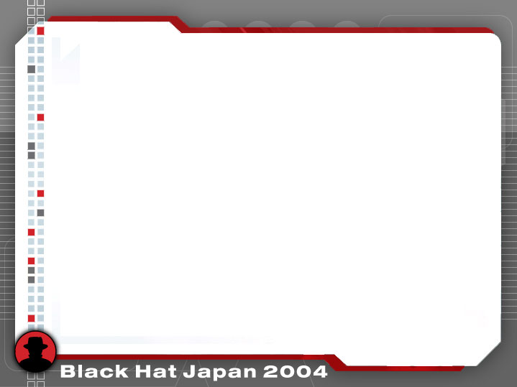
Capture the Flag Games
Measuring Skill with Hacking Contests
By Riley “Caezar” Eller
Notes:
About the Speaker:
Director of Special Projects for CoCo Communication Corp., a secure wireless mesh networking company
Founding member of the Ghetto Hackers; 3-time DEFCON Capture the Flag winners
Scoring Architect of the Root Fu game series

Slide 2
Security Training Problems
Computer security problems are here to stay
Hackers know more than administrators
Consultants are hard to measure
Administrators need to minimize the delay between discovering a vulnerability and patching the problem
Notes:
These problems will not disappear, even with consistent inspection and defense. The nature of testing is always to be ahead of development.
Each hacker needs to focus on only one problem, every administrator needs to be prepared for all problems. There is no way to completely catch up.
It is crucial that administrators learn about hackers as well as measure the skills of their consultants. This will minimize the number of hackers in the world who are able to exploit a particular vulnerability before it is corrected.

Slide 3
Solution: Security Games
“Capture the Flag” or “CTF” games
  Spread security techniques
  Measure security skill
  Strengthen technical and management skills
CTF is difficult because
  Security is arduous work
  Player skill varies greatly
  Scoring is often imbalanced or indeterminate
Notes:
Many people worry about security contests as if the game encouraged criminal behavior. Quite the opposite, they bring out the best in the players, encourage information sharing and result in better-skilled professionals. A hidden value is that if the game is carefully planned, we can use the results to evaluate the capabilities of the teams. This can be seen as a breakthrough since, up until now, it has been challenging to compare the talents of different security personnel.
The complexity of the security field is so high that it is almost impossible to measure. Making a game with a clearly defined winner is even more difficult as players may not find the scoring to be balanced or fair. Failure means the players may lose interest or quit altogether.

Slide 4
Spreading Security Techniques
Accelerating the learning curve of our administrators is critical
Convincing hackers to demonstrate their tricks in public is an exceptionally good way to do this
Security professionals can take what they learn back to work
Notes:
Since hackers will always be more advanced than administrators, it is beneficial to learn their tricks as early as possible. The only other option is to wait and be victimized.
Many hackers will demonstrate new skills in order to win prizes or recognition in a public forum if the rewards are sufficiently large. This is yet another reason corporations should subsidize these contests.
Security professionals can learn from hackers during these events, in a setting conducive to information sharing.

Slide 5
Measuring Security Skill
It is difficult to measure the value of security consultants and employees
“Capture the Flag” games have matured in the 21st century
With a well-considered scoring system, these games can be used to accurately measure player skill
Notes:
Due to the nature of computer security auditing, no two people will perform identically in a given test even if they have identical talents. There are simply too many ways that a security vulnerability can be exploited for any person to evaluate all of them.
Rather than run away from the problem, we can use a completely different approach. We can use carefully constructed games to measure skills relative to other people or teams. In this way, we can determine if two players have incongruent capabilities because one of them will emerge victorious.

Slide 6
Learning From Performance
Careful event logging allows us to measure
  Effectiveness
  Responsiveness
  Team Coordination
Learn more from competition than testing
Notes:
Using a fine-grained database to track the events during a game, we can measure subtle traits like coordination, responsiveness, and effectiveness. Combining these traits, we can derive ranks for players’ capabilities.
Using competition avoids “stale” scores like those found in standardized tests. Furthermore, standardized tests encourage the subject only to study the test itself rather than developing broad skills.

Slide 7
Capture the Flag
Originally a children’s game to simulate small team combat, based on defending an immobile flag while trying to capture the flag of the other team
Now, generally any game where teams defend and attack symmetrical targets simultaneously
Notes:
The “Capture the Flag” format is ideally suited to the security world because it is a physical manifestation of the digital reality. The game is played by small teams just like networks are defended by small teams. Any person can win the game just like any hacker could penetrate a network’s defenses. The best players coordinate their efforts just like administrators should. Subtlety and deception are similarly effective in both situations.

Slide 8
DEFCON Game History
Early years
  Initially there were free terminals provided for conference attendees, who immediately tried to print text on the screens of other users
Notes:
This is the standard game playing behavior we should expect wherever 18-25 year-old males congregate. Nothing was learned, no information shared.

Slide 9
DEFCON Game History
DEFCON 4
  Formalized game with several servers provided as hacking targets
  Judges were used to decide when a machine had been hacked and then awarded a point
Notes:
Here the contest begins to take shape. The game measured certain narrow categories of skill, but nothing exists today as a public record for learning from the outcome. There is no evidence to support any claim that the contest was fair or that the results are meaningful today.

Slide 10
DEFCON Game History
DEFCON 5 and 6
  Invited participants either to provide a server to be attacked, or to attack the provided servers
  Problems abounded due to lack of oversight, poor scoring systems, unreliable networks and poorly configured target servers
Notes:
The focus these two years was on reliability and automation. The organizers intended to add automatic scoring using PGP secret keys but that system never materialized. It takes a dedicated staff to solve these technical problems, which DEFCON did not have in the 1990s.

Slide 11
DEFCON Game History
DEFCON 7, 8 and 9
  Game was dominated by the Ghetto Hackers
  Chaotic blend of rule changes made the game unpredictable
  During these years, winning was about hacking the contest rather than hacking the servers
Notes:
This three-year period was most notably marked by the presence of the Ghetto Hackers “Drive-By Crew”. A group of hackers-turned-professionals, we concentrated for a year on developing a set of tools and tricks in order to win each contest. Every year, it became more obvious that the game required more attention to detail. Problems with rule changes negatively affected player morale and the game became stagnant.

Slide 12
DEFCON Game History
DEFCON 7, 8, and 9
  Other teams appeared to be competitive but Ghetto offense consistently overwhelmed the other teams
  After DEFCON 9, we decided to produce a superior contest, meant to truly measure security prowess
Notes:
After DEFCON 9, the Ghetto Hacker community created a team of volunteers to design and produce the CTF game for DEFCON 10. So much work and effort went into the design of the game that we made a new name for the format that has now become standard among security contests. While the format itself is still most like the children’s game Capture the Flag, the “Root Fu” game is our hallmark.

Slide 13
DEFCON Game History
DEFCON 10, 11 and 12
  Contest provided by the Ghetto Hackers, based on a scoring system designed by myself
  A few technical difficulties arose during DEFCON 11
  With three years of engineering, the system is mature and stable, easy to customize and operate
Notes:
I started to think about security contest scoring systems late in the year 2000, so by August 2002 we were well prepared to start a new era of games. The graphics proved to be the most unreliable element because we’re all network engineers, not graphic designers. This was most evident in the failed “Talking Head” experiment during DEFCON 11. The idea was to have an automated news anchor presenting dynamically generated stories every 15 minutes or so. Due to a combination of three software defects, the news presentation was abysmal.
For DEFCON 12 we reverted to a simple scoreboard interspersed with film clips found on the Internet. The system was stable and provided an excellent contest.

Slide 14
System Topology
Eight teams, arranged in a star pattern around a central network router
One CAT5 cable each, connected to a custom router port
Forward and reverse NAT hide all network addresses so teams cannot discriminate between each other and the scoring system
Notes:
The router itself is a Linux machine running several User Mode Linux (UML) processes, one for each team, one for the score collection program, and one to serve results to the scoreboard display computer. The systems see each other as an internal network whose IP addresses are completely hidden from the outside world. Using forward NAT, each team is given a Class C subnet. Using reverse NAT, connections inbound from other UML processes are disguised so they appear to originate from the team’s interface. In this way, teams cannot simply filter each other’s IP address to prevent attacks.

Slide 15
Scoring System
A virtual 9th team resides in the router
That machine runs in a loop, querying each of the other teams’ computers
These queries emulate normal usage, enabling many forms of attack
Players abuse these patterns to gain unauthorized access to protected information
Notes:
Currently, the score system uses this virtual 9th team to house a polling loop that is dissimilar to the process employed by the eight real teams. Eventually, we would like to give the service checking code to each of the teams as a way to verify their own performance and that of their opponents, and also as the mechanism for stealing information from each other. This would eliminate the possibility of detecting the difference between a live opponent and the central scoring robot.

Slide 16
Tokens
Periodically, the scoring system creates “tokens” for each service on the network
It transfers them to each team and then waits for a random duration to pass
While waiting, the system monitors the network to detect “information leaks,” which imply offensive scoring
Notes:
The score system maintains a single database of tokens, representing individual transactions with each service on each team during each time period. The polling cycle alternately adds tokens to the database and updates the status field that informs the scoring display. Stolen information causes additional tokens to be created, which are linked to the original stolen token through the parent_id field. In this way, we can track precisely when and how each intrusion causes information to flow through the network.

Slide 17
Token format
Tokens are three-part
  Expiration: time for the token to be in play
  Base: the hash of a random number
  Token: concatenation of the base plus a DSA signature of the base
Base-64 encoded for easy cut-and-paste
Notes:
Because we sign the tokens with a key known only to the router, it is impractical for a team to create forged tokens during the course of the contest. Token security means that the scoring system as well as the players can validate tokens to halt denial-of-service attacks. Adding a work token algorithm to prevent token request floods would be a good idea.
An example token:
Base: 7GalZRPcPRfpwYwi
Token: 7GalZRPcPRfpwYwiVxL7956J9Gv6WKDhuVeRbMs1dYOv31K4AAAuALaLv/9AwGNbrZk1zRD//o3YStmoAAAqAA==

Slide 18
Scoring Points
Periodically, the scoring system performs a “deposit” operation on each team’s services
Each deposit is timed for “withdrawal”
If another team penetrates system defenses to view a token, it can “exchange” the token using an upload script
Notes:
This system mimics the semantic of banking both because that was the DEFCON 12 CTF game theme and because financial transactions are a good model for any system in which the flow of information must be rigorously monitored. It is in this spirit that our token-based scoring system was created.

Slide 19
Scoring Points
Each token is scored as
  1 offensive point for the last team to exchange it when the token expires; OR
  1 defensive point for the owner if no team exchanges it; OR
  0 points if the owner loses the information by rebooting or otherwise discards it
Notes:
The actual token database used in the following slides, which contains the entire history of the game play at DEFCON 12, is stored in an Excel spreadsheet on the materials CD.

Slide 20
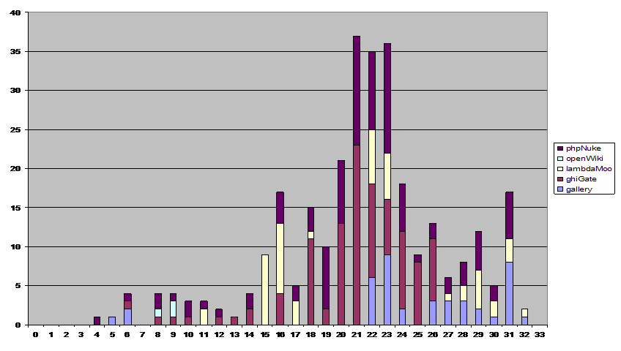
Offense (Yellow Team)
Notes:
The yellow team captured 302 tokens, primarily from the phpNuke and ghiGate services.

Slide 21
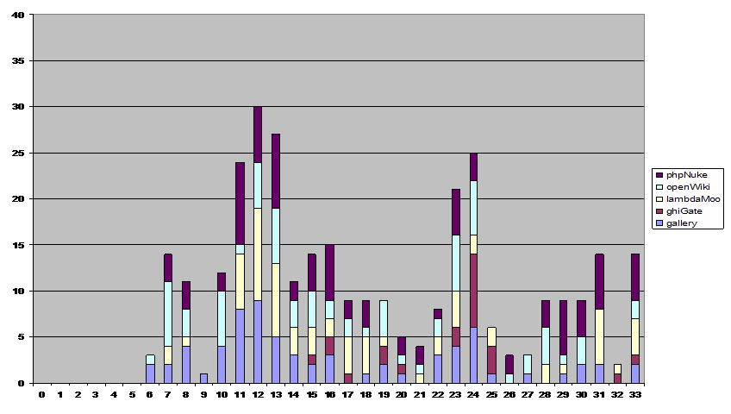
Offense (Red Team)
Notes:
Red team performed much more consistently throughout the contest. They successfully attacked every service against every team, leading to a consistent flow of points.

Slide 22
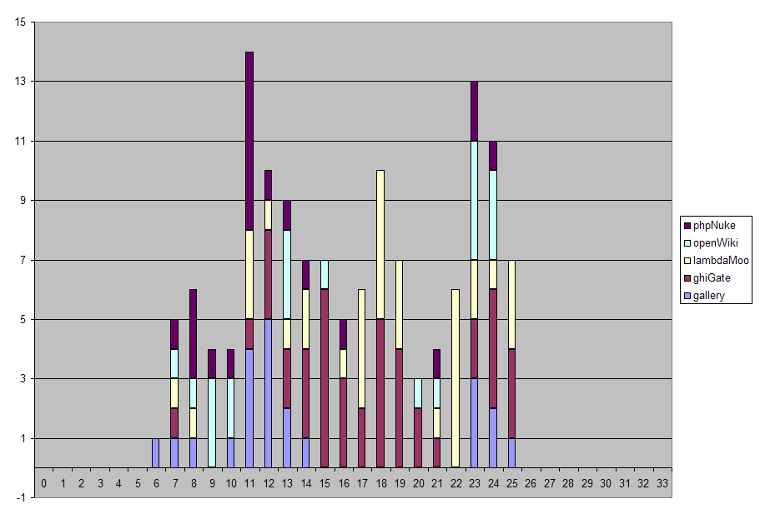
Total Attacks Against Yellow
Notes:
Here is a chart of every successful attack against the Yellow team. No service remained unscathed until the 26th hour, when their defense took control. After that point, yellow team was impermeable.

Slide 23
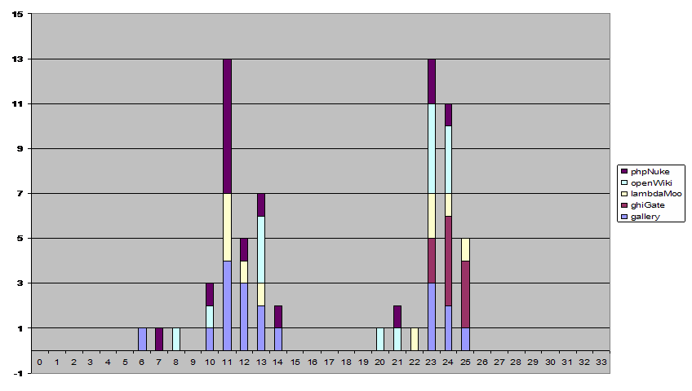
Red Attacks Yellow
Notes:
Here we see a detail view of the attacks from Red team against only the Yellow team. Compared to previous charts, attacks appear to be quite sparse. It is clear from the pattern that Yellow team had some successful defense in the middle of and toward the end of the contest. Referring to the previous slide, we can see that Red did not attack anyone for the first six hours, so there is no reason to believe that Yellow’s defense was well prepared at this point.

Slide 24
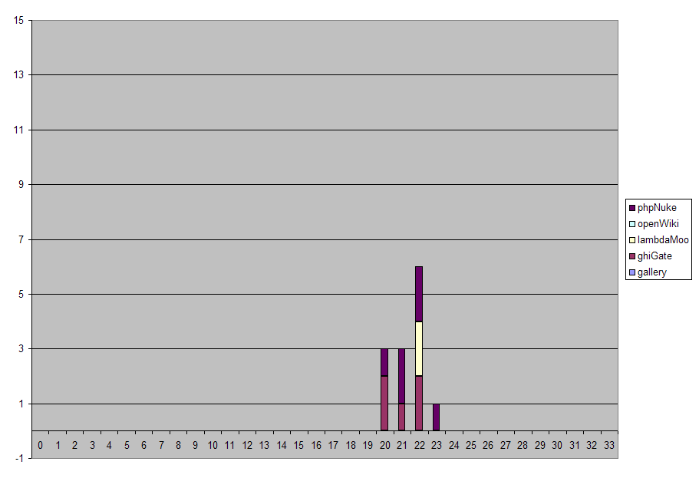
Yellow Attacks Red
Notes:
As you see here, Yellow was confined to 13 total points scored against Red, and then only during a four-hour period. Clearly, when contrasted against the previous chart, the Red team deserved the top ranking.

Slide 25
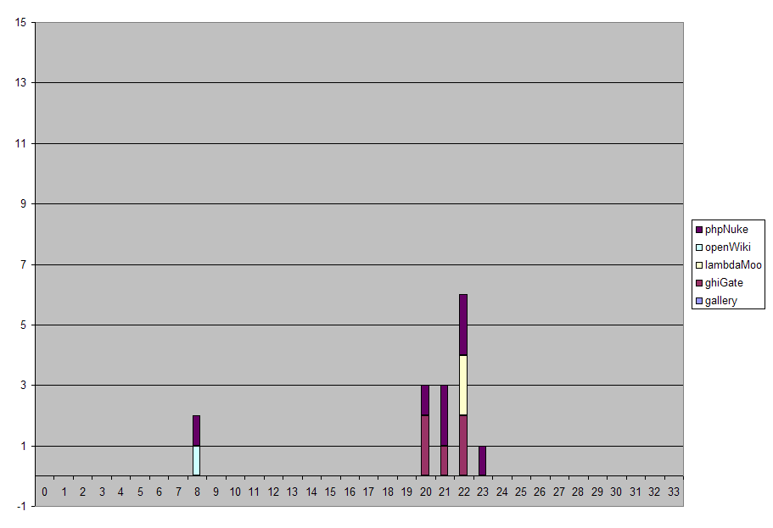
Total Attacks Against Red
Notes:
In fact, here we can see that only one other attack was ever successfully carried out against the Red team, during the hour eight. This is the kind of defense that should make a team proud. Unfortunately for our game, we should note that this team appears to have recognized a pattern in the game that revealed whether a request originated in the scoring system or an opposing team. For this reason, they were able to avoid almost any impact from offensive attacks. In the future, we will be more careful to ensure precisely identical communication from opponents and the scoreboard.
The specific difference was that packets originating from inside the router—for instance requests from the scoring system—had a TTL value one less than packets originating from other teams. Astute observers might have increased the TTL by 1 on their attacking machines to avoid this trap.

Slide 26
What We Learned
The scoring system determines the quality of the game
  Small, simple scoring events are much more accurate than larger, more complex ones
  Defensive scoring helps motivate teams early in the contest
  Bandwidth penalties eliminate the need for many rules
Notes:
Because of the changes to the scoring system itself, this year’s contest was the most successful ever. Teams understood and enjoyed the game much more quickly. Token-based scoring made the results detailed, complete, accurate and balanced.

Slide 27
Scoring Systems
Terminology
  Score: a simple event count
  Ranking: a measure of players by direct comparison
    Example: If A beats B, then A ranks above B
  Ladder: the list of players, sorted by ranking
  Rating: the scale of difference in ranking
    Example: A is twice as good as B
Notes:
Much of this section was learned from Bernd Kreimeier’s excellent article, “Rising from the Ranks: Ratings for Multiplayer Games,” which appears online in Gamasutra. Relevant portions of his text appear in the notes to these slides.
http://www.gamasutra.com/features/20000209/kreimeier_01.htm

Slide 28
Successful Rating
Criteria for a successful rating algorithm:
  Reproducible
  Comprehensive
  Detailed
  Well balanced
Notes:
1. We need reproducible results. Given identical performance, the algorithm should result in nearly-identical scores. Players with comparable ability should produce a comparable rank. Reproducible also implies that the meaning of a given score should remain constant over time.
2. Our scores also have to be comprehensive. The average player has to instantly and intuitively understand scores. Scores have to match the player's ideas of significance.
3. Performance indicators need to be detailed enough to convey sufficient meaningful information so that observers understand the nature of the scoring system and get a feeling for a player’s record.
4. If we mistakenly assign the same rating value to each scored event, then the ratings will be imbalanced by strong players or large teams picking on weaker or smaller opponents. Instead, we should assess the difficulty of each score as a component of the rating.

Slide 29
Scoring Events
As discussed earlier, the Root Fu scoring system measures the flow of information through a hostile network
This provides reproducible, comprehensive and detailed measure of the following performance indicators:
  Information theft
  Durable defense
  Service reliability
Notes:
Estimating player skill is where it all begins, and that's what rating is all about. You are in for a bit of theory here, so I will give you the bottom line right away: if you are creating a competitive multiplayer game without a proper rating system, then your game design has a potentially fatal flaw.
Skill estimates based on proper rating are the first step to change inherently imbalanced game mechanics. Better yet, it takes only about a dozen lines of code to add a mathematically sound rating calculation to your game.

Slide 30
Balancing Scores
The final requirement is to reliably estimate the value of a scored event
To achieve this, we predict that the outcome will follow the compared ratings of two players
  Example: If A has twice the rating of B, then we expect A to win and will not award many points if that happens
Notes:
Beating your equal, you will get 50% of the maximum possible gain (0.5 out of 1). If you lose the match, your loss will be 50% of the maximum possible loss (-0.5 out of -1). Diminishing losses and gains occur for very high-ranked players crushing the bottom ranks; maximum gains and losses occur in the opposite case, where a weak player beats a supposedly much stronger one. Consider the expression:
expected_gain = (expectancy)*(1-expectancy)

Slide 31
Rating Algorithm
Initialize any new player’s rating to 0.0
Repeat:
  Sample results from actual game
  Predict outcomes based on current ratings
  Compute the value of each event
  Reduce the loser’s rating and increase the winner’s rating by the value of the event
Notes:
If we look at all our players, there will be multiple average players, some really bad ones, and some outstandingly good ones. This is called a probability distribution in PQ. Figure 1, 2 and 3 show example distributions for small- and large-player populations.
Here is our link to the outcome of an actual match beyond simply determining the winner. Remember that all our swapping and sorting is an attempt to approximate the players' strengths—to solve the problem faster, we either need more samples, better samples or we need to make better use of each sample. An algorithm that outperforms our simple pair-wise exchange, converging faster on a better estimate of the true player ability, has to make use of more information as contained in a scoring event. If only we knew the difference in PQ between the winner and the loser—we do not know the PQs, so how do we get them?

Slide 32
Mathematics
The Fermi function provides an excellent model for scaling numbers
We must select two constants to begin:
  S: the “speed” of the scoring
  T: the “stability” of the scoring
    0.0 .. 2.0 : rapid adjustment, longer settling time
    2.0 .. ∞ : slower, smoother adjustment
Notes:
To account for this, we need a softer decision function, one that is sensitive not just to the sign, but the magnitude of the difference in PQ. The expected average result—the probability of a given player beating a given opponent—should be a continuous, differentiable function of the difference in ratings. If the difference becomes arbitrarily large, the probabilities should approach zero (weaker player wins) and one (stronger player wins), respectively. In the case of two equally rated players, the expected average outcome should be 0.5—not a just draw, but a 50-50 chance for each player.
The kind of function we are looking for should have the following properties:
lim x- -infinity f(x) = 0
f(0) = 0.5
lim x- +infinity f(x) = 1
More, it should be symmetric around ( 0, 0.5 ); that is f(-x)-0.5 = -f(x)+0.5 or f(-x) = 1-f(x).
Why? If the players trade places in our calculations, it should only swap the probabilities, and the sum of outcome probabilities has to equal unity. Finally, it should be strictly monotone: probability always increases, never decreases, with increasing difference in the two players' ratings.

Slide 33
The Formula
void Fermi( double& rating1,
double& rating2, double result, double S, double T )
{
  double delta = rating2 – rating1;
  double expected = 1.0/(1.0+exp(-delta/T));
  double value = S * (result – expected);
  rating1 += value;
  rating2 -= value;
}
Notes:
We simply select a T equal to 1.0 for Root Fu because we have enough events (token counts) to overcome any problems of scoring volatility. If we only counted the final event outcome as one score, then it would be important to tune the value of T.
Selecting a value of S equal to 1.0 is equally arbitrary and should be more carefully selected for a professional scoring system. The value relates to that of T in this way: Higher values of T decrease the impact of a given scoring event, and higher values of S increase that impact.
The input value of “result” must be between 0.0 and 1.0; 0.0 means that A lost to B, 0.5 means a draw, and 1.0 means A defeated B.
The effect of this formula is that the largest rating changes will happen when a player with very low rating beats one of very high rating; likewise, the smallest changes will happen when champions attack novices and win.

Slide 34
Discrimination
Over time, the skills of each player or team will become obvious by their ratings
Higher values of S will increase the speed with which scores change, but surprising performances will damage the reliability of the ratings
Notes:
In our database we set each player to zero rating on Day One. Over time, winners will increase their rating, while those who lose will end up with smaller (i.e. negative) values. As we set both T and max_gain to 1, the actual rating values (the width of the distribution) will develop based on the skill differences found among your players. If every player can beat every other player on occasiony, the distribution will be comparatively narrow—all players will have ratings within the range where the Fermi function changes significantly. If, however, we can find players A, B and C, where A will always beat B and C, and B will always beat C, then the width of the distribution will be larger. If B is an average player, then A and C will have ratings in the range where the Fermi function is asymptotic—near zero or near unity.

Slide 35
Convergence Time
After a few hundred scoring events we should have no problem determining the relative capabilities of players
Reaching the balanced state where each player’s ability is accurately reflected by the rating system is called “convergence”
Notes:
Thus, we found that the width of the distribution relative to the temperature parameter T, measures how discriminating the game is—all with respect to a given set of players and their skills. We can only measure player skill relative to other players. The more players participate, the better our model assumptions will fit. However, in the low and high "tails" of the distribution our model will fail—in the real world, there is a limit on how badly a player can perform, and the better a player, the more likely she will join. There are density functions describing such distributions, but in most cases, there should be little to gain from adding this complexity to your model.
Now, after a couple of months, when every player has played sufficiently often against a sufficient number of opponents, your rating database will approach some kind of equilibrium. If there is not much change in the player population, your rating distribution will give you an increasingly good approximation of the range of player skills you are dealing with. Your model will also aid in your predicting the outcome of matches. The more random your game, the less reliable the prediction for a single match. However, averaged over a large number of encounters, skill difference will eventually show, and the distribution of results for each player-pair can also serve as a discriminatory measure of your game. You could also use this information to adjust max_gain in order to get improved convergence.

Slide 36
Display Ratings
There are two problems with the rating system so far
  About half of all teams will have negative rating values, which incorrectly implies that they are “worse than zero”
  The scores are continuous and may appear as small fractions
Notes:
Humans prefer to see ratings in whole numbers, so we need to adapt the confusing zero-based ratings to a more presentable format. I suggest a rating between 0 and 1000, which is sufficiently large to be expressive and sufficiently small to be remembered by a standard audience. I believe that using a maximum value of 100 would be dangerous because people tend to perceive the number in “percentage” terms which is completely inaccurate for our purposes. It would be almost impossible for someone to achieve a perfect rating in this system, so a rating of 98 should be considered “absolutely fantastic” rather than “not quite complete”.

Slide 37
Display Ratings
To solve this problem, we need to convert all the scores into a positive range and scale them to match human expectation
One convenient formula is:
  S=1000.0
  T=(best_score-worst_score)/2;
  Display=S/(1.0+exp(-rating/T));
Notes:
S is the human-comfortable scaling factor. For the purposes of this presentation I want all scores to be in the range 0.0 to 1000.0.
T is the sensitivity measure. Higher numbers mean more scores at or near S/2, and lower numbers mean more scores toward 0.0 and S.

Slide 38
Rating Confidence
If we have no data—because a player has just joined, or because a player is simply not playing—then our best estimate is that the player has average strength
The solution is to require participation in a fixed number of events before publishing a player’s rating
Notes:
Some rating algorithms attempt to avoid this, but there is no "patch" to combine two unrelated properties (the player strength estimate, and our confidence about it based on the amount of data we have accumulated) into a single number. Mixing data from different domains is difficult at best, and usually a bad idea.
Many gaming associations have adopted the Elo rating system in which parameters and formula are tweaked to account for various, often mutually-exclusive purposes. At its core, all rating starts with the mechanism outlined in this article. The more complications and patches you add on top of the pure solution, the less comprehensible the results.
To express a confidence in player ratings, it is better to have a second number that describes how frequently a player has participated in matches, and how many encounters are listed in the database. If necessary, rank displays can be filtered by such a "confidence level". This type of mechanism offers an incentive for participating often—and for participating over a long time—without imposing a penalty (e.g. a decay) for temporary absence.

Slide 39
Comparing Rating Systems
Compared to Elo and the system used by the World Chess Federation (FIDE), this proposal
  Offers easier-to-explain ratings
  Is somewhat more resistant to erosion over time
  Is more fine-grained
Notes:
Day One has come and gone, and your tournament is up and running. Hopefully, more and more people will join the ongoing battle. When assigning an initial PQ to each latecomer, you will have to keep in mind that our algorithm is designed to be a "zero sum game": one player's gain is always compensated by another player's loss. If the initial PQ value of every player is set to the average of the distribution, player migration into the system will not change the zero mean value.
The chess player association did not account for this. Consequently, when chess player numbers increased, the new participants decreased the ratings for even the top level players, a steady drain that turns comparison over years into unsatisfying guesswork.

Slide 40
Conclusion
We should encourage security games to improve the abilities of our network administrators
Security games rely on the scoring system to provide meaningful results
Scoring systems are well understood but complex, so we should adopt a consistent scoring and rating scheme

Slide 41
Thank You
Riley “Caezar” Eller
Director, Special Projects Division
CoCo Communications Corp

