Slide 1



Server to Server Communication
Redis as an enabler
Orion Free
ofree@upperquadrant.com

Slide 2
What we did
Parallel Compute, Flow Control, Resource Offloading

Slide 3
Parallel Computation
Run many jobs concurrently
Separation of job concerns

Slide 4
Flow Control
Event based processing
Manage distributed and decentralized data
Coordination of messages and flow state

Slide 5
Resource Offloading
Free up threads on key servers
Mitigate thread blocking on single-threaded architectures

Slide 6
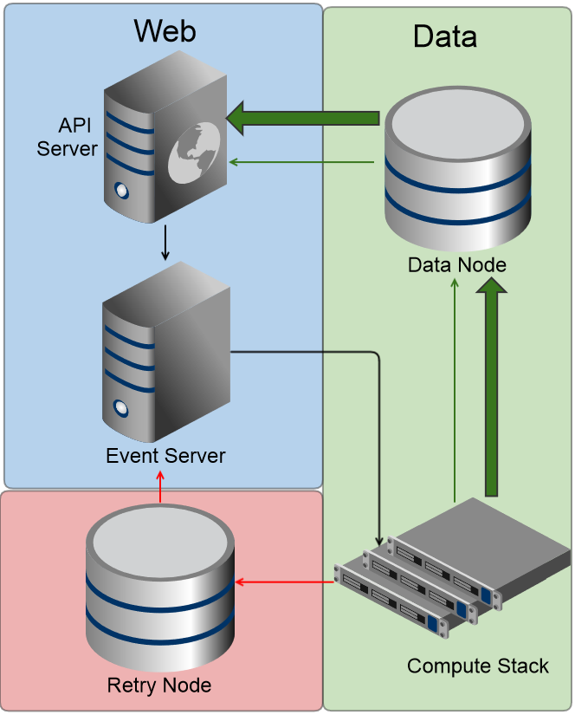
Architecture Event-Driven Isolate Parallel Processing

Slide 7
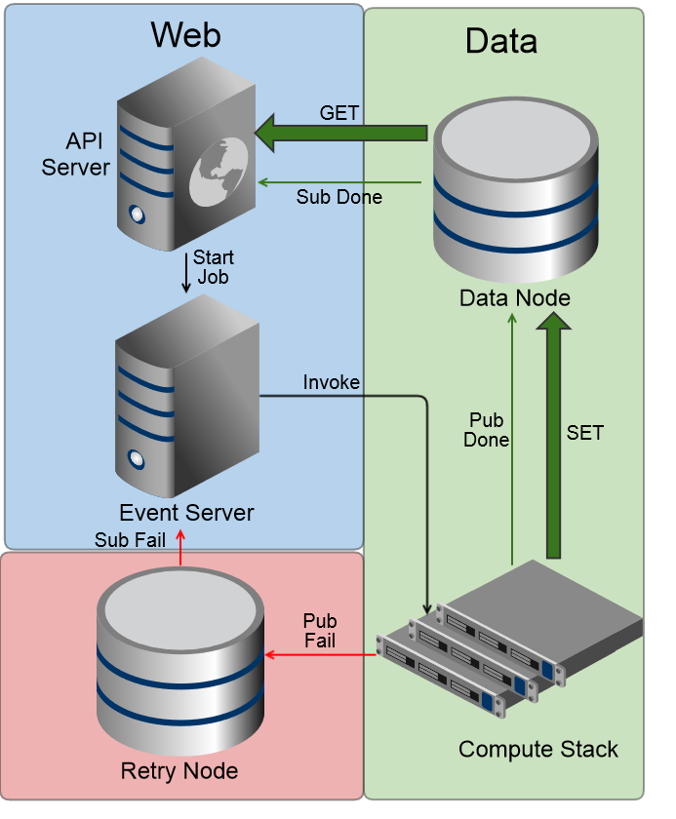
Architecture Event-Driven Isolate Parallel Processing

Slide 8
Why you should care
Cost, Scale, Speed, Resourcing, Flexibility

Slide 9
Cost
Minimal Overhead
Possibility for cost-effective, cutting-edge framework

Slide 10
Scale
Simple, Managed Horizontal Scale
Parallel and Isolated Computations

Slide 11
Speed
Fast spin-up and completion
Parallel separation of concerns reduces overall compute time

Slide 12
Resourcing
Reduces load on core actors in architecture
For single-threaded platforms, open thread for essential tasks

Slide 13
Flexibility
High availability of tools in many languages
Implementation of separate or shared resource nodes

Slide 14
How we did it
Hands-off Infrastructure, Third Party Tools

Slide 15




Hands-off Infrastructure
Managed Servers
Cloud-based Services

Slide 16
Third Party Services
Amazon Lambda
Redis

Slide 17
What is Lambda?
Amazon’s in-preview compute service
Parallel and isolated compute processes
Billing by the 100ms – we care about cycles

Slide 18
Why use it?
Highly cost-effective. Fully on-demand.
Parallel processing and high speed
Shared modules and re-use of code

Slide 19
So what’s the problem?
One way invocation. Low state visibility.
Lack of failure management.
Limited trigger and invocation access.

Slide 20
How did we solve the problem?
Redis!
Redis as a tool to alleviate the limitations of lambda
Event management separation

Slide 21
Why use Redis?
Low latency and quick connection
Speed of transactions
Robust Messaging pattern

Slide 22
Why use Redis? (Cont.)
Flexible and Plentiful Datatypes
Ease of Key Value Model

Slide 23
How it works
Events, Compute, Messaging

Slide 24
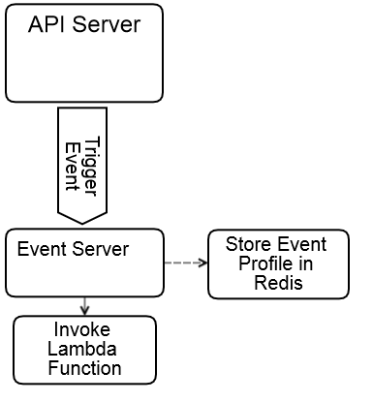
Triggering an event
The calling server sends the event profile to the Event Handler
The Event Handler stores the event profile in the Redis Retry Node
The Event Handler sends an Invoke Request to Lambda with the event data

Slide 25
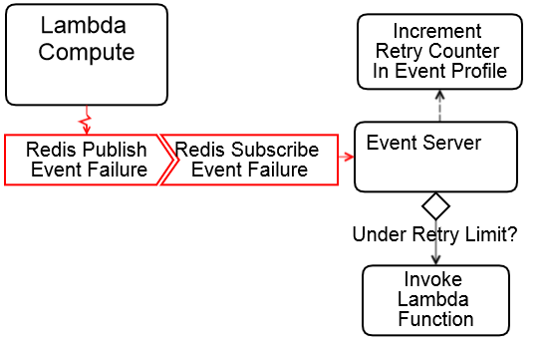
When it fails
The Lambda Compute instance sends a failure publish message with its Retry node profile key
The Event Handler receives the failure publish message through channel subscription and increments the retry counter in the event profile
The Event Handler checks the retry counter and invokes the Lambda function again, if able

Slide 26
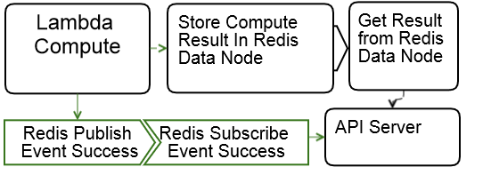
When it completes
The Lambda Compute instance stores resulting data to the Redis Data Node store
The Lambda Compute instance sends a success publish message
The originating server receives the success message through subscription channel, and synchronizes and takes any additional action with the resulting data

Slide 27
How we used it
Marketing Rules, Notification Management

Slide 28
Marketing Rules
Rules Document Conversion
Minimal Development Oversight
Realtime Business Rule Synchronization

Slide 29
Marketing Business Rules
Content Rule Document
Human Readable
Testable
for the cheer page in group test CheerTeamA for 50%
show when
the url is cheer.url.com
the query string q is cheer
the user self-identifies
with
Ready, Set, Organize! as header
a program to help you succeed faster as subheader
cheerleader as background
(We hope)

Slide 30
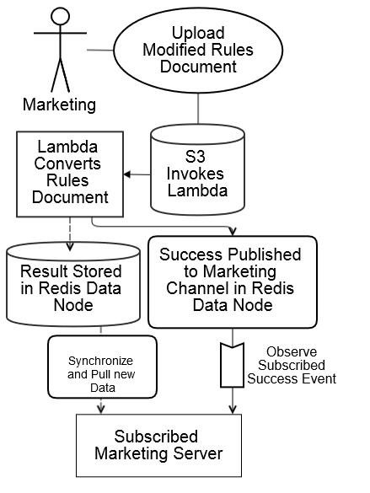
User Flow
User modifies Rules document and uploads to S3
S3 Triggers a Lambda Event
Lambda Converts the Rules document
Lambda Stores result in Redis
Lambda publishes Success
Marketing Server observes Success
Marketing Server Synchronizes data

Slide 31
Notification Management
Realtime communication to users
Trigger from any event
Client connection status

Slide 32
Infrastructure
Observer Node
Observer Node server
subscribed to Redis Notifications Channel
socket connected to user clients and rooms

Slide 33
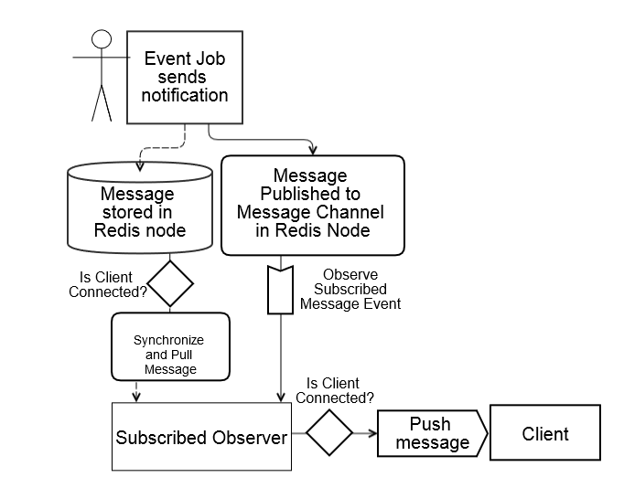
Message Flow
Event sends message
Message stored in Redis node
Message Publish to Channel
Observer observes message
Observer checks intended Client connectivity
Observer pushes message to Client if connected
Message left for recovery on Client connection if intended Client offline

Slide 34
What we gained
Less Oversight, Real-time service-to-user, Scalability

Slide 35
Oversight
Less administrative oversight on conversion and transformation tasks
Automated messaging system triggered directly from events

Slide 36
Real-time Responsivity
Instantaneous synchronization between
Compute
Jobs
Client and Application Servers
Clients
Message handling from Events

Slide 37
Scalability
Separation of one-shot jobs from Queues
Scalable Infrastructure management with Lambda and Redis
Cost-effective event scaling

Slide 38
What was the impact
Setup, Architecture, Cost Overhead

Slide 39
Setup
Usage of third party Services
Cost of Scale for additional Redis Nodes and Instances
Management of Infrastructure

Slide 40
Infrastructure
Ideally, 5 additional actors
Event Server
Observer Server
Redis Data Server
Redis Retry Server
Compute Stack

Slide 41
Overheads
Cost of Running additional Event and Observer Worker Servers
Cost of Running additional Redis Nodes
Cost of Lambda
Billing every 100ms
Impact of Redis Connection on Lambda cycles

Slide 42
Overhead - Lambda
Redis
Additional
Cycles
434849
Cycles without
Redis
16453628
30 million computations
548ms average
Estimates
Utilizing Redis to control Event Flow has a ~14.5% chance of pushing Lambda into the next billing cycle
Redis
Additional
Cost
$0.18
Cost without
Redis
$6.86
Total Cycles
16888477
Total Cost
$7.04

Slide 43
Conventional Queue
Also possible with Conventional Queue
Conventional Queue control flow impact is a time consideration
How much process time is dedicated to Redis connection?

Slide 44
Overhead - Queue
Overhead
30,000 seconds
30 million computations
Estimates
Around 8 hours per month paid time dedicated to control flow
Per Conversion
~10ms
~8 Hours
Per Month

Slide 45
What are the possibilities
Image and data processing, database cleanup, multiplicative tasks

Slide 46
Processing
Can offload single directional event flows easily
Trigger on data streams to transform and analyze data on demand
Process image and file conversions and production

Slide 47
Cleanup
Can run timed or triggered cleanup of objects or whole databases
Signal acting servers to synchronize data and states with database changes

Slide 48
Tasking
User or Internally defined Tasks
Multiple Asynchronous tasks with Response to Client
Uploading multiple files
Adding multiple records
Sending messages with receipt
Scripting possibilities for rote tasks
Generating rules, JSON, analytics, cache

Slide 49
How we move forward
Testing, Supportive Scaling

Slide 50
Testing
Proof of Concept
Still in preview
Needs robust testing and benchmarking

Slide 51
Bottlenecks
Scaling of Lambda is mostly self-sufficient
Bottleneck in Supporting Actors
Redis
Event and Observer Servers

Slide 52
Supportive Scaling
Redis Cluster
Horizontal and Vertical Event Server Scaling
Event Server Separation

Slide 53
Questions?
Thank you!

Slide 54
For these slides and more
Check out www.notsafeforproduction.com

