Slide 1
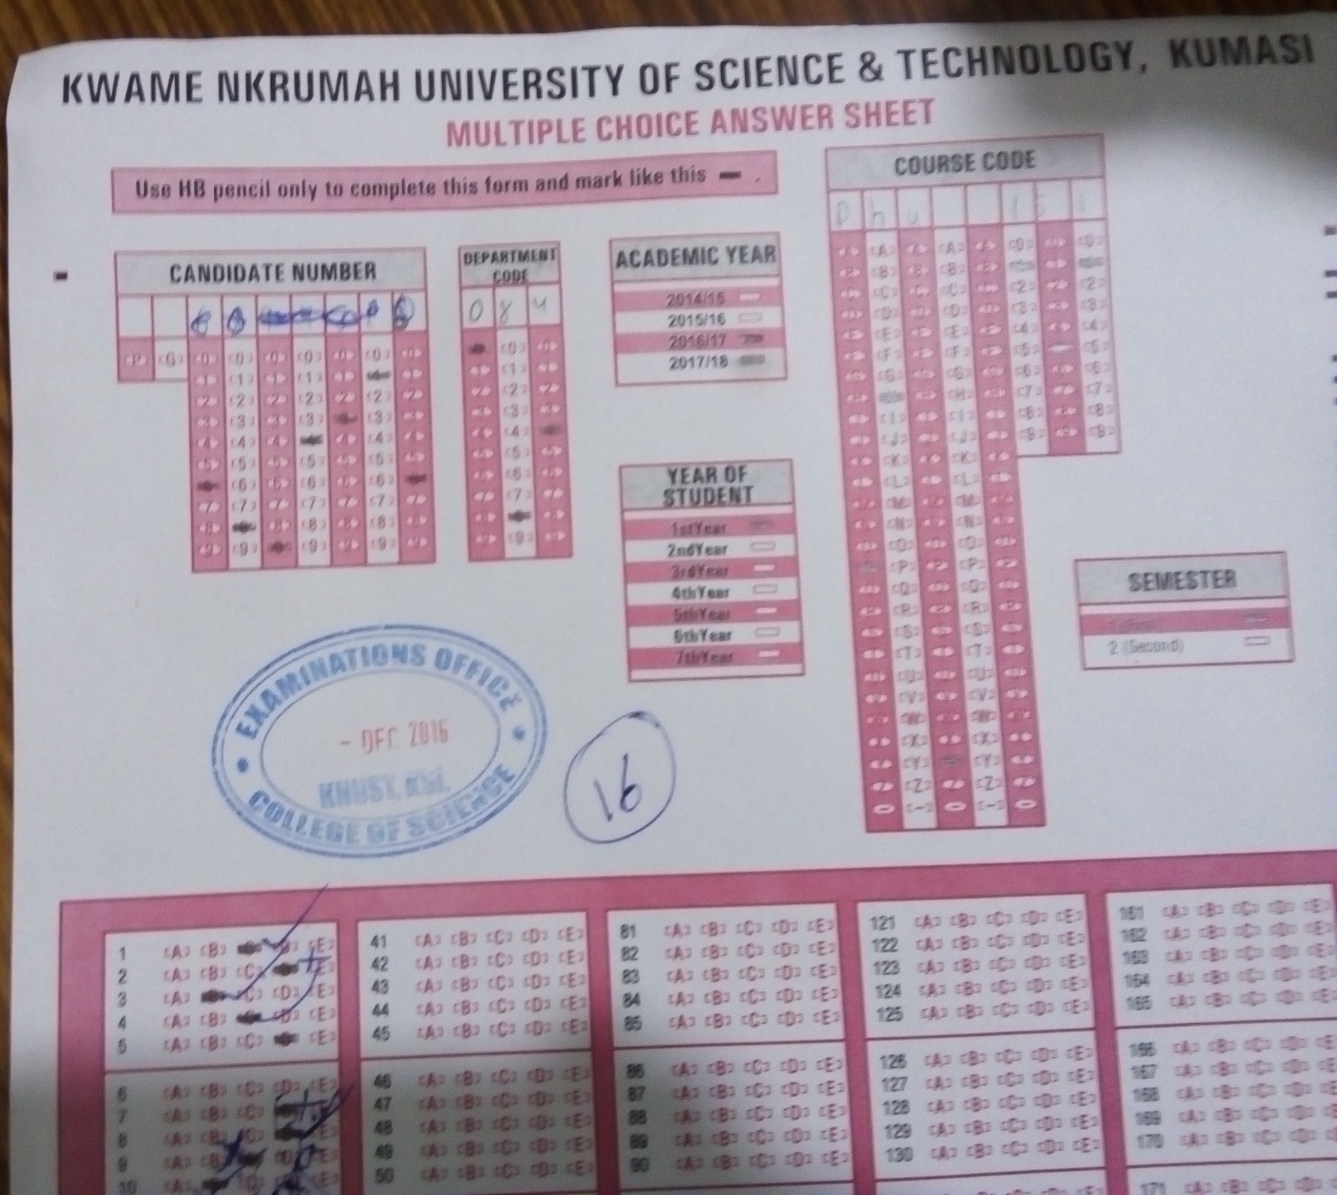

Slide 2
Rigid body
Body whose particles are not displaced with respect to the other when a force is applied on them.

Slide 3
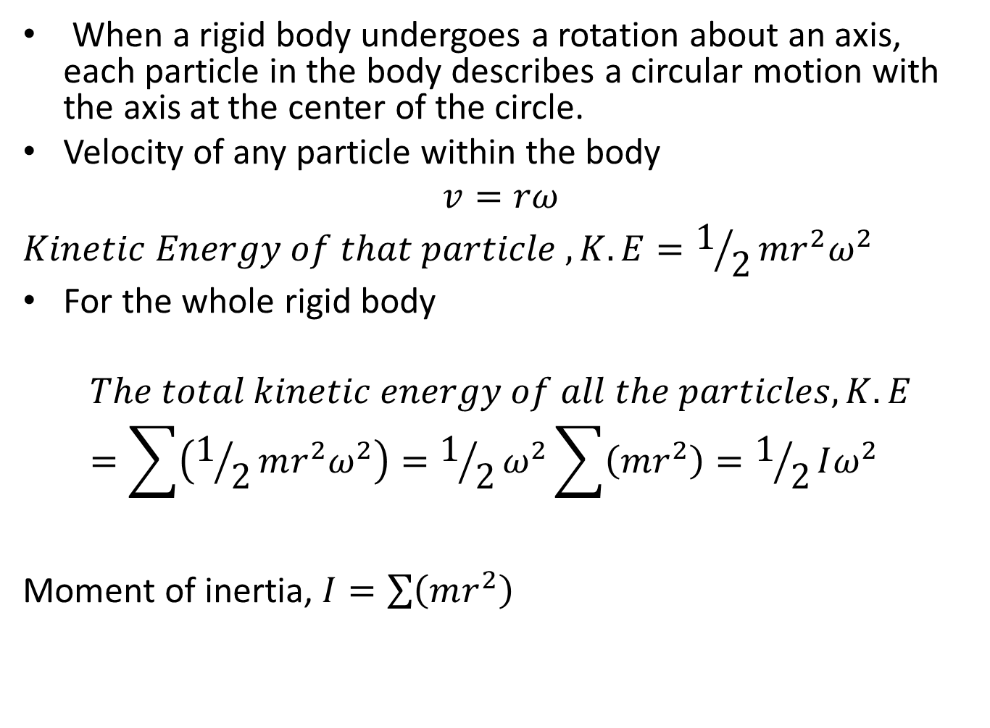
ROTATION OF RIGID BODIES
When a rigid body undergoes a rotation about an axis, each particle in the body describes a circular motion with the axis at the center of the circle.
Velocity of any particle within the body
$$v=rω$$
$$Kinetic Energy of that particle , K.E=1/2mr^{2}ω^{2}$$
For the whole rigid body
$$The total kinetic energy of all the particles, K.E=\sum{\left(1/2mr^{2}ω^{2}\right)=1/2ω^{2}\sum{\left(mr^{2}\right)}=1/2Iω^{2}}$$
Moment of inertia, $I=\sum{\left(mr^{2}\right)}$

Slide 4
Moment of Inertia
The moment of inertia is the measure of the reluctance of a body to undergo a rotational motion when a torque is applied to it or come to rest when already in rotational motion when an opposing torque is applied to it.

Slide 5
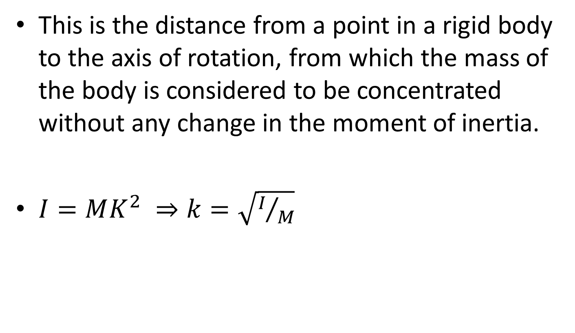
RADIUS OF GYRATION, Κ
This is the distance from a point in a rigid body to the axis of rotation, from which the mass of the body is considered to be concentrated without any change in the moment of inertia.
$I=MK^{2} ⇒k=\sqrt{I/M}$

Slide 6
TORQUE
Torque is defined as the product of the force and the perpendicular distance from the axis of rotation to the line along which the force acts.
𝜏 = 𝑟 × 𝐹 = 𝑟𝐹 sin 𝜃

Slide 7
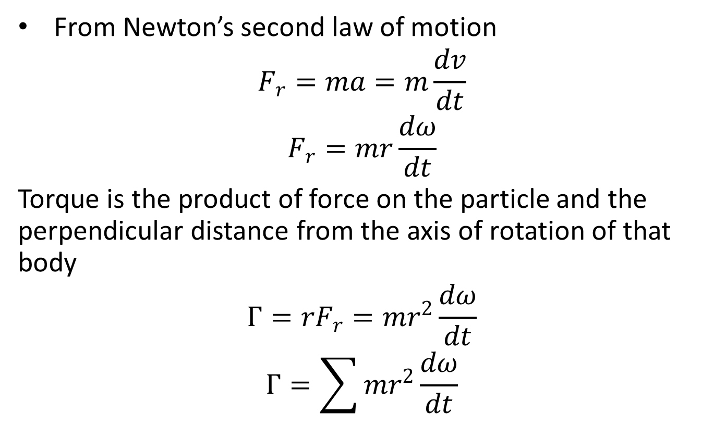
Torque and Angular Acceleration
From Newton’s second law of motion
$$F_{r}=ma=m\frac{dv}{dt}$$
$$F_{r}=mr\frac{dω}{dt}$$
Torque is the product of force on the particle and the perpendicular distance from the axis of rotation of that body
$$Γ=rF_{r}=mr^{2}\frac{dω}{dt}$$
$$Γ=\sum{mr^{2}\frac{dω}{dt}}$$

Slide 8
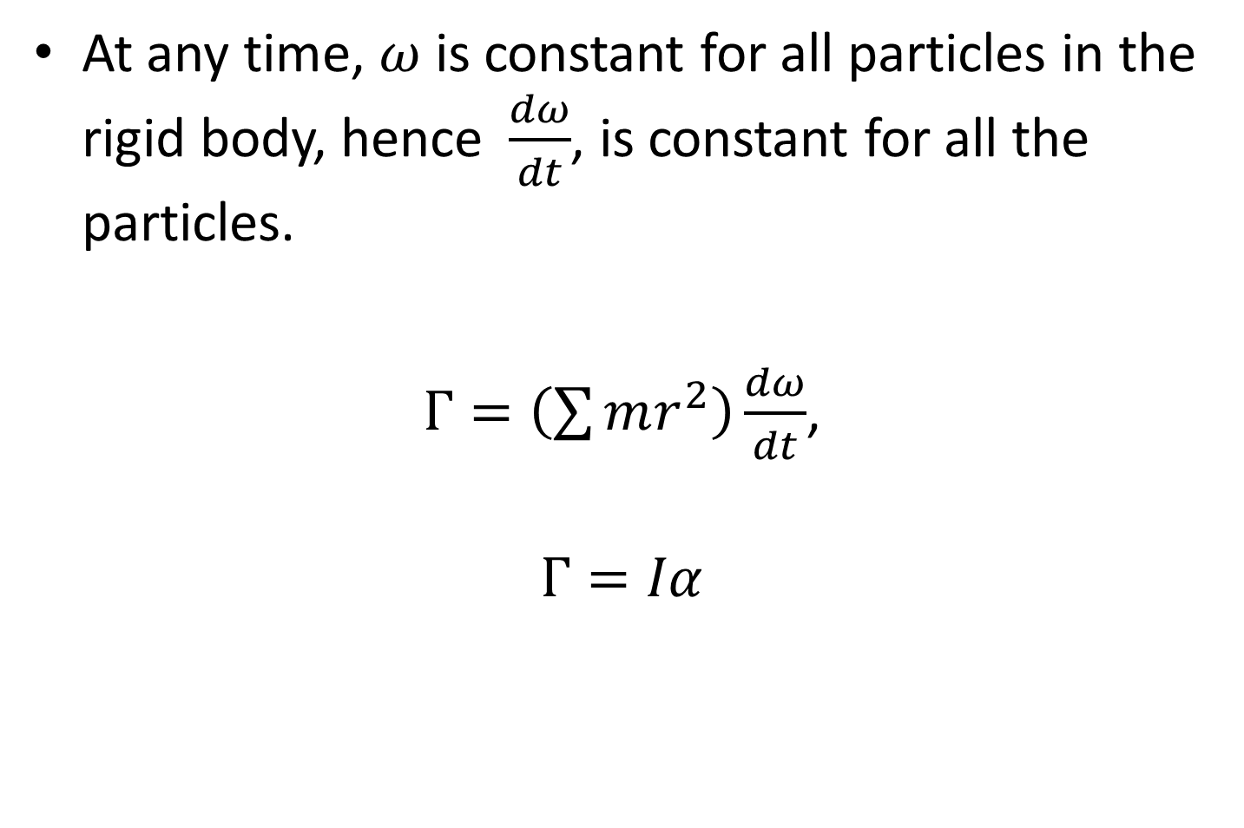
At any time, $ω$ is constant for all particles in the rigid body, hence$\frac{dω}{dt}$, is constant for all the particles.
$Γ=\left(\sum{mr^{2}}\right)\frac{dω}{dt}$,
$$Γ=Iα$$

Slide 9
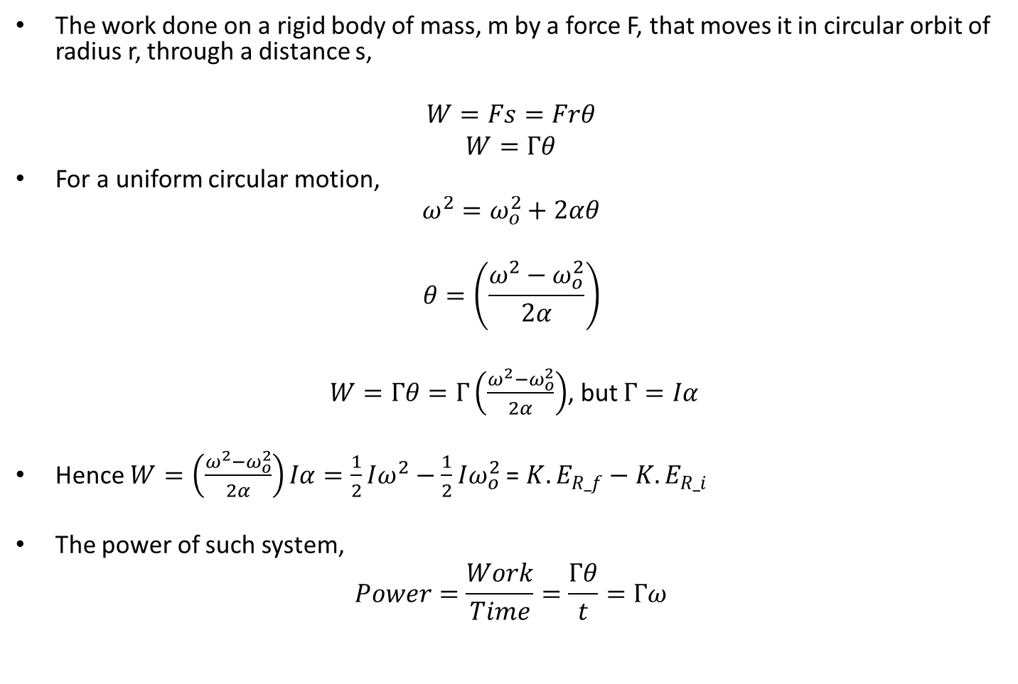
Work and Power of a rigid body performing a circular motion
The work done on a rigid body of mass, m by a force F, that moves it in circular orbit of radius r, through a distance s,
$$W=Fs=Frθ$$
$$W=Γθ$$
For a uniform circular motion,
$$ω^{2}=ω_{o}^{2}+2αθ$$
$$θ=\left(\frac{ω^{2}−ω_{o}^{2}}{2α}\right)$$
$W=Γθ=Γ\left(\frac{ω^{2}−ω_{o}^{2}}{2α}\right)$, but $Γ=Iα$
Hence $W=\left(\frac{ω^{2}−ω_{o}^{2}}{2α}\right)Iα=\frac{1}{2}Iω^{2}−\frac{1}{2}Iω_{o}^{2}$= ${K.E}_{R_f}−{K.E}_{R_i}$
The power of such system,
$$Power=\frac{Work}{Time}=\frac{Γθ}{t}=Γω$$

Slide 10
Motion of Rigid Bodies
Rolling
Sliding

Slide 11
ROLLING
SLIDING
A body is said to be rolling along a plane when the surface in contact with the plane changes continuously and always momentarily at rest with respect to the plane.
A body is said to be sliding along a plane when the surface in contact with the plane remains uncharged but the body moves with respect to the plane.

Slide 12
Forces
Force is generally defined as anything which alters the rest or uniform motion of a body in a straight line.
CONCURRENT FORCES: Forces that act in such a way that their lines of action intersect at a point.
COUPLES: A couple is constituted by two forces which are equal and act in opposite direction.
PARALLEL FORCES: forces that act in such a way that their lines of action do not intersect.

Slide 13
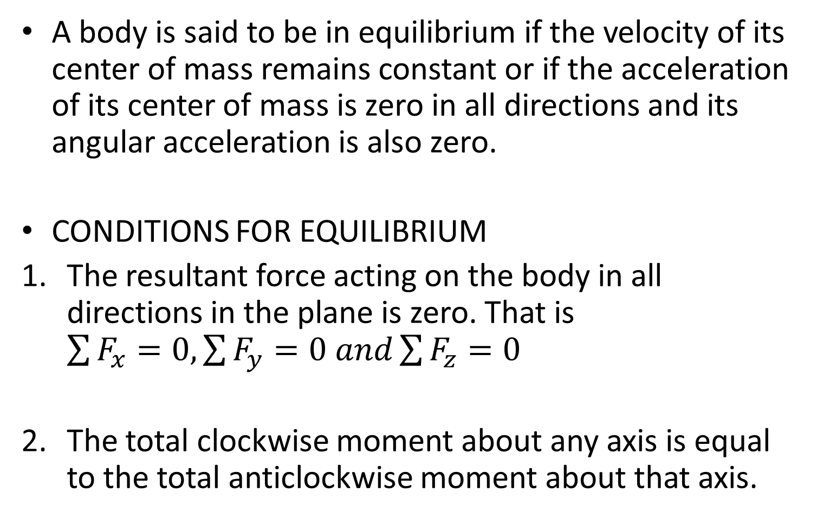
EQUILIBRIUM
A body is said to be in equilibrium if the velocity of its center of mass remains constant or if the acceleration of its center of mass is zero in all directions and its angular acceleration is also zero.
CONDITIONS FOR EQUILIBRIUM
The resultant force acting on the body in all directions in the plane is zero. That is $\sum{F_{x}=0, \sum{F_{y}=0 and\sum{F_{z}=0}}}$
The total clockwise moment about any axis is equal to the total anticlockwise moment about that axis.

Slide 14
2: The sum of clockwise moment about any axis is equal to the sum of anticlockwise moment about that axis.

Slide 15
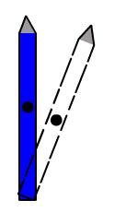
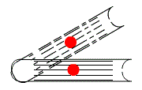
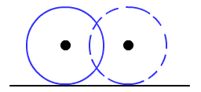
Types of Equilibrium
Stable equilibrium: This a type of equilibrium in which a body returns to its equilibrium position after it has being displaced slightly.
Unstable equilibrium: In unstable equilibrium the body does not return to its equilibrium position and does not remain in the displaced position after it has been slightly displaced.
Neutral equilibrium: A body is said to be in neutral position, if it stays in the displaced position after it has been displaced slightly.

Slide 17
MACHINE
Machines are devices on which when an effort is applied on it at one point, it can be used to overcome a load at another point. The effort is the force applied while the load is the force that must be overcome
Levers
Pulleys

Slide 18

Mechanical Advantage (M.A.)
The ratio of the load to the effort is known as the mechanical advantage M.A

Slide 19

Velocity Ratio (V.R.)
The ratio of the distance moved by the effort to the distance moved by the load at the same time is known as the velocity ratio V.R.,

Slide 20


EFFICIENCY
This is the ratio of the work done by effort to the work done against the load expressed in percentage
Input energy = work done by effort = E x d_{e}
Output energy = work done against the load = L x d_{l}

Slide 21
LEVER
First class lever
L P E
Second class lever
L
P E

Slide 22
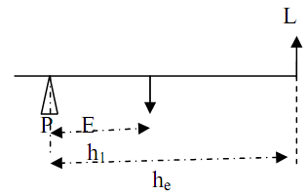


.
,
.
If the perpendicular separation of load and effort from the fulcrum are respectively h_{l} and h_{e} then taken moments about the fulcrum position
Hence for all lever systems
$$M.A.=V.R.$$

Slide 23
A man uses a rod of length 5.00 m to lift a 700 kg marble. The fulcrum is 0.50 m from the end of the bar that is under the marble. Calculate the M.A. and minimum effort required to lift the load. If the efficiency of this system is 90% determine its V.R. What class of levers does this system belongs.

Slide 24
PULLEY
This is a wheel with a grooved rim around which a cord passes and acts to change the direction of a force applied to the cord and is used to raise heavy weights.
Block and tackle

Slide 25
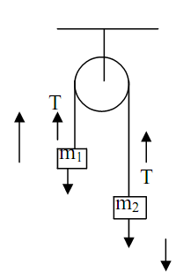
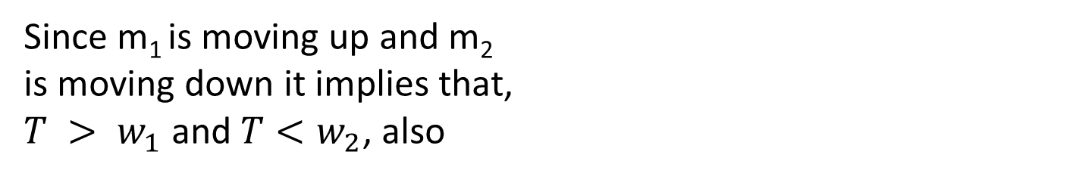
Equation of motion of a pulley system
Since m₁ is moving up and m₂
is moving down it implies that,
$T > w_{1}$ and $T<w_{2}$, also

Slide 26
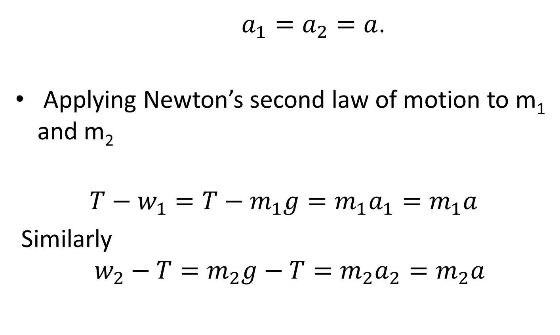
Since the two bodies are accelerating at the same rate
$a_{1}=a_{2}=a$.
Applying Newton’s second law of motion to m₁ and m₂
$$T−w_{1}=T−m_{1}g=m_{1}a_{1}=m_{1}a$$
Similarly
$$w_{2}−T=m_{2}g−T=m_{2}a_{2}=m_{2}a$$

Slide 27

By eliminating T from the above equations where ‘a’ and ‘T’ are unknown gives
$$m_{2}g−m_{1}g=m_{1}a+m_{2}a$$
Therefore
$a=\left(\frac{\left(m_{2}−m_{1}\right)g}{m_{1}+m_{2}}\right)$
Substituting, a into equation 1, gives
$T−m_{1}g=m_{1}\left(\frac{(m_{2}−m_{1})g}{m_{1}+m_{2}}\right)$
$T=\left(\frac{2m_{1}m_{2}g}{m_{2}+m_{1}}\right)$

Slide 28

Single fixed pulley
mg
dl
de
.
Load L = E
$$M.A =\frac{L}{E}=1$$
velocity ratio $V.R=\frac{d_{e}}{d_{l}}=1$

Slide 29
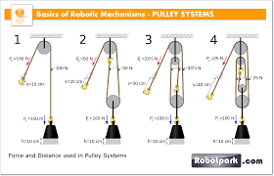
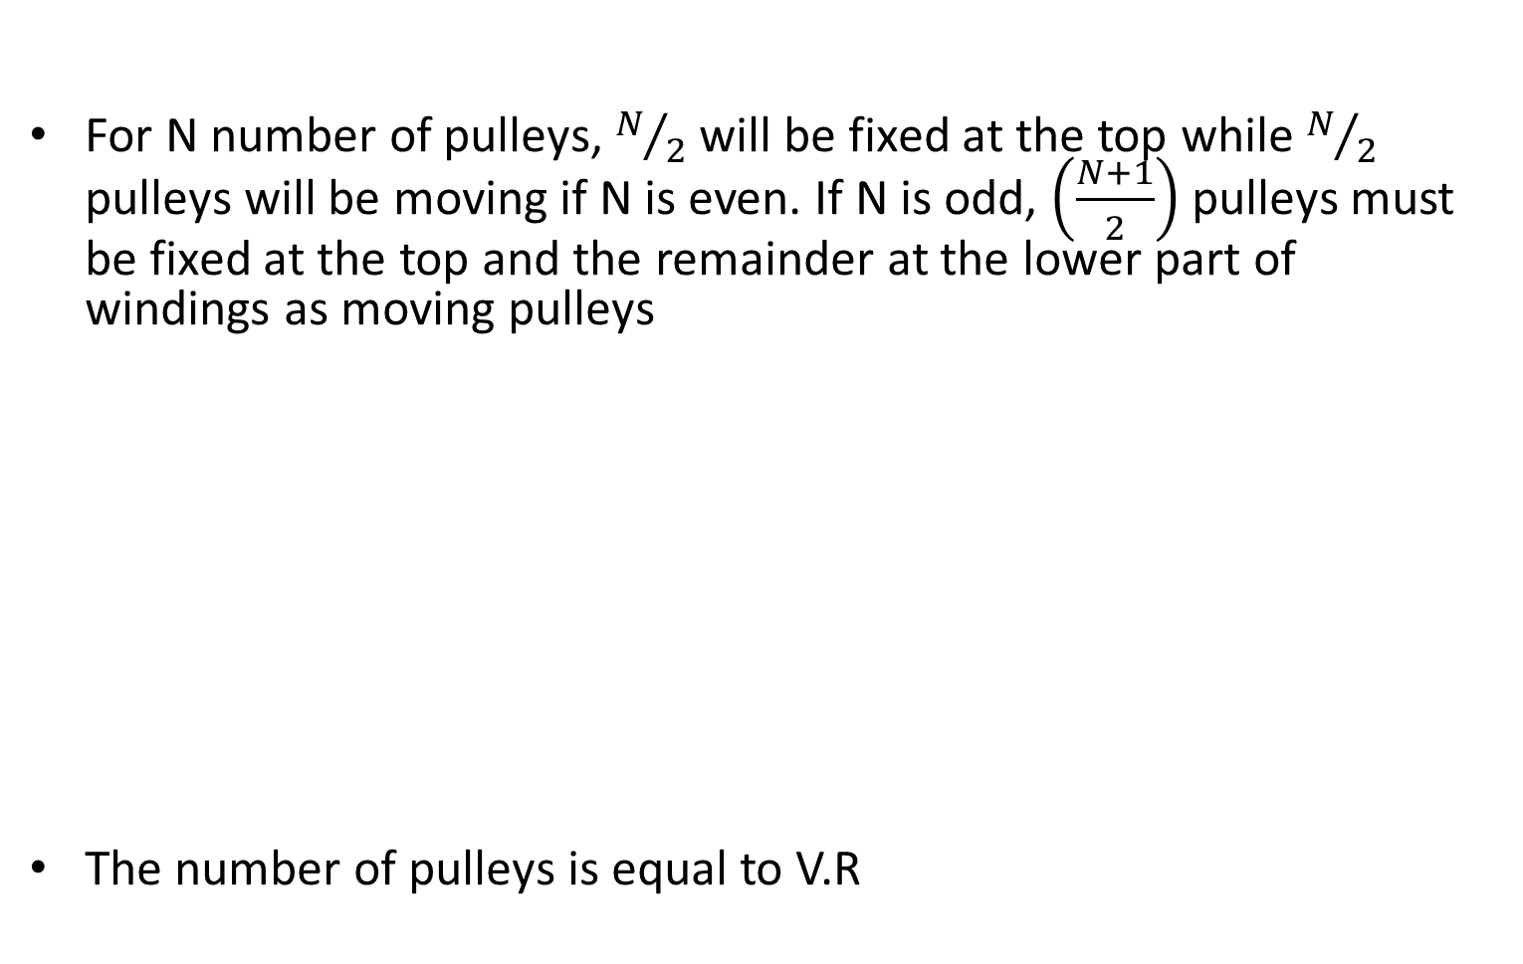
SEVERAL PULLEYS (BLOCK AND TACKLE) SYSTEMS
For N number of pulleys, $N/2$ will be fixed at the top while $N/2$ pulleys will be moving if N is even. If N is odd, $\left(\frac{N+1}{2}\right)$ pulleys must be fixed at the top and the remainder at the lower part of windings as moving pulleys
The number of pulleys is equal to V.R

Slide 30
GRAVITATION
KEPLER’S LAW
Kepler's laws of planetary motion are three scientific laws describing the motion of planets around the Sun. These laws were inferred from the analyzing of data collected on the motion of planets through the sky.
Law 1
The planets describe elliptical orbit around the sun as one at focus (centre).
Law 2
The line joining the sun and the planets sweeps out equal area in equal times interval.
Law 3
The square of the period of revolution of the planets are proportional to the cube of the planets mean distance from the sun.

Slide 31
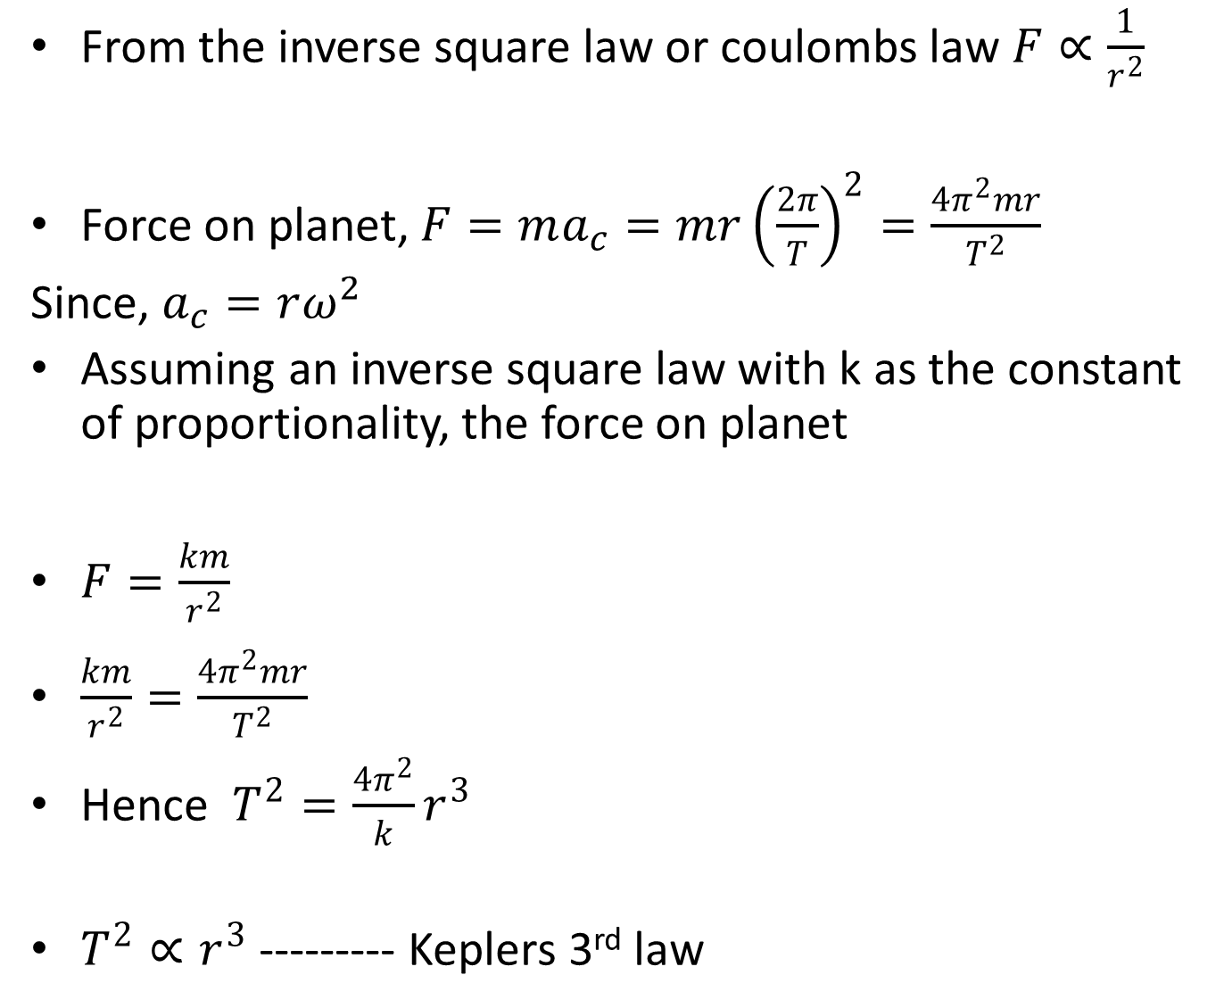
From the inverse square law or coulombs law $F∝\frac{1}{r^{2}}$
Force on planet, $F=ma_{c}=mr{\left(\frac{2π}{T}\right)}^{2}=\frac{4π^{2}mr}{T^{2}}$
Since, $a_{c}=rω^{2}$
Assuming an inverse square law with k as the constant of proportionality, the force on planet
$F=\frac{km}{r^{2}}$
$\frac{km}{r^{2}}=\frac{4π^{2}mr}{T^{2}}$
Hence $T^{2}=\frac{4π^{2}}{k}r^{3}$
$T^{2}∝r^{3}$ --------- Keplers 3rd law

Slide 32
GRAVITATION
Newton’s Universal Law Of Gravitation
G = 6.67 ×10⁻¹¹ Nm²/kg²

Slide 33

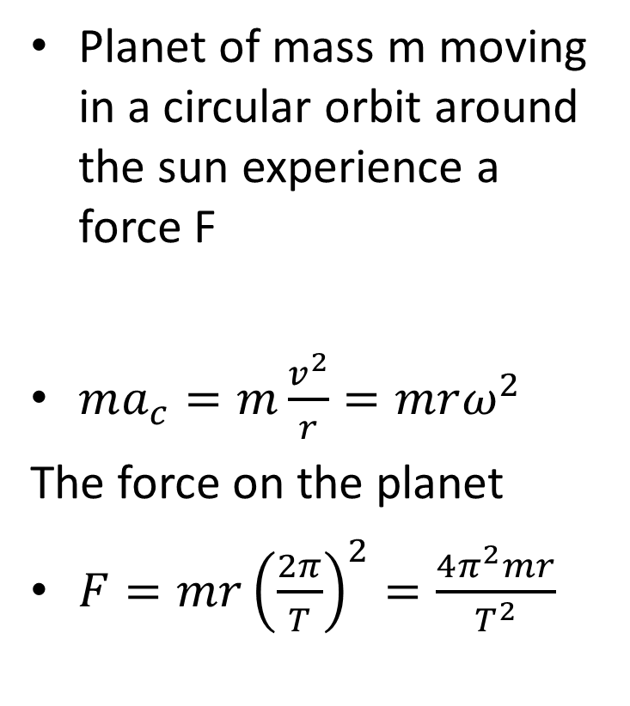
PLANET IN A CIRCULAR ORBIT
Planet
Planet of mass m moving in a circular orbit around the sun experience a force F
$ma_{c}=m\frac{v^{2}}{r}=mrω^{2}$
The force on the planet
$F=mr{\left(\frac{2π}{T}\right)}^{2}=\frac{4π^{2}mr}{T^{2}}$
$$mrω^{2}$$
Sun

Slide 34
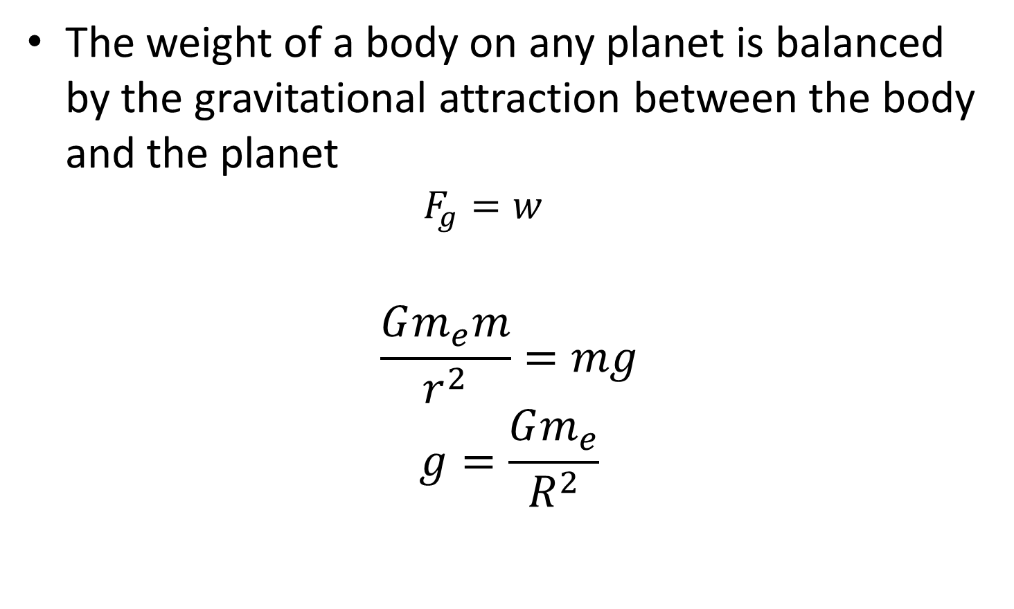
GRAVITATIONAL FORCE AND WEIGHT
The weight of a body on any planet is balanced by the gravitational attraction between the body and the planet
$$F_{g}=w$$
$$\frac{Gm_{e}m}{r^{2}}=mg$$
$$g=\frac{Gm_{e}}{R^{2}}$$

Slide 35
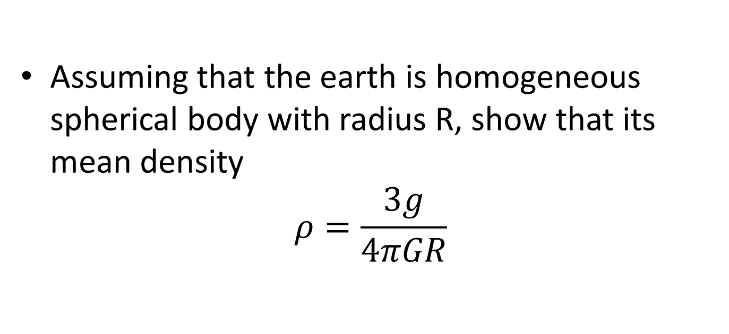
Assignment. Submission date 3/12/2017
Assuming that the earth is homogeneous spherical body with radius R, show that its mean density
$$ρ=\frac{3g}{4πGR}$$

Slide 36
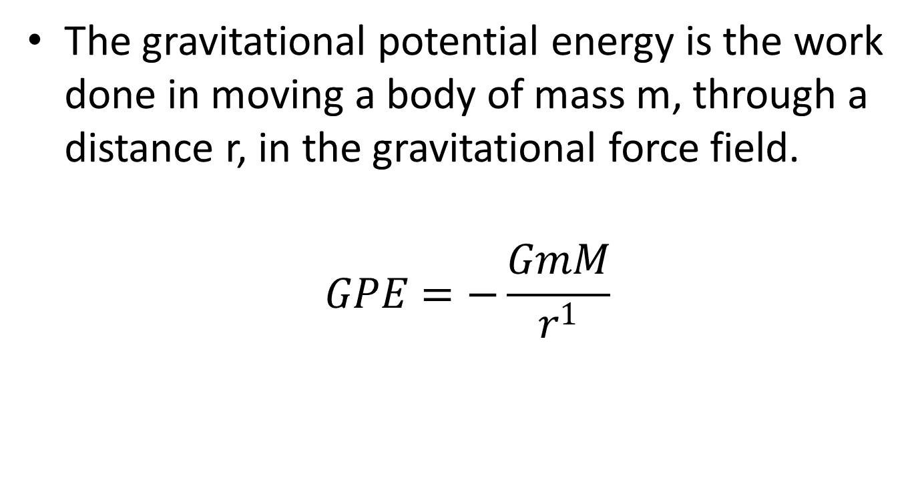
GRAVITATIONAL POTENTIAL ENERGY
The gravitational potential energy is the work done in moving a body of mass m, through a distance r, in the gravitational force field.
$$GPE=−\frac{GmM}{r^{1}}$$

Slide 37
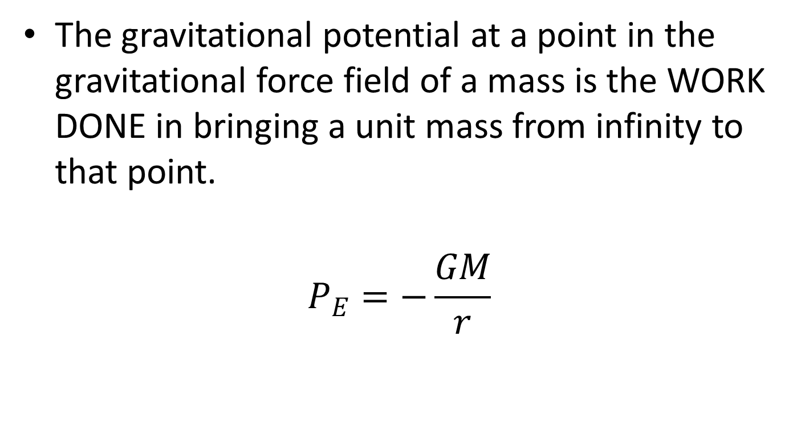
GRAVITATIONAL POTENTIAL
The gravitational potential at a point in the gravitational force field of a mass is the WORK DONE in bringing a unit mass from infinity to that point.
$$P_{E}=−\frac{GM}{r}$$

Slide 38
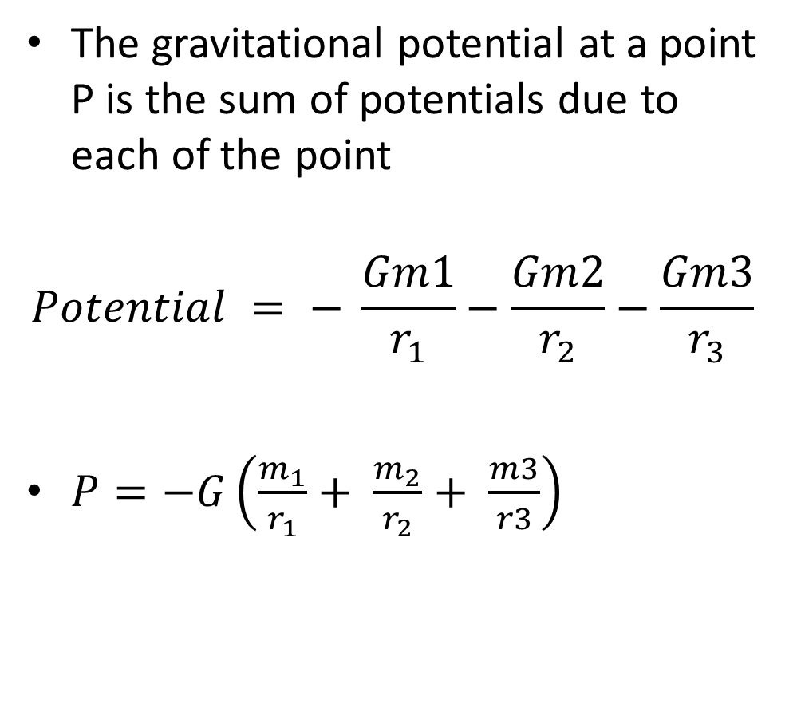
For system of masses m₁, m₂ and m₃
The gravitational potential at a point P is the sum of potentials due to each of the point
$$Potential = − \frac{Gm1}{r_{1}}−\frac{Gm2}{r_{2}}−\frac{Gm3}{r_{3}}$$
$P=−G\left(\frac{m_{1}}{r_{1}}+ \frac{m_{2}}{r_{2}}+ \frac{m3}{r3}\right)$
P
r₁ r₃
r₂
m₁
m₃ m₂

Slide 39
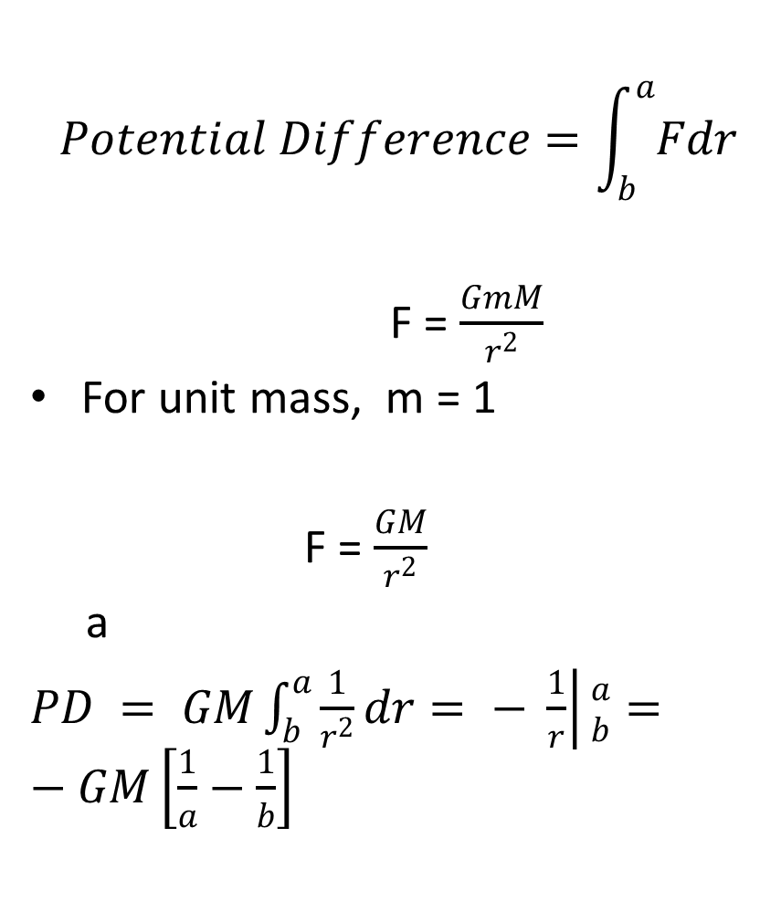
POTENTIAL DIFFERENCE BETWEEN TWO POINTS
$$Potential Difference=\int_{b}^{a}{Fdr}$$
F = $\frac{GmM}{r^{2}}$
For unit mass, m = 1
F = $\frac{GM}{r^{2}}$
a
$PD = GM\int_{b}^{a}{\frac{1}{r^{2}}}dr= − \left.\frac{1}{r}\right|{a \atop b}=−GM\left[\frac{1}{a}−\frac{1}{b}\right]$
Work Done in taking a unit mass from the higher potential to the lower potential.
If b > a, then b is at a higher potential than a.
b

Slide 40
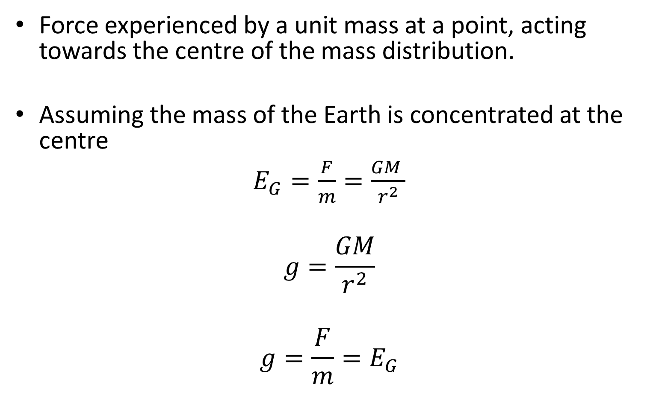
GRAVITATIONAL FIELD INTENSITY
Force experienced by a unit mass at a point, acting towards the centre of the mass distribution.
Assuming the mass of the Earth is concentrated at the centre
$E_{G}=\frac{F}{m}=\frac{GM }{r^{2}}$
$$g=\frac{GM}{r^{2}}$$
$$g=\frac{F}{m}=E_{G}$$

Slide 41
For system of masses m₁, m₂ and m₃
P
E₁, r₁ E₃, r₃
E₂, r₂
m₁ m₃
m₂

Slide 42
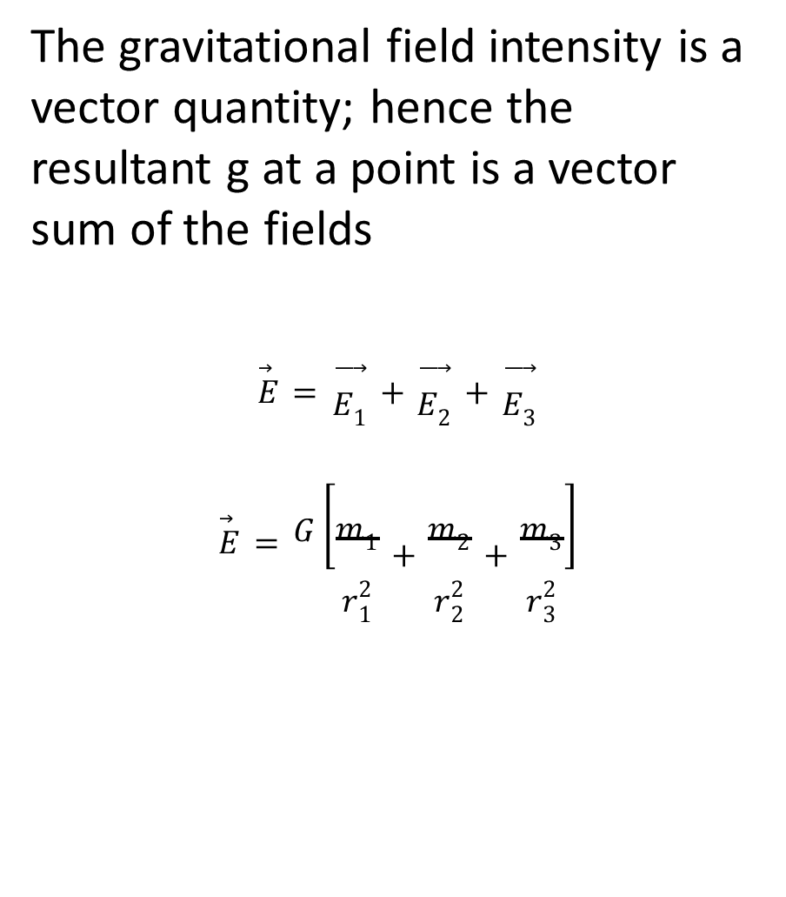

$E_{1}$
$$E_{3}=\frac{Gm_{3}}{r_{3}^{2}}$$
The gravitational field intensity is a vector quantity; hence the resultant g at a point is a vector sum of the fields
$$\vec{E}=\vec{E_{1}}+\vec{E_{2}}+\vec{E_{3}}$$
$$\vec{E}=G\left[\frac{m_{1}}{r_{1}^{2}}+\frac{m_{2}}{r_{2}^{2}}+\frac{m_{3}}{r_{3}^{2}}\right]$$

Slide 43

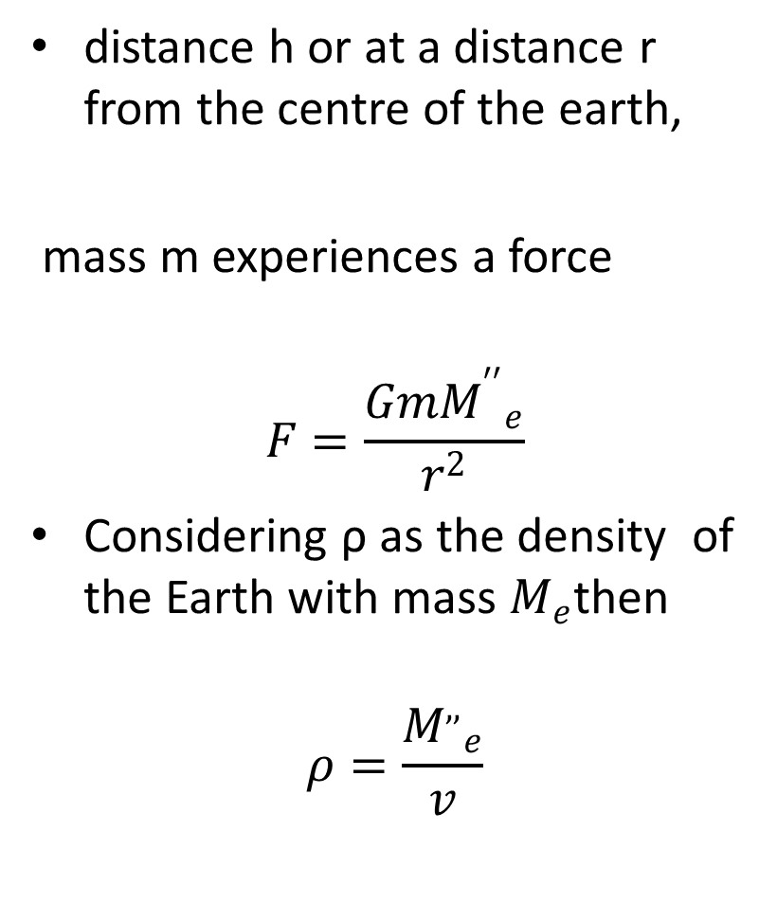
VARIATION OF ‘g’ WITH DEPTH
distance h or at a distance r from the centre of the earth,
mass m experiences a force
$$F=\frac{Gm{M^{′′}}_{e}}{r^{2}}$$
Considering ρ as the density of the Earth with mass $M_{e}$then
$$ρ=\frac{{M^{,,}}_{e}}{v}$$
.
$${M^{′′}}_{e}$$
r
h
R

Slide 44

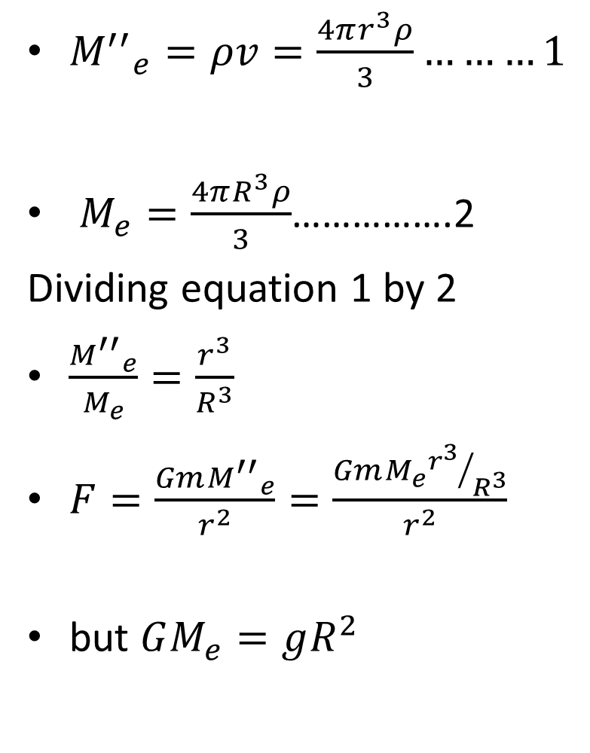
F$=\frac{mgR^{2}{r^{3}}/{R^{3}}}{r^{2}}$
$F=\frac{mgr}{R}$
$E_{G}=\frac{F}{m}=\left(\frac{g}{R}\right)r$
since g and R are constants, then
$E_{G}∝r$
${M^{′′}}_{e}=ρv=\frac{4πr^{3}ρ}{3}………1$
$M_{e}=\frac{4πR^{3}ρ}{3}$…………….2
Dividing equation 1 by 2
$\frac{{M^{′′}}_{e}}{M_{e}}=\frac{r^{3}}{R^{3}}$
$F=\frac{Gm{M^{′′}}_{e}}{r^{2}}=\frac{GmM_{e}{r^{3}}/{R^{3}}}{r^{2}}$
but $GM_{e}=gR^{2}$

Slide 45
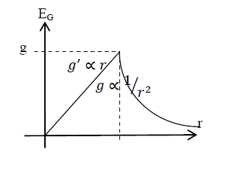
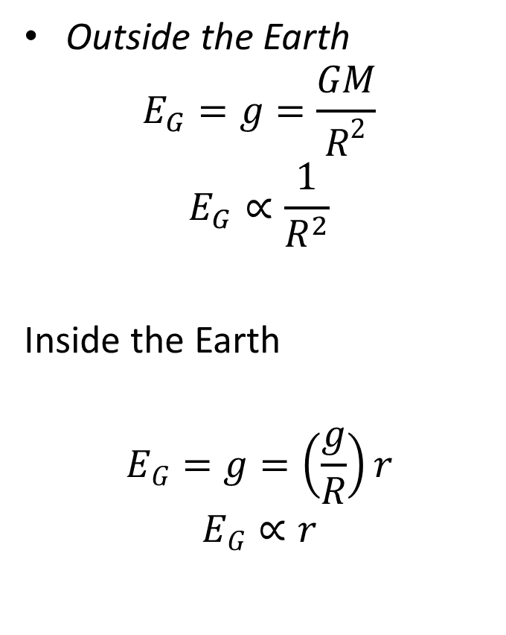
Outside the Earth
$$E_{G}=g=\frac{GM}{R^{2}}$$
$$E_{G}∝\frac{1}{R^{2}}$$
Inside the Earth
$$E_{G}=g=\left(\frac{g}{R}\right)r$$
$$E_{G}∝r$$
.

Slide 46
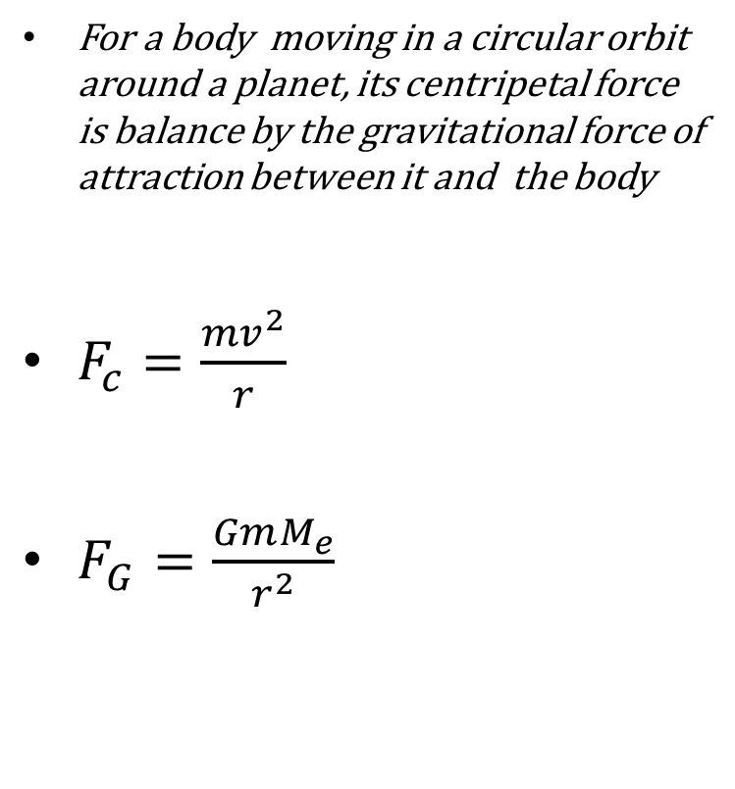
CIRCULAR ORBITS
For a body moving in a circular orbit around a planet, its centripetal force is balance by the gravitational force of attraction between it and the body
$F_{c}=\frac{{mv}^{2}}{r}$
$F_{G}=\frac{GmM_{e}}{r^{2}}$
Escape velocity
THE PERIOD OF A SATELLITE

Slide 47
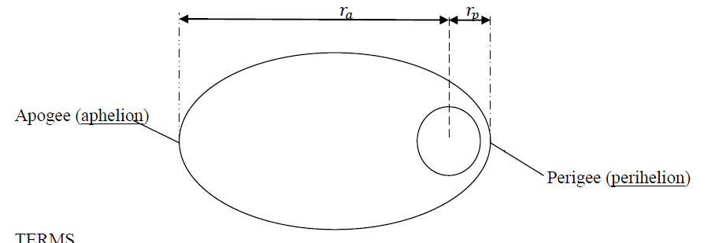
ELLIPTICAL ORBITS
orbits are shaped more like "stretched out" circles or ovals

Slide 48
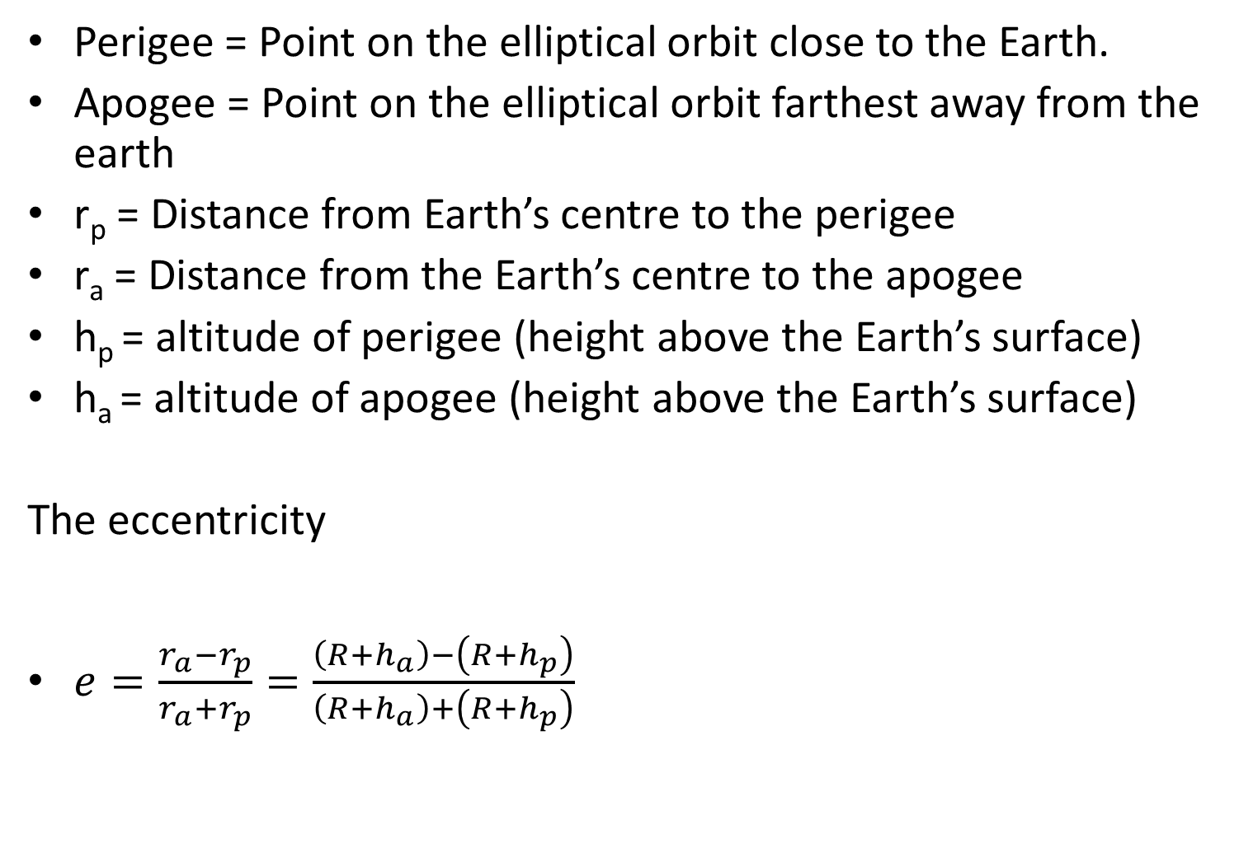
Perigee = Point on the elliptical orbit close to the Earth.
Apogee = Point on the elliptical orbit farthest away from the earth
r_{p} = Distance from Earth’s centre to the perigee
r_{a} = Distance from the Earth’s centre to the apogee
h_{p} = altitude of perigee (height above the Earth’s surface)
h_{a} = altitude of apogee (height above the Earth’s surface)
The eccentricity
$e=\frac{r_{a}−r_{p}}{r_{a}+r_{p}}=\frac{\left(R+h_{a}\right)−\left(R+h_{p}\right)}{\left(R+h_{a}\right)+\left(R+h_{p}\right)}$

Slide 49
The term, eccentricity, e is used to describe how round or how "stretched out" an ellipse is.
The eccentricity is a measure of the amount of elongation. If the eccentricity of an ellipse is close to one (like 0.8 or 0.9), the ellipse is long and skinny. If the eccentricity is close to zero, the ellipse is more like a circle.

Slide 50
GRAVITATIONAL MASS
ACTIVE GRAVITATIONAL MASS
PASSIVE GRAVITATIONAL MASS
EISTEIN’S PRINCIPLE OF EQUIVALENCE

Slide 51
VIBRATIONS
Simple harmonic motion corresponds to oscillation between two special position for an indefinite period of time with no lose in mechanical energy.
Particle executes simple harmonic motion when its position is a function of time and can be represented by a single ‘sine’ or ‘cosine’ curve.

Slide 52
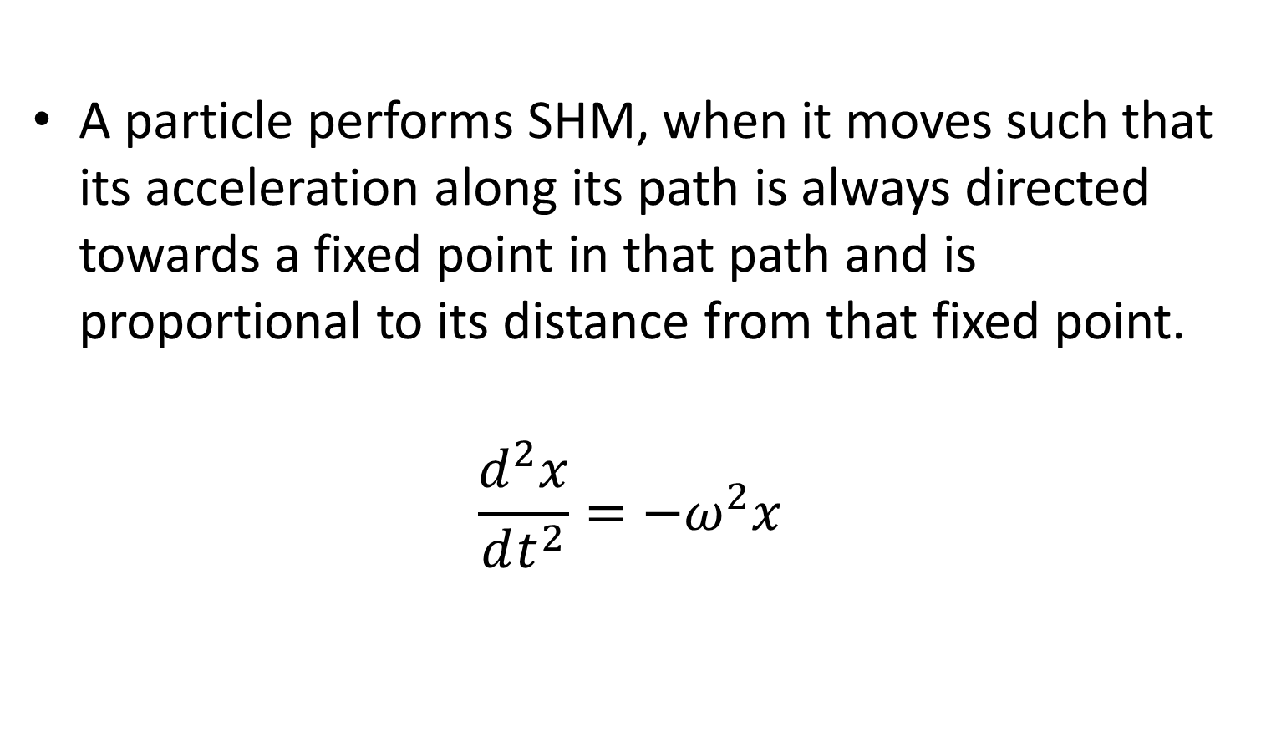
SIMPLE HARMONIC MOTION (SHM)
A particle performs SHM, when it moves such that its acceleration along its path is always directed towards a fixed point in that path and is proportional to its distance from that fixed point.
$$\frac{d^{2}x}{dt^{2}}=−ω^{2}x$$

Slide 53
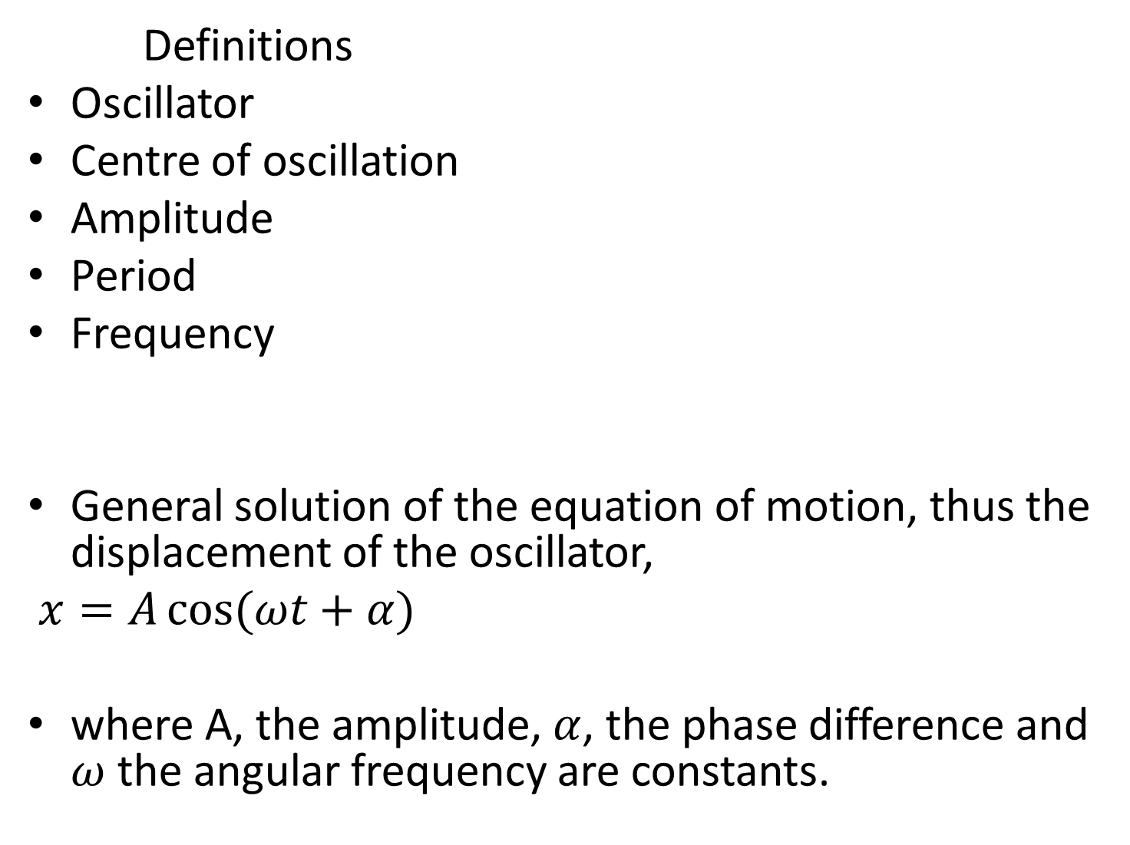
Definitions
Oscillator
Centre of oscillation
Amplitude
Period
Frequency
General solution of the equation of motion, thus the displacement of the oscillator,
$x=A\cos{(ωt+α)}$
where A, the amplitude, $α$, the phase difference and $ω$ the angular frequency are constants.

Slide 54
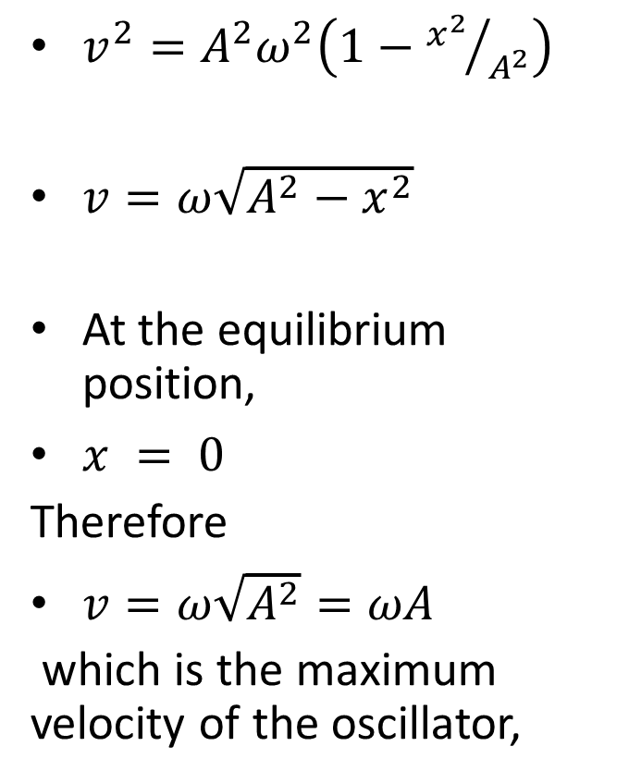
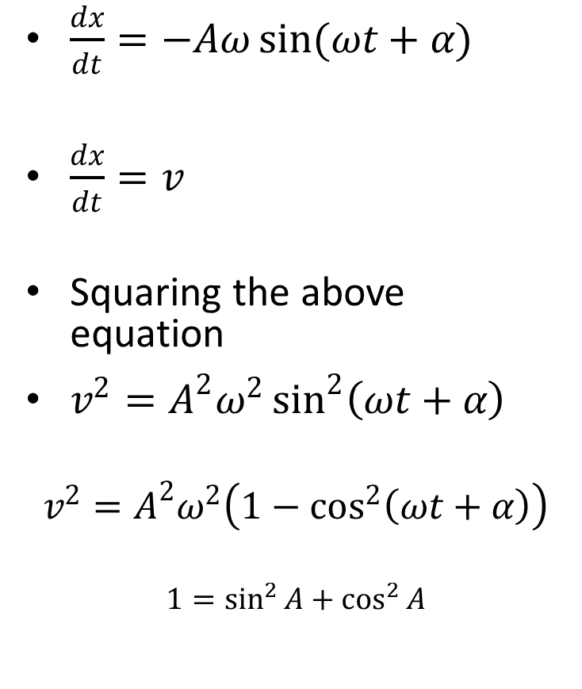
Speed of the Simple Harmonic Oscillator
$\frac{dx}{dt}=−Aω\sin{(ωt+α)}$
$\frac{dx}{dt}=v$
Squaring the above equation
$v^{2}=A^{2}ω^{2}\sin^{2}\left(ωt+α\right)$
$$v^{2}=A^{2}ω^{2}\left(1−\cos^{2}\left(ωt+α\right)\right)$$
$$1=\sin^{2}{A}+\cos^{2}{A}$$
$v^{2}=A^{2}ω^{2}\left(1−{x^{2}}/{A^{2}}\right)$
$v=ω\sqrt{A^{2}−x^{2}}$
At the equilibrium position,
$x = 0$
Therefore
$v=ω\sqrt{A^{2}}=ωA$
which is the maximum velocity of the oscillator,

Slide 55
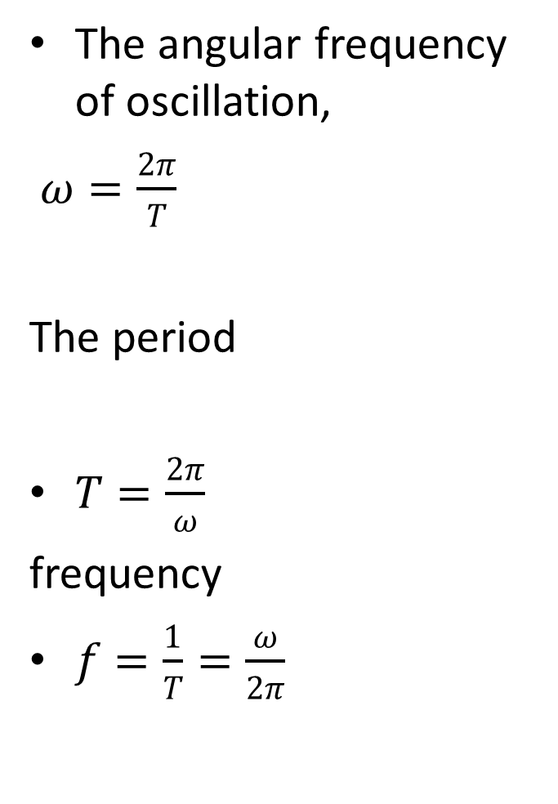
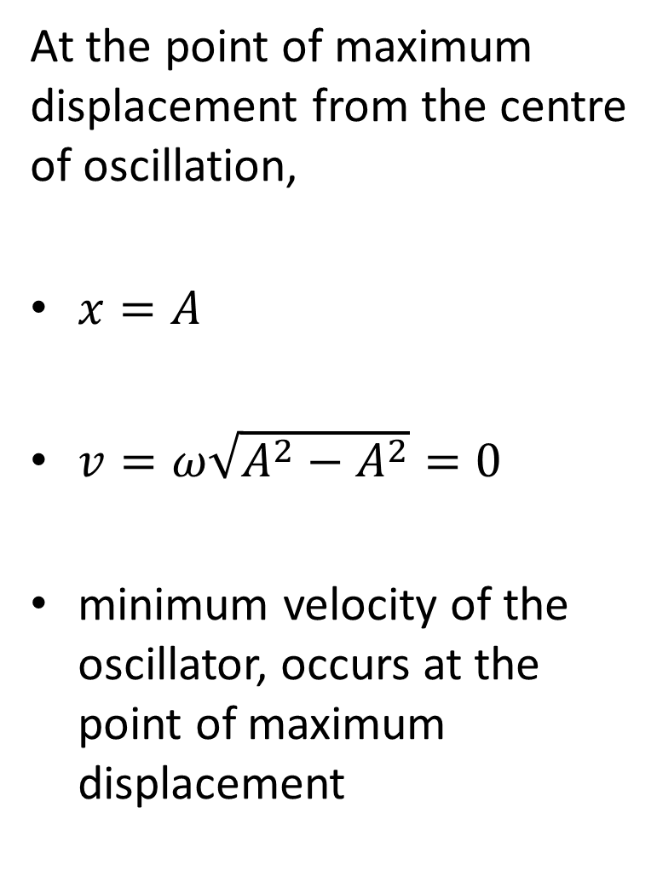
At the point of maximum displacement from the centre of oscillation,
$x=A$
$v=ω\sqrt{A^{2}−A^{2}}=0$
minimum velocity of the oscillator, occurs at the point of maximum displacement
The angular frequency of oscillation,
$ω=\frac{2π}{T}$
The period
$T=\frac{2π}{ω}$
frequency
$f=\frac{1}{T}=\frac{ω}{2π}$

Slide 56
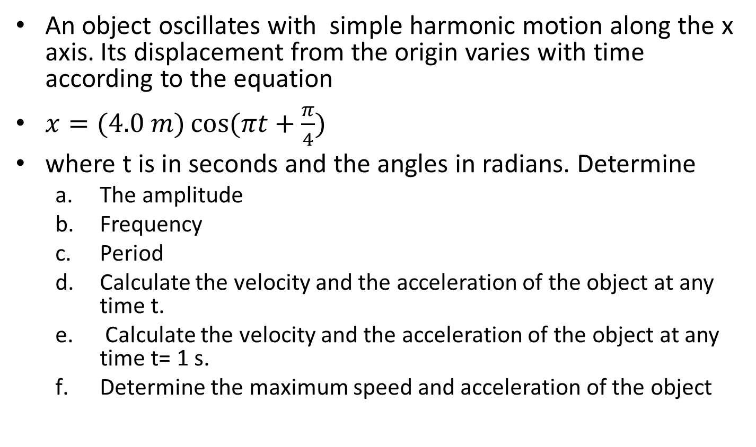
Question
An object oscillates with simple harmonic motion along the x axis. Its displacement from the origin varies with time according to the equation
$x=(4.0 m)\cos{(πt+\frac{π}{4})}$
where t is in seconds and the angles in radians. Determine
The amplitude
Frequency
Period
Calculate the velocity and the acceleration of the object at any time t.
Calculate the velocity and the acceleration of the object at any time t= 1 s.
Determine the maximum speed and acceleration of the object

Slide 57
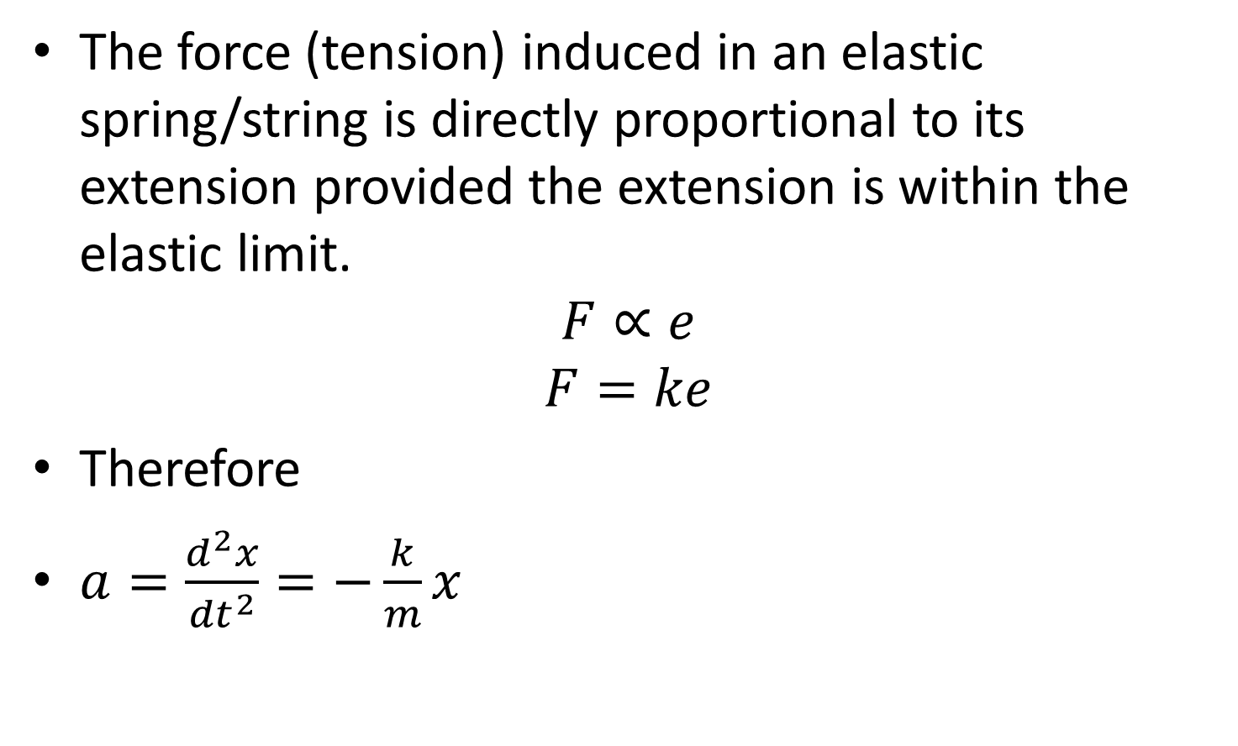
HOOK’S LAW
The force (tension) induced in an elastic spring/string is directly proportional to its extension provided the extension is within the elastic limit.
$$F∝e$$
$$F=ke$$
Therefore
$a=\frac{d^{2}x}{{dt}^{2}}=−\frac{k}{m}x$

Slide 58
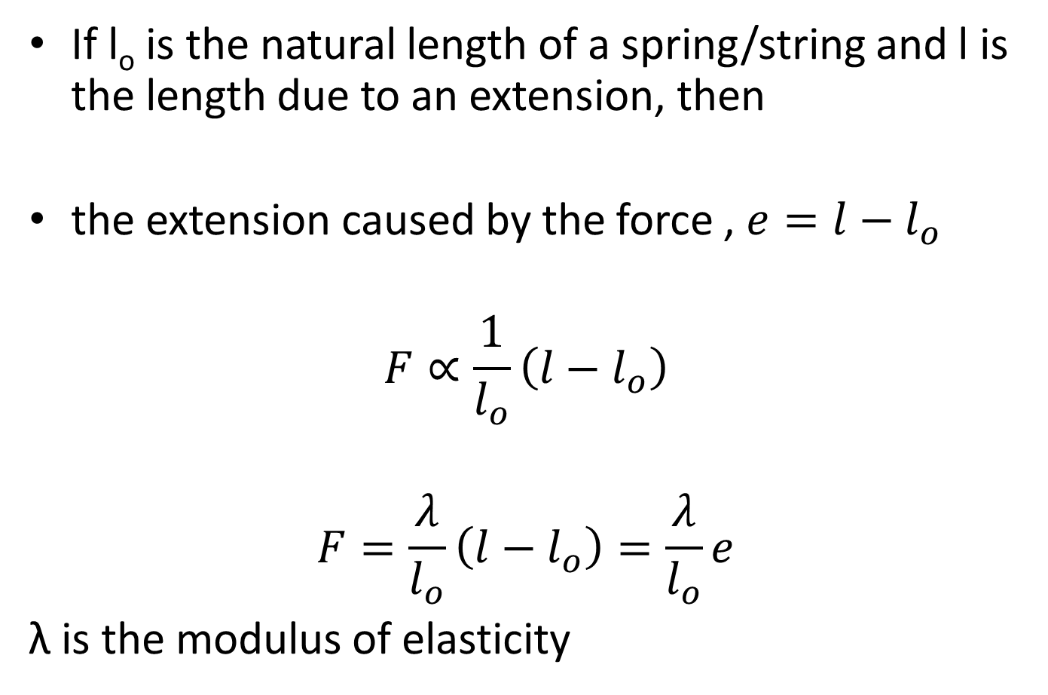
MODULUS OF ELASTICITY
If l_{o} is the natural length of a spring/string and l is the length due to an extension, then
the extension caused by the force , $e=l−l_{o}$
$$F∝\frac{1}{l_{o}}\left(l−l_{o}\right)$$
$$F=\frac{λ}{l_{o}}\left(l−l_{o}\right)=\frac{λ}{l_{o}}e$$
λ is the modulus of elasticity

Slide 59
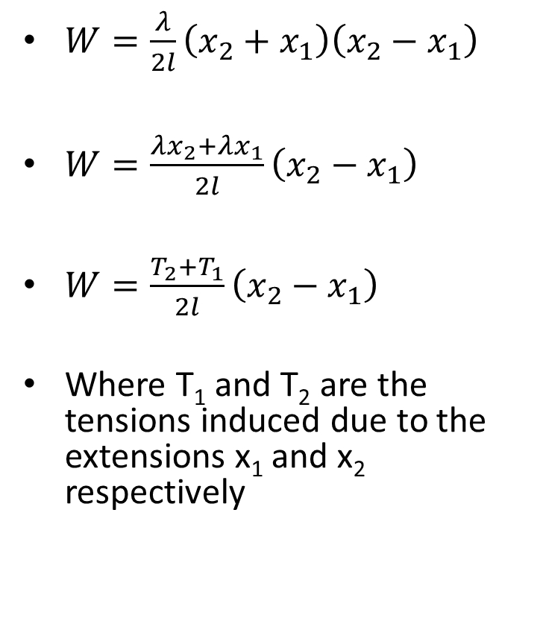
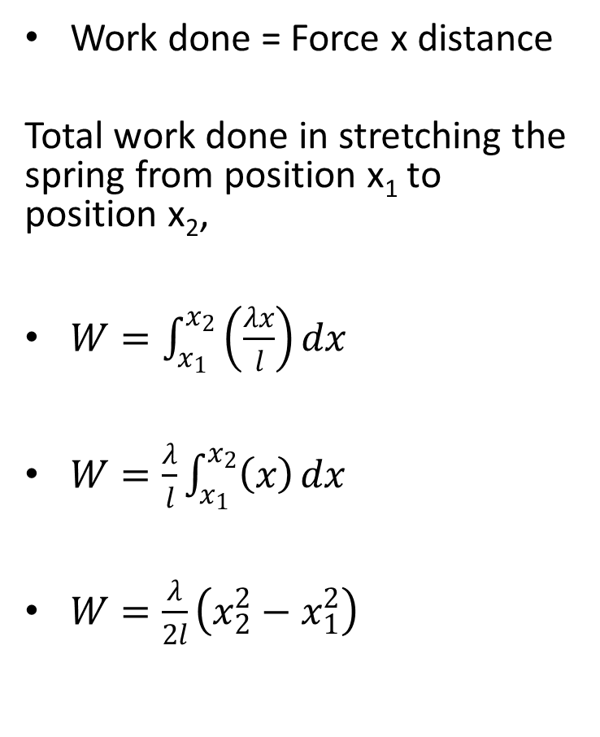
WORK DONE IN A STRETCHED ELASTIC STRING OR SPRING
Work done = Force x distance
Total work done in stretching the spring from position x₁ to position x₂,
$W=\int_{x_{1}}^{x_{2}}{\left(\frac{λx}{l}\right)}dx$
$W=\frac{λ}{l}\int_{x_{1}}^{x_{2}}{\left(x\right)}dx$
$W=\frac{λ}{2l}\left(x_{2}^{2}−x_{1}^{2}\right)$
$W=\frac{λ}{2l}\left(x_{2}+x_{1}\right)\left(x_{2}−x_{1}\right)$
$W=\frac{λx_{2}+λx_{1}}{2l}\left(x_{2}−x_{1}\right)$
$W=\frac{T_{2}+T_{1}}{2l}\left(x_{2}−x_{1}\right)$
Where T₁ and T₂ are the tensions induced due to the extensions x₁ and x₂ respectively

Slide 60
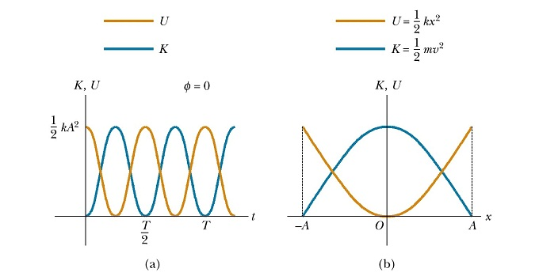
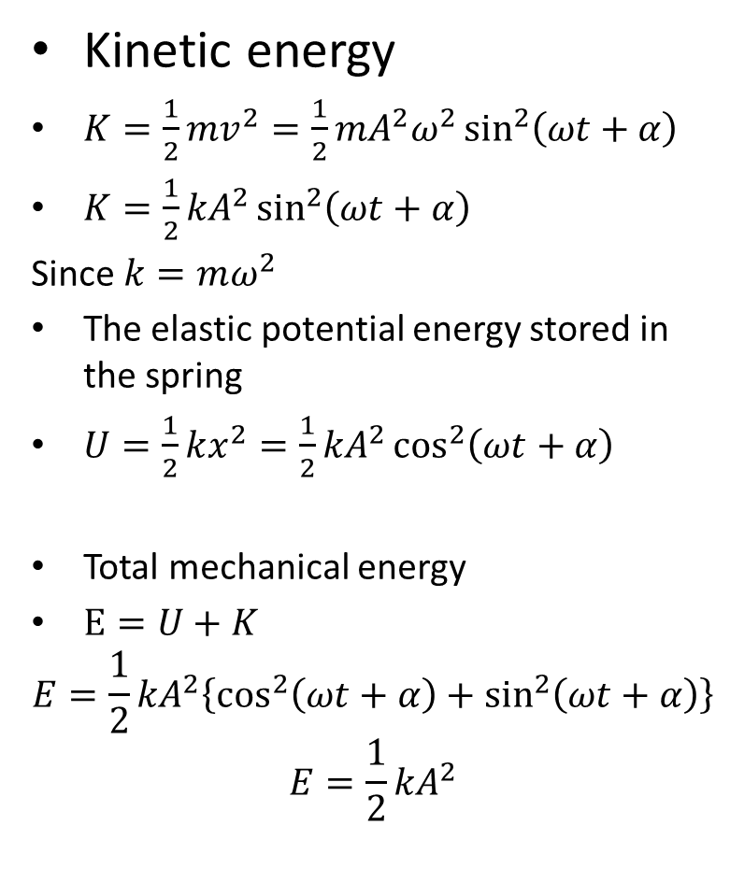
Energy of a simple harmonic oscillator
Kinetic energy
$K=\frac{1}{2}mv^{2}=\frac{1}{2}{mA}^{2}ω^{2}\sin^{2}\left(ωt+α\right)$
$K=\frac{1}{2}{kA}^{2}\sin^{2}\left(ωt+α\right)$
Since $k=mω^{2}$
The elastic potential energy stored in the spring
$U=\frac{1}{2}kx^{2}=\frac{1}{2}{kA}^{2}\cos^{2}\left(ωt+α\right)$
Total mechanical energy
$E=U+K$
$$E=\frac{1}{2}{kA}^{2}\left\{\cos^{2}\left(ωt+α\right)+\sin^{2}\left(ωt+α\right)\right\}$$
$$E=\frac{1}{2}{kA}^{2}$$
Total mechanical energy of a simple
Harmonic is a constant

Slide 61

SIMPLE HARMORNIC MOTION IN A VERTICALL SUSPENDED SPRING

Slide 62


force experience by the spring
$F=mg$
$F=\frac{λe}{l}=ke$
where ‘e’ is the extension at equilibrium and $l$ natural length of spring
$mg=\frac{λe}{l}$
In Fig c the particles is displaced from it equilibrium position in Fig b, by an extension x.
The total force induced in the spring
$F=\frac{λ}{l}(e+x)$

Slide 63


EQUATION OF MOTION
$mg−\frac{λ}{l}\left(e+x\right)=m\frac{d^{2}x}{dt^{2}}$
$mg−\frac{λe}{l}−\frac{λx}{l}=m\frac{d^{2}x}{dt^{2}}$
$m\frac{d^{2}x}{dt^{2}}=−\frac{λx}{l}$
$\frac{d^{2}x}{dt^{2}}=−\frac{λ}{ml}x$
$\frac{d^{2}x}{dt^{2}}=−ω^{2}x$
$ω^{2}=\frac{λ}{ml}$ = $\frac{k}{m}$
Assuming that the maximum displacement of the mass from it equilibrium position is A, we get the general solution
$x=\operatorname{Acos}{ (ωt+α})$
When t = 0, x = A
$A=A\cos{α}$
$\cos{α=1}$
$α=0$
$x=\operatorname{Acos}{ωt}$
$x=A\cos{\sqrt{λ/{ml}} }t=A\cos{\sqrt{k/m} }t$
since spring constant $k=\frac{λ}{l}$

Slide 64


OSCILLATION OF A MASS ON A SMOOTH HORIZONTAL PLANE
EQUATION OF MOTION
Since g acts vertically downwards it has no component in the horizontal direction of motion
$\sum{F=ma}$
$F=\frac{λx}{l}=−m\frac{d^{2}x}{dt^{2}}$
$\frac{d^{2}x}{dt^{2}}=−\frac{λ}{ml}x$
$ω^{2}=\frac{λ}{ml}$
$\frac{d^{2}x}{dt^{2}}=−ω^{2}x$

Slide 65


Assignment: Simple Pendulum
Prove that the period of a simple pendulum is given as
$T=2π\sqrt{L/g}$

Slide 66

Damped Oscillation motion
This is a form oscillation in which dissipative force such as friction, retard the motion. This leads to lost in mechanical energy of the system.
Retarding force
R= -bv
Where b is the damping coefficient
The storing force of spring system
F = -kx

Slide 67


From Newton’s Second Law of Motion
$\sum{F_{x}=−kx−bv=ma_{x}}$
$−kx−b\frac{dx}{dt}=m\frac{d^{2}x}{{dt}^{2}}$
$m\frac{d^{2}x}{{dt}^{2}}+b\frac{dx}{dt}+kx=0$
This is in the form of a homogeneous second order differential equation and has a solution of the form
$$x={Ae}^{γt}$$
$$\frac{dx}{dt}=Aγe^{γt}$$
$$\frac{d^{2}x}{{dt}^{2}}={Aγ}^{2}e^{γt}$$
$$mγ^{2}+bγ+k=0$$
$$γ=\frac{−b±\sqrt{b^{2}−4mk}}{2m}$$

Slide 68


General solution
When b is very small compared with the maximum retarding force, the solution to the equation which is an exponentially decaying sinusoid is
$x=Ae^{−λt}\cos\left(ωt+α\right)$
Where $λ=\frac{b}{2m}$
$x=Ae^{−\frac{b}{2m}t}\cos\left(ωt+α\right)$
$ω=\sqrt{\frac{k}{m}−{\left(\frac{b}{2m}\right)}^{2}}$
$ω=\sqrt{{ω_{o}}^{2}−{\left(\frac{b}{2m}\right)}^{2}}$

Slide 69

Overdamped: the system returns to equilibrium without oscillating.
$${ω_{o}}^{2}−{\left(\frac{b}{2m}\right)}^{2}>0$$
Critically damped: the system returns to equilibrium as quickly as possible without oscillating.
$${ω_{o}}^{2}−{\left(\frac{b}{2m}\right)}^{2}=0$$
Under damped: the system oscillates with the amplitude gradually decreasing to zero.
$${ω_{o}}^{2}−{\left(\frac{b}{2m}\right)}^{2}<0$$

Slide 70

Underdamped Oscillator

Slide 71


Slide 72

Force Oscillation
This occurs when there is an energy input in the system to overcome the retarding. The applitude of the oscillation remains constant when the input energy per cycle is exactly equals the energy lost as a result of damping.
Such force is given as
$F=F_{ext}\cos{ωt}$
Where ω is the angular frquency of the periodic force and $F_{ext}$ is constant

Slide 73

The equation of motion of such a system is given as
$$F_{ext}\cos{ωt}−kx−b\frac{dx}{dt}=m\frac{d^{2}x}{{dt}^{2}}$$
When the system is in a steady state, the solution
$$x=A\cos\left(ωt+α\right)$$
Where
$$A=\frac{{F_{ext}}/m}{\sqrt{{\left(ω^{2}−{ω_{0}}^{2}\right)}^{2}+{\left(\frac{bω}{m}\right)}^{2}}}$$
and
$$ω_{0}=\sqrt{\frac{k}{m}}$$

Slide 74

Resonance Frequency
When the frequency of the driving force is equal to the natural frequency of the oscillator, the maximum amplitude is produced. The frequency at which this ocurs is the resonance frequency of the system.
$$ω=ω_{0}$$

