Slide 1

HR Turnover Analysis
Orion Tran | 2025
Reducing attrition, saving costs, improving retention

Slide 2
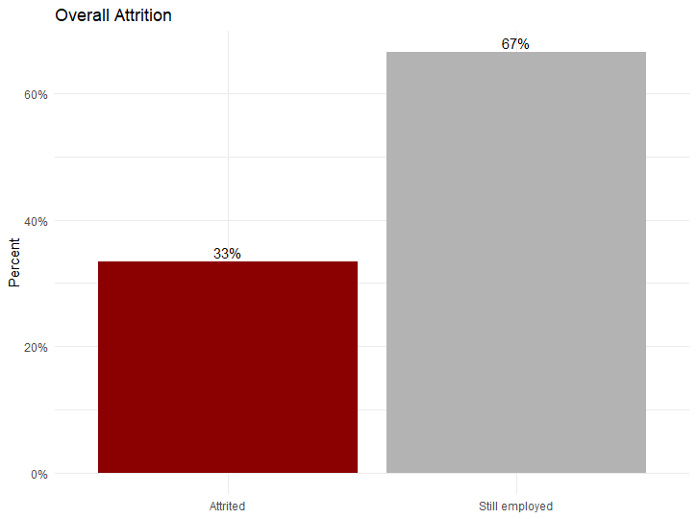
Why Turnover Matters
• 33% of employees leave overall
• Turnover costs 6–9 months of salary per employee (SHRM, 2016)
• Turnover is a costly and recurring challenge
1 in 3 employees leave overall

Slide 3
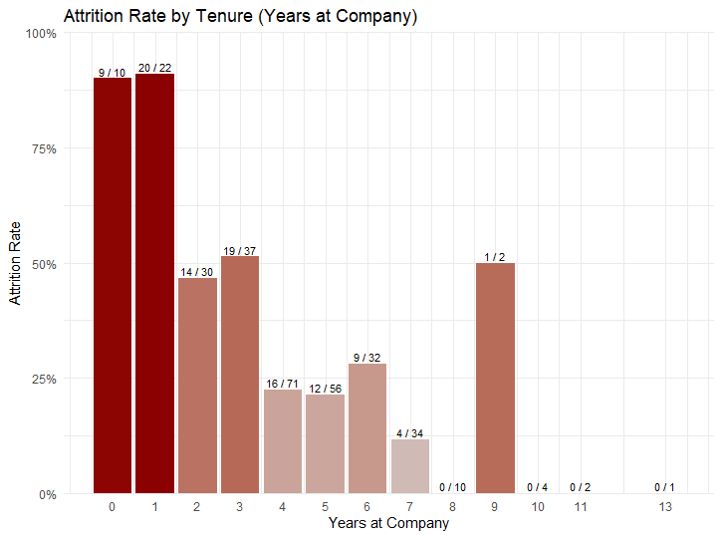
Attrition is Heavily Front-Loaded
• Most exits occur in the first year
• Retention improves significantly with longer tenure
• Early-tenure = most vulnerable period
Most exits occur in the first year;
retention stabilizes with longer tenure.

Slide 4
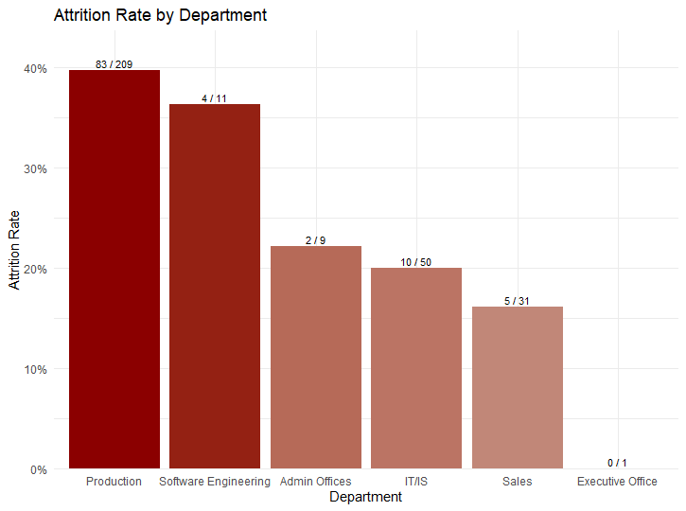
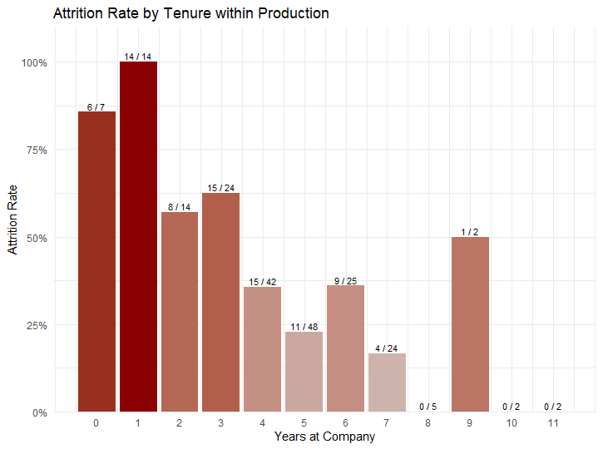
Production Has the Highest Attrition
• Production employees leave at the highest rate
• Drill-down shows first-year Production employees face extreme risk (100% attrition rate first 2 years)
• Other departments stabilize after early tenure
Production has the highest attrition
rate among all departments.
First-year Production employees are at extreme risk of leaving.

Slide 5
Retention Gains Pay for Themselves
Reducing first-year Production attrition by just 5% can equal
~$375K saved annually
Once stabilized in Production, scaling across departments could exceed $800K
Even cautious estimates show retention improvements deliver big returns
ROI Calculation Source: SHRM (2016), Human Capital Benchmarking Report

Slide 6
What HR Should Prioritize
Stronger onboarding
Early-tenure mentoring and support
Targeted retention programs in Production
These actions directly address the most vulnerable employees and create a tangible ROI.

