Slide 1
Implementation of a Heterogeneous System for Image Processing on an FPGA
Pierre-Hugues BLELLY
Samuel Riedel
Matheus Cavalcante
Luca Benini
pblelly@student.ethz.ch
sriedel@iis.ee.ethz.ch
matheusd@iis.ee.ethz.ch
lbenini@iis.ee.ethz.ch

Slide 2
Heterogeneous systems
Image processing on smartphone SoC for High resolution images.
Distribution of the processing on integrated GPU and DSPs.
Programming Model: Hard to write reusable code.

Slide 3
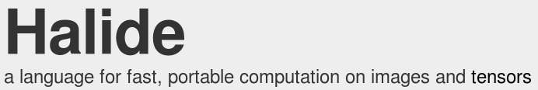
Halide
Functional paradigm.
Cross platform and OS.
Design:
Separation between processing and scheduling.
Designed for Heterogeneous systems (GPU, DSP).

Slide 4
Goal of the project
Test Halide.
Enable Halide on the HERO platform.
Compare Halide with an already available solution: OpenMP.

Slide 5
The Halide Language
Functional Paradigm.
Separation between the algorithm and the schedule.
Easier programming and optimization.

Slide 6
Halide vs OpenMP
OpenMP
Halide
#pragma omp parallel for collapse(2)
for (int y_outer = 0; y_outer < 2; y_outer++) {
for (int x_outer = 0; x_outer < 2; x_outer++) {
for (int y_inner = 0; y_inner < 4; y_inner++) {
for (int x_inner = 0; x_inner < 4; x_inner++) {
int x = x_outer * 4 + x_inner;
int y = y_outer * 4 + y_inner;
output[y][x] += A[k][x] * B[y][k];
}
}
}
}
matmul(x,y) += A(x,k) * B(k,y);
out(x,y) = matmul(x,y) ;
out.tile(x,y,x_outer,x_inner,x_inner,y_inner,4,4);
out.fuse(x_outer, y_outer);
out.parallel(tile_index);

Slide 7
Schedule examples
out.realize();
out.tile(x,y,x_o,y_o,x_i,y_i);
out.tile(x,y,x_o,y_o,x_i,y_i);
out.fuse(x_o,y_o,tile_index);
out.parallel(tile_index);

Slide 8
About the Implementation
halide_do_par_for
Create the tasks on the task queue
Every task runs halide_par_for_fork
halide_par_for_fork
Wrapper around the pipeline function
Execute the task if its id matches the core id

Slide 9
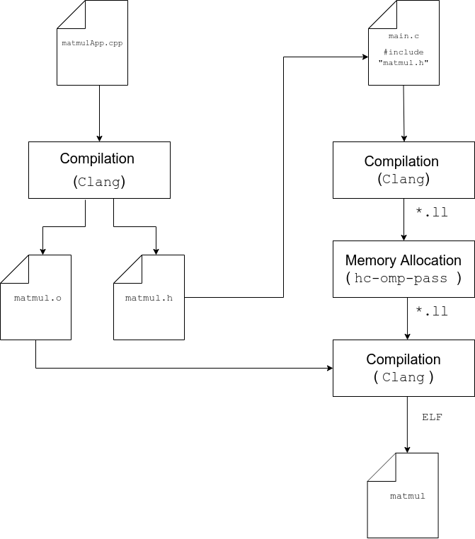
Compilation Workflow

Slide 10
Test Setup
Random Matrices of various sizes
Matrices stored in the L1 cache for minimal access time.
Benchmark of the default and multithreaded schedules.

Slide 11
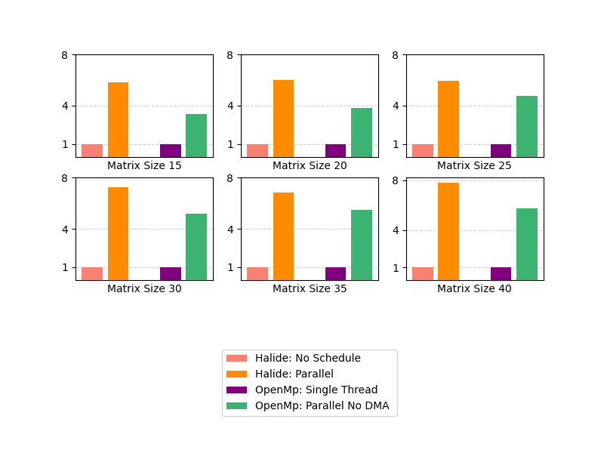
Basic Results: Halide vs OpenMP
Benchmarks results relative to Halide single threaded execution time

Slide 12
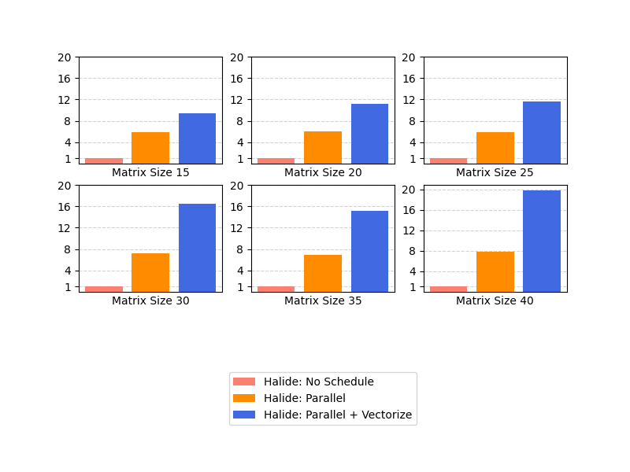
Optimization of the Schedule
Facilitate schedule changes
Vectorize schedule performed best because of data reutilization.
Combine it with the parallel schedule for best performances.

Slide 13
Next Steps
Halide can't replace OpenMP (to change)
Supporting the full Hero Platform
Adding support for the auto-scheduler

Slide 14
Conclusion

