Slide 1
Implementation of a Heterogeneous System for Image Processing on an FPGA
Samuel Riedel
Matheus Cavalcante
Luca Benini
sriedel@iis.ee.ethz.ch
matheusd@iis.ee.ethz.ch
lbenini@iis.ee.ethz.ch

Slide 2
Heterogeneous systems
Image processing on smartphone SoC for High resolution images
Distribute the processing on integrated GPU and DSP
Problem: Programming Model

Slide 3
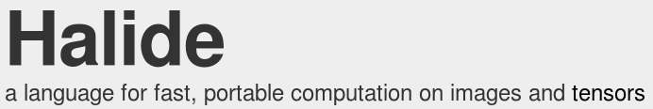
Halide
Functional paradigm
Cross platform and OS.
Design:
Separation between processing and scheduling
Designed for Heterogeneous systems (GPU, DSP)

Slide 4
Goal of the project
Test Halide.
Enable Halide on the HERO platform.
Compare Halide with an already available solution: OpenMP

Slide 5
The Halide Language
Functional Paradigm
Separation between the algorithm and the schedule
Easier programming and optimization

Slide 6
Halide vs OpenMP
OpenMP
Halide
#pragma omp parallel for collapse(2)
for (int y_outer = 0; y_outer < 2; y_outer++) {
for (int x_outer = 0; x_outer < 2; x_outer++) {
for (int y_inner = 0; y_inner < 4; y_inner++) {
for (int x_inner = 0; x_inner < 4; x_inner++) {
int x = x_outer * 4 + x_inner;
int y = y_outer * 4 + y_inner;
output[y][x] += A[k][x] * B[y][k];
}
}
}
}
matmul(x,y) += A(x,k) * B(k,y);
out(x,y) = matmul(x,y) ;
out.tile(x,y,x_outer,x_inner,x_inner,y_inner,4,4);
out.fuse(x_outer, y_outer);
out.parallel(tile_index);

Slide 7
Schedule examples
out.realize();
out.tile(x,y,x_o,y_o,x_i,y_i);
out.tile(x,y,x_o,y_o,x_i,y_i);
out.fuse(x_o,y_o,tile_index);
out.parallel(tile_index);

Slide 8
About the Implementation
halide_do_par_for
Create the tasks on the task queue
Every task runs halide_par_for_fork
halide_par_for_fork
Wrapper around the pipeline function
Execute the task if it's id match the core id

Slide 9
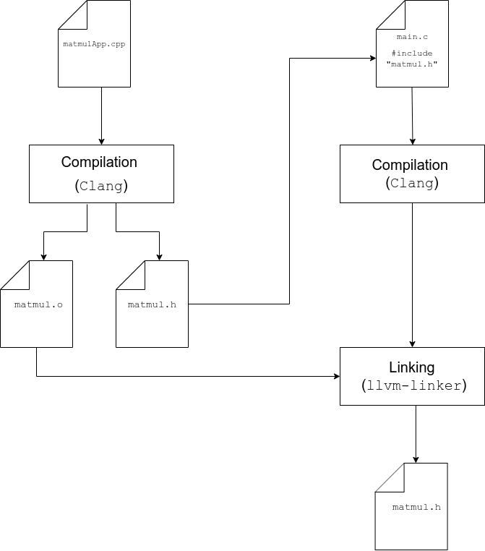
Compilation Workflow

Slide 10
Test Setup
Random Matrices of various sizes
Matrices storied in the L1 cache for minimal access time
Benchmark of the default and multithreaded implementation

Slide 11
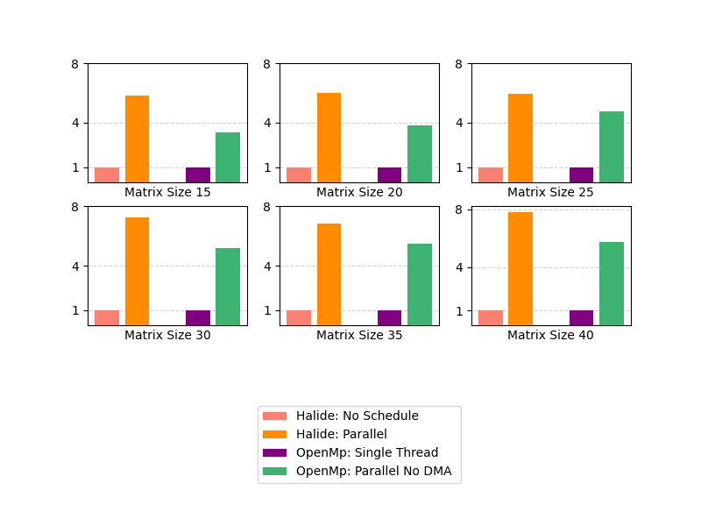
Basic Results: Halide vs OpenMP
Benchmarks results relative to Halide single threaded execution time

Slide 12
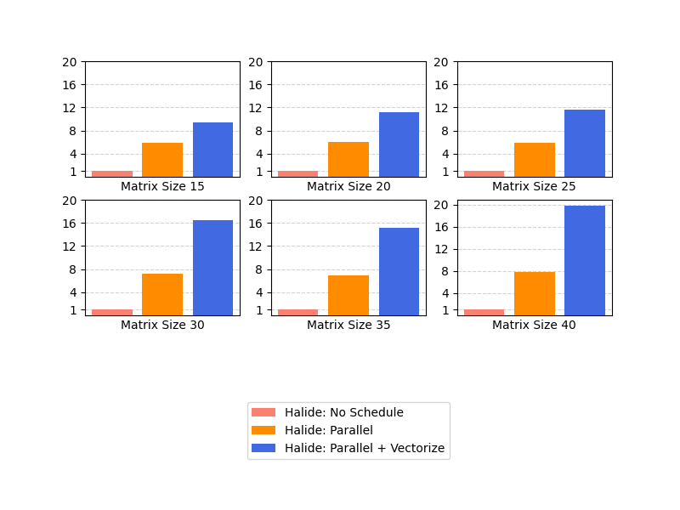
Optimization of the Schedule
Facilitate schedule changes
Vectorize schedule performed best because of data reutilization.
Combine it with the parallel schedule for best performances.

Slide 13
Next Steps
Halide can't replace OpenMP (to change)
Supporting the full Hero Platform
Adding support for the auto-scheduler

Slide 14
Conclusion

