Slide 1
爱因斯坦对二十一世纪
理论物理学的影响

Slide 2
爱因斯坦是二十世纪最伟大的物理学家

Slide 3
他与牛顿是历史上最伟大的两位物理学家

Slide 4
深
广
创新
坚持
孤独

Slide 5
二十世纪之三大革命中两个是他创建的。另一个他作了奠基性的贡献。

Slide 6
第一个革命
狭义相对论

Slide 7
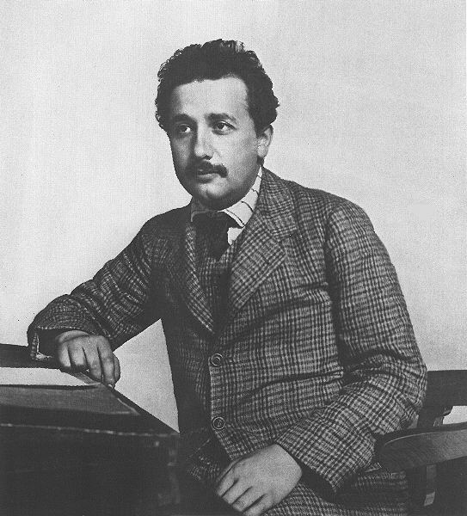
Einstein as patent clerk, ca. 1905

Slide 8
1887 Michelson-Morley
Lorentz (1853-1928)
Poincare (1854-1912)
Fitzgerald (1851-1901)
Lamor (1857-1942)

Slide 9
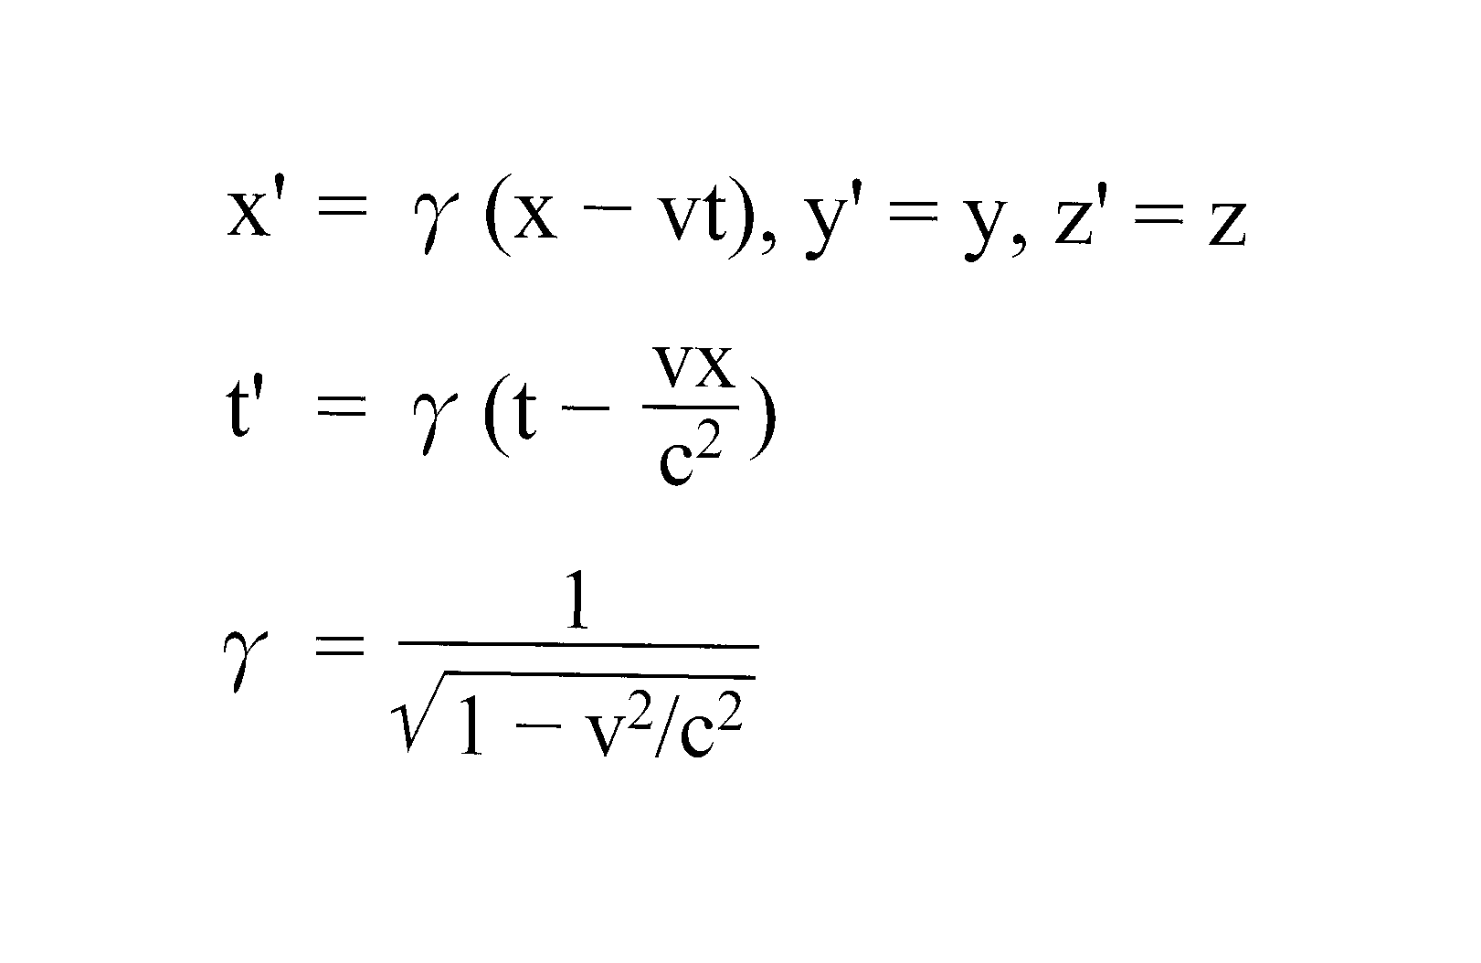

Slide 10
Lorentz wrote in 1915 (Pais p. 167):
“The chief cause of my failure was my clinging to the idea that only the variable t can be considered as the true time and that my local time t' must be regarded as no more than an auxiliary mathematical quantity.”

Slide 11
Lorentz有了数学，但未懂其物理意义。

Slide 12
Poincare in 1904
(In <Physics for a New Century> AIP publication on History, volume 5, 1986)

Slide 13
“The principle of relativity, according to which the laws of physical phenomena should be the same, whether for an observer fixed, or for an observer carried

Slide 14
along in a uniform movement of translation; so that we have not and could not have any means of discerning whether or not we are carried along in such a motion.”

Slide 15
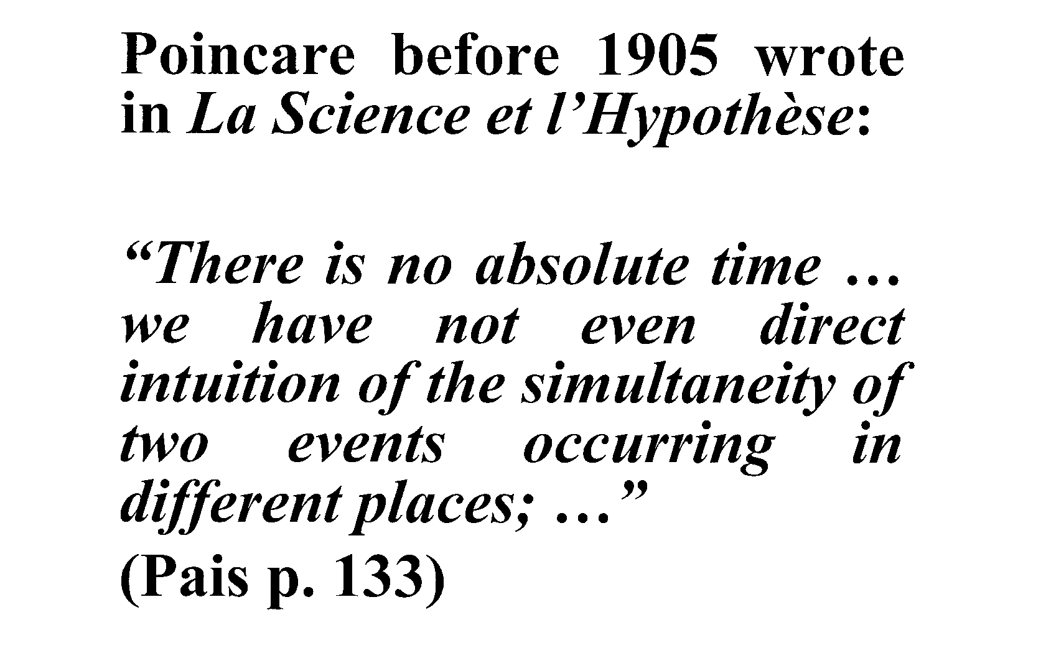

Slide 16
“同时间”（simultaneity）
之相对性

Slide 17
Poincare有了哲学，但未懂其物理意义

Slide 18
是一位26岁的小职员真懂了“相对”的革命性的物理意义

Slide 19
第二个革命
广义相对论

Slide 20
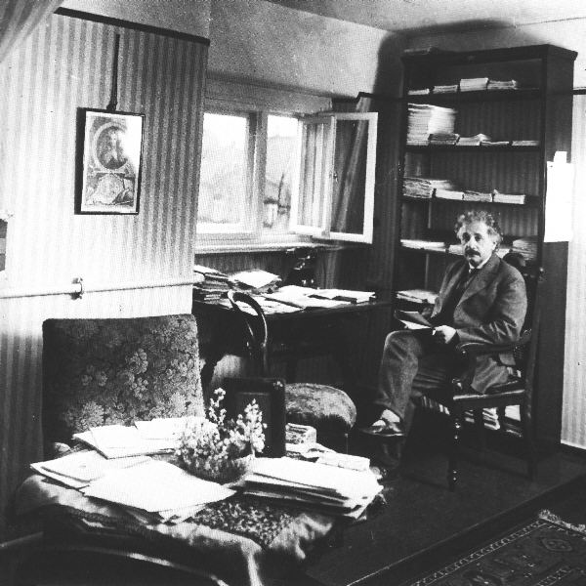
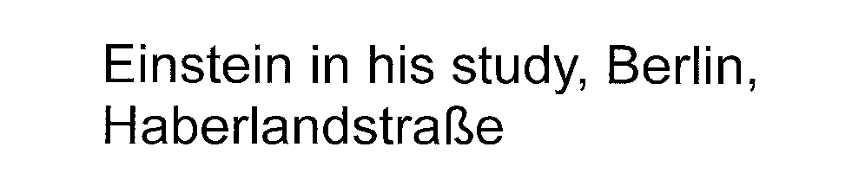

Slide 21
关于广义相对论之最早起源，爱因斯坦晚年写道：

Slide 22
“… that the basic demand of the special theory of relativity (invariance of the laws under Lorentz-transformations) is too narrow, i.e. that an invariance of the laws must be postulated also relative to non-linear transformations

Slide 23
of the coordinates in the four-dimensional continuum.
This happened in 1908.”
Einstein: Autobiographical Notes
in <Albert Einstein>, ed. P.A.
Schilpp, p.67

Slide 24
宇宙学
几何学
统一场论
规范场

Slide 25
第三个革命
量子力学

Slide 26
Planck
Einstein Bohr
de Broglie Heisenberg
Schrödinger Born

Slide 27
1905 Energy = hν
1916 Momentum = hν/c

Slide 28
Bose-Einstein Statistics
1924-1925
Bose-Einstein Condensation
1925

Slide 29
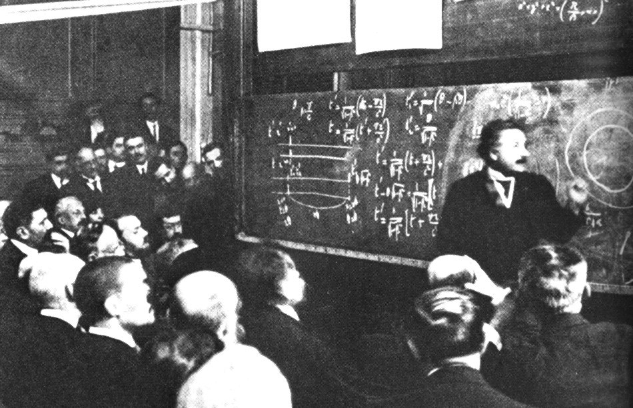
Einstein was giving a lecture in 1922
at the College de France in Paris

Slide 30
统一场论

Slide 31
统一场论虽然至今还未成功，但将持续为基础物理学的目标

Slide 32
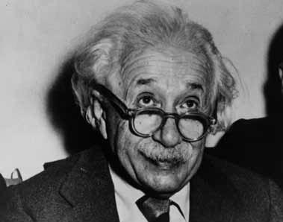
Einstein in Princeton

Slide 33
“There was never any attempt by him to browbeat us. He made us feel extremely comfortable intellectually and emotionally.”
Hoffmann, Woolf p. 476

Slide 34
爱因斯坦的非专业性文章十分简短，但是往往非常深刻。

Slide 35
“人类最美的经验是神秘感。神秘感是真艺术与真科学的真源泉。”

Slide 36
“一般不认识到一个人的品德与他（她）的学术贡献有极大关系”

