Slide 1

Project 2
Team 3: Raja Abhishek, Denise Franta, Orkhan Garajayev, Conor Hunt , Joshua Neft
Notes:
Presentation Speakers:
Orkan- introduction
Josh-models chosen and overview of models
Conor- data analysis, process and cleaning
Conor- feature analysis and results
Denise- conclusion

Slide 2
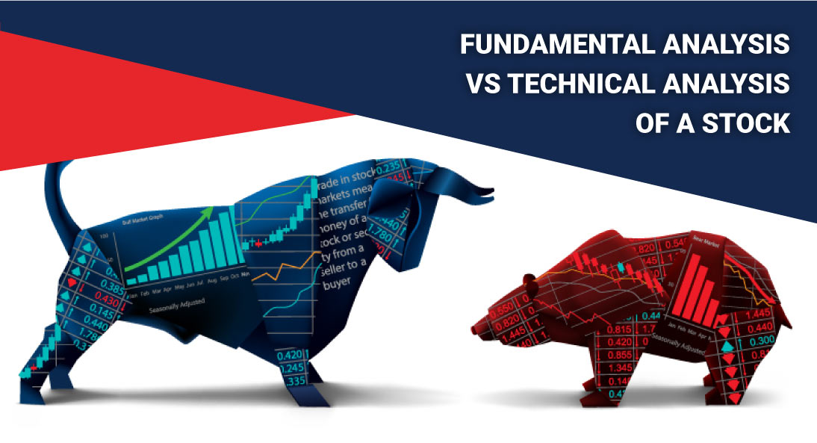
Notes:
Fundamental Analysis in stock price analysis
Can machine learning models use the financial reporting data sues in fundamental analysis to determine if a company’s stock price would go up or down?
Of those financial reports, which financial ratios have more of an effect on the stock than others.
The ultimate goal of fundamental analysis is to quantify the intrinsic value of a security. The security’s intrinsic value can then be compared to its current market price to help with investment decisions.
Bottom-up approach. Instead of starting the analysis from the larger scale, the bottom-up approach immediately dives into the analysis of individual stocks. The rationale of investors who follow the bottom-up approach is that individual stocks may perform much better than the overall industry.
The bottom-up approach is primarily concentrated on various microeconomic factors such as a company’s earnings and financial metrics. Analysts who use such an approach develop a thorough assessment of each company to gain a better understanding of its operations. https://corporatefinanceinstitute.com/resources/knowledge/trading-investing/fundamental-analysis/
Technical analysis is a tool, or method, used to predict the probable future price movement of a security – such as a stock or currency pair – based on market data.
The theory behind the validity of technical analysis is the notion that the collective actions – buying and selling – of all the participants in the market accurately reflect all relevant information pertaining to a traded security, and therefore, continually assign a fair market value to the security.
Technical traders believe that current or past price action in the market is the most reliable indicator of future price action. Technical analysis is not only used by technical traders. Many fundamental traders use fundamental analysis to determine whether to buy into a market, but having made that decision, then use technical analysis to pinpoint good, low-risk buy entry price levels. https://corporatefinanceinstitute.com/resources/knowledge/trading-investing/technical-analysis/

Slide 3

ML Effectiveness in Fundamental Analysis
Fundamental Analysis
Can a machine learning model determine if a company’s stock price would go up or down using a public company’s financial reporting?
What model is the most effective?
What financial ratios have the most impact on the model’s ability to predict the price going up or down?

Slide 4

Stock Analysis using Machine Learning Models
Machine learning systems can evaluate multiple factors that influence investment decisions.
The use of machine learning models make trading decisions more efficient.
We used different models in order to find out the most effective one.
Logistic Regression and Random Forest were two models used in this project.

Slide 5

Models Chosen & Why
Classification
Predicting stock price would require a lot more information to develop an effective model. Classification of stock price movement requires less intense data to train and fit a model.
Interested in knowing which feature had more of an effect on stock price. Wanted to conduct a feature analysis
Logistic Regression
Random Forest
Gradient Boost
Notes:
Logistic Regression
Random Forests
Gradient Boost
Classifier models- did price go up or down
-easier to classify price movement than predicting stock price
Feature analysis
-which feature was more important in the price going up or down

Slide 6
Model Advantages
Random Forest
Reduces the risk of overfitting, averaging many uncorrelated trees lowers overall variance and prediction error
Robust against outliers
Gradient Boost
Works by random sampling the data set with replacement, sampling more heavily the observations with worst prediction
Logistic Regression
Provides a probability that can be used to classify data by giving a probability cutoff value
Ability to make accurate predictions with precision and substantial recall “is almost unparalleled”
Robust against overfitting
Works efficiently with large data sets
Robust against noise
Works efficiently with large data sets

Slide 7

Data Preparation
Notes:
Data source: SimFin https://simfin.com/
Used API pull from paid subscription to all financial ratios and stock price data. Financial ratio data was organized by quarters going back as far as Q1 2007. Stock price data was organized by daily stock price going back as far a Jan 1, 2007.
Challenges with the data:
Multi-index. Data was grouped by by ticker and date
Date mismatch. Ratio dates were quarterly, stock prices were daily
Approaches
Combiner
Pulling select stocks from each dataset (ratios and prices) then combining ratio and price data for each “portfolio”

Slide 8

Data Source and Challenges
Data source: SimFin https://simfin.com/ (2,479 Tickers, 8,185,900 rows of prices, ~84,083 rows of ratios)
Used Simfin API to pull financial ratios and stock price data. Financial ratio data was organized by quarters going back as far as Q1 2007. Stock price data was organized by daily stock price going back as far a Jan 1, 2007.
Challenges with the data:
Multi-index. Data was grouped by ticker and date
Date mismatch. Ratio dates were quarterly, stock prices were daily
How to differentiate price increase vs decrease for day after earnings report
Approaches
Combiner: Pulling select stocks from each dataset (ratios and prices) then merging ratio and price data for each “portfolio”
Unique Key: Assign a unique key for every ticker as an index consisting of ”Ticker”+”Date” to avoid multi-index issue

Slide 9
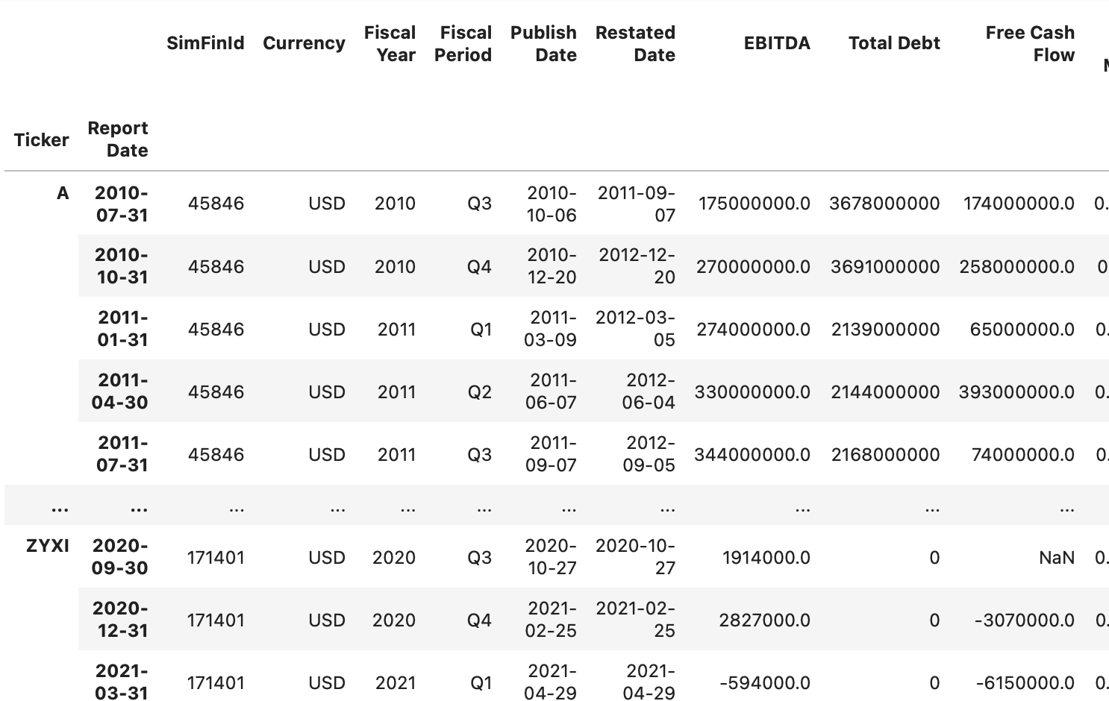
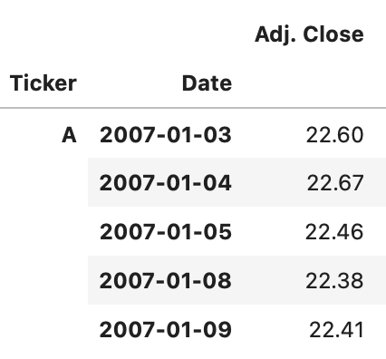
Prices DataFrame
Ratios DataFrame

Slide 10
Data Cleaning Process
Import ratios and price data separately
Drop erroneous columns
Change price data to daily return (shifted down 1 row)
Create Unique Index
Merge data frames
Change Pct to Change (+ or -) and remove nulls
Slice by Ticker using function

Slide 11
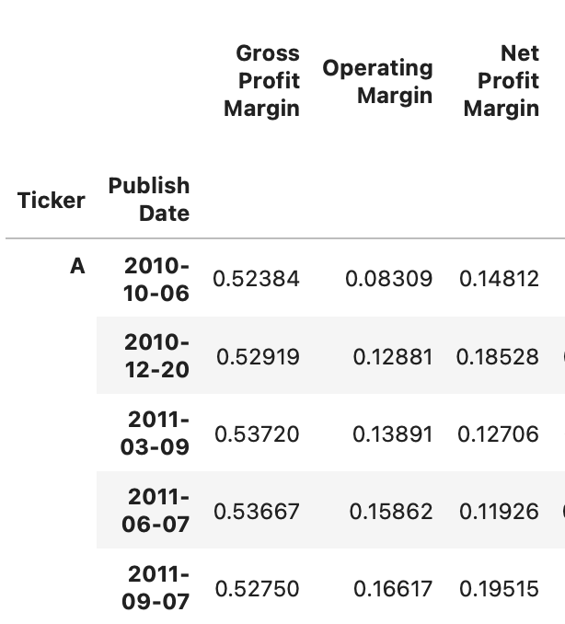
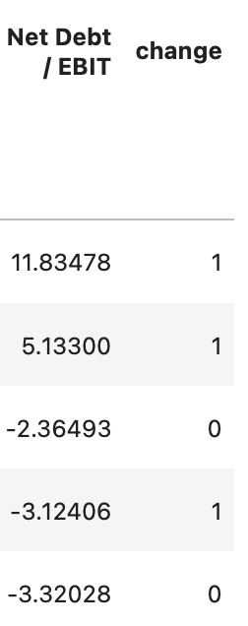
Combined DataFrame
Notes:
Ratios data pull resulted in 84085 rows × 30 columns. Dropped 5 rows with unrelated data (Currency and SimFinId)
Both Price and Ratio data pulls required a unique key to be established in order to rest the index from a multi-index of Ticker and Report Date
Price data pull results in 8,184,900 rows and 3 columns
Price data was reformatted from daily price to quarterly (to match published date for quarterly earning on ratio data)
Returns were calculated and then classified as 1 = price increase, 0 = price decrease
Final, merged dataset used for modeling was 77,400 rows and 30 columns

Slide 12
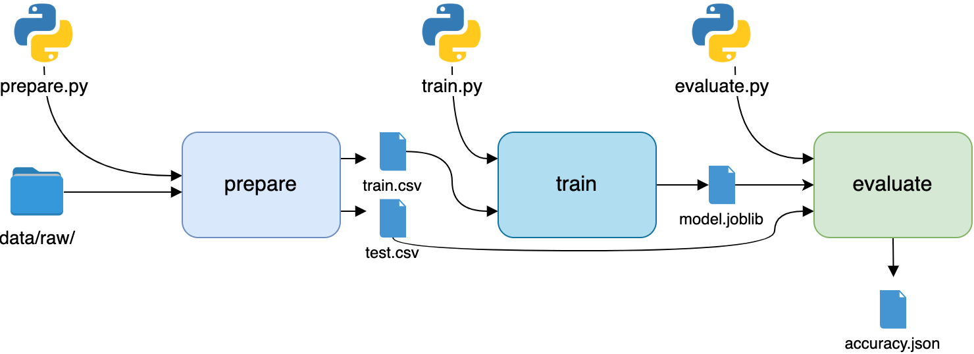
Modeling and Training Process
Drop “Change” to Define X df and use “Change” columns as y
Scale Data with Standard Scaler()
Use train_test_split to separate train and test data
Fit Models to Data and Predict

Slide 13
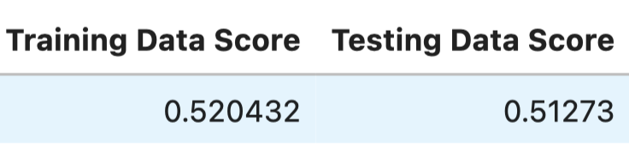
Logistic Regression
Number of rows in data = 77,000

Slide 14
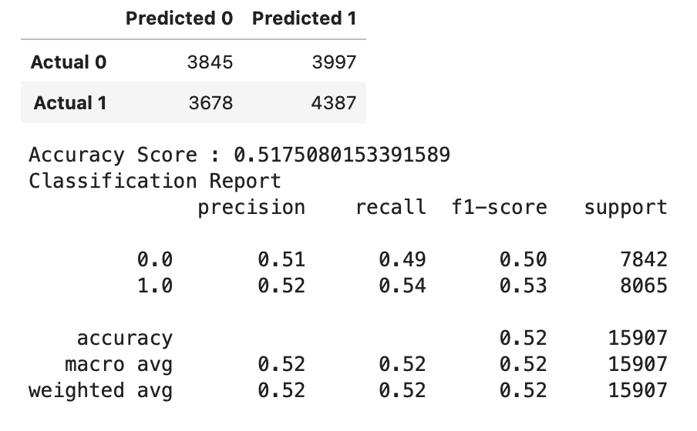
Random Forest

Slide 15
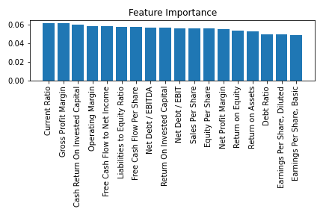
Random Forest

Slide 16
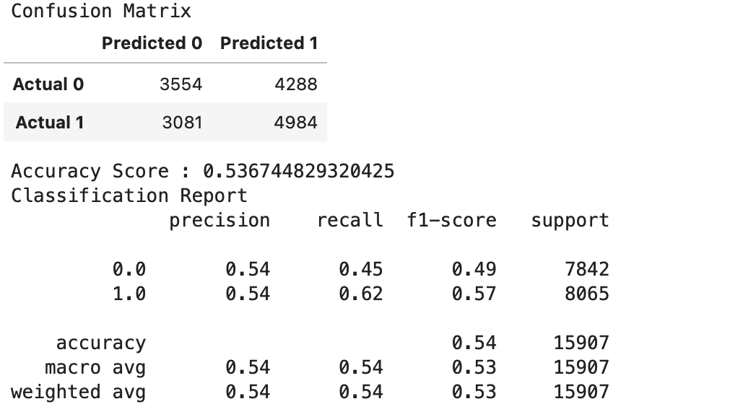
Gradient Boost

Slide 17
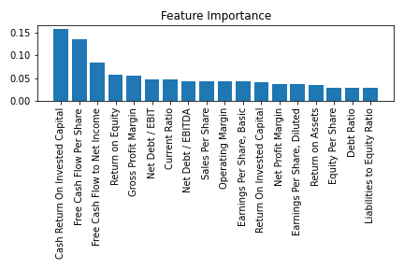
Gradient Boost

Slide 18
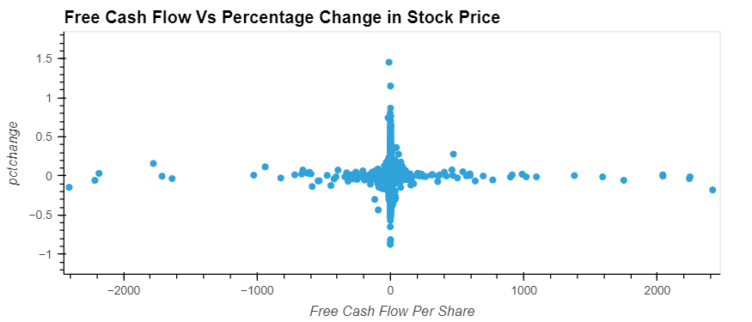
Data Exploration: Free Cash Flow Vs Percentage change in stock price
Free cash flow (FCF) represents the cash available for the company to repay creditors and pay out dividends and interest to investors. Because FCF accounts for changes in working capital, it provides important insight into the value of a company and the health of its fundamental trends. A decrease in accounts payable (outflow) could mean that vendors are requiring faster payment. A decrease in accounts receivable (inflow) could mean the company is collecting cash from its customers quicker. An increase in inventory (outflow) could indicate a building stockpile of unsold products.

Slide 19
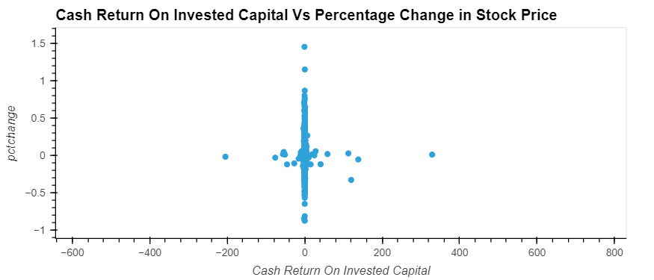
Data Exploration: Cash Return on Invested Capital Vs Percentage change in stock price
The Cash Return On Invested Capital, or CROIC, measures how effectively a company uses its Invested Capital to generate Cash. It is calculated as Free Cash Flow divided by Invested Capital. The higher the CROIC, the better and a CROIC above 10% is usually regarded as good.

Slide 20
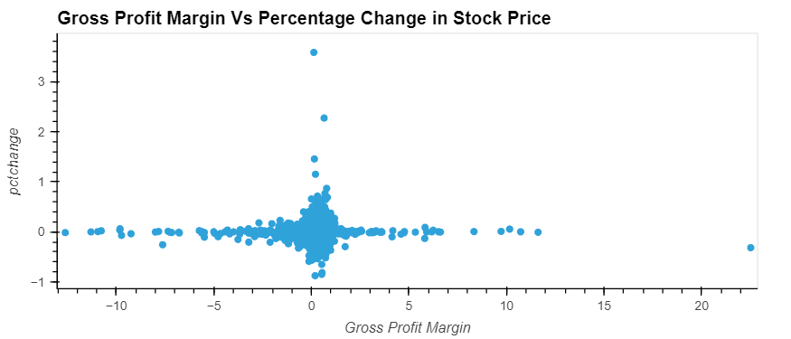
Data Exploration: Gross Profit Margin Vs Percentage change in stock price
Gross profit margin is expressed as a company's net sales minus the cost of goods sold (COGS). If a company's gross profit margin wildly fluctuates, this may signal poor management practices and/or inferior products.

Slide 21
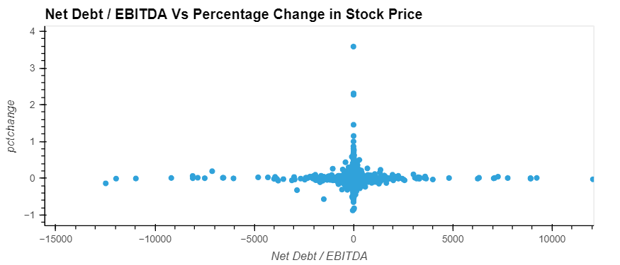
Data Exploration: Net Debt/EBITDA Vs Percentage change in stock price
The net debt-to-EBITDA ratio is a debt ratio that shows how many years it would take for a company to pay back its debt if net debt and EBITDA are held constant. Ratios higher than 4 or 5 typically set off alarm bells because this indicates that a company is less likely to be able to handle its debt burden, and thus is less likely to be able to take on the additional debt required to grow the business

Slide 22
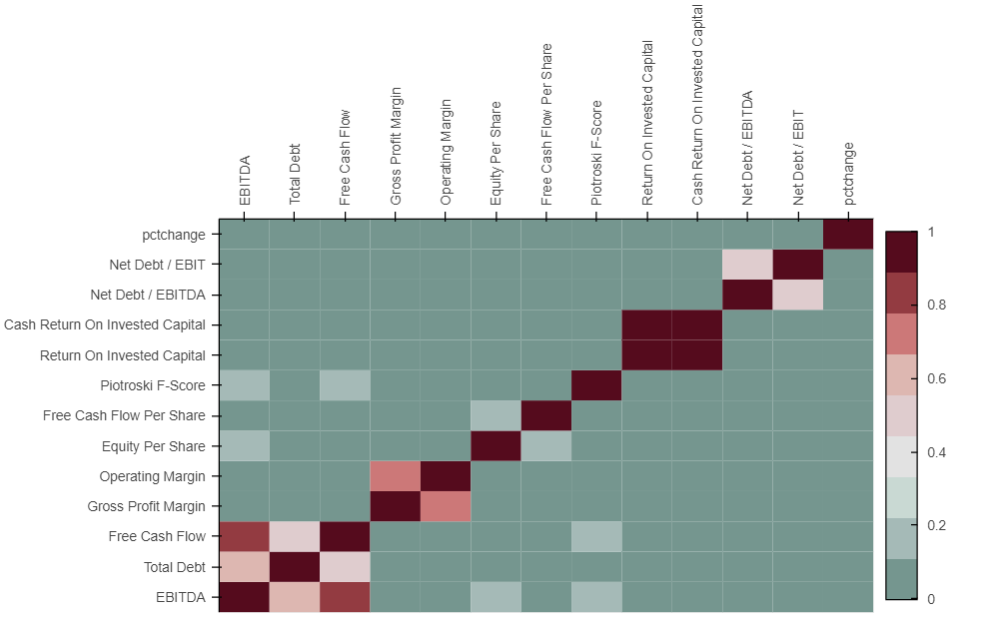
Data Exploration: Correlation Analysis
Individual financial metrics doesn't have any significant correlation with percentage change in stock price

Slide 23
Conclusions
 | Accuracy | Precision |  | Recall |  | F1
 |  | 0.0 | 1.0 | 0.0 | 1.0 | 0.0 | 1.0
Random Forest | 0.5175 | 0.51 | 0.52 | 0.49 | 0.54 | 0.5 | 0.53
Gradient Boost | 0.5367 | 0.54 | 0.54 | 0.45 | 0.62 | 0.49 | 0.57
 | Training Data Score | Test Data Score
Logistic Regression | 0.5204 | 0.5127
Notes:
All models had close performance scores
Gradient Boost slightly outperformed Linear Regression and Random Forest
RF higher precision and F1
GB higher recall for price increase

Slide 24
Conclusions
Top 5 Features
RANDOM FOREST
Current Ratio
Gross Profit Margin
Cash Return on Invested Capital
Operating Margin
Free Cash Flow to Net Income
GRADIENT BOOST
Cash Return on Invested Capital
Free Cash Flow per Share
Free Cash Flow to Net Income
Return on Equity
Gross Profit Margin
Top 3 features across models
Cash Return on Invested Capital, Free Cash Flow to Net Income, Gross Profit Margin,

Slide 25

Implications of Findings

