Slide 1

CSE 4800: Thesis
Binary Function Clone Detection
Using MBA Simplification
Presented By -
Tasnimul Hasnat (190041113)
Sumit Alam Khan (190041207)
Md Abdullahil Kafi (190041224)
Supervised By -
Dr. Md Moniruzzaman,
Assistant Professor, IUT
Imtiaj Ahmed Chowdhury,
Lecturer, IUT

Slide 2
Table of Contents
1
2
3
Relevant Concepts
Existing Literature
Motivation
4
5
Problem Statement
Proposed Methodology

Slide 3
Motivation
Copyright infringement is a serious issue in the software development industry.
Verification and code reuse identification in closed-source applications is significantly difficult.
Cybersecurity challenges increase as attackers modify the existing malwares to evade antivirus detection.
Existing methodologies for finding function clone is mostly Machine learning based which is difficult to scale.
A systematic method to find function clones from binary files could be scalable and easy to use.

Slide 4
Function Cloning
Function cloning is a method of modifying a function in such a way that the changes are limited to the internal code structure, without altering the function's overall behavior.
Function cloning can be broadly categorized into two types:
Optimization
Obfuscation

Slide 5
Function Cloning (Optimization)
func1:
mov -20[rbp], edi
mov -24[rbp], esi
mov -8[rbp], 10
mov eax, -8[rbp]
xor eax, -20[rbp]
sub eax, -24[rbp]
mov -4[rbp], eax
mov eax, -24[rbp]
imul eax, -4[rbp]
mov edx, eax
mov eax, -20[rbp]
add eax, edx
ret
int func1(int a, int b){
int x;
int y;
x = 10;
y = (x ^ a) - b;
return b * y + a;
}
func1:
mov eax, edi
xor eax, 10
sub eax, esi
imul esi, eax
lea eax, [rsi+rdi]
ret
No Optimization
Source Function
O1 Optimization

Slide 6
Function Cloning (Obfuscation)
int func1(int a, int b) {
int x;
int y;
x = 10;
y = (((x ^ a) & ~b) << 1)
- ((x ^ a) ^ b);
return ((b * y - ~a) -1);
}
func1:
mov edx, edi
xor edx, 10
mov eax, esi
not eax
and eax, edx
add eax, eax
xor edx, esi
sub eax, edx
imul esi, eax
not edi
sub esi, edi
lea eax, -1[rsi]
ret
func1:
mov eax, edi
xor eax, 10
sub eax, esi
imul esi, eax
lea eax, [rsi+rdi]
ret
~
~
Equivalent Obfuscated Function
Optimized and obfuscated
O1 Optimized Function

Slide 7
Relevant Concepts

Slide 8
Control Flow Graph (CFG)
int f() {
...
y = read();
z = y * 2;
if (z == 12) {
return;
} else {
printf("OK");
}
}
start
y = read()
z = y*2
z == 12
Represents flow of execution
Nodes →Basic block of codes
Edges → Flow of control
return
end
printf(“OK”)

Slide 9
Symbolic Execution
Explores a single control flow path within a CFG.
Execution is carried out using symbolic inputs rather than specific, concrete values.
start
int f() {
...
y = read();
z = y * 2;
if (z == 12) {
return;
} else {
printf("OK");
}
}
y = λ
y = read()
z = λ*2
z = y*2
λ * 2 == 12
z == 12
λ * 2 != 12
return
end
printf(“OK”)

Slide 10
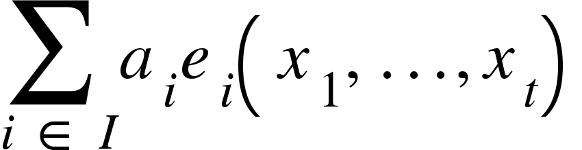
Mixed Boolean Arithmetic (MBA)
MBA Expression:
Expression containing both traditional arithmetic operations (+, −, ×, . . .) and bitwise boolean operators (∧, ∨, ¬, ⊕, . . .)
where,
x_{t} → variables a_{i} → constant coefficient
e_{i}(x₁ … x_{t}) → bitwise expressions
Figure: Formal Definition of MBA Expression¹
[1] MBA-Blast: Unveiling and Simplifying Mixed Boolean-Arithmetic Obfuscation in the Proceedings of USENIX Security Symposium, 2021.

Slide 11
Mixed Boolean Arithmetic (MBA)
MBA Expression:
A sequence of assembly instructions can be represented as MBA expressions.
inc eax
eax = eax + 1
eax = ((eax + 1) & ebx) & ecx
and eax, ebx
eax = eax & ebx
and eax, ecx
eax = eax & ecx
Figure: Assembly instructions to MBA expressions.

Slide 12
Existing Literature

Slide 13
Binary Function Clone Search in the Presence of Code Obfuscation and Optimization over Multi-CPU Architectures
ASIA CCS '23: Proceedings of the 2023 ACM Asia Conference on Computer and Communications Security, July 2023
Abdullah Qasem, Concordia University
Mourad Debbabi, Concordia University
Bernard Lebel, Thales Research and Technologies
Marthe Kassouf, Hydro-Québec Research Institute

Slide 14
Contribution
Developed and implemented BinFinder.
Identified resilient, interpretable binary function features against code optimizations and obfuscations on multi-CPU architectures.
Designed Siamese neural network architecture for training a model using proposed features to generate binary function embeddings.
Evaluated BinFinder in 3 scenarios- x86 with different optimization and obfuscation, multi-cpu architecture with and without optimization and obfuscation.

Slide 15
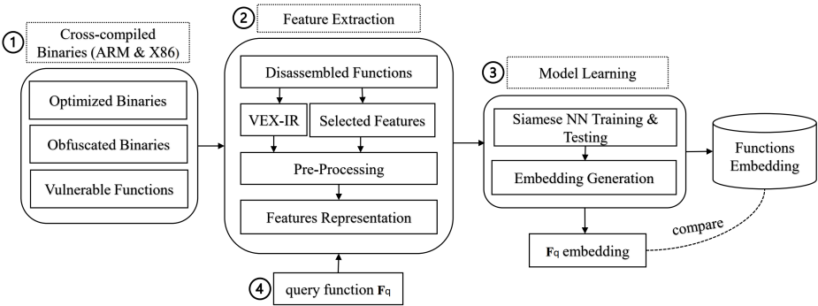
BinFinder - Methodology
[2] Binary Function Clone Search in the Presence of Code Obfuscation and Optimization over Multi-CPU Architectures ACM Asia Conference on Computer and Communications Security, July 2023

Slide 16
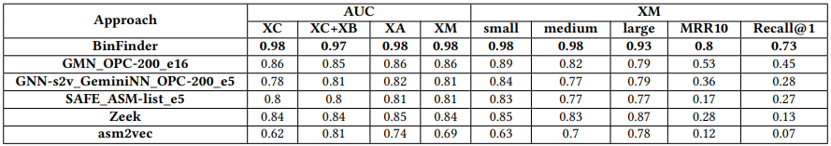
BinFinder - Evaluation
XA → Different Architecture, Same Obfuscation, Different Optimization.
XB → Same Architecture, Different Obfuscation.
XC → Different Architecture, Same Obfuscation, Same Optimization.
XM → Different Architecture, Different Obfuscation, Different Optimization.
[2] Binary Function Clone Search in the Presence of Code Obfuscation and Optimization over Multi-CPU Architectures ACM Asia Conference on Computer and Communications Security, July 2023

Slide 17
Qsynth- A Program Synthesis based Approach for Binary Code Deobfuscation
NDSS Symposium Binary Analysis Research Workshop, 2020
Robin David, Quarkslab
Luigi Coniglio, University of Trento
Mariano Ceccato, University of Verona

Slide 18
Contribution
Introduced a combination of dynamic symbolic execution, dataflow graph extraction, and program synthesis against obfuscation.
Proposed a black-box synthesis method based on offline enumerative search.
Utilized precomputed lookup tables for near constant-time expression synthesis.
Iteratively simplified complex obfuscated expressions.
Empirical validation through a comparison with the deobfuscation tool Syntia, demonstrating superior accuracy and speed (20x faster).

Slide 19
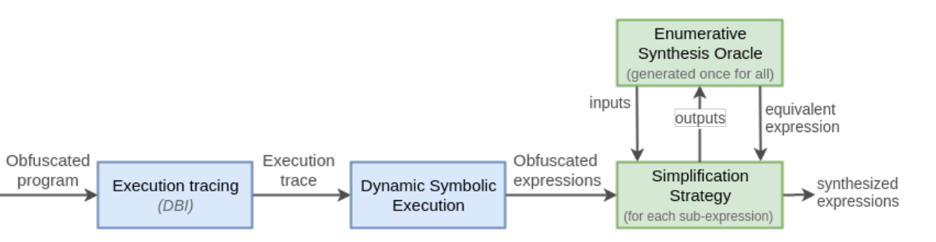
Qsynth - Methodology
Uses dynamic binary instrumentation (DBI) to trace paths in the binary.
From the traces, compute expressions at particular offsets using dynamic symbolic execution (DSE).
A synthesis oracle simplifies a complex equation.
[3] Qsynth- A Program Synthesis based Approach for Binary Code Deobfuscation NDSS Symposium Binary Analysis Research Workshop, 2020

Slide 20
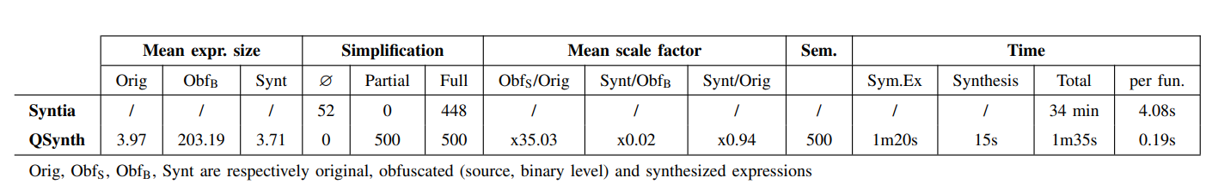
Qsynth - Evaluation
[3] Qsynth- A Program Synthesis based Approach for Binary Code Deobfuscation NDSS Symposium Binary Analysis Research Workshop, 2020

Slide 21
Simplifying Mixed Boolean-Arithmetic Obfuscation
by Program Synthesis and Term Rewriting
CCS '23: Proceedings of the 2023 ACM SIGSAC Conference on Computer and Communications Security, November 2023. Pages 2351–2365
Jaehyung ­Lee, Hanyang University, Ansan, Korea
Woosuk Lee, Hanyang University, Ansan, Korea

Slide 22
Contributions
Proposes a novel and versatile method called ProMBA for deobfuscating MBA expressions.
Combines program synthesis, term rewriting, and algebraic simplification methods.
Unlike existing techniques, ProMBA can deobfuscate a much broader class of MBA expressions.
Implemented the proposed method in an open source tool.
The experimental results show that ProMBA outperforms the state-of-the-art deobfuscation method, MBASolver by a large margin.

Slide 23
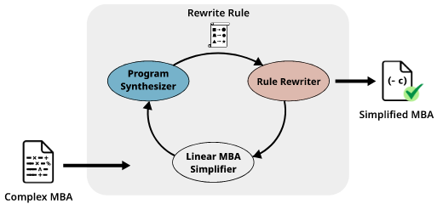
ProMBA - Methodology
Proposed method first simplifies linear MBA sub-expressions using an off-the-shelf deobfuscator.
Recursively simplifies non-linear sub-expressions by synthesizing simpler sub-expressions.
Applies the resulting rewrite rules to other sub-expressions until no further simplification is possible.
[4] Simplifying Mixed Boolean-Arithmetic Obfuscation by Program Synthesis and Term Rewriting ACM SIGSAC Conference on Computer and Communications Security, November 2023

Slide 24
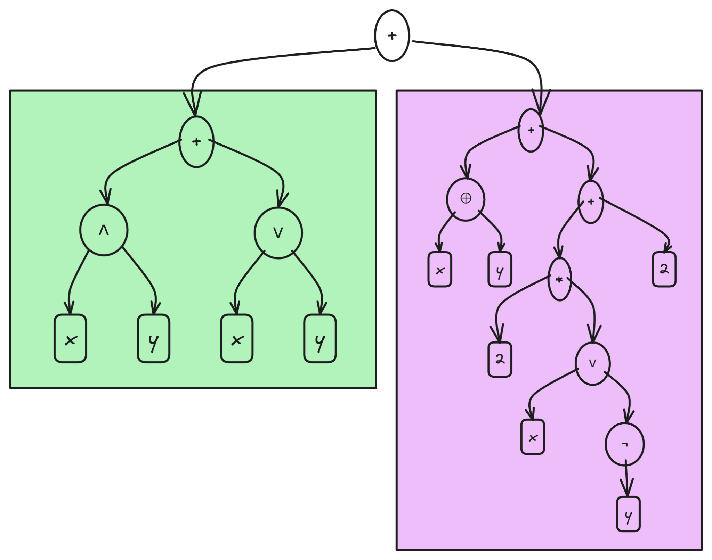
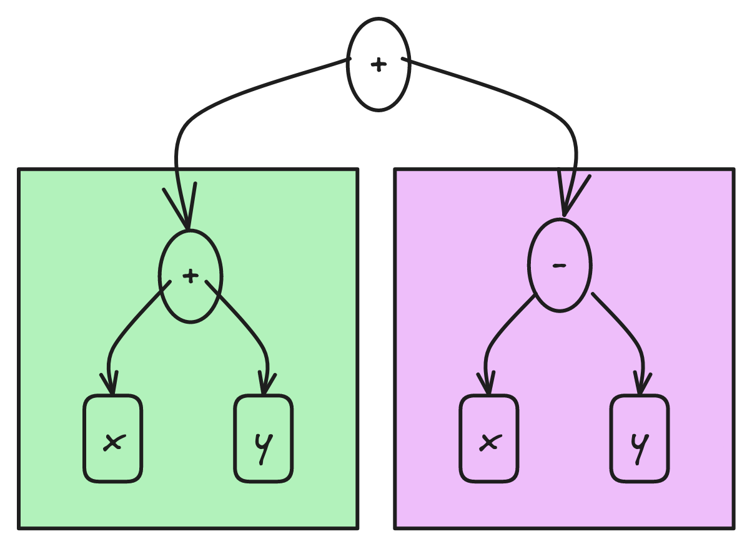
MBA Simplification
Known Rules:
x + y == (x ∧ y) + (x ∨ y)
x - y == x ⊕ y + 2 * (x ∨ ¬y) + 2
{(x ∧ y) + (x ∨ y)} + {x ⊕ y + 2 * (x ∨ ¬y) + 2}
x + y + x - y => 2x

Slide 25
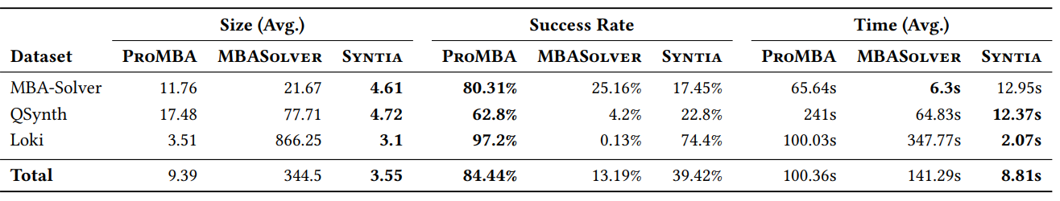
ProMBA - Evaluation
[4] Simplifying Mixed Boolean-Arithmetic Obfuscation by Program Synthesis and Term Rewriting ACM SIGSAC Conference on Computer and Communications Security, November 2023

Slide 26
Limitations of existing literature
Machine Learning based solutions incur unnecessary overhead.
Existing synthesis methods spend time deriving the same expressions again and again.
Works properly for only small to medium sized binaries.

Slide 27
Problem Statement
Given two binary files identify any function equivalency through extraction and simplification of MBA expressions

Slide 28
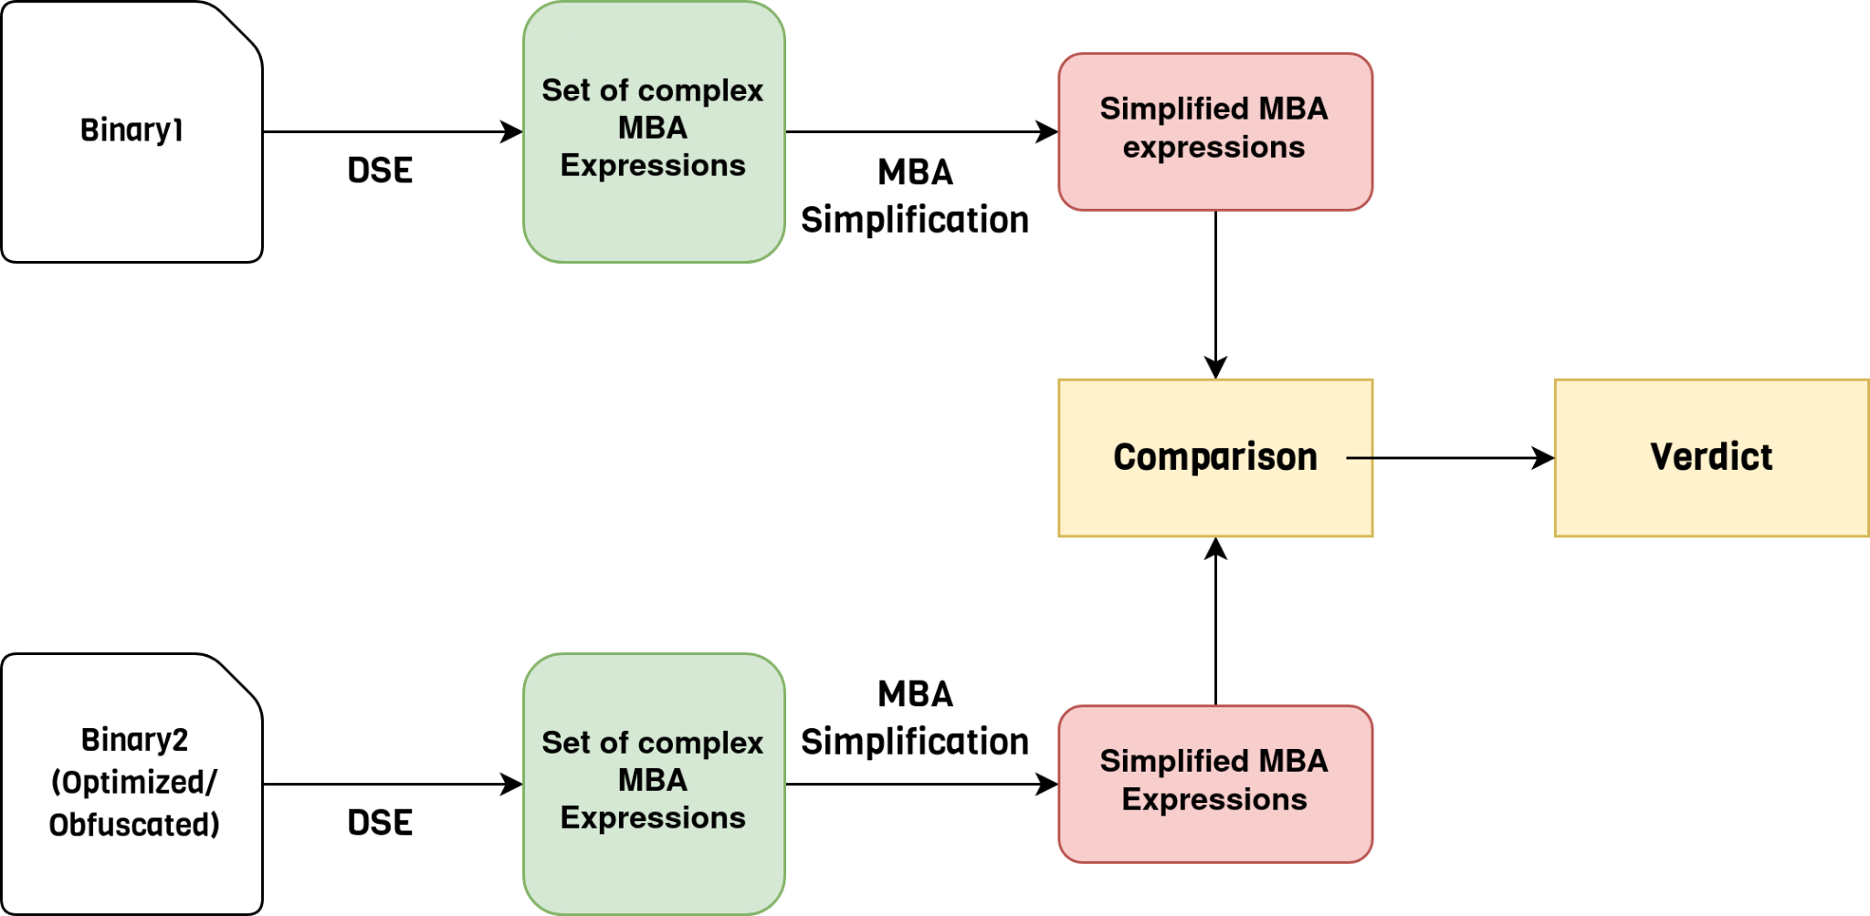
Proposed Methodology

Slide 29
Proposed Methodology
Create obfuscated binaries from TREX binary database.
Extraction of complex MBA expressions from obfuscated binary through dynamic symbolic execution.
Simplify the set of MBA expressions.
Check for equivalency between set of expressions using possible means e.g. SMT, fuzzing, program synthesis, graph isomorphism etc.

Slide 30
Challenges
Extracting MBA expressions from branches and loops.
Comparing equivalence of set of simplified expressions
Choosing the appropriate form of verdict (binary vs similarity metrics).

Slide 31
Reference
MBA-Blast: Unveiling and Simplifying Mixed Boolean-Arithmetic Obfuscation in the Proceedings of USENIX Security Symposium, 2021.
Binary Function Clone Search in the Presence of Code Obfuscation and Optimization over Multi-CPU Architectures ACM Asia Conference on Computer and Communications Security, July 2023
Qsynth- A Program Synthesis based Approach for Binary Code Deobfuscation NDSS Symposium Binary Analysis Research Workshop, 2020
Simplifying Mixed Boolean-Arithmetic Obfuscation by Program Synthesis and Term Rewriting ACM SIGSAC Conference on Computer and Communications Security, November 2023

Slide 32
Thank You

