Slide 1

Data Analytics on AWS
Emre Kütük, Data Engineer
Orkun Berk Yüzbaşıoğlu, Data Scientist

Slide 2
AWS SageMaker
Amazon SageMaker is a fully managed service that provides every developer and data scientist with the ability to build, train, and deploy machine learning (ML) models quickly. SageMaker removes the heavy lifting from each step of the machine learning process to make it easier to develop high quality models.

Slide 3
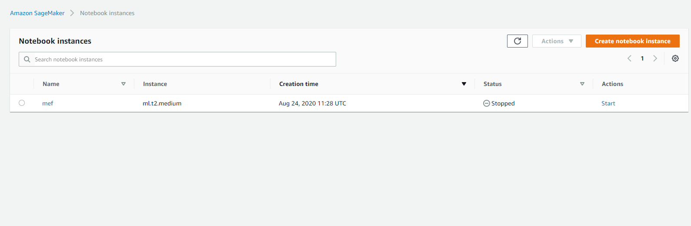
Creating Notebook Instance

Slide 4
AWS S3
Object storage built to store and retrieve any amount of data from anywhere
Amazon S3 or Amazon Simple Storage Service is a service offered by Amazon Web Services that provides object storage through a web service interface. Amazon S3 uses the same scalable storage infrastructure that Amazon.com uses to run its global e-commerce network.

Slide 5
Boto3 Client and Buckets 1

Slide 6
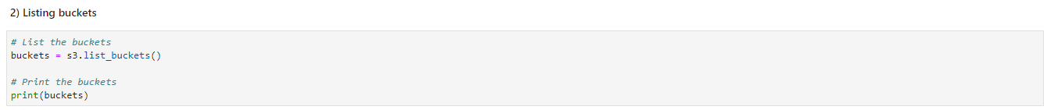
Boto3 Client and Buckets 2

Slide 7
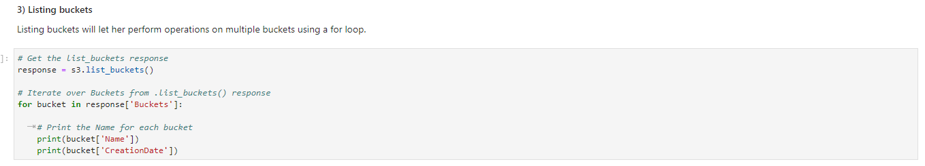
Listing Buckets

Slide 8
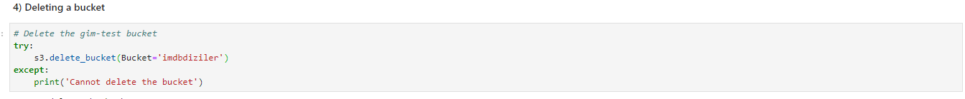
Deleting a Bucket

Slide 9
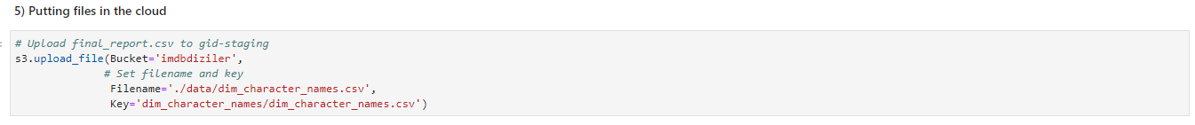
Putting Files in the Bucket

Slide 10
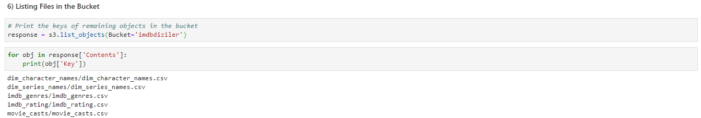
Listing Files in the Bucket

Slide 11
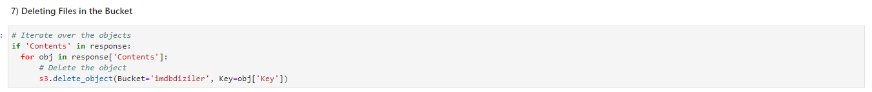
Deleting Files in the Bucket

Slide 12
AWS Glue
AWS Glue is a fully managed extract, transform, and load (ETL) service that makes it easy for customers to prepare and load their data for analytics. You can create and run an ETL job with a few clicks in the AWS Management Console. You simply point AWS Glue to your data stored on AWS, and AWS Glue discovers your data and stores the associated metadata (e.g. table definition and schema) in the AWS Glue Data Catalog. Once cataloged, your data is immediately searchable, queryable, and available for ETL.

Slide 13
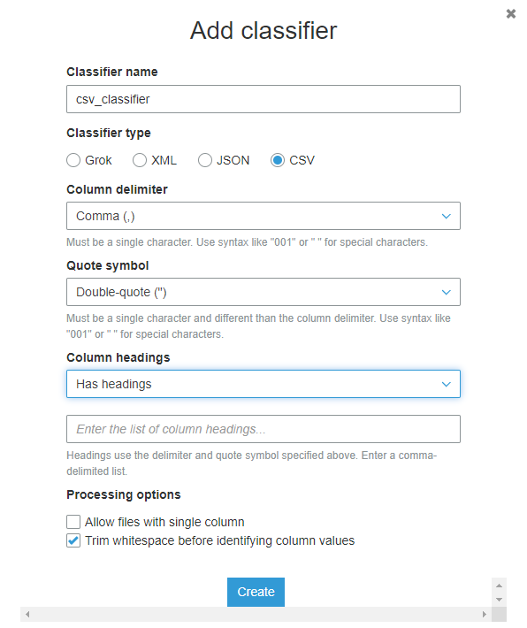
AWS Glue CSV Classifier

Slide 14
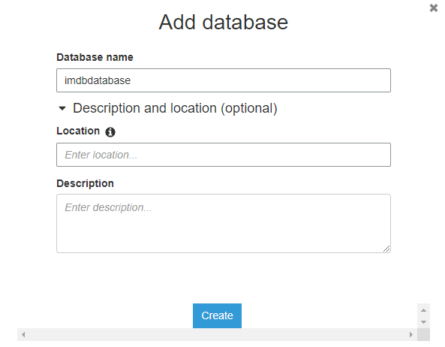
Add Database

Slide 15
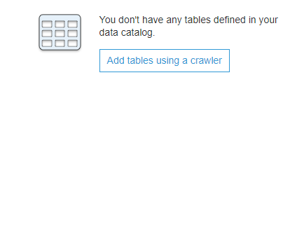
Add tables using a crawler

Slide 16
Run Crawler

Slide 17
AWS Athena
Amazon Athena is an interactive query service that makes it easy to analyze data in Amazon S3 using standard SQL. Athena is serverless, so there is no infrastructure to manage, and you pay only for the queries that you run.
Athena is out-of-the-box integrated with AWS Glue Data Catalog, allowing you to create a unified metadata repository across various services, crawl data sources to discover schemas and populate your Catalog with new and modified table and partition definitions, and maintain schema versioning.

Slide 18
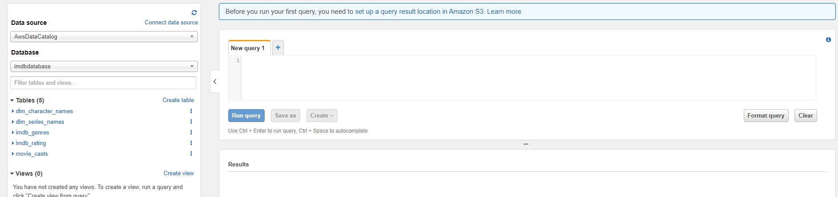
AWS Athena

Slide 19
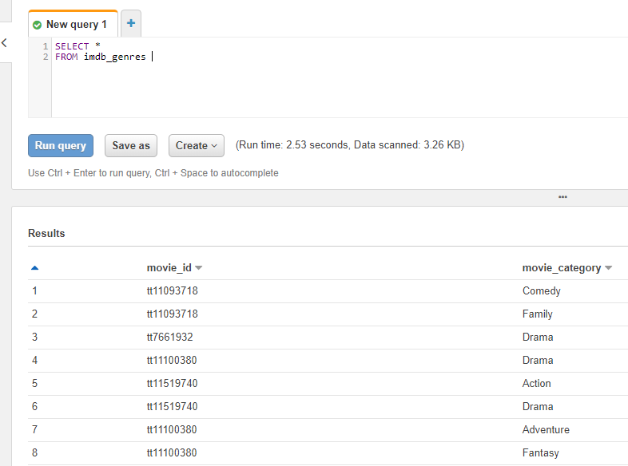
AWS Athena

Slide 20
AWS Athena
Q1) Which series has the greatest number of votes?
Q2) What is the genre of the series with the highest rating?

