Slide 1
G2M Case Study Virtual Internship
Orkun Kınay

Slide 2
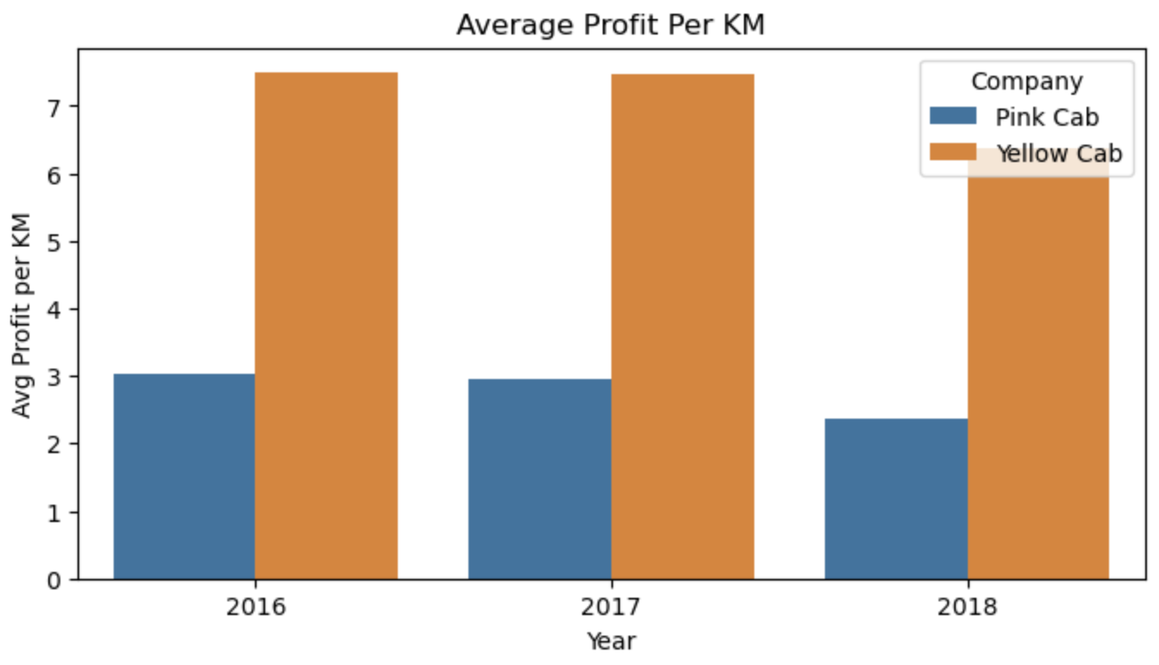
Yellow Cab consistently outperforms Pink Cab in average profit per KM with profits more than double those of Pink Cab each year.

Slide 3
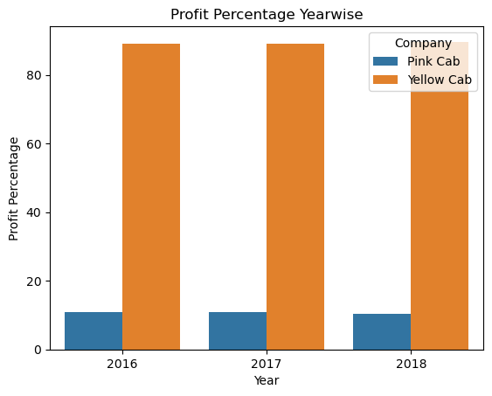
Yellow Cab has a dominant market profitability.

Slide 4
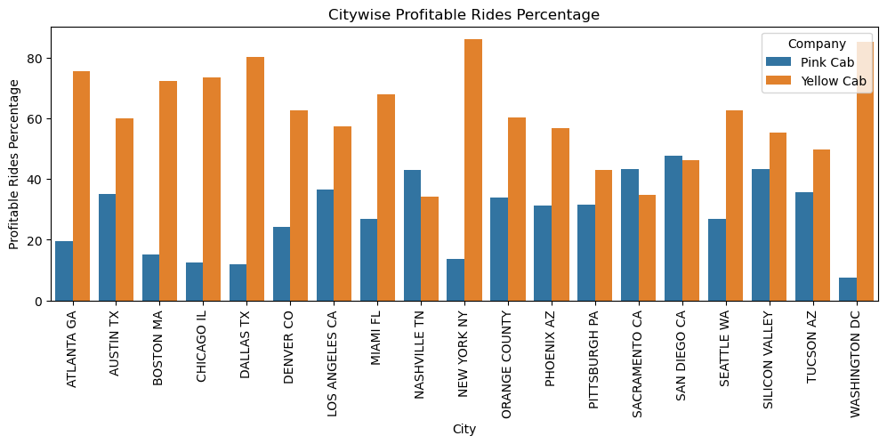
Across various cities, Yellow Cab consistently shows a higher percentage of profitable rides compared to Pink Cab, indicating stronger operational efficiency and market presence in most locations.

Slide 5
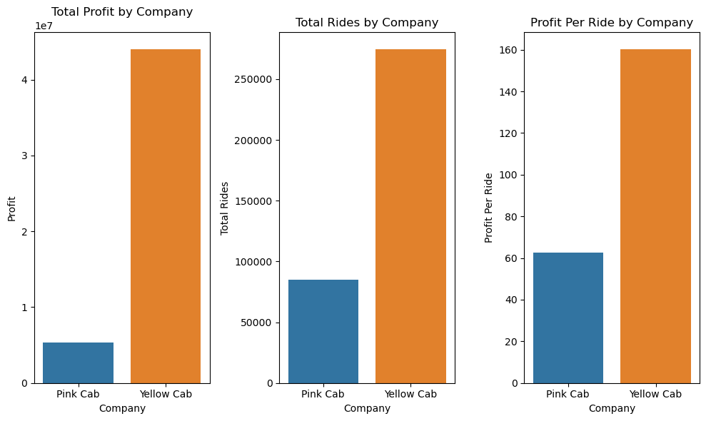

Slide 6
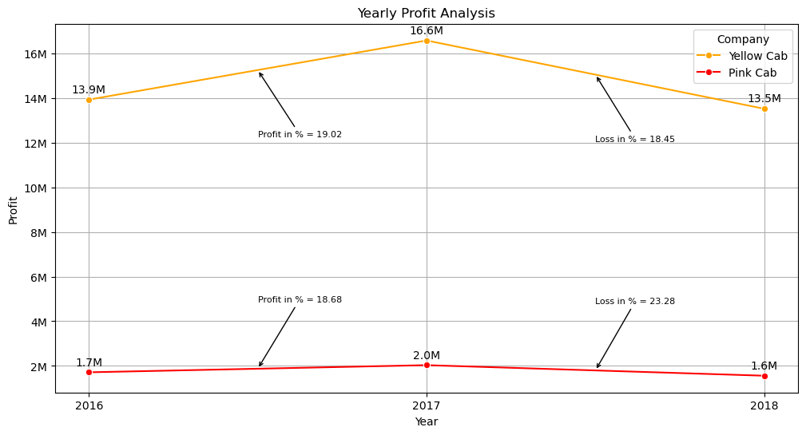
Yellow Cab shows a peak profit in 2017 followed by a slight decline in 2018, while Pink Cab exhibits a minor increase in 2017 but faces a significant profit drop in 2018.

Slide 7
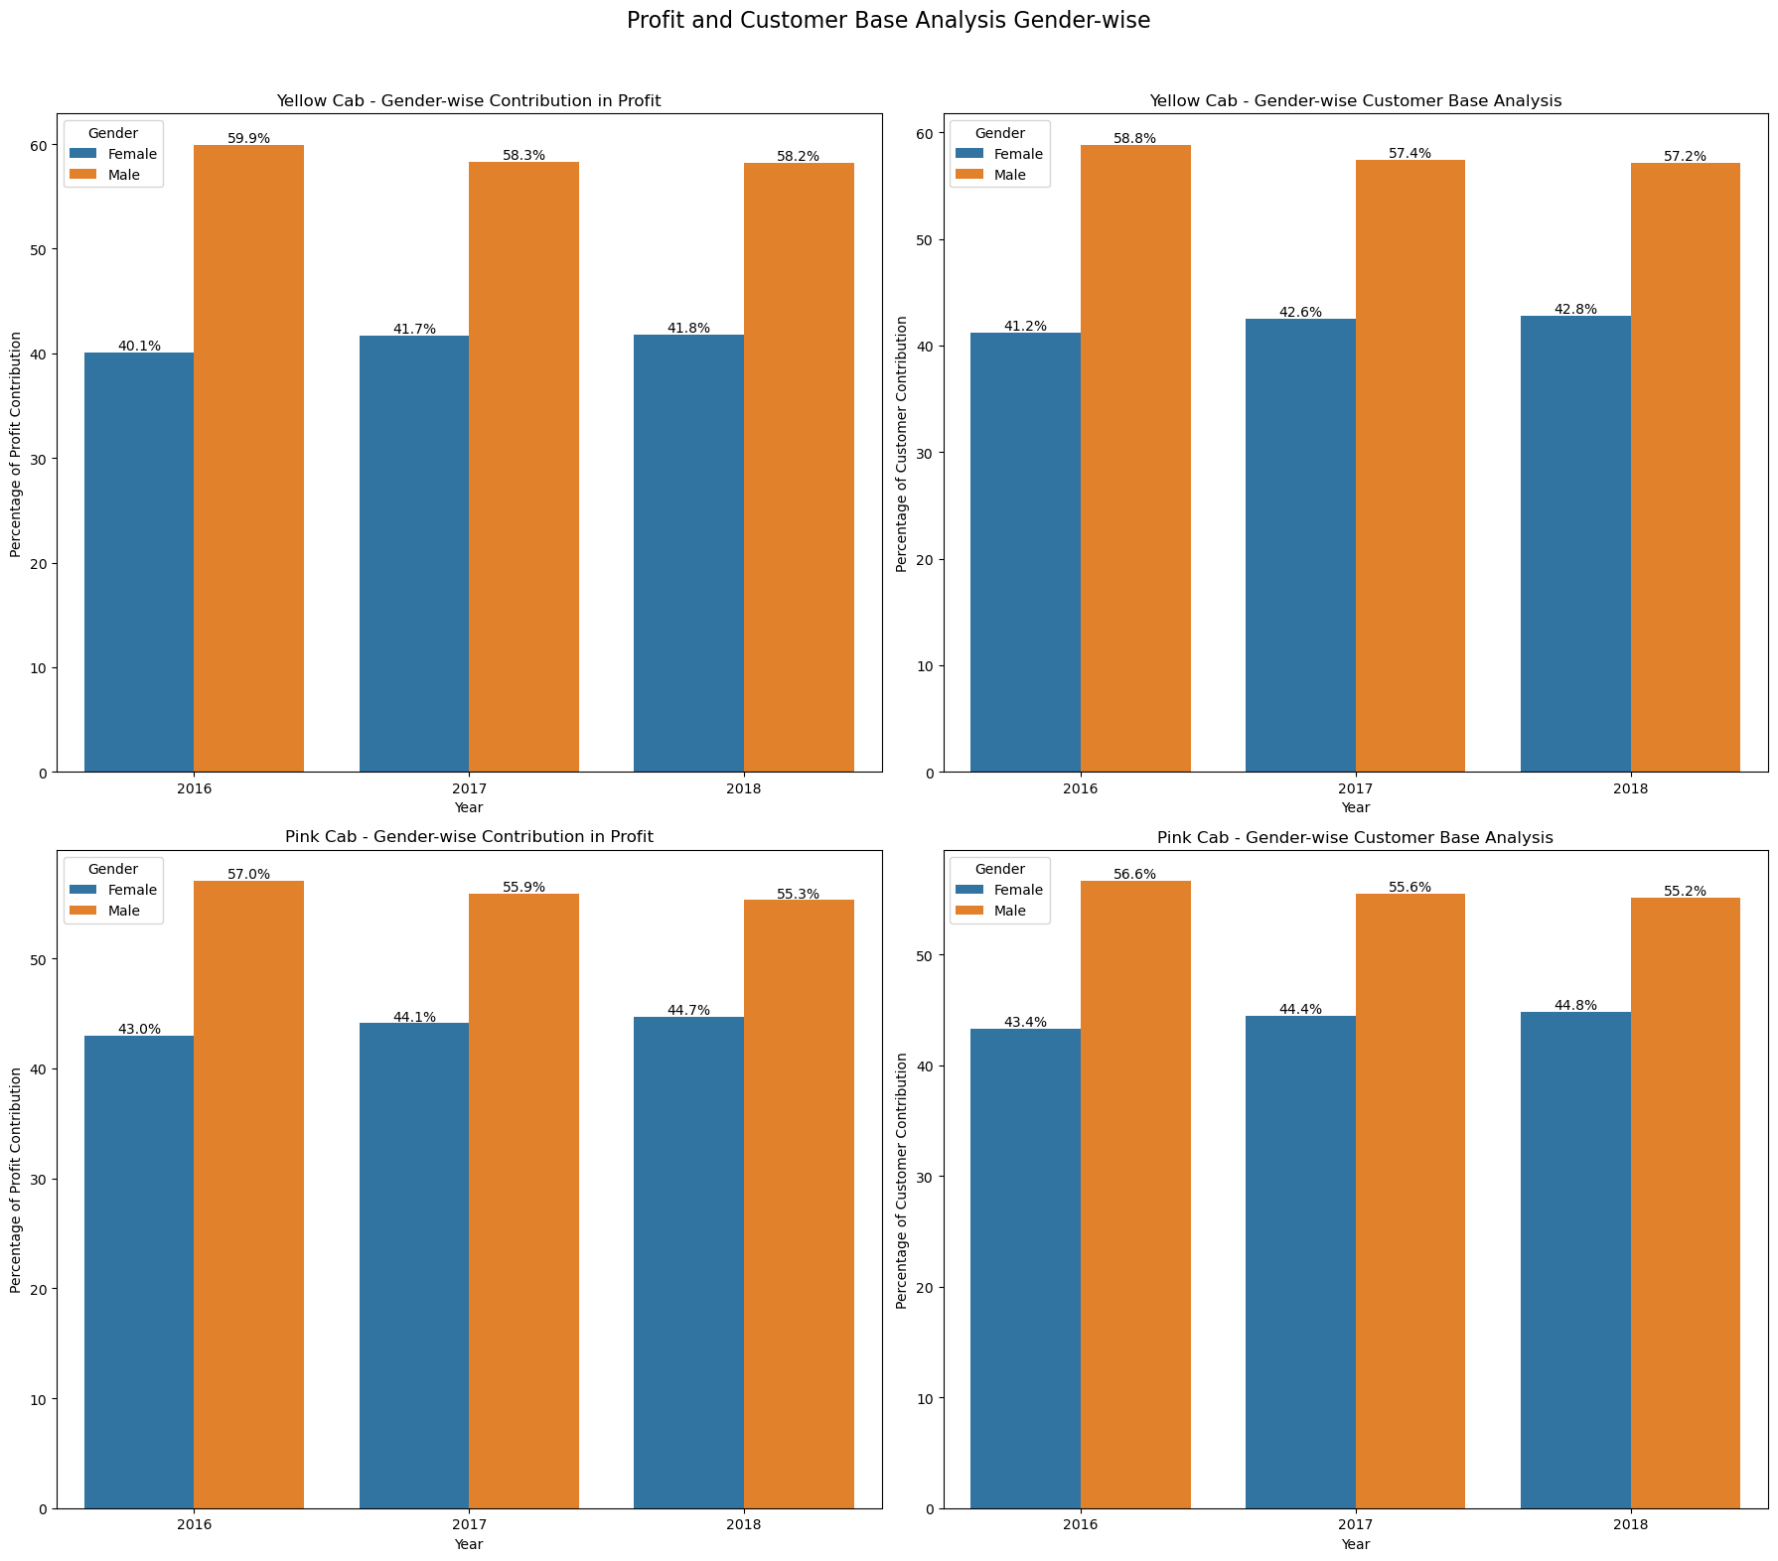
Yellow Cab sees a higher contribution to profit and customer base from male customers consistently with males contributing around 58-60% and females around 40-42%.

Slide 8
Male customers contribute more to both profit and customer base for Pink Cab.

Slide 9
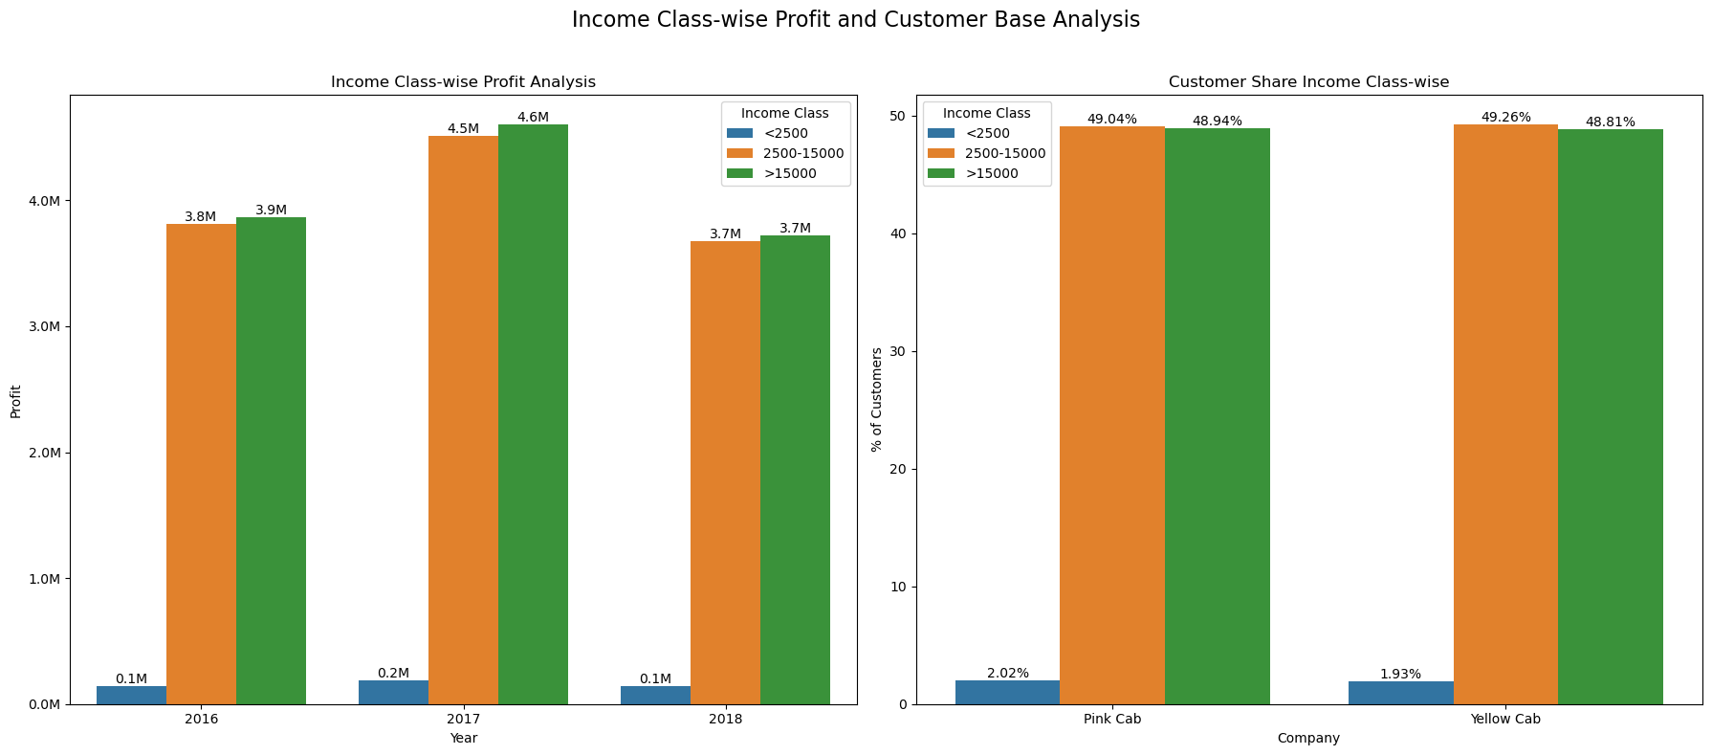

Slide 10
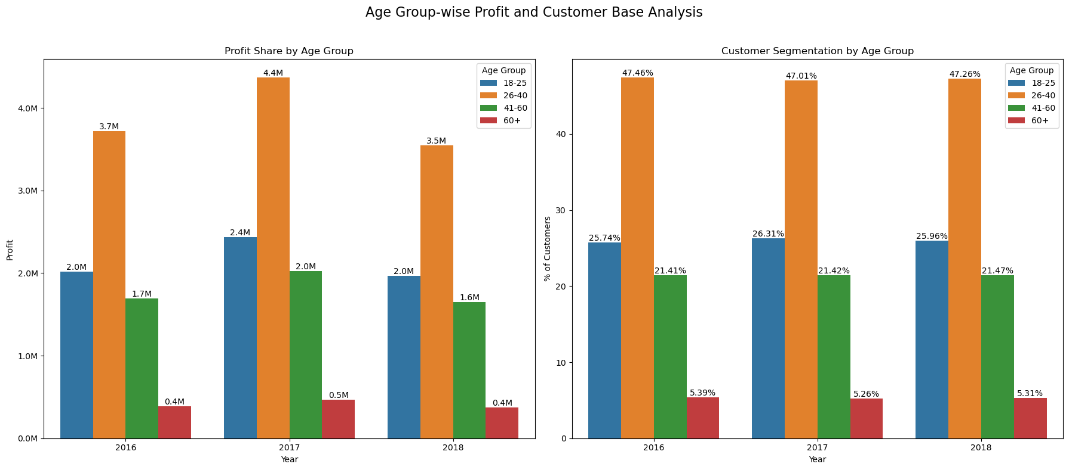
There is a strong influence of middle-aged customers in the cab industry.

Slide 11
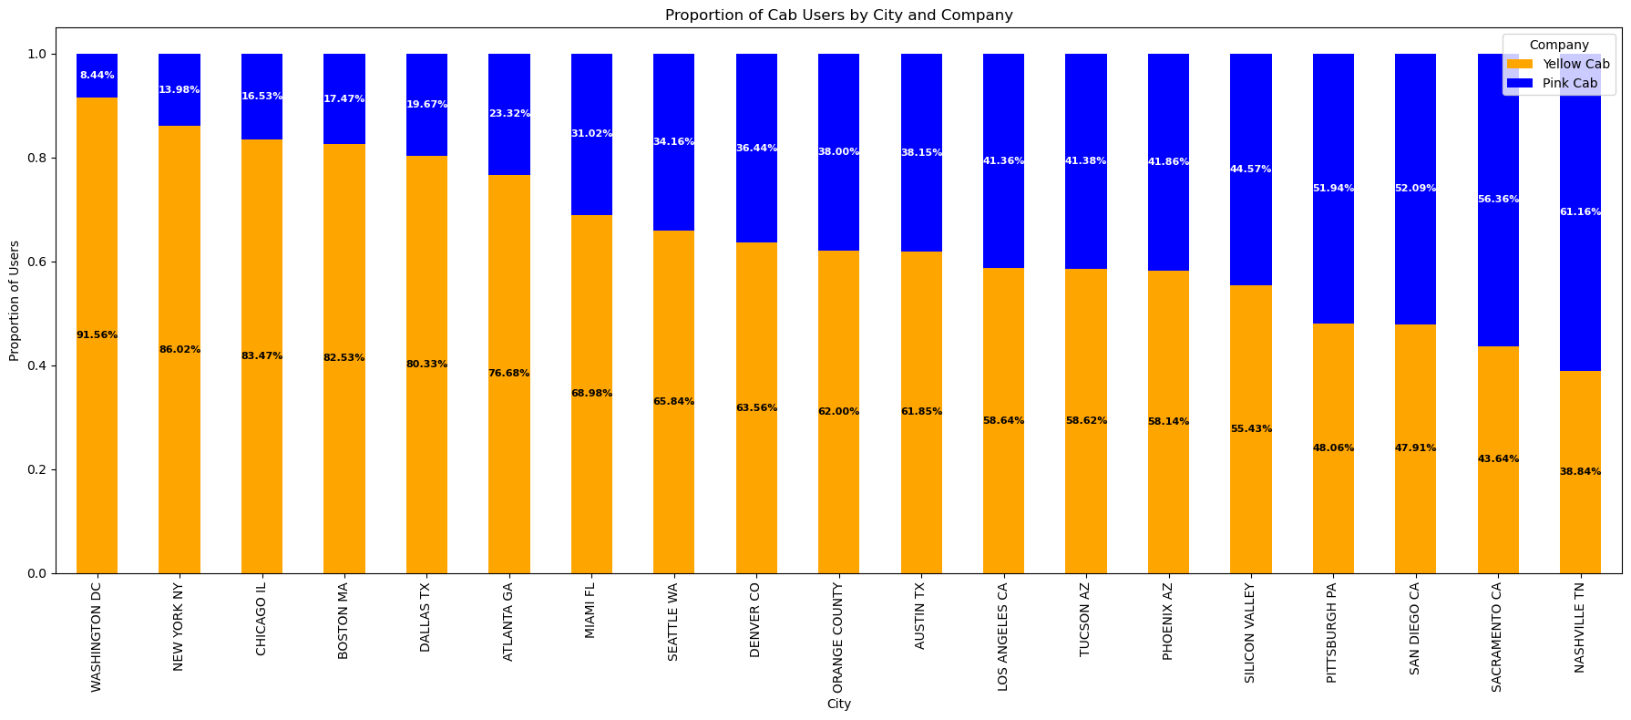
Yellow Cab has a higher proportion of users compared to Pink Cab in most cities, with the highest user proportion in Washington DC (91.56%) and the lowest in Nashville TN (38.84%).

Slide 12
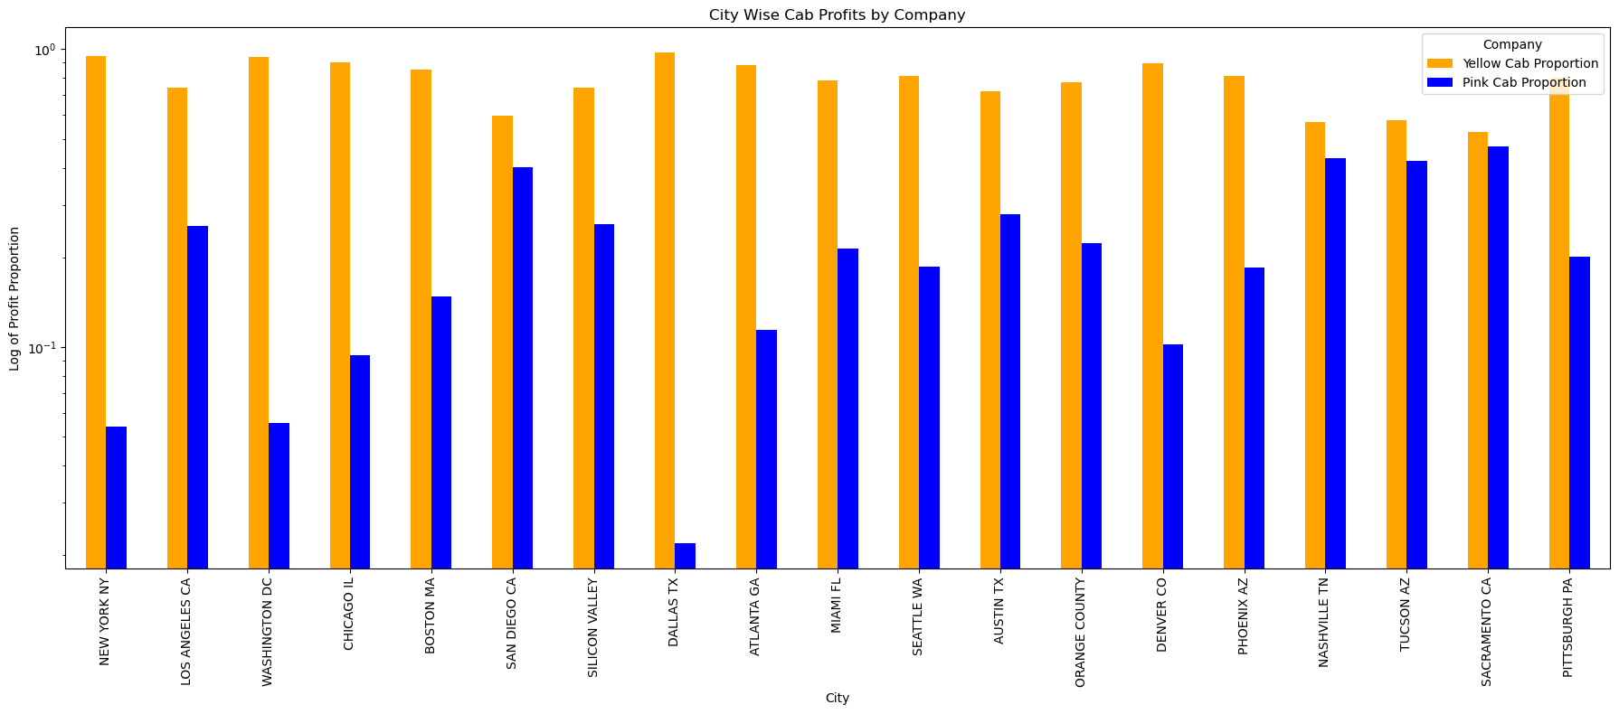
Yellow Cab consistently generates higher profits compared to Pink Cab across most cities, with significant differences evident in major cities like New York, Los Angeles, and Washington DC.

Slide 13
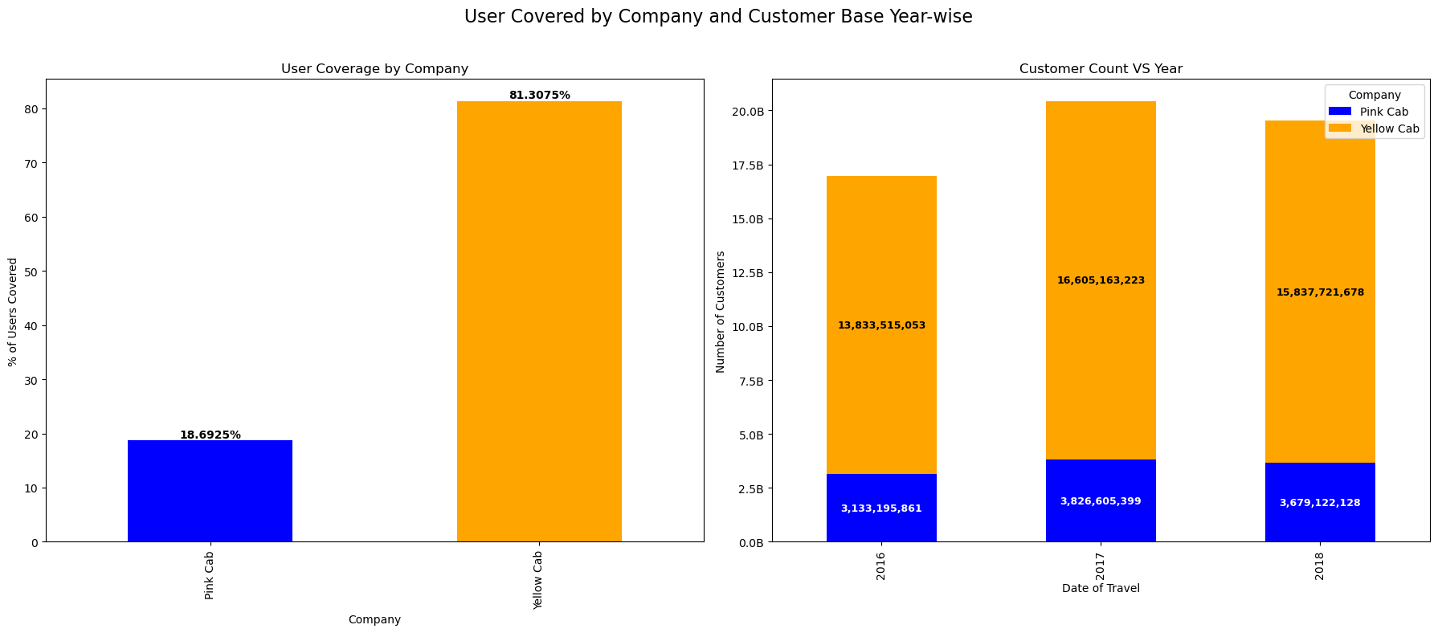
Yellow Cab covers a significantly higher percentage of users (81.31%) compared to Pink Cab (18.69%). Year-wise customer counts show Yellow Cab consistently attracting more customers each year.

Slide 14
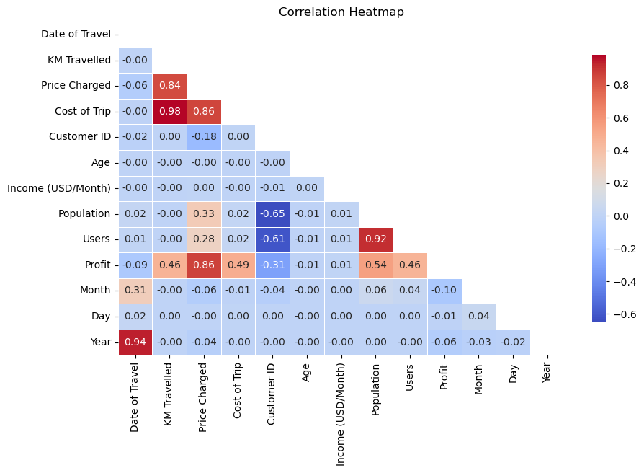
The heatmap reveals strong positive correlations between cost of trip and price charged, as well as between profit and price charged. It also highlights negative correlations between population and users.

Slide 15
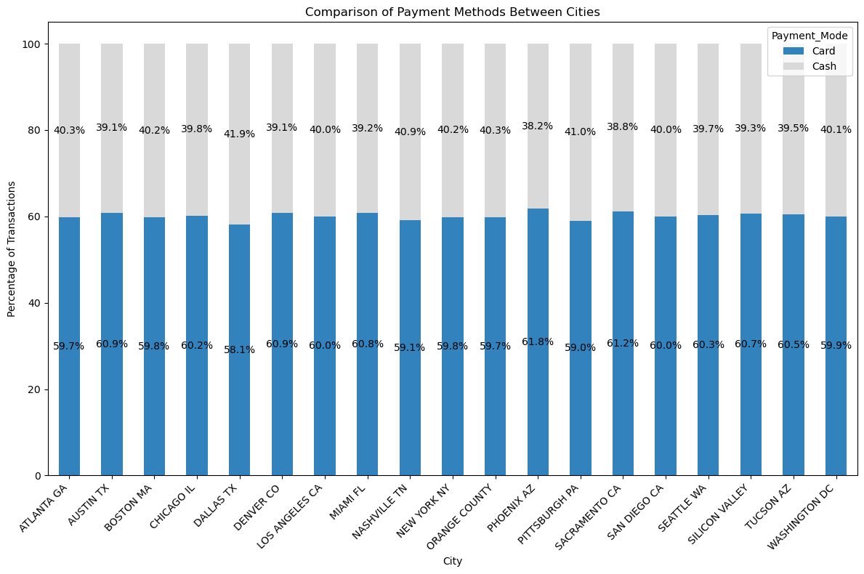
The chart shows that card payments are consistently more popular than cash payments across all cities, with card usage ranging from 58.1% to 61.8%.

Slide 16
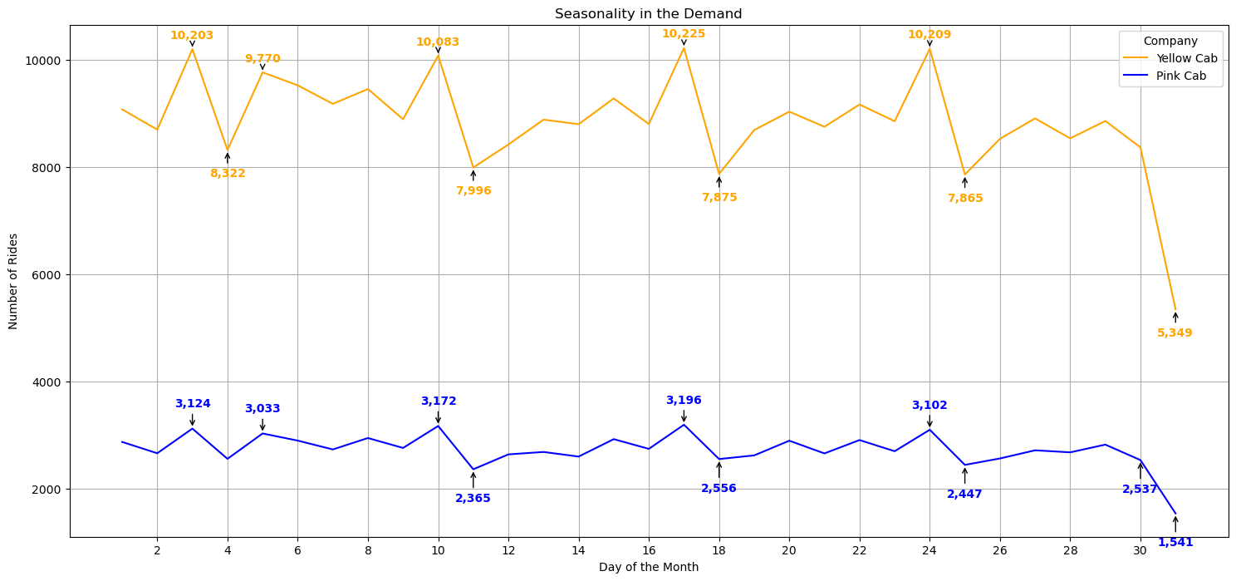
The chart shows that Yellow Cab experiences higher demand peaks around the 3rd, 10th, and 23rd days of the month, while Pink Cab maintains relatively stable demand with minor fluctuations.

Slide 17
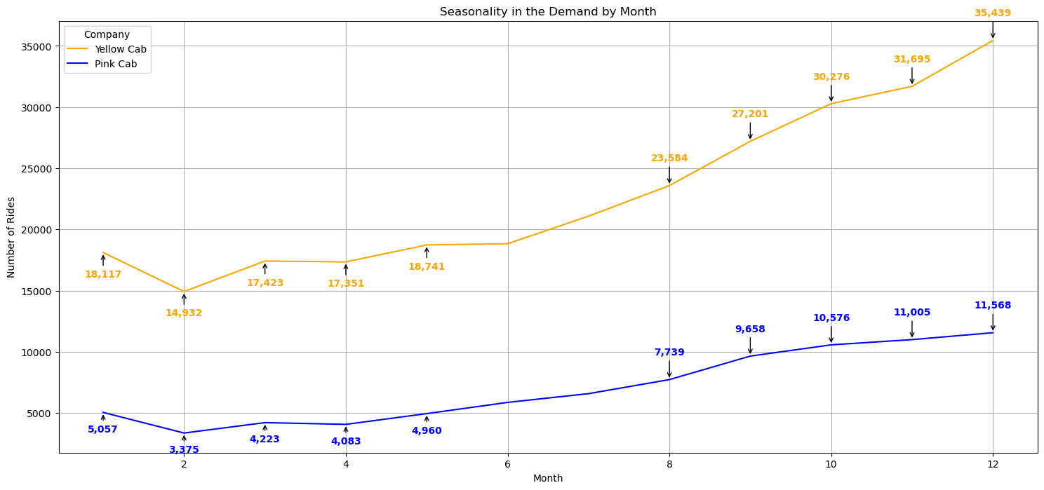
The chart indicates that both Yellow Cab and Pink Cab experience increasing demand towards the end of the year, with Yellow Cab showing a steeper rise, particularly in December.

Slide 18
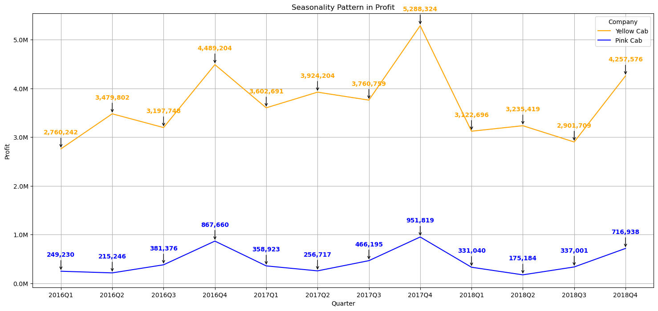
Yellow Cab exhibits significant quarterly profit fluctuations, with peaks in Q4 2016 and Q4 2018, while Pink Cab shows relatively stable but lower profit trends with a notable increase in Q4 each year.

Slide 19
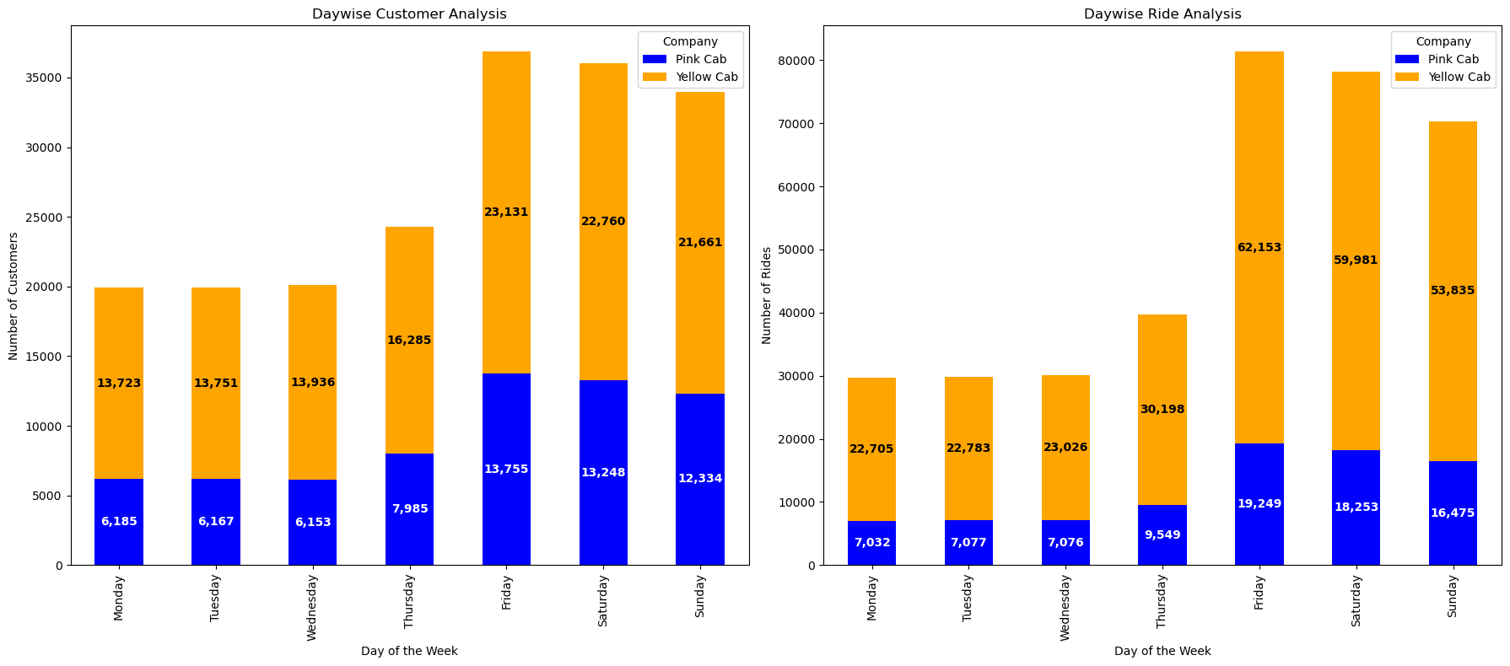
Yellow Cab sees the highest customer and ride numbers on weekends, particularly on Fridays and Saturdays, indicating increased demand during these days compared to weekdays.

Slide 20
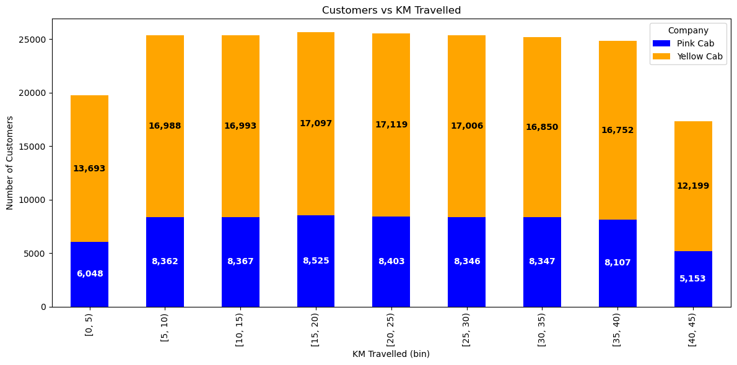
Yellow Cab consistently attracts more customers across all distance bins compared to Pink Cab, with the highest customer count in the 10-15 KM and 15-20 KM ranges.

Slide 21
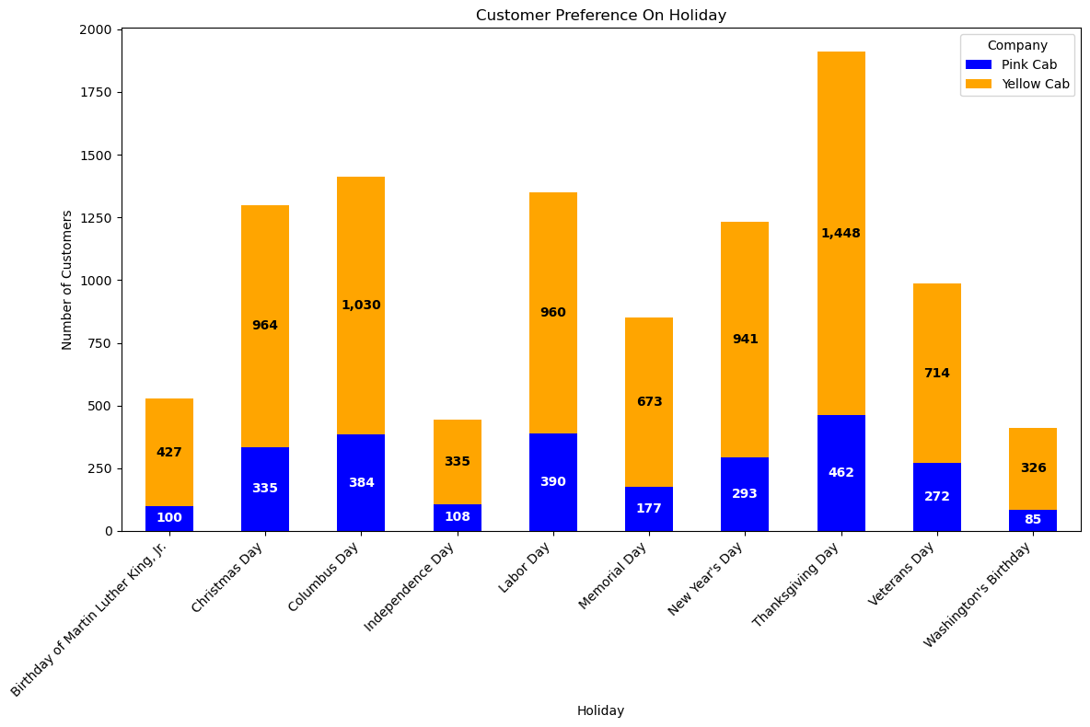
Yellow Cab consistently attracts more customers than Pink Cab across various holidays, with the highest customer counts observed on Thanksgiving Day and Columbus Day.

Slide 22
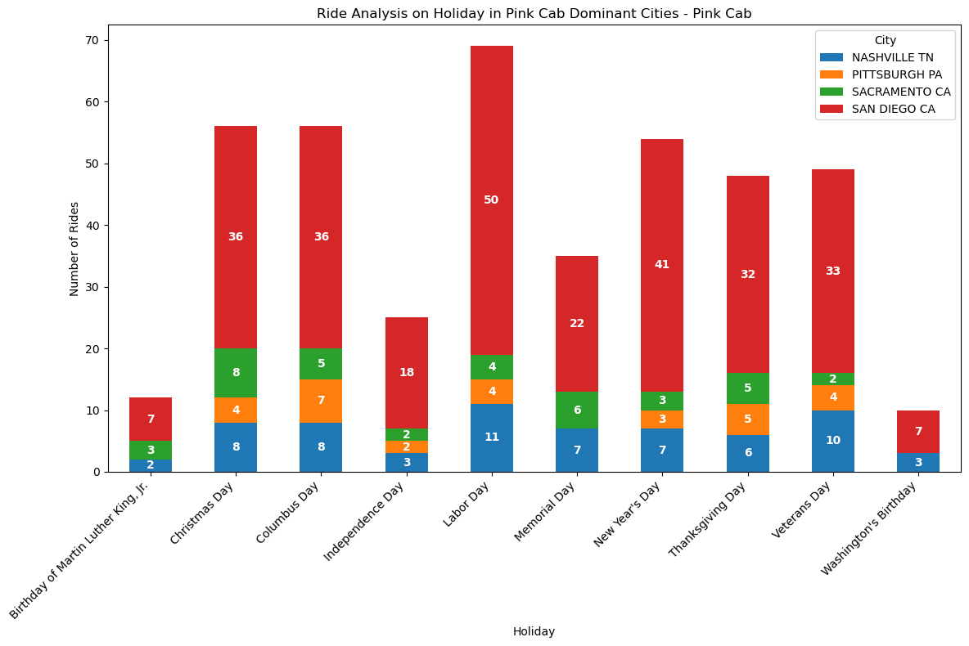
Pink Cab sees the highest number of holiday rides in San Diego, especially on Labor Day, Christmas Day, and Thanksgiving Day, indicating strong holiday demand in this city.

Slide 23
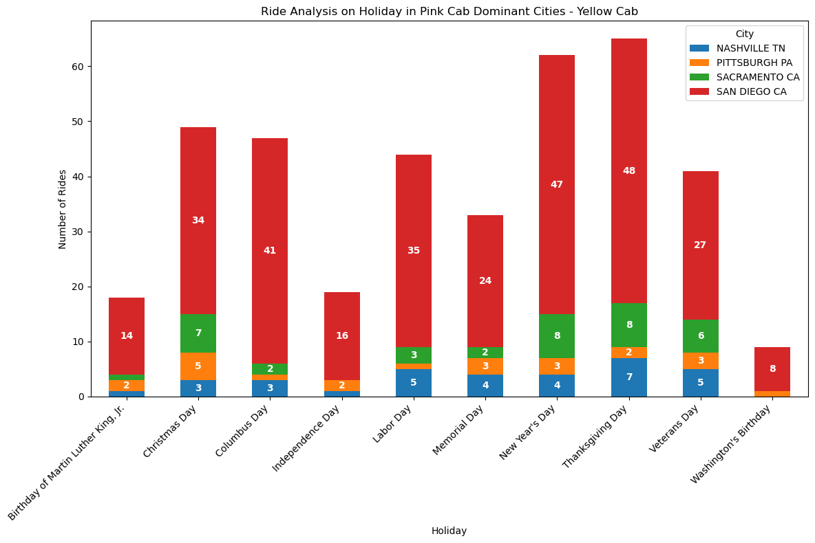
Yellow Cab experiences the highest number of holiday rides in San Diego, particularly on Thanksgiving Day and Christmas Day, demonstrating significant demand in this city during holidays.

Slide 24
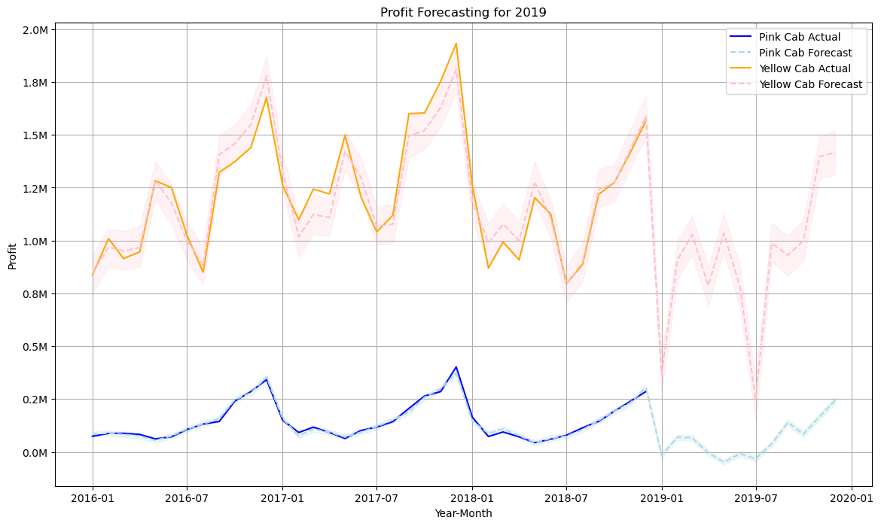
The forecast shows an upward trend in profits for both Yellow Cab and Pink Cab in 2019, with Yellow Cab expected to maintain higher profit levels throughout the year compared to Pink Cab.

Slide 25
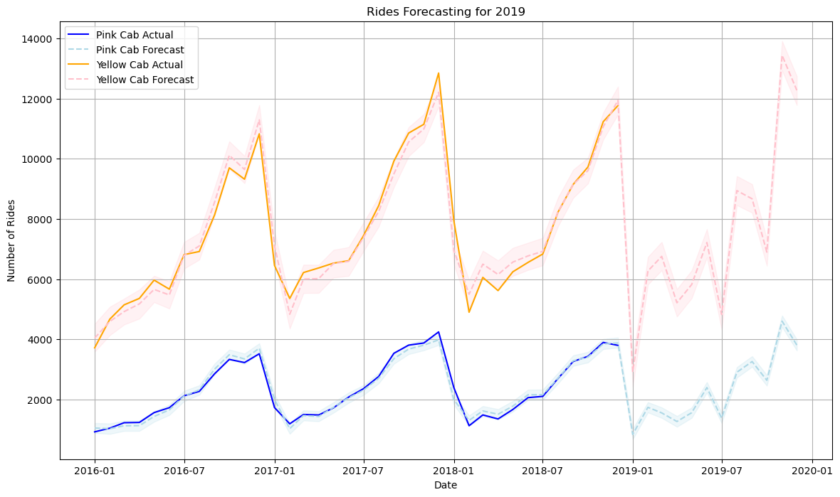
The forecast indicates an upward trend in the number of rides for both Yellow Cab and Pink Cab in 2019, with Yellow Cab expected to maintain a significantly higher ride volume compared to Pink Cab.

Slide 26
Recommendations
Invest in Yellow Cab
- Higher Profitability: Yellow Cab consistently shows higher average profit per KM and profit percentages year-wise compared to Pink Cab.
- Stronger Market Presence: Yellow Cab has a larger user base across most cities and demonstrates a dominant market presence.
- Higher Demand: Yellow Cab experiences greater demand peaks and higher seasonal demand towards the end of the year.
- Customer Preference: Yellow Cab attracts more customers, especially on weekends and holidays.
- Positive Forecasts: Projections for 2019 indicate an upward trend in both profits and the number of rides for Yellow Cab.
Conclusion: Given its superior profitability, market presence, and positive forecasts, XYZ firm should invest in Yellow Cab.

