Slide 1

Creating a Web Server in Node.js with HTTP Module

Slide 2
Creating a Basic HTTP Server
Learning back-end development is understanding how to set up a server that can handle requests and send responses. Node.js’s http module provides the ability to create such a server easily.
Import the http module, then use http.createServer() to set up a basic server.
The server uses a callback function to handle each request, where req represents the incoming request, and res represents the outgoing response.

Slide 3
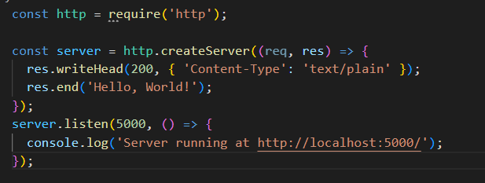
Example
Here’s a simple HTTP server that listens on port 5000 and sends a “Hello, World!” response to every request.
Notes:
const http = require('http');
const server = http.createServer((req, res) => {
res.writeHead(200, { 'Content-Type': 'text/plain' });
res.end('Hello, World!');
});
server.listen(3000, () => {
console.log('Server running at http://localhost:3000/');
});

Slide 4
Returning Different Types of Content
Understand how to respond with different types of content (plain text, JSON, HTML) and how to set the appropriate Content-Type headers for each. This is a key skill in building dynamic and interactive web applications.
Use res.writeHead() to set the Content-Type header based on the content you’re returning.
Serving different content types helps cater to varied use cases, such as plain text for logs, JSON for APIs, and HTML for web pages.

Slide 5
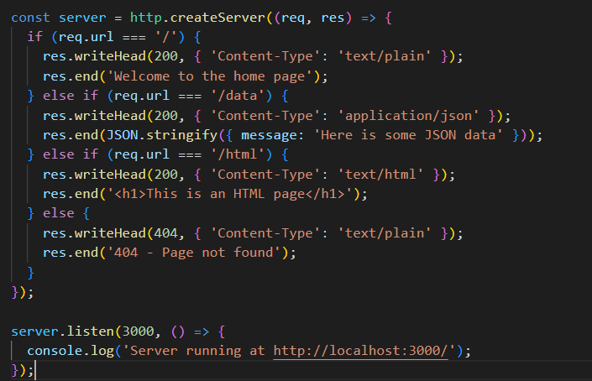
Example
Here’s an extended server that returns different content based on the requested URL.
Notes:
const http = require('http');
const server = http.createServer((req, res) => {
if (req.url === '/') {
res.writeHead(200, { 'Content-Type': 'text/plain' });
res.end('Welcome to the home page');
} else if (req.url === '/data') {
res.writeHead(200, { 'Content-Type': 'application/json' });
res.end(JSON.stringify({ message: 'Here is some JSON data' }));
} else if (req.url === '/html') {
res.writeHead(200, { 'Content-Type': 'text/html' });
res.end('<h1>This is an HTML page</h1>');
} else {
res.writeHead(404, { 'Content-Type': 'text/plain' });
res.end('404 - Page not found');
}
});
server.listen(3000, () => {
console.log('Server running at http://localhost:3000/');
});

Slide 6
Serving an HTML Page from a File
HTML pages are usually served from files rather than being embedded directly in the server code. This section teaches how to use the fs module to read an HTML file and serve it as a response.
Use fs.readFile() to load the HTML file content.
Send the content as the response, along with the Content-Type: text/html header.

Slide 7
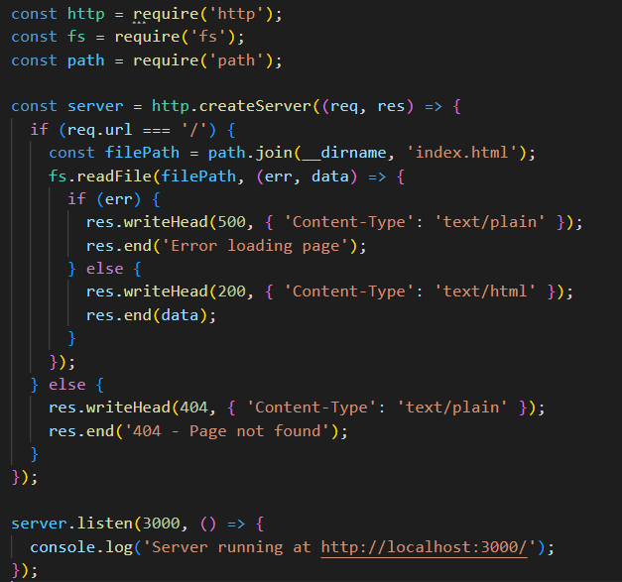
Example
This example serves an HTML page from a file called index.html.
Notes:
const http = require('http');
const fs = require('fs');
const path = require('path');
const server = http.createServer((req, res) => {
if (req.url === '/') {
const filePath = path.join(__dirname, 'index.html');
fs.readFile(filePath, (err, data) => {
if (err) {
res.writeHead(500, { 'Content-Type': 'text/plain' });
res.end('Error loading page');
} else {
res.writeHead(200, { 'Content-Type': 'text/html' });
res.end(data);
}
});
} else {
res.writeHead(404, { 'Content-Type': 'text/plain' });
res.end('404 - Page not found');
}
});
server.listen(3000, () => {
console.log('Server running at http://localhost:3000/');
});

Slide 8
Managing Routes using an HTTP Request Object
Routing allows a server to handle different requests based on the URL and HTTP method. This is an essential skill for building more complex applications that handle multiple types of requests.
Use req.url to determine the path and req.method to determine the type of request (GET, POST, etc.).

Slide 9
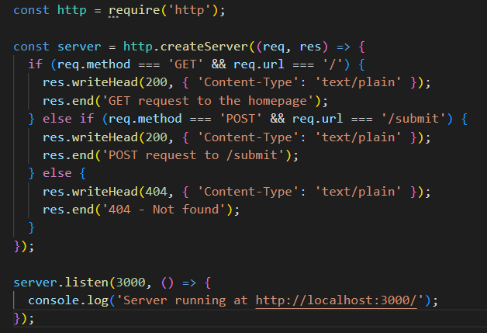
Example
The server responds differently to GET and POST requests.
Notes:
const http = require('http');
const server = http.createServer((req, res) => {
if (req.method === 'GET' && req.url === '/') {
res.writeHead(200, { 'Content-Type': 'text/plain' });
res.end('GET request to the homepage');
} else if (req.method === 'POST' && req.url === '/submit') {
res.writeHead(200, { 'Content-Type': 'text/plain' });
res.end('POST request to /submit');
} else {
res.writeHead(404, { 'Content-Type': 'text/plain' });
res.end('404 - Not found');
}
});
server.listen(3000, () => {
console.log('Server running at http://localhost:3000/');
});

Slide 10
Activity 1
Create an HTTP server that listens on port 3000 and sets up routes for handling different requests. Using Postman
Set Up Routes:
Define the following routes:
GET /: Respond with "Welcome to the Home Page".
GET /json: Respond with JSON data, { "message": "Hello, JSON world!" }.
GET /html: Serve the index.html file with <h1>Your Basic Information</h1>.
POST /submit: Accept a JSON payload and respond with a confirmation message.

