Slide 1
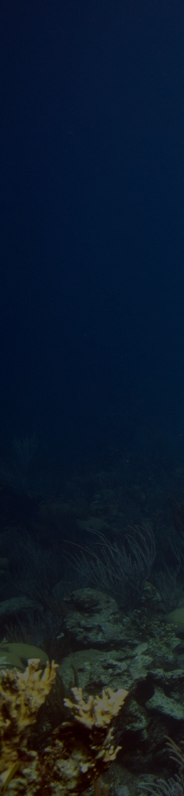

1. Overview
2. Economics
3. Tourism
4. Proposal
Motivation
Decline of coral reefs under climate change (driven by the few) will disproportionally affect the many who rely on their local reefs.
Specific motivation
Upcoming EAERE Interdisciplinary school workshop. Extended abstract required:
Valuing and monitoring the state of ecosystems is essential for assessing the socio-economic consequences of service degradation and informing sustainable management practices … there is a strong need to further develop and implement appropriate methods for the valuation of natural resources
Submission deadline Monday 3rd November.
Orlando Timmerman
Department of Earth Sciences
Calcifiers Group Meeting | 30.10.25

Slide 2
1. Overview
2. Economics
3. Tourism
4. Proposal
Motivation
Decline of coral reefs under climate change (driven by the few) will disproportionally affect the many who rely on their local reefs.
Specific motivation
Upcoming EAERE Interdisciplinary school workshop. Extended abstract required:
Valuing and monitoring the state of ecosystems is essential for assessing the socio-economic consequences of service degradation and informing sustainable management practices … there is a strong need to further develop and implement appropriate methods for the valuation of natural resources
Submission deadline Monday 3rd November.
Orlando Timmerman
Department of Earth Sciences
Calcifiers Group Meeting | 30.10.25

Slide 3





1. Overview
2. Economics
3. Tourism
4. Proposal
Contents
Methods of ecosystem evaluation
Case study of reef tourism
Abstract proposal
Discussion!
https://resourcewatch.org/dashboards/coral-reefs
Orlando Timmerman
Department of Earth Sciences
Calcifiers Group Meeting | 30.10.25

Slide 4
1. Overview
2. Economics
3. Tourism
4. Proposal
Methods of Economic Valuation
Market-based methods – value of fishery catch; tourism revenues (reef-related travel, diving, lodging)
Revealed- / Stated-preference methods – estimate via value of proxies e.g. cost and number of recreational visits / choice experiments (asking visitors how much they’d pay in hypothetical markets)
Cost-based methods – thinking counterfactually e.g. how much would replacing the service cost? How much cost (e.g. by avoided floods) is avoided currently?
… plagued by complex, messy, incomplete, not-built-for-purpose datasets requiring lots of dangerous extrapolation/interpolation
Credit: Graves, A, et al, 2009,
Valuation of Natural Resources: A NERC Scoping Study
Orlando Timmerman
Department of Earth Sciences
Calcifiers Group Meeting | 30.10.25

Slide 5
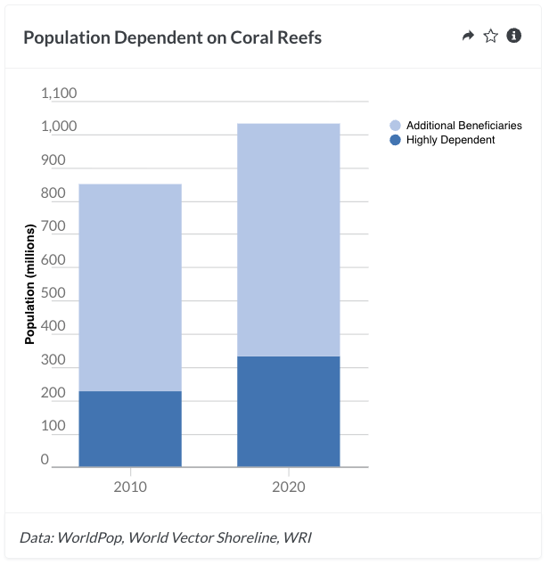
1. Overview
2. Economics
3. Tourism
4. Proposal
Tourism
~ 70 million annual tourist trips
~ $36 billion annual expenditure
Fisheries
Important protein source for millions
Support ~6 million reef fishers (inc. many artisanal)
~ $6.8 billion in 2011
Women represent ~50% workforce in sector
Shoreline protection
Protect ~150,000 km of shoreline
Reduce expected storm damage by > $4 billion annually
Orlando Timmerman
Department of Earth Sciences
Calcifiers Group Meeting | 30.10.25
Notes:
Worldwide, approximately 1 billion people live within 100 km of reefs, many of whom are likely to derive some benefits from the ecosystem services reefs provide. More than 330 million people reside in the direct vicinity of coral reefs (within 30 km of reefs and less than 10 km from the coast), where livelihoods are most likely to depend on reefs and related resources. This number of people dependent on coral reefs is estimated to have increased by 20 percent over the last decade.

Slide 6
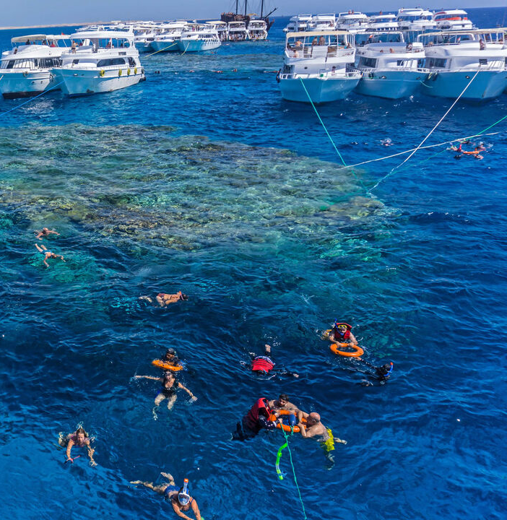
1. Overview
2. Economics
3. Tourism
4. Proposal
Tourism
~ 70 million annual tourist trips
~ $36 billion annual expenditure
Fisheries
Important protein source for millions
Support ~6 million reef fishers (inc. many artisanal)
~ $6.8 billion in 2011
Women represent ~50% workforce in sector
Shoreline protection
Protect ~150,000 km of shoreline
Reduce expected storm damage by > $4 billion annually
Al-Monitor
Orlando Timmerman
Department of Earth Sciences
Calcifiers Group Meeting | 30.10.25
Notes:
Worldwide, approximately 1 billion people live within 100 km of reefs, many of whom are likely to derive some benefits from the ecosystem services reefs provide. More than 330 million people reside in the direct vicinity of coral reefs (within 30 km of reefs and less than 10 km from the coast), where livelihoods are most likely to depend on reefs and related resources. This number of people dependent on coral reefs is estimated to have increased by 20 percent over the last decade.

Slide 7
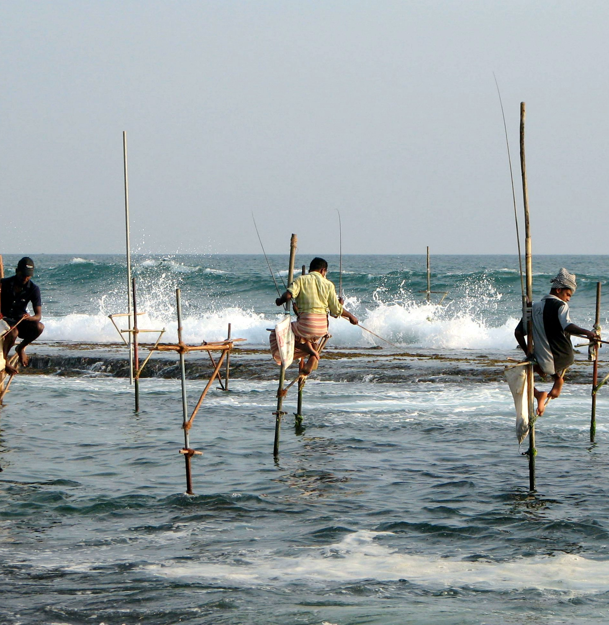
1. Overview
2. Economics
3. Tourism
4. Proposal
Tourism
~ 70 million annual tourist trips
~ $36 billion annual expenditure
Fisheries
Important protein source for millions
Support ~6 million reef fishers (inc. many artisanal)
~ $6.8 billion in 2011
Women represent ~50% workforce in sector
Shoreline protection
Protect ~150,000 km of shoreline
Reduce expected storm damage by > $4 billion annually
Wikimedia
Orlando Timmerman
Department of Earth Sciences
Calcifiers Group Meeting | 30.10.25
Notes:
Sri lanka

Slide 8
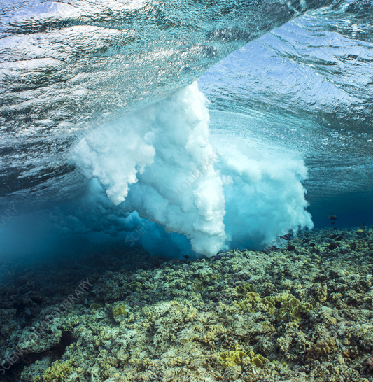
1. Overview
2. Economics
3. Tourism
4. Proposal
Tourism
~ 70 million annual tourist trips
~ $36 billion annual expenditure
Fisheries
Important protein source for millions
Support ~6 million reef fishers (inc. many artisanal)
~ $6.8 billion in 2011
Women represent ~50% workforce in sector
Shoreline protection
Protect ~150,000 km of shoreline
Reduce expected storm damage by > $4 billion annually
Stolen from Science Photo Library
Orlando Timmerman
Department of Earth Sciences
Calcifiers Group Meeting | 30.10.25

Slide 9
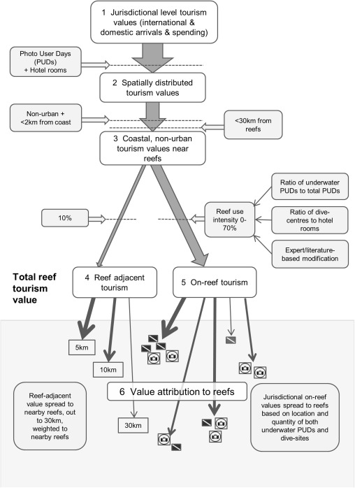

1. Overview
2. Economics
3. Tourism
4. Proposal
Case study: tourism(because only this data was easily accessible ^{for download)}
From Spalding et al. (2017): Mapping the global value and distribution of coral reef tourism
Used multiple datasets to estimate touristic revenue attributable to reefs
Considered direct and indirect effects
Key findings:
Global value of USD36 billion per year
Very high-value reefs are found in 70% of coral reef jurisdictions
~70% of reefs had zero touristic-attributable revenue
Orlando Timmerman
Department of Earth Sciences
Calcifiers Group Meeting | 30.10.25

Slide 10
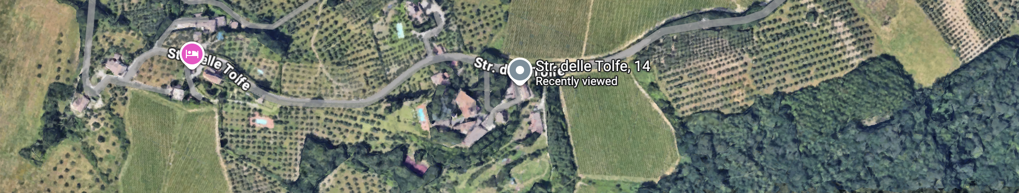
1. Overview
2. Economics
3. Tourism
4. Proposal
Case study: tourism(because only this data was easily accessible ^{for download)}
From Spalding et al. (2017): Mapping the global value and distribution of coral reef tourism
Used multiple datasets to estimate touristic revenue attributable to reefs
Considered direct and indirect effects
Key findings:
Global value of USD36 billion per year
Very high-value reefs are found in 70% of coral reef jurisdictions
~70% of reefs had zero touristic-attributable revenue
Orlando Timmerman
Department of Earth Sciences
Calcifiers Group Meeting | 30.10.25

Slide 11
1. Overview
2. Economics
3. Tourism
4. Proposal
Orlando Timmerman
Department of Earth Sciences
Calcifiers Group Meeting | 30.10.25

Slide 12
1. Overview
2. Economics
3. Tourism
4. Proposal
Orlando Timmerman
Department of Earth Sciences
Calcifiers Group Meeting | 30.10.25

Slide 13
1. Overview
2. Economics
3. Tourism
4. Proposal
Arbitrary, much?
“assign a simple estimate of 10% of the value of all reef-coast tourism to coral reefs”
“…a single on-reef use intensity statistic was generated, weighted 2:1 in favour of underwater PUDs over the dive shop metric … this single weighted number was … capped at 70% as the preferred metric for the proportion of remaining reef-coast tourism which could be assigned to on-reef value”
“where data were considered poor and were clearly divergent from a recent and comparable literature source, the numbers were replaced with that alternative (four territories)”
“where there was evidence, based on expert-knowledge and/or available references, that both metrics [dive shops/underwater PUDs] were under- or over-reporting, scores were altered to the best approximation of the authors (nine territories)”
Orlando Timmerman
Department of Earth Sciences
Calcifiers Group Meeting | 30.10.25
Notes:
117 jurisdictions

Slide 14
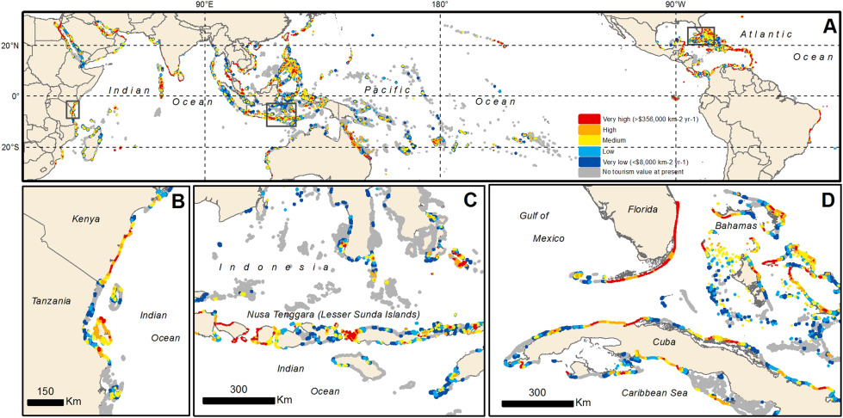
1. Overview
2. Economics
3. Tourism
4. Proposal
Orlando Timmerman
Department of Earth Sciences
Calcifiers Group Meeting | 30.10.25

Slide 15
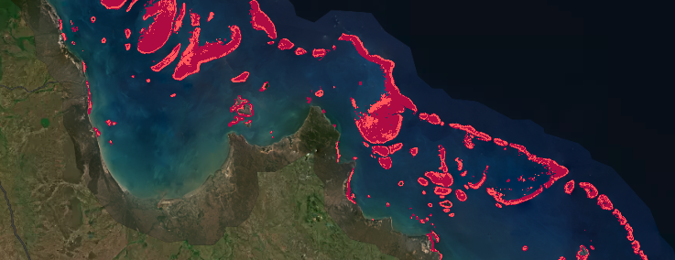
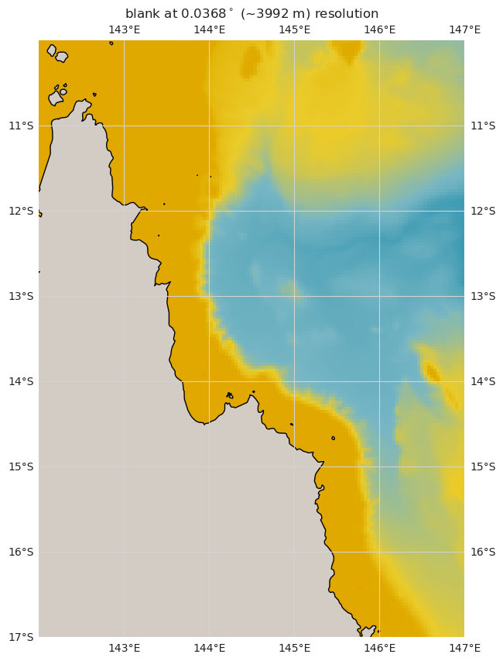
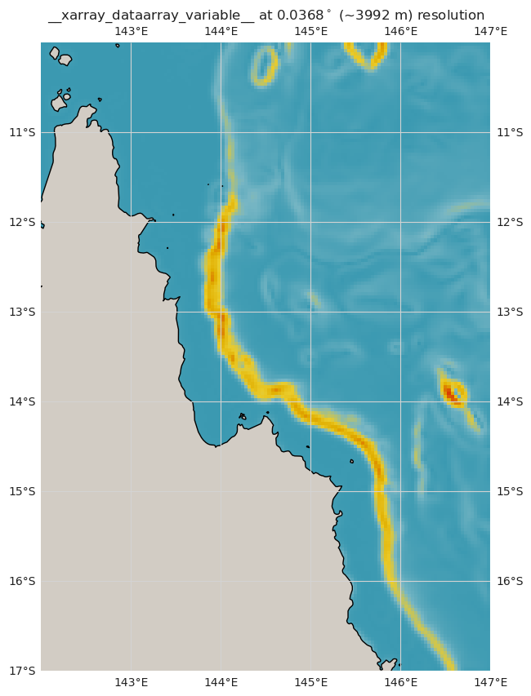

1. Overview
2. Economics
3. Tourism
4. Proposal
Coral presence ground truth
UNEP-WCMC Global Distribution of Coral Reefs
30m (~3×10⁻⁴ º)
Static, acquired 1980-2018
Depth & Seafloor Slope
General Bathymetric Chart of the Oceans (GEBCO)
~452m (~4×10⁻³ º)
Regular updates, latest 2023
Depth
Slope
Orlando Timmerman
Department of Earth Sciences
Calcifiers Group Meeting | 30.10.25
Notes:
Create a multivariate space where each axis is an environmental variable
Determine the envelope of environmental conditions at which reefs occur ('reeference' points)
Calculate the multivariate mean of those conditions, mu. Centre of the multivariate centroid
Account for the correlations between those variables through the covariance matrix
For each point, x with a vector of environmental conditions, can determine the distance away from the centroid
Higher D – more unusual, further away from optimal after considering both the spread and correlation of variables
We turn this on its head and calculate, for any point, the probability of observing a distance as large or larger than the overall distance
Environmental variables are correlated i.e. their axes are not orthogonal
Distance between two points in multivariate space relative to the centroid (the overall mean for multivariate data, where the means from all variables intersect)
This distance measures the squared distance of x from the multivariate mean μ, accounting for the shape of the data cloud (as defined by Σ\SigmaΣ).
Higher D – more unusual, further away from optimal after considering both the spread and correlation of variables
Assuming data has a multivariate normal distribution, the squared distances follow a chi-squared distribution with k degrees of freedom
P-value is the probability of observing a Mahalanobis distance as large or larger than D2
X is a column vector of the point whose distance you are calculating.
Example: if you’re measuring temperature and salinity, xxx might be [24∘C,35 PS
It represents the environmental conditions or observations at a particular location or time.
This is the mean vector of the reference distribution.
It’s the "centre" of the suitable environmental conditions (e.g., the mean temperature and salinity where corals are found).
x−μ is the vector of differences, telling you how far xxx is from the mean in each variable.
Sigma is the covariance matrix of the distribution.
It describes the variability and correlation between your environmental variables.
If your variables are uncorrelated, Σ\SigmaΣ is diagonal.
If they are correlated, Σ\SigmaΣ has off-diagonal terms.
Sima-1 This is the inverse covariance matrix, sometimes called the precision matrix.
It scales and rotates the space so that distances take into account the spread and correlation of the data.
A large variance in a variable → less contribution to the distance in that direction.
Correlated variables → the distance adjusts for redundancy.

Slide 16

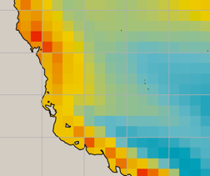
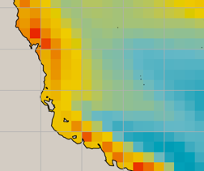
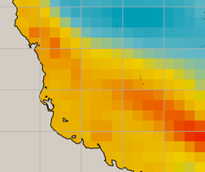
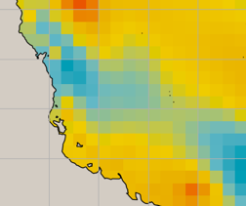
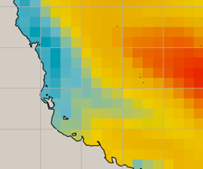
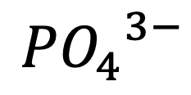

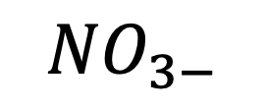
1. Overview
2. Economics
3. Tourism
4. Proposal
WCRP Coupled Model Intercomparison Project (CMIP6)
Hindcast (1850 - 2014) & forecast (2015 - 2100) monthly means
~27km (0.25º) spatial resolution
$$Ω$$
$${{PO}_{4}}^{3−}$$
$${NO}_{3−}$$
+ more
Orlando Timmerman
Department of Earth Sciences
Calcifiers Group Meeting | 30.10.25
Notes:
Create a multivariate space where each axis is an environmental variable
Determine the envelope of environmental conditions at which reefs occur ('reeference' points)
Calculate the multivariate mean of those conditions, mu. Centre of the multivariate centroid
Account for the correlations between those variables through the covariance matrix
For each point, x with a vector of environmental conditions, can determine the distance away from the centroid
Higher D – more unusual, further away from optimal after considering both the spread and correlation of variables
We turn this on its head and calculate, for any point, the probability of observing a distance as large or larger than the overall distance
Environmental variables are correlated i.e. their axes are not orthogonal
Distance between two points in multivariate space relative to the centroid (the overall mean for multivariate data, where the means from all variables intersect)
This distance measures the squared distance of x from the multivariate mean μ, accounting for the shape of the data cloud (as defined by Σ\SigmaΣ).
Higher D – more unusual, further away from optimal after considering both the spread and correlation of variables
Assuming data has a multivariate normal distribution, the squared distances follow a chi-squared distribution with k degrees of freedom
P-value is the probability of observing a Mahalanobis distance as large or larger than D2
X is a column vector of the point whose distance you are calculating.
Example: if you’re measuring temperature and salinity, xxx might be [24∘C,35 PS
It represents the environmental conditions or observations at a particular location or time.
This is the mean vector of the reference distribution.
It’s the "centre" of the suitable environmental conditions (e.g., the mean temperature and salinity where corals are found).
x−μ is the vector of differences, telling you how far xxx is from the mean in each variable.
Sigma is the covariance matrix of the distribution.
It describes the variability and correlation between your environmental variables.
If your variables are uncorrelated, Σ\SigmaΣ is diagonal.
If they are correlated, Σ\SigmaΣ has off-diagonal terms.
Sima-1 This is the inverse covariance matrix, sometimes called the precision matrix.
It scales and rotates the space so that distances take into account the spread and correlation of the data.
A large variance in a variable → less contribution to the distance in that direction.
Correlated variables → the distance adjusts for redundancy.

Slide 17




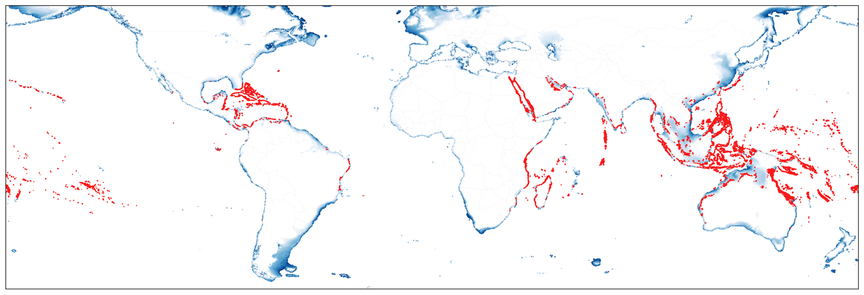
1. Overview
2. Economics
3. Tourism
4. Proposal
PRESENT DAY
1850
→ 2100
Orlando Timmerman
Department of Earth Sciences
Calcifiers Group Meeting | 30.10.25
Notes:
Create a multivariate space where each axis is an environmental variable
Determine the envelope of environmental conditions at which reefs occur ('reeference' points)
Calculate the multivariate mean of those conditions, mu. Centre of the multivariate centroid
Account for the correlations between those variables through the covariance matrix
For each point, x with a vector of environmental conditions, can determine the distance away from the centroid
Higher D – more unusual, further away from optimal after considering both the spread and correlation of variables
We turn this on its head and calculate, for any point, the probability of observing a distance as large or larger than the overall distance
Environmental variables are correlated i.e. their axes are not orthogonal
Distance between two points in multivariate space relative to the centroid (the overall mean for multivariate data, where the means from all variables intersect)
This distance measures the squared distance of x from the multivariate mean μ, accounting for the shape of the data cloud (as defined by Σ\SigmaΣ).
Higher D – more unusual, further away from optimal after considering both the spread and correlation of variables
Assuming data has a multivariate normal distribution, the squared distances follow a chi-squared distribution with k degrees of freedom
P-value is the probability of observing a Mahalanobis distance as large or larger than D2
X is a column vector of the point whose distance you are calculating.
Example: if you’re measuring temperature and salinity, xxx might be [24∘C,35 PS
It represents the environmental conditions or observations at a particular location or time.
This is the mean vector of the reference distribution.
It’s the "centre" of the suitable environmental conditions (e.g., the mean temperature and salinity where corals are found).
x−μ is the vector of differences, telling you how far xxx is from the mean in each variable.
Sigma is the covariance matrix of the distribution.
It describes the variability and correlation between your environmental variables.
If your variables are uncorrelated, Σ\SigmaΣ is diagonal.
If they are correlated, Σ\SigmaΣ has off-diagonal terms.
Sima-1 This is the inverse covariance matrix, sometimes called the precision matrix.
It scales and rotates the space so that distances take into account the spread and correlation of the data.
A large variance in a variable → less contribution to the distance in that direction.
Correlated variables → the distance adjusts for redundancy.

Slide 18


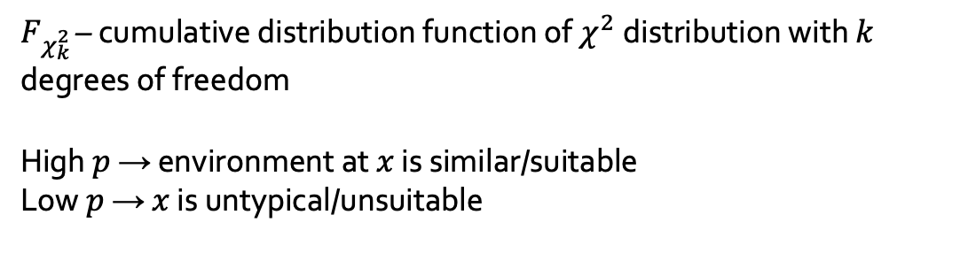

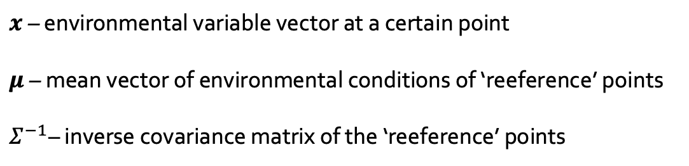



1. Overview
2. Economics
3. Tourism
4. Proposal
Ecological Niche Factor Analysis
$$D^{2}\left(x\right)={\left(x−μ\right)}^{T}Σ^{−1}\left(x−μ\right)$$
$$X_{2}$$
$x$ – environmental variable vector at a certain point
$μ$ – mean vector of environmental conditions of ‘reeference’ points
$Σ^{−1}$– inverse covariance matrix of the ‘reeference’ points
DISTANCE
$$p=1−F_{χ_{k}^{2}}(D^{2}\left(x\right))$$
$$X_{1}$$
$F_{χ_{k}^{2 }}$– cumulative distribution function of $χ^{2}$distribution with $k$ degrees of freedom
High $p$ → environment at $x$ is similar/suitable
Low $p$ → $x$ is untypical/unsuitable
$P$-VALUE
Orlando Timmerman
Department of Earth Sciences
Calcifiers Group Meeting | 30.10.25
Notes:
Create a multivariate space where each axis is an environmental variable
Determine the envelope of environmental conditions at which reefs occur ('reeference' points)
Calculate the multivariate mean of those conditions, mu. Centre of the multivariate centroid
Account for the correlations between those variables through the covariance matrix
For each point, x with a vector of environmental conditions, can determine the distance away from the centroid
Higher D – more unusual, further away from optimal after considering both the spread and correlation of variables
We turn this on its head and calculate, for any point, the probability of observing a distance as large or larger than the overall distance
Environmental variables are correlated i.e. their axes are not orthogonal
Distance between two points in multivariate space relative to the centroid (the overall mean for multivariate data, where the means from all variables intersect)
This distance measures the squared distance of x from the multivariate mean μ, accounting for the shape of the data cloud (as defined by Σ\SigmaΣ).
Higher D – more unusual, further away from optimal after considering both the spread and correlation of variables
Assuming data has a multivariate normal distribution, the squared distances follow a chi-squared distribution with k degrees of freedom
P-value is the probability of observing a Mahalanobis distance as large or larger than D2
X is a column vector of the point whose distance you are calculating.
Example: if you’re measuring temperature and salinity, xxx might be [24∘C,35 PS
It represents the environmental conditions or observations at a particular location or time.
This is the mean vector of the reference distribution.
It’s the "centre" of the suitable environmental conditions (e.g., the mean temperature and salinity where corals are found).
x−μ is the vector of differences, telling you how far xxx is from the mean in each variable.
Sigma is the covariance matrix of the distribution.
It describes the variability and correlation between your environmental variables.
If your variables are uncorrelated, Σ\SigmaΣ is diagonal.
If they are correlated, Σ\SigmaΣ has off-diagonal terms.
Sima-1 This is the inverse covariance matrix, sometimes called the precision matrix.
It scales and rotates the space so that distances take into account the spread and correlation of the data.
A large variance in a variable → less contribution to the distance in that direction.
Correlated variables → the distance adjusts for redundancy.

Slide 19
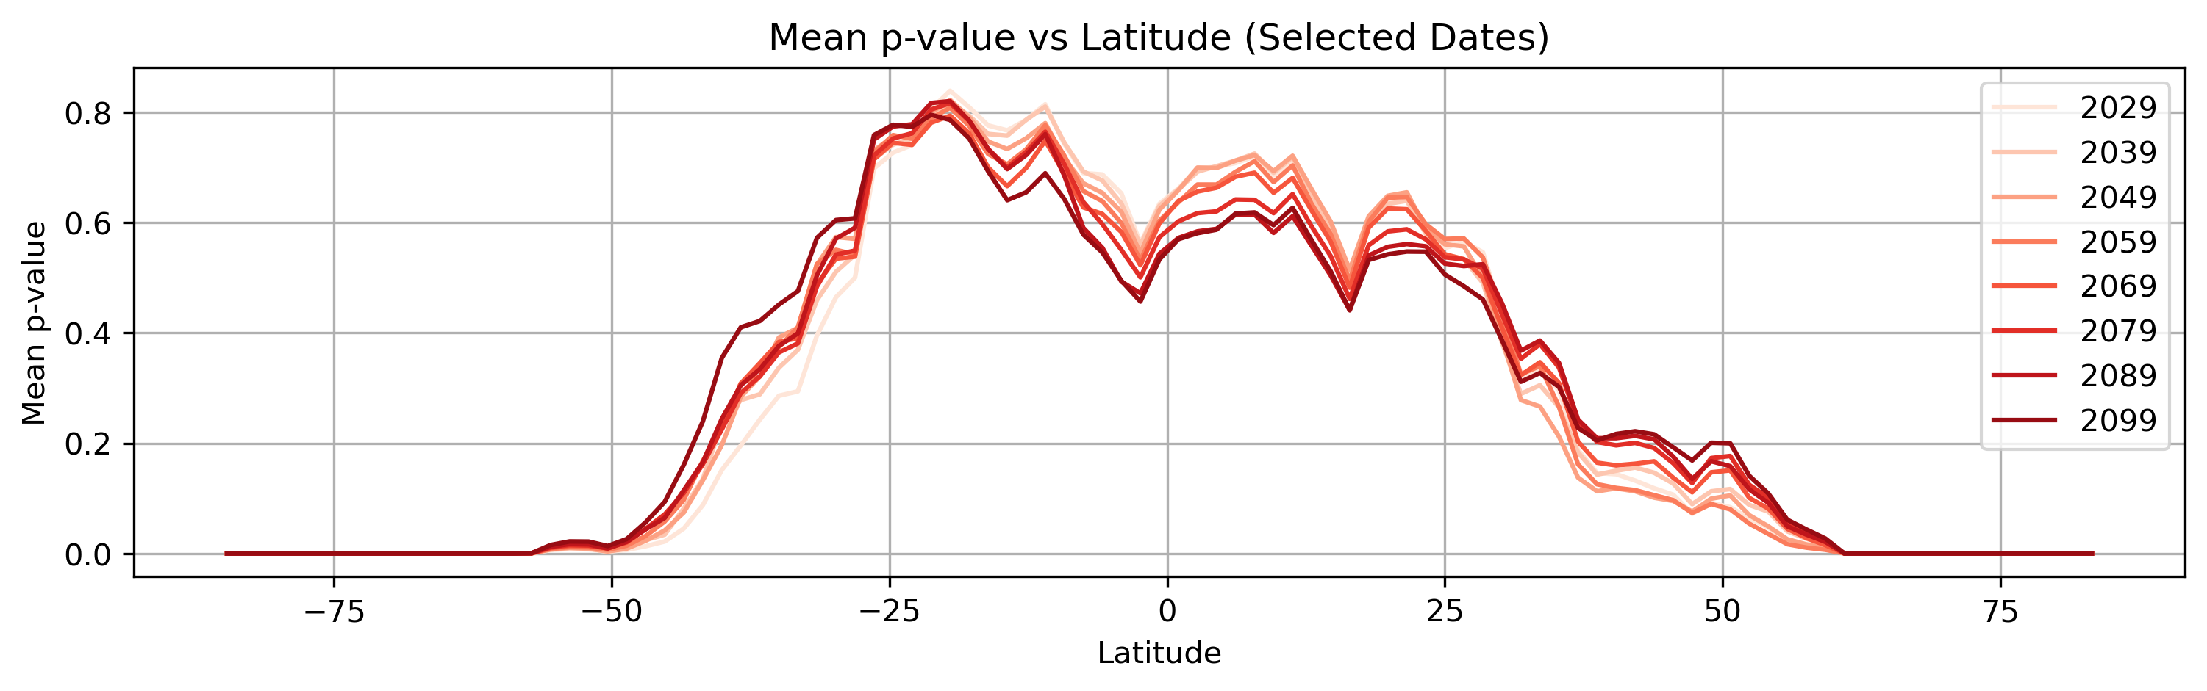
1. Overview
2. Economics
3. Tourism
4. Proposal
Orlando Timmerman
Department of Earth Sciences
Calcifiers Group Meeting | 30.10.25
Notes:
Create a multivariate space where each axis is an environmental variable
Determine the envelope of environmental conditions at which reefs occur ('reeference' points)
Calculate the multivariate mean of those conditions, mu. Centre of the multivariate centroid
Account for the correlations between those variables through the covariance matrix
For each point, x with a vector of environmental conditions, can determine the distance away from the centroid
Higher D – more unusual, further away from optimal after considering both the spread and correlation of variables
We turn this on its head and calculate, for any point, the probability of observing a distance as large or larger than the overall distance
Environmental variables are correlated i.e. their axes are not orthogonal
Distance between two points in multivariate space relative to the centroid (the overall mean for multivariate data, where the means from all variables intersect)
This distance measures the squared distance of x from the multivariate mean μ, accounting for the shape of the data cloud (as defined by Σ\SigmaΣ).
Higher D – more unusual, further away from optimal after considering both the spread and correlation of variables
Assuming data has a multivariate normal distribution, the squared distances follow a chi-squared distribution with k degrees of freedom
P-value is the probability of observing a Mahalanobis distance as large or larger than D2
X is a column vector of the point whose distance you are calculating.
Example: if you’re measuring temperature and salinity, xxx might be [24∘C,35 PS
It represents the environmental conditions or observations at a particular location or time.
This is the mean vector of the reference distribution.
It’s the "centre" of the suitable environmental conditions (e.g., the mean temperature and salinity where corals are found).
x−μ is the vector of differences, telling you how far xxx is from the mean in each variable.
Sigma is the covariance matrix of the distribution.
It describes the variability and correlation between your environmental variables.
If your variables are uncorrelated, Σ\SigmaΣ is diagonal.
If they are correlated, Σ\SigmaΣ has off-diagonal terms.
Sima-1 This is the inverse covariance matrix, sometimes called the precision matrix.
It scales and rotates the space so that distances take into account the spread and correlation of the data.
A large variance in a variable → less contribution to the distance in that direction.
Correlated variables → the distance adjusts for redundancy.

Slide 20

1. Overview
2. Economics
3. Tourism
4. Proposal
How do you evaluate the non-monetary impacts of an ecosystem?
…?
…?
How can conservation be done effectively and at scale without economic involvement?
Orlando Timmerman
Department of Earth Sciences
Calcifiers Group Meeting | 30.10.25

