Slide 1
AI PROTOTYPE SUBMISSION
Clinical Document Intelligence Hub
Structured, confidence-graded clinical document summaries
Orlando G. Mercado Tellado
github.com/orlando-mercado/clinical-document-intelligence-hub

Slide 2
1
PROBLEM UNDERSTANDING & OBJECTIVE
Clinical documentation review doesn't scale by adding more reviewers
The problem
Scope, locked on day one
At a mid-size healthcare provider, clinical and administrative staff spend significant time manually reading intake forms, discharge summaries, lab reports, and physician notes to pull out the facts that matter, a diagnosis, a critical lab value, a follow-up date. The process is slow, inconsistent between reviewers, and error-prone exactly where errors are costliest.
IN
Discharge summaries & lab reports
IN
Plain text & text-layer PDF input
IN
Per-field confidence + source citation
OUT
OCR / scanned or image input
The objective
OUT
Intake forms & physician notes
Build a working prototype that ingests a real clinical document and surfaces structured, decision-ready intelligence: the extracted facts, how confident the system is in each one, a plain-language summary, a risk flag, and a recommended next step — in the time it takes to upload a file.
OUT
EHR / FHIR integration
A deliberate 5-day tradeoff, documented in docs/scope.md — depth on two document types over shallow coverage of four.

Slide 3
2
SOLUTION ARCHITECTURE & DESIGN FLOW
Two LLM calls, never trusted at their word
Document Loader
Schema-Constrained Extraction
Confidence & Source-Grounding
Summarization & Recommendation
Streamlit UI
→
→
→
→
.txt · pdfplumber → pypdf fallback
Claude structured outputs + Pydantic
citation verified against raw text
risk flag + next steps
upload → color-coded card
↓
PDF Export
Audit Log
Multi-Doc Comparison
clinician-ready artifact
SQLite, every run
current vs. prior visit
CORE DESIGN DECISION
A field's confidence badge is never the model's self-reported score. It's recomputed deterministically from that score and whether the model's cited quote is a verbatim, whitespace-normalized match against the source document — a hallucinated citation is caught automatically and downgraded, regardless of how confident the model claimed to be.

Slide 4
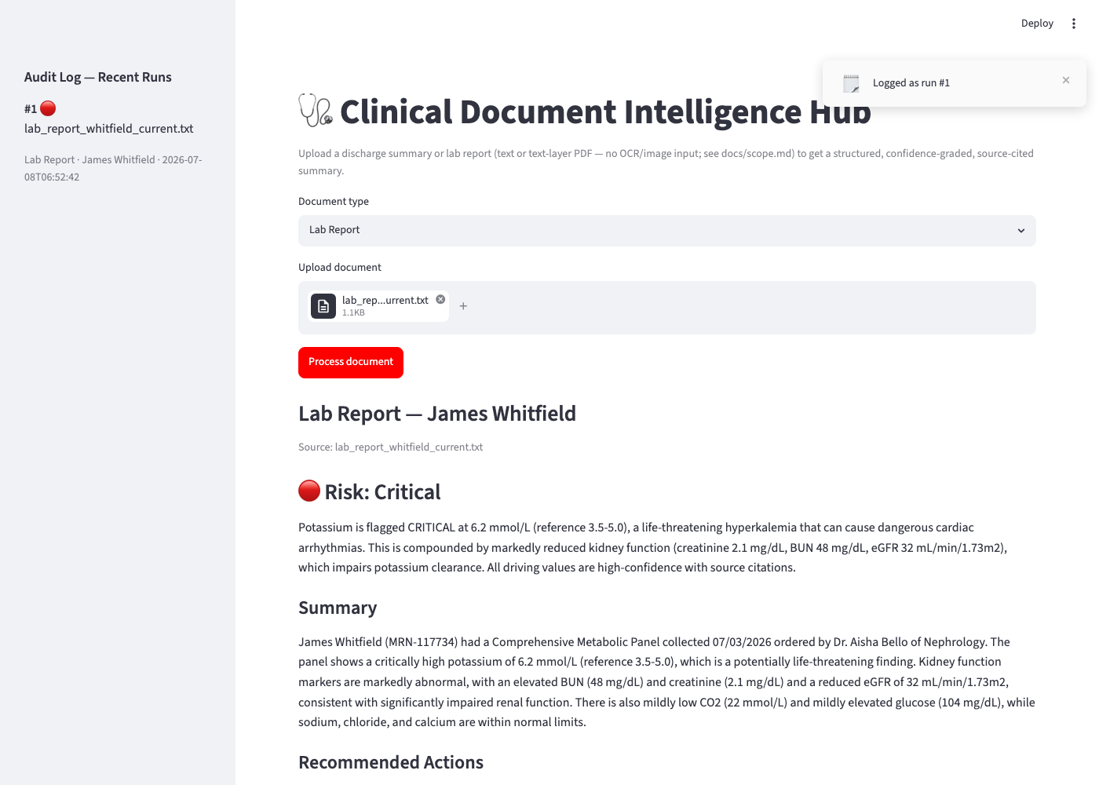
3
IMPLEMENTATION HIGHLIGHTS
What the pipeline does under the hood
Structured outputs, not prompt-and-pray
Every LLM call is constrained to a Pydantic schema via client.messages.parse(output_format=…), with a bounded retry loop covering safety refusals, API errors, and numeric bounds structured outputs don't enforce server-side.
Two-stage separation of concerns
Extraction produces graded facts; summarization consumes only that graded data never the raw document so the risk assessment can't silently drift from what was grounded.
Trajectory-aware comparison
Comparing current vs. prior visit escalates risk for values trending toward critical, even when neither single visit crossed that line alone.
The grounding check, in practice
def is_verbatim_citation(citation, source_text):
# column padding & line wraps shouldn't count
live run · lab_report_whitfield_current.txt · claude-opus-4-8
# as a hallucination — normalize whitespace first
return (normalize(citation)
in normalize(source_text))

Slide 5
4
CHALLENGES & LEARNINGS
Four real bugs, caught before they shipped
PROBLEM
FIX
Infinite recursion in a Pydantic validator
An explicit method instead of implicit re-validation
validate_assignment=True made the validator's own self.confidence_level = … assignment re-trigger the same validator, forever.
clear_ungrounded_citation() does a plain, un-validated attribute write — correct and no longer self-triggering.
PROBLEM
FIX
A missing API key crashed the whole UI
A last-resort boundary at the UI layer
No credentials raised a plain TypeError from the SDK — not an anthropic.APIError subclass — so it slipped past every typed exception handler.
Caught with a broad except Exception at the one place it's appropriate: the outermost UI call site, never silently swallowed elsewhere.
PROBLEM
FIX
Real citations were flagged as hallucinated
Whitespace-normalized comparison
Lab report values are column-padded with extra spaces — an exact substring match rejected genuinely grounded quotes.
Collapse whitespace on both sides before checking containment — catches real hallucinations without false-flagging formatting.
PROBLEM
FIX
The audit log couldn't reload its own data
extra="ignore" for assembled, not LLM-facing, objects
extra="forbid" on the assembled summary card rejected its own computed fields when reloading from the JSON stored in SQLite.
Reserved forbid for schemas the model writes directly; objects assembled in code tolerate their own round-trip.

Slide 6
5
DEMO SUMMARY & NEXT STEPS
Working end to end, on real synthetic cases
Live-tested against synthetic discharge summaries and lab reports, including a critical hyperkalemia case (potassium 6.2 mmol/L) correctly escalated to Critical risk with immediate-priority recommendations, and a paired current/prior lab comparison correctly identifying a Worsening trend as potassium climbed from 5.3 → 6.2 mmol/L.
If given more time
More document types
intake forms and physician notes fit the same extraction pattern already built.
OCR / scanned input
37
2
3
currently rejected by design; would need a vision step ahead of extraction.
Durable audit storage
PASSING TESTS
DOCUMENT TYPES
LLM-BACKED STAGES
today's SQLite file is ephemeral on cloud hosting; a managed database would persist across deploys.
Repository
github.com/orlando-mercado/clinical-document-intelligence-hub
Auth & multi-tenant access
Live demo
orlando-mercado-clinical-document-intelligence-h-appmain-beando.streamlit.app
needed before this touches more than one reviewer's documents.
EHR / FHIR integration
replace manual upload with a live system connection.

