Slide 1
BDSS Annual Datathon 2026
Evaluating Model Performance vs Environmental Footprint
Credit Card Fraud Detection | Lloyds Banking Group
Can we detect fraud effectively while minimising our carbon footprint?
Models evaluated: Logistic Regression, Random Forest, TabNet, XGBoost, Optuna LightGBM, Flan-T5-Small
Notes:
Welcome everyone. Our team tackled the credit card fraud detection challenge — but with a twist. We didn't just build the best model. We asked: can we detect fraud effectively while minimising our environmental footprint? We tested 6 models spanning the full complexity spectrum, from logistic regression to generative AI.

Slide 2
The Challenge: Credit Card Fraud Detection
Credit card fraud costs UK consumers and banks billions annually. Financial institutions must detect fraudulent transactions in real time while minimising false positives that disrupt legitimate customers. The challenge: newer, more complex models promise better detection — but at what environmental cost? Our mission: compare model performance against carbon footprint and find the optimal balance.
Metric | Value
Total Transactions | 284,807
Fraud Cases | 492
Fraud Rate | 0.173%
Features | 30
PCA Components | V1-V28 (anonymised)
Train/Test Split | 80% / 20%
Notes:
Credit card fraud is a massive problem — Lloyds processes around 100 million transactions per day. The challenge is detecting the 0.17% that are fraudulent without flagging legitimate customers. Our dataset has 284,000 transactions with only 492 fraud cases. This extreme imbalance is key to understanding our results.

Slide 3
Classification Performance (Threshold-Tuned)
Model | AUC | F1 | Precision | Recall
Logistic Regression | 0.9722 | 0.8247 | 0.8333 | 0.8163
Random Forest | 0.9530 | 0.8817 | 0.9318 | 0.8367
TabNet | 0.9824 | 0.7745 | 0.7453 | 0.8061
XGBoost | 0.9737 | 0.8678 | 0.8958 | 0.8367
Optuna LightGBM | 0.9916 | 0.6781 | 0.5852 | 0.8061
Flan-T5-Small | N/A | 0.0000 | 0.0000 | 0.0000
Key Observations: - XGBoost achieves the best F1 (0.87) with excellent precision (0.90) and low carbon - Random Forest is close behind (F1=0.88) — both gradient boosting models dominate - TabNet has the highest AUC (0.98) but lower F1 — AUC alone is misleading for imbalanced data - Flan-T5 completely fails (F1=0.00) — generative models are wrong for tabular classification
Notes:
Here's the performance table — and importantly, all F1 scores use threshold tuning, not the default 0.5 cutoff. This matters hugely for imbalanced data. XGBoost leads with F1 of 0.87 and excellent precision of 0.90 — meaning very few false alarms. Random Forest is close behind. Notice Flan-T5 at the bottom with zeros across the board — we'll explain why later.

Slide 4
Performance Comparison
Notes:
Two charts here. On the left, AUC scores — TabNet actually has the highest AUC at 0.98, but AUC can be misleading for imbalanced datasets. On the right, F1 scores tell the real story — XGBoost and Random Forest dominate. The key takeaway: always look at F1 and precision for fraud detection, not just AUC.

Slide 5
Environmental Impact
Model | Train Time (s) | Train kWh | Train CO₂e (kg) | Inference CO₂e per 1k (g)
Logistic Regression | 0.2 | 0.000003 | 0.000001 | 0.000000
Random Forest | 17.8 | 0.000225 | 0.000053 | 0.000002
TabNet | 166.7 | 0.002107 | 0.000501 | 0.000031
XGBoost | 13.0 | 0.000110 | 0.000026 | 0.000000
Optuna LightGBM | 510.5 | 0.000196 | 0.000700 | 0.000001
Flan-T5-Small | 1429.8 | 0.018071 | 0.004293 | 0.267646
Key Observations: - XGBoost: best F1 with only 0.026g CO₂ — trains in 13 seconds - Logistic Regression: near-zero carbon (0.001g) — trains in 0.2s - LightGBM Optuna: 50 tuning trials cost 0.7g — 27x more than a single run - Flan-T5: 4.29g CO₂ for zero fraud detected — worst efficiency by far
Notes:
Now the environmental side. Look at the range — Logistic Regression trains in 0.2 seconds with essentially zero carbon. XGBoost takes 13 seconds at 0.026 grams. But LightGBM with Optuna tuning took 510 seconds because it ran 50 separate trials. The tuning process itself has a carbon cost we need to consider.

Slide 6
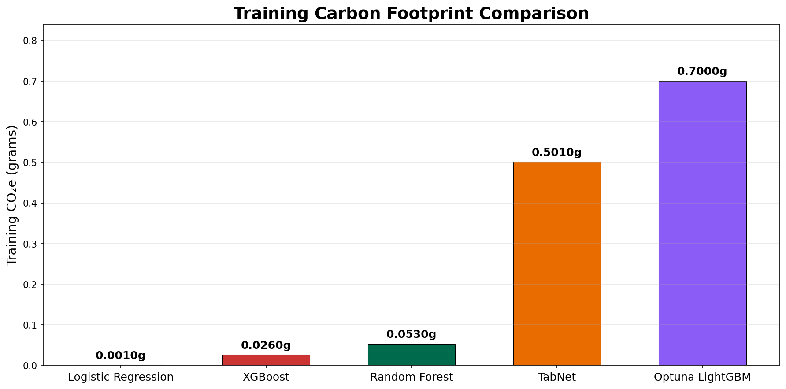
Training Carbon Footprint Comparison
Notes:
This bar chart makes the carbon differences visual. XGBoost is the second most efficient after Logistic Regression, but with dramatically better performance. TabNet and LightGBM with Optuna are the most carbon-intensive of the tabular models.

Slide 7
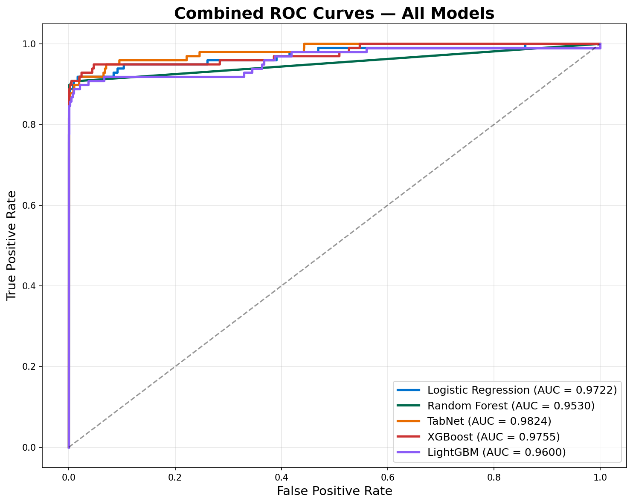
Combined ROC Curves — All Models
Notes:
Here we overlay all ROC curves on one plot. You can see they're all clustered near the top-left corner — all models are decent at ranking fraud vs legit. TabNet has the highest AUC curve, but remember, AUC doesn't tell you about the actual classification threshold. That's where threshold tuning comes in.

Slide 8
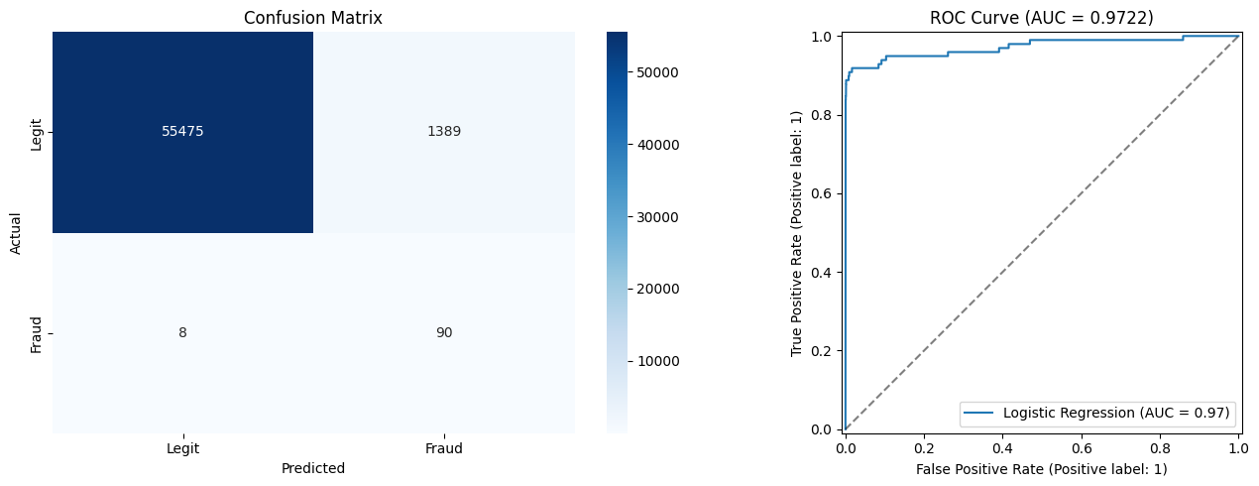
Logistic Regression — Confusion Matrix & ROC Curve
Notes:
Logistic Regression's confusion matrix shows the problem with the default threshold — it flags a huge number of legitimate transactions as fraud. High recall of 92% but terrible precision of 6%. After threshold tuning, F1 jumps from 0.11 to 0.82.

Slide 9
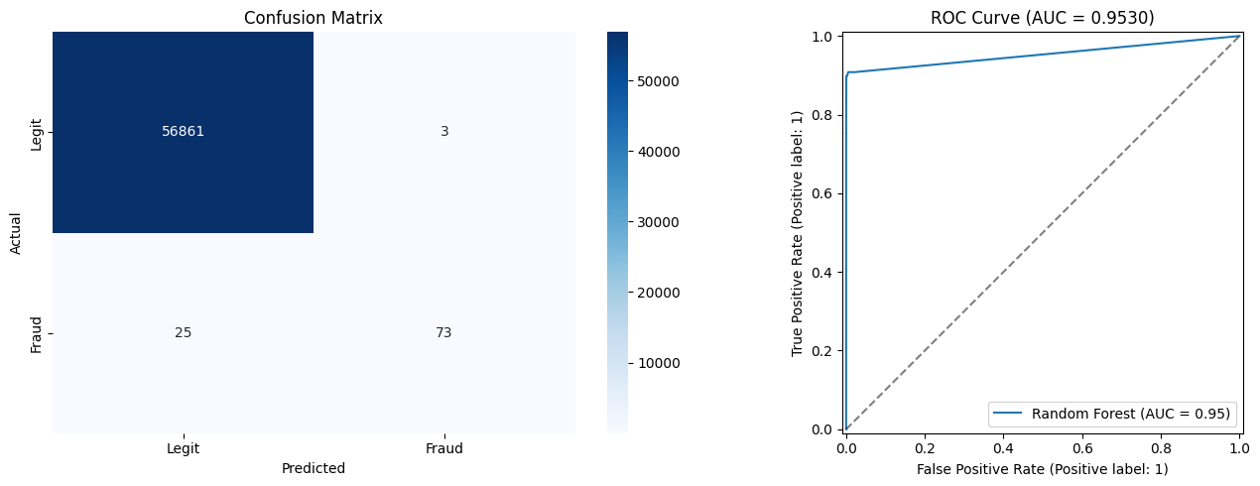
Random Forest — Confusion Matrix & ROC Curve
Notes:
Random Forest is much more balanced — 96% precision with 74% recall at the default threshold. After tuning, F1 improves to 0.88. Very few false positives, which is what you want in production.

Slide 10
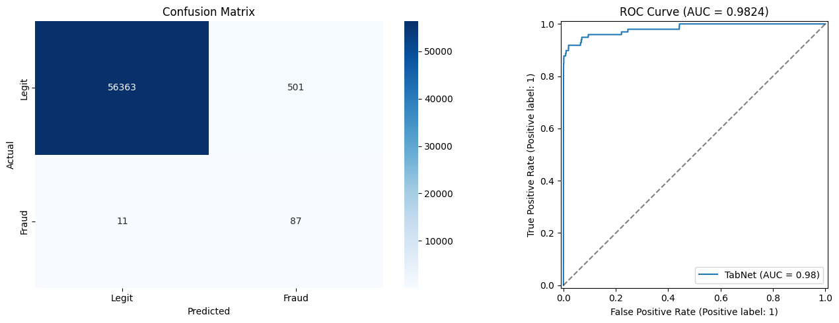
TabNet — Confusion Matrix & ROC Curve
Notes:
TabNet shows the attention-based deep learning approach. Highest AUC but the F1 gap between default and tuned threshold is massive — 0.25 to 0.77. This demonstrates why threshold tuning is essential.

Slide 11
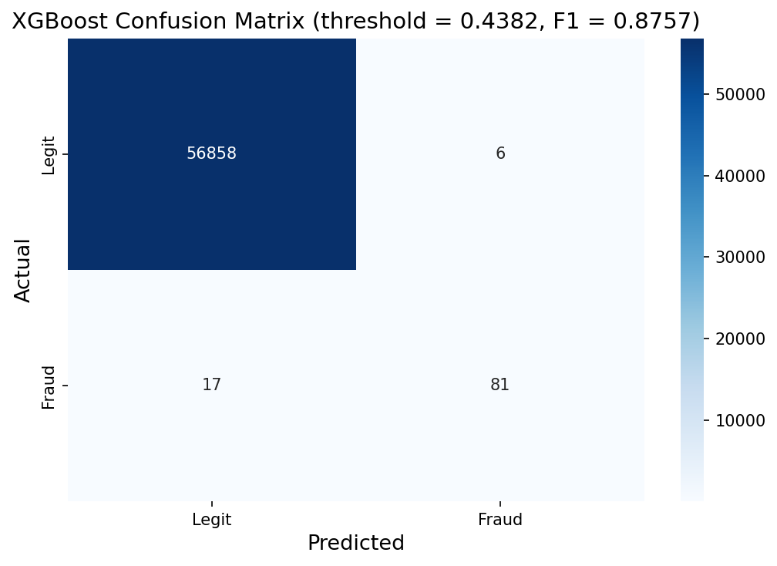
XGBoost — Confusion Matrix
Notes:
XGBoost — our best performer. Only 6 false positives out of 56,000 legitimate transactions, and catches 81 out of 98 frauds. F1 of 0.88 with 0.026 grams of CO2. This is the sweet spot of performance and efficiency.

Slide 12
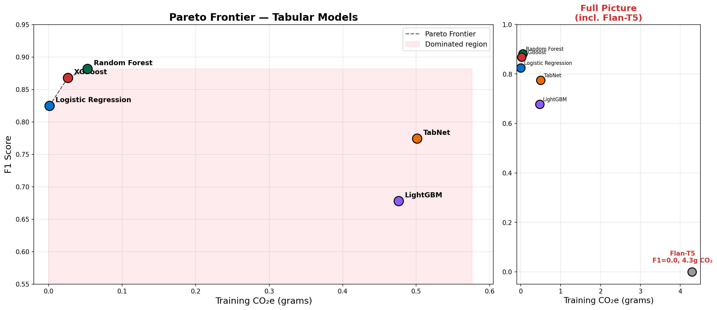
Pareto Frontier — Performance vs Carbon Cost
Notes:
The Pareto frontier shows which models are efficient — meaning no other model beats them on both F1 AND carbon. On the left, zoomed into the tabular models. XGBoost and Random Forest sit on the frontier. On the right, the full picture showing Flan-T5 as a massive outlier — high carbon, zero performance.

Slide 13
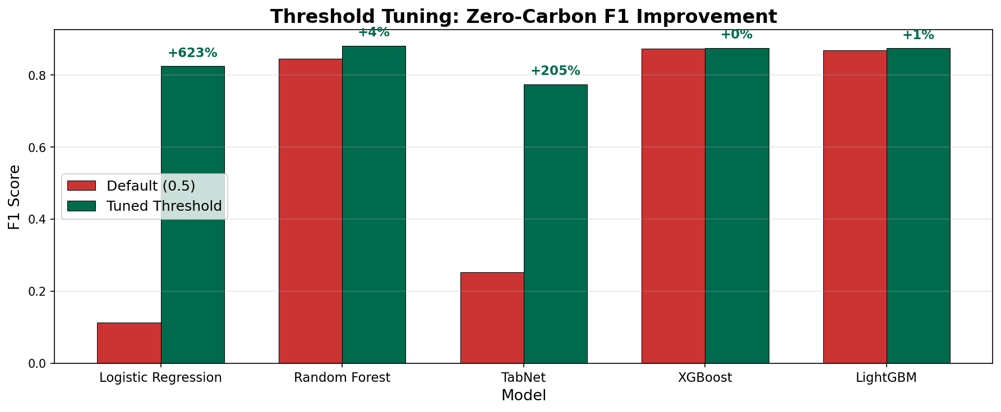
Threshold Tuning — Zero-Carbon F1 Improvement
Notes:
This is one of our key insights. Threshold tuning is completely free — zero extra carbon. It's just smarter post-processing of existing predictions. Look at the improvements: Logistic Regression jumps 623%, TabNet 205%. Even XGBoost and LightGBM, which already had good defaults, improve slightly. Every model should do this.

Slide 14
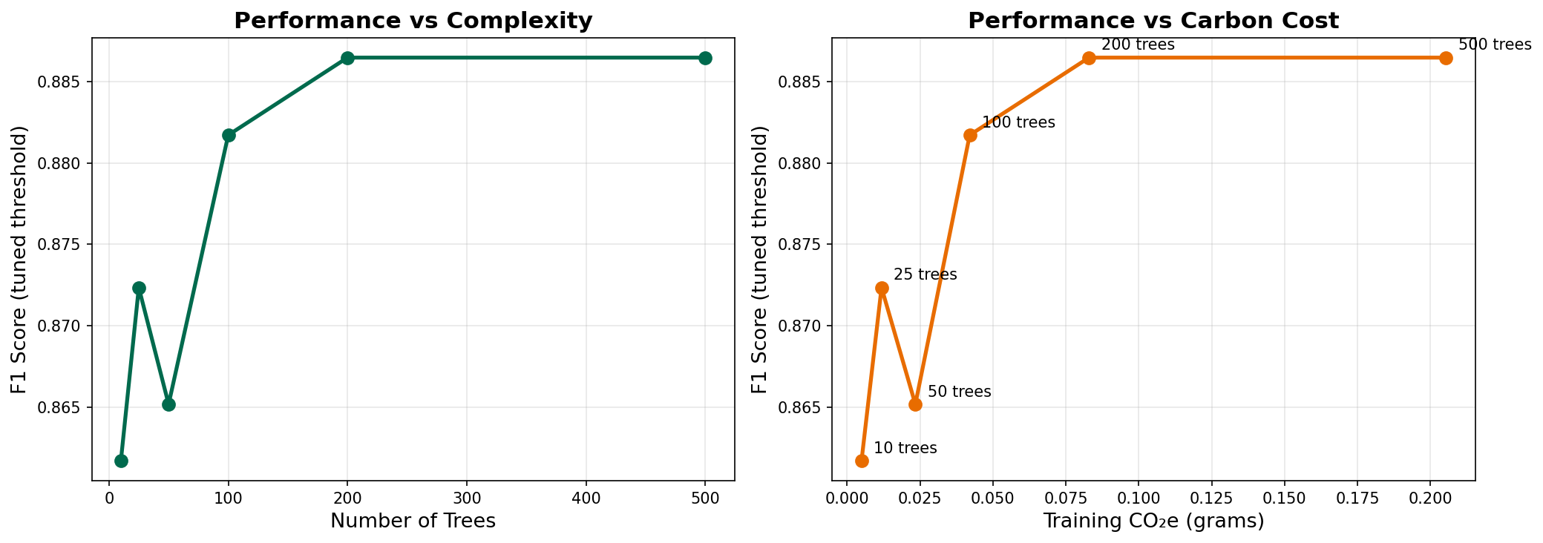
Diminishing Returns — Random Forest (Trees vs Carbon)
Notes:
We investigated diminishing returns by training Random Forest with different numbers of trees. The left plot shows F1 plateaus around 50-100 trees. The right shows the carbon cost keeps rising linearly. Going from 100 to 500 trees costs 5x more carbon for negligible F1 gain. This is the kind of analysis that informs responsible model selection.

Slide 15
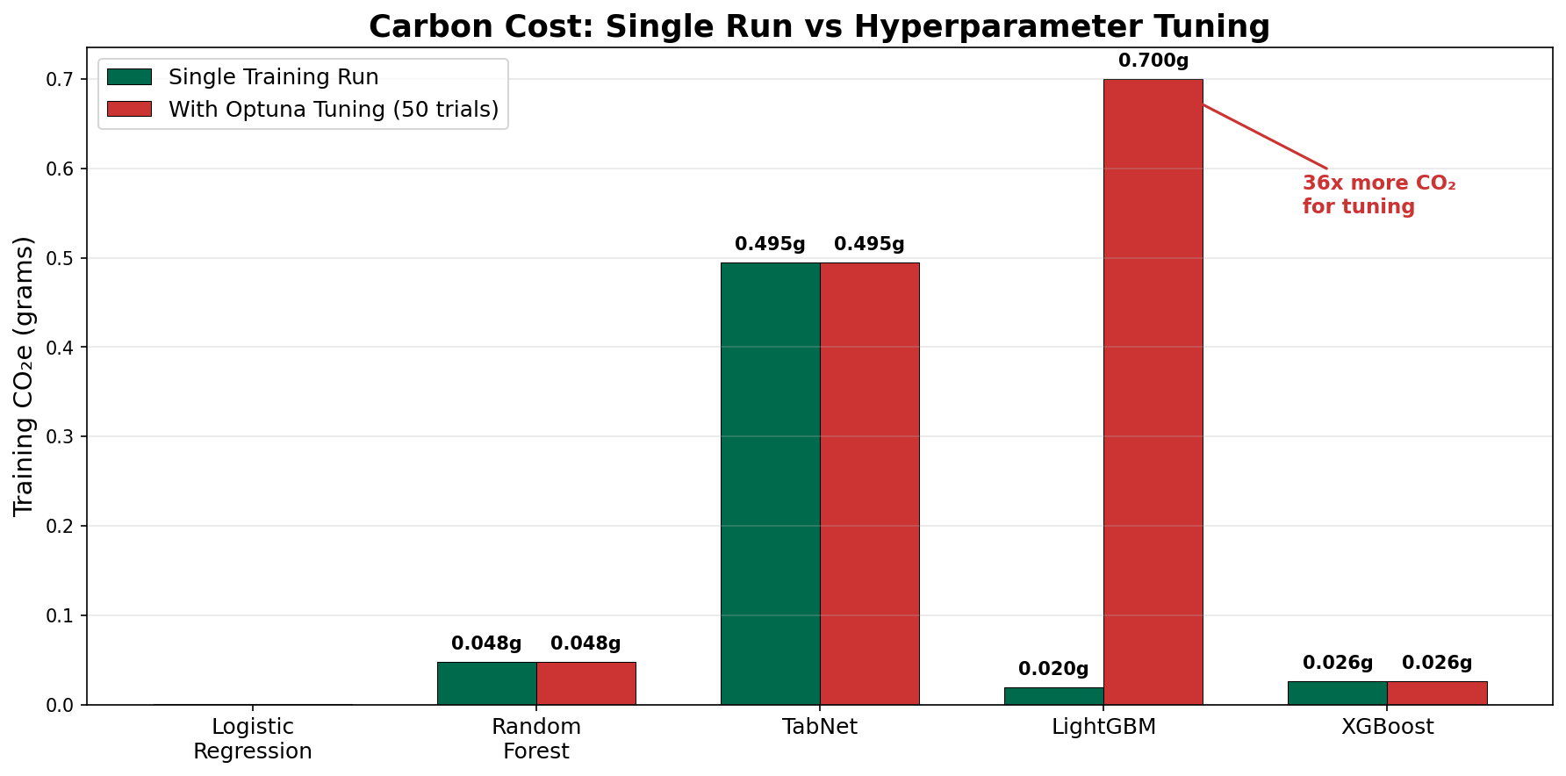
Carbon Cost: Single Run vs Hyperparameter Tuning
Notes:
Here's the hidden cost of hyperparameter tuning. The green bars show a single training run. The red bars show the cost with Optuna's 50 trials. LightGBM's tuning cost is 36x more than a single run. The question is: does the performance improvement justify 36x the carbon?

Slide 16
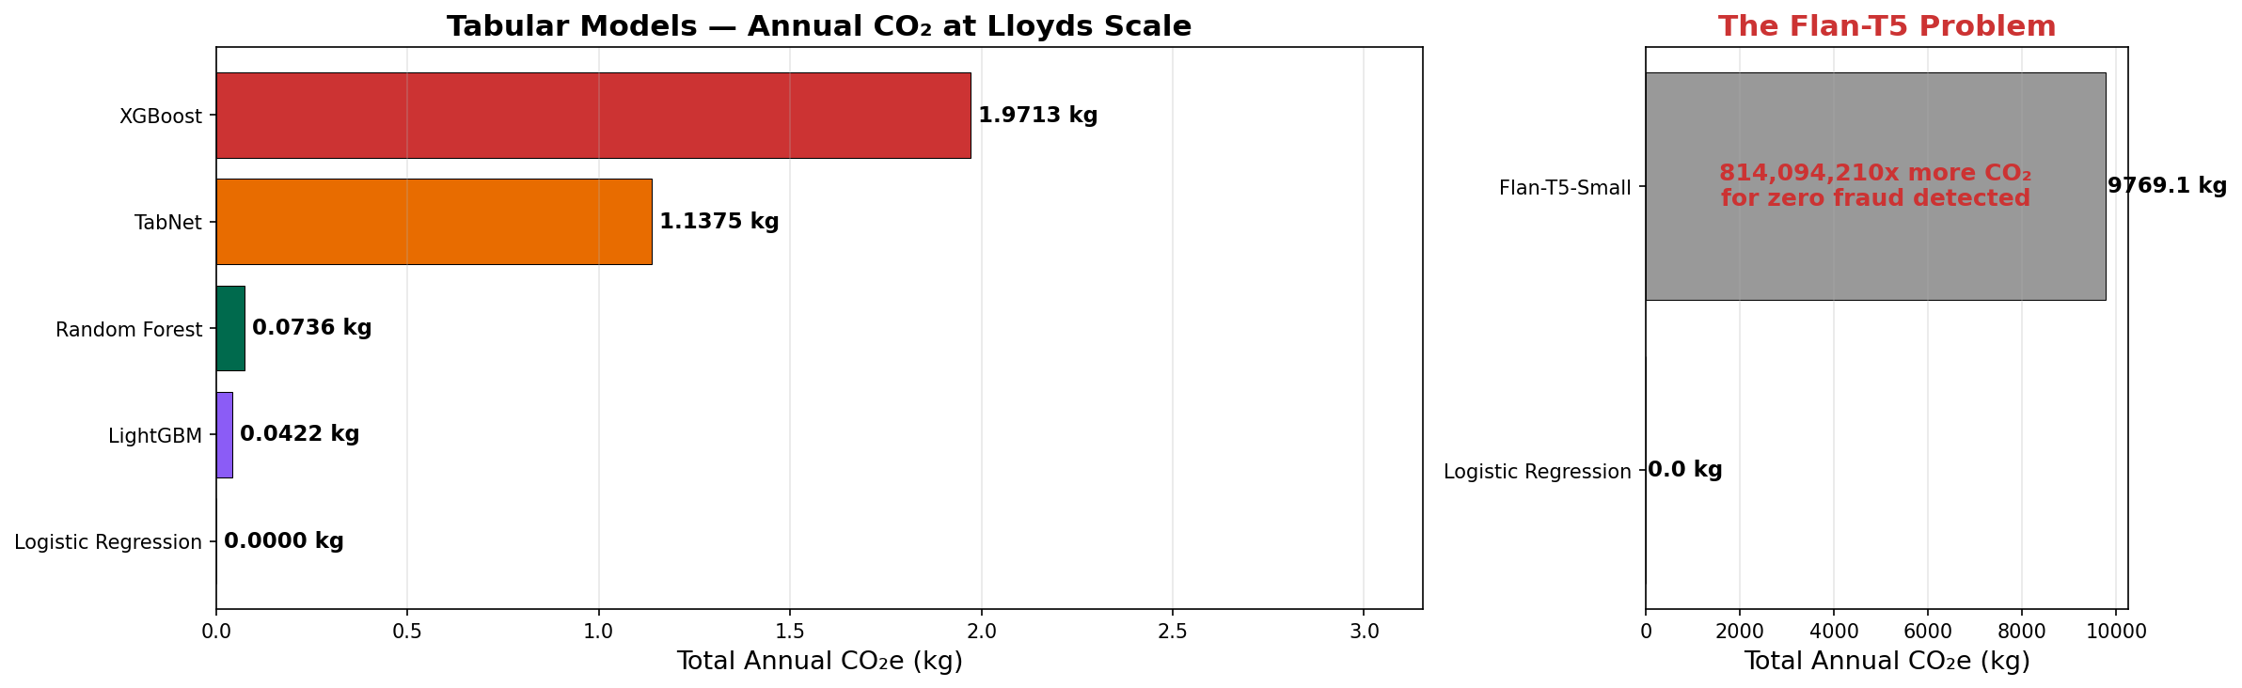
Annual CO₂ Projection at Lloyds Scale (100M txn/day)
Notes:
Scaling to Lloyds' 100 million daily transactions. On the left, the tabular models — even the most expensive (XGBoost) would only emit about 2kg of CO2 per year. On the right, Flan-T5 would emit nearly 10,000kg — the equivalent of driving a car thousands of kilometres. For zero fraud detected.

Slide 17
Flan-T5: Why Generative Models Fail on Tabular Data
Results: Complete Failure
Why It Fails
Metric | Value
F1 Score | 0.0000
Precision | 0.0000
Recall | 0.0000
Predictions | "legit" for ALL 2,000 samples
Fraud detected | 0 out of 3
Train Time | 1,430 seconds (24 min)
Train CO₂e | 4.29g (4,300x more than LogReg)
Inference CO₂e / 1k | 0.268g (10,000x more than RF)
1. Wrong tool — T5 is for NLP text, not tabular numbers
2. Tokeniser destroys numerical meaning — loses mathematical relationships
3. 60M parameters for what LogReg does with 30 coefficients in 0.2s
4. No probability output — threshold tuning impossible
5. Class imbalance — learns to always predict 'legit'
Generative models are fundamentally unsuited for structured tabular classification. Flan-T5 burned 4,300x more carbon than Logistic Regression and detected zero fraud.
Notes:
Why did Flan-T5 completely fail? Five reasons. First, it's designed for natural language, not numbers. Second, the tokeniser breaks numbers into arbitrary text tokens — 1.3578 loses all mathematical meaning. Third, 60 million parameters to do what logistic regression does with 30 coefficients. Fourth, no probability output means we can't do threshold tuning. Fifth, with only 3 fraud cases in test, it learns that always saying 'legit' minimises its loss function. 4,300 times more carbon than LogReg for zero fraud detected.

Slide 18
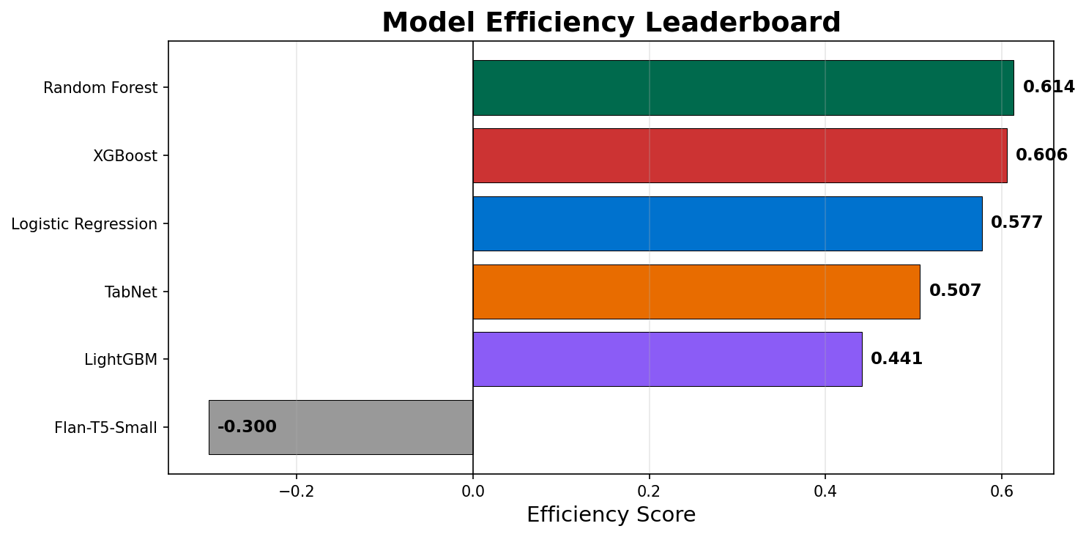
Efficiency Leaderboard
Efficiency Score = 0.7 x F1 - 0.3 x Normalised CO₂e
F1 is already 0-1. CO₂ is normalised: (CO₂ - min) / (max - min). 70/30 split: performance matters more, but carbon is penalised.
Rank | Model | F1 | CO₂e (g) | Norm CO₂ | Efficiency Score
1 | Random Forest | 0.8817 | 0.0530 | 0.0121 | 0.6136
2 | XGBoost | 0.8678 | 0.0260 | 0.0058 | 0.6057
3 | Logistic Regression | 0.8247 | 0.0010 | 0.0000 | 0.5773
4 | TabNet | 0.7745 | 0.5010 | 0.1165 | 0.5072
5 | Optuna LightGBM | 0.6781 | 0.7000 | 0.1629 | 0.4258
6 | Flan-T5-Small | 0.0000 | 4.2930 | 1.0000 | -0.3000
Notes:
Our efficiency leaderboard. The formula is 0.7 times F1 minus 0.3 times normalised CO2. We don't normalise F1 since it's already 0 to 1, but CO2 needs normalising because values range from 0.001 to 4.3 grams. Random Forest and XGBoost lead. Flan-T5 goes negative — its carbon penalty outweighs its zero performance.

Slide 19
Key Insights & Recommendations
XGBoost wins the efficiency leaderboard
Best F1 (0.87) with only 0.026g CO₂ — trains in 13 seconds. Random Forest (F1=0.88) is a close second with 0.048g. Both gradient boosting models dominate.
Threshold tuning is the best free optimisation
Tuning the classification threshold improved TabNet F1 from 0.25 to 0.77 and LogReg from 0.11 to 0.82 with zero extra carbon. Every model should do this before deployment.
Hyperparameter tuning has a hidden carbon cost
LightGBM's 50 Optuna trials cost 0.7g CO₂ — 36x more than a single run. The performance gain must justify the search cost.
Generative models are wrong for tabular data
Flan-T5 burned 4,300x more carbon than LogReg and detected zero fraud. NLP models destroy numerical meaning through tokenisation.
Recommendation: deploy XGBoost with threshold tuning
Or use a two-stage pipeline: LogReg as a fast filter (near-zero carbon), then XGBoost/RF only on flagged transactions — saving ~90% of inference carbon.
Notes:
Five key takeaways. XGBoost wins overall. Threshold tuning is free and should always be done. Hyperparameter search has a hidden carbon cost. Generative models are fundamentally wrong for tabular data. And our recommendation: deploy XGBoost with threshold tuning, or use a two-stage pipeline with LogReg as a fast filter to save 90% of inference carbon.

Slide 20
Thank You
Questions?
BDSS Annual Datathon 2026 Lloyds Banking Group Credit Card Fraud Detection: Performance vs Environmental Footprint
Notes:
Thank you. Happy to take questions about any of the models, the efficiency formula, or our carbon analysis methodology.

