Slide 1
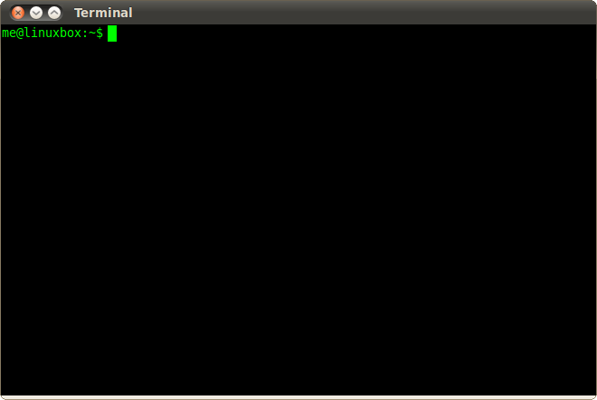
Tmux Demo:
Feel free to just watch as I go through some of Tmux’s cool features. If you want to follow along. You have two options.
1) Download the lightweight app:
Mac: “brew install tmux” Ubuntu: “apt-get install tmux”
Extra: “git clone https://github.com/orlandoc01/presntation.git”
2) SSH into the session I’ve provided:
“ssh guest@10.6.30.111”
password: “password”
Run: “. ./setup”
(not sure how many concurrent SSH sessions I can do so if it times out, maybe try the first option

Slide 2
Tmux Sessions
Session can many windows (like tabs)
Windows can have many panes
Special Tmux Commands start with ‘Prefix’ Key: [Ctrl-B]
Start Session Commands:
“tmux” -> starts up tmux server with new session named 0 or 1 or 2 etc…
“tmux new –s sessionName” -> starts up tmux server with specific name

Slide 3
Tmux Pane Commands
[Ctrl-B], [%] -> Split Vertically
[Ctrl-B], [”] -> Split Horizontally
[Ctrl-B], [o] -> Switch to next pane
[Ctrl-B], [z] -> Zoom on Pane
[Ctrl-B], [q], [0..9] -> Select Pane

Slide 4
Tmux Window Commands:
[Ctrl-B], [,] -> Rename window
[Ctrl-B], [c] -> Create New Window
[Ctrl-B], [n] -> Next Window
[Ctrl-B], [p] -> Prev Window
[Ctrl-B], [&] -> Kill Window

Slide 5
Tmux Session Commands:
When not in session:
‘tmux ls’ -> List avaible sessions
‘tmux kill-ses –t named’ -> kill session
‘tmux a –t named’ -> Attach to session
When in session:
[Ctrl-B], [d] -> Detach from TMUX
[Ctrl-B], [s] -> List other sessions
[Ctrl-B], [$] -> Rename session

