Slide 1

NYC Taxi Data Platform
How does adverse weather affect taxi demand across New York City, and do those patterns change over time?
Team AMO: Ariana Lopez, Maryam Choudhury, Orlando Marin
Notes:
ORLANDO: Good morning, everyone. Ariana, Maryam, and I are Team AMO, and today we'll show how adverse weather affects taxi demand across New York City.

Slide 2
Topics of Discussion
1
The Business Question and Key Finding
2
Data and Architecture
3
Data Quality
4
Year-over-Year Analysis
5
Future State and Recommendations
Notes:
To answer our business question, we'll start by diving deeper into the business question and.
Then we'll walk through the data, architecture, and data quality work that supported our analysis.
Finally, we'll share our year-over-year results and close with recommendations for future improvements.

Slide 3
1
The Business Question and Key Finding
Notes:
Let’s start with the business question at the center of our analysis and the key finding that reveals where taxi operators can make the greatest impact

Slide 4
The Business Question
How Does Adverse Weather Influence Taxi Demand, and Have Those Patterns Changed Over Time?
Comparison of January-May 2025 and January-May 2026
Why This Matters
🚕 Operations
Anticipate demand changes during poor weather
💰 Business Decisions
Understand where weather has the greatest impact
🏙️ City Planning
Support transportation planning across boroughs
Scope
🚕 Yellow + Green taxi, Jan-May 2025 vs Jan-May 2026
📊 39.2 million trip records
🌦️ Hourly NYC weather conditions
🗺️ 265 taxi zones mapped to 5 boroughs
🌧️ Adverse weather = rain and snow
How We Measured Impact
We combined hourly weather conditions with taxi activity and compared the same months across both years to ensure a fair comparison.
Notes:
Starting with the business problem we set out to solve.
Weather affects people's daily routines, but it's not always clear how much of an impact it has on transportation demand or whether that impact changes over time. Our goal was to better understand that relationship and determine if adverse weather influences taxi demand differently across New York City's boroughs.
This question matters because understanding how demand shifts during poor weather can help support better planning and decision-making. Whether it's allocating resources, preparing for demand changes, or understanding transportation patterns across the city, weather can be an important factor.
For this analysis, we focused on adverse weather conditions such as rain and snow. We then compared patterns across 2025 and 2026 to see whether the relationship between weather and demand remained consistent or changed over time.
With our business question established, let's look at the data we used to answer it.

Slide 5
Headline Finding
A single storm-hour during rush hour now costs more in lost revenue than several off-peak storm-hours combined.
38M+
Trip Records Analyzed
10 months
Jan-May 2025 vs 2026
5 boroughs
Weather Impact Compared
Business Insight
Pre-position vehicles before forecasted storms, prioritize rush-hour coverage, and consider dynamic incentives for drivers to stay on the road during adverse conditions.
Notes:
We'll start with the biggest insight from our analysis.
We found that the timing of a storm matters just as much as the storm itself.
A single hour of bad weather during rush hour can have a greater business impact than several hours of adverse weather during off-peak times.
For taxi operators, that means planning around when disruptions occur, not just predicting the weather.

Slide 6
2
Data and Architecture
Notes:
I'm going to pass it on to Ariana to go through our data and architecture

Slide 7
The Data
What We Were Given
• 20 Parquet files in S3
• Yellow: 38.8M rows
• Green: 465K rows
• Jan-May 2025 & 2026
• 265 taxi zones
What We Added
Open-Meteo Historical Weather API
7,248 hourly records
Temperature
Snow
Rain
Preciptation
Weather description
Wind
Schema Challenges
Different timestamp fields
Green-only fields
Case-sensitive inferred columns
39,224,735
Total Trip Records
7,248
Weather Hours
265
Taxi Zones
Notes:
Before we get into the platform we built, I want to briefly explain the data behind our analysis.
Our primary dataset consists of New York City taxi trips, where each record represents a single ride from pickup to dropoff. For each trip, we have details such as the timestamp, trip distance, fare amount, and pickup and dropoff locations.
We worked with both Yellow Taxi and Green Taxi data.
Yellow taxis operate throughout the city and make up the vast majority of the dataset, while Green taxis primarily serve areas outside of Manhattan's central business districts.
In total, the raw data included approximately 38.8 million Yellow Taxi trips and 465,000 Green Taxi trips spanning January through May of 2025 and 2026.
One challenge was that the trip data only contained numeric location IDs rather than borough or neighborhood names. To make the data more meaningful, we used New York City's taxi zone lookup table to map those IDs to 265 taxi zones across the city.
To add context, we also incorporated hourly weather data for the same period, including measures such as precipitation, temperature, wind speed, and weather conditions. This allowed us to connect weather patterns directly to taxi activity.
Before any analysis could begin, we had to clean and standardize the data. The Yellow and Green Taxi datasets used different schemas, naming conventions, and formats, so we transformed them into a consistent structure that could be analyzed together. We will go more in detail on data cleaning later on.
After combining everything, our final dataset included more than 39 million taxi trips, 7,200+ hourly weather records, and all 265 taxi zones, giving us a strong foundation for analysis.

Slide 8
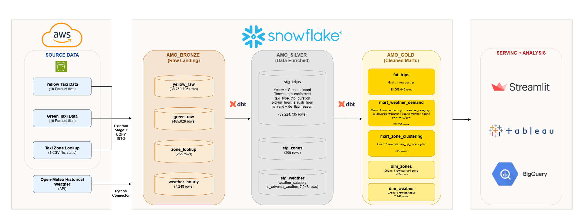
Pipeline Architecture
Current Performance: Full pipeline rebuild in ~6 minutes, with dashboard queries returning results in under 1 second.
Scalability: Architecture can support 10x growth through Snowpipe ingestion, incremental dbt models, and Snowflake warehouse scaling without a redesign.
Notes:
This diagram shows how data moves through our platform, from raw taxi and weather sources to the dashboards and analytics used by business teams.
On the left are our source datasets, including Yellow Taxi trips, Green Taxi trips, taxi zone information, and historical weather data. These datasets are loaded into Snowflake, which serves as the central platform for storage and transformation.
We organize the data using a Medallion Architecture with Bronze, Silver, and Gold layers.
The Bronze layer stores the raw source data exactly as received, providing a complete audit trail and preserving the original records.
The Silver layer is where data is standardized, combined, and enriched. Here we merge the taxi datasets, add weather and time-based attributes, and perform data quality checks. Instead of immediately deleting invalid records, we flag them so data quality can be monitored and investigated over time.
The Gold layer contains trusted, business-ready datasets. Only validated records move forward, ensuring that reporting and analysis are based on reliable information.
All transformations between the Bronze, Silver, and Gold layers are managed through dbt, which applies business rules consistently and makes the pipeline repeatable and maintainable.
Finally, tools such as Tableau, Streamlit, and BigQuery connect to the Gold layer, allowing users to explore trends, answer business questions, and make data-driven decisions.
This architecture is also designed to scale as data volumes grow. Instead of loading data in large scheduled batches, Snowpipe can automatically load new data as it arrives, reducing delays and keeping information more up to date.
Combined with incremental dbt processing and Snowflake's ability to add computing power on demand, the platform can support significantly larger volumes of data without requiring a full redesign.

Slide 9
Architecture Decision: Snowflake + DBT
Why We Chose This Approach
Our team has the strongest experience with SQL, allowing us to move quickly and confidently.
The architecture had the fewest moving parts, making it the best fit for a one-week sprint
All transformation logic was tested, version-controlled, and maintainable through dbt
Snowflake efficiently processed our 39 million records without acquiring additional distributed computing tools
End-to-end pipeline execution completed in approximately 6 minutes, enabling rapid development and testing
Key Design Decisions
Materialized staging tables instead of views to avoid repeatedly processing 39 million records during dashboard queries
Data quality filtering implemented through an is_valid = True flag, ensuring only trusted records reached the Gold layer
Weather data joined at the hour level, matching taxi trip timestamp granularity and achieving a 100% join match rate
Centralized orchestration approach, where a single command executes the entire pipeline, supports repeatability, fast failure detection, and simplified operations
Speed, Trust, Simplicity
Notes:
When designing our solution, we focused on three priorities: speed, trust, and simplicity.
To achieve that, we selected Snowflake as our cloud data platform and dbt to manage transformations.
Together, they allowed us to turn nearly 39 million taxi trips into a scalable and reliable analytics pipeline.
To improve performance, we stored transformed data in tables rather than recalculating millions of records every time a dashboard is opened.
This allows users to access insights much more quickly.
We also built data quality checks directly into the pipeline. Invalid records are flagged and excluded from reporting datasets, ensuring that dashboards and analysis are based on trusted data.
To support our weather analysis, we matched weather observations to taxi trips at the hourly level. This allowed us to accurately measure how weather conditions relate to trip demand and revenue patterns.
Finally, we automated the entire workflow through a single process. This reduces manual effort, improves consistency, and makes the pipeline easier to maintain as new data becomes available.
Overall, these design decisions gave us a solution that can efficiently process millions of records while remaining reliable, scalable, and easy to operate.

Slide 10
Additional Paths We Explored
NYC Permit Data
Explored as enrichment
Could road work affect taxi demand?
Taxi data only identified pickup/drop-off zones
We could not reliably determine which construction sites a trip encountering
Decided to exclude this data to avoid making any unsupported assumptions
Data Pipeline
Partially Built
Used AWS Glue + PySpark for transformation
Valuable hands-on experience with AWS
Steeper learning curve and required more development effort
Less practical within our project timeline
What the Exploration Taught Us
Not every enrichment source can be relatively connected to our data
Exploring a different pipeline implementation gave us valuable AWS and PySpark experience
Comparing both approaches helped us make an informed architecture experience
Notes:
One thing we wanted to highlight is that this project was not a straight line from start to finish. Like most real-world projects, some of our biggest lessons came from approaches that didn't make it into the final solution.
First, we explored adding New York City permit data. While the idea was interesting, our taxi data only showed pickup and dropoff locations, not the actual route taken by each taxi. Because of that, we couldn't reliably determine whether a trip was impacted by construction, so we decided not to include it.
We also experimented with AWS Glue and PySpark as part of our pipeline. While the solution worked, AWS Glue made debugging difficult, as identifying errors often required digging through CloudWatch logs and troubleshooting multiple services. Because of the additional complexity and time required, we chose a simpler architecture that let us focus on data analysis and business insights.
In the end, these experiences helped us make better decisions. They reinforced the importance of working within the limits of the data and choosing tools work well for our end goal.

Slide 11
3
Data Quality
Notes:
I'm going to pass it off to Maryam to go over data quality and some of our findings.

Slide 12
Data Quality Findings
Data Quality Findings
Null/zero passenger count: 9.2M (23%) → Retained (warning)
Payment type 0 (undocumented): 9M (23%) → Retained (warning)
Invalid timestamps: 702K (1.8%) → Flagged invalid
Negative fares: 247K (0.6%) → Flagged invalid
Distance > 100 miles: 131K (0.3%) → Flagged invalid
Dropoff before pickup: 87K (0.2%) → Flagged invalid
Pipeline Reconciliation
The Cash Tip Trap
Cash tips are not captured in the dataset because tip amounts are only recorded for credit card transactions.
To ensure accurate reporting, cash tips were excluded from all total revenue calculations.
Stage | Rows
Source Files | 39,224,735
Bronze | 39,224,735
Silver | 39,224,735
Gold (Valid Only) | 38,053,445
Our Approach: Flag, Don't Delete
Instead of immediately removing questionable records, we added two fields:
is_valid: indicates whether a trip passed validation
dq_flag_reason: records why a trip failed
Silver retains all records for transparency and future analysis, while Gold contains only validated records used for reporting.
This preserves traceability and allows future analysis of data quality trends.
Notes:
As we began working with the taxi data, one of our first priorities was understanding its quality and determining whether any issues could affect our analysis.
The good news is that the pipeline successfully loaded all 39.2 million records from the source files into both our Bronze and Silver layers. However, we discovered several data quality issues within the dataset.
Some records contained invalid timestamps, negative fares, unrealistic trip distances, or drop-off times that occurred before pickup times. These were clear data quality issues, so those records were flagged as invalid.
We also found two issues that were much more common: missing or zero passenger counts and a payment type value of zero. Together, these accounted for nearly a quarter of the dataset each. Since these values were not necessarily incorrect, we chose to retain them as warnings rather than discard them.
Rather than immediately deleting questionable records, we adopted a "flag, don't delete" approach. Every trip was assigned an is_valid flag and, when applicable, a dq_flag_reason explaining why it failed a quality check.
This approach gave us two benefits. First, our final reporting layer only contains validated records, which helps ensure trustworthy results. Second, we preserved the original records so future teams could analyze data quality trends and investigate source-system issues if needed.
We also uncovered an important business consideration around tipping. In the source data, cash tips are not recorded and instead appear as zero-dollar tips. If we included those transactions, tip-related analysis would be misleading. To avoid that issue, we limited all tip analysis to credit card transactions only.
In total, about 1.17 million trips, or roughly 3% of the dataset, were flagged as invalid, leaving us with more than 38 million validated trips for our analysis.

Slide 13
4
Our Findings
Notes:
With clean, validated data in hand, we will now walk through our findings.

Slide 14
Year-over-Year Finding
[STATE THE YEAR-OVER-YEAR FINDING HERE]
e.g., During rain/snow events, outer-borough demand fell X% YoY while Manhattan held steady
Is the comparison fair?
Same months (Jan-May), same vehicle types, same DQ filters applied to both years. Weather conditions matched on same hourly granularity.
Could a DQ issue explain it?
[What we checked and ruled out: e.g., invalid rows distributed evenly across both years, no systematic bias]
Is it large enough to be real?
[Evidence the change is not noise, or honest confidence statement]
So What?
[Business recommendation: e.g., stage more drivers in X borough during Y weather because Z]

Slide 15


Visualizations
WILL REITERATE BUSINESS QUESTION HERE
Tableau – Setting the Stage
Streamlit – Analysis to Business Recommendations
WILL ADD TAKEAWAY HERE
Notes:
Tableau Speaker Notes
Transition into Tableau
For the Tableau portion, I focused on how taxi activity was distributed across the five boroughs plus EWR, how that distribution differed during adverse weather, and how those patterns changed from 2025 to 2026.
One important note: these Tableau views show relative geographic shifts in trip activity, rather than claiming that weather directly caused a specific percentage increase or decrease in total demand.
1. Overall Taxi Volume by Pickup Area and Year
Main takeaway: Overall taxi volume was nearly flat year over year, but growth differed substantially by pickup area.
Across January through May, total trips increased only about 0.8%, from approximately 18.92 million in 2025 to 19.06 million in 2026.
However, that stability hides some area-level differences. Brooklyn grew about 40%, from 571,000 to 797,000 trips, and the Bronx grew about 41%, from 134,000 to 188,000. Meanwhile, Manhattan remained by far the largest market but declined slightly, from 16.49 million to 16.36 million trips.
This gives us the baseline: the overall market was stable, but the geographic mix was already changing.
Transition: From there, I wanted to see whether that geographic mix also looked different during adverse weather.
2. Pickup Area Distribution of Trips by Weather
Main takeaway: Manhattan dominates taxi activity in every weather condition, but the geographic mix shifts slightly between adverse and non-adverse weather.
Each bar represents 100% of trips within that year and weather condition, and the colors show how those trips were distributed across pickup areas.
So, for example, if an area represents 5% of an adverse-weather bar, that means 5% of all trips observed during that condition came from that area.
I kept this chart mainly as context because Manhattan's volume is so dominant that the smaller changes are difficult to see precisely here.
Transition: The next chart calculates those differences directly, so we can see which areas actually gained or lost relative share.
3. Pickup Area Share Shift During Adverse Weather
Main takeaway: The adverse-weather pattern changed noticeably from 2025 to 2026, particularly for Brooklyn and Manhattan.
This chart subtracts each pickup area's non-adverse share of trips from its adverse-weather share.
Positive values mean the area represented a larger share of taxi activity during adverse weather; negative values mean a smaller share. These are percentage-point changes, not percentage changes in total demand.
In 2025, Manhattan gained about +0.7 percentage points during adverse weather, while Queens declined about −0.8 points.
In 2026, that pattern shifted: Brooklyn increased from +0.2 to +0.8 points, while Manhattan flipped from +0.7 to −0.5 points. Queens remained negative but became somewhat less negative, moving from −0.8 to −0.4 points.
So the major year-over-year story is that adverse-weather activity became relatively more concentrated in Brooklyn and less concentrated in Manhattan in 2026.
Transition: The annual values summarize the overall pattern, but the monthly view shows that these effects were not consistent throughout the year.
4. Monthly Weather Share Shift
Main takeaway: The weather-related geographic shift varied significantly month to month, with some of the strongest changes occurring in 2026.
This heatmap uses the same share-shift calculation, but calculates it separately for each month.
A few examples show why the monthly detail matters.
In early 2026, Brooklyn consistently gained share during adverse weather — approximately +1.1 points in January and +1.7 in February.
At the same time, Manhattan moved in the opposite direction, falling about −1.2 points in January and −3.0 points in February.
But the pattern later reversed: Manhattan gained about +1.8 points in April and +1.5 in May, while Queens fell approximately −2.2 and −1.4 points in those same months.
So the impact of adverse weather was not uniform across either location or time. The annual results are really the combination of several different monthly patterns.
Tableau Story / Conclusion
The monthly view shows that these shifts weren’t consistent throughout the year, but the broader pattern is still clear: overall taxi volume stayed relatively stable, while adverse weather was associated with changes in where that activity was concentrated.
The biggest year-over-year change was between Brooklyn and Manhattan. Brooklyn became more prominent during adverse weather in 2026, while Manhattan shifted from gaining share in 2025 to losing share in 2026.
Overall, the takeaway is that adverse weather does not affect every pickup area the same way, and those geographic patterns changed meaningfully between 2025 and 2026.

Slide 16
Discovering Similar Taxi Zone Patterns with Big Query ML
What We Looked For
Are there pickup zones that behave similarly?
Do factors like trip volume, distance, fare amount, and weather help separate these zones?
Can we group zones in a way that makes the patterns easier to explore?
What We Did
Used BigQuery ML clustering on the mart_zone_clustering table.
Clustered data at the pickup zone and year level.
Tested different numbers of clusters to find useful groupings.
Assigned each pickup zone-year record to the cluster it most closely matched.
How We Used the Results
Brought the cluster results into Tableau.
Compared clusters to understand what made each group different.
Used the clusters to support the business analysis and visual storytelling.
Taxi Trip Data → Zone-Year Summary → BigQuery ML Clustering → Tableau Analysis
Data used: mart_zone_clustering, with one row per pickup zone and year.
Notes:
After analyzing individual trends, we wanted to take a step back and see whether different taxi zones naturally shared similar characteristics.
Using BigQuery ML clustering, we grouped pickup zones with similar patterns based on factors such as trip volume, fare amounts, trip distances, trip timing, and weather exposure.
Rather than reviewing hundreds of zones one at a time, clustering allowed us to identify a small number of meaningful groups with similar behavior.
We then brought those results into Tableau to better understand what made each cluster unique and uncover patterns that would be difficult to see through traditional analysis alone.
The goal here wasn't to predict anything. It was to simplify a large and complex dataset into distinct groups that could support future business-decisions.

Slide 17
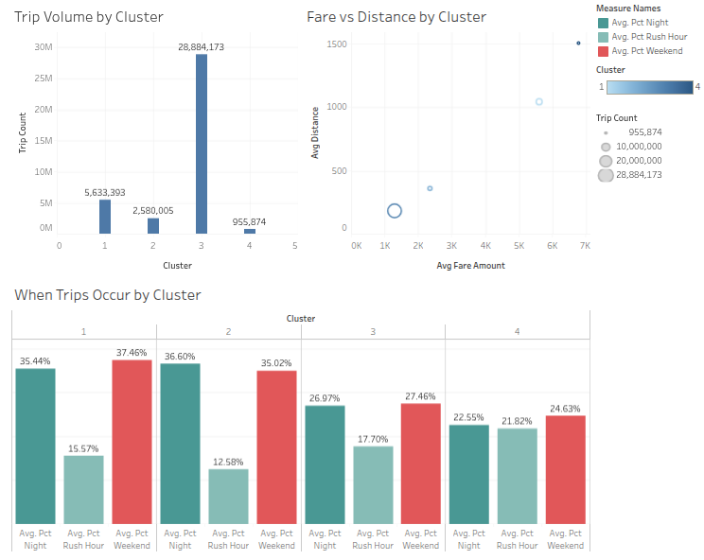
Big Query ML: What We Learned
Cluster 1: Nightlife & Weekend Zones
High night and weekend activity
Moderate trip volume
Cluster 2: Strongest Nighttime Demand
Highest share of night trips
Lowest rush-hour activity
Cluster 3: High-Demand Core Zones
Highest overall trip volume
Higher fares and longer trips
Cluster 4: Commuter-Oriented Zones
Highest rush-hour activity
Longer-distance, lower-volume trip
Weather had minimal impact on cluster formation.
Adverse weather exposure was similar across all four clusters (roughly 5-6%).
Business Value of Clustering
Target operations by zone type: Different clusters can support tailored strategies for driver allocation, pricing, and service planning based on demand patterns.
Improve forecasting and resource planning: Understanding which zones are commuter-focused, nightlife-focused, or high-demand helps predict future demand and allocate resources more effectively.
Notes:
This dashboard helps us understand what each cluster actually represents from a business perspective.
Starting with Cluster 1, these zones show high levels of both nighttime and weekend activity. This suggests these areas are more associated with leisure, entertainment, and social travel.
Cluster 2 looks similar, but has the highest share of nighttime trips and the lowest amount of rush-hour activity. This indicates demand that is less tied to traditional commuting patterns.
Cluster 3 stands out as the major demand center. It contains by far the highest trip volume in our dataset and also shows higher average fares and trip distances. These are likely the busiest zones where the majority of taxi activity takes place.
Cluster 4 appears to be more commuter-focused. It has the highest percentage of rush-hour trips and longer average trip distances, suggesting travel patterns related to workday commuting.
While it's not shown here, we found that adverse weather exposure was very similar across all four clusters. While we expected weather to be a stronger differentiator, the results showed that factors such as trip volume, trip timing, fare amount, and trip distance were much more influential in defining the clusters.
From a business perspective, this is valuable because it allows organizations to stop treating all taxi zones the same. Instead, they can tailor strategies based on the characteristics of each cluster. For example, high-demand zones may benefit from increased driver availability, while commuter-focused zones may require additional coverage during peak rush-hour periods.

Slide 18
Summary Of Our Findings
Taxi zones naturally grouped into four distinct patterns nightlife/weekend areas, commuter-focused zones, high-demand core zones, and mixed-demand areas.
Demand patterns were a stronger differentiator than weather
adverse weather exposure had little impact on cluster formation.
Clustering can support smarter operations
zone-specific insights can help guide driver allocation, service planning, and demand forecasting.
Notes:
WHOS DOING THIS?

Slide 19
5
Future State and Recommendations
Notes:
ADD NOTES HERE

Slide 20
Future State Proposal
Real-Time Ingestion
What We Would Do
Stream trip and weather data continuously
Business Benefit
Near real-time visibility into demand during storms
ML Forecasting
What We Would Do
Predict demand changes before weather events occur
Business Benefit
Improve driver positioning and reduce idle time
Multi-City Expansion
What:
Extend the solution to additional cities
Business Benefit:
Enable broader demand and weather insights across markets
Highest Impact: Real-Time Ingestion. Fleet operators need minute-level demand signals during active storms.
Notes:
We identified three potential next steps to build on this solution.
First, real-time ingestion would allow trip and weather data to flow continuously, giving operators a more up-to-date view of demand during storms.
Second, machine learning forecasting could help predict demand changes before weather events occur, enabling more proactive planning.
Third, the solution is scalable and could be expanded to other cities with similar taxi and weather data.
Our top recommendation is real-time ingestion because it offers the greatest business value with the lowest implementation effort.

Slide 21
PLACEHOLDER Recommendation
[One clear recommendation tied to the finding]
e.g., Pre-position 15% more vehicles in outer boroughs during forecasted rain events
Actionable Next Step
[What the client should do first]
Implementation Cost
[What it would take: time, team, tools]

Slide 22
Thank You
Questions?
Notes:
To summarize: adverse weather measurably changes taxi demand, and that impact varies by borough and has shifted year over year. Our pipeline is reproducible, tested, and ready for production use. We are happy to take your questions.

Slide 23
AI Use Disclosure
Where We Used AI What For What We Verified
[Tool] [Purpose] [Verification]
[Tool] [Purpose] [Verification]
[Tool] [Purpose] [Verification]
What We Rejected or Corrected From AI Suggestions
[Describe corrections made, things that required manual verification, etc.]

