Slide 1
NYC Taxi Data Platform
How does adverse weather affect taxi demand across New York City, and how have those patterns changed over time?
Team AMO: Ariana Lopez, Maryam Choudhury, Orlando Marin
Notes:
ORLANDO: Good morning everyone, and thank you for being here. I'm Orlando, joined by Ariana and Maryam, and we're going to answer the question: how does adverse weather affect taxi demand across New York City, and have those patterns changed over time?

Slide 2
Topics of Discussion
1
The Business Question and Key Finding
2
Data and Architecture
3
Our Findings
4
Future State
Notes:
ORLANDO: I'll open with a breakdown of our business question and our key findings. Ariana and Maryam will walk through the data and pipeline architecture, as well as additional paths that we explored. We'll share the YoY analysis that supports our findings, and then we'll close by sharing a few things we'd implement with more time. We look forward to answering your questions afterward.

Slide 3
1
The Business Question and Key Finding
Notes:
ORLANDO: Let's start with what we set out to answer, and our key findings.

Slide 4
The Business Question
How Does Adverse Weather Influence Taxi Demand, and Have Those Patterns Changed Over Time?
Comparison of January-May 2025 and January-May 2026
Why This Matters
🚕 Operations
Anticipate demand changes during poor weather
💰 Business Decisions
Understand where weather has the greatest impact
🏙️ City Planning
Support transportation planning across boroughs
Scope
🚕 Yellow + Green taxi, Jan-May 2025 vs Jan-May 2026
📊 39.2 million trip records
🌦️ 7,248 hours of NYC weather conditions
🗺️ 265 taxi zones mapped to 5 boroughs
🌧️ Adverse weather = rain and snow
How We Measured Impact
We combined hourly weather conditions with taxi activity and compared the same months across both years to ensure a fair comparison.
Notes:
ORLANDO: The business question that we set out to answer is "how does adverse weather (which includes rain and snow) impact taxi demand, and has that relationship changed year over year?" We scoped this to January through May in both 2025 and 2026 to ensure a fair YoY comparison. We combined over 39 million trip records with about 7,250 hours of weather data, so every trip is paired with the exact weather conditions at the time of pickup. This matters for operations, business decisions, and city planning.

Slide 5
Headline Finding
Weather doesn't change what a ride costs. It changes how many rides happen, and that impact is concentrated in the hours and boroughs that matter most.
38M+
Trip Records Analyzed
10 months
Jan-May 2025 vs 2026
5 boroughs
Weather Impact Compared
Business Insight
During rain, prioritize Brooklyn where demand and earnings both surge. During snow, per-minute earnings rise 8-29% across all boroughs. During clear weather, choose Manhattan for volume or Queens for per-trip returns
Notes:
ORLANDO: The headline from our analysis that adverse weather doesn't change what a ride costs. Fares stay essentially flat across all boroughs regardless of conditions. What changes is how many rides happen, and that impact is not spread evenly. It concentrates in specific boroughs and specific hours. We analyzed over 38 million trips across 10 months and all five boroughs. The key insight is that each weather condition creates a different positioning opportunity. During rain, Brooklyn demand surges 27 percent and per-minute earnings rise 11 percent. During snow, per-minute earnings rise in every borough, from 8 percent in Manhattan to 29 percent in the Bronx. And during clear weather, drivers choose between Manhattan's taxi trip volume or Queens' 14 percent per-minute premium on longer trips.

Slide 6
2
Data and Architecture
Notes:
ORLANDO: With that context in mind, I'll pass it to Maryam and Ariana, and they'll walk through the data and our pipeline architecture.

Slide 7
The Data
What We Were Given
• 20 Parquet files in S3
• Yellow: 38.8M rows
• Green: 465K rows
• Jan-May 2025 & 2026
• 265 taxi zones
What We Added
Open-Meteo Historical Weather API
7,248 hourly records
Temperature
Snow
Rain
Preciptation
Weather description
Wind
Schema Challenges
Different timestamp fields
Green-only fields
Case-sensitive inferred columns
39,224,735
Total Trip Records
7,248
Weather Hours
265
Taxi Zones
Notes:
MARYAM: Before we get into the platform we built, we'll briefly go through and explain the data.
Our primary dataset consists of New York City taxi trips, where each record represents a single ride from pickup to dropoff.
We worked with both Yellow and Green Taxi data.
For context, yellow taxis operate throughout the city and make up the vast majority of the dataset, while Green taxis primarily serve areas outside of Manhattan's central business districts.
In total, the raw data included approximately 38.8 million Yellow Taxi trips and 465,000 Green Taxi trips spanning January through May of 2025 and 2026 and we also mapped 265 taxi zones across the city.
In addition, as an external data source, we incorporated hourly weather data. This allowed us to connect weather patterns directly to taxi activity.
There were some schema challenges with the data, but we'll explore that later on in the presentation.
After combining everything, our final dataset included more than 39 million taxi trips, 7,200+ hourly weather records, and all 265 taxi zones, giving us a strong foundation for analysis.

Slide 8
Data Quality Findings
Data Quality Findings
Null/zero passenger count: 9.2M (23%) → Retained (warning)
Payment type 0 (undocumented): 9M (23%) → Retained (warning)
Invalid timestamps: 702K (1.8%) → Flagged invalid
Negative fares: 247K (0.6%) → Flagged invalid
Distance > 100 miles: 131K (0.3%) → Flagged invalid
Dropoff before pickup: 87K (0.2%) → Flagged invalid
Pipeline Reconciliation
The Cash Tip Trap
Cash tips are not captured in the dataset because tip amounts are only recorded for credit card transactions.
To ensure accurate reporting, cash tips were excluded from all total revenue calculations.
Stage | Rows
Source Files | 39,224,735
Bronze | 39,224,735
Silver | 39,224,735
Gold (Valid Only) | 38,053,445
Our Approach: Flag, Don't Delete
Instead of immediately removing questionable records, we added two fields:
is_valid: indicates whether a trip passed validation
dq_flag_reason: records why a trip failed
Silver retains all records for transparency and future analysis, while Gold contains only validated records used for reporting.
This preserves traceability and allows future analysis of data quality trends.
Notes:
MARYAM: Before we could trust any insights, we needed to trust the data itself.
Although all 39.2 million records loaded successfully, we found several quality issues that affected about 3% of trips.
Rather than deleting those records, we adopted a "flag, don't delete" approach.
We flagged each record with data quality indicators and preserved the original data.
This gave us reliable reporting based on validated trips without losing the underlying records.
We also identified that the dataset only records tips paid by credit card, and cash tips appear as zero.
To avoid misleading results, we excluded cash tips from all tip and total revenue calculations.
After our findings, we were left with 38 million records to do analysis on.
And to describe how we did this, I'm going to pass it on to Ariana to go over our architecture.

Slide 9
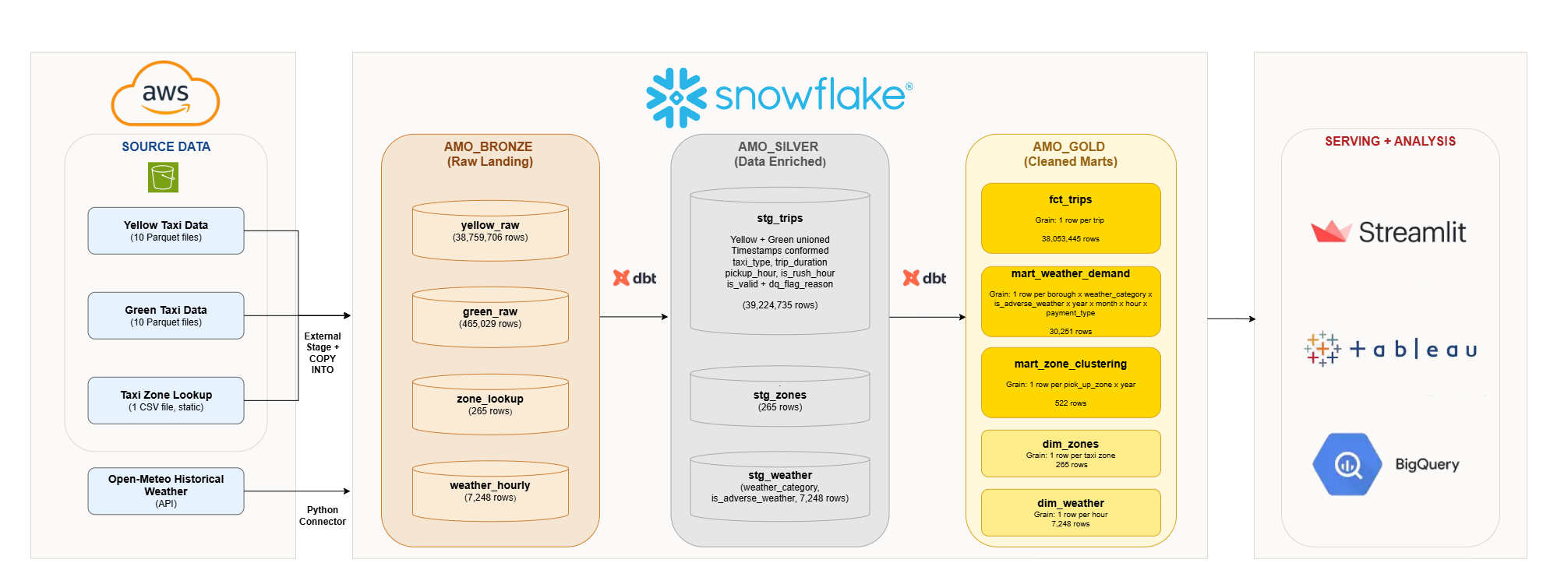
Pipeline Architecture
Current Performance: Full pipeline rebuild in ~6 minutes, with dashboard queries returning results in under 1 second.
Scalability: Architecture can support 10x growth through Snowpipe ingestion, incremental dbt models, and Snowflake warehouse scaling without a redesign.
Notes:
This diagram shows how data moves through our platform, moving from left to right, with raw taxi and weather sources on the left and our end user platforms on the right.
Starting on the left with our source datasets. This data includes Yellow Taxi trips, Green Taxi trips, taxi zone information, and historical weather data. These datasets are loaded into Snowflake, which serves as the central platform for storage and transformation.
We organize the data using a Medallion Architecture with Bronze, Silver, and Gold layers.
The Bronze layer stores the raw source data exactly as received, providing a complete audit trail and preserving the original records.
The Silver layer is where data is standardized, combined, and enriched. Here we merge the taxi datasets, add weather and time-based attributes, and perform data quality checks. Instead of immediately deleting invalid records, we flag them so data quality can be monitored and investigated over time.
The Gold layer contains trusted, business-ready datasets. Only validated records are present here, ensuring that reporting and analysis are based on reliable information.
All transformations between the Bronze, Silver, and Gold layers are managed through dbt, which applies business rules consistently and makes the pipeline repeatable and maintainable.
Finally, tools such as Tableau, Streamlit, and BigQuery connect to the Gold layer, allowing users to explore trends, answer business questions, and make data-driven decisions.
This architecture is also designed to scale as data volumes grow. Instead of loading data in large scheduled batches, further fimplementation of Snowpipe would automatically load new data as it arrives, reducing delays and keeping information more up to date.
Combined with incremental dbt processing and Snowflake's ability to add computing power on demand, the platform can support significantly larger volumes of data without requiring a full redesign further in the future.

Slide 10
Architecture Decision: Snowflake + DBT
Why We Chose This Approach
Our team has the strongest experience with SQL, allowing us to move quickly and confidently.
The architecture had the fewest moving parts, making it the best fit for a one-week sprint
All transformation logic was tested, version-controlled, and maintainable through dbt
Snowflake efficiently processed our 39 million records without acquiring additional distributed computing tools
End-to-end pipeline execution completed in approximately 6 minutes, enabling rapid development and testing
Key Design Decisions
Materialized staging tables instead of views to avoid repeatedly processing 39 million records during dashboard queries
Data quality filtering implemented through an is_valid = True flag, ensuring only trusted records reached the Gold layer
Weather data joined at the hour level, matching taxi trip timestamp granularity and achieving a 100% join match rate
Centralized orchestration approach, where a single command executes the entire pipeline, supports repeatability, fast failure detection, and simplified operations
Speed, Trust, Simplicity
Notes:
We designed our solution around three priorities: speed, trust, and simplicity.
Using Snowflake and dbt, we built a scalable pipeline capable of processing nearly 39 million taxi trips.
We improved performance by storing transformed data in tables, and built-in quality checks flag invalid records and keep them out of reporting.
We also integrated hourly weather data to support our analysis and automated the entire workflow through a single process.
Our result here is a reliable, scalable platform that delivers fast and trusted insights.

Slide 11
Additional Paths We Explored
NYC Permit Data
Explored as enrichment
Could road work affect taxi demand?
Taxi data only identified pickup/drop-off zones
We could not reliably determine which construction sites a trip encountering
Decided to exclude this data to avoid making any unsupported assumptions
Data Pipeline
Partially Built
Used AWS Glue + PySpark for transformation
Valuable hands-on experience with AWS
Steeper learning curve and required more development effort
Less practical within our project timeline
What the Exploration Taught Us
Not every enrichment source can be relatively connected to our data
Exploring a different pipeline implementation gave us valuable AWS and PySpark experience
Comparing both approaches helped us make an informed architecture experience
Notes:
One thing we wanted to highlight is that this project was not a straight line from start to finish.
Like most real-world projects, some of our biggest lessons came from approaches that didn't make it into the final solution.
First, we explored adding New York City permit data. While the idea was interesting, our taxi data only showed pickup and dropoff locations, not the actual route taken by each taxi.
Because of that, we couldn't reliably determine whether a trip was impacted by construction, so we decided not to incorporate permit data.
We also experimented with AWS Glue and PySpark as part of our pipeline. While the solution worked, AWS Glue made debugging very difficult, as identifying errors required digging through CloudWatch logs and troubleshooting multiple services.
Because of the additional complexity and time required, we chose a simpler architecture that let us focus on data analysis and business insights.
In the end, these experiences helped us make better decisions. They reinforced the importance of working within the limits of the data and choosing tools that work well for our end goal.

Slide 12
3
Our Findings
Notes:
Now, moving onto our findings.

Slide 13
Discovering Similar Taxi Zone Patterns with BigQuery ML
What We Looked For
Are there pickup zones that behave similarly?
Do factors like trip volume, distance, fare amount, and weather help separate these zones?
Can we group zones in a way that makes the patterns easier to explore?
What We Did
Used BigQuery ML clustering on the mart_zone_clustering table.
Clustered data at the pickup zone and year level.
Tested different numbers of clusters to find useful groupings.
Assigned each pickup zone-year record to the cluster it most closely matched.
How We Used the Results
Brought the cluster results into Tableau.
Compared clusters to understand what made each group different.
Used the clusters to support the business analysis and visual storytelling.
Taxi Trip Data → Zone-Year Summary → BigQuery ML Clustering → Tableau Analysis
Data used: mart_zone_clustering, with one row per pickup zone and year.
Notes:
Here, we wanted to take a step back and see if different taxi zones naturally shared similar characteristics.
Using BigQuery ML clustering, we grouped pickup zones with similar patterns based on factors such as trip volume, fare amounts, trip distances, trip timing, and weather exposure.
We then brought those results into Tableau to better understand what made each cluster unique and uncover patterns that would be difficult to see through traditional analysis alone.
The goal here wasn't to predict anything. It was to identify a small number of meaningful groups with similar behavior within the data.

Slide 14
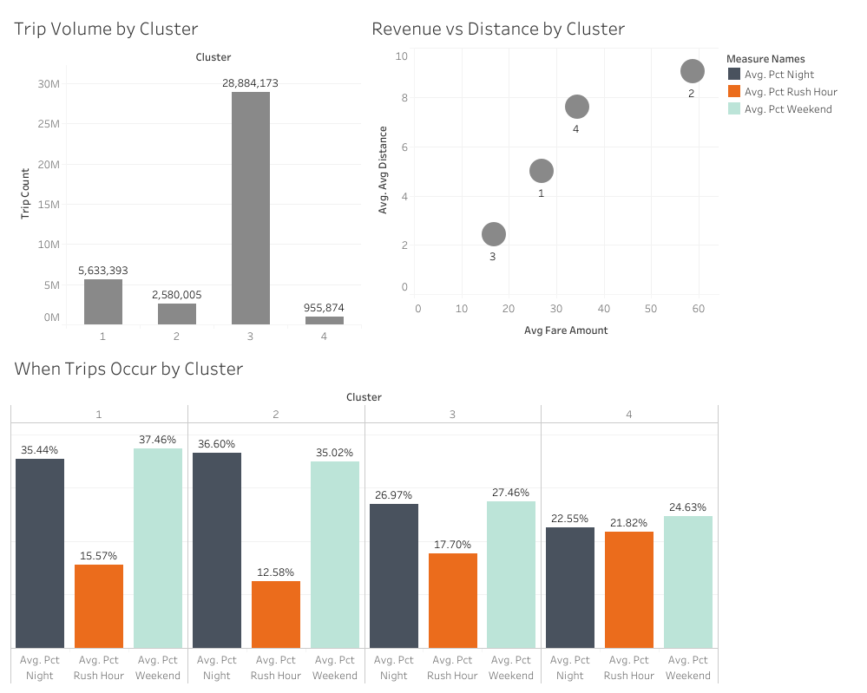
BigQuery ML: What We Learned
Clustering Results
Cluster 1: Nightlife & Weekend Zones
High night and weekend activity
Cluster 2: Strongest Nighttime Demand
Highest share of late-night trips with highest fares
Cluster 3: High-Demand Core Zones
Highest overall trip volume with lowest fares
Cluster 4: Commuter-Oriented Zones
Highest trip volume during rush hours
Business Value of Clustering
Target operations by zone type
Predict resource needs based on travel behavior
Weather had minimal impact on cluster formation, but it remained an important factor in day-to-day taxi demand and trip patterns.
Notes:
This dashboard helps us understand what each cluster represents from a business perspective.
Cluster 3 immediately stands out, accounting for nearly 29 million trips and serving as the primary demand center in our dataset. It also shows higher average fares and longer trip distances, highlighting its outsized impact on overall taxi demand and revenue.
Looking at trip timing, Clusters 1 and 2 show more nighttime and weekend activity, suggesting leisure-focused travel, while Cluster 4 has the strongest rush-hour patterns, indicating commuter behavior.
Together, these findings show that trip volume, fare levels, distance, and trip timing were the main drivers of cluster formation.
Weather did influence taxi demand and rider behavior at a more detailed level, which Maryam and Orlando will explore in the upcoming slides.

Slide 15
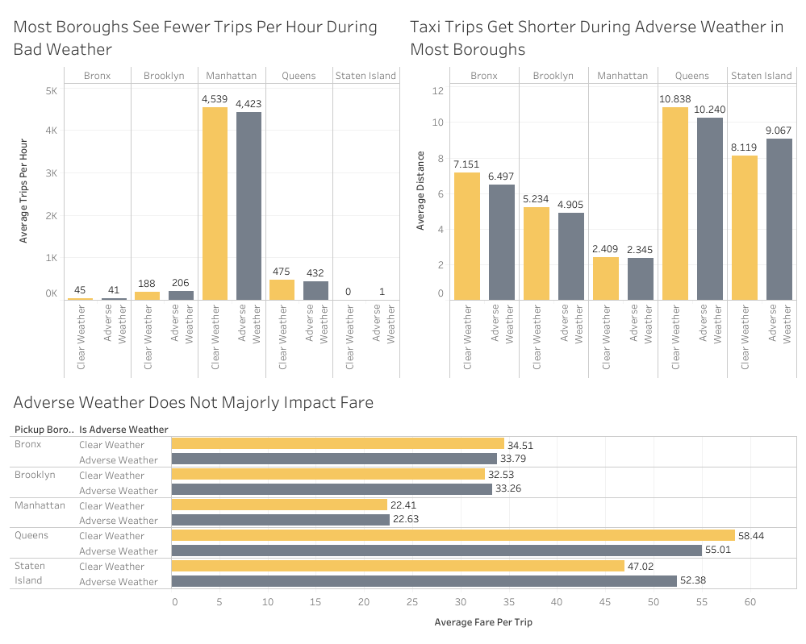
Adverse Weather's Impact on NYC Taxi Demand
Key Findings
Fewer Trips Per Hour
Most boroughs see reduced trip volume during adverse weather
Shorter Distances
Riders take shorter trips during bad weather, suggesting that quicker, nearby rides replace longer commutes
Fares Stay Flat
Average fares barely change across all boroughs
Takeaway
The business risk is fewer rides, not less expensive ones
Notes:
MARYAM: This Tableau dashboard gives us a high-level view of how adverse weather (rain and snow) affects taxi behavior across NYC's five boroughs.
[Top left chart – Trips per Hour] In the top left chart, we can see that most boroughs experience fewer trips per hour during adverse weather. Queens drops from 475 to 432 trips per hour, and The Bronx drops from 45 to 41. Manhattan, which dominates overall volume at over 4,500 trips per hour, still dips by about 100 trips per hour during bad weather.
[Top right chart – Distance] In the chart on the top right, we see that when people do take a taxi in bad weather, they're going shorter distances. This suggests that riders are using taxis for quicker, nearby trips rather than longer commutes.
[Bottom – Fare] The key insight from this dashboard is that despite fewer trips and shorter distances during adverse weather, the average fare per trip barely changes when compared to clear weather. For example, Manhattan averages $22.41 in clear weather versus $22.63 in adverse weather, which is nearly identical. This pattern holds across every borough.
So weather's impact is about volume, not price. To build on this, Orlando will walk through our Streamlit dashboard, which layers in the year-over-year comparison between 2025 and 2026, time of day, and specific weather types like rain versus snow to see what's driving these patterns.

Slide 16
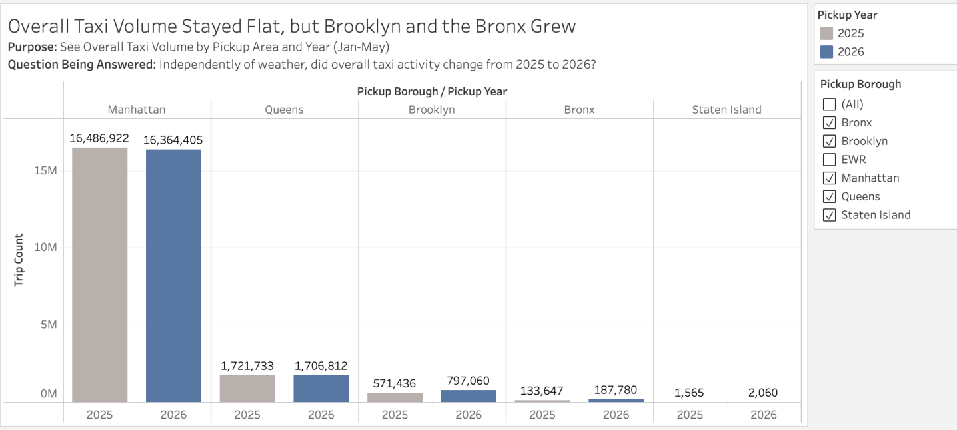
YoY Trip Analysis – Viz 1
Notes:
MARYAM: “Building on the clustering analysis, we saw that weather wasn’t a major factor in defining the broader types of taxi zones, but it still mattered for day-to-day demand patterns.
So for the Tableau portion, we looked more closely at how taxi activity differed across the five boroughs, and how those patterns changed with adverse weather from 2025 to 2026.”
1. Overall Taxi Volume
“First, we wanted to establish a baseline independent of weather.
Overall taxi volume was essentially flat year over year. From January through May, total trips increased only about 0.8%, from 18.92 million in 2025 to 19.06 million in 2026.
But underneath that stable total, the boroughs behaved differently. Brooklyn and the Bronx both grew by around 40%, while Manhattan remained by far the largest market but declined slightly.
So what we’re seeing here is that the overall market stayed stable, but where that activity was occurring was already changing.”

Slide 17
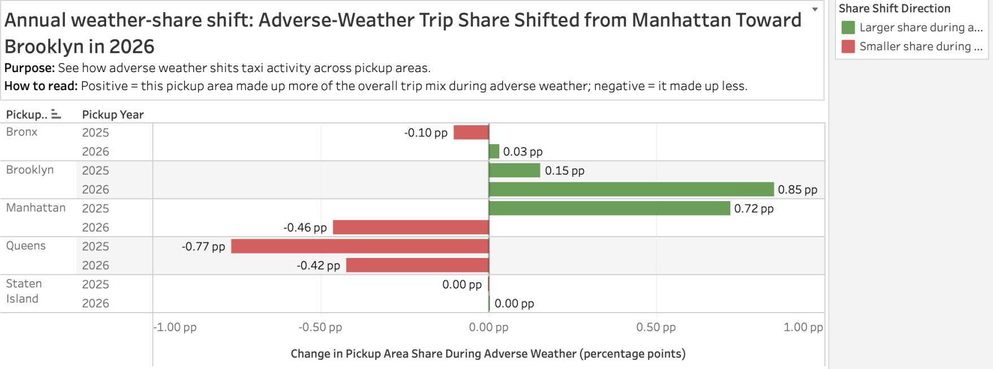
YoY Trip Analysis – Viz 2
Notes:
2. Annual Weather-Share Shift
“From there, we wanted to see whether adverse weather changed that geographic mix.
For this chart, zero means a borough’s share of the overall trip mix stayed about the same. A positive value means it made up more of the trip mix during adverse weather, and a negative value means it made up less.
The clearest year-over-year change is between Brooklyn and Manhattan.
Brooklyn’s adverse-weather share increased from about +0.2 in 2025 to +0.9 in 2026. Manhattan moved in the opposite direction, from about +0.7 to −0.5. Queens stayed negative in both years, although the decline became smaller.
So here we’re seeing that adverse-weather activity shifted relatively toward Brooklyn and away from Manhattan in 2026.
That tells us the geographic response to weather was not the same from one year to the next.”

Slide 18
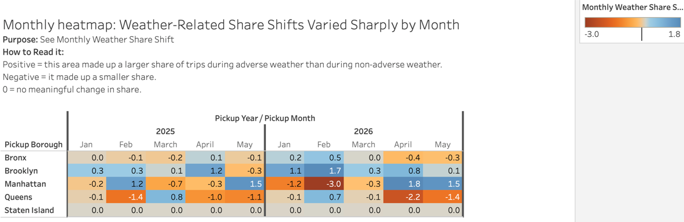
YoY Trip Analysis – Viz 3
Notes:
3. Monthly Heatmap
“The annual chart gives us the overall direction, but this heatmap shows that the pattern is much more dynamic month to month.
The interpretation is the same: positive means a borough represented a larger share of trips during adverse weather, negative means a smaller share, and values near zero mean there was very little shift.
A few broader patterns stand out.
Brooklyn is the most consistent in 2026 — it gains share during adverse weather in every month shown.
Manhattan is much more variable. It moves between gaining and losing share depending on the month, rather than showing one consistent response.
And Queens often moves in the opposite direction from Manhattan, which suggests adverse weather can redistribute activity between areas rather than affecting the whole city uniformly.
So what we’re seeing here is that weather’s effect depends not only on the borough, but also on when the weather occurs. The annual result is really the combination of several different monthly patterns.”
“Putting these three views together, the overall taxi market stayed fairly stable, but the geographic distribution underneath it changed — and adverse weather was associated with different borough-level patterns in 2025 and 2026. Namely, Brooklyn became noticeably more prominent during adverse weather in 2026, while Manhattan became much more variable.
So Tableau gives us the where of the story, which is that weather doesn’t affect every borough the same way, and those patterns can change over time.
From here, Orlando will take the analysis further into the why and when, including year-over-year demand, time of day, and specific weather types like rain versus snow.

Slide 19


Visualizations
How Does Adverse Weather Influence Taxi Demand, and Have Those Patterns Changed Over Time?
BigQuery ML Results
YoY Trip Analysis
Additional Analysis

Slide 20
Summary Of Our Findings
Stable Overall Market
Jan-May trips rose just 0.8% despite ~40% growth in Brooklyn and the Bronx.
Major Brooklyn/Manhattan Weather Shift
Brooklyn: +0.2 -> +0.8 pp; Manhattan: +0.7 -> -0.5 pp; Queens: -0.8 -> -0.4 pp
Strong Month-to-Month Variability
Brooklyn gained share in all five 2026 months, while Manhattan ranged from –3.0 to +1.8 pp.
Weather's demand impact flipped YoY
In 2025, adverse weather increased taxi demand, while in 2026, it decreased. The relationship between weather and demand is not static.
Snow drives the drop, while rain still boosts ridership
The YoY shift is explained by 2026's more severe snow season.
Revenue losses concentrate during rush hour
The business impact of adverse weather is not evenly distrubuted. It's heavily weighted toward high-demand windows
Taxi zones naturally grouped into four distinct patterns nightlife/weekend areas, commuter-focused zones, high-demand core zones, and mixed-demand areas.
Demand patterns were a stronger differentiator than weather
adverse weather exposure had little impact on cluster formation.
Clustering can support smarter operations
zone-specific insights can help guide driver allocation, service planning, and demand forecasting.
Notes:
This slide brings our main findings together into one story: the overall taxi market stayed fairly stable year-to-year, but the activity underneath the surface shifted in meaningful ways.
Growth was concentrated in Brooklyn and the Bronx, while Manhattan's share became more volatile, showing that demand is no longer moving uniformly across neighborhoods.
We also found that weather influenced rider behavior differently from one year to the next, reinforcing that past patterns are not always reliable predictors of future demand.
The largest impacts were tied to severe winter weather, and those effects were felt most during rush hour, when a large share of daily trips and revenue are typically generated.
When we looked beyond individual trips and weather events, a clearer pattern emerged in how different areas of the city generate demand. Taxi zones naturally fell into four distinct demand profiles, suggesting that where demand occurs matters more than short-term weather conditions.
Overall, while the taxi market remained stable at a citywide level, demand shifted across boroughs, weather impacts changed over time, and distinct travel patterns emerged that can help guide future operational and planning decisions.

Slide 21
Summary and Recommendation (NEW VERSION)
When It Rains, Get to Brooklyn
The Data
Brooklyn demand surges +27% during rain (188 → 238 trips/hr)
Per-minute earnings rise +11% ($1.14 → $1.26/min)
Why It Matters
Brooklyn is the only borough where both volume and earnings efficiency increase during rain
When It Snows, Stay on the Road
The Data
Earnings per active minute rise in every borough during snow (+8% to +29%)
Manhattan: $1.52/min clear → $1.64/min snow (+8%)
Why It Matters
Drivers who remain available during snow face less competition and earn more per minute of driving time
Clear Weather: Manhattan or Queens
Manhattan: Volume
4,539 trips/hr, $1.52/min earnings
Minimal idle time between fares
Queens: Efficiency
$58 avg fare, $1.73/min earnings (+14% over Manhattan)
Longer trips with higher per-minute return
Why It Matters
94.5% of hours are clear. Manhattan guarantees volume; Queens rewards drivers who stay busy with airport and cross-borough runs.
Each weather condition calls for a different positioning strategy. Rain is an opportunity, snow rewards persistence, and clear weather is about volume consistency
Notes:
ORLANDO: So what should taxi drivers do with this information? Our data supports three recommendations. First, when it rains, focus on Brooklyn. Brooklyn is the only borough where both demand and earnings per minute increase during rain. Demand increases by 27 percent, and per-minute earnings rise 11 percent. No other borough shows that combination. Second, when it snows, stay on the road. This might sound counterintuitive because total trip volume drops during snow. But the drivers who remain available earn more per active minute of driving, in every single borough, ranging from 8 percent more in Manhattan to 29 percent more in the Bronx. In Manhattan, that's $1.52 per minute during clear weather rising to $1.64 during snow.
Third, during clear weather, which accounts for 94.5 percent of all operating hours, drivers have two strong options. Manhattan offers the highest taxi trip demand at over 4,500 trips per hour, meaning minimal idle time between fares, at $1.52 per active minute. Queens offers a 14 percent earnings premium at $1.73 per active minute, driven by longer trips averaging $58 per fare. For drivers who can stay busy in Queens, particularly with airport runs, the per-minute return is higher. The bottom line is that each weather condition calls for a different strategy. Rain is an opportunity, snow rewards those who stay, and clear weather is about choosing between volume consistency in Manhattan or higher per-trip efficiency in Queens.

Slide 22
4
Future State
Notes:
Now, our future state proposal

Slide 23
Future State Proposal
Real-Time Ingestion
What We Would Do
Stream trip and weather data continuously
Business Benefit
Near real-time visibility into demand during storms
ML Forecasting
What We Would Do
Predict demand changes before weather events occur
Business Benefit
Improve driver positioning and reduce idle time
Multi-City Expansion
What We Would Do
Extend the solution to additional cities
Business Benefit
Enable broader demand and weather insights across markets
Highest Impact: Real-Time Ingestion. Fleet operators need minute-level demand signals during active storms.
Notes:
We identified three potential next steps to build on this solution.
First, real-time ingestion would allow trip and weather data to flow continuously, giving operators a more up-to-date view of demand during storms.
Second, machine learning forecasting could help predict demand changes before weather events occur, enabling more proactive planning.
Third, as our current solution is scalable, it could be expanded to other cities with similar taxi and weather data.
Our top recommendation is real-time ingestion because it offers the greatest business value with the lowest implementation effort.

Slide 24
Future State Proposal (NEW VERSION)
Real-Time Ingestion
What We Would Do
Stream trip and weather data continuously
Business Benefit
Near real-time visibility into demand during storms
ML Forecasting
What We Would Do
Predict demand changes before weather events occur
Business Benefit
Improve driver positioning and reduce idle time
Expanded Analysis
What We Would Do
Extend to full-year data for seasonal patterns
Incorporate Uber/Lyft to compare surge pricing during adverse weather
Business Benefit
Understand how demand shifts across all seasons and how rideshare surge pricing competes with taxis
Highest Impact: Real-Time Ingestion. Fleet operators need minute-level demand signals during active storms.
Notes:
We identified three potential next steps to build on this solution.
First, real-time ingestion would allow trip and weather data to flow continuously, giving operators a more up-to-date view of demand during storms.
Second, machine learning forecasting could help predict demand changes before weather events occur, enabling more proactive planning.
Third, we would expand the analysis itself. Our current dataset covers January – May. A full year of data would show how these patterns hold across all seasons. We'd also incorporate rideshare data from Uber and Lyft. This would help us answer questions that we can't answer with taxi and weather data alone such as: are taxis gaining or losing market share during storms when rideshare apps show surge pricing?
Our top recommendation is real-time ingestion because it offers the greatest business value with the lowest implementation effort.

Slide 25
Thank You
Questions?
Notes:
Thank you for your time and attention today.
We appreciate the opportunity to share our findings and would be happy to answer any questions.

Slide 26
AI Use Disclosure
Where We Used AI What For What We Verified
[Tool] [Purpose] [Verification]
[Tool] [Purpose] [Verification]
[Tool] [Purpose] [Verification]
What We Rejected or Corrected From AI Suggestions
[Describe corrections made, things that required manual verification, etc.]

Slide 27
AI Use Disclosure (NEW VERSION)
Where We Used AI
Pipeline development and SQL transformations
Streamlit visualizations and chart logic
Data analysis and revenue calculations
Presentation content and speaker notes
How We Verified
Ran full pipeline end-to-end and reconciled row counts against source
Cross-checked all calculations against raw data and Tableau results
Reviewed and revised all generated content before committing
Every number on every slide traces back to a verifiable query
What We Corrected
Fare calculations initially included tips, inflating averages. Caught and corrected.
Hourly earnings used an unverifiable utilization assumption. Replaced with $/active-minute.
Initial summary slide was descriptive. Reworked to be prescriptive with data-backed actions.
AI accelerated development. Human judgement drove each analytical decision and verified all output.

