Slide 1
Road Accident Data Analysis
Date:
26rd April 2025

Slide 2

CoreTech Labs
Is a tech company specialising in software development, AI, and data analytics. They deliver smart, scalable solutions to help businesses improve operations, make data-driven decisions, and stay ahead in a digital world. Services include custom app development, intelligent automation, and business intelligence tools.

Slide 3

Problem Statement
Road accidents are a critical public safety concern influenced by multiple factors (e.g., weather, speed, road type).
Raw accident data is often unstructured, hindering actionable insights.
Stakeholders struggle to make informed decisions without clear visualization or analysis.
Need for data-driven road safety interventions.

Slide 4

Project Objectives
Clean and standardise dataset to ensuring accuracy and consistency for analysis.
Identifies trends in accident frequency and severity
Uncovers high-risk factors impacting causality, and
Performing descriptive statistical and correlation analysis.
The goal is to develop interactive dashboards for effective data visualization and provide actionable, data-driven recommendations to enhance road safety and inform policy decisions.

Slide 5
Project Flow
Problem Definition
Data Preparation
Statistical Analysis
Exploratory Analysis
Risk Identification
Dashboard Development
Recommendations
&
Reporting

Slide 6

Techniques and Tools Used
Techniques
Descriptive Statistics
Correlation Analysis
Exploratory Data Analysis
Tools
Data analytic tools (Descriptive and Correlation)
Frequency table (for categorical data)
Aggregate functions
Calculate Item (for formatting categorical data

Slide 7
Dataset Overview
The dataset includes detailed records of road traffic accidents with 23 columns, covering key attributes such as accident date and time, severity levels, road and lighting conditions, and urban vs. rural location. It also captures weather conditions at the time of each incident and the types of vehicles involved.
Year Covered – 2021 & 2022
Total Accident – 307,972
Total Casualties – 417,883

Slide 8
DATA CLEANING AND FORMATTING
DATA CLEANING | FORMATTING CATEGORICAL VARIABLES
No duplicate value found No missing data | Time of the day Speed limit Road surface condition Vehicle Types

Slide 9
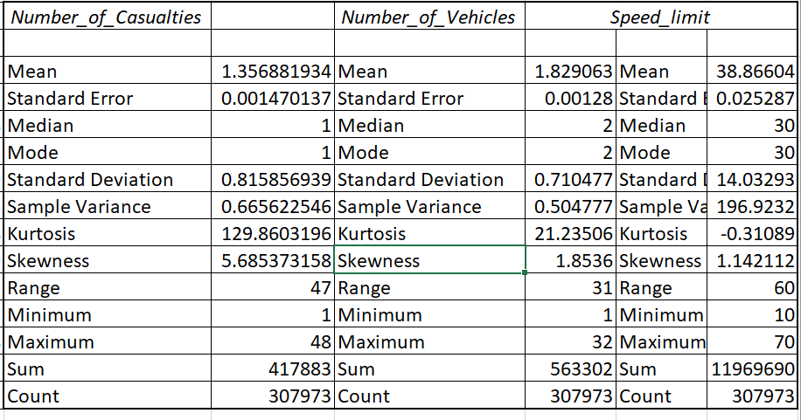


Descriptive Statistics
Measuring Central Tendencies | Detecting Outlier
Number of Casualties | No outlier
Number of Vehicles | No outlier
Speed limit | There is an outlier

Slide 10
Correlation Analysis
 | Number_of_Casualties | Number_of_Vehicles
Number_of_Casualties | 1
Number_of_Vehicles | 0.234499407 | 1
There is a low positive correlation between the number of casualties and the number of vehicles on the road, and the speed limit.
 | Num of Casulties | Speed_limit
Number of Casualties | 1
Speed_limit | 0.137291921 | 1

Slide 11

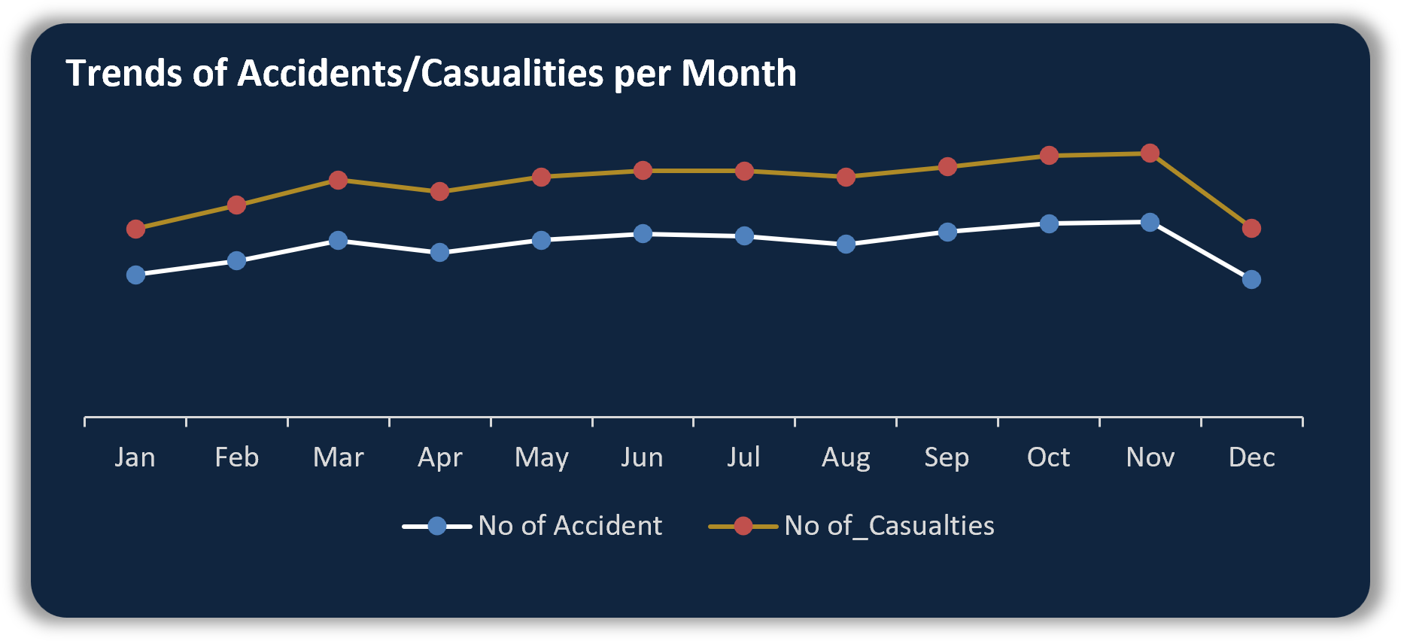
Trends of Monthly Accidents/Casualties
Finding:
2021
Higher accident/casualties recorded between Oct & Nov, steadily came down between Dec. The least accident/ casualties was recorded in Feb
2022
Higher accident/casualties recorded between Oct & Nov, steadily came down between Dec. The least accident/ casualties was recorded in Jan

Slide 12
Accident’s Severities and it Impact on Casualties
Finding:
Fatal Accident/Casualitie
1% of total accidents were fatal with 2% casualties recorded
85% of accidents were slight with 84% casualties.
Although the % of slight severity is high, it is still better than fatality rate.
1%
2%
Accidents
3953
Casualitie
7135
Serious Accident/Casualitie
13%
14%
Accidents
40740
Casualitie
59312
Slight Accident/Casualitie
86%
84%
Accidents
263280
Casualitie
351436

Slide 13
Rural vs Urban Area Why is there a high fatality rate in rural areas?
Lack /inadequate emergency service
Proximity of the emergency unit
Absence of automated speed limit monitor
Fatality Rate:
Urban – Fatality is 1%
Rural – Fatality is 3%

Slide 14
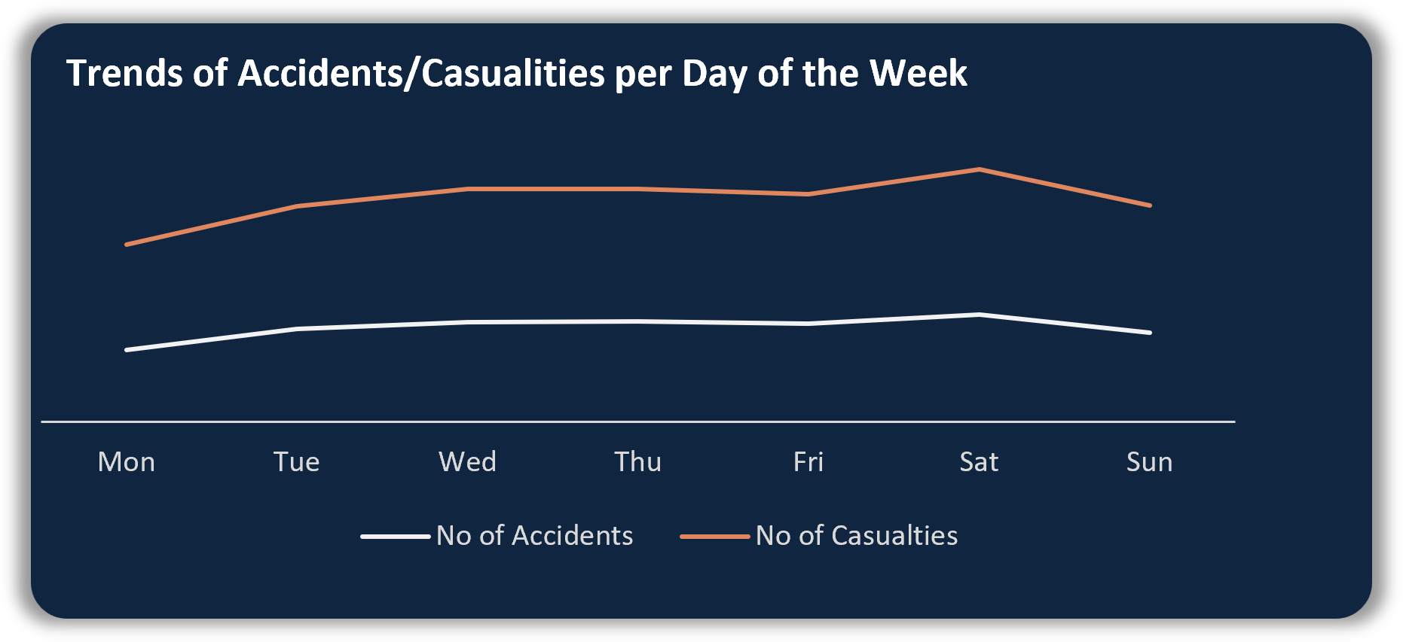
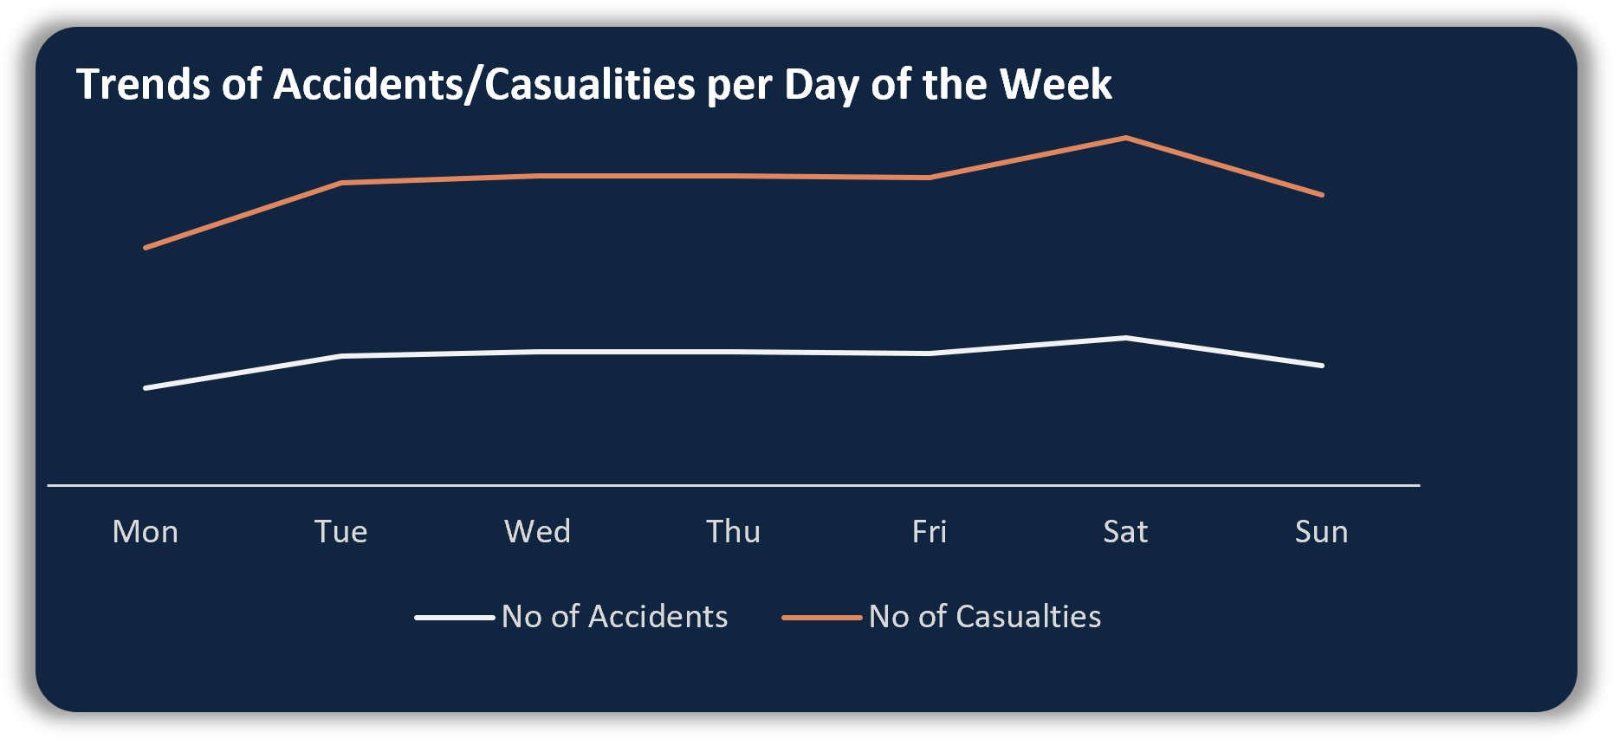
Trends of Accident/Casualties by Days of the Week
Finding:
2021
Most accident/casualties occurred over the weekend (Fri-Sun)
2022
Most accident/casualties occurred on Tuesday and over the weekend (Fri-Sun)

Slide 15
High Risk Factors
Impact of Speed Limit of Casualties on Severity
Speed Limit | Fatal | Serious | Slight
Low Speed Limit | 1% | 12% | 87%
Mid Speed Limit | 1% | 12% | 87%
Normal Speed Limit | 3% | 16% | 81%
High Speed Limit | 4% | 4% | 77%

Slide 16
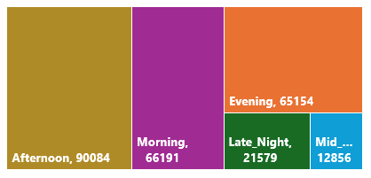
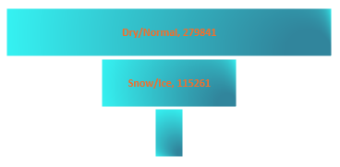
High Risk Factors
Impact of Time of the Day, Road Surface Condition, and Road Type on Severity
Casualties by Time of the Day
Casualities by Road Types
Casualties by Road Surface Condition

Slide 17






High Risk Factors
Impact of Weather Condition, Junction Details and Vehicle Type on Severity
Casualties by Wealther Condition
No of Casultiesby Vehicle Types
1,032
3,332
Casualities by Junction
33,472
33,764
333,485
12,798

Slide 18
High Risk Factors
Impact of Time of the Day, Weather Condition and Road Type Severity
Casualties by Wealther Condition
No of Casualties by Vehicle Types
1,032
3,332
Casualities by Junction
33,472
33,764
333,485
12,798

Slide 19

Recommendations
Establish
Establish variable speed limits that adjust based on real-time conditions (e.g., weather, traffic density).
Launch
Launch campaigns targeting peak accident times to educate drivers on safe practices during rush hours.
Provide
Provide training programs for drivers on handling adverse weather conditions, focusing on rural and urban differences.
Increase
Increase police patrols and use automated speed cameras in areas with high casualty rates
Develop
Develop policies incentivizing the adoption of safety technologies in vehicles like collision avoidance systems.

Slide 20

Questions & Answer
Thank You

