Slide 1
Attendance Tracker Semester Final
Group 2

Slide 2
Problem
Hands-off attendance sign-in kiosk
Streamline recording of attendance and attendance tracking in the classroom

Slide 3
Goal
Android application for confirming student daily attendance via identifying QR code
Support for multiple users with user authentication
Database storage of student attendance information
QR code generation and distribution via email

Slide 4
Client Requirements and Design Constraints
Android application
Java code
User authentication
CSV formatted information (easy import to Microsoft Excel)

Slide 5
Requirement Glossary
QR code — Quick Response Code, a graphical encoding which can be scanned with a camera
Oauth — Open Authorization, an open standard for user authorization which allows sites to verify users without storing username and password on the client
CSV file — Comma Separated Values file, a plain text file in which values are separated by commas and entries are separated by line breaks

Slide 6








Software Tools

Slide 7
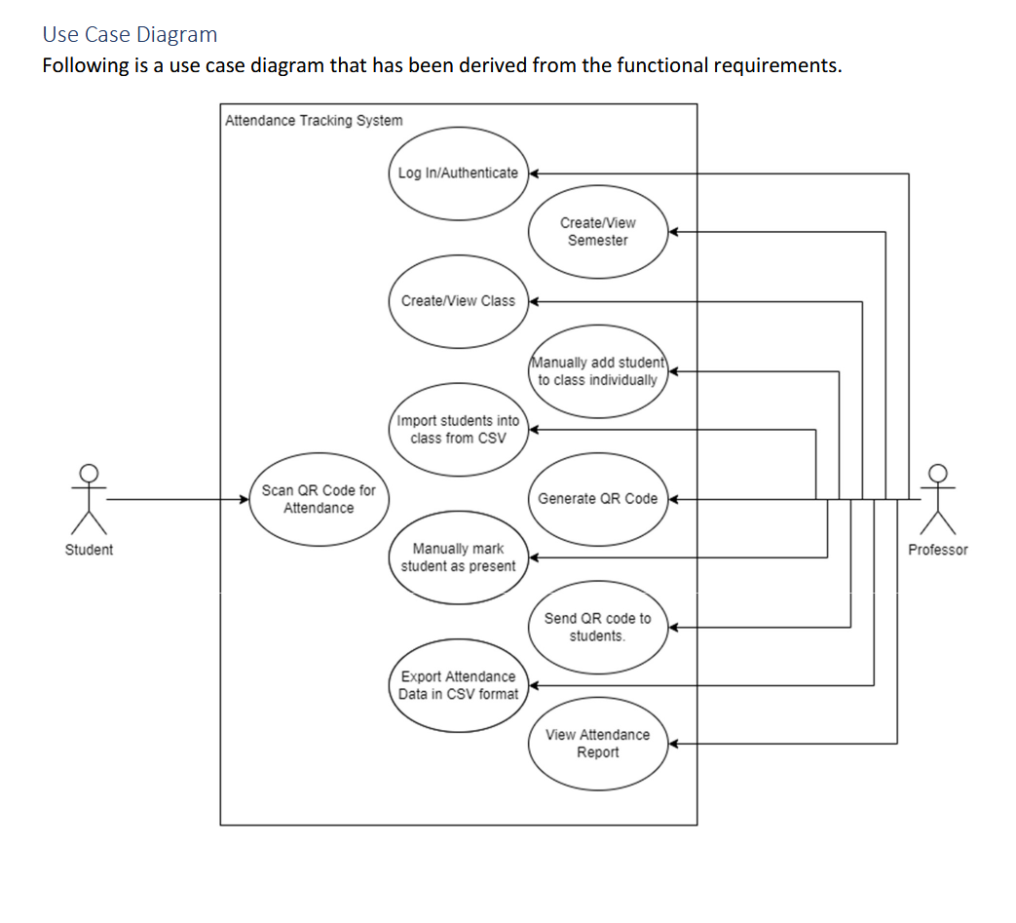

Slide 8
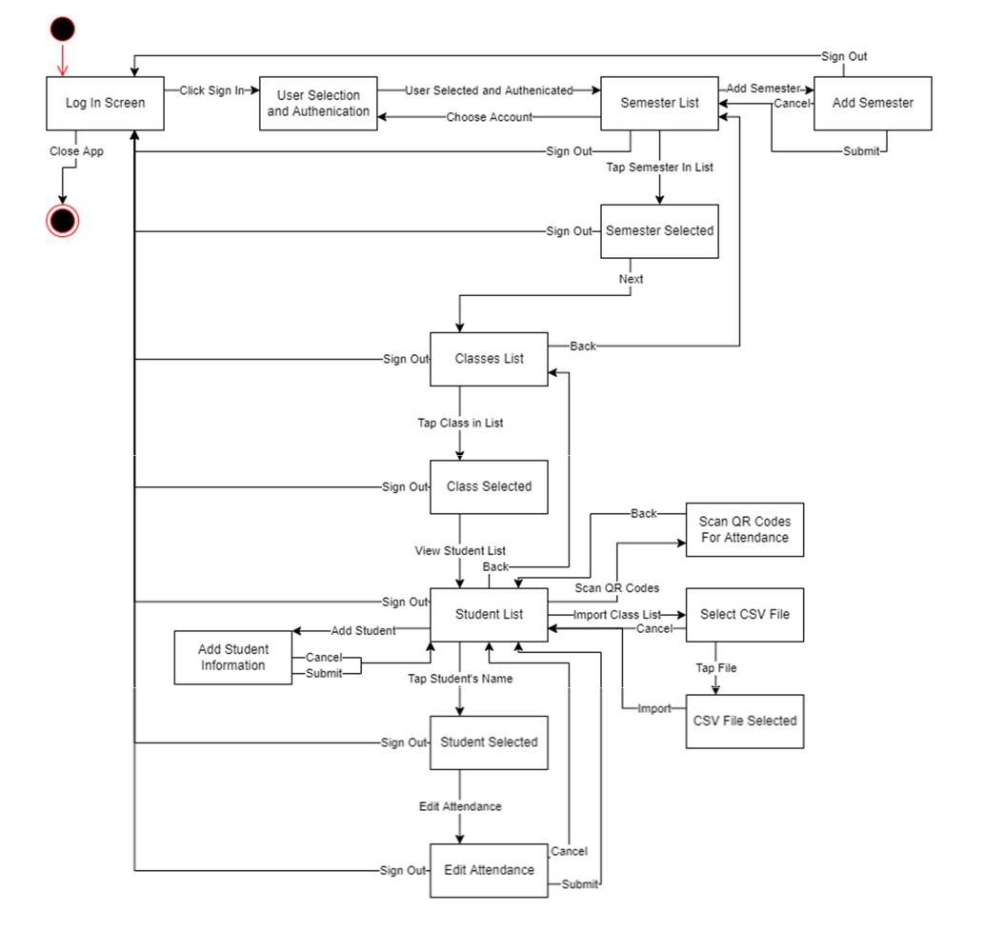
State Model

Slide 9
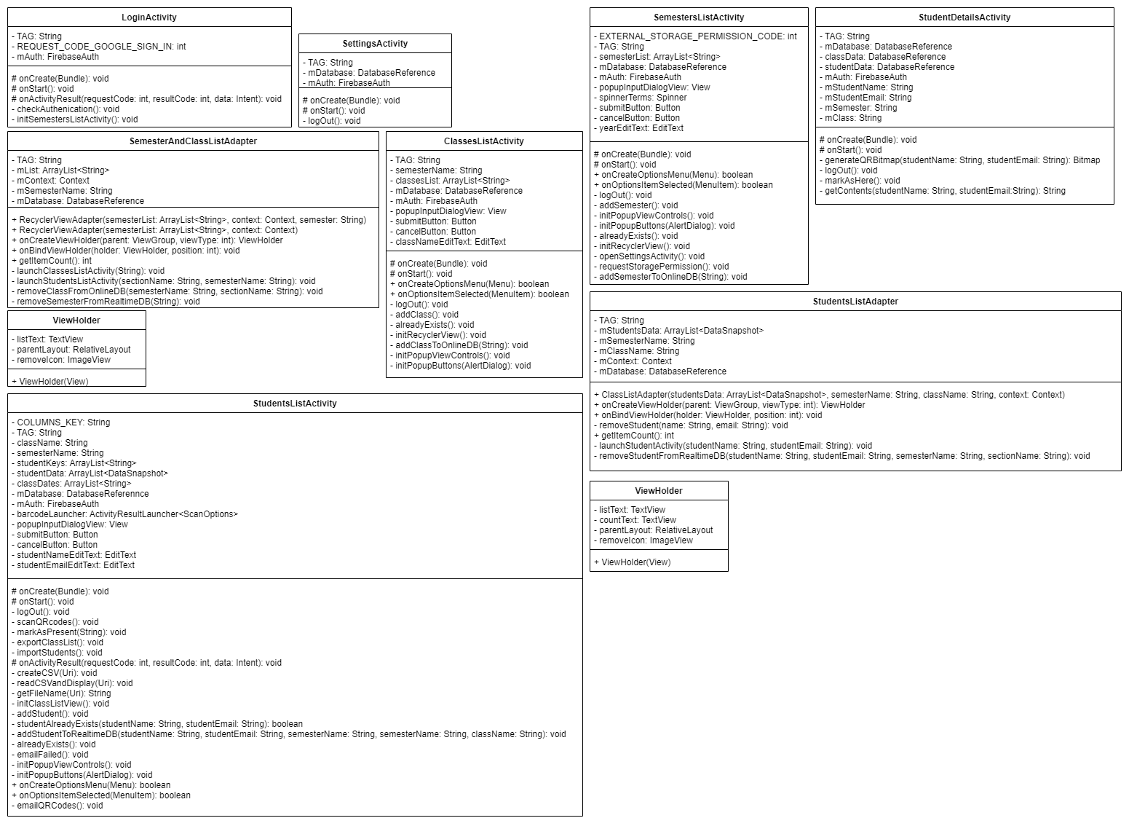
Updated Class Model

Slide 11
Implementation in 8 Major Modules
Login
Semester List
Class List
Student List
Scan QR Codes
Import CSV
Export CSV
Email QR Codes

Slide 12
Design/Arch Pattern
Iterative design pattern
Individual module developed at each iteration
Facilitated by GitHub branching

Slide 13
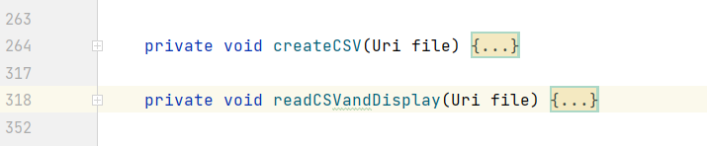
Cohesion
User navigates through sequentially cohesive Activities
Operations are contained within their own functions demonstrating functional cohesion

Slide 14
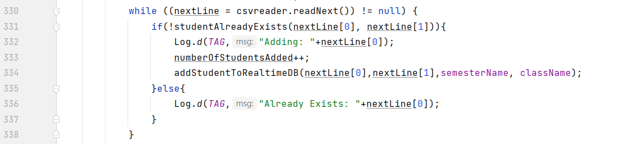
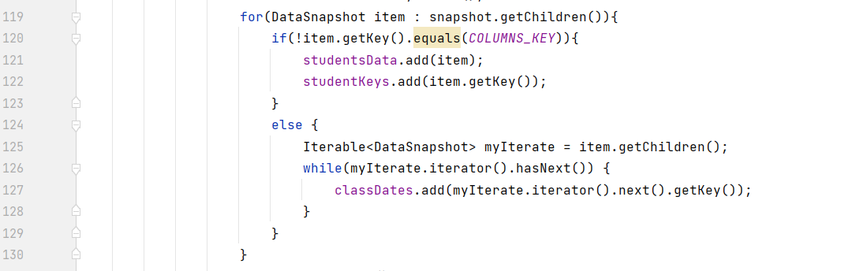
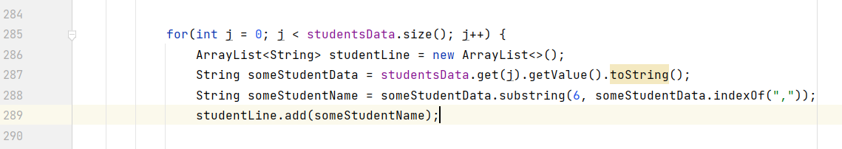
Data Coupling
Importing writes directly to database
Exporting works on a data structure built from an instance of the database

Slide 15
Test Cases
Log in with Gmail
Log out
Add semester
Open semester
Add class
Open class
Add student
Import class list
Email QR codes
Scan QR codes
Manually mark student as present
Export class attendance record

Slide 16
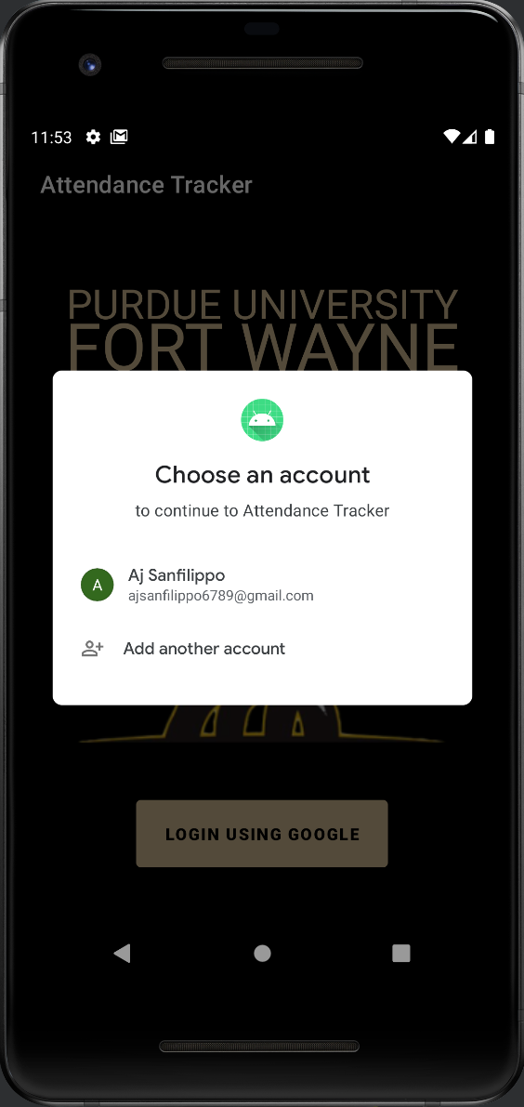
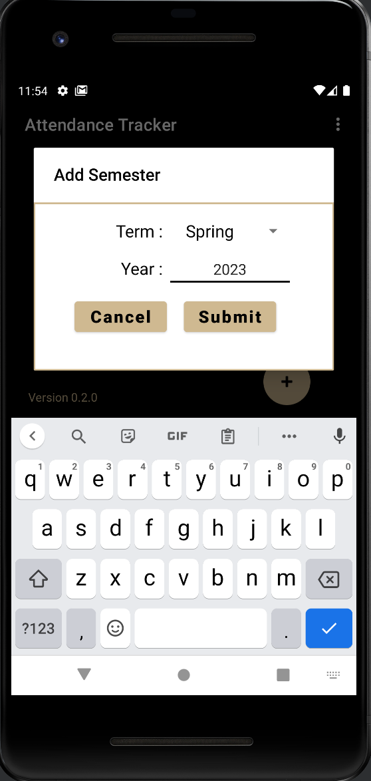
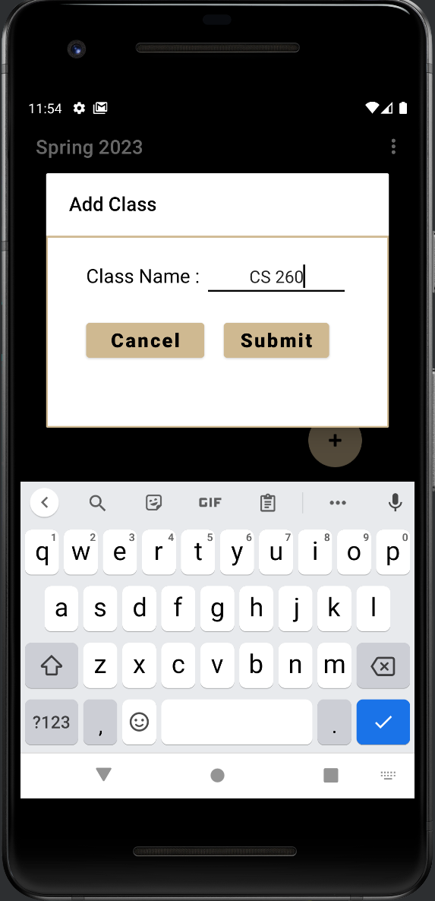
Demo Screen Captures

Slide 17
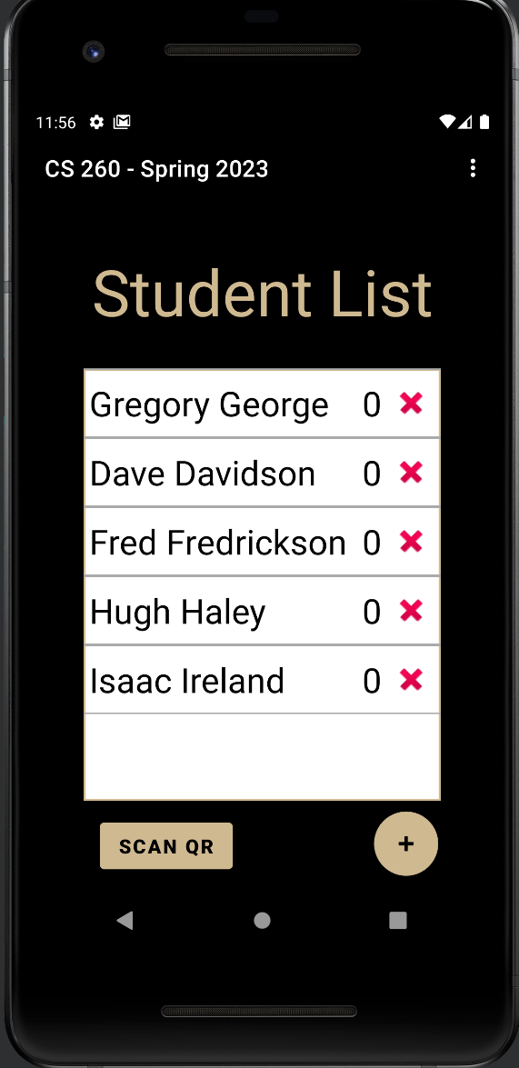
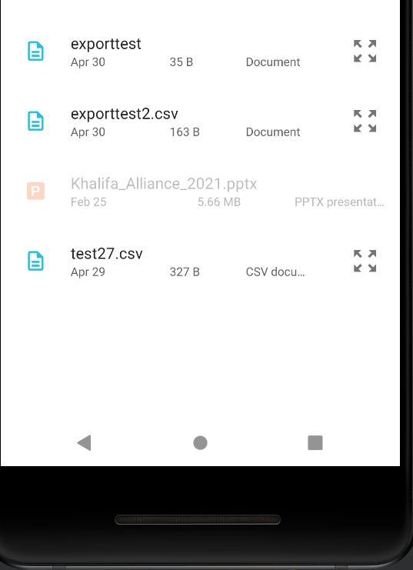
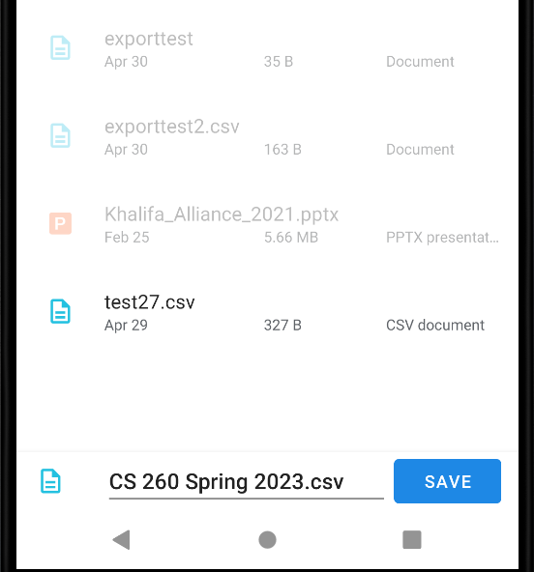

Slide 18
[Application Demonstration]

